Slide 1







STACKOVER DEVELOPER SURVEY INSIGHT PRESENTATION
CHRISTIAN CHUKWUEMEKA NZEANORUE
08-15-2024

Slide 2



OUTLINE
Executive Summary
Introduction
Methodology
Results
Visualization – Charts
Dashboard
Discussion
Findings & Implications
Conclusion
Appendix

Slide 3

EXECUTIVE SUMMARY
Data gathering, contextualization and analysis goal.
Methodology description.
Data gathering.
Data analysis.
Data visualizations e.g. three different dashboards on technology trends and preferences for developers
Results presentation and insight documentation.
Discussion of overall findings and implications for future technology usage and deployment.
Final conclusions.

Slide 4

INTRODUCTION
Stackoverflow conducted a comprehensive survey to gather technology preference of developers worldwide at the moment and in the future.
Stack Overflow’s annual Developer Survey is the largest and most comprehensive survey of people who code around the world, gathering their preferences and demographic info.
Results don’t represent everyone in the developer community evenly as the data(subset) used is a modified version the actual survey.
Over 90,000 developers filled the survey.
This project is aimed at:
Extracting insight on developers’ technology current use
Insight on future Technology use preference
Insight on the demographics of respondents

Slide 5

METHODOLOGY
Collect survey data & explore its content through:
Web Scraping
APIs.
Request library.
Data Wrangling
Exploratory data analysis
Data reformatting
Analyzing data distribution.
Handling outliers.
Correlations.
Data Visualization
Highlight distribution of data, relationships, the composition and comparison of data.
Dashboards
IBM Cognos Analytics
Documentation and Reporting
PowerPoint Presentation
Github

Slide 6
RESULTS

Slide 7
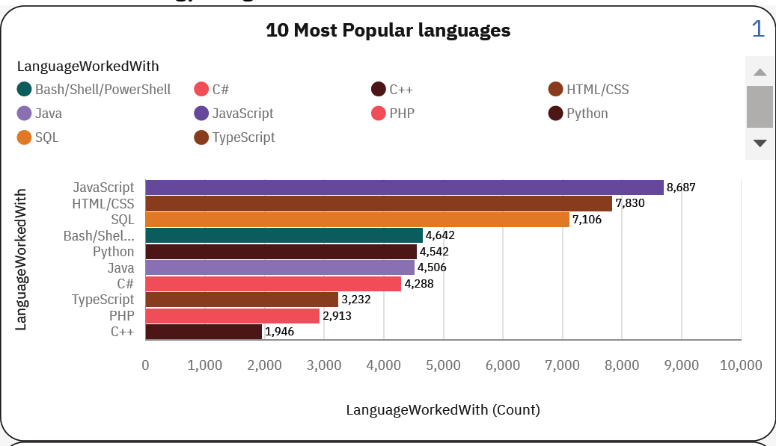
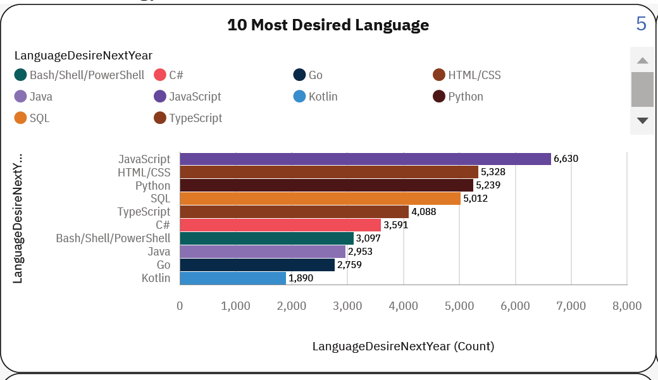
PROGRAMMING LANGUAGE TRENDS
Current Year
Next Year

Slide 8
PROGRAMMING LANGUAGE TRENDS - FINDINGS & IMPLICATIONS
Findings
JavaScript/HTML is the most used programming language both currently and desired in the future.
Python and SQL remains relatively in high growth and demand
Kotlin and GO could become a high demand programming language in the Future as they the new entrants in the top 10 of programming languages desired in the future.
Implications
JavaScript/HTML will still lead the park in the years to come in web development preferred Technology.
They could be a shift in programming language preference Python/SQL gain popularity amongst developers, especially for new developers and learners.
With the introduction of Kotlin and Go, Java might be retired as the preferred programming language for app development.

Slide 9
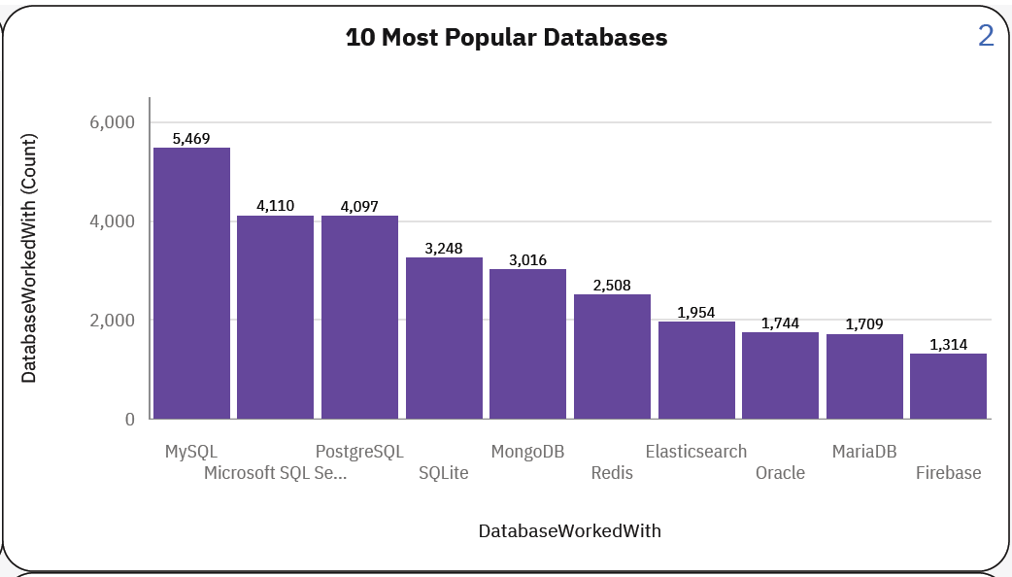
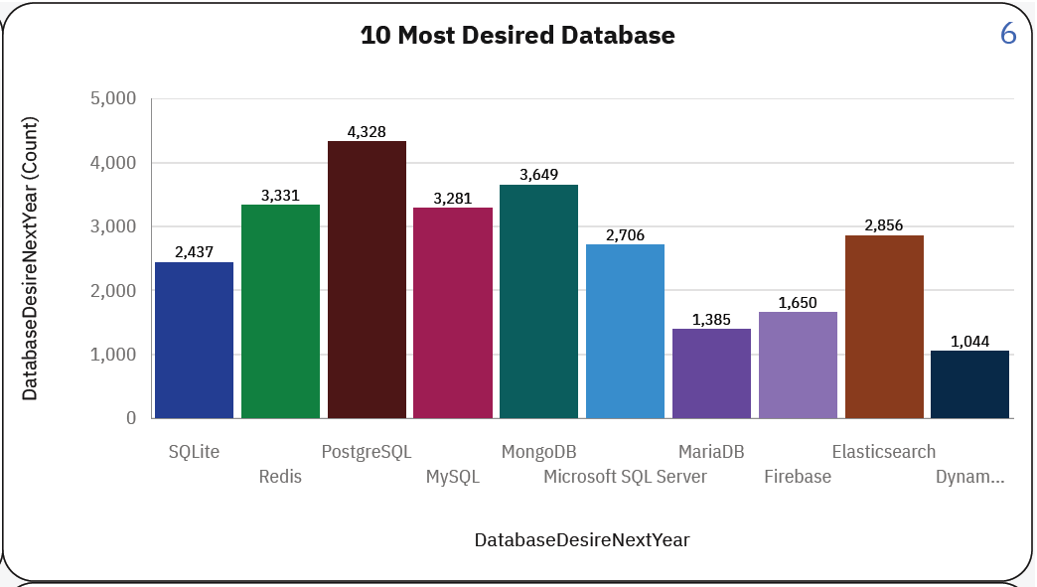
DATABASE TRENDS
Current Year
Next Year

Slide 10
DATABASE TRENDS - FINDINGS & IMPLICATIONS
Findings
MySQL is the most used database.
PostgreSQL is the fastest growing database and the most desired.
MongoDB is also one of the fastest growing DB of the future.
Implications
With the massive enterprise adoption of MySQL, it will be difficult to displace as the number one database.
This is an indication that the next challenger of SQL as the top most database technology of the future is PostgreSQL.
This indicates that the need for NoSQL and BigData data technology awareness is growing as enterprises sorts ways to harness massive volume of unstructured data.

Slide 11

DASHBOARD
https://github.com/ngwuprince/IBM_Data_Analyst_Capstone_Project/blob/main/_%20Technology_trend_dashboard_with_filter.pdf

Slide 12
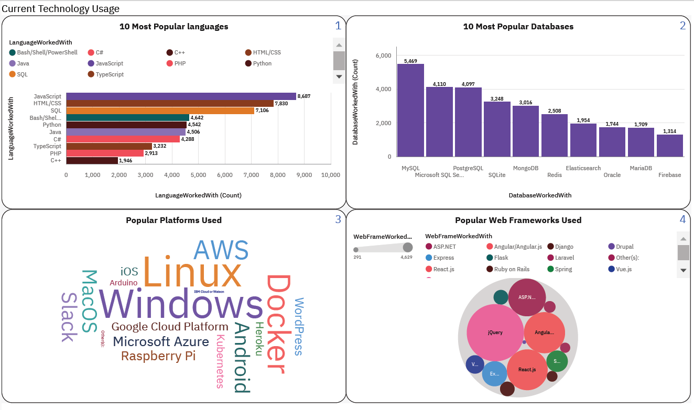
DASHBOARD TAB 1

Slide 13
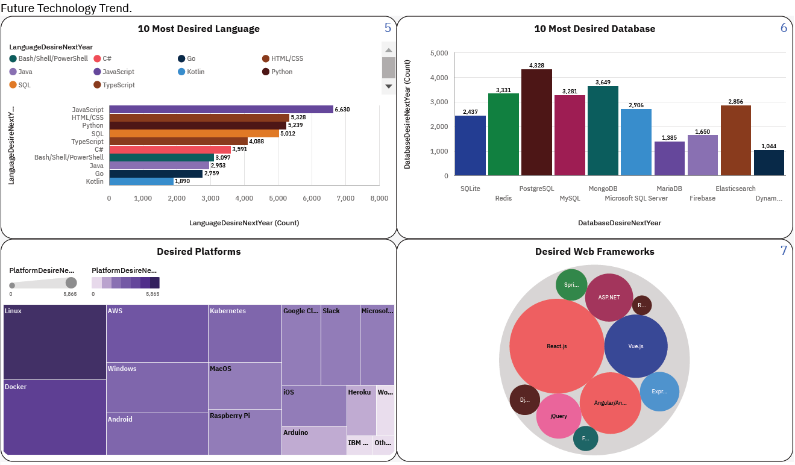
DASHBOARD TAB 2

Slide 14
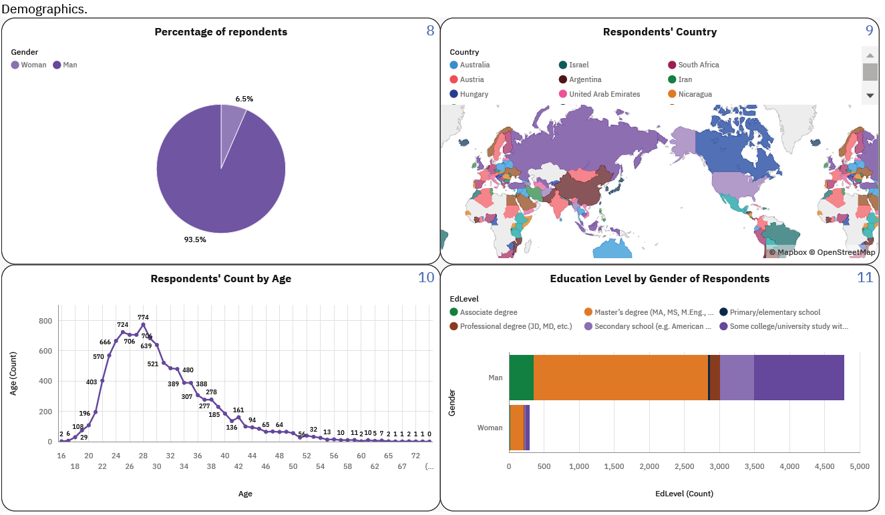
DASHBOARD TAB 3

Slide 15
DISCUSSION
The findings suggest that MySQL and JavaScript/HTML will continue to dominate their respective fields, while PostgreSQL and Python/SQL show promising growth. The implications highlight the increasing importance of NoSQL and Big Data technologies, as well as potential shifts in programming language preferences. This indicates a dynamic and evolving landscape in the database and programming language domains.

Slide 16
OVERALL FINDINGS & IMPLICATIONS
Findings
MySQL and JavaScript/HTML continue to dominate their respective fields.
PostgreSQL and Python/SQL show promising growth in popularity.
NoSQL and Big Data technologies are becoming increasingly important in the database landscape.
Implications
Organizations and developers should continue to invest in MySQL and JavaScript/HTML skills to maintain their competitiveness in the market, leveraging the extensive community support and resources available for these technologies to maximize their potential.
Businesses and developers should consider incorporating PostgreSQL and Python/SQL into their technology stacks to take advantage of their growing popularity and potential benefits, while training programs and educational institutions should include these skills in their curriculum to meet the increasing demand.
Companies should explore the adoption of NoSQL and Big Data technologies to effectively manage and analyze large volumes of data, while data professionals should acquire skills in these technologies to stay relevant in an evolving data landscape. Additionally, organizations may need to invest in infrastructure and tools that support NoSQL and Big Data technologies to harness their potential for business insights.

Slide 17

CONCLUSION
Continued investment in MySQL and JavaScript/HTML skills is essential for maintaining competitiveness in the market.
Incorporating PostgreSQL and Python/SQL into technology stacks can provide potential benefits and leverage their growing popularity.
Adoption of NoSQL and Big Data technologies is crucial for effective management and analysis of large volumes of data, requiring professionals to acquire relevant skills and organizations to invest in supporting infrastructure and tools.
Training programs and educational institutions should include PostgreSQL, Python/SQL, NoSQL, and Big Data skills in their curriculum to meet increasing demand.

Slide 18
JOB POSTINGS

Slide 19
POPULAR LANGUAGES

