Slide 1

Introduction to MS Excel
Basic Microsoft Office Programs
Lecture 3

Slide 2

Apply cell borders
Select the cell or range of cells that you want to add a border to.

Slide 3

2. On the Home tab, in the Font group, click the arrow next to Borders , and then click the border style that you want.

Slide 4
Change text color and alignment
Select the cell or range of cells that contain (or will contain) the text that you want to format. You can also select one or more portions of the text within a cell and apply different text colors to those sections.

Slide 5
2. To change the color of text in the selected cells, on the Home tab, in the Font group, click the arrow next to Font Color , and then under Theme Colors or Standard Colors, click the color that you want to use.
Note: To apply a color other than the available theme colors and standard colors, click More Colors, and then define the color that you want to use on the Standard tab or Custom tab of the Colors dialog box.

Slide 6

3. To change the alignment of the text in the selected cells, on the Home tab, in the Alignment group, click the alignment option that you want.
For example, to change the horizontal alignment of cell contents, click Align Text Left , Center , or Align Text Right .

Slide 7
Apply cell shading
1. Select the cell or range of cells that you want to apply cell shading to.
2. On the Home tab, in the Font group, click the arrow next to Fill Color , and then under Theme Colors or Standard Colors, click the color that you want.

Slide 8
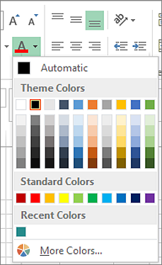
Change the text color for a cell or range of cells
1. Select the cell or range of cells that has the data you want to format. You can also select just a portion of the text within a cell.
2. On the Home tab, choose the arrow next to Font Color .
3. Under Theme Colors or Standard Colors, choose a color.

Slide 9
Format the color of a worksheet tab
1. Right-click the worksheet tab whose color you want to change.
2. Choose Tab Color, and then select the color you want.
The color of the tab changes, but not the color of the font. When you choose a dark tab color, the font switches to white, and when you choose a light color for the tab, the font switches to black.

Slide 10

Apply a pattern or fill effects
When you want something more than a just a solid color fill, try applying a pattern or fill effects.
1. Select the cell or range of cells you want to format.
2. Click Home > Format Cells dialog launcher, or press Ctrl+Shift+F.

Slide 11
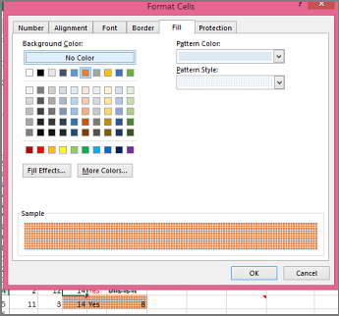
3. On the Fill tab, under Background Color, pick the color you want.

Slide 12
4. To use a pattern with two colors, pick a color in the Pattern Color box, and then pick a pattern in the Pattern Style box.
To use a pattern with special effects, click Fill Effects, and then pick the options you want.
Tip: In the Sample box, you can preview the background, pattern, and fill effects you selected.

Slide 13

Remove cell colors, patterns, or fill effects
To remove any background colors, patterns, or fill effects from cells, just select the cells. Then click Home > arrow next to Fill Color, and then pick No Fill.

Slide 14
Print cell colors, patterns, or fill effects in color
If print options are set to Black and white or Draft quality — either on purpose, or because the workbook has large or complex worksheets and charts that caused draft mode to be turned on automatically — cells won't print in color. Here's how you can fix that:

Slide 15

1. Click Page Layout > Page Setup dialog box launcher.
2. On the Sheet tab, under Print, uncheck the Black and white and Draft quality check boxes.

Slide 16
Apply or remove cell borders on a worksheet
By using predefined border styles, you can quickly add a border around cells or ranges of cells. If predefined cell borders do not meet your needs, you can create a custom border.
By default, Excel doesn't print the column headings (A, B, C, etc.) or row headings (1, 2, 3, etc.) that appear along the borders of the sheet.

Slide 17
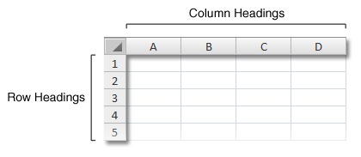

Follow these steps to print the column and row headings for a worksheet:
1. Click the worksheet. If you want to do this for multiple worksheets, you can group them.

Slide 18
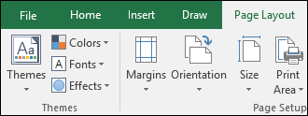
2. On the Ribbon, click the Page Layout tab.

Slide 19

3. In the Sheet Options group, under Headings, select the Print check box.
Note: You can also click the small expansion icon , and then under Print, select the Row and column headings check box.
To print the worksheet, press CTRL+P to open the Print dialog box, and then click OK.

Slide 20
Tips
To preview the worksheet before printing, press CTRL+F2.
To print specific data at the top or side of each printed page—such as the names of the months that appear across the first row of a worksheet—see Repeat row or columns on every printed page.
To add headers or footers to your printed worksheet, see Headers and footers in worksheets.

Slide 21
If you’re having trouble finding the grave accent mark key (`), it is often located in the upper left corner on keyboards, but not always.
If it’s difficult to find on your keyboard, you can also show and hide formulas by going to the Formulas tab and then clicking Show Formulas. To switch back to the standard view, click the button again.

Slide 22
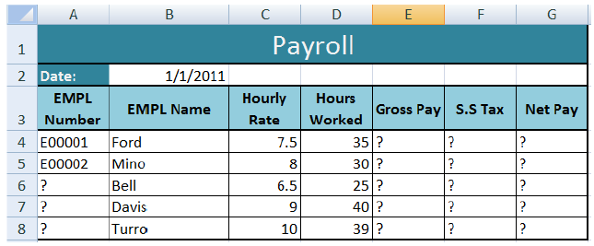
Task 1

Slide 23
Open a new workbook and save the file with the name “Payroll”.
Enter the labels and values in the exact cells locations as desired.
Use AutoFill to put the Employee Numbers into cells A6:A8.
Set the columns width and rows height appropriately.
Set labels alignment appropriately.
Use warp text and merge cells as desired.

Slide 24
Apply borders, gridlines and shading to the table as desired.
Format cell B2 to Short Date format.
Format cells E4:G8 to include dollar sign with two decimal places.
Calculate the Gross Pay for employee; enter a formula in cell E4 to multiply Hourly Rate by Hours Worked.
Calculate the Social Security Tax (S.S Tax), which is 6% of the Gross Pay; enter a formula in cell F4 to multiply Gross Pay by 6%.

Slide 25
Calculate the Net Pay; enter a formula in cell G4 to subtract Social Security Tax from Gross Pay.
Set the worksheet vertically

Slide 26
Task 2
Open the workbook called: Plain Toys( https://www.wiseowl.co.uk/files/exercise-question-files/qf-219.zip )
Make the following formatting changes:
Insert some extra rows at the top and type in the title
Format the font, size etc of the title
Change the row heights to space them out more
Change the vertical cell alignment of these rows to centred

Slide 27
Insert more rows between the titles and first row of data and before the totals
Format all the numbers except the Q Ordered column to show £ and 2 decimal places
Change the column widths
Line up the column titles with the numbers on the right
Centre everything in the Q Ordered column
Add borders, gridlines and shading as desired!

Slide 28
Task 3
Open the workbook called: Plain credit payments
(https://www.wiseowl.co.uk/files/exercise-question-files/qf-219.zip).
Make the following formatting changes:
Insert some extra rows at the top and type in the title
Format the font, size etc of the title
Change the row heights to space them out more
Change the vertical cell alignment of these rows to centred

Slide 29
Insert more rows between the titles and first row of data and before the totals
Format the "Cost" figures to show £ sign and no decimal places
Format the " Payment" figures to show the £ sign and 2 decimal places
Change the column widths
Line up the column titles with the numbers on the right
Add borders, gridlines and shading as desired!

Slide 30
Task 4
Open the workbook called: Plain telephone call stats ( https://www.wiseowl.co.uk/files/exercise-question-files/qf-219.zip ).
Make the following formatting changes:
Insert some extra rows at the top and type in the title
Format the font, size etc of the title
Change the row heights to space them out more

Slide 31
Change the vertical cell alignment of these rows to centred
Insert more rows between the titles and first row of data and before the totals
Format the "Calls per Hour" figures to show only 2 decimal places
Format the " Bonus" figures to show the £ sign and 2 decimal places

Slide 32
Change the column widths
Line up the column titles with the numbers on the right
Add borders, gridlines and shading as desired!

Slide 33
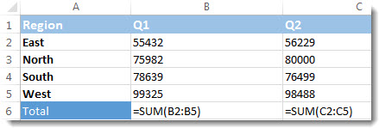
Formula finding
With a quick key combination you can see formulas instead of formula results in a worksheet.

Slide 34
To show formulas in all cells press CTRL+` (that little mark is the grave accent mark key). When the formulas are visible, print your worksheet as you normally would.
To switch back to showing formula results in all cells, press CTRL+` again.

Slide 35
Task 5
Open an excel file that your created earlier and do the following operations:
1. Sum a range of cells: Use the SUM formula and specify the range of cells you want to sum.
2. Count the number of cells with data: Use the COUNT formula and specify the range of cells you want to count.

Slide 36
3. Average a range of cells: Use the AVERAGE formula and specify the range of cells you want to average.
4 Find the maximum value in a range of cells: Use the MAX formula and specify the range of cells you want to find the maximum value in.
5. Find the minimum value in a range of cells: Use the MIN formula and specify the range of cells you want to find the minimum value in.
6. Conditional formatting based on cell values: Use the IF formula to specify the conditions for formatting cells.

Slide 37
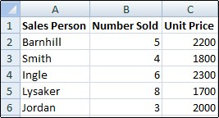
Show or hide gridlines on a worksheet
Gridlines are the faint lines that appear between cells on a worksheet.

Slide 38
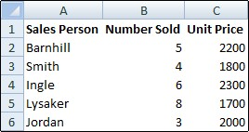
If the design of your workbook requires it, you can hide the gridlines:

Slide 39
1. Select one or more worksheets.
Tip: When multiple worksheets are selected, [Group] appears in the title bar at the top of the worksheet. To cancel a selection of multiple worksheets in a workbook, click any unselected worksheet. If no unselected sheet is visible, right-click the tab of a selected sheet, and then click Ungroup Sheets.

Slide 40


2. In Excel 2007: On the View tab, in the Show/Hide group, clear the Gridlines check box.
In all other Excel versions: On the View tab, in the Show group, clear the Gridlines check box.

Slide 41
Task 6
1. Open the Excel file with the exercise.
2. Select the cells or range of cells that you want to show or hide gridlines for.
3. Go to the "Home" tab in the Excel ribbon.
4. In the "Font" group, click on the "Borders" button to access border options.
5. From the drop-down menu, select the "No Border" option to hide gridlines, or select a border option to show gridlines.

Slide 42
Print row and column headings
By default, Excel doesn't print the column headings (A, B, C, etc.) or row headings (1, 2, 3, etc.) that appear along the borders of the sheet.

Slide 43
Follow these steps to print the column and row headings for a worksheet:
Click the worksheet. If you want to do this for multiple worksheets, you can group them.
On the Ribbon, click the Page Layout tab.

Slide 44
In the Sheet Options group, under Headings, select the Print check box.
Note: You can also click the small expansion icon , and then under Print, select the Row and column headings check box.

Slide 45
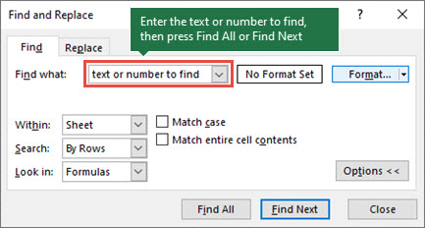
Find
To find something, press Ctrl+F, or go to Home > Editing > Find & Select > Find.
Note: In the following example, we've clicked the Options >> button to show the entire Find dialog. By default, it will display with Options hidden.

Slide 46
1. In the Find what: box, type the text or numbers you want to find, or click the arrow in the Find what: box, and then select a recent search item from the list.
2. Click Find All or Find Next to run your search.
Tip: When you click Find All, every occurrence of the criteria that you are searching for will be listed, and clicking a specific occurrence in the list will select its cell. You can sort the results of a Find All search by clicking a column heading.
3. Click Options>> to further define your search if needed:

Slide 47
Within: To search for data in a worksheet or in an entire workbook, select Sheet or Workbook.
Search: You can choose to search either By Rows (default), or By Columns.
Look in: To search for data with specific details, in the box, click Formulas, Values, Notes, or Comments.
Note: Formulas, Values, Notes and Comments are only available on the Find tab; only Formulas are available on the Replace tab.

Slide 48
Match case: Check this if you want to search for case-sensitive data.
Match entire cell contents: Check this if you want to search for cells that contain just the characters that you typed in the Find what: box.

Slide 49
Replace
To replace text or numbers, press Ctrl+H, or go to Home > Editing > Find & Select > Replace.
Note: In the following example, we've clicked the Options >> button to show the entire Find dialog. By default, it will display with Options hidden.

Slide 50
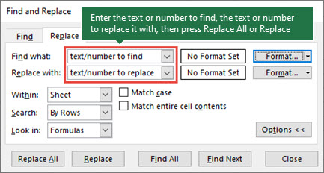
1. In the Find what: box, type the text or numbers you want to find, or click the arrow in the Find what: box, and then select a recent search item from the list.

Slide 51
Tips: You can use wildcard characters — question mark (?), asterisk (*), tilde (~) — in your search criteria.
Use the question mark (?) to find any single character — for example, s?t finds "sat" and "set".
Use the asterisk (*) to find any number of characters — for example, s*d finds "sad" and "started".
Use the tilde (~) followed by ?, *, or ~ to find question marks, asterisks, or other tilde characters — for example, fy91~? finds "fy91?".

Slide 52
2. In the Replace with: box, enter the text or numbers you want to use to replace the search text.
3. Click Replace All or Replace.
Tip: When you click Replace All, every occurrence of the criteria that you are searching for will be replaced, while Replace will update one occurrence at a time.

Slide 53
4. Click Options>> to further define your search if needed:
Within: To search for data in a worksheet or in an entire workbook, select Sheet or Workbook.
Search: You can choose to search either By Rows (default), or By Columns.
Look in: To search for data with specific details, in the box, click Formulas, Values, Notes, or Comments.
Note: Formulas, Values, Notes and Comments are only available on the Find tab; only Formulas are available on the Replace tab.

Slide 54
Match case: Check this if you want to search for case-sensitive data.
Match entire cell contents: Check this if you want to search for cells that contain just the characters that you typed in the Find what: box.

Slide 55
5. If you want to search for text or numbers with specific formatting, click Format, and then make your selections in the Find Format dialog box.
Tip: If you want to find cells that just match a specific format, you can delete any criteria in the Find what box, and then select a specific cell format as an example. Click the arrow next to Format, click Choose Format From Cell, and then click the cell that has the formatting that you want to search for.

Slide 56
Task 7
1. Create a simple worksheet with a range of numbers and use the SUM formula to find the total.
2. Create a worksheet with a range of numbers and use the COUNT formula to find the number of cells with data.
3. Create a worksheet with a range of numbers and use the AVERAGE formula to find the average of the values.

Slide 57
4. Create a worksheet with a range of numbers and use the IF formula to apply conditional formatting to cells based on their values.
5. Create two worksheets, one with a list of names and one with a list of grades, and use the VLOOKUP formula to find and display the grade for a specific name.
6. Create a worksheet with a range of text values and use the CONCATENATE formula to combine the values into a single string.

Slide 58

Rename
By default, Excel names worksheets Sheet1, Sheet2, Sheet3 and so on, but you can easily rename them.

Slide 59
3 ways to rename a worksheet
1. Double-click the sheet tab, and type the new name.
2. Right-click the sheet tab, click Rename, and type the new name.
3. Use the keyboard shortcut Alt+H > O > R, and type the new name.

Slide 60
Copy
You can use the Move or Copy Sheet command to move or copy entire worksheets (also known as sheets), to other locations in the same or a different workbook. You can use the Cut and Copy commands to move or copy a portion of the data to other worksheets or workbooks.

Slide 61
Task 8
1. Create a worksheet with a range of data and use the Filter and Sort features to sort and filter the data based on specific criteria.
2. Create a worksheet with a range of numbers and use the COUNT formula to find the number of cells with data.
3. Create a worksheet with a range of numbers and use the AVERAGE formula to find the average of the values.

Slide 62
4. Create a worksheet with a range of numbers and use the IF formula to apply conditional formatting to cells based on their values.
5. Create two worksheets, one with a list of names and one with a list of grades, and use the VLOOKUP formula to find and display the grade for a specific name.
6. Create a worksheet with a range of text values and use the CONCATENATE formula to combine the values into a single string.

Slide 63
Move a worksheet within a workbook
Select the worksheet tab, and drag it to where you want it.
Caution: When you move a sheet to another workbook, check any formulas or charts that refer to data on the sheet because moving the sheet might cause errors or produce unintended results in your data. Similarly, if you move a sheet that is referred to by 3-D references, the calculation might include or leave out data on the sheet.

Slide 64
Copy a worksheet in the same workbook
Press CTRL and drag the worksheet tab to the tab location you want.
OR
1. Right click on the worksheet tab and select Move or Copy.
2. Select the Create a copy checkbox.

Slide 65
3. Under Before sheet, select where you want to place the copy.
4. Select OK.

Slide 66
Delete a file by using File Explorer
1. Open a File Explorer window.
Tip: A quick way to get to File Explorer is to press Windows Key + E.
2. Locate the file that you want to delete.
3. Select the file and press your Delete key, or click Delete on the Home tab of the ribbon.

Slide 67
Remove a file from your recently used list in an Office program
If you want to keep the file, but simply remove it from your recently used files list, follow these steps:
1. Click File > Open.
2. Locate the file that you want to delete.
3. Right-click the file, and then click Remove from list.

Slide 68
Task 9
1. Use the PMT formula to calculate loan payments based on the loan amount, interest rate, and term.
2. Use data validation to create drop-down lists in a worksheet and restrict data entry to specific values.
3. Use the SUMIF and SUMIFS functions to sum values based on specified criteria.

Slide 69
4. Use the COUNTIF and COUNTIFS functions to count values based on specified criteria.
5. Use text functions like LEFT, RIGHT, and MID to extract characters from text values.

Slide 70


Slide 71
Thank You

