Slide 1

Introduction to MS Excel
Basic Microsoft Office Programs
Lecture 2

Slide 2

Keyboard Shortcuts

Slide 3
1. CTRL + PAGE UP and CTRL + PAGE DOWN
These keyboard shortcuts are probably the quickest and easiest way to move between sheets in Excel.
Simply press CTRL + PAGE UP to move to the previous sheet, or CTRL + PAGE DOWN to move to the next sheet.
You can also hold down the CTRL key and use the mouse scroll wheel to move between sheets.

Slide 4
2. Use the sheet tabs
Another quick and easy way to move between sheets is to simply click on the sheet tabs at the bottom of the Excel window.
This is probably the most intuitive way to move between sheets, and it's also very fast once you get used to it.

Slide 5
3. CTRL + TAB
This keyboard shortcut works similarly to the previous two, but it has the added benefit of allowing you to move between sheets in both directions.
Simply press CTRL + TAB to move to the next sheet, or CTRL + SHIFT + TAB to move to the previous sheet.

Slide 6
4. keyboard shortcut CTRL + SHIFT + PAGE UP or CTRL + SHIFT + PAGE DOWN
These keyboard shortcuts work just like the regular PAGE UP and PAGE DOWN shortcuts, but they also allow you to select multiple sheets at the same time.
This can be very useful if you need to move or copy data between sheets.

Slide 7
5. Use the keyboard shortcut ALT + F11
This keyboard shortcut opens the Excel VBA editor, which allows you to view and edit the code for your Excel macros.
This can be very useful if you need to make changes to a macro that is located on a different sheet.

Slide 8
6. Use the keyboard shortcut CTRL + SHIFT + O
This keyboard shortcut opens the "Select Objects" dialog box, which allows you to select multiple objects on a sheet.
This can be very useful if you need to move or delete multiple objects at the same time.

Slide 9
Task 1
Try to shift from one tab to another with keyboard shortcuts.
Select multiple table using only keyboard and take a screenshot.
Open the Excel VBA editor and modify the codes to make all the floating point number to three decimal points.

Slide 10
7. Use the keyboard shortcut CTRL + SHIFT + F
This keyboard shortcut opens the "Find and Replace" dialog box, which allows you to quickly find and replace text in your Excel spreadsheet.
This can be very useful if you need to make changes to a large number of cells at the same time.

Slide 11
8. Use the keyboard shortcut CTRL + SHIFT + H
This keyboard shortcut opens the "Replace" dialog box, which allows you to quickly find and replace text in your Excel spreadsheet.
This can be very useful if you need to make changes to a large number of cells at the same time.

Slide 12
9. Use the keyboard shortcut CTRL + SHIFT + J
This keyboard shortcut opens the "Go To" dialog box, which allows you to quickly jump to a specific cell in your Excel spreadsheet.
This can be very useful if you need to make changes to a large number of cells at the same time

Slide 13
10. Use the keyboard shortcut CTRL + SHIFT + K
This keyboard shortcut opens the "Insert" dialog box, which allows you to quickly insert a new sheet into your Excel workbook.
This can be very useful if you need to add a new sheet to your workbook on a regular basis.

Slide 14
Bonus tip: Use the keyboard shortcut CTRL + SHIFT + L
This keyboard shortcut opens the "Filter" dialog box, which allows you to quickly filter your data by various criteria.
This can be very useful if you need to analyze a large amount of data on a regular basis.

Slide 15
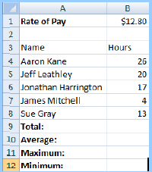
Task 1
Find “Aaron Kane” from the given sheet and replace with “John Ratliff”.
Goto cell B7 using the keyboard
Insert a new sheet in the workspace using keyboard shortcut.

Slide 16
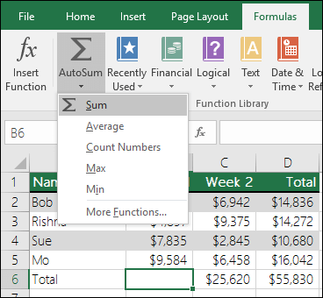
Use AutoSum
The easiest way to add a SUM formula to your worksheet is to use AutoSum.
Select an empty cell directly above or below the range that you want to sum, and on the Home or Formula tabs of the ribbon, click AutoSum > Sum.

Slide 17
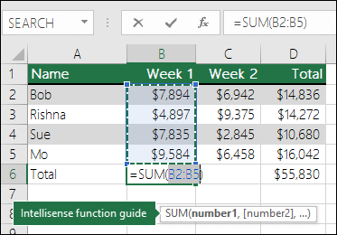
AutoSum will automatically sense the range to be summed and build the formula for you.
This also works horizontally if you select a cell to the left or right of the range that you need to sum.

Slide 18
In the figure above, the AutoSum feature is seen to automatically detect cells B2:B5 as the range to sum. All you need to do is press ENTER to confirm it.
If you need to add/exclude more cells, you can hold the Shift Key + the arrow key of your choice until your selection matches what you want. Then press Enter to complete the task.

Slide 19
Intellisense function guide
The SUM(number1,[number2], …) floating tag beneath the function is its Intellisense guide.
If you click the SUM or function name, it will change o a blue hyperlink to the Help topic for that function.
If you click the individual function elements, their representative pieces in the formula will be highlighted. In this case, only B2:B5 would be highlighted, since there is only one number reference in this formula. \
The Intellisense tag will appear for any function.

Slide 20
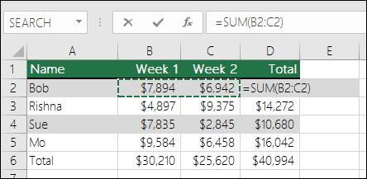
AutoSum horizontally

Slide 21
SUM Function
The SUM function is used to add more than two numbers together.
NOTE: If you only have two numbers to add together (A1 and A2 for example) then it is more efficient to simply add them without using the SUM function (=A1 + A2).

Slide 22
However, if there were three or more numbers to add, using the SUM function is quicker and more efficient. Open a new spreadsheet and copy the labels and values exactly as shown in the task. Select the Home tab and use the Bold icon to embolden the cells shown.

Slide 23
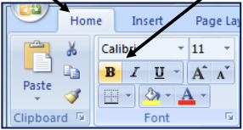
To find the total number of hours worked you need to click in cell B9. Enter the formula =SUM(B4:B8) the press . This should give the value 80.

Slide 24
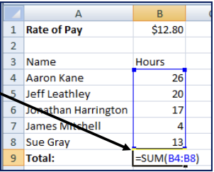
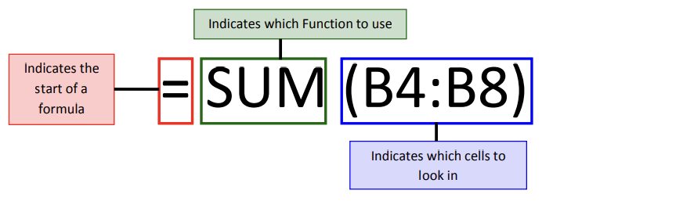

Slide 25
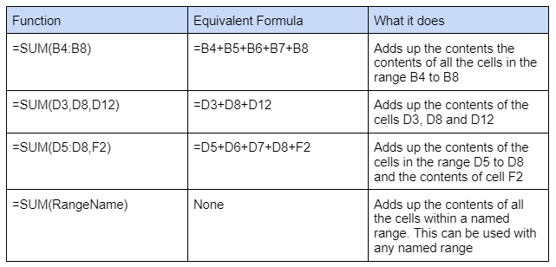

Slide 26
AVERAGE function
To find the AVERAGE number of hours worked, click into cell B10. Enter the formula =AVERAGE(B4:B8). This should give the value 16.

Slide 27
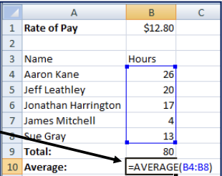
There are many ways of using the AVERAGE function. Some of these ways are highlighted in the table below:

Slide 28
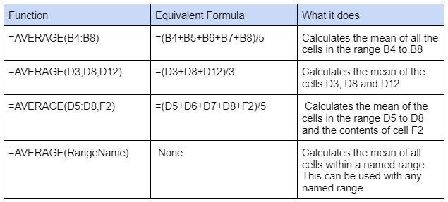

Slide 29
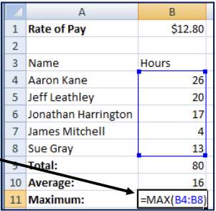
MAX function
To find the person who worked the most (MAX) hours, click into cell B11. Enter the formula =MAX(B4:B8). This should give the value 26.

Slide 30
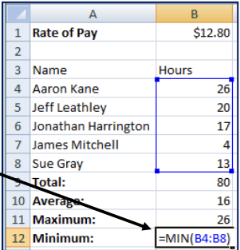
MIN function
To find the person who worked the least (MIN) number of hours, click into cell B12. Enter the formula =MIN(B4:B8). This should give the value 4.

Slide 31
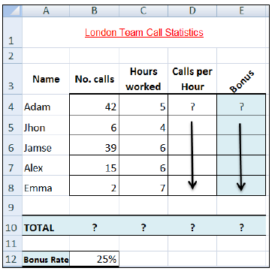
Task 1

Slide 32
Format column E to include euro (€) sign with two decimal places.
Open a new workbook and save the file with the name “Call Statistics”.
Delete Sheet 2 & 3, and rename Sheet 1 to (Call Statistics).
Enter the labels and values in the exact cells locations as desired.
Set the row height of rows 1 & 3 to size 30; and rows 4 until 10 to size 20.
Set labels alignment appropriately.
Use Warp Text, Orientation and merge cells as desired.
Apply border, gridlines and shading to the table as desired.

Slide 33
Format cell B12 to include % sign with 0 Decimal places.
Calculate the Calls per Hour, enter a formula in cell D4 to divide numbers of calls by Hours worked. Using AutoFill, copy the formula to the remaining cells.
Calculate the Bonus. Enter a formula in cell E4 to multiply ‘Calls per Hours’ by the fixed Bonus Rate in cell B12. Using AutoFill, copy the formula to the remaining cells.
Calculate the ‘TOTAL’.

Slide 34
Set the worksheet vertically and horizontally on the page.
Create a header that includes your name in the left section, and your ID number in the right section. Create the footer that includes the current Date in the center.

Slide 35
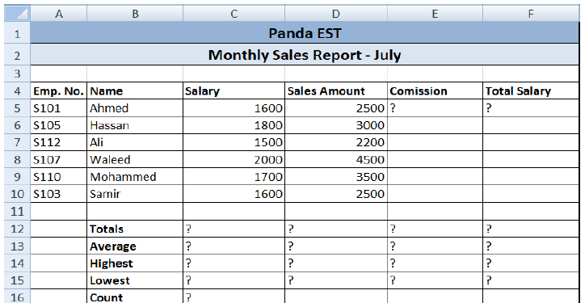
Task 2

Slide 36
Create the worksheet shown above.
Set the column widths as follows: Column A: 8, Column B: 14, Columns C & D: 15, Columns E & F: 14.
Enter the formula to find COMMISSION for the first employee.
The commission rate is 2% of sales, COMMISSION = SALES * 2%
Copy the formula to the remaining employees.

Slide 37
Enter the formula to find TOTAL SALARY for the first employee where:
TOTAL SALARY = SALARY + COMMISSION
Copy the formula to the remaining employees.
Enter formula to find TOTALS, AVERAGE, HIGHEST, LOWEST, and COUNT values.
Copy the formula to each column.
Format numeric data to include commas and two decimal places

Slide 38
Align all column title labels horizontally and vertically at the center.
Create a Header that includes your name in the left section, page number in the center section, and your ID number in the right section.
Create footer with DATE in the left section and TIME in the right section.
Save the file with name Exercise 3.

Slide 39
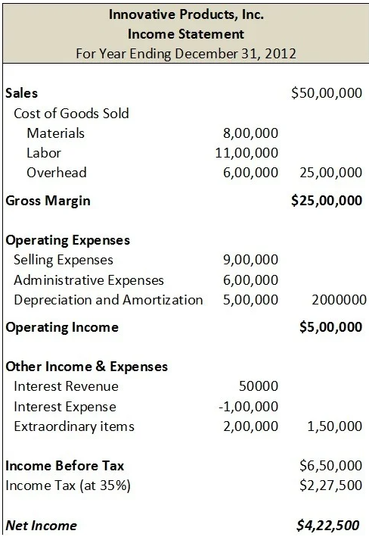
Task 3
Create an income statement like this.
Here, you are only allowed to change the value for sales and all other values in the first column. All remaining values should update automatically whenever a change is made.

Slide 40
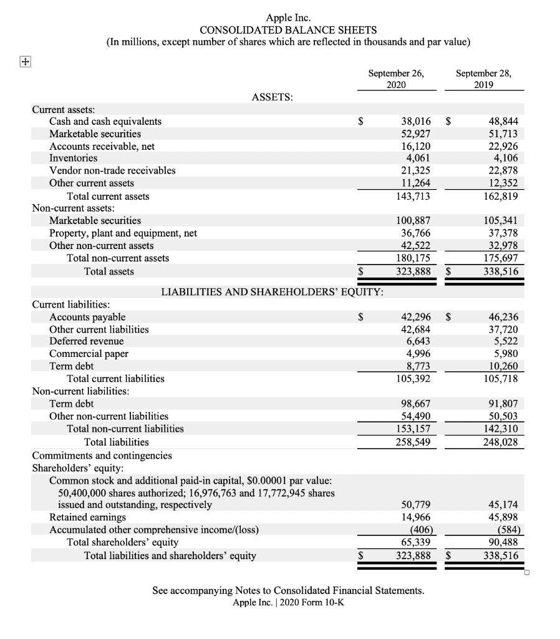
Task 4
Prepare a balance sheet like this clearly showing the current assets, non current assets, current liabilities, non current liabilities, and shareholders equity.
(See next slides for clearer photos)

Slide 44


Slide 45
Thank You

