Slide 1

Introduction to MS Teams
Lecture : 2
Advance Microsoft Office Programs

Slide 2
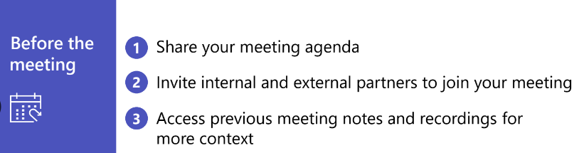
Tips to make meetings more productive and collaborative

Slide 3
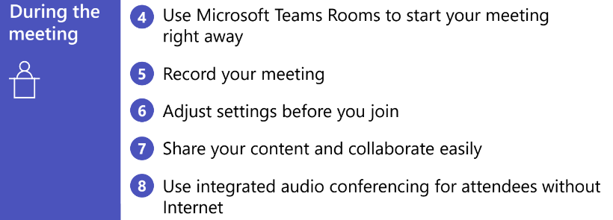
Tips to make meetings more productive and collaborative

Slide 4

Tips to make meetings more productive and collaborative

Slide 5
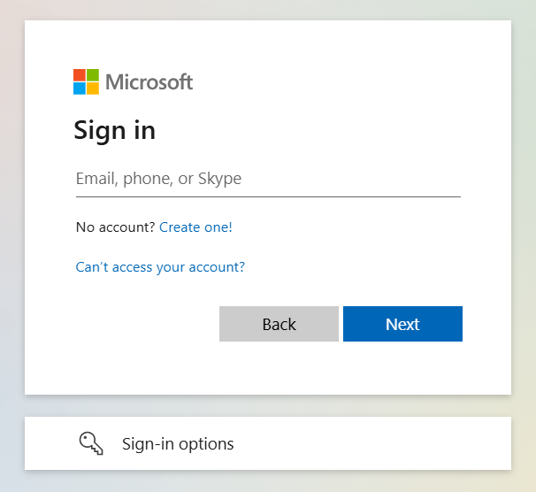
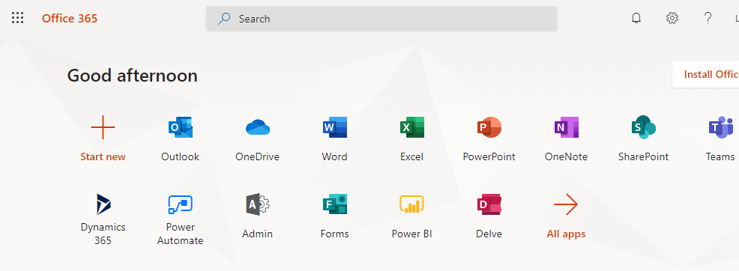
How to log into MS Team?
Open the web browser, type www.office.com
Enter your username
Enter password
Once you sign in you will see Teams icon.
Click it and you will be able to see all the Teams you are assigned to.

Slide 6

Types of Team Meeting in MS Teams
1. Meet now Meetings
2.Channel Meetings
3. Private Meetings
4. Webinars
5. Live Events

Slide 7
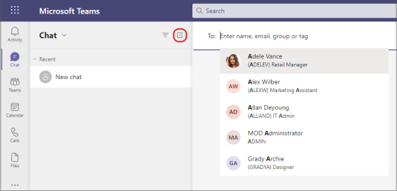
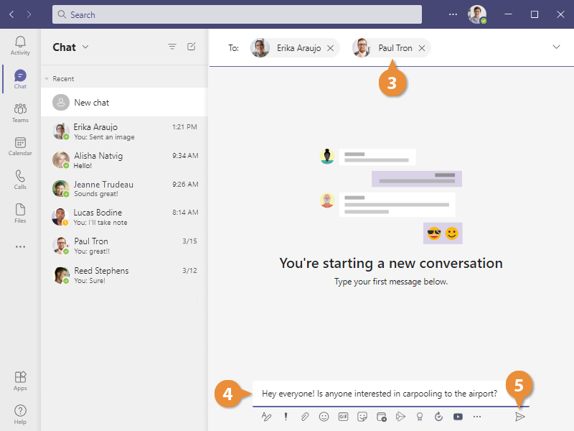
Private Conversation
Open team channels are great for collaboration, but sometimes you need to talk privately. For this Teams provide Chat and Group Chat option

Slide 8
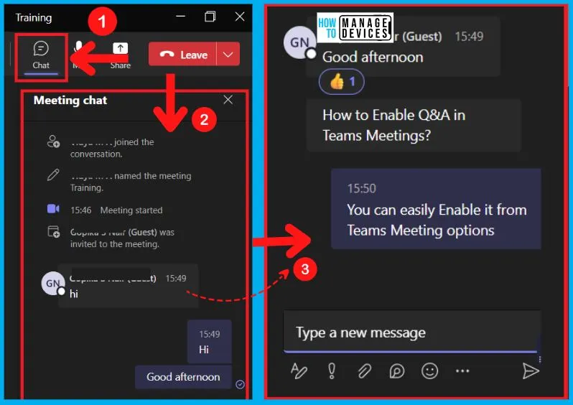
Meeting in a chat
Meetings within chat are great for working with a smaller group or for a quick sync.

Slide 9
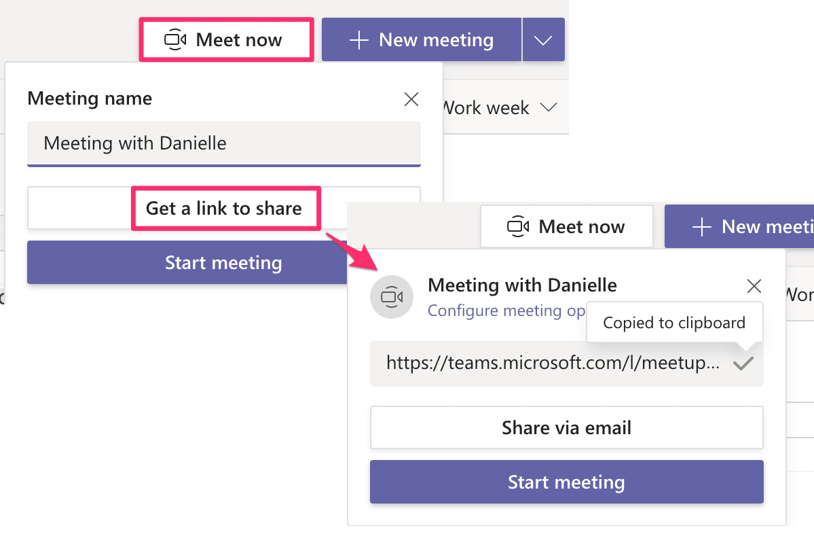
Meet now
Quickly jump on a meeting from your Microsoft Teams or Outlook calendar or from a channel conversation. Select Meet now, then add participants for an impromptu sync.

Slide 10
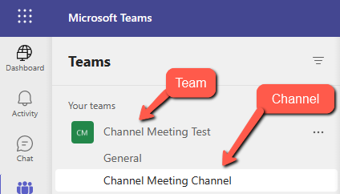
Channel Meetings
These meetings are associated with a Microsoft Teams channel, so all team members can choose to join the meeting, view the agenda and conversation, and share files – All from within the context of that channel.

Slide 11
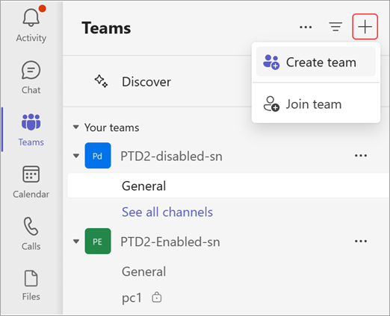
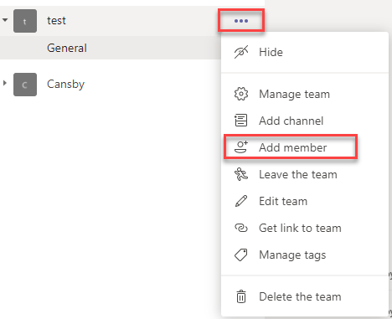
Creating Team and Invite Members
Navigate to the Teams module and click on Create a new team
Choose the type of the team (Private/Public/Org-wide)
Give your team a name and a description.
Invite and add members to the team

Slide 12
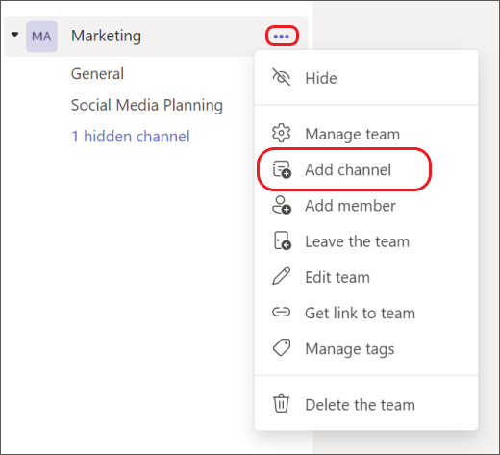
Adding Channels
To add additional channels to your team, click the more options icon (3 dots) next to your team name and select Add Channel.
Give your new Channel a name, a description and check the Show this channel in everyone's channel list, then hit Add

Slide 13
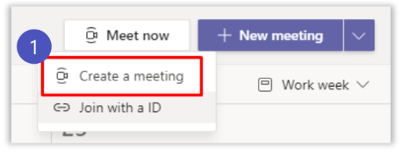
Create a Meeting Link
Create a Title for your meeting and select either Get a link to share or Start meeting.

Slide 14
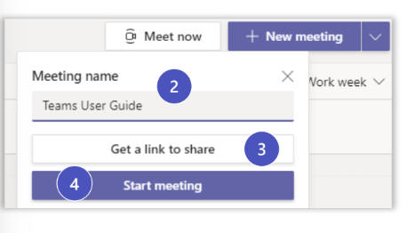
Create a Meeting Link
On the next screen select the Join Now icon.

Slide 15
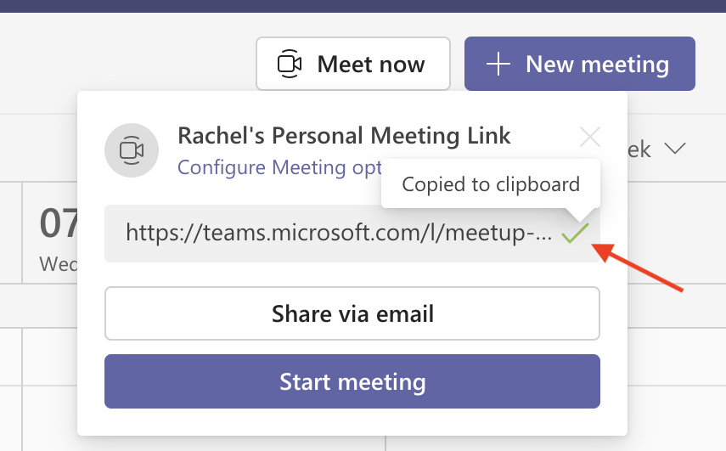
Create a Meeting Link
In the Invite people to join you, you have a couple of options.
Copy Meeting Link: You would copy the link and send to participates, example in chat.

Slide 16
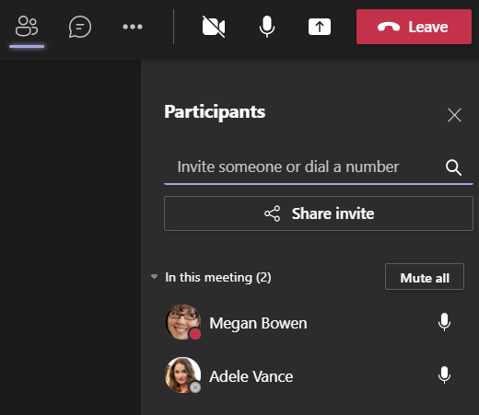
Create a Meeting Link
Add participants: Type participants name in search field.

Slide 17
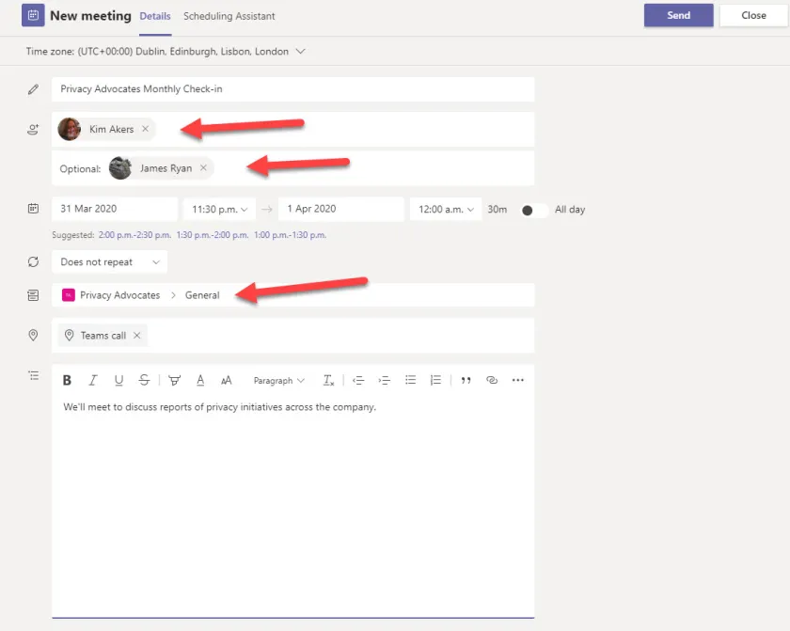
Create a Meeting Link
Share via default email: Type participant(s) email address in To field.

Slide 18
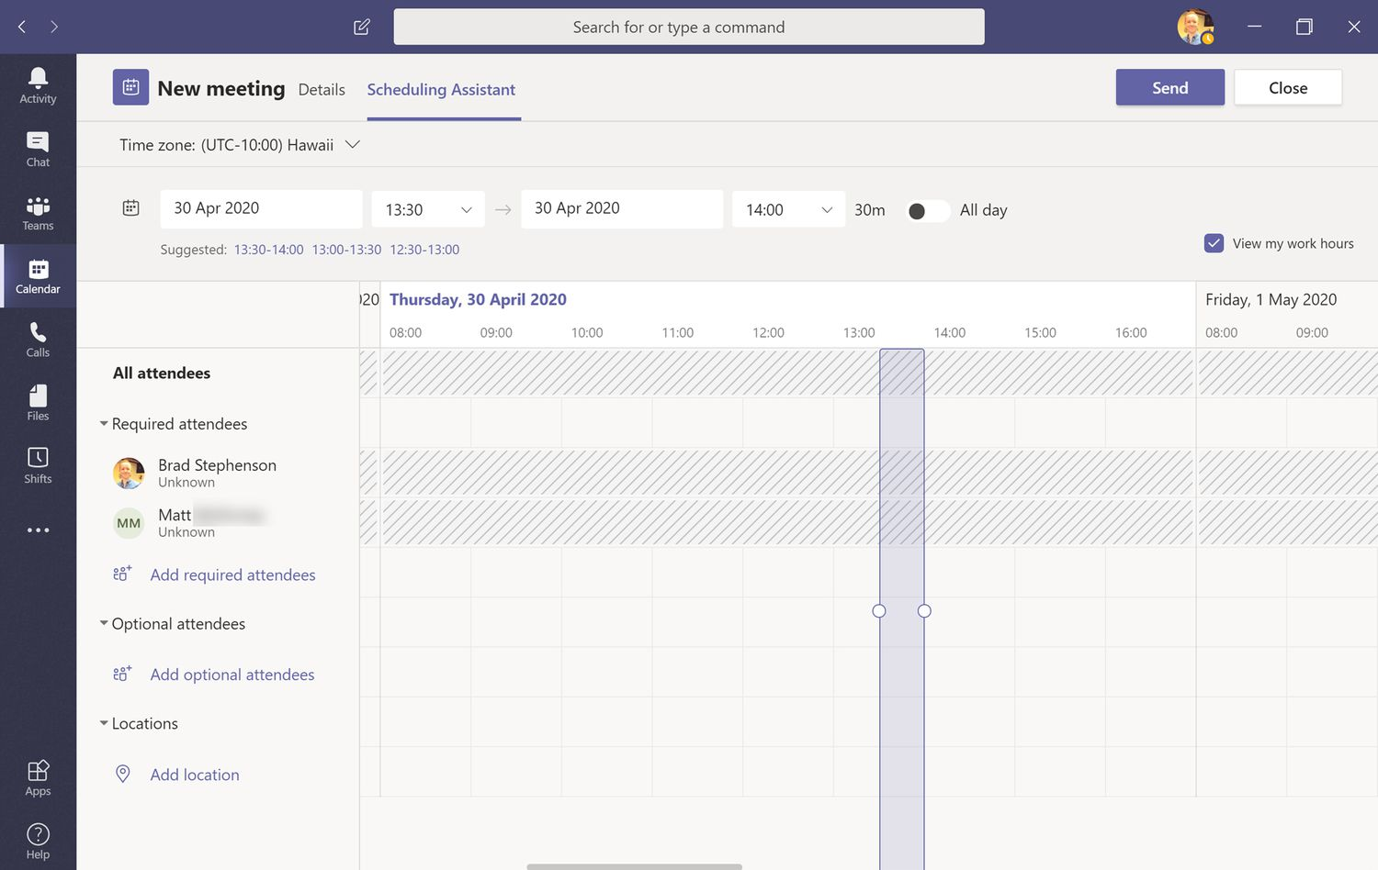
Use of Calendar
Open the Calendar pane in Outlook.
Under the Home tab, select Calendar Groups.
Check Show Manager's Team Calendars.
By default, your calendar in Microsoft Teams is visible to anyone who has access to the team

Slide 19
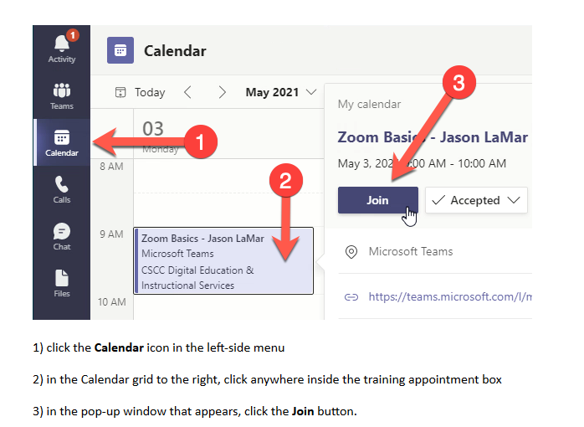
Join using Calendar
When you select Calendar, you will see your full calendar details and all meeting schedule.
You can select on the meeting to find more details of the meeting. You can then select ‘Join Teams meeting’ to join

Slide 20
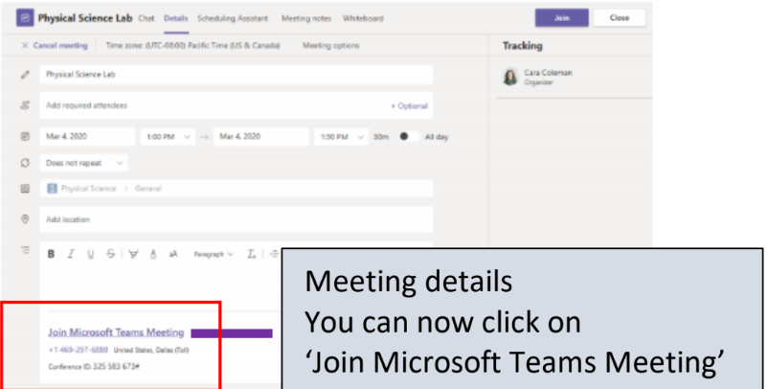
Join using Calendar
You can also click on Teams then click on Calendar
When you click on the meeting invitation in the channel of your team or your Teams calendar you will have a break-down of the meeting details.

Slide 21
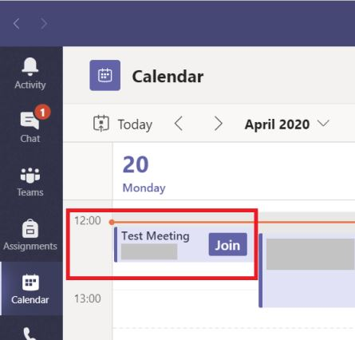
Join using Calendar
If you use teams, you can simply click the Join button on your teams calendar appointment.

Slide 22
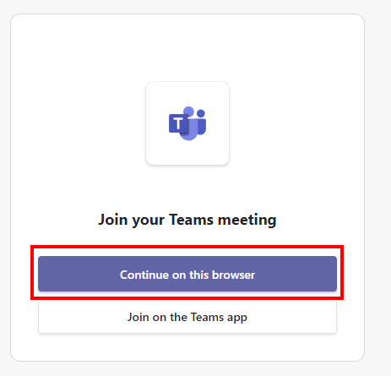
Join Team as an External User
If you don't use teams, you can click on the Join Microsoft Teams Meeting link in your email invitation.
You'll be prompted to either:
-Install the Teams app and create an account, or
-simply join the meeting using your web browser without having to install or create an account

Slide 23
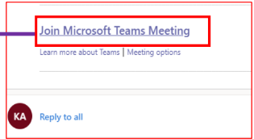
Join Team by using Email Invite Link
Email invite containing the link to the Microsoft Team meeting.
As you can see that you need to click the link that says ‘Join Microsoft Teams Meeting’

Slide 24
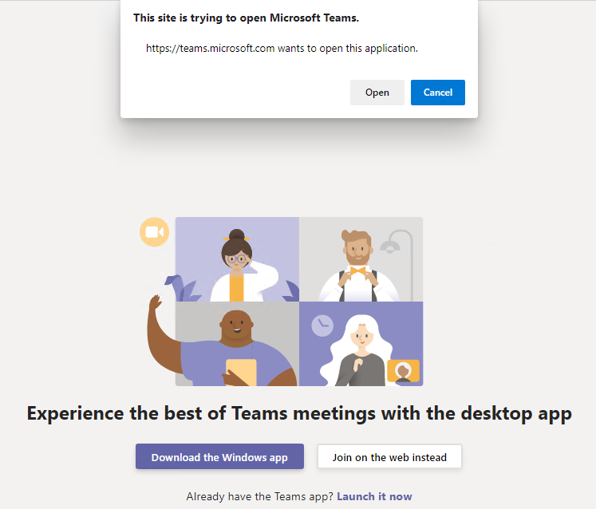
Join Team by using Email Invite Link
When you click on the link, the link will open in the default web browser taking you to Microsoft Team website.
Click on ‘Open Microsoft Teams’ to open Team meeting
Or you can select cancel and open Teams from selecting ‘Join on the web instead’.

Slide 25
Join Team by using Email Invite Link
You will find it more feasible to Download the Windows app. This will open the meeting using the Downloaded Teams app.

Slide 26
Join and create a Microsoft Teams
meeting on mobile
Open Microsoft Teams and navigate to the Calendar app.
From the agenda view, navigate to the meeting you’d like to join and select Join.
To create a new meeting, select the Plus icon. Next, fill in required and select Done.

Slide 27
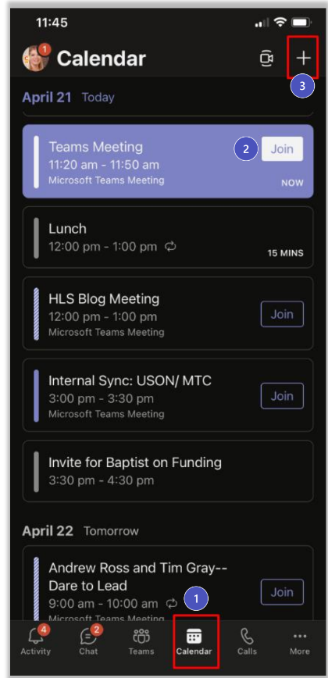
Join and create a Microsoft Teams
meeting on mobile

Slide 28
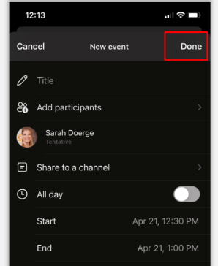
Join and create a Microsoft Teams
meeting on mobile

Slide 29
Optimize your Microsoft Teams
meetings experience
Bring your best network connection​
A wired network connection is best. When using a wireless connection, consider the distance from your router. Avoid a VPN connection, where possible.
• BEST: Connect via wired Ethernet to your home router​
• BETTER: 5GHz Wi-Fi provides internet at faster speeds, ​but to smaller areas of your house​
• GOOD: 2.4GHz Wi-Fi provides internet to a larger area, but​ sacrifices speed​

Slide 30
Optimize your Microsoft Teams
meetings experience
​Test your bandwidth
If you are experiencing connectivity or bandwidth issues, you can run an Internet speed test to validate you have adequate bandwidth to the Internet.
Speed Test:
https://www.speedtest.net/

Slide 31
Optimize your Microsoft Teams
meetings experience
​Verify Office 365 connectivity
Looking for suggestions to improve your experience with Office 365 services?
Look no further.
Network Performance for O365
https://connectivity.office.com/

Slide 32
Optimize your Microsoft Teams
meetings experience
​Consider other online services
Limit usage of other services while participating in Microsoft Teams meetings –
Netflix, YouTube, Xbox Live, etc.

Slide 33
Optimize your Microsoft Teams
meetings experience
​If your Internet connection is experiencing issues, try these alternatives:​
Join your Microsoft Teams meeting with your mobile device, using a cellular network
Microsoft Teams App
https://www.microsoft.com/en-us/microsoft-teams/download-app

Slide 34
Optimize your Microsoft Teams
meetings experience
​If your Internet connection is experiencing issues, try these alternatives:​
Join your Microsoft Teams meeting via ‘Dial In’ or ’Call Me’, using the Public Switched Telephone Network

Slide 35

Let’s do some exercises!

Slide 36

Exercises
Log in to Microsoft Teams using your organizational account.
Schedule a team meeting and a private meeting.
Start a private chat with a friend
Create a new team for a project
Invite members to your newly created team
Add a new channel to your team
Post a message in a channel and start a discussion
Join an existing team using a code
Join a scheduled meeting from the Teams calendar

Slide 37

Thanks!

