Slide 1

Introduction to MS Excel
Advance Microsoft Office Programs
Lecture 4

Slide 2
How to create a 3-D reference in Excel
To make a formula with a 3D reference, perform the following steps:
1. Click the cell where you want to enter your 3D formula.
2. Type the equal sign (=), enter the function's name, and type an opening parenthesis, e.g. =SUM(

Slide 3
3. Click the tab of the first worksheet that you want to include in a 3D reference.
4. While holding the Shift key, click the tab of the last worksheet to be included in your 3D reference.
5. Select the cell or range of cells that you want to calculate.
6. Type the rest of the formula as usual.
7. Press the Enter key to complete your Excel 3-D formula.

Slide 4
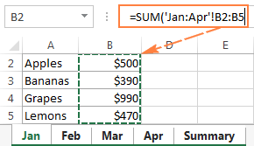

Slide 5
Task 1
Create a 3D reference to summarize data from multiple worksheets in a single chart with the following steps:
1. Create a new workbook with multiple worksheets containing data. Each worksheet should have the same structure and contain similar data.

Slide 6
2. On a new worksheet, create a chart that summarizes data from the multiple worksheets.
3. To create the 3D reference, select the range of data you want to include in the chart.
4. On the Formulas tab, in the Defined Names group, click Define Name.
5. In the New Name dialog box, type a name for the reference in the Name box, and then select the data range in the Refers to box.

Slide 7
6. Repeat the process for each worksheet that you want to include in the 3D reference.
7. In the chart, click the chart element that you want to change, and then click the formula bar.
8. In the formula bar, enter the following formula: =SERIES(Sheet1!$A$1,Sheet2!$A$1:$B$10,Sheet3!$A$1:$B$10,1).

Slide 8
9. Replace "Sheet1", "Sheet2", and "Sheet3" with the names of your worksheets, and replace "$A$1:$B$10" with the range of data you want to include in the chart.
10. Press Enter, and the chart should be updated to reflect the 3D reference.

Slide 9
How to create a structured reference in Excel
To create a structured reference, this is what you need to do:
1. Start typing a formula as usual, beginning with the equality sign (=).
2. When it comes to the first reference, select the corresponding cell or range of cells in your table. Excel will pick up the column name(s) and create an appropriate structured reference for you automatically.

Slide 10
3. Type the closing parenthesis and press Enter. If the formula is created inside the table, Excel automatically fills the entire column with the same formula.
As an example, let's add up the sales numbers for 3 months in each row of our sample table, named Sales. For this, we type =SUM( in E2, select B2:D2, type the closing parenthesis, and press Enter:

Slide 11
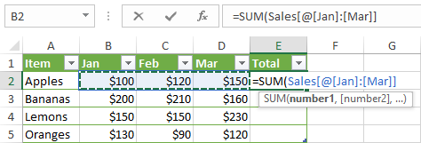

Slide 12
As the result, the whole column E is auto-filled with this formula:
=SUM(Sales[@[Jan]:[Mar]])
Though the formula is the same, the data is calculated in each row individually. To understand the inner mechanics, please take a look at the table reference syntax.

Slide 13
If you are entering a formula outside the table, and that formula requires only a range of cells, a faster way to make a structured reference is this:
1. After the opening parenthesis, start typing the table name. As you type the first letter, Excel will show all matching names. If necessary, type a couple more letters to narrow down the list.
2. Use the arrow keys to select the table name in the list.
3. Double-click the selected name or press the Tab key to add it to your formula.
4. Type the closing parenthesis and press Enter.

Slide 14
For example, to find the largest number in our sample table, we start typing the MAX formula, after the opening parenthesis type "s", select the Sales table in the list, and press Tab or double-click the name.
As the result, we have this formula:
=MAX(Sales)

Slide 15
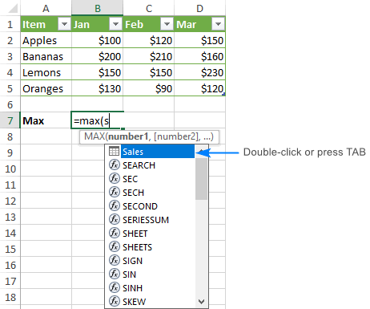

Slide 16
Task 2
Create a pivot table using a structured reference to summarize data from a table with the following steps:
1. Open a new workbook and create a table with data.
2. On a new worksheet, click the Insert tab and select Pivot Table.

Slide 17
3. In the Create Pivot Table dialog box, select the range of data you want to use for your pivot table and click OK.
4. In the PivotTable Fields panel, select the fields you want to include in your pivot table and drag them to the appropriate areas: Rows, Columns, and Values.
5. To use a structured reference in your pivot table, right-click any cell in the table and select Table Name from the context menu.
6. In the Table Name dialog box, type a name for your table and click OK.

Slide 18
7. On the formula bar, type an equals sign (=) and the name of the table, followed by a square bracket ([) and the name of the field you want to include in the pivot table.
8. For example, if your table name is "SalesData" and you want to include the "Quantity" field in the pivot table, you would type the following formula in the formula bar: =SalesData[Quantity].
9. Press Enter and the pivot table should be updated to reflect the structured reference.

Slide 19
Excel structured reference
A structured reference, or table reference, is special way for referencing tables and their parts that uses a combination of table and column names instead of cell addresses.
This special syntax is required because Excel tables (vs. ranges) are very powerful and resilient, and normal cell references cannot adjust dynamically as data is added or removed from a table.
For example, to sum the values in cells B2:B5, you use the SUM function with a usual range reference:
=SUM(B2:B5)

Slide 20
To add up the numbers in the "Sales" column of Table1, you use a structured reference:
=SUM(Table1[Sales])

Slide 21
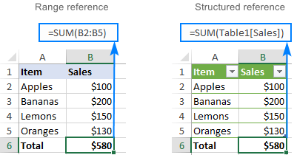

Slide 22
Task 3
Use a structured reference to create a formula that calculates the total sales for each region based on data in a table with the following steps:
1. Open a new workbook and create a table with data. The table should have at least two columns: one for the region and one for the sales amount.

Slide 23
2. On a new worksheet, create a summary table with a column for each region and a row for the total sales.
3. To use a structured reference in your formula, select the first cell in the total sales row.
4. On the formula bar, type an equals sign (=) and the name of the table, followed by a square bracket ([) and the name of the field you want to include in the calculation.

Slide 24
5. For example, if your table name is "SalesData" and you want to include the "Amount" field in the calculation, you would type the following formula in the formula bar: =SUM(SalesData[Amount]).
6. Press Enter and the formula will calculate the total sales for all regions.
7. To calculate the total sales for each region, modify the formula to include the region name in the reference.
8. For example, if you want to calculate the total sales for

Slide 25
Key features of structured references
Easily created
To add structured references to your formula, you simply select the table cells you want to refer to. The knowledge of a special syntax is not required.

Slide 26
Resilient and automatically updated
When you rename a column, references are automatically updated with the new name, and a formula does not break. Moreover, as you add new rows to the table, they are immediately included in the existing references, and the formulas calculate the full set of data.
So, whatever manipulations you do with your Excel tables, you don't have to worry about updating the structured references.
Can be used inside and outside a table

Slide 27
Formula auto-fill
To perform the same calculation in each table row, it is enough to enter a formula in just one cell. All other cells in that column are filled automatically.

Slide 28
Task 4
Use a structured reference to create a formula that calculates the total sales for each region based on data in a table with the following steps:
1. Open a new workbook and create a table with data. The table should have at least three columns: one for the product, one for the category, and one for the sales amount.

Slide 29
2. On a new worksheet, create a summary table with a column for each product category and a row for the average sales.
3. To use a structured reference in your formula, select the first cell in the average sales row.
4. On the formula bar, type an equals sign (=) and the following formula: =AVERAGEIFS(SalesData[Amount],SalesData[Category],A2)

Slide 30
5. Replace "SalesData" with the name of your table and "Amount" and "Category" with the names of your fields.
6. Replace "A2" with the cell reference that contains the name of the first product category you want to include in the calculation.
7. Press Enter and the formula will calculate the average sales for the first product category.

Slide 31
8. To calculate the average sales for each product category, copy the formula to the cells for the other categories and update the reference to match the product category.

Slide 32
How to create a structured reference in Excel
To create a structured reference, this is what you need to do:
1. Start typing a formula as usual, beginning with the equality sign (=).
2. When it comes to the first reference, select the corresponding cell or range of cells in your table. Excel will pick up the column name(s) and create an appropriate structured reference for you automatically.

Slide 33
3. Type the closing parenthesis and press Enter. If the formula is created inside the table, Excel automatically fills the entire column with the same formula.

Slide 35
As the result, the whole column E is auto-filled with this formula:
=SUM(Sales[@[Jan]:[Mar]])
Though the formula is the same, the data is calculated in each row individually. To understand the inner mechanics, please take a look at the table reference syntax.

Slide 36
If you are entering a formula outside the table, and that formula requires only a range of cells, a faster way to make a structured reference is this:
1. After the opening parenthesis, start typing the table name. As you type the first letter, Excel will show all matching names. If necessary, type a couple more letters to narrow down the list.
2. Use the arrow keys to select the table name in the list.

Slide 37
3. Double-click the selected name or press the Tab key to add it to your formula.
4. Type the closing parenthesis and press Enter.
For example, to find the largest number in our sample table, we start typing the MAX formula, after the opening parenthesis type "s", select the Sales table in the list, and press Tab or double-click the name.

Slide 38
As the result, we have this formula:
=MAX(Sales)

Slide 39
Structured reference syntax
As already mentioned, you do not need to know the syntax of structured references to include them in your formulas, however it will help you understand what each formula is actually doing.
Usually, a structured reference is represented by a string that begins with a table name and ends with a column specifier.

Slide 40

As an example, let's break down the following formula that adds up the totals of the South and North columns in the table named Regions:
The reference includes three components:
1. Table name
2. Item specifier
3. Column specifiers

Slide 41
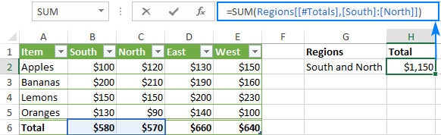

Slide 42
Task 5
Use a 3D reference and a structured reference to create a formula that calculates the total sales for each region and product category based on data in multiple tables with the following steps:
1. Open a new workbook and create two tables with data, one for each region. Each table should have at least three columns: one for the product, one for the category, and one for the sales amount.

Slide 43
2. On a new worksheet, create a summary table with a column for each region and product category and a row for the total sales.
3. To use a 3D reference in your formula, select the first cell in the total sales row.
4. On the formula bar, type an equals sign (=) and the following formula: =SUM(Region 1:Region 2!Sales Data[Amount]).

Slide 44
5. Replace "Region1" and "Region2" with the names of your worksheets and "SalesData" with the name of your table.
6. Replace "Amount" with the name of the sales amount field in your table.
7. Press Enter and the formula will calculate the total sales for all regions and products.
8. To use a structured reference in your formula, modify the formula to include the product category in the reference.

Slide 45
9. For example, if you want to calculate the total sales for the first product category, you would type the following formula in the formula bar: =SUMIFS(Region1:Region2!SalesData[Amount],Region1:Region2!SalesData[Category],"Electronics").
10. Replace "Electronics" with the name of the first product category you want to include in the calculation.
11. Press Enter and the formula will calculate the total sales for the first product category in all regions.

Slide 46
12. To calculate the total sales for each region and product category, copy the formula to the cells for the other categories and regions and update the references to match the product category and region.

Slide 47
Table name
The table name references only the table data, without header row or total rows. It can be a default table name like Table1 or a custom name like Regions. To give a custom name to your table, carry out these steps.
If your formula is located within the table it refers to, the table name is usually omitted because it is implied.

Slide 48
Column specifier
Column specifier references the data in the corresponding column, without the header row and total row. A column specifier is represented by the column name enclosed in brackets, e.g. [South].
To refer to more than one contiguous columns, use the range operator like [[South]:[East]].

Slide 49
Item specifier
To refer to specific parts of a table, you can use any of the following specifiers:

Slide 50
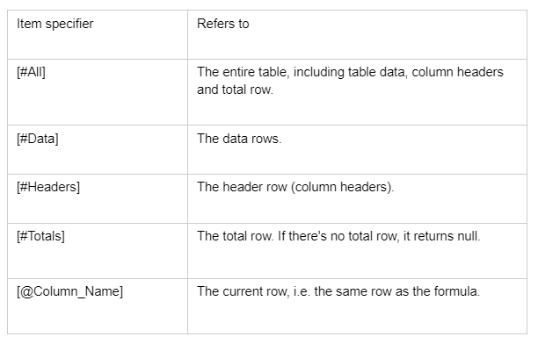

Slide 51
Please notice that the pound sign (#) is used with all the item specifiers, except the current row. To refer to the cells in the same row where you enter the formula, Excel uses the @ character followed by the column name.
For example, to add numbers in the South and West columns of the current row, you'd use this formula:
=SUM(Regions[@South], Regions[@West])

Slide 52
If the column names contain spaces, punctuation marks or special characters, an additional set of brackets around the column name will appear:
=SUM(Regions[@[South sales]], Regions[@[West sales]])

Slide 53
Task 6
Use a 3D reference and a structured reference to create a formula that calculates the average sales for each quarter and product category based on data in multiple tables. The data should span across multiple years with the following steps:
1. Open a new workbook

Slide 54
2. Create multiple tables with data, one for each year. Each table should have at least four columns: one for the date, one for the product, one for the category, and one for the sales amount.
3. On a new worksheet, create a summary table with a column for each quarter and product category and a row for the average sales.
4. To use a 3D reference in your formula, select the first cell in the average sales row.

Slide 55
5. On the formula bar, type an equals sign (=) and the following formula: =AVERAGE(Year1:YearN!SalesData[Amount]).
6. Replace "Year1" and "YearN" with the names of your worksheets and "SalesData" with the name of your table.
7. Replace "Amount" with the name of the sales amount field in your table.
8. Press Enter and the formula will calculate the average sales for all years and products.

Slide 56
9. To use a structured reference in your formula, modify the formula to include the product category and quarter in the reference.
10. To do this, you will need to use the IF and DATE functions in addition to the AVERAGE and SUMIFS functions.
11. For example, if you want to calculate the average sales for the first quarter and the first product category, you would type the following formula in the formula bar:

Slide 57
=AVERAGEIFS(Year1:YearN!SalesData[Amount],Year1:YearN!SalesData[Category],"Electronics",Year1:YearN!SalesData[Date],IF(MONTH(Year1:YearN!SalesData[Date])<=3,Year1:YearN!SalesData[Date])).
12. Replace "Electronics" with the name of the first product category you want to include in the calculation.
13. Press Enter and the formula will calculate the average sales for the first quarter and the first product category for all years.

Slide 58
14. To calculate the average sales for each quarter and product category, copy the formula to the cells for the other categories and quarters and update the references to match the product category, quarter, and year.

Slide 59


Slide 60
Thank You

