Slide 1

Operating Systems
Lecture : 10

Slide 2

Explain the process and steps to install and configure an operating system

Slide 3
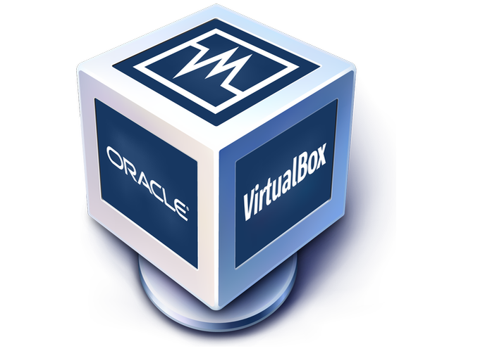
Installing Virtualbox
First we will install the VirtualBox
After installing the VirtualBox, we will install two different operating systems in VirtualBox

Slide 4
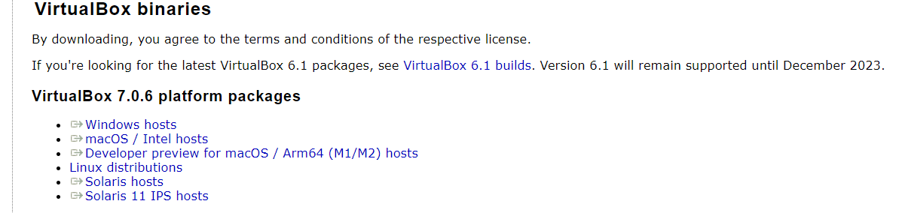
Installing Virtualbox (cont.)
Step 1:
Go to https://www.virtualbox.org/wiki/Downloads and download the latest version of VirtualBox for Windows

Slide 5
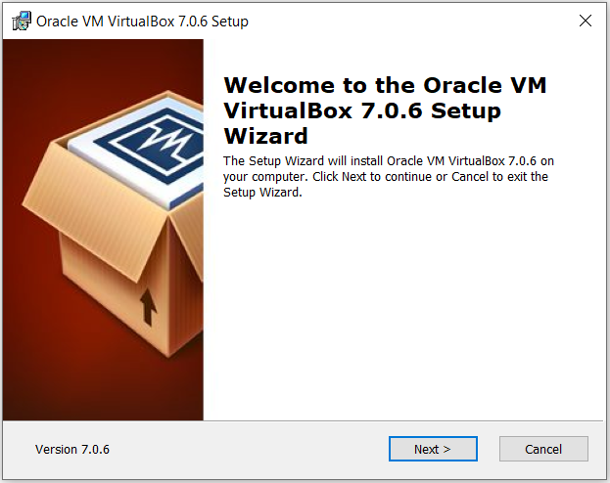
Installing Virtualbox (cont.)
Step 2:
After downloading, double click the “.exe” file and then click “Next”

Slide 6
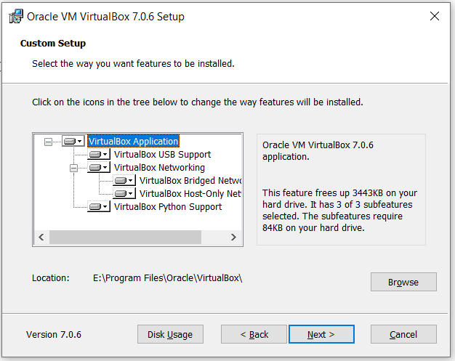
Installing Virtualbox (cont.)
Step 3:
Select the installation location

Slide 7
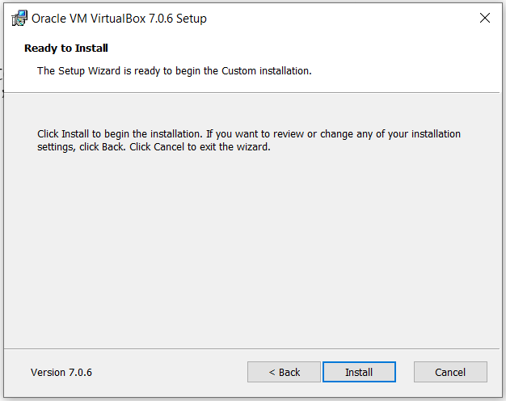
Installing Virtualbox (cont.)
Step 4:
Now, it is ready to install. Click the “Install” button

Slide 8
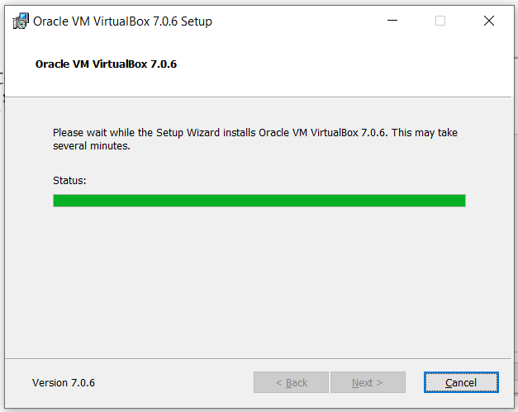
Installing Virtualbox (cont.)
Step 5:
Then It will install files and packages

Slide 9
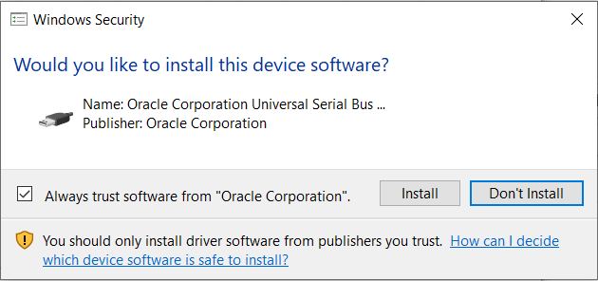
Installing Virtualbox (cont.)
Step 6:
Install certificates if requires

Slide 10
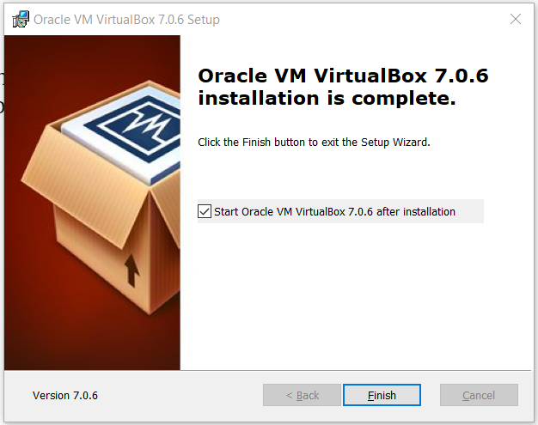
Installing Virtualbox (cont.)
Step 7:
Now you can finish the installation and open the VirtualBox

Slide 11


Installing Ubuntu 22.04 on VirtualBox

Slide 12
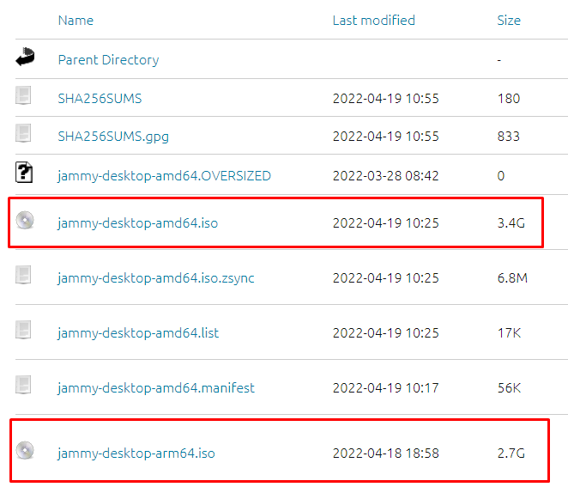
Installing Ubuntu (cont.)
Step 1:
First download the ubuntu 22.04 ISO file.
Highlighted ISO files indicates the type of computer systems they are built for.

Slide 13
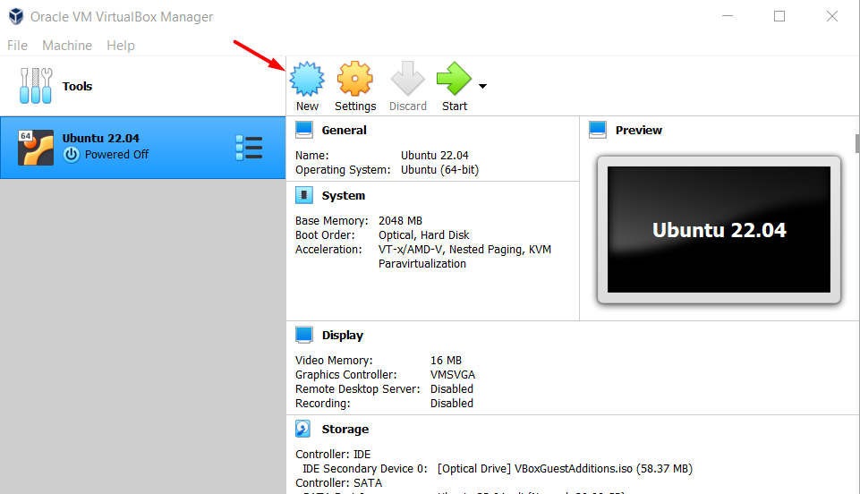
Installing Ubuntu (cont.)
Step 2:
Now run the VirtualBox
Click on the ‘New’ button to generate a new virtual machine

Slide 14
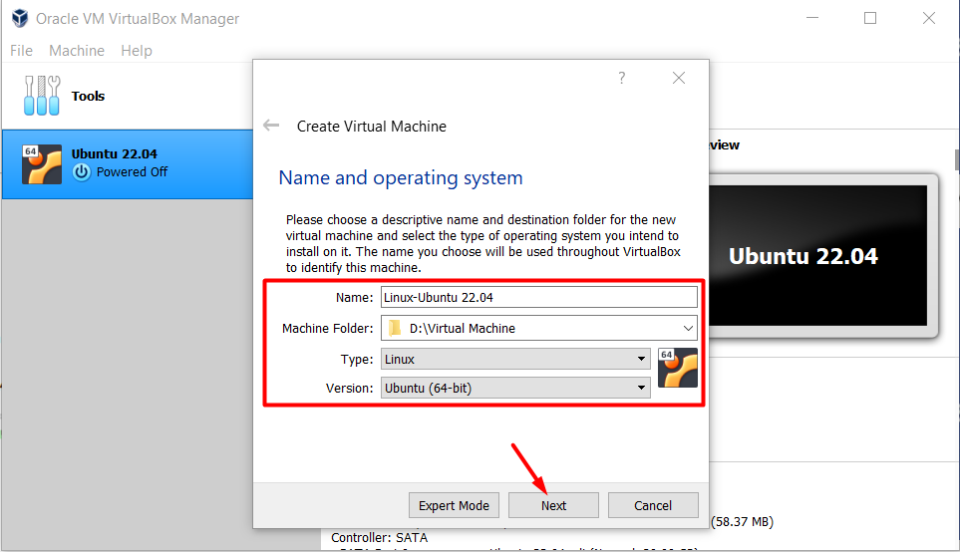
Installing Ubuntu (cont.)
Step 3:
Write your machine name and set its type and version as indicated in the screenshot.

Slide 15
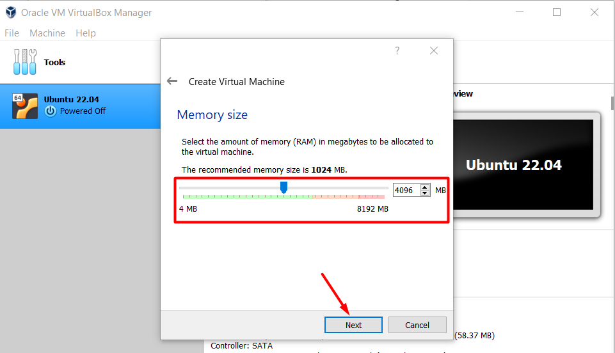
Installing Ubuntu (cont.)
Step 4:
Set the RAM for the VM. You choose the RAM of your choice but 4GB is recommended.

Slide 16
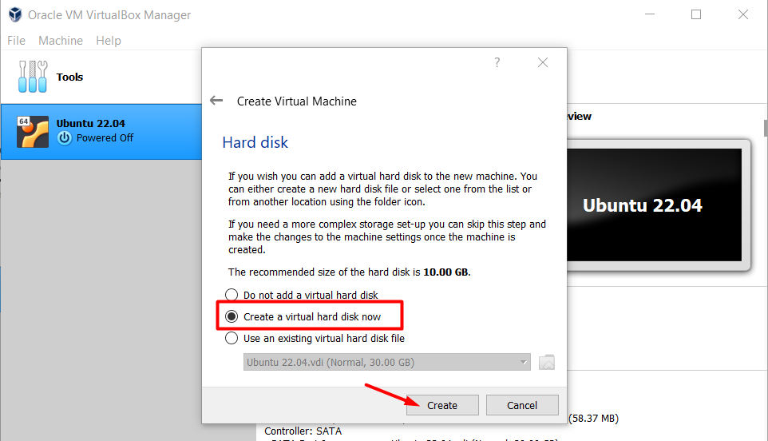
Installing Ubuntu (cont.)
Step 5:
Now select the second option and click create

Slide 17
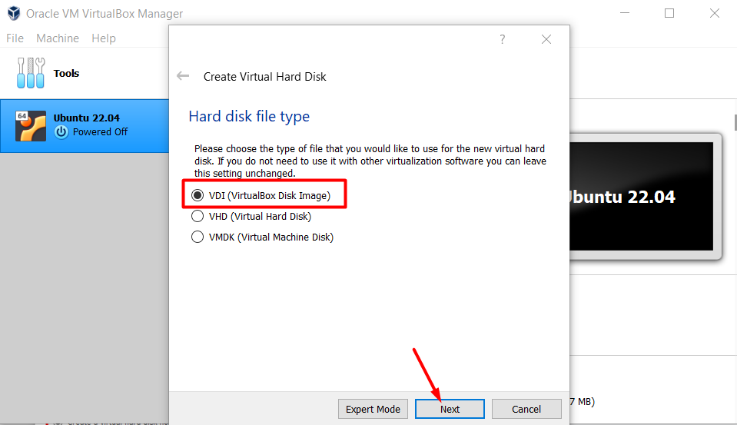
Installing Ubuntu (cont.)
Step 6:
Select the by default option which is VDI, however if you wish to utilize Virtual Hard Disk then you can choose VHD option.

Slide 18
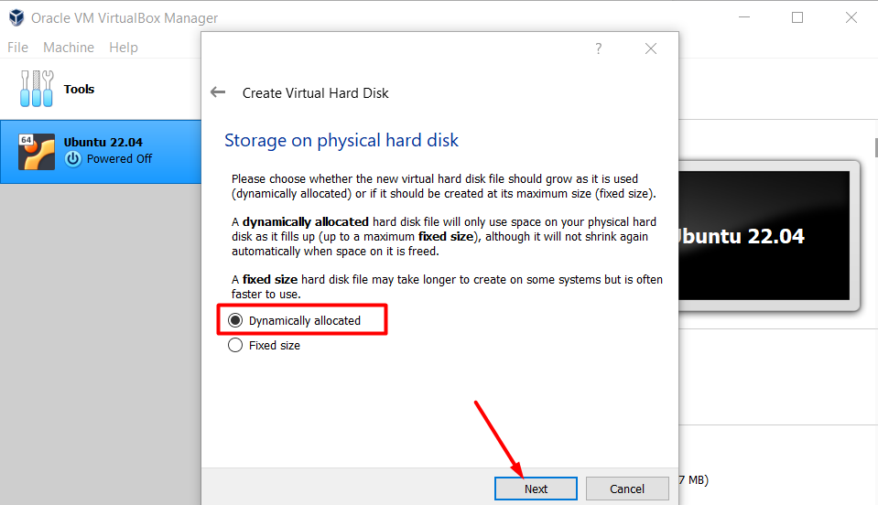
Installing Ubuntu (cont.)
Step 7:
Now choose the ‘Dynamically allocated’ option which makes the hard disk to take up only the required amount of space.

Slide 19
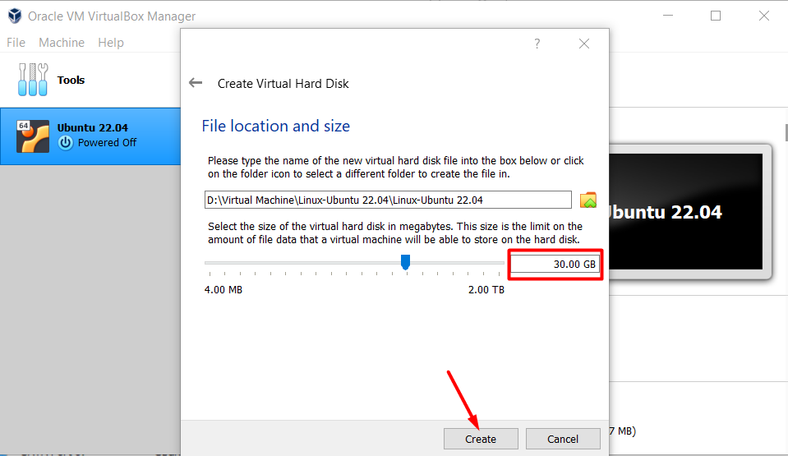
Installing Ubuntu (cont.)
Step 8:
Now allocate space according to your requirements(e.g. 30GB) and create the virtual machine.

Slide 20
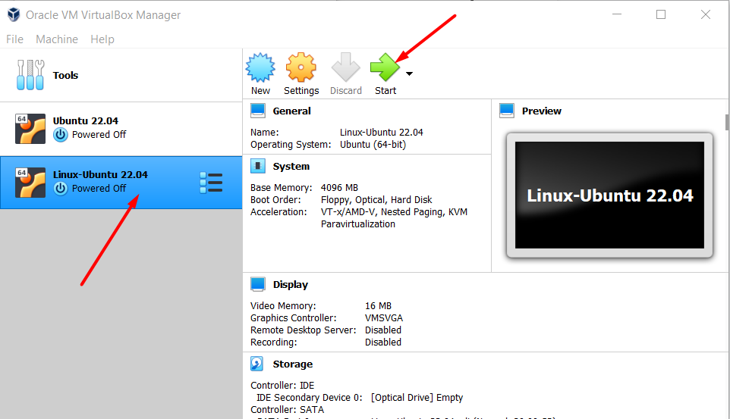
Installing Ubuntu (cont.)
Step 9:
After performing the above steps your machine will be created and will appear on the sidebar menu. Now select that particular machine and press start.

Slide 21
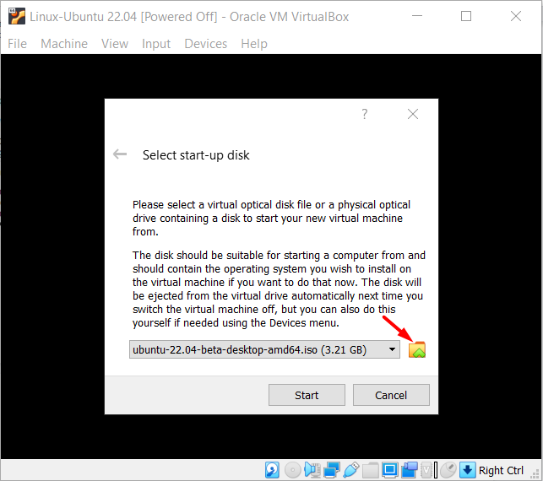
Installing Ubuntu (cont.)
Step 10:
In order to boot the machine include the downloaded ISO file that will act as a startup disk

Slide 22
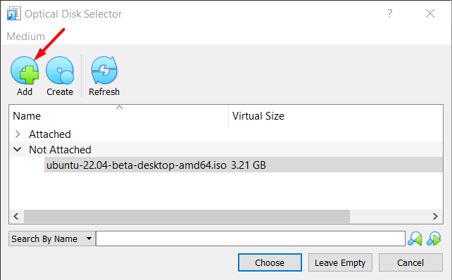
Installing Ubuntu (cont.)
Step 11:
A pop up will appear when you click the folder option. Now first click on the add button as indicated in the screenshot.

Slide 23
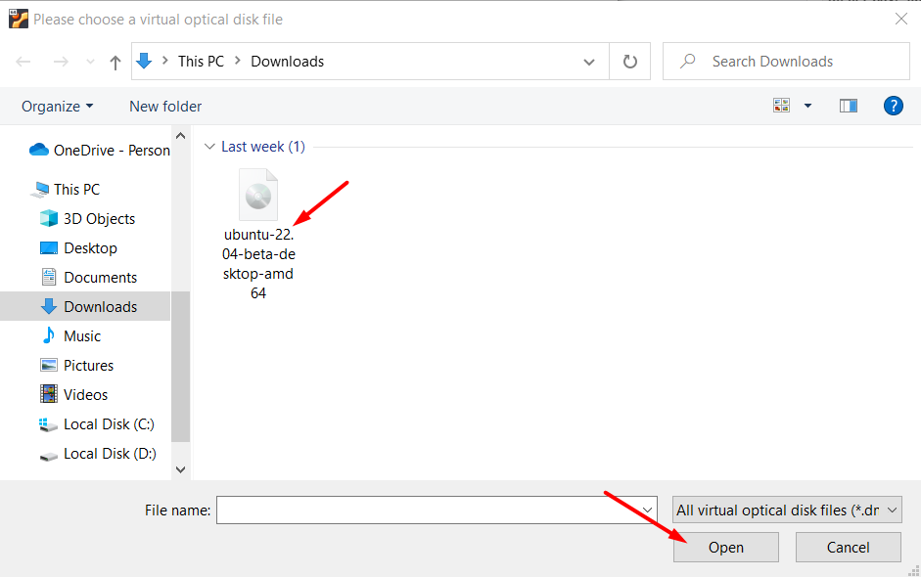
Installing Ubuntu (cont.)
Step 12:
A window will open up and from there select the downloaded file.

Slide 24
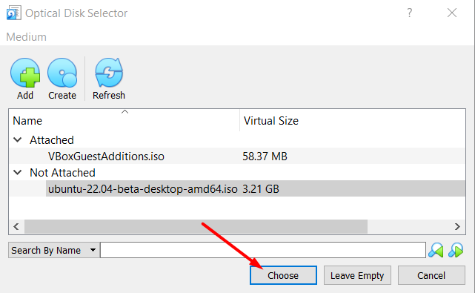
Installing Ubuntu (cont.)
Step 13:
Now finally select the ‘choose’ option.

Slide 25
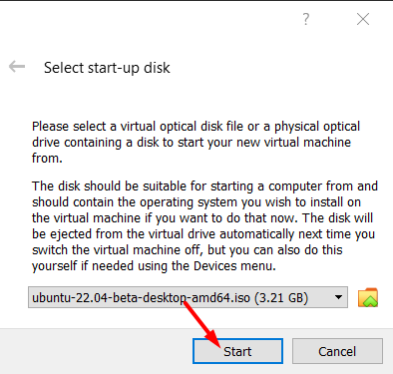
Installing Ubuntu (cont.)
Step 14:
Once the file is added, press the start button.

Slide 26
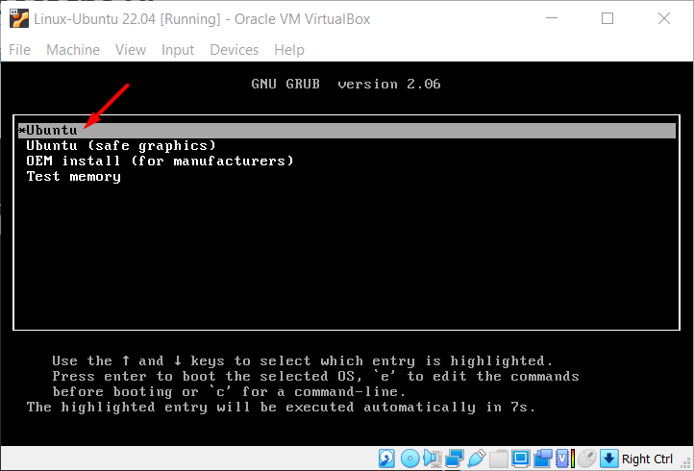
Installing Ubuntu (cont.)
Step 15:
Once the machine is started, you will see the Grub menu, from there select the ‘Ubuntu’ option by pressing “Enter” to boot the machine.

Slide 27
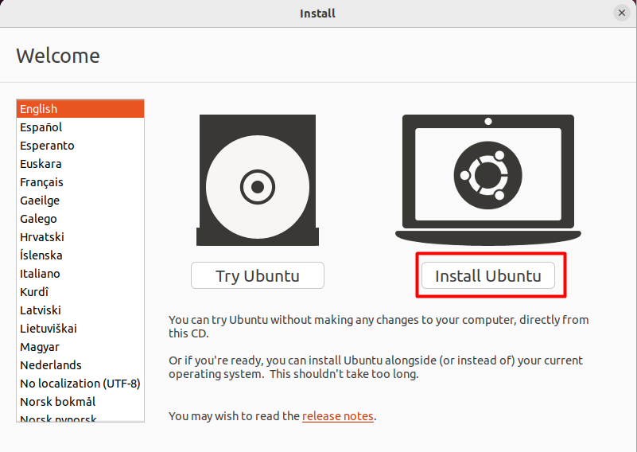
Installing Ubuntu (cont.)
Step 16:
To install Ubuntu select the ‘Install Ubuntu’ option, whereas, if you just want to experience Ubuntu in a live environment then go for the ‘Try Ubuntu’ option.

Slide 28
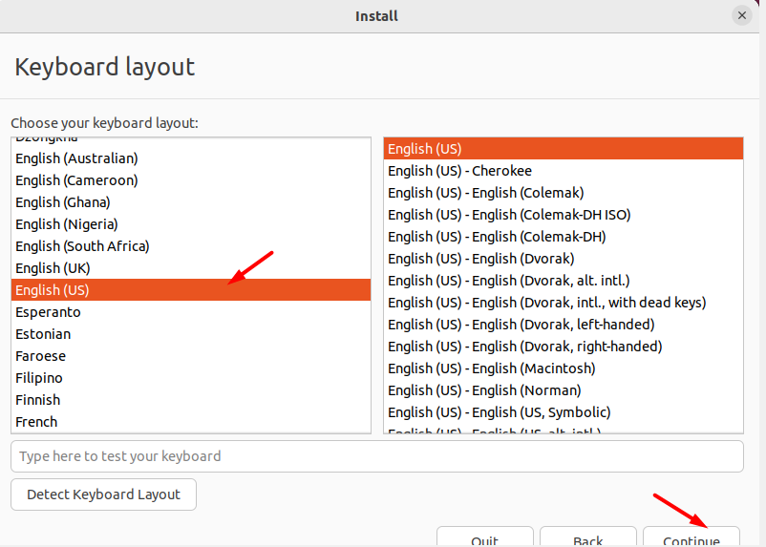
Installing Ubuntu (cont.)
Step 17:
Select the language you prefer. For instance, here we have selected the ‘English(US)’ option. Once the language is selected press the ‘continue’ option.

Slide 29
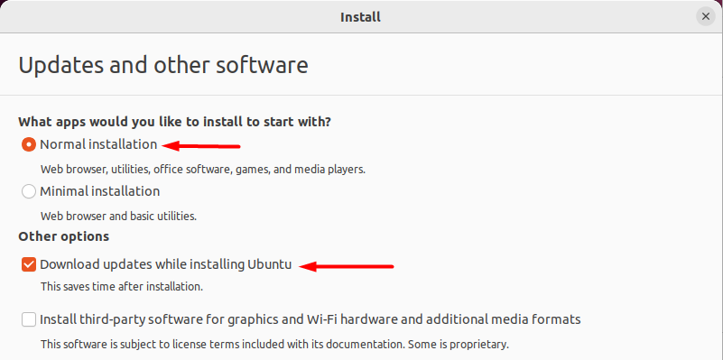
Installing Ubuntu (cont.)
Step 18:
Now when you come to this step you either have to select the ‘Normal Installation’ option or the ‘Minimal Installation’ option depending upon your requirements. Moreover, if you are a GPU user then also select the last option.

Slide 30
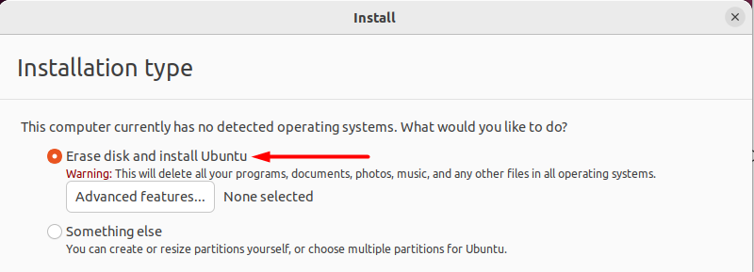
Installing Ubuntu (cont.)
Step 19:
For this step choose “Erase Disk and install Ubuntu” option(Don’t worry, it won’t delete any of your guest operating system’s data).

Slide 31
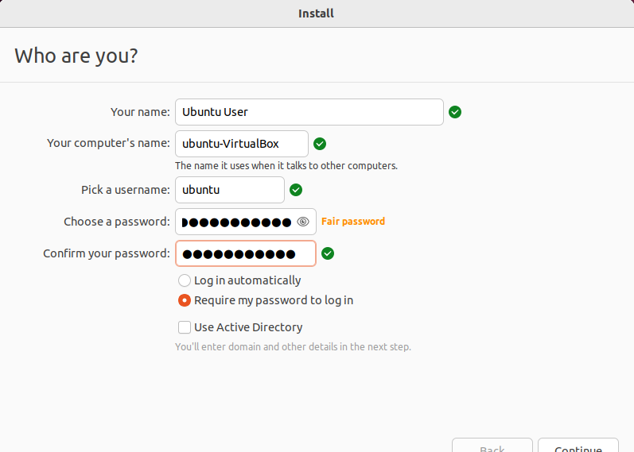
Installing Ubuntu (cont.)
Step 20:
Now set up your account.

Slide 32
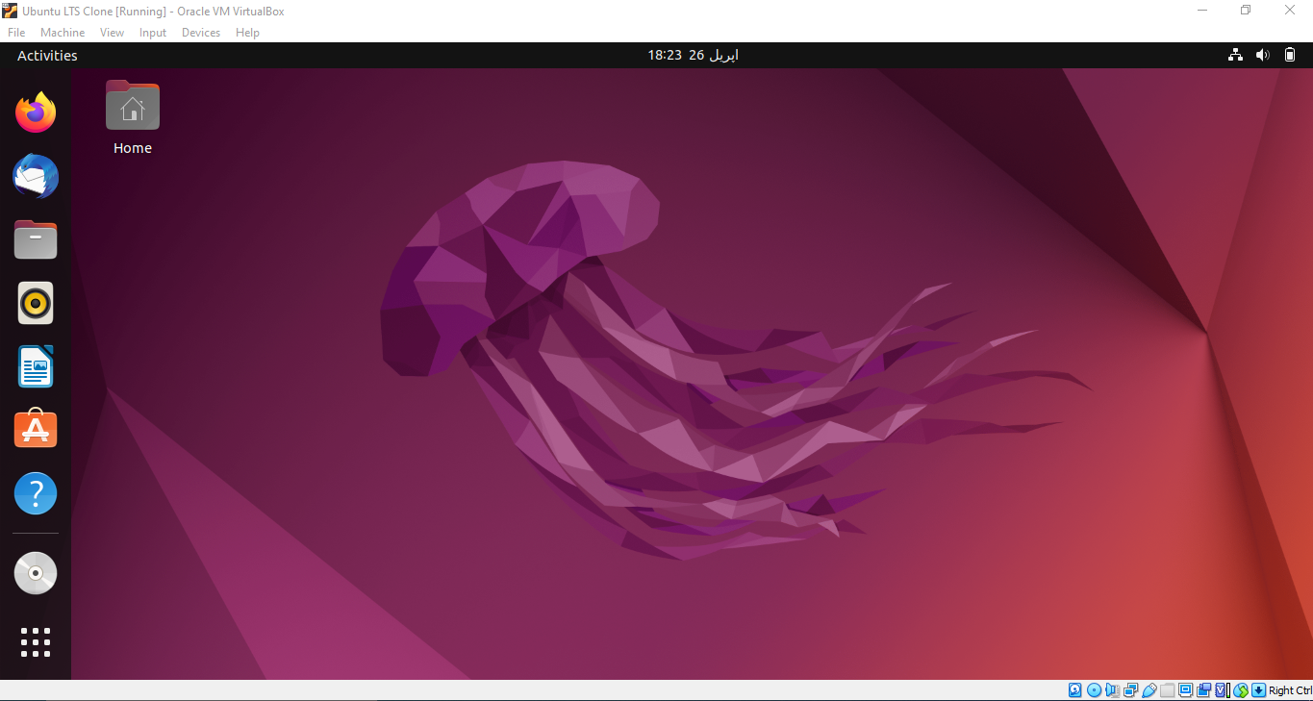
Installing Ubuntu (cont.)
Once you continue, the system will start to install Ubuntu 22.04 and finish in a while and you will be asked to restart your system.
After successful restart of the system, you will have the fresh new look of the Ubuntu 22.04 on your Virtual Box.

Slide 33

Installing Windows on VirtualBox

Slide 34
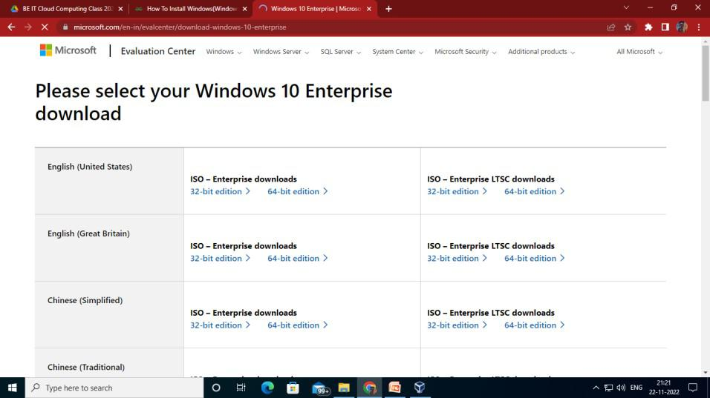
Installing Windows
Step 1:
Search and download Microsoft Windows Evaluation 10 ISO file from microsoft.com (Link).
Then fill up all the requirements and click on Continue to download it. Note that you have to register before moving to the ISO file download page as shown below.

Slide 35
Installing Windows
Step 2:
Now run the VirtualBox
Click on the ‘New’ button to generate a new virtual machine

Slide 36
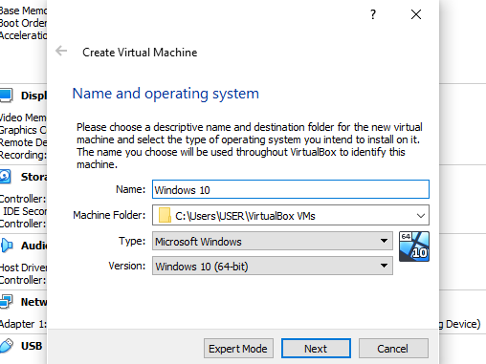
Installing Windows
Step 3:
Select a name, then the type as MS Windows and the version as Windows 10(64-bit) with respect to the machine used.

Slide 37
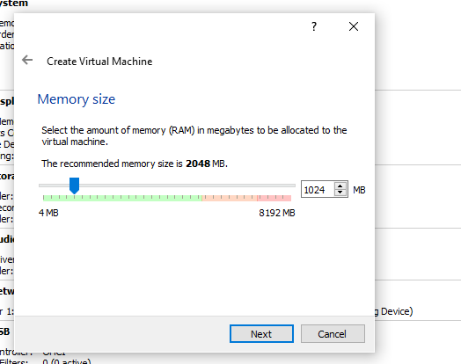
Installing Windows
Step 4:
Then provide memory according to our RAM size preferably 2-4GB. 4 GB is recommended.

Slide 38
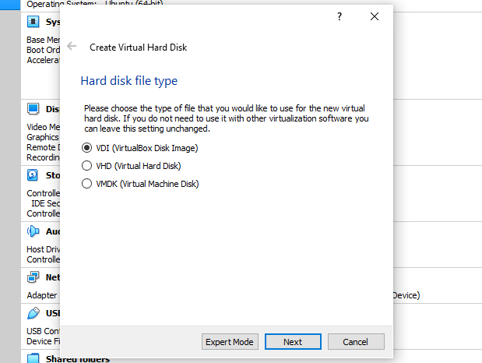
Installing Windows
Step 5:
Then leave the Hard disk file type as VDI.

Slide 39
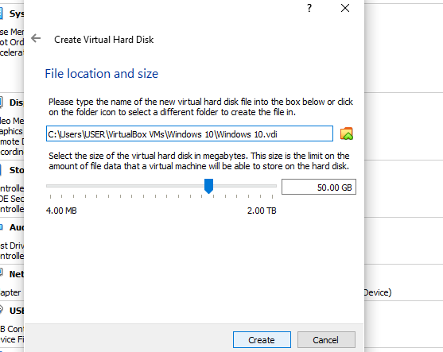
Installing Windows
Step 6:
Then select the virtual hard disk size. We selected here 50GB. You can select according to your CPU space available.

Slide 40
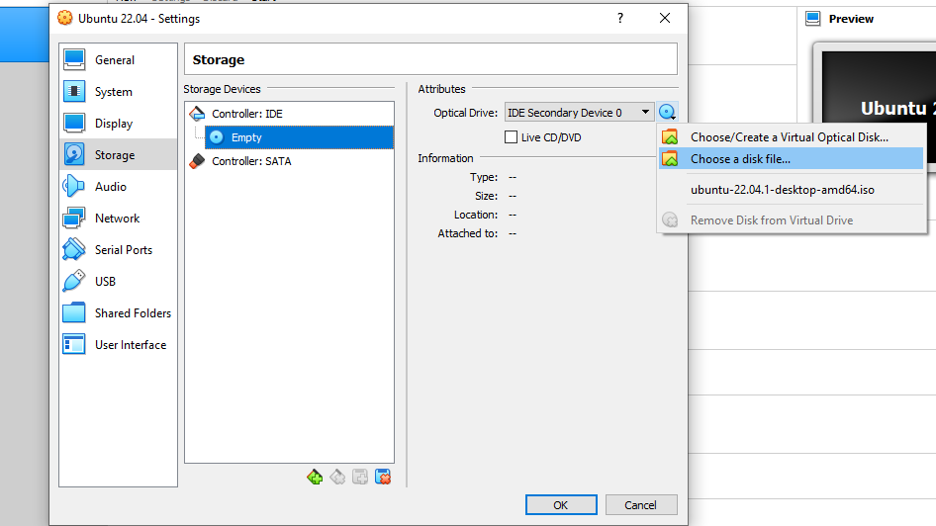
Installing Windows
Step 7:
Go to Settings->Storage->Click on “Empty” under “Controller” choose the CD icon and then click on “choose a disk file”.
Browse to the location where you have downloaded the Windows 10 ISO file. Copy the location and paste it.
Once this is done, other settings can be changed also or can be kept default.

Slide 41
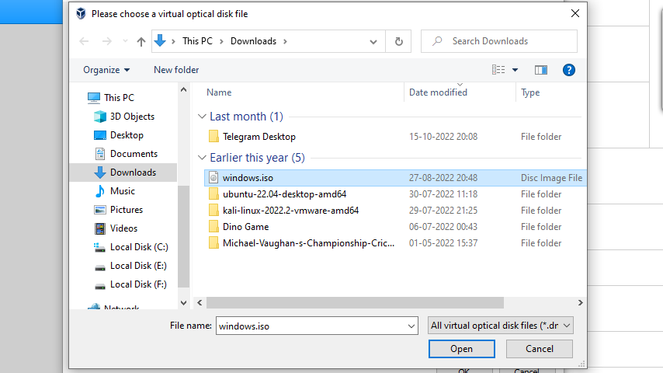
Installing Windows
Step 8:
Browse to the location where you have downloaded the Windows 10 ISO file and select it so that Windows 10 gets installed on VirtualBox.

Slide 42
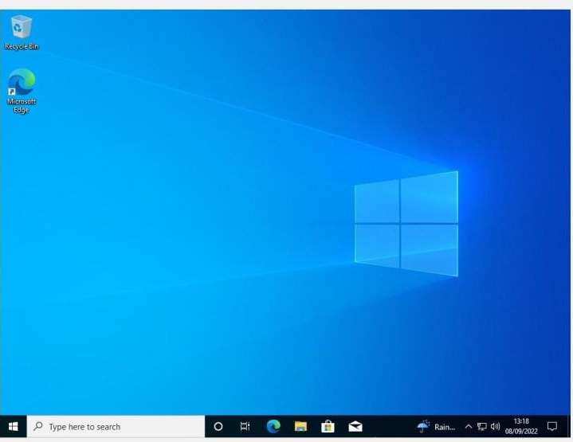
Installing Windows
Windows 10 has been installed on the Virtual Machine.
You can now open the Windows 10 operating system in VM. Set up a new username and password and use Windows 10 in VM for various purposes.

Slide 43
Installing Windows
Installing windows directly to your machine is very similar. You will just need an installation media like USB drive for that.
To do that:
Go here and download and install windows installation tool.
Open it and choose “Create installation media (USB flash drive, DVD, or ISO file) for another PC”.
Follow the instructions. Select “USB Flash drive” when asked “Which media to use”.
When done, restart the computer and choose to boot from USB drive. To do that, you may need to change the boot order by entering BIOS settings. How to enter BIOS depends on the computer that you are using. When you PC is booting, you must press your BIOS key set by your manufacturer which could be F10, F2, F12, F1, or DEL

Slide 44
Installing Windows
Once booted from the USB drive, everything should be similar to installing on VBox.

Slide 45

Let’s do some exercises!

Slide 46
Exercises
What is VirtualBox and what does it do?
How does VirtualBox compare to other virtualization software?
What are the system requirements for running VirtualBox?
What are some common use cases for VirtualBox?
Download and Install the VirtualBox
What are the differences between Windows and Ubuntu operating systems?
How does the user interface differ between Windows and Ubuntu?
Can you run Windows software on Ubuntu and vice versa?
What are the pros and cons of using Windows and Ubuntu?
Install Ubuntu 23.04 in the VirtualBox (Download Link)

Slide 47

Thanks!

