Slide 1
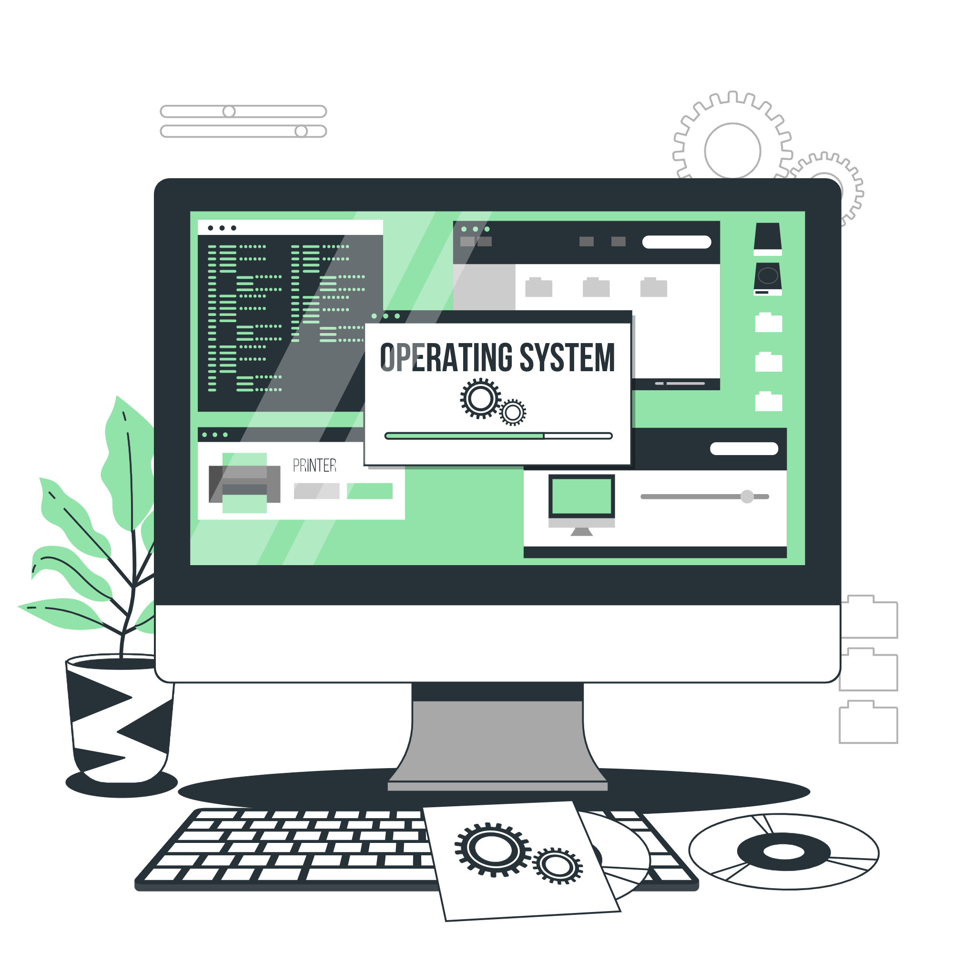
Operating System
Lecture: 1

Slide 2

Operating system, Computer System Architecture,
Storage structure,
I/O structure

Slide 3
What is an Operating System?
An Operating System (OS) is a software layer that sits between a computer's hardware and the user. It manages hardware resources and provides an environment for applications to run.

Slide 4
What Operating Systems Do
Depends on the point of view
Users want convenience, ease of use and good performance
Don’t care about resource utilization
But shared computer such as mainframe or minicomputer must keep all users happy
Operating system is a resource allocator and control program making efficient use of HW and managing execution of user programs
Users of dedicate systems such as workstations have dedicated resources but frequently use shared resources from servers
Mobile devices like smartphones and tables are resource poor, optimized for usability and battery life
Mobile user interfaces such as touch screens, voice recognition
Some computers have little or no user interface, such as embedded computers in devices and automobiles
Run primarily without user intervention

Slide 5
Defining Operating Systems
Term OS covers many roles
Because of myriad designs and uses of OSes
Present in toasters through ships, spacecraft, game machines, TVs and industrial control systems
Born when fixed use computers for military became more general purpose and needed resource management and program control

Slide 6
Computer System Structure
Computer system can be divided into four components:
Hardware – provides basic computing resources
CPU, memory, I/O devices
Operating system
Controls and coordinates use of hardware among various applications and users
Application programs – define the ways in which the system resources are used to solve the computing problems of the users
Word processors, compilers, web browsers, database systems, video games
Users
People, machines, other computers

Slide 7
Computer Startup
Bootstrap program is loaded at power-up or reboot
Typically stored in ROM or EPROM, generally known as firmware
Initializes all aspects of system
Loads operating system kernel and starts execution

Slide 8
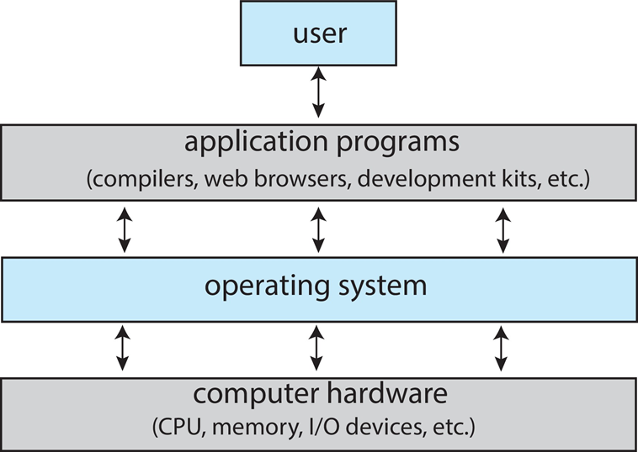
Abstract View of Components of Computer

Slide 9
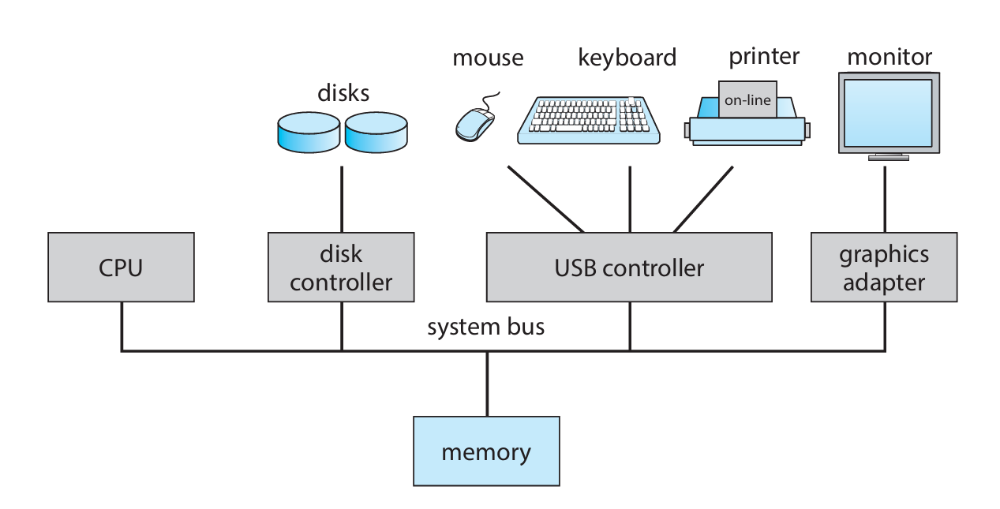
Computer System Architecture
Fig. A Typical PC Computer System

Slide 10
Computer System Operation
I/O devices and the CPU can execute concurrently
Each device controller is in charge of a particular device type
Each device controller has a local buffer
Each device controller type has an operating system device driver to manage it
CPU moves data from/to main memory to/from local buffers
I/O is from the device to local buffer of controller
Device controller informs CPU that it has finished its operation by causing an interrupt

Slide 11
Computer System Architecture
A modern general-purpose computer system consists of one or more CPUs and a number of device controllers connected through a common bus that provides access between components and shared memory. Each device controller is in charge of a specific type of device (for example, a disk drive, audio device, or graphics display).
Depending on the controller, more than one device may be attached. For instance: One system USB port can connect to a USB hub, to which several device can connect.

Slide 12
Common Functions of Interrupts
Interrupt transfers control to the interrupt service routine generally, through the interrupt vector, which contains the addresses of all the service routines
Interrupt architecture must save the address of the interrupted instruction
A trap or exception is a software-generated interrupt caused either by an error or a user request
An operating system is interrupt driven

Slide 13
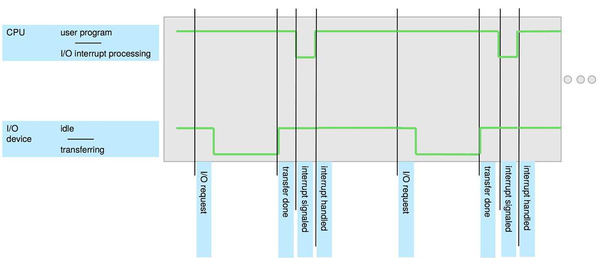
Interrupt Timeline

Slide 14
Interrupt Handling
The operating system preserves the state of the CPU by storing the registers and the program counter
Determines which type of interrupt has occurred:
Separate segments of code determine what action should be taken for each type of interrupt

Slide 15
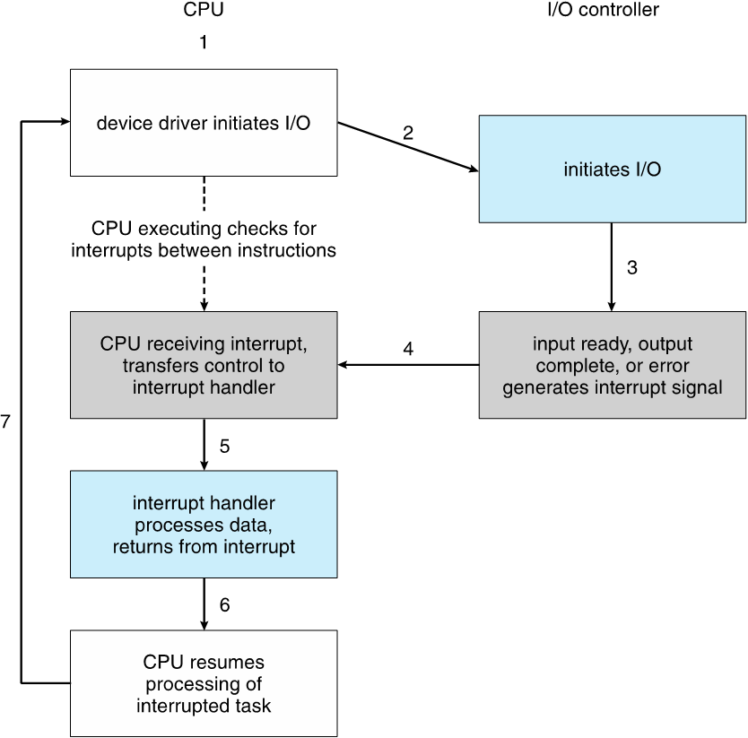
Interrupt-drive I/O Cycle

Slide 16
I/O Structure
Two methods for handling I/O
After I/O starts, control returns to user program only upon I/O completion
After I/O starts, control returns to user program without waiting for I/O completion

Slide 17
I/O Structure
After I/O starts, control returns to user program only upon I/O completion
Wait instruction idles the CPU until the next interrupt
Wait loop (contention for memory access)
At most one I/O request is outstanding at a time, no simultaneous I/O processing
After I/O starts, control returns to user program without waiting for I/O completion
System call – request to the OS to allow user to wait for I/O completion
Device-status table contains entry for each I/O device indicating its type, address, and state
OS indexes into I/O device table to determine device status and to modify table entry to include interrupt

Slide 18
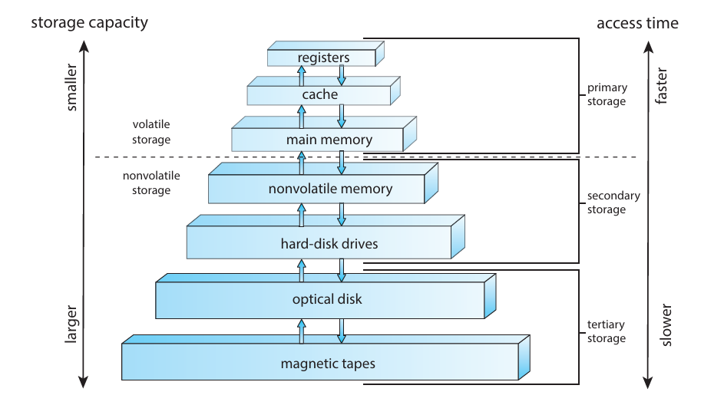
I/O Structure
Storage systems, including registers, main memory, secondary storage, and cache memory, are organized hierarchically based on speed, size, and volatility. Volatile storage loses data when power is off, while nonvolatile storage retains it. Mechanical storage (e.g., HDDs) is cheaper and larger but slower than electrical storage (e.g., SSDs), which is faster and more expensive. Proper storage system design balances cost, speed, and capacity.

Slide 19
Storage Structure
A modern computer system uses CPUs and device controllers connected via a common bus. Programs run from RAM, which is volatile, so EEPROM stores essential data like the bootstrap program. Secondary storage (e.g., HDDs, NVM) supplements RAM, while storage systems are organized hierarchically based on speed, size, and volatility.
Programs ideally reside in main memory, but it's limited in size and volatile, necessitating secondary storage like HDDs and NVM for permanent data storage.

Slide 20
Storage Structure
Main memory – only large storage media that the CPU can access directly
Random access
Typically volatile
Typically random-access memory in the form of Dynamic Random-access Memory (DRAM)
Secondary storage – extension of main memory that provides large nonvolatile storage capacity

Slide 21
Storage Structure
Hard Disk Drives (HDD) – rigid metal or glass platters covered with magnetic recording material
Disk surface is logically divided into tracks, which are subdivided into sectors
The disk controller determines the logical interaction between the device and the computer
Non-volatile memory (NVM) devices– faster than hard disks, nonvolatile
Various technologies
Becoming more popular as capacity and performance increases, price drops

Slide 22
Storage Hierarchy
Storage systems organized in hierarchy
Speed
Cost
Volatility
Caching – copying information into faster storage system; main memory can be viewed as a cache for secondary storage
Device Driver for each device controller to manage I/O
Provides uniform interface between controller and kernel

Slide 23
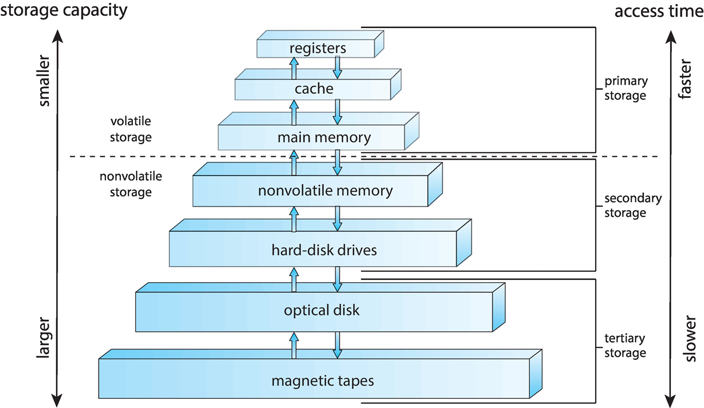
Storage Hierarchy

Slide 24
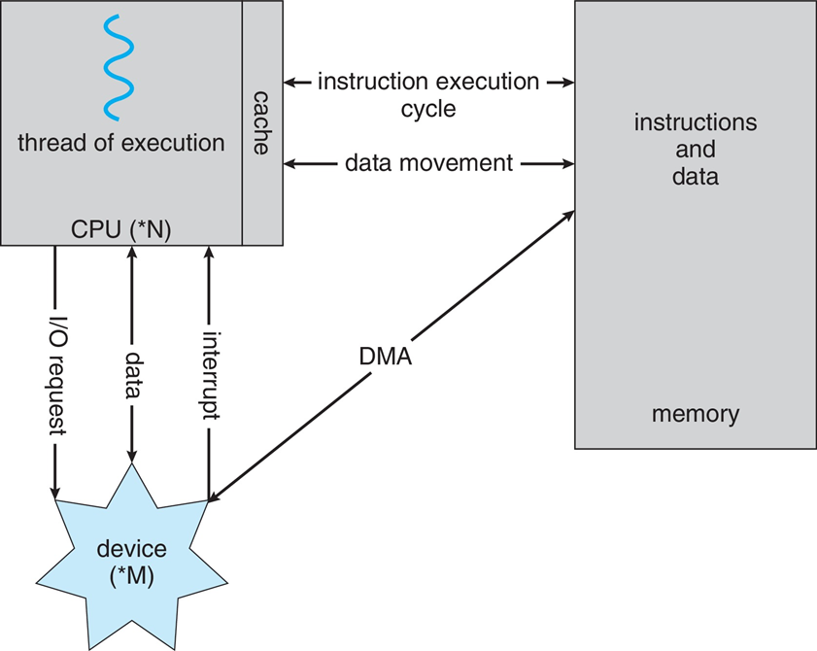
How a Modern Computer Works
A von Neumann architecture

Slide 25
Direct Memory Access Structure
Used for high-speed I/O devices able to transmit information at close to memory speeds
Device controller transfers blocks of data from buffer storage directly to main memory without CPU intervention
Only one interrupt is generated per block, rather than the one interrupt per byte

Slide 26
Operating-System Operations
Bootstrap program – simple code to initialize the system, load the kernel
Kernel loads
Starts system daemons (services provided outside of the kernel)
Kernel interrupt driven (hardware and software)
Hardware interrupt by one of the devices
Software interrupt (exception or trap):
Software error (e.g., division by zero)
Request for operating system service – system call
Other process problems include infinite loop, processes modifying
other or the operating system

Slide 27
Multiprogramming (Batch system)
Single user cannot always keep CPU and I/O devices busy
Multiprogramming organizes jobs (code and data) so CPU always has one to execute
A subset of total jobs in system is kept in memory
One job selected and run via job scheduling
When job has to wait (for I/O for example), OS switches to another job

Slide 28
Multitasking (Timesharing)
A logical extension of Batch systems– the CPU switches jobs so frequently that users can interact with each job while it is running, creating interactive computing
Response time should be < 1 second
Each user has at least one program executing in memory process
If several jobs ready to run at the same time CPU scheduling
If processes don’t fit in memory, swapping moves them in and out to run
Virtual memory allows execution of processes not completely in memory

Slide 29
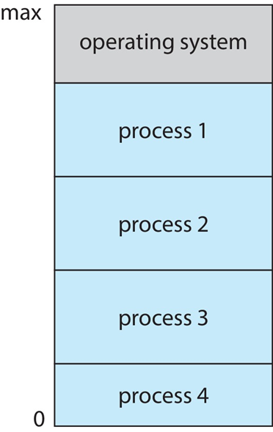
Memory Layout for Multiprogrammed System

Slide 30
Dual-mode Operation
Dual-mode operation allows OS to protect itself and other system components
User mode and kernel mode
Mode bit provided by hardware
Provides ability to distinguish when system is running user code or kernel code.
When a user is running mode bit is “user”
When kernel code is executing mode bit is “kernel”
How do we guarantee that user does not explicitly set the mode bit to “kernel”?
System call changes mode to kernel, return from call resets it to user
Some instructions designated as privileged, only executable in kernel mode

Slide 31
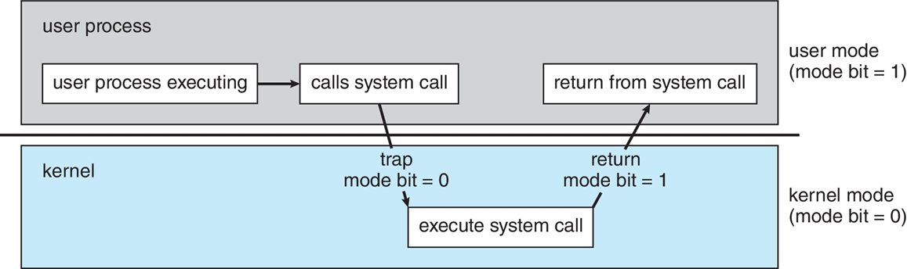
Transition from User to Kernel Mode

Slide 32
Timer
Timer to prevent infinite loop (or process hogging resources)
Timer is set to interrupt the computer after some time period
Keep a counter that is decremented by the physical clock
Operating system set the counter (privileged instruction)
When counter zero generate an interrupt
Set up before scheduling process to regain control or terminate program that exceeds allotted time

Slide 33

Let’s do some exercises!

Slide 34

Exercises
Define an operating system and its three main functions.
List and describe three types of storage used in a computer system.
Explain Interrupt-drive I/O Cycle
Define multiprogramming and list two benefits it provides.
Create a scenario where multiprogramming improves system efficiency.
Describe an example of how multitasking is used in a modern operating system.
Explain the purpose of a timer in an operating system.
Describe how a timer is used to manage process scheduling.

Slide 35
Thanks!

