Slide 1

Operating Systems
Lecture : 11

Slide 2

Explain the process and steps to install and configure Fedora Linux on VirtualBox
Directory Structure in
Different OS

Slide 3


Installing Fedora on VirtualBox

Slide 4
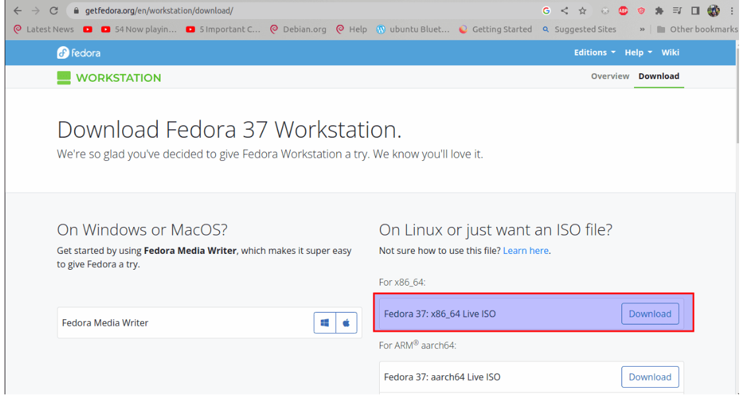
Installing Fedora
Step 1:
Download the Fedora ISO (Fedora 37:x86_64 DVD ISO) from Feodora’s Official website
https://fedoraproject.org/en/workstation/download

Slide 5
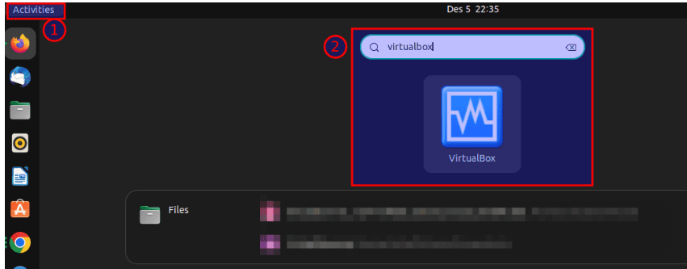
Installing Fedora
Step 2:
Fedora, by default, requires a minimum of 20GB disk space and 2GB RAM to install and successfully run it.
Since we are using Ubuntu as our primary OS, we will click on the “Activities” bar and use the search bar to scout for VirtualBox. Such an icon will appear; click on it to open it:

Slide 6
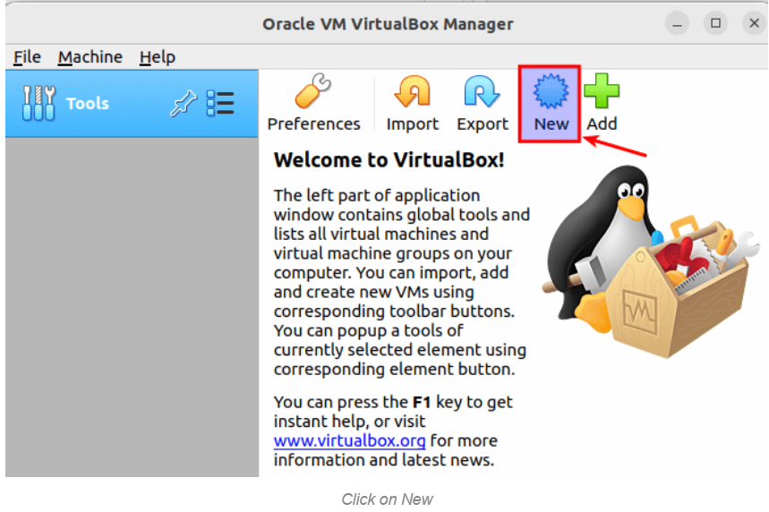
Installing Fedora
Step 3:
After starting Virtual Box, click on the “New” button as shown here:

Slide 7
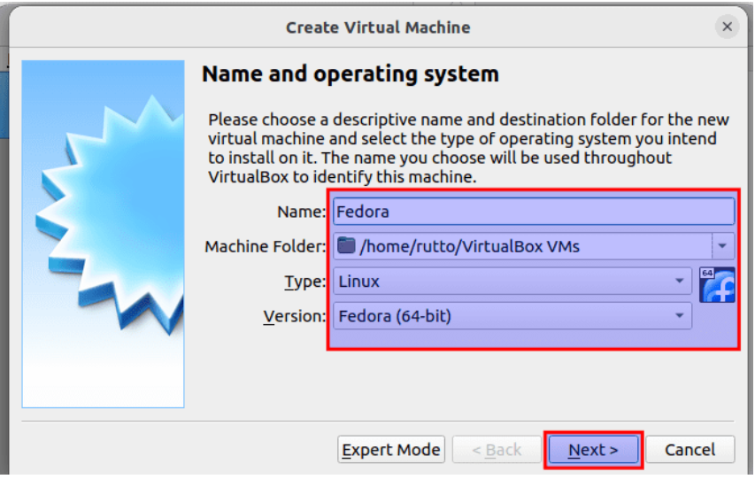
Installing Fedora
Step 4:
In the next window set “Type” and the “Version,” to Linux and Fedora (64-bit), respectively.

Slide 8
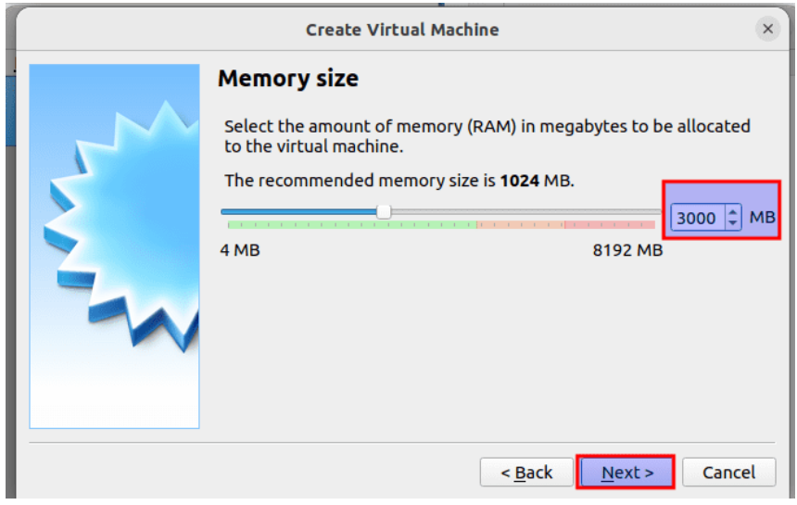
Installing Fedora
Step 5:
Select RAM of at least 2GB to set up Fedora.

Slide 9
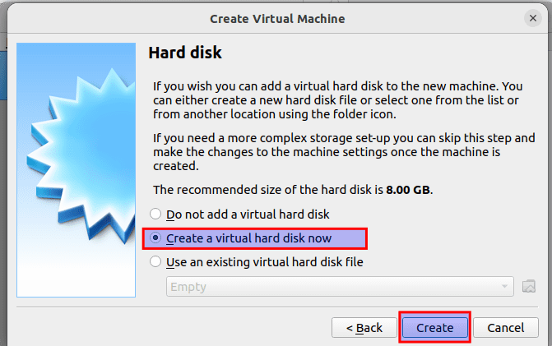
Installing Fedora
Step 6:
In the next window, pick “Create a virtual hard disk now, ” then click on “Create,” as highlighted below:

Slide 10
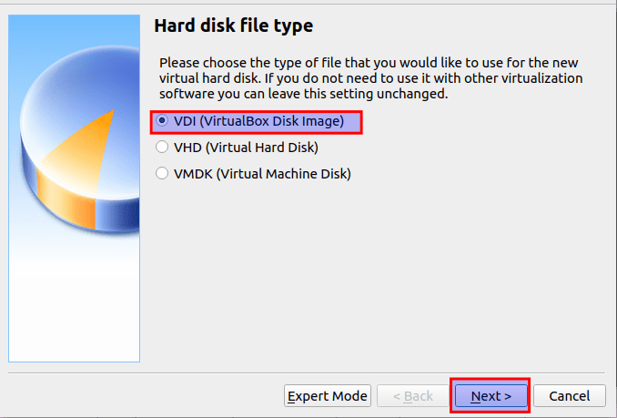
Installing Fedora
Step 7:
Select VDI in the next window (VirtualBox Disk Image) as the Hard disk file type and click on “Next.”

Slide 11
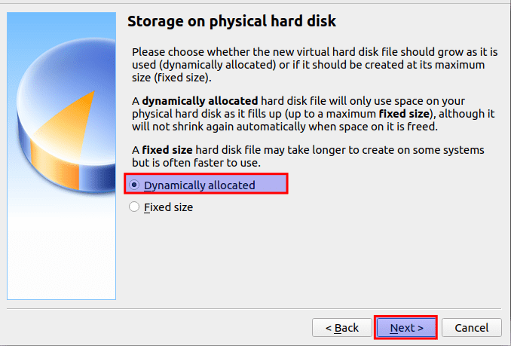
Installing Fedora
Step 8:
Select “Dynamically allocated” and click on “Next.”

Slide 12
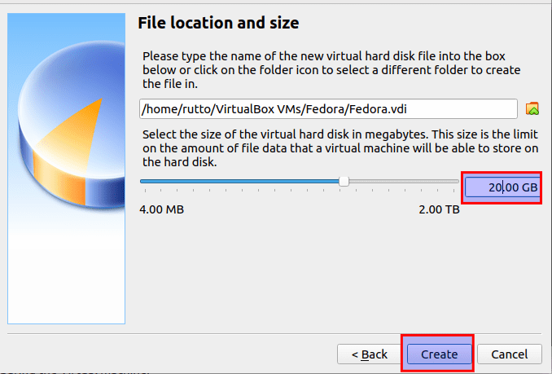
Installing Fedora
Step 9:
Configure the amount of hard disk space you intend the virtual machine to operate on and click on “create” as highlighted here:

Slide 13
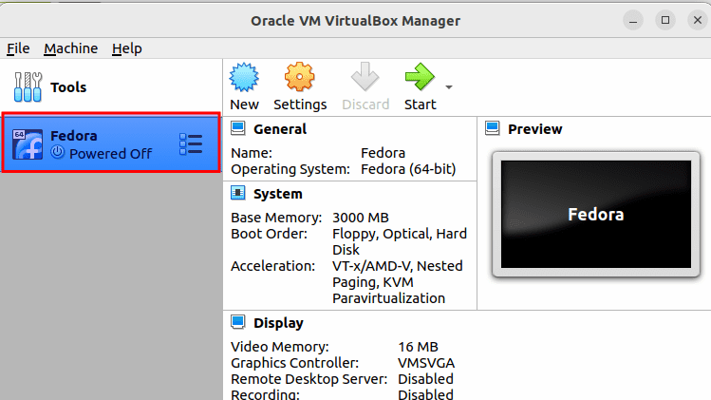
Installing Fedora
Step 10:
Your new virtual machine should be created:

Slide 14
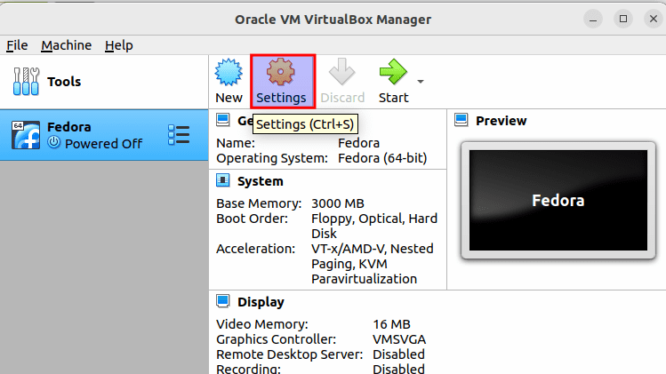
Installing Fedora
Step 11:
To configure the virtual machine, select it and click on “Settings,” as highlighted in the snapshot below:

Slide 15
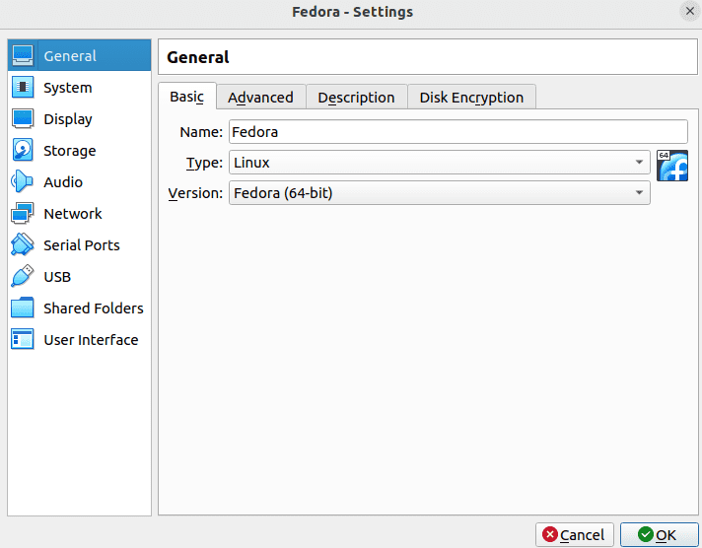
Installing Fedora
Step 12:
The default virtual machine settings will be displayed as seen in this screenshot:

Slide 16
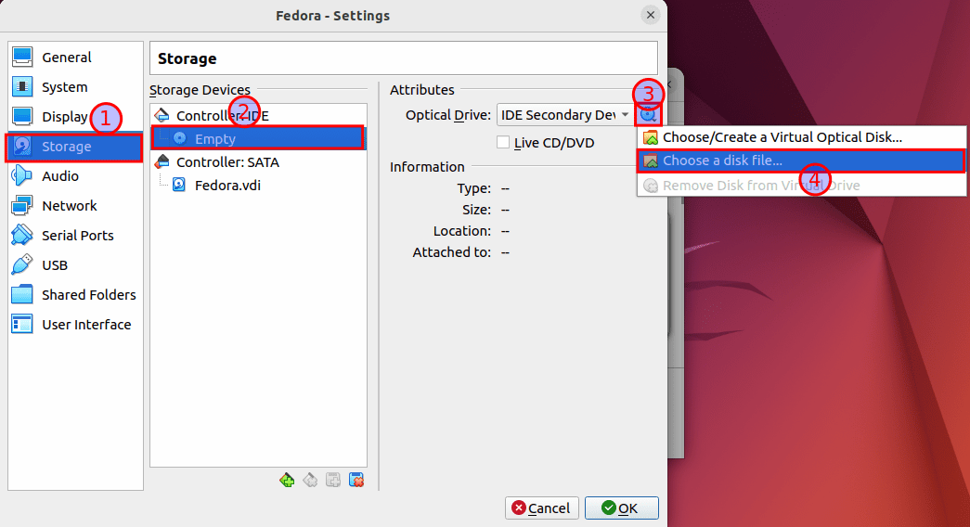
Installing Fedora
Step 13:
Next, navigate to the Storage tab (1), click on Empty from the Controller:IDE section (2), and from the CD () dropdown menu (3), click the “Choose a disk file…(4)” as marked in numbers in this screenshot:

Slide 17
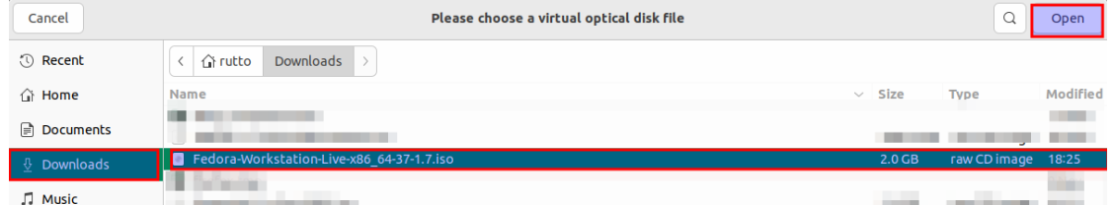
Installing Fedora
Step 14:
A file selector should be opened. Navigate to where your ISO file is. If you did not alter the default storage location of downloaded files, you should then locate your ISO file in the “Downloads” directory. If you did go to the location you redirected your downloaded files to and then click on “Open,” as shown in the snapshot below:

Slide 18
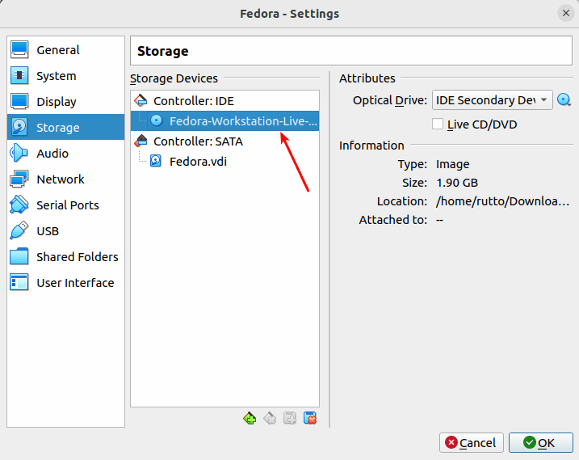
Installing Fedora
Step 15:
The Fedora Workstation 37 ISO image should be loaded in the previously empty location of the storage settings:

Slide 19
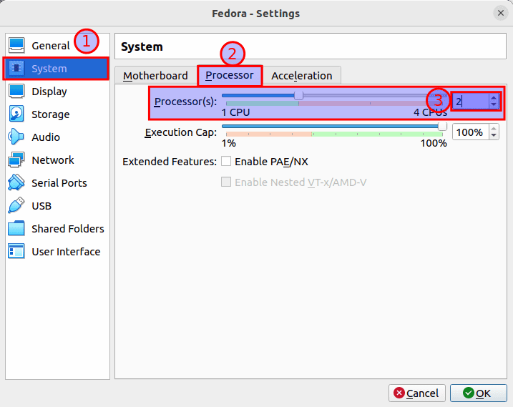
Installing Fedora
Step 16:
Now, maneuver to the “System > Processor” and select the number of CPU cores you intend your virtual machine to use. For running Fedora workstation 37, we recommend at least 2 CPU cores:

Slide 20
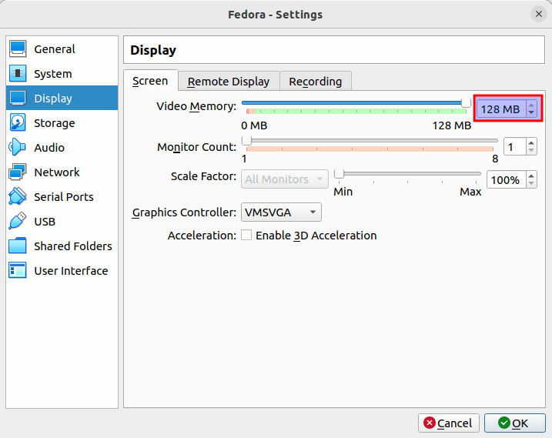
Installing Fedora
Step 17:
Then go the “Display > Screen”.
Increase the Video Memory of the virtual machine to 128 MB:

Slide 21
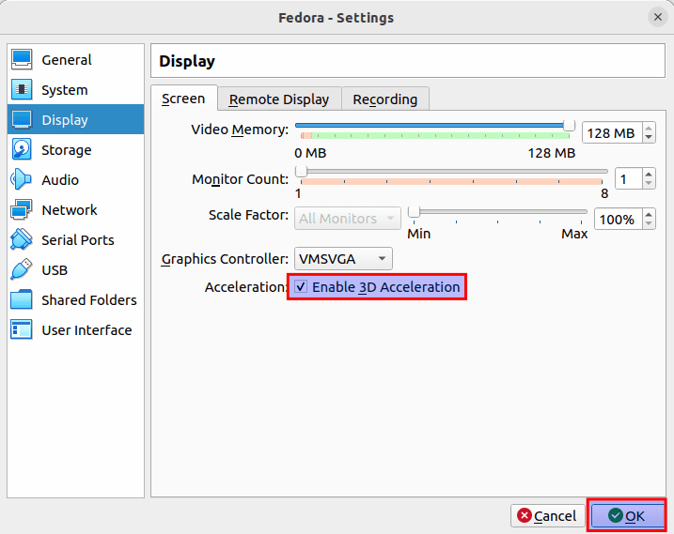
Installing Fedora
Step 18:
Select VMSVGA from the Graphics controller dropdown menu.
Next, check the “Enable 3D Acceleration checkbox.”
After you are done, click on “OK.”

Slide 22
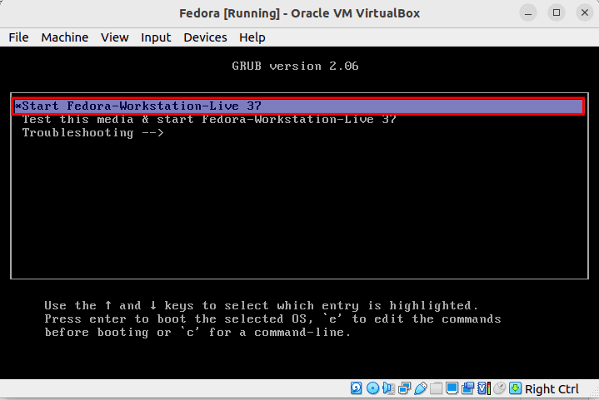
Installing Fedora
Step 19:
To start your virtual machine, select it and click on “Start”
The virtual machine should boot from the Fedora Workstation ISO image to such a window:

Slide 23
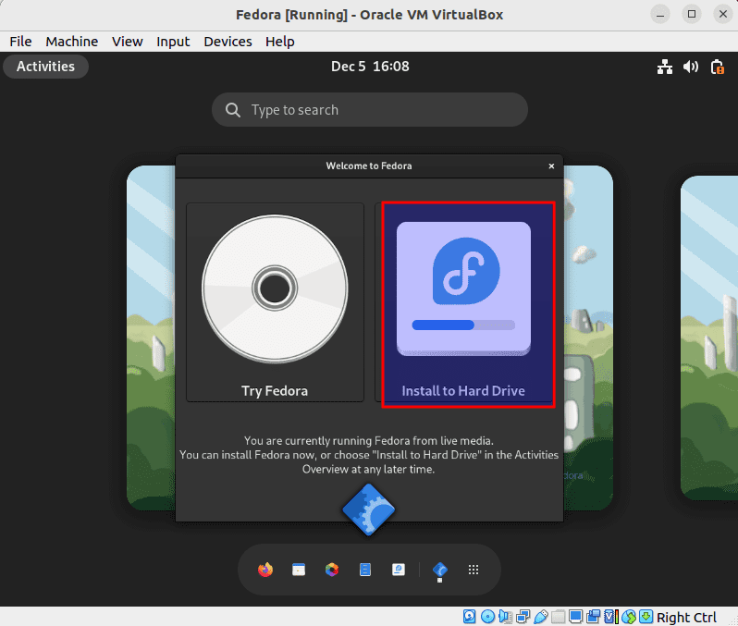
Installing Fedora
Step 20:
In the above window, select “Start Fedora Workstation Live 37 and press “Enter.”
Your Fedora should boot from the ISO image in Live mode. To proceed, click “Install to Hard Drive,” as shown below:

Slide 24
Installing Fedora
Step 21:
The Fedora Workstation 37 installer will be displayed.
Select your preferred language and click on “Continue.”
Click on “Installation Destination”.
Choose the “Automatic” storage config for simplicity.
Once you are done, click on “Begin installation”.
Fedora, workstation 37, is being set up on the virtual machine. It may take a while to complete.

Slide 25
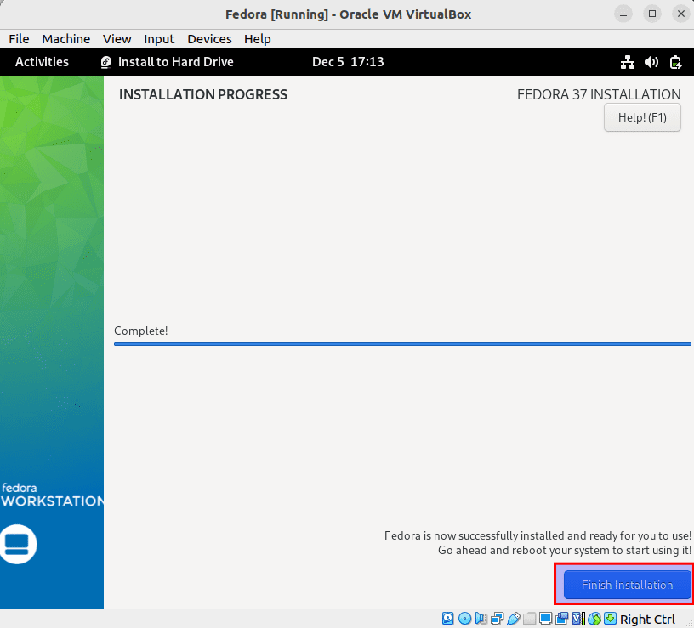
Installing Fedora
Step 22:
Once the workstation is installed, click on “Finish installation.”

Slide 26
Explain the difference between various operating system directory structure

Slide 27
Directory Structure in OS
The directory structure in an operating system refers to the way files and directories are organized on a computer's storage.
Each operating system has its own unique directory structure, with a root directory at the top and subdirectories branching off from it.

Slide 28

Windows OS Directory Structure

Slide 29
Windows Directory structure
The Windows operating system uses a hierarchical file and directory structure to organize files and directories on a computer's storage. The following is a brief overview of the most important directories in the Windows directory structure:
Windows - The root directory of the Windows operating system, it contains the files and directories that are necessary for the operating system to run.
Program Files - Contains the executables and support files for installed software programs.

Slide 30
Windows Directory structure (cont.)
Program Files (x86) - Similar to Program Files, but contains 32-bit software programs on a 64-bit version of Windows.
Users - Contains subdirectories for each user account on the computer, which store the user's personal files and settings.
Documents and Settings - Contains subdirectories for each user account on the computer, which store the user's personal files and settings.
Temp - Contains temporary files that are created by the operating system or applications.

Slide 31
Windows Directory structure (cont.)
Recycle Bin - Contains files and directories that have been deleted by the user, but are still recoverable.
Overall, the Windows directory structure is designed to be user-friendly and easy to navigate, making it easy for users to locate and manage their files.

Slide 32
Linux OS Directory Structure

Slide 33
Linux Directory structure
The Linux operating system uses a hierarchical file and directory structure, known as the Filesystem Hierarchy Standard (FHS), to organize files and directories on a computer's storage. The following is a brief overview of the most important directories in the Linux directory structure:
/ - The root directory of the Linux file system, it contains all other directories and files in the file system.
/bin - Contains essential user command utilities, such as 'ls', 'cd', and 'pwd', that are required for a minimal Linux system to operate.

Slide 34
Linux Directory structure (cont.)
/sbin - Contains system utilities that are used for system maintenance and administration, such as 'init', 'fdisk', and 'ifconfig'.
/usr - Contains user-related files, such as libraries, documentation, and applications.
/var - Contains files that change frequently, such as log files, spool files, and temporary files.
/etc - Contains configuration files for the system and applications.

Slide 35
Linux Directory structure (cont.)
/dev - Contains special files that represent device nodes, such as hard disk partitions, serial ports, and terminals.
/home - Contains subdirectories for each user account on the computer, which store the user's personal files and settings.
Overall, the Linux directory structure is designed to be flexible and standardized, making it easy for users and administrators to locate and manage files and directories on a Linux system.

Slide 36
MacOS Directory Structure

Slide 37
MacOS Directory structure
The directory structure of macOS is based on the Unix file system and follows a hierarchical structure. Here are some of the key directories in the macOS file system:
/Applications: This directory contains all the applications installed on the system.
/Library: This directory contains resources and configuration files that are used by the system and installed applications. It includes subdirectories such as the PreferencePanes, LaunchDaemons, and Frameworks directories.

Slide 38
MacOS Directory structure (cont.)
/System: This directory contains the core components of the mac OS operating system, including the kernel, system libraries, and device drivers.
/Users: This directory contains individual user accounts, each with its own Home directory, which stores personal files, preferences, and settings.
/Volumes: This directory contains mounted disk volumes, including external hard drives, flash drives, and network volumes.

Slide 39
MacOS Directory structure (cont.)
/bin: This directory contains essential command-line tools that are available to all users.
/sbin: This directory contains system-level tools that are used for administrative tasks.
/usr: This directory contains user-installed software and shared resources, including libraries, headers, and documentation.
This is a brief overview of the macOS directory structure. Understanding the different directories and how they are used can be helpful for software developers, system administrators, and users who need to manage files and resources on a mac OS system.

Slide 40
Android OS Directory Structure

Slide 41
Android Directory structure
The Android operating system uses a hierarchical file system structure similar to other Unix-based systems. Here are some of the key directories in the Android file system:
/system: This directory contains the core components of the Android operating system, including the Linux kernel, libraries, and device drivers.
/data: This directory contains user data, including application data, databases, and shared preferences.
/cache: This directory contains cache files used by applications, such as temporary data and downloaded files.

Slide 42
Android Directory structure (cont.)
/storage: This directory contains removable storage, such as SD cards, and internal storage.
/proc: This directory contains information about running processes, including system information and process statistics.
/system/app: This directory contains pre-installed applications that come with the Android operating system.
/system/priv-app: This directory contains privileged applications that have special permissions and access to sensitive data.
This is a brief overview of the Android directory structure.

Slide 43

Let’s do some exercises!

Slide 44
Exercises
1.Create a chart or table to compare and contrast the root directories of Windows, MacOS, Linux and Android operating system.
2. Divide in 2 groups and discuss the directory structure of three different operating systems, such as Unix-like systems, Microsoft Windows, and Apple macOS.
3.Explain how the boot process differs between different operating systems, such as Windows, Linux, and MacOS.
4. Identify the key differences in the naming conventions and directory structure of each operating system.
5. Analyze the purpose and function of the most important directories in each operating system.

Slide 45
Exercises (cont.)
6. Research how user accounts are managed in each operating system and how that affects the directory structure.
7. Analyze how the different directory structures can impact software compatibility between operating systems.
8. In a scenario where you are setting up a new computer with Windows operating system, what are the key directories you need to be aware of and what is their purpose?
9. Suppose you are trying to troubleshoot a problem on a Linux system, how would you navigate the directory structure to find relevant log files?
10. In a hypothetical scenario where you are migrating from Windows to Mac OS, what are some of the differences in the directory structure that you need to be aware of?

Slide 46
Exercises (cont.)
11. If you were to install a new software application on an Android device, where in the directory structure would you typically place the files and why?
12. Imagine you have a dual-boot system with both Windows and Linux operating systems, how would you access files from one operating system from the other, given their different directory structures?
13. How do the directory structures of Unix-like systems differ from those of other operating systems, such as Windows or MacOS, and why is this significant?
14. Can you provide a real-world scenario where understanding the differences in operating system directory structures is critical for success?

Slide 47
Exercises (cont.)
15. If you were to develop a cross-platform application that runs on multiple operating systems, how would you design the directory structure to accommodate the differences between operating systems?
16. How would you go about searching for a specific file on a Unix-like system if you are unfamiliar with the directory structure and file hierarchy?
17. Explain the process of installing Fedora Linux on VirtualBox.

Slide 48

Thanks!

