Slide 1

Operating Systems
Lecture : 12

Slide 2

Select the appropriate commands and options to troubleshoot and resolve problems

Slide 3
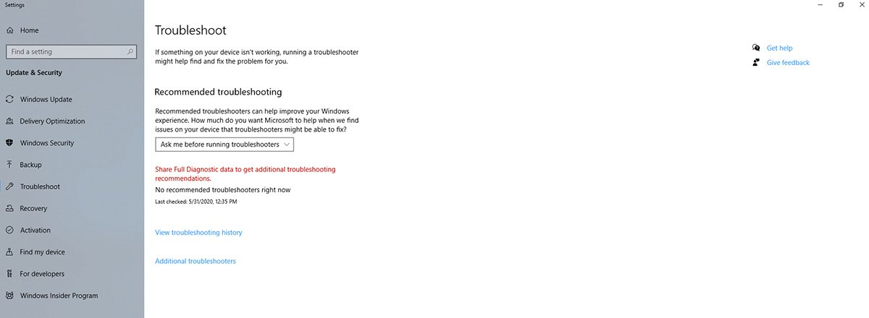
Troubleshooting Problems
How to access Windows 10 troubleshooter?
You can access the Troubleshooter in Windows 10 by opening Settings and clicking on Update and Security, followed by the Troubleshoot tab.
This will bring you to the Troubleshoot screen

Slide 4
Troubleshooting Problems (cont.)
The first option on this screen asks if you want to be notified before Windows runs a troubleshooter.
By default, if a problem occurs and a troubleshooter could help, Windows will ask if you want to run a troubleshooter.
However, you can also configure this option to run a troubleshooter automatically -- with or without notifying you -- or to disable troubleshooting altogether

Slide 5
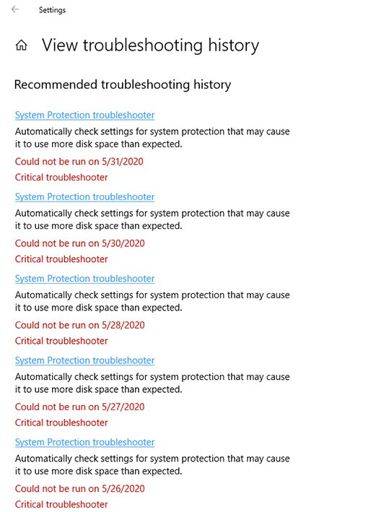
Troubleshooting Problems (cont.)
Troubleshooting history
The window also contains a link to the history of Troubleshooter use within the OS.
This type of historical data allows you to see what issues Windows has experienced in the past.
For example, the System Protection Troubleshooter ran several times in May 2020, when the machine was running low on disk space

Slide 6
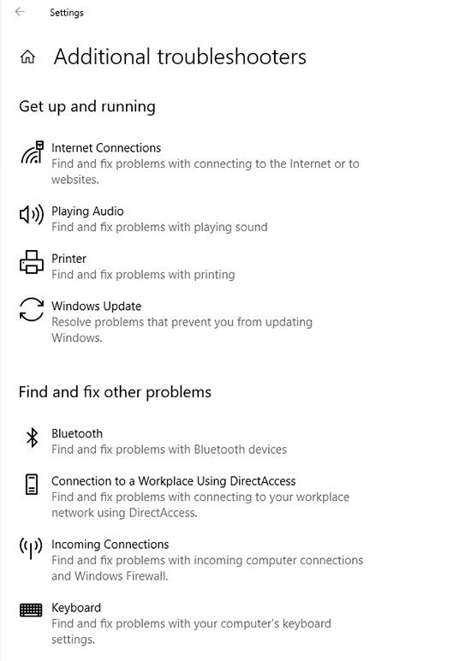
Troubleshooting Problems (cont.)
Common Windows 10 issues to troubleshoot
If you need to troubleshoot a specific problem, click on the Additional Troubleshooters link. This will take you to the Additional Troubleshooters screen.
This screen provides access to the individual troubleshooters.

Slide 7

Troubleshooting Problems (cont.)
Updating issues or a problem after the update
If you experience problems with a Windows Update or if Windows exhibits problems following an update, you can use the Windows Update Troubleshooter to resolve the issue.
On the Additional Troubleshooters screen, click on the Windows Update icon, followed by the Run the Troubleshooter button.
The Windows Update Troubleshooter checks for several issues, such as missing service registrations or settings that have been changed.

Slide 8

Troubleshooting Problems (cont.)
Issues with background apps
If you are having trouble with background apps, running the Windows Store Apps Troubleshooter can be an easy fix.
This troubleshooter will check for missing and corrupt files, as well as other issues associated with Windows Store apps.

Slide 9
Troubleshooting Problems (cont.)
Issues with background apps (cont.)
If the troubleshooter cannot resolve the issue and you continue to have problems with disabling or disabled background apps, go to Settings and click Privacy.
Next, click the Background Apps tab. This tab includes an option to allow apps to run in the background. There is also a separate "run in the background" option for each individual app.

Slide 10

Troubleshooting Problems (cont.)
Wi-Fi connectivity issues
If you are having trouble connecting to a Wi-Fi network, you should start with the Network Adapter Troubleshooter.
When the troubleshooter begins, it will display a list of the network adapters that are present in your PC.
Select the wireless network adapter and click Next. Windows will perform a series of diagnostic tests to determine why network connectivity is not working properly.

Slide 11

Troubleshooting Problems (cont.)
Problems with Bluetooth
If you are having problems with Bluetooth connectivity, you can run the Bluetooth Troubleshooter.
From there, Windows will begin looking for Bluetooth-related problems.
The troubleshooter may report that the device does not have Bluetooth in some cases.

Slide 12
Troubleshooting Problems (cont.)
Problems with Bluetooth (cont.)
This is especially true if Bluetooth is disabled within the computer's BIOS, or if you are using an external Bluetooth adapter.
In these situations, make sure that Bluetooth is enabled -- if it is integrated into the computer's system board -- and that any required device drivers are installed.

Slide 13
Troubleshooting Problems (cont.)
Can not start in safe mode
If you are unable to boot your computer into safe mode, you might start the troubleshooting process by running the Windows Update Troubleshooter.
If this troubleshooter fails to find any problems, enter the MSConfig command at the computer's Run prompt.
This will launch the System Configuration tool. Select the tool's Boot tab and make sure that the safe mode checkbox is selected and click OK.

Slide 14
Troubleshooting Problems (cont.)
Can not start in safe mode (cont.)
Another option is to boot the machine from the Windows installation media and click the Troubleshoot option, rather than installing Windows.
Select Troubleshoot, followed by Advanced Options. Go to Windows Startup Settings and click the Restart button when prompted.
You will be taken to a screen that allows you to enable safe mode.

Slide 15

Troubleshooting Problems (cont.)
Problems with PnP devices
If the plug and play (PnP) device that you are having trouble with happens to be an audio device or a network adapter, you can run the Playing Audio Troubleshooter or the Network Adapter Troubleshooter.
For other PnP devices, open the Windows Device Manager, right-click on the device that you are having trouble with and select the Update Driver command from the shortcut menu. Windows will help you to find a more suitable driver for the malfunctioning device.

Slide 16
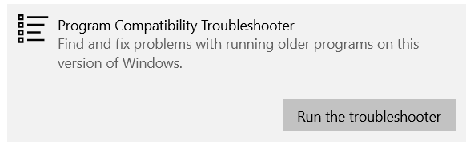
Troubleshooting Problems (cont.)
Issue with running older program
If you are having trouble running older programs on your current version of Windows, you should start with the Program Compatibility Troubleshooter.
When the troubleshooter begins, it will display a list of the program, from which you need to select the specific program which is not running properly.

Slide 17
Troubleshooting Problems (cont.)
Missing DLL files
If your computer is experiencing issues with missing dynamic link library (DLL) files, you can begin your troubleshooting efforts by running the Windows Update Troubleshooter and the Windows Store Apps Troubleshooter. These will both look for missing or corrupt files.
If the troubleshooter cannot correct the problem, open an elevated Command Prompt window and enter the following command:
This will run the System File Checker, which scans for missing DLL files.

Slide 18
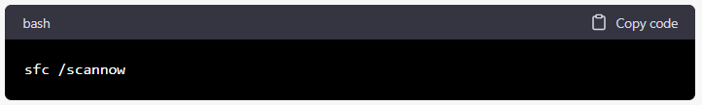
Troubleshooting Problems (cont.)
Missing system files
SFC (System File Checker) - Scans and repairs corrupt or missing system files.
To run the SFC command, open the command prompt as an administrator and type:

Slide 19
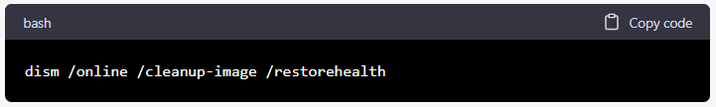
Troubleshooting Problems (cont.)
Repairing the Windows system image
DISM (Deployment Image Servicing and Management) - Repairs the Windows system image, which includes the operating system, drivers, and applications.
To run the DISM command, open the command prompt as an administrator and type:

Slide 20
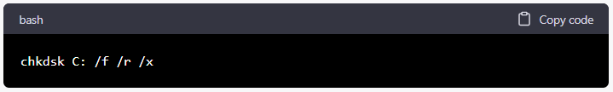
Troubleshooting Problems (cont.)
Hard drive error
CHKDSK (Check Disk) - Scans the hard drive for errors and bad sectors.
To run the CHKDSK command, open the command prompt as an administrator and type:
(replace C: with the drive letter of the drive you want to scan)

Slide 21
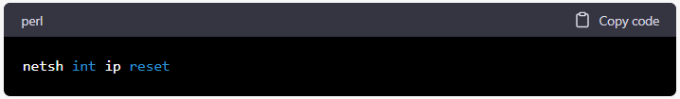
Troubleshooting Problems (cont.)
Repairing network-related issues
NETSH (Network Shell) - Troubleshoots and repairs network-related issues.
To reset the TCP/IP stack, open the command prompt as an administrator and type:

Slide 22
Troubleshooting Problems (cont.)
An application is frozen
Sometimes an application may become stuck, or frozen. When this happens, you won't be able to close the window or click any buttons within the application.
Force quit the application. If a program has become completely unresponsive, you can press (and hold) Ctrl+Alt+Delete (the Control, Alt, and Delete keys) on your keyboard to open the Task Manager. You can then select the unresponsive application and click End task to close it.

Slide 23
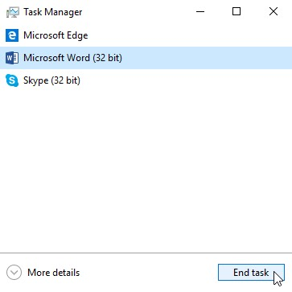
Troubleshooting Problems (cont.)
An application is frozen(cont.)
Restart the computer. If you are unable to force quit an application, restarting your computer will close all open apps.

Slide 24
Troubleshooting Problems (cont.)
The Computer is frozen
Sometimes your computer may become completely unresponsive, or frozen. When this happens, you won't be able to click anywhere on the screen, open or close applications, or access shut-down options.
Restart Windows Explorer. To do this, press and hold Ctrl+Alt+Delete on your keyboard to open the Task Manager. Next, locate and select Windows Explorer from the Processes tab and click Restart. If you're using Windows 8, you may need to click More Details at the bottom of the window to see the Processes tab.

Slide 25
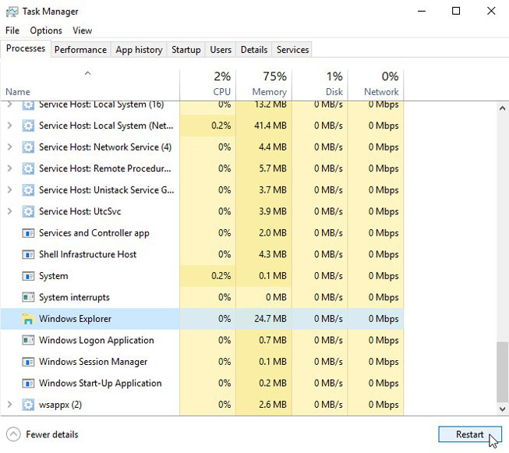
Troubleshooting Problems (cont.)
The Computer is frozen(cont.)
Press and hold the Power button for 5-10 seconds. This will force the computer to shut down.
If the computer still won't shut down, you can unplug the power cable from the electrical outlet. If you're using a laptop, you may be able to remove the battery to force the computer to turn off. Note: This solution should be your last resort after trying the other suggestions above.

Slide 26
Troubleshooting Problems (cont.)
The mouse/keyboard has stopped working
Sometimes your mouse/keyboard may become completely unresponsive, or frozen. When this happens, you won't be able to click anywhere on the screen, or type anything on the keyboard.
If you're using a wired mouse or keyboard, make sure it's correctly plugged in to the computer.
If you're using a wireless mouse or keyboard, make sure it is turned on and that its batteries are charged.

Slide 27
Troubleshooting Problems (cont.)
The screen is blank
Sometimes your screen may become completely unresponsive, or blank. When this happens, you won't be able to see anything on the screen.
The computer may just be in Sleep mode. Simply click the mouse or press any key on the keyboard to wake it.
Make sure the monitor is plugged in and turned on.
Make sure the computer is plugged in and turned on.
If you're using a desktop computer, make sure the monitor cable is properly connected to the computer tower and the monitor.

Slide 28
Troubleshooting Problems (cont.)
Cannot hear the sound on computer
Sometimes your screen may not hear anything on your computer.
Check the volume level. Click the audio button in the bottom-right corner of the screen to make sure the sound is turned on and the volume is up.
Check the audio player controls. Many audio and video players will have their own separate audio controls. Make sure the sound is turned on and the volume is up in the player.
Connect headphones to the computer to determine if you can hear sound from the headphones.

Slide 29
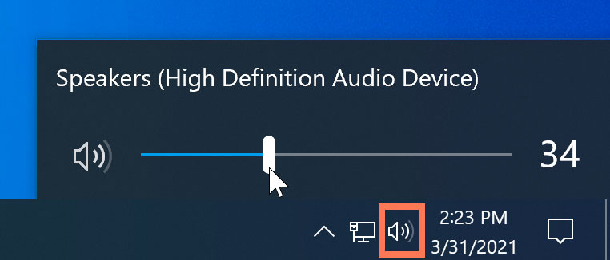
Troubleshooting Problems (cont.)
Cannot hear the sound on computer(cont.)
Check the cables. Make sure external speakers are plugged in, turned on, and connected to the correct audio port or a USB port. If your computer has color-coded ports, the audio output port will usually be green.

Slide 30

Let’s do some exercises!

Slide 31

Exercises
You're trying to connect to a remote server via SSH, but you're unable to establish a connection. Which command can you use to check the network connectivity between your system and the server, and what options should you use to troubleshoot the issue?
Your web server is not responding to requests, and you suspect that one of the services has stopped working. Which command can you use to check the status of the web server service, and what options should you use to troubleshoot the issue?
Your computer is running slowly, and you suspect that one of the processes is consuming too much CPU or memory. Which command can you use to view the running processes, and what options should you use to identify the process that's causing the issue?

Slide 32
Exercises (cont.)
You're having issues with your Wi-Fi connection, and you suspect that the wireless network interface is not working properly. Which command can you use to check the status of the wireless network interface, and what options should you use to troubleshoot the issue?
You're experiencing issues with your hard drive, and you suspect that there might be some bad sectors. Which command can you use to check the disk for errors, and what options should you use to troubleshoot the issue?
Your computer is not booting up properly, and you suspect that there might be some issues with the system files. Which command can you use to check the integrity of the system files, and what options should you use to troubleshoot the issue?

Slide 33
Exercises (cont.)
Your computer is not displaying the correct time, and you suspect that the system clock might be out of sync. Which command can you use to check the time settings, and what options should you use to troubleshoot the issue?
You're unable to access a particular website, and you suspect that the website might be blocked by a firewall. Which command can you use to check the firewall settings, and what options should you use to troubleshoot the issue?
Your computer is not recognizing a peripheral device, and you suspect that there might be some issues with the device driver. Which command can you use to check the device driver settings, and what options should you use to troubleshoot the issue?

Slide 34
Exercises (cont.)
You're having issues with your VPN connection, and you suspect that the VPN client might be misconfigured. Which command can you use to check the VPN client settings, and what options should you use to troubleshoot the issue?
Your computer is not shutting down properly, and you suspect that there might be some issues with the shutdown process. Which command can you use to check the shutdown settings, and what options should you use to troubleshoot the issue?
Your computer is not playing audio, and you suspect that there might be some issues with the audio driver. Which command can you use to check the audio settings, and what options should you use to troubleshoot the issue?

Slide 35
Exercises (cont.)
You're trying to install a new software program, but the installation fails with an error message. What steps can you take to diagnose the problem, and what software tools can you use to troubleshoot the issue?
Your computer is displaying an error message indicating that a particular system file is missing or corrupted, and you suspect that there might be some issues with the operating system. What steps can you take to diagnose the problem, and what software tools can you use to troubleshoot the issue?

Slide 36

Thanks!

