Slide 1

Operating Systems
Lecture : 13

Slide 2

Evaluate and resolve common OS and software issues

Slide 3
Resolving OS and Software Issues
Trouble setting up 3 monitors
After upgrading from Windows 7 or 8 to Windows 10, many users have reported that they are no longer able to connect three monitors.
Solution:
Plug in all monitors, and go to Control panel > Display > Change display settings.
You should see all three screens displayed there. If one shows as disconnected (the screen is a darker color than the others), click that screen and choose Extend desktop to this display. (You might need to restart your machine once you plug all three monitors in, and then try this.)

Slide 4
Resolving OS and Software Issues(cont.)
Too many notifications
Windows 10 can be a little notification-heavy at times. If these pop-ups are interrupting your workflow, you can adjust them by going to Start > Settings > System > Notifications & actions.
There, you can decide which notifications you want on or off.

Slide 5
Resolving OS and Software Issues(cont.)
Cortana stops working
Is Microsoft's virtual assistant Cortana not assisting you? A bunch of different things could be going wrong.
Start by going to Start > Cortana > Settings and turning it off and on again.
Then, check your microphone under Settings > Sound -- if you aren't using the default computer one, it may have been disconnected.
You can also try restarting your device and checking for updates that may be in place to fix the issue.

Slide 6
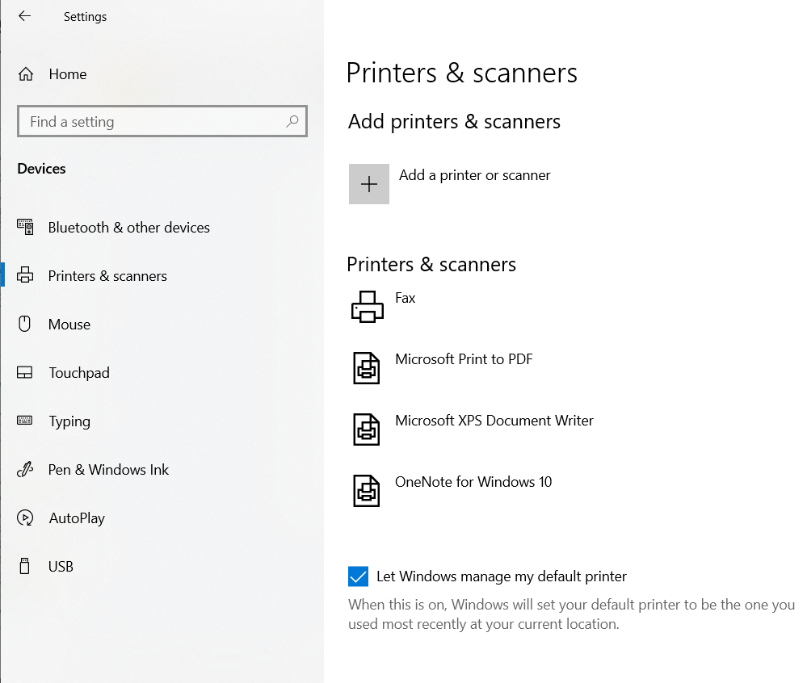
Resolving OS and Software Issues(cont.)
Printer connection issues
Windows 10 supports most printers, but connection issues happen.
To install or add a printer (whether it's networked, wireless or Bluetooth), go to Start > Settings > Devices > Printers & scanners.
Select Add a printer or scanner. Your device should find the printer (assuming it's on and connected to Wi-Fi or the network) and let you select Add device.

Slide 7
Resolving OS and Software Issues(cont.)
Printer connection issues (cont.)
If your printer isn't in the list, select "The printer that I want isn't listed," and then follow the instructions to add it manually using one of the options.
If you're trying to install a local printer, you can typically just plug it into your USB port and follow the same instructions.
If your printer stops working, you can try doing the process again.

Slide 8
Resolving OS and Software Issues(cont.)
Files opening in the wrong apps
When you update Windows 10 your apps and files might go back to their default settings or switch settings.
One way to change this is to go to Start > Settings > Apps > Default apps. Select which default you want to set, and then choose the app.
When you go to open a file, you can also right-click it to see your options.
You can choose Open with and then Choose another app, and find which one you want.
You'll see an option asking if you always want to use that app when opening that type of file.

Slide 9
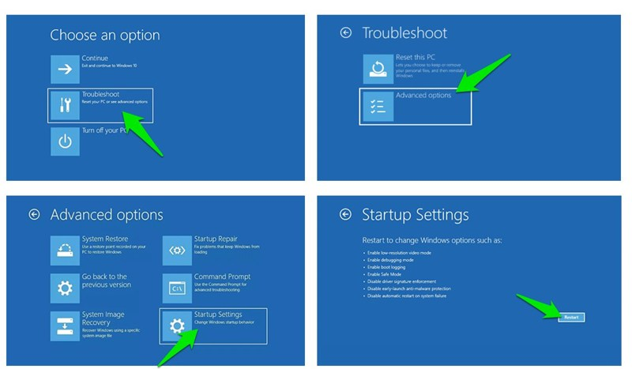
Resolving OS and Software Issues(cont.)
Resolving issues by accessing safe mode
Going into safe mode is necessary to solve many problems like driver issues, file corruption, and virus infections, etc. However, the previous go-to methods of accessing Safe mode won’t work in Windows 10.

Slide 10
Resolving OS and Software Issues(cont.)
Resolving issues by accessing safe mode (cont.)
Especially, if you are upgrading from Windows 7, then you’ll be surprised that the usual method of going berserk on the F8 key while Windows starts to open safe mode won’t work in Windows 10. Actually, there are multiple ways to access Safe mode in Windows 10, but I am going to show the easiest one.
While inside Windows 10, go to the Power option from the Start menu. Here hold the Shift key and click on Restart.
This will restart the PC and Windows Recovery Environment will open up. Here go to Troubleshoot > Advanced options > Startup Settings > Restart.
Your PC will restart again and then you can use numbers keys to access the right Safe mode type.

Slide 11
Resolving OS and Software Issues(cont.)
Disable background apps
Windows 10 has way too many native apps that run in the background and keep hogging resources even if you don’t use them. Disabling them is a great way to get a boost in system performance.
Here’s how to do it:

Slide 12
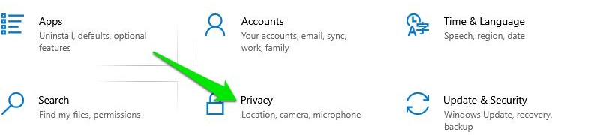
Resolving OS and Software Issues(cont.)
Disable background apps (cont.)
Access Settings from the Start menu and click on Privacy here
Move to the Background app option in the left panel and a list of all the apps that run in the background will open up.

Slide 13
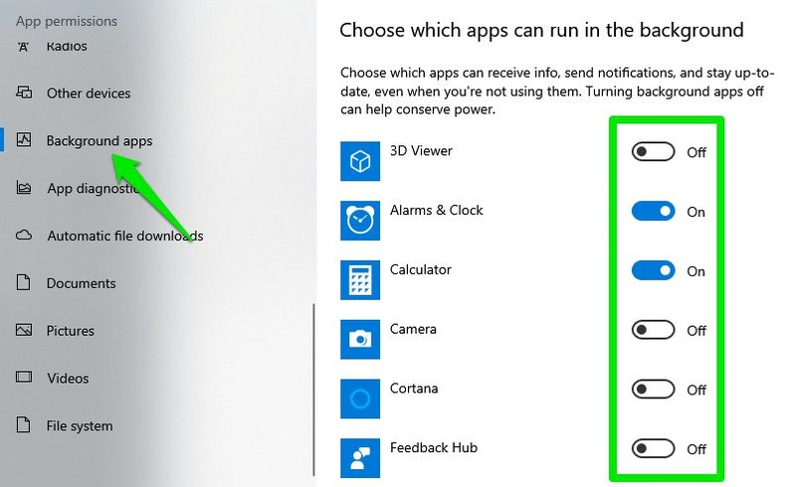
Resolving OS and Software Issues(cont.)
Disable background apps (cont.)
Simply turn off the ones you don’t want to run in the background. Although be careful not to disable app that must run in the background to offer timely service, such as the Alarm app if you are using it for alarms.

Slide 14
Resolving OS and Software Issues(cont.)
Computer Constantly Freezes
Computers are complex machines that manage multiple processes without you even seeing them. This complexity can sometimes cause your computer to freeze or not respond to your actions.
Nine out of 10 times you can remedy this simply by rebooting your system.
In the event that you are experiencing constant freezes, it could be a sign of insufficient system memory, registry errors, corrupted files, or even spyware. You should check each of these potential issues one by one until the problem is rectified.

Slide 15
Resolving OS and Software Issues(cont.)
Computer Constantly Freezes (cont.)
Running system checks in the background will tell you if you don’t have sufficient memory in your system for the applications you use.
Antivirus and malware programs can run a more thorough check.
They can see if your system’s resources are being impacted by viral infections and registry errors. They’ll help you correct them, too.

Slide 16
Resolving OS and Software Issues(cont.)
Slow Performance
You may start to notice slower performance in applications you use every day. That’s likely a problem stemming from your operating system.
Typically, this is a result of fragmentation on your C drive (C:). It’s not a big problem – easily resolved by doing some basic software cleanup.
Run a quick system check from your Task Manager to see which applications are taking up the most CPU and RAM resources.
Remove any unnecessary programs or processes running in the background that you don’t use.

Slide 17
Resolving OS and Software Issues(cont.)
Intermittent Connectivity Issues
Use commands like `netstat` to check network utilization and troubleshoot network congestion.

Slide 18
Resolving OS and Software Issues(cont.)
Printer Driver Corruption
Use commands like `printui` to check the status of the printer driver and troubleshoot issues.

Slide 19
Resolving OS and Software Issues(cont.)
Video Codec Problems
Use commands like `ffmpeg` to check the properties of the video file and troubleshoot codec issues.

Slide 20
Resolving OS and Software Issues(cont.)
Memory Errors
Use commands like `mdsched` to check the memory for errors and troubleshoot memory issues.

Slide 21
Resolving OS and Software Issues(cont.)
Faulty USB Port
Use commands like `devmgmt.msc` to check the status of the USB ports and troubleshoot issues.

Slide 22
Resolving OS and Software Issues(cont.)
Incorrect System Time
Use commands like `timedate.cpl` to check the time settings and troubleshoot synchronization issues.

Slide 23
Resolving OS and Software Issues(cont.)
Firewall Blocking Website
Use commands like `firewall.cpl` to check firewall settings and troubleshoot blocking issues.

Slide 24
Resolving OS and Software Issues(cont.)
Misconfigured VPN Client
Use commands like `rasphone` to check VPN client settings and troubleshoot configuration issues.

Slide 25
Resolving OS and Software Issues(cont.)
Shutdown Issues
Use commands like `shutdown` to check shutdown settings and troubleshoot shutdown problems.

Slide 26
Resolving OS and Software Issues(cont.)
Software Installation Fails
Diagnose the problem using the error message provided.
Use tools like Event Viewer and Windows Installer logs to troubleshoot the issue.

Slide 27
Resolving OS and Software Issues(cont.)
Missing or Corrupted System File
Diagnose the problem by running sfc /scannow to check for and repair missing or corrupted system files.

Slide 28
Resolving OS and Software Issues(cont.)
Missing or Corrupted System File
Diagnose the problem by running sfc /scannow to check for and repair missing or corrupted system files.

Slide 29
Resolving OS and Software Issues(cont.)
Peripheral Device Not Recognized
Use commands like `devmgmt.msc` to check device driver settings and troubleshoot issues.

Slide 30

Let’s do some exercises!

Slide 31

Exercises
Your computer is experiencing intermittent connectivity issues, and you suspect that there might be some network congestion. Which command can you use to check the network utilization, and what options should you use to troubleshoot the issue?
You're having issues with your printer, and you suspect that the printer driver might be corrupted. Which command can you use to check the status of the printer driver, and what options should you use to troubleshoot the issue?
Your web application is not working as expected, and you suspect that there might be some issues with the database. Which command can you use to check the status of the database server, and what options should you use to troubleshoot the issue?

Slide 32
Exercises (cont.)
You're unable to play a video file, and you suspect that there might be some issues with the video codec. Which command can you use to check the properties of the video file, and what options should you use to troubleshoot the issue?
Your computer is experiencing intermittent freezes, and you suspect that there might be some issues with the memory. Which command can you use to check the memory for errors, and what options should you use to troubleshoot the issue?
Your computer is not recognizing a USB device, and you suspect that the USB port might be faulty. Which command can you use to check the status of the USB ports, and what options should you use to troubleshoot the issue?

Slide 33
Exercises (cont.)
Your computer is not displaying the correct time, and you suspect that the system clock might be out of sync. Which command can you use to check the time settings, and what options should you use to troubleshoot the issue?
You're unable to access a particular website, and you suspect that the website might be blocked by a firewall. Which command can you use to check the firewall settings, and what options should you use to troubleshoot the issue?
Your computer is not recognizing a peripheral device, and you suspect that there might be some issues with the device driver. Which command can you use to check the device driver settings, and what options should you use to troubleshoot the issue?

Slide 34
Exercises (cont.)
You're having issues with your VPN connection, and you suspect that the VPN client might be misconfigured. Which command can you use to check the VPN client settings, and what options should you use to troubleshoot the issue?
Your computer is not shutting down properly, and you suspect that there might be some issues with the shutdown process. Which command can you use to check the shutdown settings, and what options should you use to troubleshoot the issue?
Your computer is not playing audio, and you suspect that there might be some issues with the audio driver. Which command can you use to check the audio settings, and what options should you use to troubleshoot the issue?

Slide 35
Exercises (cont.)
You're trying to install a new software program, but the installation fails with an error message. What steps can you take to diagnose the problem, and what software tools can you use to troubleshoot the issue?
Your computer is displaying an error message indicating that a particular system file is missing or corrupted, and you suspect that there might be some issues with the operating system. What steps can you take to diagnose the problem, and what software tools can you use to troubleshoot the issue?

Slide 36

Thanks!

