Slide 1

Operating System
Lecture: 2

Slide 2

Process Management, Memory Management,
File Management,
Mass Storage Management, Virtualization, Distributed Systems

Slide 3
Process Management
A process is a program in execution. It is a unit of work within the system. Program is a passive entity; process is an active entity.
Process needs resources to accomplish its task
CPU, memory, I/O, files
Initialization data
Process termination requires reclaim of any reusable resources
Single-threaded process has one program counter specifying location of next instruction to execute
Process executes instructions sequentially, one at a time, until completion
Multi-threaded process has one program counter per thread
Typically system has many processes, some user, some operating system running concurrently on one or more CPUs
Concurrency by multiplexing the CPUs among the processes / threads

Slide 4
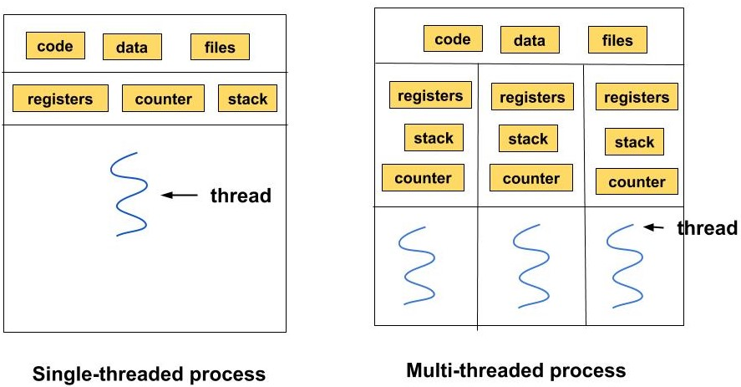
Single and Multi Threaded Process
A single-threaded process is a process that contains only one thread of execution. This process performs one task at a time. The CPU executes instructions sequentially, one after the other, without concurrent execution within the same process.
A multi-threaded process is a process that contains multiple threads of execution. Each thread runs independently and can execute concurrently within the same process. This allows for parallel execution of tasks.

Slide 5
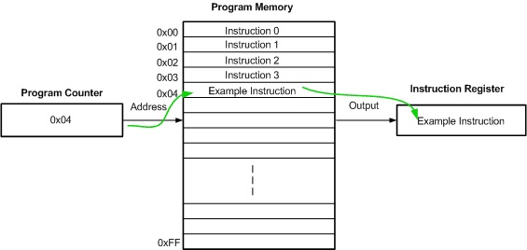
Program Counter
A program counter (PC) is a special register in a computer's CPU that holds the address of the next instruction to be executed. It is essential for the sequential execution of instructions in a program. As the CPU fetches and executes each instruction, the program counter is automatically incremented to point to the following instruction in the sequence.

Slide 6
Process Management Activities
The operating system is responsible for the following activities in connection with process management:
Creating and deleting both user and system processes
Suspending and resuming processes
Providing mechanisms for process synchronization
Providing mechanisms for process communication
Providing mechanisms for deadlock handling

Slide 7
Memory Management
To execute a program all (or part) of the instructions must be in memory
All (or part) of the data that is needed by the program must be in memory
Memory management determines what is in memory and when
Optimizing CPU utilization and computer response to users
Memory management activities
Keeping track of which parts of memory are currently being used and by whom
Deciding which processes (or parts thereof) and data to move into and out of memory
Allocating and deallocating memory space as needed

Slide 8
File-system Management
OS provides uniform, logical view of information storage
Abstracts physical properties to logical storage unit - file
Each medium is controlled by device (i.e., disk drive, tape drive)
Varying properties include access speed, capacity, data-transfer rate, access method (sequential or random)
File-System management
Files usually organized into directories
Access control on most systems to determine who can access what
OS activities include
Creating and deleting files and directories
Primitives to manipulate files and directories
Mapping files onto secondary storage
Backup files onto stable (non-volatile) storage media

Slide 9
Mass-Storage Management
Usually disks used to store data that does not fit in main memory or data that must be kept for a “long” period of time
Proper management is of central importance
Entire speed of computer operation hinges on disk subsystem and its algorithms
OS activities
Mounting and unmounting
Free-space management
Storage allocation
Disk scheduling
Partitioning
Protection

Slide 10
Caching
Important principle, performed at many levels in a computer (in hardware, operating system, software)
Information in use copied from slower to faster storage temporarily
Faster storage (cache) checked first to determine if information is there
If it is, information used directly from the cache (fast)
If not, data copied to cache and used there
Cache smaller than storage being cached
Cache management important design problem
Cache size and replacement policy

Slide 11
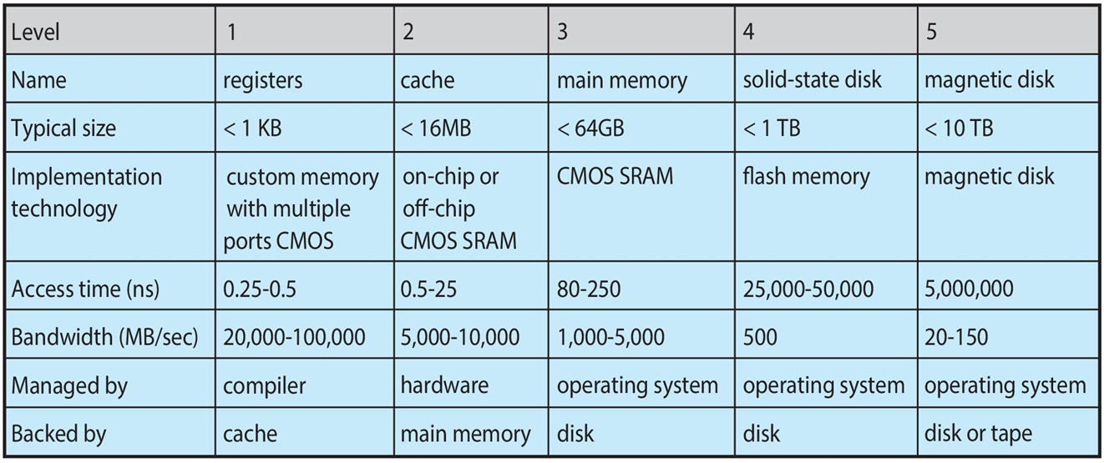
Characteristics of Various Types of Storage
Movement between levels of storage hierarchy can be explicit or implicit

Slide 12
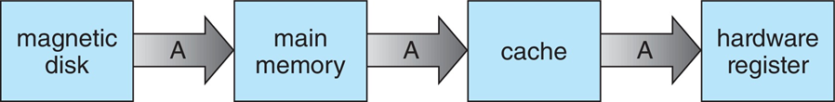
Migration of data “A” from Disk to Register
Multitasking environments must be careful to use most recent value, no matter where it is stored in the storage hierarchy
Multiprocessor environment must provide cache coherency in hardware such that all CPUs have the most recent value in their cache
Distributed environment situation even more complex
Several copies of a datum can exist

Slide 13
I/O Subsystem
One purpose of OS is to hide peculiarities of hardware devices from the user
I/O subsystem responsible for
Memory management of I/O including buffering (storing data temporarily while it is being transferred), caching (storing parts of data in faster storage for performance), spooling (the overlapping of output of one job with input of other jobs)
General device-driver interface
Drivers for specific hardware devices

Slide 14
Protection and Security
Protection – any mechanism for controlling access of processes or users to resources defined by the OS
Security – defense of the system against internal and external attacks
Huge range, including denial-of-service, worms, viruses, identity theft, theft of service
Systems generally first distinguish among users, to determine who can do what
User identities (user IDs, security IDs) include name and associated number, one per user
User ID then associated with all files, processes of that user to determine access control
Group identifier (group ID) allows set of users to be defined and controls managed, then also associated with each process, file
Privilege escalation allows user to change to effective ID with more rights

Slide 15
Virtualization
Allows operating systems to run applications within other OSes
Vast and growing industry
Emulation used when source CPU type different from target type (i.e. PowerPC to Intel x86)
Generally slowest method
When computer language not compiled to native code – Interpretation
Virtualization – OS natively compiled for CPU, running guest OSes also natively compiled
Consider VMware running WinXP guests, each running applications, all on native WinXP host OS
VMM (virtual machine Manager) provides virtualization services

Slide 16
Virtualization
Use cases involve laptops and desktops running multiple OSes for exploration or compatibility
Apple laptop running Mac OS X host, Windows as a guest
Developing apps for multiple OSes without having multiple systems
Quality assurance testing applications without having multiple systems
Executing and managing compute environments within data centers
VMM can run natively, in which case they are also the host
There is no general-purpose host then (VMware ESX and Citrix XenServer)

Slide 17
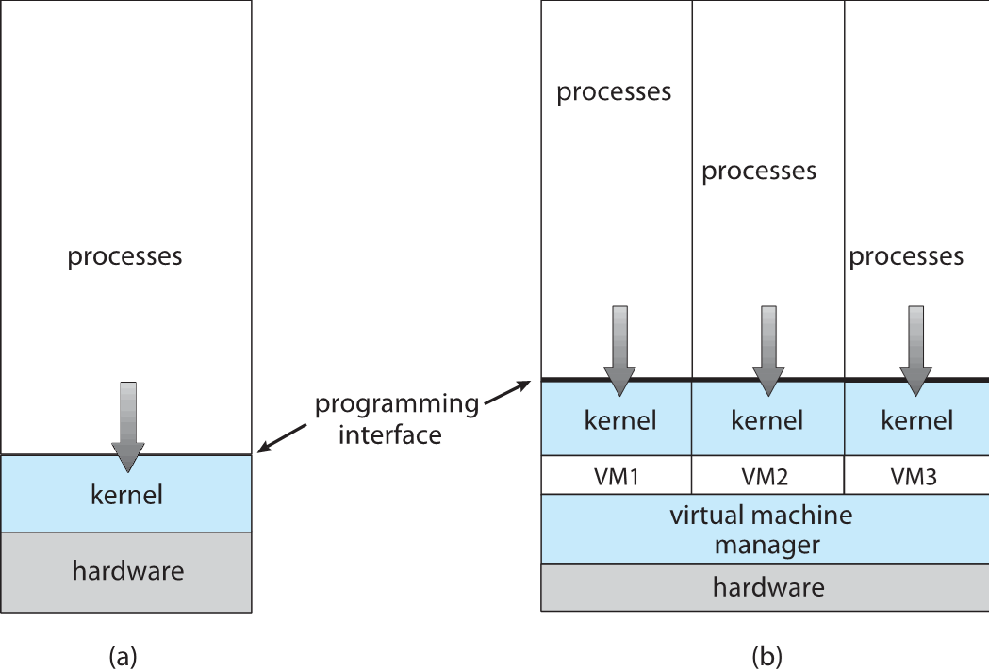
Computing Environments - Virtualization

Slide 18
Distributed Systems
Collection of separate, possibly heterogeneous, systems networked together
Network is a communications path, TCP/IP most common
Local Area Network (LAN)
Wide Area Network (WAN)
Metropolitan Area Network (MAN)
Personal Area Network (PAN)
Network Operating System provides features between systems across network
Communication scheme allows systems to exchange messages
Illusion of a single system

Slide 19
TCP/IP Model
The TCP/IP model is a fundamental framework for computer networking. It stands for Transmission Control Protocol/Internet Protocol, which are the core protocols of the Internet. This model defines how data is transmitted over networks, ensuring reliable communication between devices.
It consists of four layers:
Link Layer or Network Access Layer
Internet Layer
Transport Layer
Application Layer

Slide 20
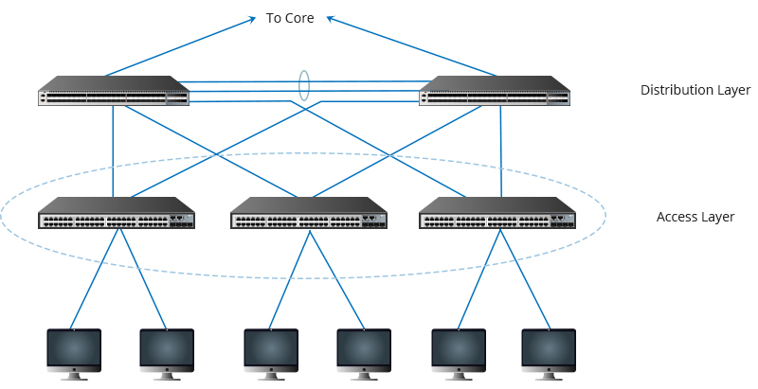
Network Access Layer
It is a group of applications requiring network communications. This layer is responsible for generating the data and requesting connections. It acts on behalf of the sender and the Network Access layer on the behalf of the receiver.

Slide 21
Internet Layer
It defines the protocols which are responsible for the logical transmission of data over the entire network. The main protocols residing at this layer are as follows:
IP: IP stands for Internet Protocol and it is responsible for delivering packets from the source host to the destination host by looking at the IP addresses in the packet headers.
ICMP: ICMP stands for Internet Control Message Protocol. It is encapsulated within IP datagrams and is responsible for providing hosts with information about network problems.
ARP: ARP stands for Address Resolution Protocol. Its job is to find the hardware address of a host from a known IP address.
The Internet Layer is responsible for routing packets of data from one device to another across a network. It does this by assigning each device a unique IP address, which is used to identify the device and determine the route.

Slide 22
Transport Layer
The TCP/IP transport layer protocols exchange data receipt acknowledgments and retransmit missing packets to ensure that packets arrive in order and without error. Transmission Control Protocol (TCP) and User Datagram Protocol are transport layer protocols at this level (UDP).
TCP: Applications can interact with one another using TCP as though they were physically connected by a circuit. TCP transmits data in a way that resembles character-by-character transmission rather than separate packets. For example text message transcription.
UDP: The datagram delivery service is provided by UDP, the other transport layer protocol. Connections between receiving and sending hosts are not verified by UDP. It eliminates the processes of establishing and validating connections.

Slide 23
Application Layer
It is responsible for end-to-end communication and error-free delivery of data. It shields the upper-layer applications from the complexities of data. The three main protocols present in this layer are:
HTTP and HTTPS: HTTP stands for Hypertext transfer protocol. It is used by the World Wide Web to manage communications between web browsers and servers. HTTPS stands for HTTP-Secure. It is a combination of HTTP with SSL(Secure Socket Layer). It is efficient in cases where the browser needs to fill out forms, sign in, authenticate, and carry out bank transactions.
SSH: SSH stands for Secure Shell. It sets up a secure session over a TCP/IP connection.
NTP: NTP stands for Network Time Protocol. It is used to synchronize the clocks on our computer to one standard time source. It is very useful in situations like bank transactions.

Slide 24
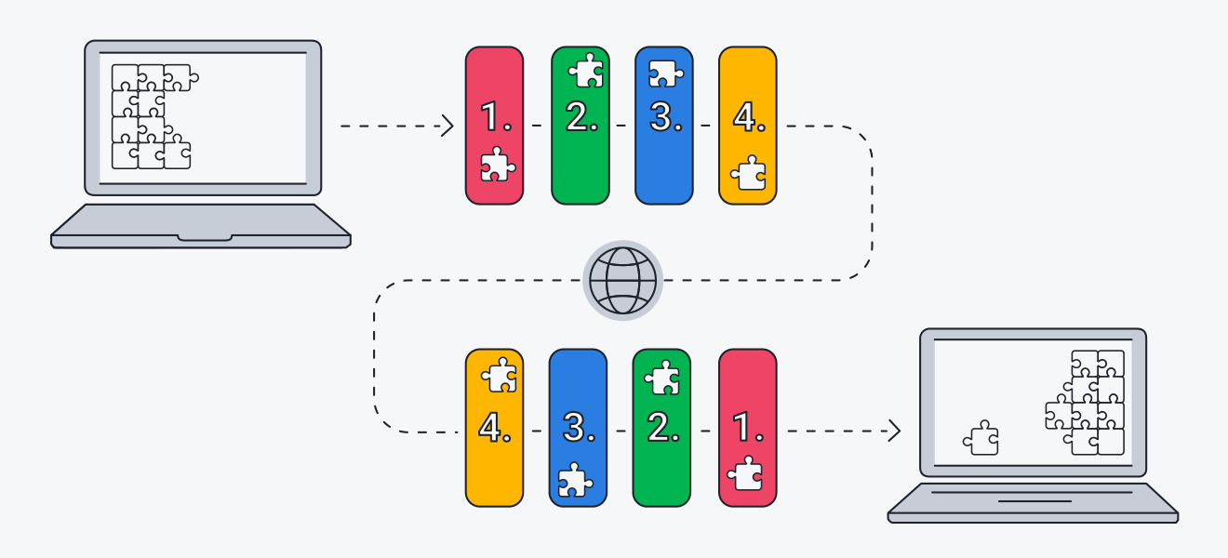
What does TCP/IP do?
The main work of TCP/IP is to transfer the data of a computer from one device to another. The main condition of this process is to make data reliable and accurate so that the receiver will receive the same information which is sent by the sender. To ensure that, each message reaches its final destination accurately, the TCP/IP model divides its data into packets and combines them at the other end, which helps in maintaining the accuracy of the data while transferring from one end to another end.

Slide 25
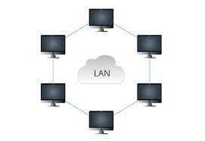
Local Area Network(LAN)
A local area network (LAN) is a connected environment spanning one or more buildings – typically in a one-kilometer radius – that links computing devices within close proximity of each other by using ethernet and Wi-Fi technology. LAN is among the most foundational components of the global networked landscape, both at consumer and enterprise levels.

Slide 26
Application of LAN
Connecting computers and devices within a single office or building
Facilitating file and resource sharing (e.g., printers, scanners) among users
Enabling centralized data storage and management through file servers
Supporting internal communication via email, chat, or collaboration tools
Providing a local platform for software applications and services (e.g., databases, ERP systems)
Enhancing network security with controlled access to network resources
Enabling high-speed internet access to multiple devices within the contained area
Supporting multimedia applications such as video conferencing and VoIP
Facilitating gaming and entertainment networks in homes or gaming centers

Slide 27
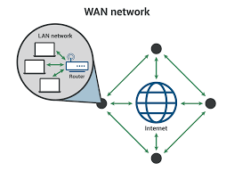
Wide Area Network(WAN)
In its simplest form, a wide-area network (WAN) is a collection of local-area networks (LANs) or other networks that communicate with one another. A WAN is essentially a network of networks, with the Internet the world's largest WAN.

Slide 28
Application of WAN
Connecting branch offices and remote locations of a business or organization
Enabling secure data transfer and communication across cities, countries, or continents
Supporting international and long-distance business operations and collaborations
Facilitating cloud computing and remote access to centralized servers and databases
Providing internet connectivity to geographically dispersed users and sites
Supporting large-scale video conferencing and virtual meetings

Slide 29
WAN vs LAN
- LAN exists in a contained area, while WAN provides connectivity over long distances.
- LAN typically shares a single central point of Internet connection, whereas WAN connects multiple LANs.
- LAN infrastructure is usually fully controlled by the organization, while WAN relies on external infrastructure.
- LAN needs only one router for Internet connection and may use switches; WAN includes multiple routers and switches.
- Example use cases: LAN for office or home networks; WAN for corporate networks across cities or countries.

Slide 30
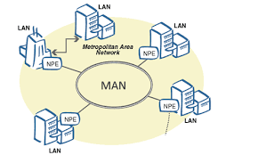
Metropolitan Area Network (MAN)
A Metropolitan Area Network (MAN) is a type of computer network that spans over a metropolitan area, typically a city. It provides high-speed data communication services such as video, audio, and data transfer between multiple LANs (Local Area Networks) and WANs (Wide Area Networks). The main purpose of a MAN is to connect different LANs in a city to share resources and exchange data, as well as to provide internet access to users.

Slide 31
Application of MAN
Providing internet connectivity to multiple buildings within a metropolitan area, often used by municipalities.
Connecting various campuses of a university or school district within a city.
Linking different government offices, departments, and agencies within a city for efficient communication and data sharing.
Connecting various branches of a company within a metropolitan area, facilitating seamless business operations and resource sharing.
Offering widespread public Wi-Fi access across parks, transportation hubs, and public squares.
Integrating hospitals, clinics, and medical offices within a city for centralized patient records and telemedicine services

Slide 32
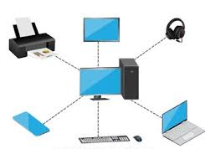
Personal Area Network (PAN)
Personal Area Network (PAN) is the computer network that connects computers/devices within the range of an individual person. As PAN provides a network range within a person’s range typically within a range of 10 meters(33 feet) it is called a Personal Area Network. A Personal Area Network typically involves a computer, phone, tablet, printer, PDA (Personal Digital Assistant) and other and other entertainment devices like speakers, video game consoles, etc.

Slide 33
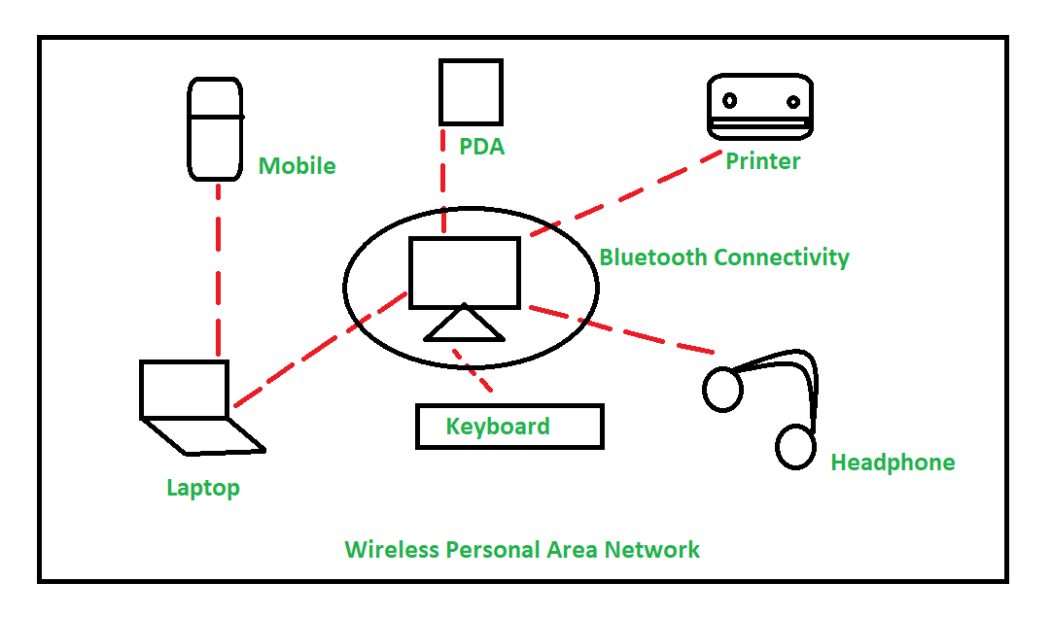
Types of PAN
Wireless PAN:
Wireless Personal Area Network (WPAN) is connected through signals such as infrared, ZigBee, Bluetooth and ultrawideband, etc.

Slide 34
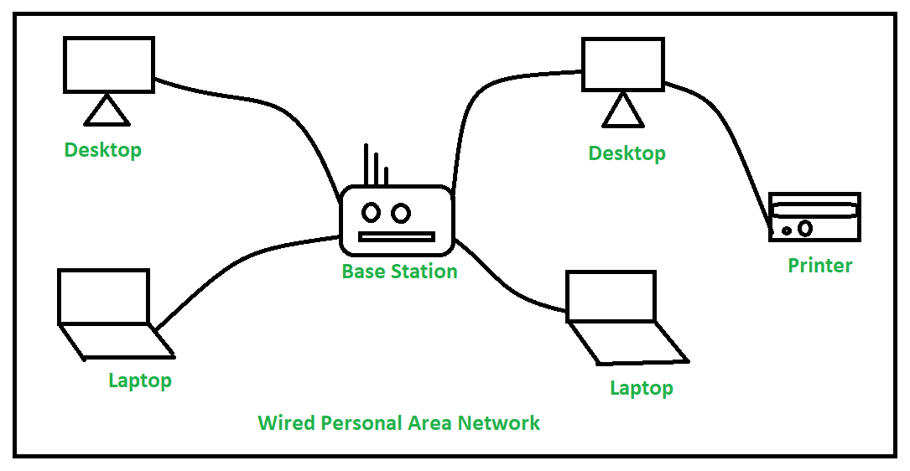
Types of PAN
Wired PAN:
Wired PAN is connected through cables/wires such as Firewire or USB (Universal Serial Bus).

Slide 35
Applications of PAN
Home and Offices
Organizations and the Business sector
Medical and Hospital
School and College Education
Military and Defense

Slide 36

Let’s do some exercises!

Slide 37

Exercises
Describe the difference between a program and a process.
Discuss why memory management is crucial for executing a program.
Describe the activities involved in memory management.
Explain how memory management optimizes CPU utilization.
Describe the decision-making process for moving processes and data in and out of memory.
Explain the concept of memory allocation and deallocation.
Describe the logical view of information storage provided by the OS.
Describe the concept of virtualization in operating systems.
Explain the different use cases for virtualization.

Slide 38
Exercises
Explain the differences between sequential and random access methods.
List the activities involved in file-system management.
Explain how the OS manages file access control.
Discuss the importance of mapping files onto secondary storage.
Explain why disks are used for mass storage.
Describe the activities involved in mass-storage management.
Explain the concept of free-space management in mass storage.
Define the principle of caching.
Describe the different types of networks (LAN, WAN, MAN, PAN) used in distributed systems.
Explain applications of WAN.
Explain the differences between LAN and WAN

Slide 39
Thanks!

