Slide 1

Operating System
Lecture: 3

Slide 2

Key functions and types of Kernel.
Kernel data structures: List, stack, queue, hash, tree, bitmap.

Slide 3
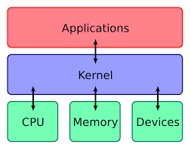
What is Kernel ?
The kernel is the core component of an operating system. It is responsible for managing the system's resources and facilitating communication between hardware and software components. The kernel acts as a bridge between applications and the physical hardware of a computer

Slide 4
Key Functions of Kernel ?
Process Management
Memory Management
Device Management
File System Management
5. System Calls
6.Interrupt Handling
7.Security and Protection

Slide 5
Process Management
Process management involves the creation, scheduling, and termination of processes in an operating system. It ensures that processes are efficiently executed by the CPU, managing resources like CPU time and memory allocation. Key functions include process synchronization, inter-process communication, and handling deadlocks to maintain smooth system operation.

Slide 6
Memory Management
Memory management is responsible for controlling and coordinating computer memory, assigning blocks to various running programs to optimize overall system performance. It involves memory allocation and deallocation, swapping, and paging. Effective memory management ensures that applications have sufficient memory while optimizing the use of physical and virtual memory.

Slide 7
Device Management
Device management oversees the control and utilization of hardware devices through the operating system. It involves managing input/output operations, device drivers, and buffering. Device management ensures that hardware resources are efficiently allocated and accessed by applications, providing a smooth interface between software and hardware.

Slide 8
File System Management
File system management handles the storage, retrieval, and organization of data on storage devices. It includes the management of file directories, access permissions, and file operations like reading, writing, and deletion. A well-managed file system ensures data integrity, security, and efficient data access.

Slide 9
System Calls
System calls are the interface between a program and the operating system, allowing user-level applications to request services from the kernel. They provide essential functions such as process control, file manipulation, and communication. System calls are crucial for enabling applications to perform tasks that require interaction with the hardware or other system resources.

Slide 10
Interrupt Handling
Interrupt handling is the process by which the operating system responds to hardware and software interrupts. Interrupts signal the CPU to stop its current task and execute an interrupt service routine (ISR). Effective interrupt handling ensures timely and prioritized responses to critical events, maintaining system stability and performance.

Slide 11
Security and Protection
Security and protection mechanisms safeguard the system from unauthorized access, misuse, and breaches. This includes user authentication, access control, encryption, and auditing. Security measures protect sensitive data and resources, ensuring system integrity and privacy. Protection mechanisms enforce rules that prevent malicious or accidental damage to the system.

Slide 12
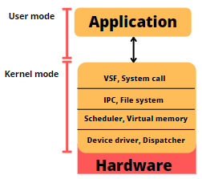
Types of Kernel
Monolithic Kernel
A monolithic kernel includes all the core functions and device drivers in a single large block of code running in a single address space.
Examples: Linux, traditional Unix.

Slide 13
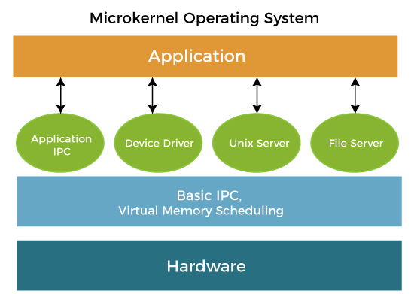
Types of Kernel
Micro Kernel
A microkernel architecture separates basic services (like process and memory management) from higher-level services (like device drivers and file systems), which run in user space.
Examples: Minix, QNX.

Slide 14
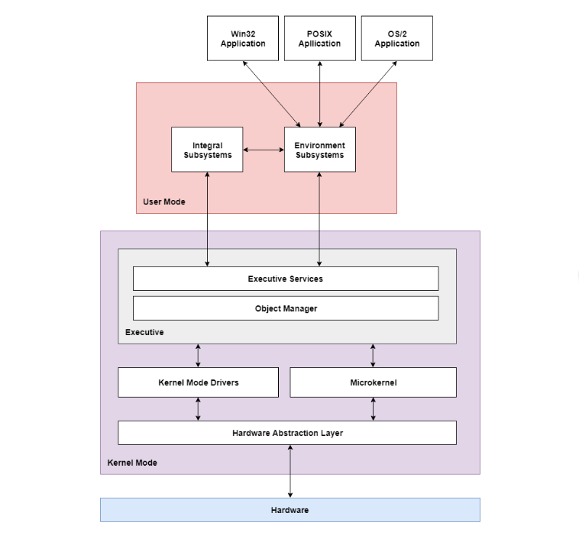
Types of Kernel
Hybrid Kernel
A hybrid kernel combines elements of both monolithic and microkernel architectures.
It typically includes some core functions in the kernel space for performance reasons while running other services in user space.
Examples: Windows NT, macOS.

Slide 15
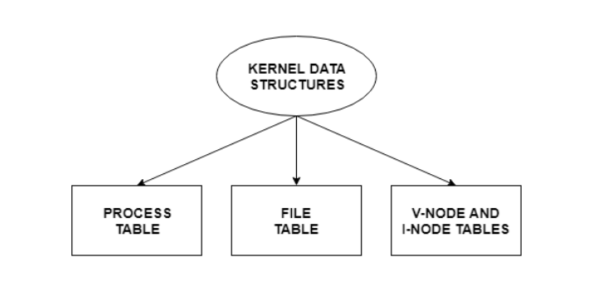
Kernel Components
The kernel stores and organizes a lot of information. So it has data about which processes are running in the system, their memory requirements, files in use etc. To handle all this, three important structures are used. These are process table, file table and v node/ i node information.

Slide 16
Kernel Components
Process Table
Manages all processes currently running in the system.
Each entry in the process table contains information about a specific process, such as:
Process ID (PID)
Process state (running, waiting, etc.)
3.Registers and memory pointers
4.CPU scheduling information
5.Memory management information (page tables, segment tables)
5.Open file descriptors
6.Accounting information (CPU time used, priority)

Slide 17
Kernel Components
File Table
Tracks all open files in the system.
Each entry in the file table includes:
File descriptor (unique identifier for the open file)
File pointer (current position in the file)
3.Reference count (number of processes that have the file open)
4.Access mode (read, write, execute)
5.Pointer to the file’s v-node/i-node

Slide 18
Kernel Components
v-node/i-node
Represents files and directories on a storage device.
Each v-node (virtual node) or i-node (index node) contains metadata about a file, such as:
File type (regular file, directory, symbolic link)
File size
3.Ownership (user ID, group ID)
4.Permissions (read, write, execute for owner, group, others)
5.Timestamps (creation, modification, access)
6.Pointers to data blocks (locations of the file's actual data on disk)

Slide 19
What is Kernel data structure?
A kernel data structure is a specialized format used by the Kernel components for organizing and managing data within the kernel of an operating system. These structures are crucial for the efficient execution of various kernel tasks.

Slide 20
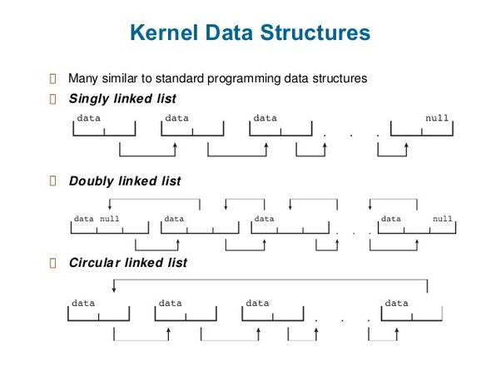
Kernel data structure
List
A list in the context of kernel data structures refers to a collection of elements that are linked together in a sequence. Each element in a list is typically referred to as a node. Each node contains data and one or more pointers to other nodes.

Slide 21
Kernel data structure
Uses of List
Lists are commonly used for managing dynamic sets of data within the kernel. For example, linked lists are used to manage process control blocks (PCBs) and maintain lists of active processes. They are also used in managing device queues and handling memory blocks in memory management.

Slide 22
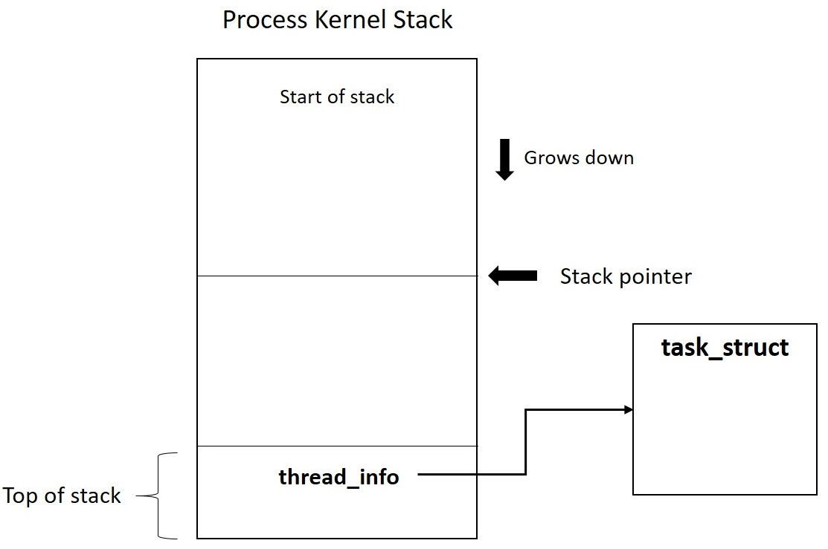
Kernel data structure
Stack
A stack in the context of kernel data structures refers to a collection of elements that maintains LIFO (Last In, First Out) structures or various kernel operations.
Stacks are basically used in function calls, interrupt handling, and nested operations.

Slide 23
Kernel data structure
Uses of Stack
Stacks are used for managing function calls and local variables within the kernel. The call stack tracks active subroutines and their return addresses, facilitating function execution and nested function calls. Stacks are also used in handling interrupts and managing the context switching of processes.

Slide 24
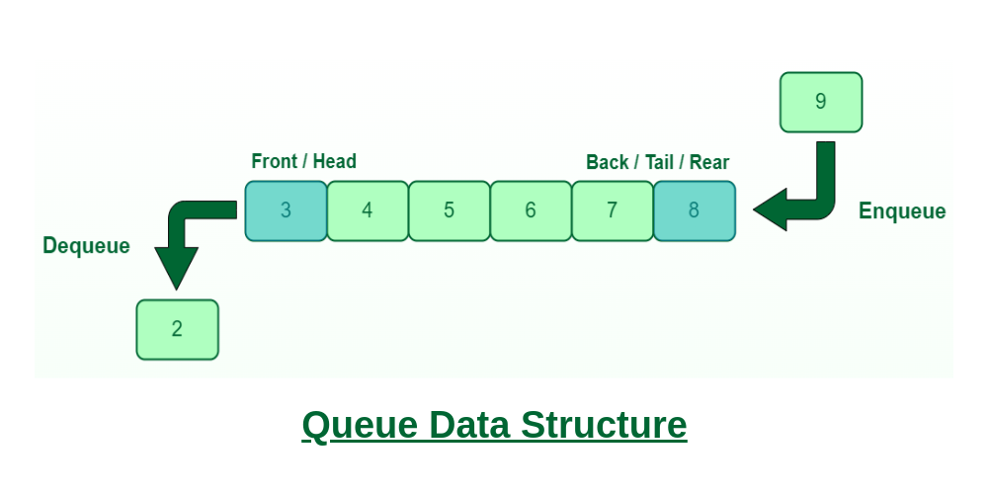
Kernel data structure
Queue
A stack in the context of kernel data structures refers to a collection of elements that maintains FIFO (First In, First Out) structures or various kernel operations.
Queues are basically used for process scheduling, I/O request handling, and network packet management. It stores elements in the order they are to be processed.

Slide 25
Kernel data structure
Uses of Queue
Queues are used in the kernel for scheduling purposes. For instance, they manage processes in a ready queue for CPU scheduling, or in I/O request queues for disk scheduling. They are essential for buffering data in communication systems, such as in network packet handling.

Slide 26
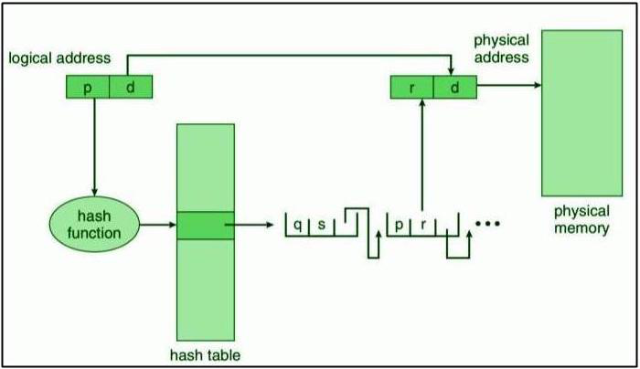
Kernel data structure
Hash Table
A hash function processes input data to produce a numeric value, which serves as an index to quickly access data in a table or array. This method significantly improves search efficiency, potentially reducing retrieval time to O(1), compared to the O(n) comparisons required for searching through a list of size n.

Slide 27
Kernel data structure
Uses of Hash Map
Hash maps are used in the kernel for fast data lookup. Examples include managing file descriptors, routing tables in networking, and caches for virtual memory page tables. They provide quick access to data through hashing techniques, which is crucial for performance in various kernel operations.

Slide 28
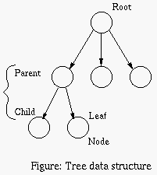
Kernel data structure
Tree
A tree is a data structure that can be used to represent data hierarchically. Data values in a tree structure are linked through parent–child relationships. In a general tree, a parent may have an unlimited number of children. In a binary tree, a parent may have at most two children, which we term the left child and the right child.

Slide 29
Kernel data structure
Uses of Tree
Trees are used in the kernel for organizing hierarchical data. Examples include directory structures in file systems (e.g., inode trees), managing process hierarchies, and implementing balanced trees (like red-black trees) for efficient scheduling algorithms and memory management structures.

Slide 30
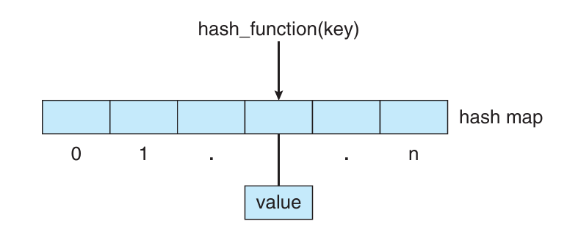
Kernel data structure
Bitmaps
A bitmap is a string of n binary digits that can be used to represent the status of n items. It is used in memory management, file systems, and process ID tracking.

Slide 31
Kernel data structure
Uses of Bitmap
Bitmaps are used for efficient resource tracking in the kernel. They are commonly used in memory management for tracking free and used memory blocks, managing block allocation in file systems, and keeping track of active or inactive processes. Bitmaps provide a compact and fast way to manage large sets of binary states.

Slide 32
Advantages of using Kernel data structures
List
Dynamic Size: Lists can grow and shrink dynamically, making them suitable for managing collections of varying sizes, such as process control blocks or device queues.
Ease of Insertion/Deletion: Adding or removing elements is efficient, especially when dealing with frequent insertions or deletions, as lists do not require shifting elements like arrays.
Flexibility: Lists can easily represent complex relationships and structures, like linked lists or doubly linked lists.

Slide 33
Advantages of using Kernel data structures
Queue
Order Maintenance: Queues maintain the order of elements in a FIFO manner, which is essential for fair scheduling and task management.
Efficient Resource Management: Useful for managing tasks and I/O requests in an orderly fashion, ensuring resources are allocated and processes are executed in the correct order.
Buffering: Ideal for buffering data in communication systems, such as network packets, ensuring data is processed in the order it arrives.

Slide 34
Advantages of using Kernel data structures
Stack
LIFO Access: The Last-In-First-Out nature is perfect for managing nested operations, such as function calls and recursive algorithms.
Memory Management: Useful for tracking function calls and local variables, making it easy to manage and clean up after functions complete.
Interrupt Handling: Efficiently handles nested interrupts and context switches, maintaining system stability.

Slide 35
Advantages of using Kernel data structures
HashMap
Fast Access: Provides constant time complexity (O(1)) for lookups, insertions, and deletions, making it highly efficient for data retrieval.
Efficient Data Management: Suitable for managing large datasets where quick access is necessary, such as routing tables or file descriptors.
Scalability: Can handle large volumes of data without significant performance degradation.

Slide 36
Advantages of using Kernel data structures
Tree
Hierarchical Organization: Perfect for representing hierarchical data, such as file systems and process trees.
Balanced Trees: Structures like red-black trees ensure that operations like insertion, deletion, and lookup remain efficient (O(log n)), maintaining system performance.
Flexibility: Can efficiently manage sorted data, making it useful for scheduling and memory management tasks.

Slide 37
Advantages of using Kernel data structures
Bitmap
Compact Storage: Uses minimal memory to track the state of resources, such as free and used memory blocks, making it memory-efficient.
Fast Operations: Provides quick and simple operations to set, clear, and test bits, making resource management tasks efficient.
Scalability: Can easily manage large numbers of resources, such as disk blocks or memory pages, with minimal overhead.

Slide 38

Let’s do some exercises!

Slide 39

Exercises
Explain what a kernel is in an operating system and describe its primary functions.
List and briefly explain the different types of kernels.
What information is typically stored in the process table?
Describe the use of lists as a kernel data structure and provide an example of where it might be used.
Explain the role of stacks in the kernel and provide an example of their use.
What are queues used for in the kernel? Provide an example.
How are hash tables utilized in the kernel, and what is their primary advantage?
What is a bitmap, and how is it used in the kernel?

Slide 40
Thanks!

