Slide 1
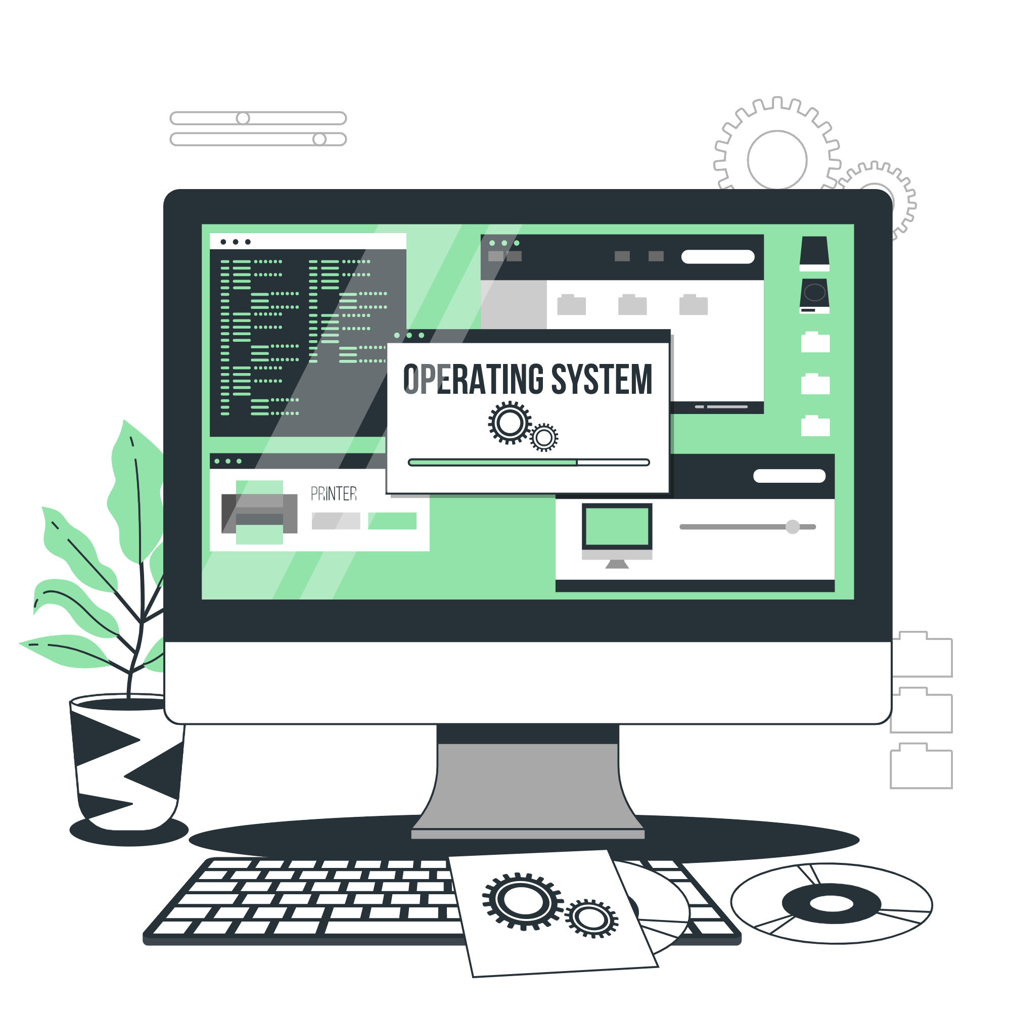
Operating System
Lecture: 7

Slide 2

Operating System Services, System Call, System services, Linkers and Loaders

Slide 3
Operating System Services
Operating systems provide an environment for execution of programs
and services to programs and users
One set of operating-system services provides functions that are
helpful to the user:
User interface - Almost all operating systems have a user
interface (UI).
Varies between Command-Line (CLI), Graphics User
Interface (GUI), Batch

Slide 4
Operating System Services
Program execution - The system must be able to load a
program into memory and to run that program, end execution,
either normally or abnormally (indicating error)
I/O operations - A running program may require I/O, which may
involve a file or an I/O device

Slide 5
Operating System Services
One set of operating-system services provides functions that are helpful to
the user (Cont.):
File-system manipulation - The file system is of particular interest.
Programs need to read and write files and directories, create and delete
them, search them, list file Information, permission management.
Communications – Processes may exchange information, on the same
computer or between computers over a network
Communications may be via shared memory or through message
passing (packets moved by the OS)

Slide 6
Operating System Services
Error detection – OS needs to be constantly aware of possible errors
May occur in the CPU and memory hardware, in I/O devices, in user
program
For each type of error, OS should take the appropriate action to
ensure correct and consistent computing
Debugging facilities can greatly enhance the user’s and
programmer’s abilities to efficiently use the system

Slide 7
Operating System Services
Another set of OS functions exists for ensuring the efficient operation of the
system itself via resource sharing
Resource allocation - When multiple users or multiple jobs running
concurrently, resources must be allocated to each of them
Many types of resources - CPU cycles, main memory, file storage,
I/O devices.
Accounting - To keep track of which users use how much and what
kinds of computer resources

Slide 8
Operating System Services
Protection and security - The owners of information stored in a
multi user or networked computer system may want to control use of
that information, concurrent processes should not interfere with each
other
Protection involves ensuring that all access to system resources is
controlled
Security of the system from outsiders requires user authentication,
extends to defending external I/O devices from invalid access attempts

Slide 9
System Call
Programming interface to the services provided by the OS
Typically written in a high-level language (C or C++)
Mostly accessed by programs via a high-level Application Programming Interface (API) rather than direct system call use
Three most common APIs are Win32 API for Windows, POSIX API for POSIX-based systems (including virtually all versions of UNIX, Linux, and Mac OS X), and Java API for the Java virtual machine (JVM)
Note that the system-call names used throughout this text are generic

Slide 10
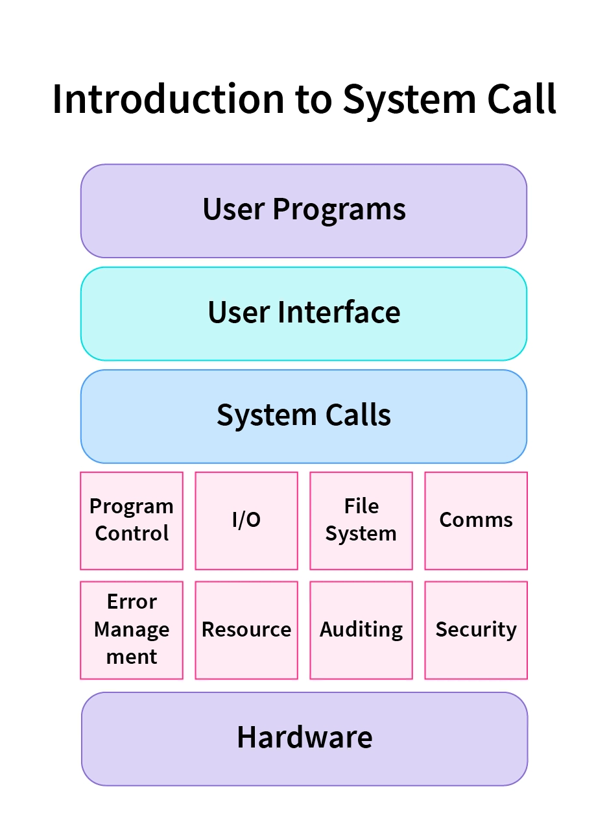
System Call

Slide 11
System Call Implementation
Typically, a number associated with each system call
System-call interface maintains a table indexed according to these numbers
The system call interface invokes the intended system call in OS kernel and returns status of the system call and any return values
The caller need know nothing about how the system call is implemented
Just needs to obey API and understand what OS will do as a result call
Most details of OS interface hidden from programmer by
Managed by run-time support library (set of functions built into libraries included with compiler)

Slide 12
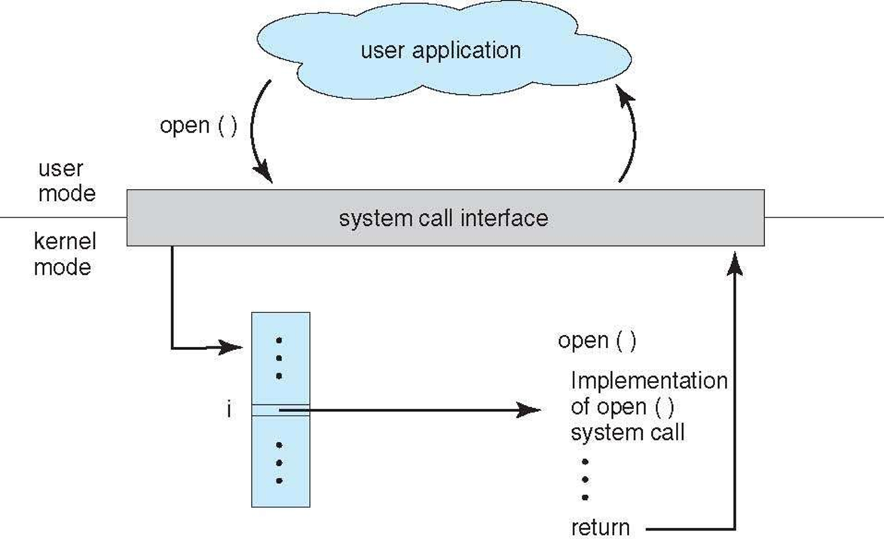
API – System Call – OS Relationship

Slide 13
System Call Parameter Passing
Often, more information is required than simply identity of desired system call
Exact type and amount of information vary according to OS
and call
Three general methods used to pass parameters to the OS
Simplest: pass the parameters in registers. In some cases, may be more parameters than registers
Parameters stored in a block, or table, in memory, and address of block passed as a parameter in a register
This approach taken by Linux and Solaris
Parameters placed, or pushed, onto the stack by the program and popped off the stack by the operating system
Block and stack methods do not limit the number or length of parameters being passed

Slide 14
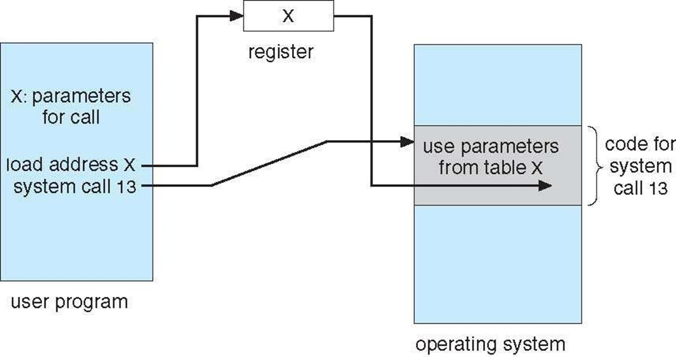
Parameter Passing via Table

Slide 15
Types of System Calls
Process control
create process, terminate process
end, abort
load, execute
get process attributes, set process attributes
wait for time
wait event, signal event
allocate and free memory
Dump memory if error
Debugger for determining bugs, single step execution
Locks for managing access to shared data between processes

Slide 16
Types of System Calls
File management
create file, delete file
open, close file
read, write, reposition
get and set file attributes
Device management
request device, release device
read, write, reposition
get device attributes, set device attributes
logically attach or detach devices

Slide 17
Types of System Calls
Information maintenance
get time or date, set time or date
get system data, set system data
get and set process, file, or device attributes
Communications
create, delete communication connection
send, receive messages if message passing model to host name or process name
From client to server
Shared-memory model create and gain access to memory
regions
transfer status information
attach and detach remote devices

Slide 18
Types of System Calls
Protection
Control access to resources
Get and set permissions
Allow and deny user access

Slide 19
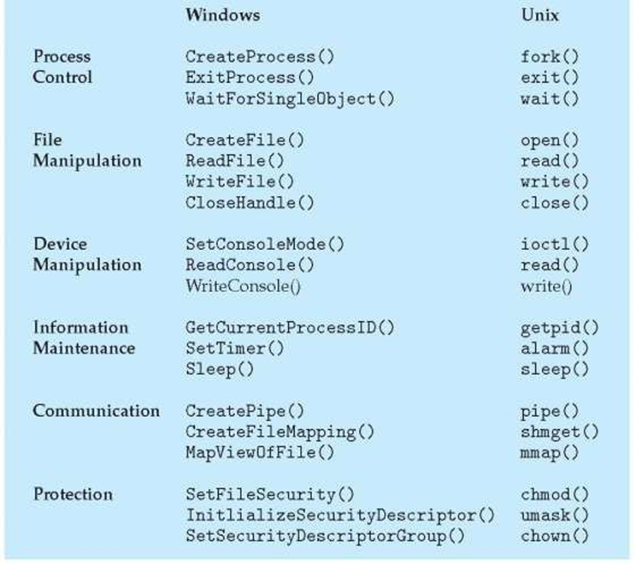
Examples of Windows and Unix System Calls

Slide 20
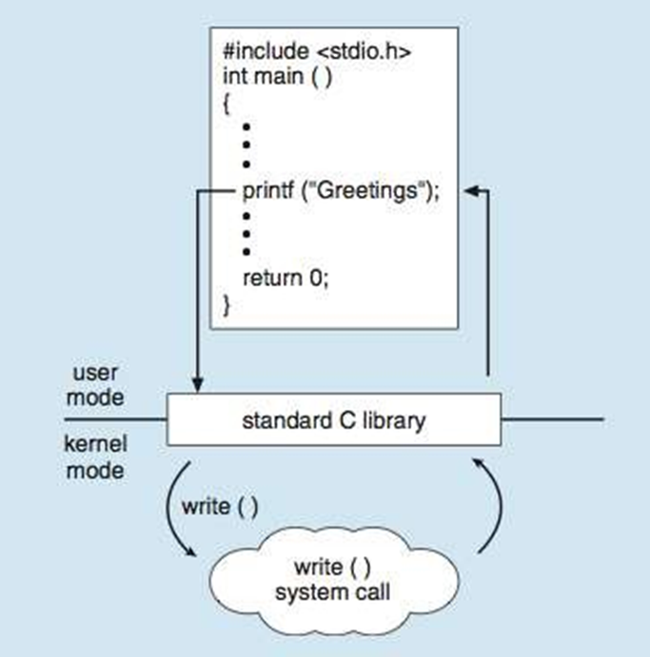
Standard C Library Example
C program invoking printf() library call, which calls write() system call

Slide 21
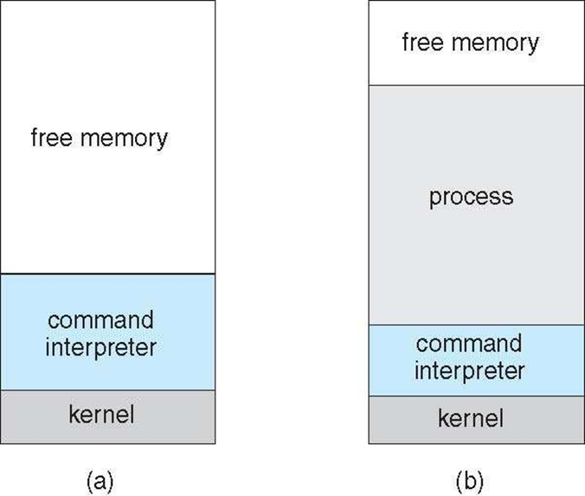
Example: MS-DOS
Single-tasking
Shell invoked when system booted
Simple method to run program
No process created
Single memory space
Loads program into memory, overwriting all but the kernel
Program exit -> shell reloaded

Slide 22
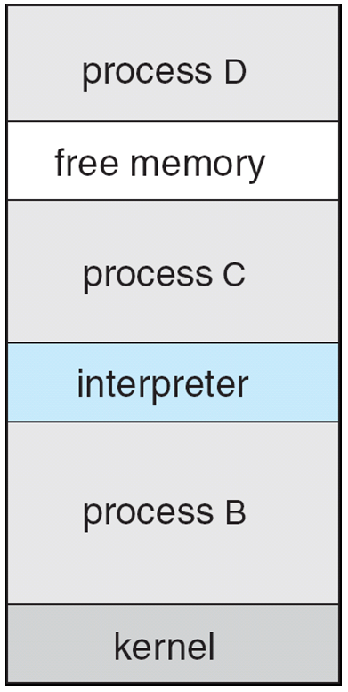
Example: FreeBSD
Unix variant
Multitasking
User login -> invoke user’s choice of shell
Shell executes fork() system call to create process
Executes exec() to load program into process
Shell waits for process to terminate or continues with user commands
Process exits with:
code = 0 – no error
code > 0 – error code

Slide 23
System Programs
System programs provide a convenient environment for program development and execution. They can be divided into:
File manipulation
Status information sometimes stored in a File modification
Programming language support
Program loading and execution
Communications
Background services
Application programs
Most users’ view of the operating system is defined by system programs, not the actual system calls

Slide 24
System Programs
Provide a convenient environment for program development and execution
Some of them are simply user interfaces to system calls; others are considerably more complex
File management - Create, delete, copy, rename, print, dump, list, and generally manipulate files and directories
Status information
Some ask the system for info - date, time, amount of available memory, disk space, number of users
Others provide detailed performance, logging, and debugging information
Typically, these programs format and print the output to the terminal or other output devices
Some systems implement a registry - used to store and retrieve configuration information

Slide 25
System Programs
File modification
Text editors to create and modify files
Special commands to search contents of files or perform
transformations of the text
Programming-language support - Compilers, assemblers, debuggers and interpreters sometimes provided
Program loading and execution- Absolute loaders, relocatable loaders, linkage editors, and overlay-loaders, debugging systems for higher-level and machine language

Slide 26
Linkers
Linker: A linker is a program that combines multiple object files generated by a compiler into a single executable file. It resolves references between these files and assigns final memory addresses to create a coherent, executable program.
Linkers are of 2 types:
1. Linkage Editor
2. Dynamic Linker

Slide 27
Linkers
The linker performs several tasks, including:
Symbol resolution: The linker resolves symbols in the program that are defined in one module and referenced in another.
Code optimization: The linker optimizes the code generated by the compiler to reduce code size and improve program performance.
Memory management: The linker assigns memory addresses to the code and data sections of the program and resolves any conflicts that arise.
Library management: The linker can link external libraries into the executable file to provide additional functionality.

Slide 28
Loaders
Loader: A loader is a part of an operating system that loads an executable file into memory for execution. It sets up the program's memory space, initializes the program's variables, and starts the execution of the program. The embedded computer systems don’t have loaders. In them, code is executed through ROM. There are following various loading schemes:
1. Absolute Loaders
2. Relocating Loaders
3. Direct Linking Loaders
4. Bootstrap Loaders

Slide 29
Loaders
The loader performs several tasks, including:
Loading: The loader loads the executable file into memory and allocates memory for the program.
Relocation: The loader adjusts the program’s memory addresses to reflect its location in memory.
Symbol resolution: The loader resolves any unresolved external symbols that are required by the program.
Dynamic linking: The loader can dynamically link libraries into the program at runtime to provide additional functionality.

Slide 30
Loaders
The loader performs several tasks, including:
Loading: The loader loads the executable file into memory and allocates memory for the program.
Relocation: The loader adjusts the program’s memory addresses to reflect its location in memory.
Symbol resolution: The loader resolves any unresolved external symbols that are required by the program.
Dynamic linking: The loader can dynamically link libraries into the program at runtime to provide additional functionality.

Slide 31
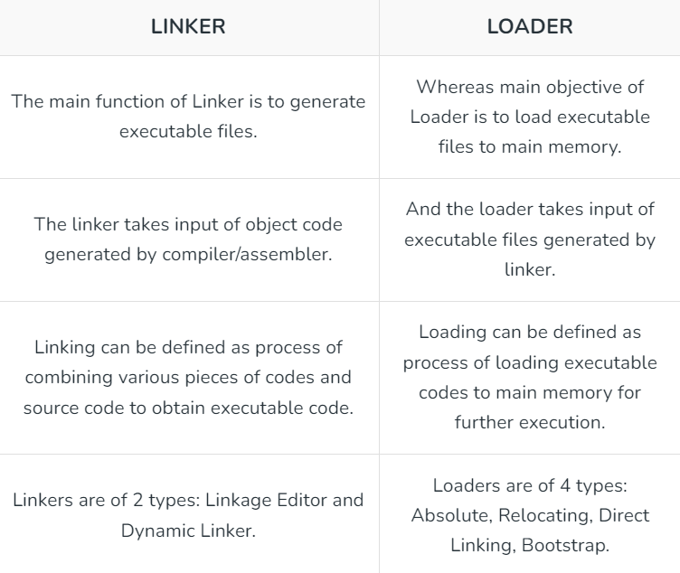
Differences between Linker and Loaders

Slide 32
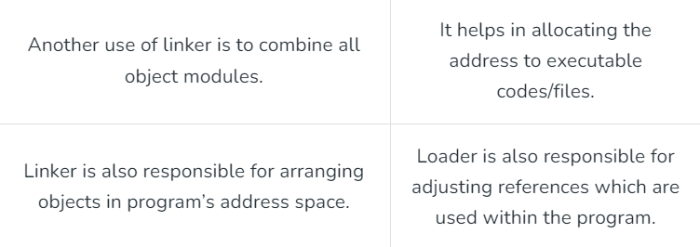
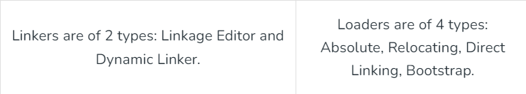
Differences between Linker and Loaders

Slide 33
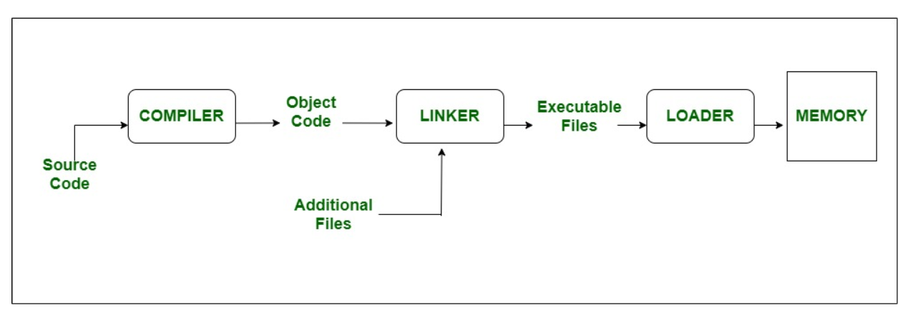
Role of Linkers and Loaders

Slide 34

Let’s do some exercises!

Slide 35

Exercises
1. Explain the differences between Command-Line Interface (CLI) and Graphics User Interface (GUI) in operating systems, and provide examples of each.
2. Describe the process of how an operating system handles file-system manipulation. Include steps for reading, writing, creating, and deleting files and directories.
3. How does the error detection mechanism in an operating system enhance system stability and user experience? Provide examples of common errors and the corresponding actions taken by the OS.
4. Discuss the role of system calls in an operating system. Describe how a system call is executed from the user's perspective and the operating system's perspective.
5. What are the differences between a linker and a loader in the context of operating systems? Explain their roles and how they interact during program execution.

Slide 36
Thanks!

