Slide 1
Building Interactive Tutorials with learnr
Chris Aberson
Department of Psychology
Materials at github/chrisaberson/learnr-workshop

Slide 2
Overview
What is learnr?
Tour of a learnr tutorial and learnr Markdown file
Building a tutorial (longest part)
Using your own data in a tutorial
Using packages
Distributing as a package
Workshop materials at GitHub … and we’ll post those the R collective Google Drive
Note: In many places, I’ll provide screen shots rather than try to navigate in RStudio

Slide 3
learnr
learnr is developed by members of the RStudio team to provide an easy-to-use (relatively) approach to building interactive tutorials
Tutorials can include videos, quizzes, images, equations, shiny apps, and a space to run analyses directly inside the tutorial
learnr tutorials are shiny apps but you don’t have to know anything about building shiny apps to develop them
(Tour of a learnr tutorial/Markdown file)

Slide 4
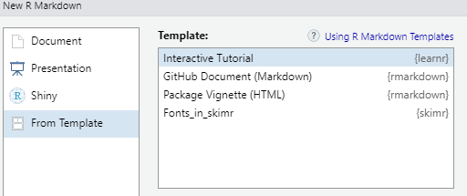
Getting Started
Choose file – new file – R Markdown – from Template
(or just use someone else’s existing tutorial and modify)

Slide 5
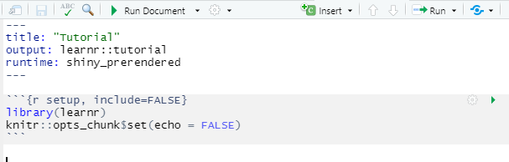
Template
Top part is the header – don’t mess with that, it is fussy
First code chunk loads learnr, add whatever packages you are using inside this chunk (be sure to include your package!)
Template includes examples of questions, exercises, etc.

Slide 6
Components: Adding Pages
Organize logically using different pages
Formatting the look of the tutorial involves three different levels
These are noted with #
# Title of Tutorial
## New Page
### New section within a page
Be sure to put a space after the #, otherwise it is read as a comment

Slide 7
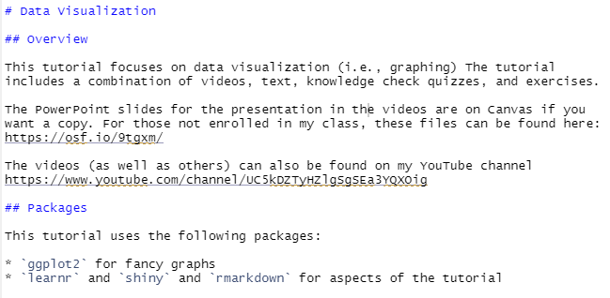
Examples: Adding Pages

Slide 8

Components: Videos
Adding video is simple. All you need is a web link
This will run in an window inside the tutorial
I am working on keeping videos about 5-10 minutes long

Slide 9
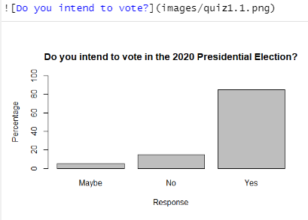
Components: Images
Just like a video

Slide 10
Components: Quizzes
Quizzes are a bit challenging
Require a very specific format
Quizzes do not record data. They are for students to check their knowledge
Can provide feedback
Can allow student to try again (I always do this as I want them to eventually land on the right answer)
This is a nice way to bring in low stakes testing as it allows the student to work toward mastery

Slide 11
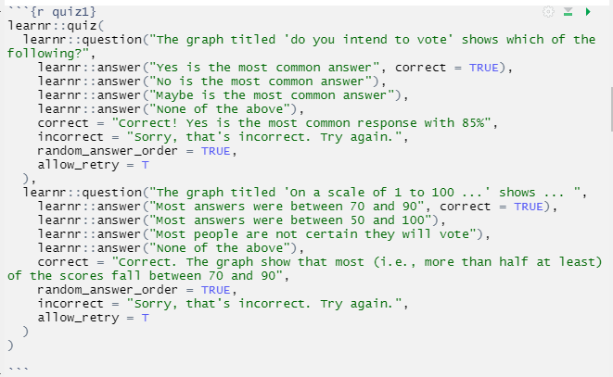
Example: Quizzes

Slide 12
Troubleshooting Quizzes
If something isn’t working for me, it is usually a quiz
Somethings I’ve learned
You can check the quiz by running the chunk (the little play button in the right hand corner)
If you have multiple quiz items and something isn’t working, create a chunk with just the first question, test, and if that works move to the 2nd.
Detail is a key – it is almost always a comma, paren, or quotation mark that is screwing things up
Some symbols (like #) cannot be used in quiz text because they are read as commands to do something else – there are probably others so I try to avoid symbols

Slide 13
Adding text
You literally just type text
*italics*
**bold**
Superscript^2^
Subscript~2~
Help menu in RStudio has a useful markdown cheat sheet and quick reference

Slide 14
Adding equations
If you know LaTeX you can write these inline
If not, doing it in Word and then inserting as an image works too
https://sv.overleaf.com/learn/latex/Mathematical_expressions provides a nice overview of LaTeX for mathematical copy. It took me an hour or two to get the hang of it
I’ve been working on writing some common ones – I’m happy to share that with anyone who wants them

Slide 15
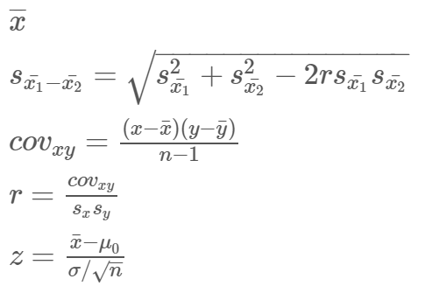
Examples on the left, render to the right
$\bar{x}$
$s_{\bar{x_1}-\bar{x_2}} =\sqrt{s_{\bar{x_1}}^2+s_{\bar{x_2}}^2 - 2rs_{\bar{x_1}}s_{\bar{x_2}}}$
$cov_{xy} = \frac{(x-\bar{x})(y-\bar{y})}{n-1}$
$r = \frac{cov_{xy}}{s_xs_y}$
$z = \frac{\bar{x} - \mu_0}{\sigma / \sqrt{n}}$

Slide 16
Running Code
The true power, in my opinion, of learnr comes from the ability to execute code
This is a relatively simple thing to do
Major applications
Go line by line through complex code with a description after each (you don’t need learnr for this but it is a strategy I like)
Provide code that generates output for interpretation
Ask questions and have students write and execute code to address question (with an option to add a solution – the correct code – if they get stuck)

Slide 17
Running Code: Code Chunks (basic markdown)
Sample code runs a bar plot
Important elements
echo – T means show the code in the tutorial, F means hide it
eval – T means run code, F means don’t run
Applications
echo = T, eval= T show and run code, display output
echo = T, eval= F show code, don’t run (great for going line by line and explaining each piece of code)
echo = F, eval= T just show output (useful for generating output for a quiz)
echo = F, eval = F don’t run or show

Slide 18
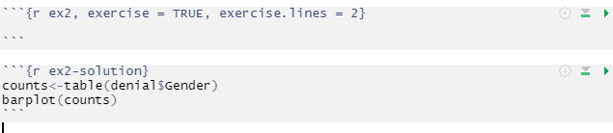
Creating exercises
The code below creates an exercise that asks the student to perform a specific analysis
The first chunk names the exercise (ex2) and indicates how big to make the code box.
The 2nd optional (but highly recommended) chunk provides the correct answer

Slide 19
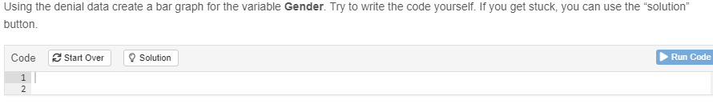
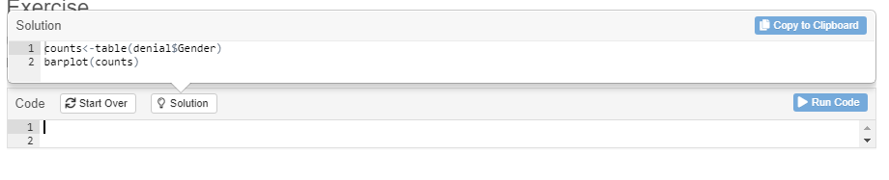
Exercise Rendered

Slide 20
Tips regarding exercises
If you are using data that is not standard R issue (e.g., iris), you should make a package (more on that later)
Test. Test. Test. Definitely make sure it is working.
Clear your workspace when testing – something may only work because you have certain packages loaded or you opened the data file earlier.
You likely have materials that would lend themselves to these exercises already!
I like to follow each exercise with a quiz (generally interpreting the output)
Don’t rely on students having run the analysis correctly! I create a new page for the quiz and run the correct analysis so that the questions address relevant output

Slide 21
Advanced: Shiny Apps
learn can run shiny apps inside the tutorial
You can write your own shiny (simple ones are pretty easy)
You can use external Shiny apps
However, you need to use the “open in browser”
Tutorials (opened in certain ways) default to opening in R Studio window but there is a button on top of that window that says “open in browser”
Shiny will not appear in the tutorial if using an RStudio window (this is a known bug)

Slide 22
Including External Shiny Apps
Need the knitr package
May need to miss with the height a bit to make things fit
Remember – this only works if you use the “open in browser” option!
(Big thanks to the RStudio team who worked to find a solution on this issue)

Slide 23
Useful Shiny Repositories
Some useful Shiny pages
http://facweb.gvsu.edu/adriand1/215apps.html
https://github.com/ShinyEd/intro-stats
https://statistics.calpoly.edu/shiny
https://www4.stat.ncsu.edu/~jbpost2/teaching.html
http://www.artofstat.com/webapps.html

Slide 24
Packaging your tutorial
If you use your own data (i.e., stuff that doesn’t come with R) and use multiple packages, it will be far easier for students if you put your tutorial in a package
Building packages isn’t particularly hard … but often the steps for doing so are not completely clear
I’ve compiled a list of steps that work for me. There are likely about 100 different ways to do this
Note: people often complain about how challenging it is to make a package – those discussions are about getting your package on CRAN. Since we aren’t doing that, the process is far easier

Slide 25
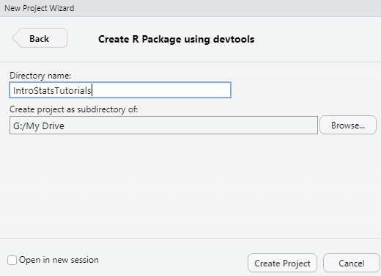
Making a Package
Click File – New Project
Choose New Directory (best to start empty)
Choose R Package using devtools
Give it a name
Create Project
At this point you will have a directory with some autogenerated files

Slide 26
Making a Package (cont.)
Necessary elements
A directory called R (auto generated)
A directory called data (for any datafiles you have)
A directory called man (it will be created automatically later)
A directory called inst
A subdirectory called tutorials, with another subdirectory for (each) tutorial - this is where your rmd files go
Manually add each directory that doesn’t exist

Slide 27
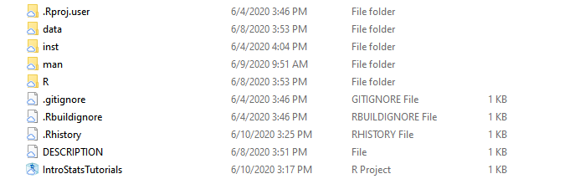
Directory Structure

Slide 28
Making a Package (cont.)
Add files
A file inside the R directory with the same name as your package (packagename.R). This provides some description and, if needed, where you specify packages used in the tutorial and various other pieces
A file inside the R directory called data.R that describes your datafiles. Note: if you have large datasets, you might just want to subset these to the variables used in exercises as you have to define all the variables. You will get errors if you specify things wrong.
There will be a file generated in there called “hello.R” - delete that
Go to inst/tutorials/tutorialname – put your markdown file (the tutorial) in that directory. If you have images, put those in inst/tutorials/tutorialname/images
Put datafiles in the data directory

Slide 29
Making a Package (data.R)
#' Climate Change Denial
#'
#' @format A data frame with 1587 rows and 11 variables:
#' \describe{
#' \item{CCD}{Climate Change Denial}
#' \item{ANITESTABL}{Anti-Establishment Beliefs}
#' \item{EXCL_ANTIEG}{Anti-Egalitarian Preferences}
#' \item{TRADVALUE}{Traditional Values}
#' \item{OPENNESS}{Openness}
#' \item{PSEUDOSCI}{Pseudoscience beliefs}
#' \item{AGREEABL}{Agreeableness}
#' \item{Age}{Age in years}
#' \item{Gender}{Gender}
#' \item{Education}{Education = Five Categories}
#' \item{ed}{Education = Two Categories}
#’ }
"denial"
First line is a descriptive name for our data
Every line is preceded with #’ (I believe that’s a devtools or roxygen2 specification)
@format – will throw an error if the numbers are wrong
\describe – define each item in order (you have to define everything in the dataset)
File name goes on the bottom
If you have multiple datafiles, just repeat the process in the same file

Slide 30
Making a Package (packagename.R)
#' Tutorials for Introductory Statistics
#'
#' @description
#'
#' This package supports online teaching for teaching introductory stats
#'
#' @import ggplot2 car lsr apaTables BayesFactor tidyverse
#' @docType package
#' @name IntroTutorials
#'
#'
#'
NULL
The main piece here is the import field
This tells R what packages people using the tutorial need and installs them
I always tell students what packages they need but I don’t want to rely on them to independently install everything
For both of the files we’ve reviewed, I like to steal a working one and modify it

Slide 31
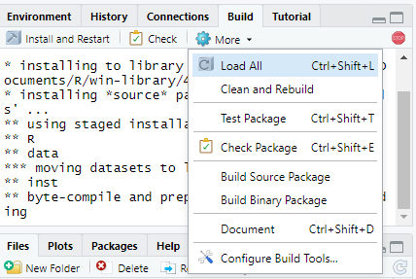
Try to build your package
Choose build – more – clean and rebuild
This will run through a package build
Check for errors. Common ones are not correctly defining the data and variables
As usual, R gives more feedback when you’ve made a mistake but says little if you’ve done something right

Slide 32
Making a Package (DESCRIPTION)
Every package has a file called DESCRIPTION
Includes basic package information and imports
Automatically generates file with spots for you to fill information
Don’t worry about license if you are not distributing
If distributing, I use GPL (>=3). This is the “General Public License” – it basically means people can use your stuff

Slide 33
DESCRIPTION file content
Package: IntroStatsTutorials
Title: Tutorials for Intro Statistics
Version: 0.0.0.9000
Authors@R:
person(given = "Chris",
family = "Aberson",
role = c("aut", "cre"),
email = "cla18@humboldt.edu",
comment = c(ORCID = "orcid.org/0000-0003-3481-7177"))
Description: Intro Statistics Tutorials.
License: GPL (>= 3)
Encoding: UTF-8
LazyData: true
Roxygen: list(markdown = TRUE)
RoxygenNote: 7.1.0
Imports:
car, ggplot2, lsr

Slide 34
Making a Package (NAMESPACE)
Every package has a file called NAMESPACE
This file controls stuff like the packages that get installed and loaded automatically
Building the package makes a NAMESPACE but it is blank
devtools::document() is a command developed to make building the NAMESPACE simple
Simply type devtools::document() with your project open (or use the pull-down menu)
Document is a quick way for the NAMESPACE to reflect what we specified in the packagename.R file (when we indicated imports)
Note: this also generates help files (not useful here but a massive time saver if you are making a package for distribution on CRAN)

Slide 35
What the NAMESPACE should look like
# Generated by roxygen2: do not edit by hand
import(BayesFactor)
import(apaTables)
import(car)
import(ggplot2)
import(lsr)
import(tidyverse)

Slide 36
Package Distribution
Easy way – Build a source file, post to canvas
Hard way – GitHub
Source file has the advantage of simplicity
GitHub has the advantage of making materials available to the entire academic community
That’s my approach but if you don’t already use GitHub, I don’t recommend learning it just for this purpose

Slide 37
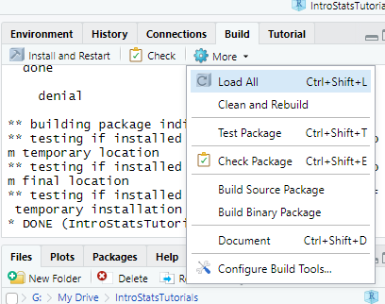
Build Source Package
Click more – build source package
Creates a compressed file called packagename.tar.gz
Warning – for some reason, I always find that this file gets built to the wrong directory (e.g., G:/My Drive rather than G:/My Drive/IntroStatsTutorials)

Slide 38
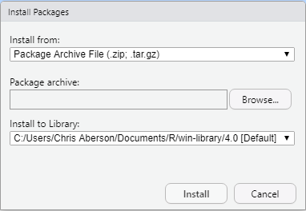
Student Installation of Source Files
Once downloaded, click install
Change Install from to “Package Archive File” and navigate to downloaded file

Slide 39
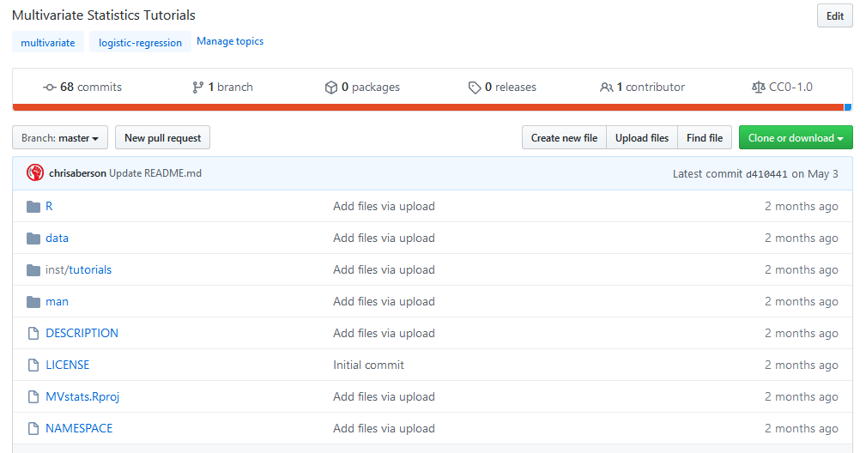
GitHub
GitHub directory would look just like your package directory

Slide 40
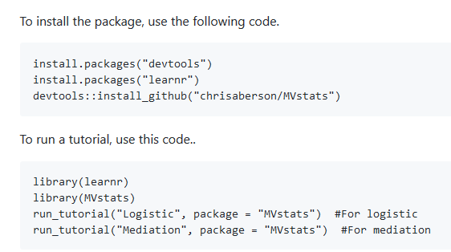
GitHub (cont.)
A nice feature of GitHub is that I can add a readme file that gives detailed instructions on how to install (see below)
Also, others can suggest improvements (and catch errors!)

Slide 41
Best Practices (I think)
Check package build on multiple platforms (Windows and Mac)
The rhub package accomplishes this easily (if you don’t have both types of machines available)
rhub::check_for_cran(email="cla18@humboldt.edu") – this does windows and linux
rhub::check_on_macos(email="cla18@humboldt.edu") – this does mac
I like to install the package on a different machine to make sure it is OK for distribution
Ask students with previous installs to update to the latest R and RStudio
To hedge my bets, I usually also have a direct link to videos and detailed instructions for running analyses as part of a handout

Slide 42
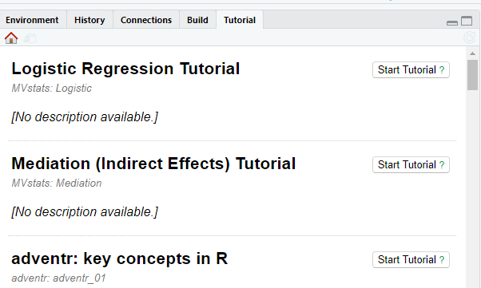
New RStudio learnr Features
RStudio’s latest release added greater learnr functionality
There is now a tutorials tab
Automatically searches for installed tutorials so students can start them with one click
Note: Does not currently have an “open in browser” option, so don’t use if you have external Shiny

Slide 43
Troubleshooting Student Installation Issues
learnr tutorials often require numerous packages
If you use ggplot2 you need digest, glue, grDevices, grid, gtable, isoband, MASS, mgcv, rlang, scales, stats, tibble, withr … many of those come with additional dependencies
Fix: manually install dependent packages before installing the tutorial
Occasionally one or more of these installs fail and create an error
Fix: install that package manually. Error message will indicate which one caused the failure (may need to do this a few times)
On Windows machines, the stand-alone program rtools is required (this is not a package). https://cran.r-project.org/bin/windows/Rtools/
Fix: Include in basic instructions for downloading R and RStudio

Slide 44
Troubleshooting Student Installation Issues (cont.)
If possible, install on a machine that is not your primary one
Ideally, an older, slow machine
Packages distributed as source files tend to cause fewer problems
Remind students who have previously used R to update everything!
Have a backup options
Video links, written copies of exercises, stand alone data from the tutorial
Likely only need these early on to prevent students from falling behind

Slide 45
Resources
https://rstudio.github.io/learnr/ - A nice, clear manual for using learnr
https://github.com/chrisaberson/ - my GitHub. Please feel free to take my work and adapt it if that lessens your workload in any way!
https://github.com/profandyfield/adventr - Andy Field wrote learnr materials to accompany one of his statistics texts. Several very good tutorials to mine for content
http://r-pkgs.had.co.nz/ - Hadley Wickham’s book on writing R packages (free online version)
https://kbroman.org/pkg_primer/ - Another good primer on writing packages

Slide 46
Questions, Comments, Ideas for Moving Forward?

