Slide 1
PROJECT TITLE: CYBER SCHOOL

Slide 2
INTRODUCTION
One of the only platforms joining the complete world together is the cyber space. Further, with the increasing technology there are numerous crimes committed through it on a daily basis. To deal with such delinquents there is an immediate need for all organizations, whether private or public to have developed a strong and secured cyber security.
And therefore arises, the need of hiring professionals in cyber forensics, biometrics, cyber laws, ethical hacking, cyber security management, etc.

Slide 3
Cont..
Since the cyber space is a common platform which can be accessed by anyone from anywhere in the world, the scope of cyber school will equally spread throughout the world. Like in any other course, one may choose to either do some course in Cyber in School additional to your main graduation or specialization after it through forum. Either way it’s one of most rewarding fields since in the current scenario there is a huge demand for professionals in various fields of cyber security. There are various institutes throughout the world that offer various full time or online courses in fields of cyber security. Cyber School is a very vast field with numerous sub divisions therefore one has a huge number of options to choose from; each of which further widens the scope of one’s knowledge and career prospects.

Slide 4
PROBLEM STATEMENT
As discussed in the introduction chapter, the number of attacks on network connected hosts has increased over the last several years, making security of networks an increasingly important problem due to lack of knowledge on how of prevention themselves from cyber crime that has prone to maliciousness and disdain of security practices that result in compromise or destruction of information, or disruption of services to other insiders and carelessness in the use of information system and/or the protection of company information.

Slide 5
OBJECTIVE
Main Objective
The main purpose of our project is to develop a system that will provide knowledge about computer security to all individuals who are interested in security of their personal information, business information, and provide means to reduce the all cybercrimes threats and effects to all individuals.

Slide 6
Cont..
Specific Objectives
The process of development will go through;
Gather information on how to create our system according to system functionalities identified.
Design system modules.
Implement of the system.

Slide 7
FUNCTIONAL REQUIREMENT
These deals with the functionality of the system, what the system does (computation).
It will register the user and give him/her an account to access materials.
It will provide question to test user’s knowledge and it give an answer whenever the user is wrong.
It provide materials such as books that will allow user to learn new things.
It provide a contact that user will interact with, to ask for a help.
It provide area to comment in blog for any suggestion.
It will allow user to login through his username and password for Security purposes and to log out

Slide 8
NON – FUNCTIONAL REQUIREMENT
These deals with the qualities and properties of the system.
The cyber school system should be secured
The system should be available 24 hours
The system should be user friendly
The system should be maintained
The system should be reliable

Slide 9
USE CASE DIAGRAM
Use Case
A formal way of representing how a business system interacts with its environment.
Illustrates the activities that are performed by the users of the system.
Each use case in a use case diagram describes one and only one function in which users interact with the system

Slide 10
Cont..
The use case has three components.
The use case task referred to as the use case that represents a feature needed in a software system.
The actor(s) who trigger the use case to activate.
The communication line to show how the actors communicate with the use case.

Slide 11
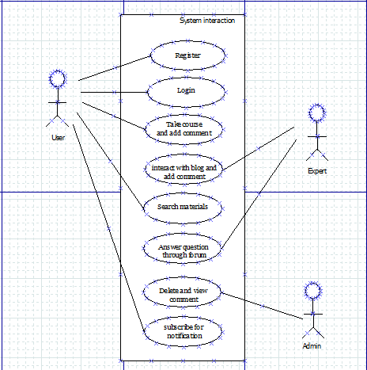
Cont..

Slide 12
ARCHITECTURE DIAGRAM
Architecture
is the conceptual structure and logical organization of a computer or computer based system. In our system architecture is all about interface of which the interface consist of about us, contact, courses, blog and home page, registration part and login.

Slide 13

Cont...

Slide 14
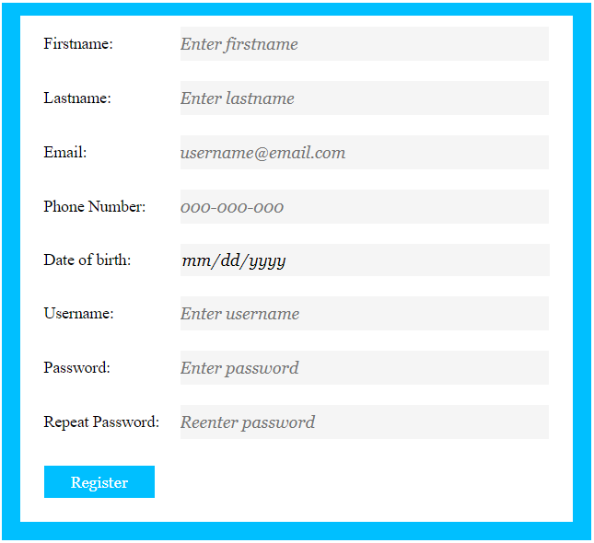
ACTIVITY DIAGRAM In this page new user is required to fill a given form in order to interact with the system and accessing the courses.

Slide 15
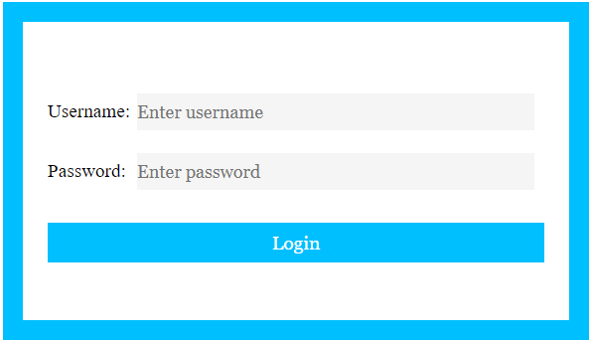
Cont.. After the user has already registered when he or she want to use the system at another time does not need to register he or she has to login.

Slide 16

Cont.. For user to get new update and information has to subscribe.

Slide 17

Cont.. Search area helps the user to search for material contained in the system for easy access.

Slide 18
ENTINTY RELATIONSHIP DIAGRAM
ERD
Entity Relationship (ER) Diagram–A detailed, logical representation of the entities, associations and data elements for an organization or business
Entities involves in our system are:
users
Admin
Expert

Slide 19
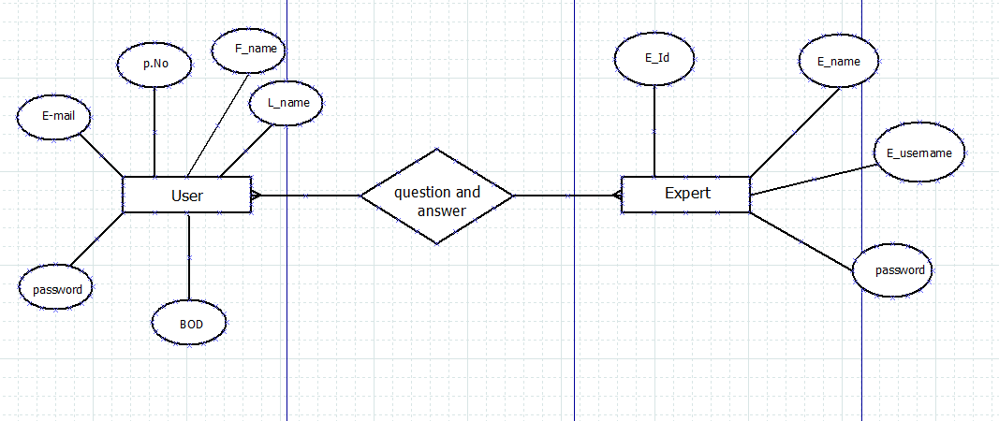
Cont.. Both users and experts can ask questions and provide answers.

Slide 20
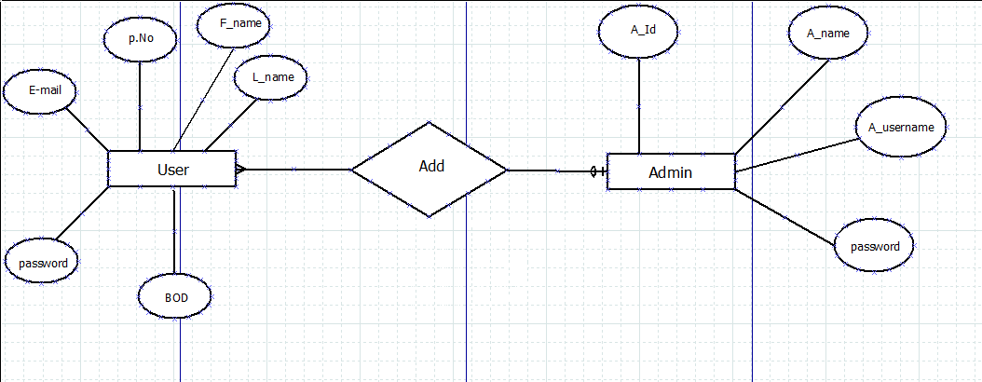
Cont.. Admin can add new users to the system

Slide 21
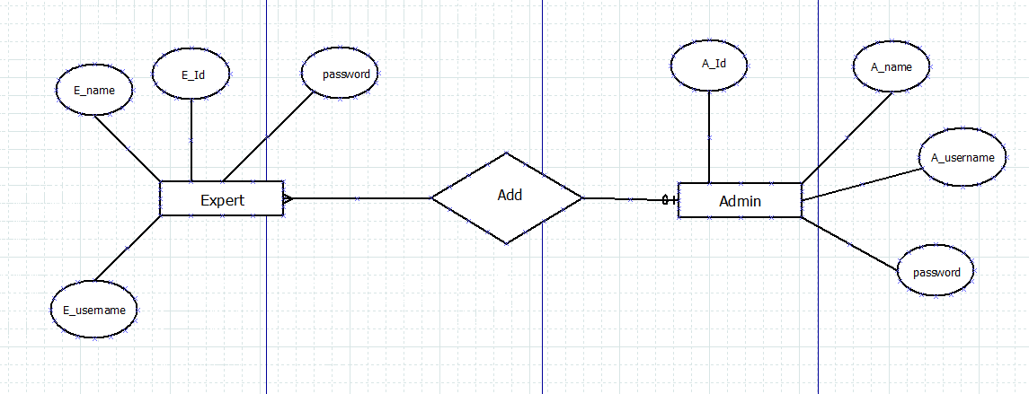
Cont.. Admin can add new experts to the system.

Slide 22
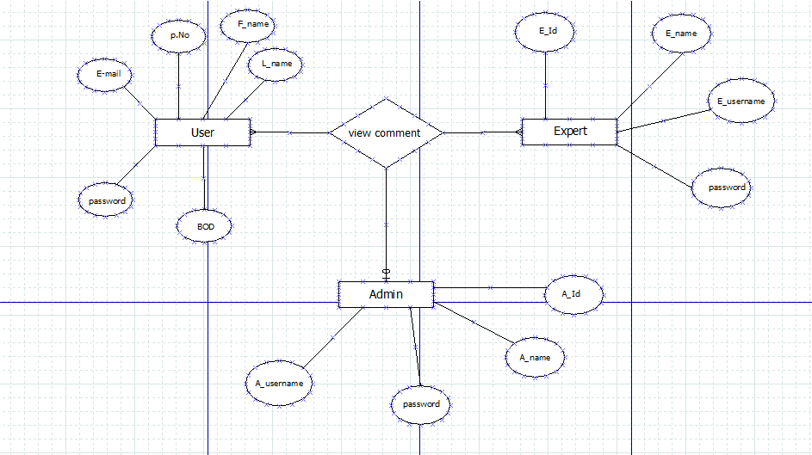
Cont.. Admin can view the comments written by users and expert but they can not notice ,but users and expert can view their comment.

Slide 23
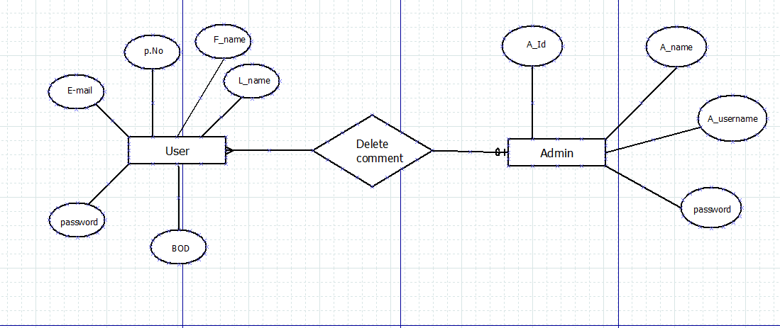
Cont.. Admin can delete the comment written by users.

Slide 24
THE END
THANK YOU

