Slide 1
Internet Anonymity
By Esra Erdin

Slide 2
Introduction
Types of Anonymity Systems
TOR Overview
Working Mechanism of TOR
I2P Overview
Working Mechanism of I2P
Conclusion

Slide 3
Introduction
Anonymity means that the real author of a message is not known
Notes:
Message can be e-mail, news, webpage,book…

Slide 4
Introduction
Anonymity is a combination of both
Unidentifiability; observers cannot identify any individual agent
Unlinkability; observers cannot link an agent to a specific message or action

Slide 5
Introduction
Why is anonymity needed on Internet?
Privacy
Freedom of Speech
Anti-cencorship

Slide 6
sentto-1119315-3675-1008119937-jpalme=dsv.su.se@returns.groups.yahoo.com Received: from n12.groups.yahoo.com (n12.groups.yahoo.com [216.115.96.62]) by unni.dsv.su.se (8.9.3/8.9.3) with SMTP id CAA21903 for <jpalme@dsv.su.se>; Wed, 12 Dec 2001 02:19:32 +0100 (MET) X-eGroups-Return: sentto-1119315-3675-1008119937-jpalme=dsv.su.se@returns.groups.yahoo.com Received: from [216.115.97.162] by n12.groups.yahoo.com with NNFMP; 12 Dec 2001 01:19:00 -0000 Received: (qmail 11251 invoked from network); 12 Dec 2001 01:18:56 -0000 Received: from unknown (216.115.97.167) by m8.grp.snv.yahoo.com with QMQP; 12 Dec 2001 01:18:56 -0000 Received: from unknown (HELO n26.groups.yahoo.com) (216.115.96.76) by mta1.grp.snv.yahoo.com with SMTP; 12 Dec 2001 01:18:59 -0000 X-eGroups-Return: lizard@mrlizard.com Received: from [216.115.96.110] by n26.groups.yahoo.com with NNFMP; 12 Dec 2001 01:12:56 -0000 X-eGroups-Approved-By: simparl <simparl@aol.com> via web; 12 Dec 2001 01:18:15 -0000 X-Sender: lizard@mrlizard.com X-Apparently-To: web-law@yahoogroups.com Received: (EGP: mail-8_0_1_2); 11 Dec 2001 20:50:42 -0000 Received: (qmail 68836 invoked from network); 11 Dec 2001 20:50:42 -0000 Received: from unknown (216.115.97.172) by m12.grp.snv.yahoo.com with QMQP; 11 Dec 2001 20:50:42 -0000 Received: from unknown (HELO micexchange.loanperformance.com) (64.57.138.217) by mta2.grp.snv.yahoo.com with SMTP; 11 Dec 2001 20:50:40 -0000 Received: from mrlizard.com (IAN2 [192.168.1.119]) by micexchange.loanperformance.com with SMTP (Microsoft Exchange Internet Mail Service Version 5.5.2653.13) id W11PL97B; Tue, 11 Dec 2001 12:53:11 -0800
Notes:
An example of the trace headers on an e-mail message, which in this case has passed many servers on its route from the original sender to the final recipient. Headers are added at the top, so the last header in the list represents the original submission of this message.

Slide 7

Steps to hide the real identity through several servers

Slide 8
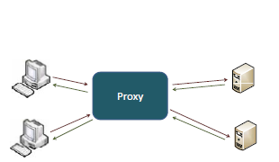
Proxy Servers
The basic idea behind a proxy server is that a client uses a proxy server to surf the web as in the figure below.

Slide 9
Remailers
Remailers enable users to send electronic messages through their server so that sender can not be traced. Remailers typically remove all identifying information from e-mails before forwarding them to their destination.
Known examples are Cypherpunk, Mixmaster.

Slide 10
Mix Network
The basic building block of these systems, is a set of mix processes where each mix process takes ciphertext messages that are encrypted with the mix process’s public key as inputs. Mix process groups messages together as a batch and forwards the encrypted messages to the next mix process at certain flush times along with dummy messages.

Slide 11
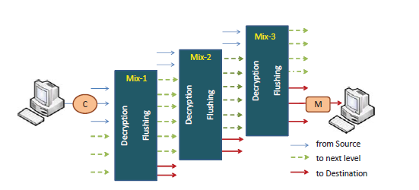

Slide 12
Onion Routing
The basic idea is very similar to the mix system but performance is improved by using symmetric keys for relaying messages and asymmetric keys to establish circuits in the system.

Slide 13
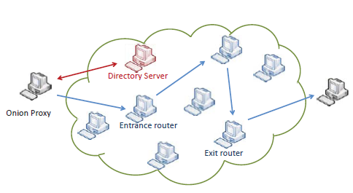

Slide 14
Tor
The Tor (The Onion Router) Project is one of the open-source solutions available to protect privacy and security over the network communication.

Slide 15
Originally developed by the US Naval Research Laboratory and formerly funded by the Electronic Frontier Foundation, Tor is designed to protect users from traffic analysis and other kinds of network surveillance.
Notes:
It works by relaying connections through a series of distributed network servers. When a Tor user visits a web site, the IP address detected and logged by that site will be the IP address of one of the Tor nodes rather than the actual user. This makes it possible for users to obscure their identity under certain circumstances.
How does traffic analysis work? Internet data packets have two parts: a data payload and a header used for routing. The data payload is whatever is being sent, whether that's an email message, a web page, or an audio file. Even if you encrypt the data payload of your communications, traffic analysis still reveals a great deal about what you're doing and, possibly, what you're saying. That's because it focuses on the header, which discloses source, destination, size, timing, and so on.
A basic problem for the privacy minded is that the recipient of your communications can see that you sent it by looking at headers. So can authorized intermediaries like Internet service providers, and sometimes unauthorized intermediaries as well. A very simple form of traffic analysis might involve sitting somewhere between sender and recipient on the network, looking at headers.
But there are also more powerful kinds of traffic analysis. Some attackers spy on multiple parts of the Internet and use sophisticated statistical techniques to track the communications patterns of many different organizations and individuals. Encryption does not help against these attackers, since it only hides the content of Internet traffic, not the headers.

Slide 16
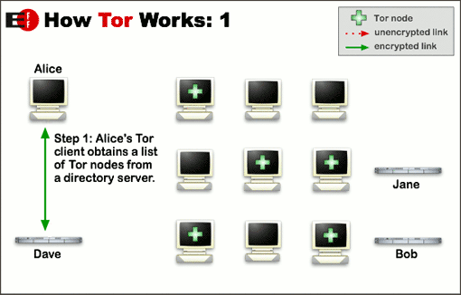
How Tor Works
Notes:
The idea is similar to using a twisty, hard-to-follow route in order to throw off somebody who is tailing you — and then periodically erasing your footprints. Instead of taking a direct route from source to destination, data packets on the Tor network take a random pathway through several relays that cover your tracks so no observer at any single point can tell where the data came from or where it's going.
To create a private network pathway with Tor, the user's software or client incrementally builds a circuit of encrypted connections through relays on the network. The circuit is extended one hop at a time, and each relay along the way knows only which relay gave it data and which relay it is giving data to. No individual relay ever knows the complete path that a data packet has taken. The client negotiates a separate set of encryption keys for each hop along the circuit to ensure that each hop can't trace these connections as they pass through.

Slide 17
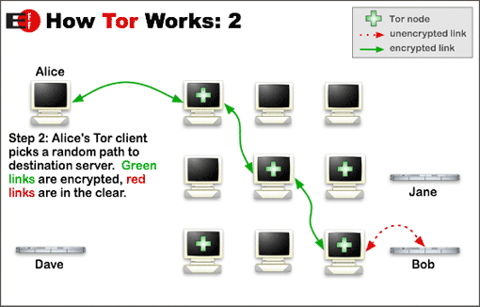
How Tor Works
Notes:
Once a circuit has been established, many kinds of data can be exchanged and several different sorts of software applications can be deployed over the Tor network. Because each relay sees no more than one hop in the circuit, neither an eavesdropper nor a compromised relay can use traffic analysis to link the connection's source and destination. Tor only works for TCP streams and can be used by any application with SOCKS support.

Slide 18
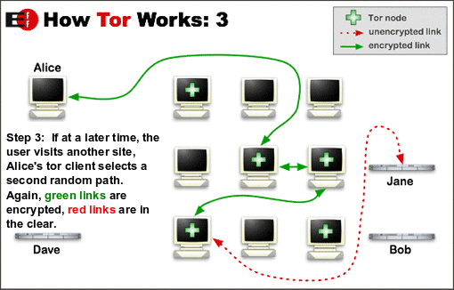
How Tor Works
Notes:
Tor efficiency, the Tor software uses the same circuit for connections that happen within the same ten minutes or so. Later requests are given a new circuit, to keep people from linking your earlier actions to the new ones.

Slide 19
Hidden Services
Tor also makes it possible for users to hide their locations while offering various kinds of services, such as web publishing or an instant messaging server. Using Tor "rendezvous points," other Tor users can connect to these hidden services, each without knowing the other's network identity

Slide 20
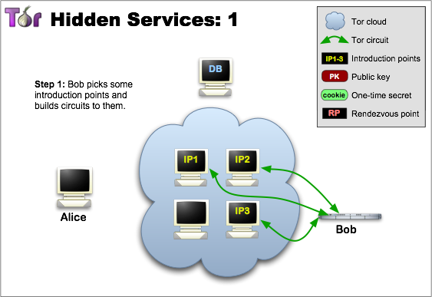

Slide 21
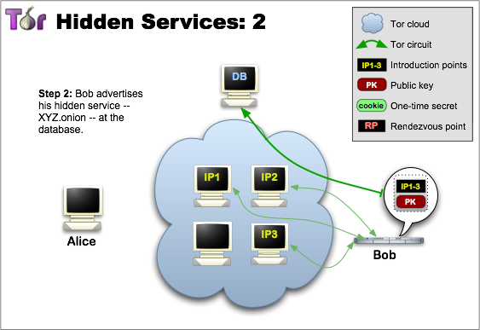

Slide 22
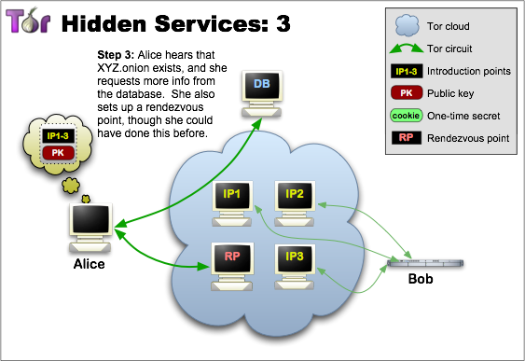

Slide 23
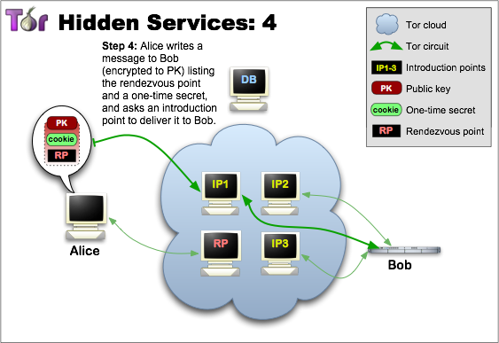

Slide 24
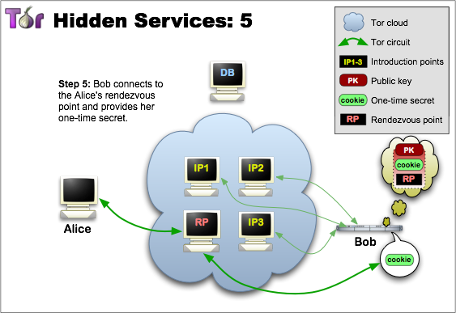

Slide 25
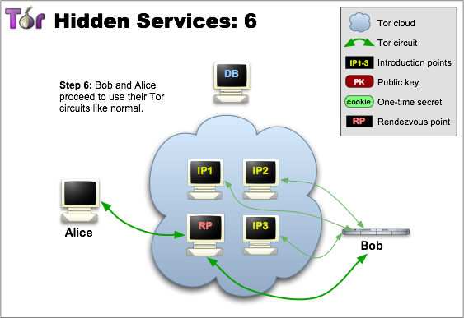

Slide 26
Keep in Mind!
TOR does not provide end-to-end encryption.
Any unencrypted traffic sent through TOR will only be protected until it exits the TOR network

Slide 27
I2P
I2P (Invisible Internet Project) is an anonymous network, exposing a simple layer that applications can use to anonymously and securely send messages to each other.
Notes:
The network itself is strictly message based (IP), but there is a library available to allow reliable streaming communication on top of it (TCP). All communication is end to end encrypted (in total there are four layers of encryption used when sending a message), and even the end points ("destinations") are cryptographic identifiers (essentially a pair of public keys).

Slide 28
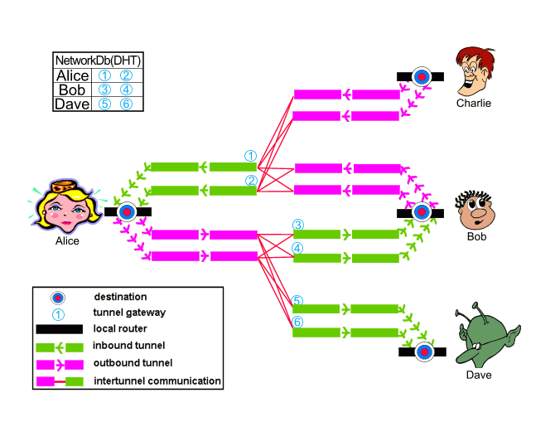
Notes:
In the above, Alice, Bob, Charlie, and Dave are all running routers with a single Destination on their local router. They each have a pair of 2-hop inbound tunnels per destination (labeled 1,2,3,4,5 and 6), and a small subset of each of those router's outbound tunnel pool is shown with 2-hop outbound tunnels. For simplicity, Charlie's inbound tunnels and Dave's outbound tunnels are not shown, nor are the rest of each router's outbound tunnel pool (typically stocked with a few tunnels at a time). When Alice and Bob talk to each other, Alice sends a message out one of her (pink) outbound tunnels targeting one of Bob's (green) inbound tunnels (tunnel 3 or 4). She knows to send to those tunnels on the correct router by querying the network database, which is constantly updated as new leases are authorized and old ones expire.
If Bob wants to reply to Alice, he simply goes through the same process - send a message out one of his outbound tunnels targeting one of Alice's inbound tunnels (tunnel 1 or 2). To make things easier, most messages sent between Alice and Bob are garlic wrapped, bundling the sender's own current lease information so that the recipient can reply immediately without having to look in the network database for the current data.

Slide 29
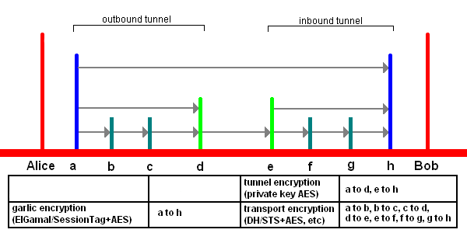
I2P works by routing traffic through other peers, as shown in the picture. All traffic is encrypted end-to-end.

Slide 30
Conclusion
Anonymity networks such as Tor & I2P can't solve all anonymity problems. It focuses only on protecting the transport of data.
Notes:
You need to use protocol-specific support software if you don't want the sites you visit to see your identifying information. For example, you can use web proxies such as Privoxy while web browsing to block cookies and withhold information about your browser type.

Slide 31
Also, to protect your anonymity, be smart. Don't provide your name or other revealing information in web forms.

Slide 32
Be aware that, like all anonymizing networks that are fast enough for web browsing, Tor does not provide protection against end-to-end timing attacks: If your attacker can watch the traffic coming out of your computer, and also the traffic arriving at your chosen destination, he can use statistical analysis to discover that they are part of the same circuit.

Slide 33
QUESTIONS ?

Slide 34
To gain higher protection of anonymity, a clever impostor can use various techniques to make identification more difficult. Examples of such techniques are:
IP numbers, trace lists and other identification can be falsified. Since this information is often created in servers, it is easier to falsify them if you have control of one or more servers.

Slide 35
Even though anonymity and pseudonymity is not something new with the Internet, the net has increased the ease for a person to distribute anonymous and pseudonymous messages. Anonymity on the Internet is almost never 100 %, there is always a possibility to find the perpetrator, especially if the same person uses the same way to gain anonymity multiple times.

Slide 36
Anon.penet.fri was a pseudonymity server started by Johan Helsingius in Finland in 1992. It was very popular by people in other countries, since they thought that relaying messages through an anonymity server in Finland would reduce the risk of their real identity being divulged. At its peak, it had 500 000 registered users and transferred 10 000 messages per day.

Slide 37
Notes:
Mikael Berglund made a study on how anonymity was used. His study was based on scanning all publicly available newsgroups in a Swedish Usenet News server, which downloaded almost everything written in Usenet News internationally in September 1995. He randomly selected a number of messages, which were pseudonymous and were shown as coming from anon.penet.fi (they may not always in reality have passed through anon.penet.fi), and classified the topic of these messages. His results were as follows:

