Slide 1
Anonymity Networks
CS 361S
Vitaly Shmatikov
slide <number>

Slide 2
Privacy on Public Networks
Internet is designed as a public network
  Machines on your LAN may see your traffic, network routers see all traffic that passes through them
Routing information is public
  IP packet headers identify source and destination
  Even a passive observer can easily figure out who is talking to whom
Encryption does not hide identities
  Encryption hides payload, but not routing information
  Even IP-level encryption (tunnel-mode IPsec/ESP) reveals IP addresses of IPsec gateways
slide <number>

Slide 3
Applications of Anonymity (1)
Privacy
  Hide Web browsing and other online behavior from intrusive governments, advertisers, archivists
Untraceable electronic mail
  Political dissidents
  Corporate whistle-blowers
  Socially sensitive communications (online AA meeting)
  Confidential business negotiations
Law enforcement and intelligence
  Sting operations and honeypots
  Secret communications on a public network
slide <number>

Slide 4
Applications of Anonymity (2)
Digital cash
  Electronic currency with properties of paper money (online purchases unlinkable to buyer’s identity)
Anonymous electronic voting
Censorship-resistant publishing
Crypto-anarchy
  “Some people say `anarchy won't work’. That's not an argument against anarchy; that's an argument against work.” – Bob Black
slide <number>

Slide 5
What is Anonymity?
Anonymity
  Observer can see who is using the system and which actions take place (email sent, website visited, etc.), but cannot link any specific action to a participant
  Hide your activities among others’ similar activities
    Anonymity is the state of being not identifiable within a
    set of subjects
  You cannot be anonymous by yourself!
    Big difference between anonymity and confidentiality
Unobservability
  Observer cannot even tell whether a certain action took place or not
slide <number>

Slide 6
Attacks on Anonymity
Passive traffic analysis
  Infer from network traffic who is talking to whom
  Consequence: to hide your traffic, must mix it with other people’s traffic
Active traffic analysis
  Inject packets or put a timing signature on packet flow
Compromise of network nodes (routers)
  It may not be obvious to a user which nodes have been compromised ⇒ better not to trust any individual node
    Assume that some fraction of nodes is good, don’t know which
slide <number>

Slide 7

Chaum’s Mix
Early proposal for anonymous email
  David Chaum. “Untraceable electronic mail, return addresses, and digital pseudonyms”. Communications of the ACM, February 1981.
Public key crypto + trusted re-mailer (Mix)
  Untrusted communication medium
  Public keys used as persistent pseudonyms
Modern anonymity systems use Mix as the basic building block
Before spam, people thought anonymous email was a good idea ☺
slide <number>

Slide 8


Basic Mix Design
B
{r₁,{r₀,M}_{pk(B)},B}_{pk(mix)}
{r₀,M}_{pk(B)},B
A
{r₅,M’’}_{pk(B)},B
C
E
{r₂,{r₃,M’}_{pk(E)},E}_{pk(mix)}
{r₃,M’}_{pk(E)},E
D
Mix
{r₄,{r₅,M’’}_{pk(B)},B}_{pk(mix)}
Adversary knows all senders and
all receivers, but cannot link a sent
message with a received message
slide <number>

Slide 9
Anonymous Return Addresses
M includes {K₁,A}_{pk(mix)}, K₂ where K₂ is a fresh public key
{r₁,{r₀,M}_{pk(B)},B}_{pk(mix)}
{r₀,M}_{pk(B)},B
B
MIX
A
A,{{r₂,M’}_{K2}}_{K1}
{K₁,A}_{pk(mix)}, {r₂,M’}_{K2}
Response MIX
Secrecy without authentication
(good for an online confession service ☺)
slide <number>

Slide 10


Mix Cascades and Mixnets
Messages are sent through a sequence of mixes
  Can also form an arbitrary network of mixes (“mixnet”)
Some of the mixes may be controlled by attacker, but even a single good mix ensures anonymity
Pad and buffer traffic to foil correlation attacks
slide <number>

Slide 11
Disadvantages of Basic Mixnets
Public-key encryption and decryption at each mix are computationally expensive
Basic mixnets have high latency
  Ok for email, but not for Web browsing
Challenge: low-latency anonymity network
  Use public-key cryptography to establish a “circuit” with pairwise symmetric keys between hops on the circuit
  Then use symmetric decryption and re-encryption to move data messages along the established circuits
  Each node behaves like a mix; anonymity is preserved even if some nodes are compromised
slide <number>

Slide 12

Onion Routing
[Reed, Syverson, Goldschlag 1997]
R
R
R₄
R
R₃
R
R₁
R
R₂
Alice
R
Bob
Sender chooses a random sequence of routers
  Some routers are honest, some controlled by attacker
  Sender controls the length of the path
slide <number>

Slide 13

Route Establishment
R₂
R₄
Alice
R₃
Bob
R₁
{M}_{pk(B)}
{B,k₄}_{pk(R4)},{ }_{k4}
{R₄,k₃}_{pk(R3)},{ }_{k3}
{R₃,k₂}_{pk(R2)},{ }_{k2}
{R₂,k₁}_{pk(R1)},{ }_{k1}
Routing info for each link encrypted with router’s public key
Each router learns only the identity of the next router
slide <number>

Slide 14

Tor
Second-generation onion routing network
  http://tor.eff.org
  Specifically designed for low-latency anonymous Internet communications (e.g., Web browsing)
  Running since October 2003
Hundreds of nodes on all continents
Over 2,500,000 users
“Easy-to-use” client
  Freely available, can use it for anonymous browsing
slide <number>

Slide 15
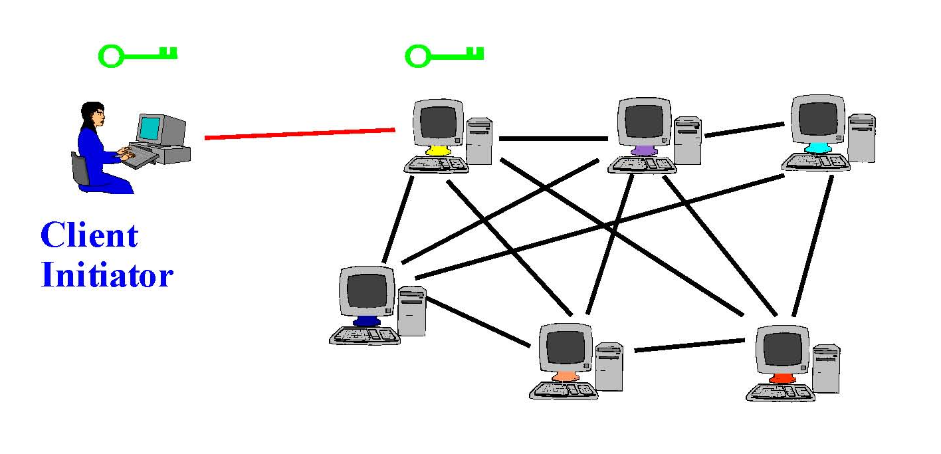
Tor Circuit Setup (1)
Client proxy establishes a symmetric session key and circuit with Onion Router #1
slide <number>

Slide 16
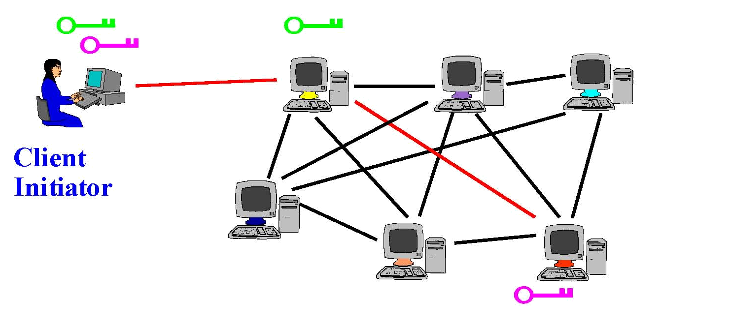
Tor Circuit Setup (2)
Client proxy extends the circuit by establishing a symmetric session key with Onion Router #2
  Tunnel through Onion Router #1
slide <number>

Slide 17
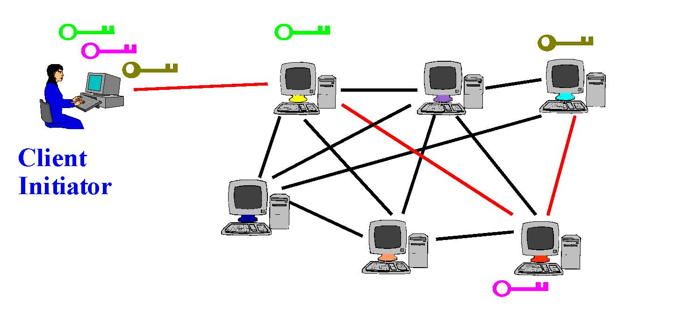
Tor Circuit Setup (3)
Client proxy extends the circuit by establishing a symmetric session key with Onion Router #3
  Tunnel through Onion Routers #1 and #2
slide <number>

Slide 18
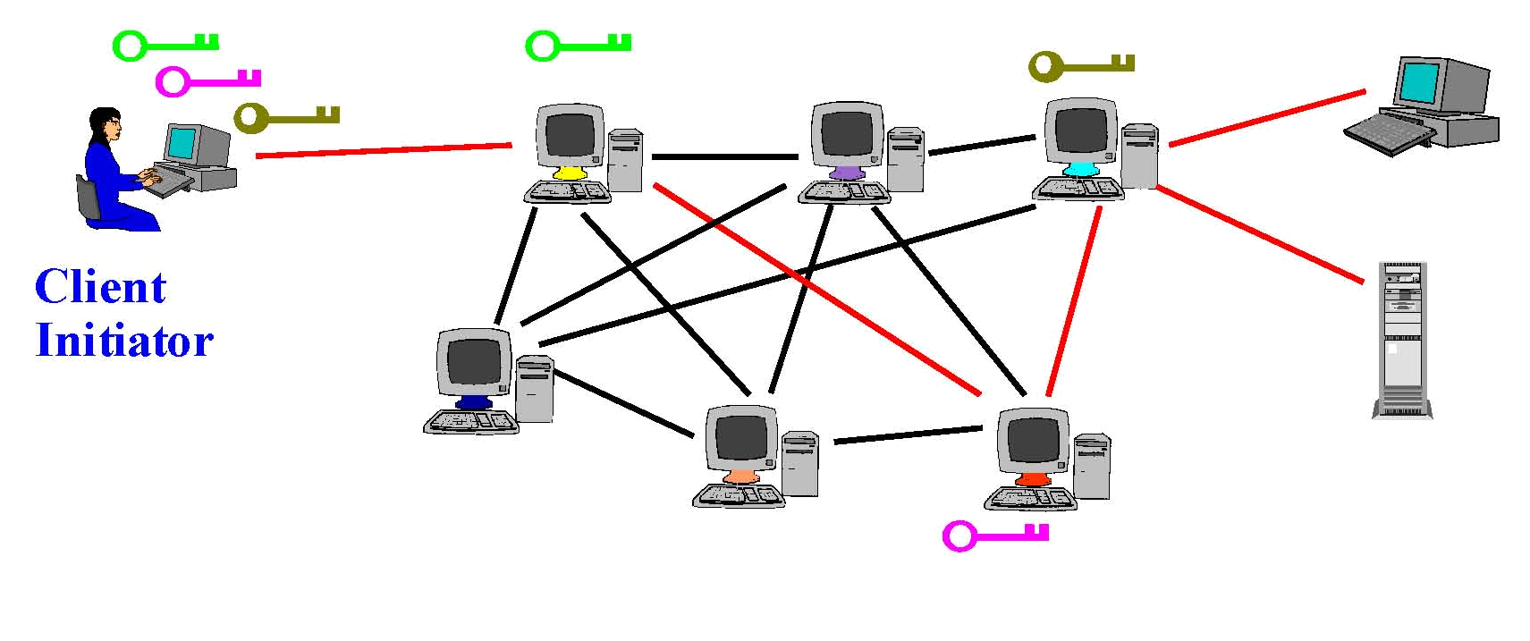
Using a Tor Circuit
Client applications connect and communicate over the established Tor circuit
  Datagrams are decrypted and re-encrypted at each link
slide <number>

Slide 19
Tor Management Issues
Many applications can share one circuit
  Multiple TCP streams over one anonymous connection
Tor router doesn’t need root privileges
  Encourages people to set up their own routers
  More participants = better anonymity for everyone
Directory servers
  Maintain lists of active onion routers, their locations, current public keys, etc.
  Control how new routers join the network
    “Sybil attack”: attacker creates a large number of routers
  Directory servers’ keys ship with Tor code
slide <number>

Slide 20
Location Hidden Services
Goal: deploy a server on the Internet that anyone can connect to without knowing where it is or who runs it
Accessible from anywhere
Resistant to censorship
Can survive a full-blown DoS attack
Resistant to physical attack
  Can’t find the physical server!
slide <number>

Slide 21
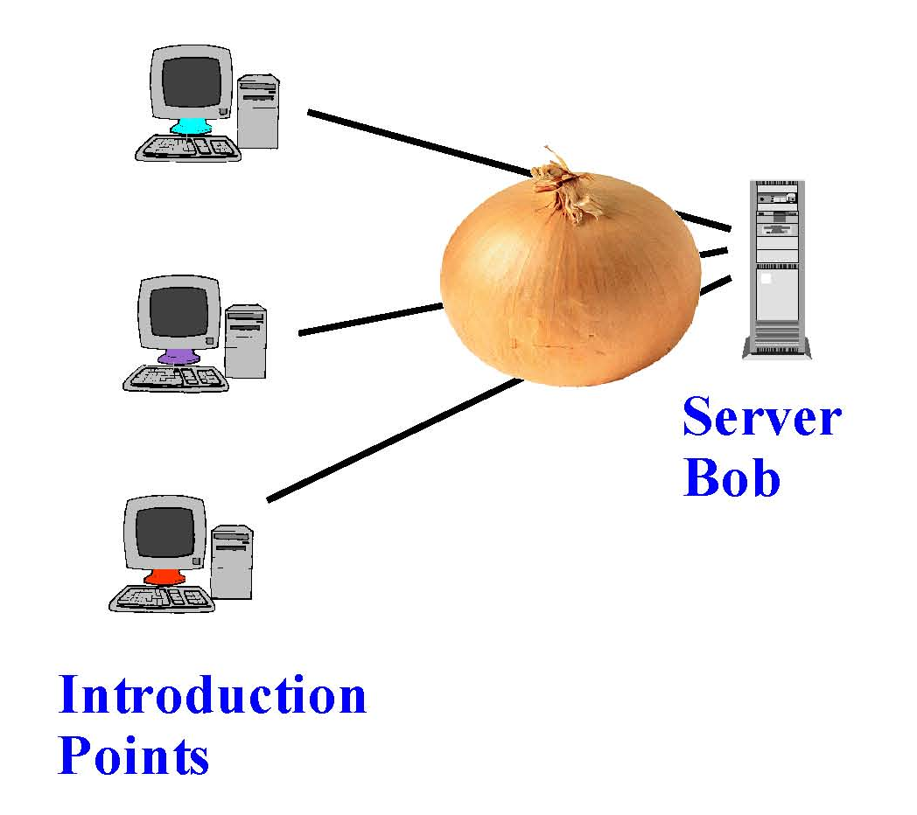
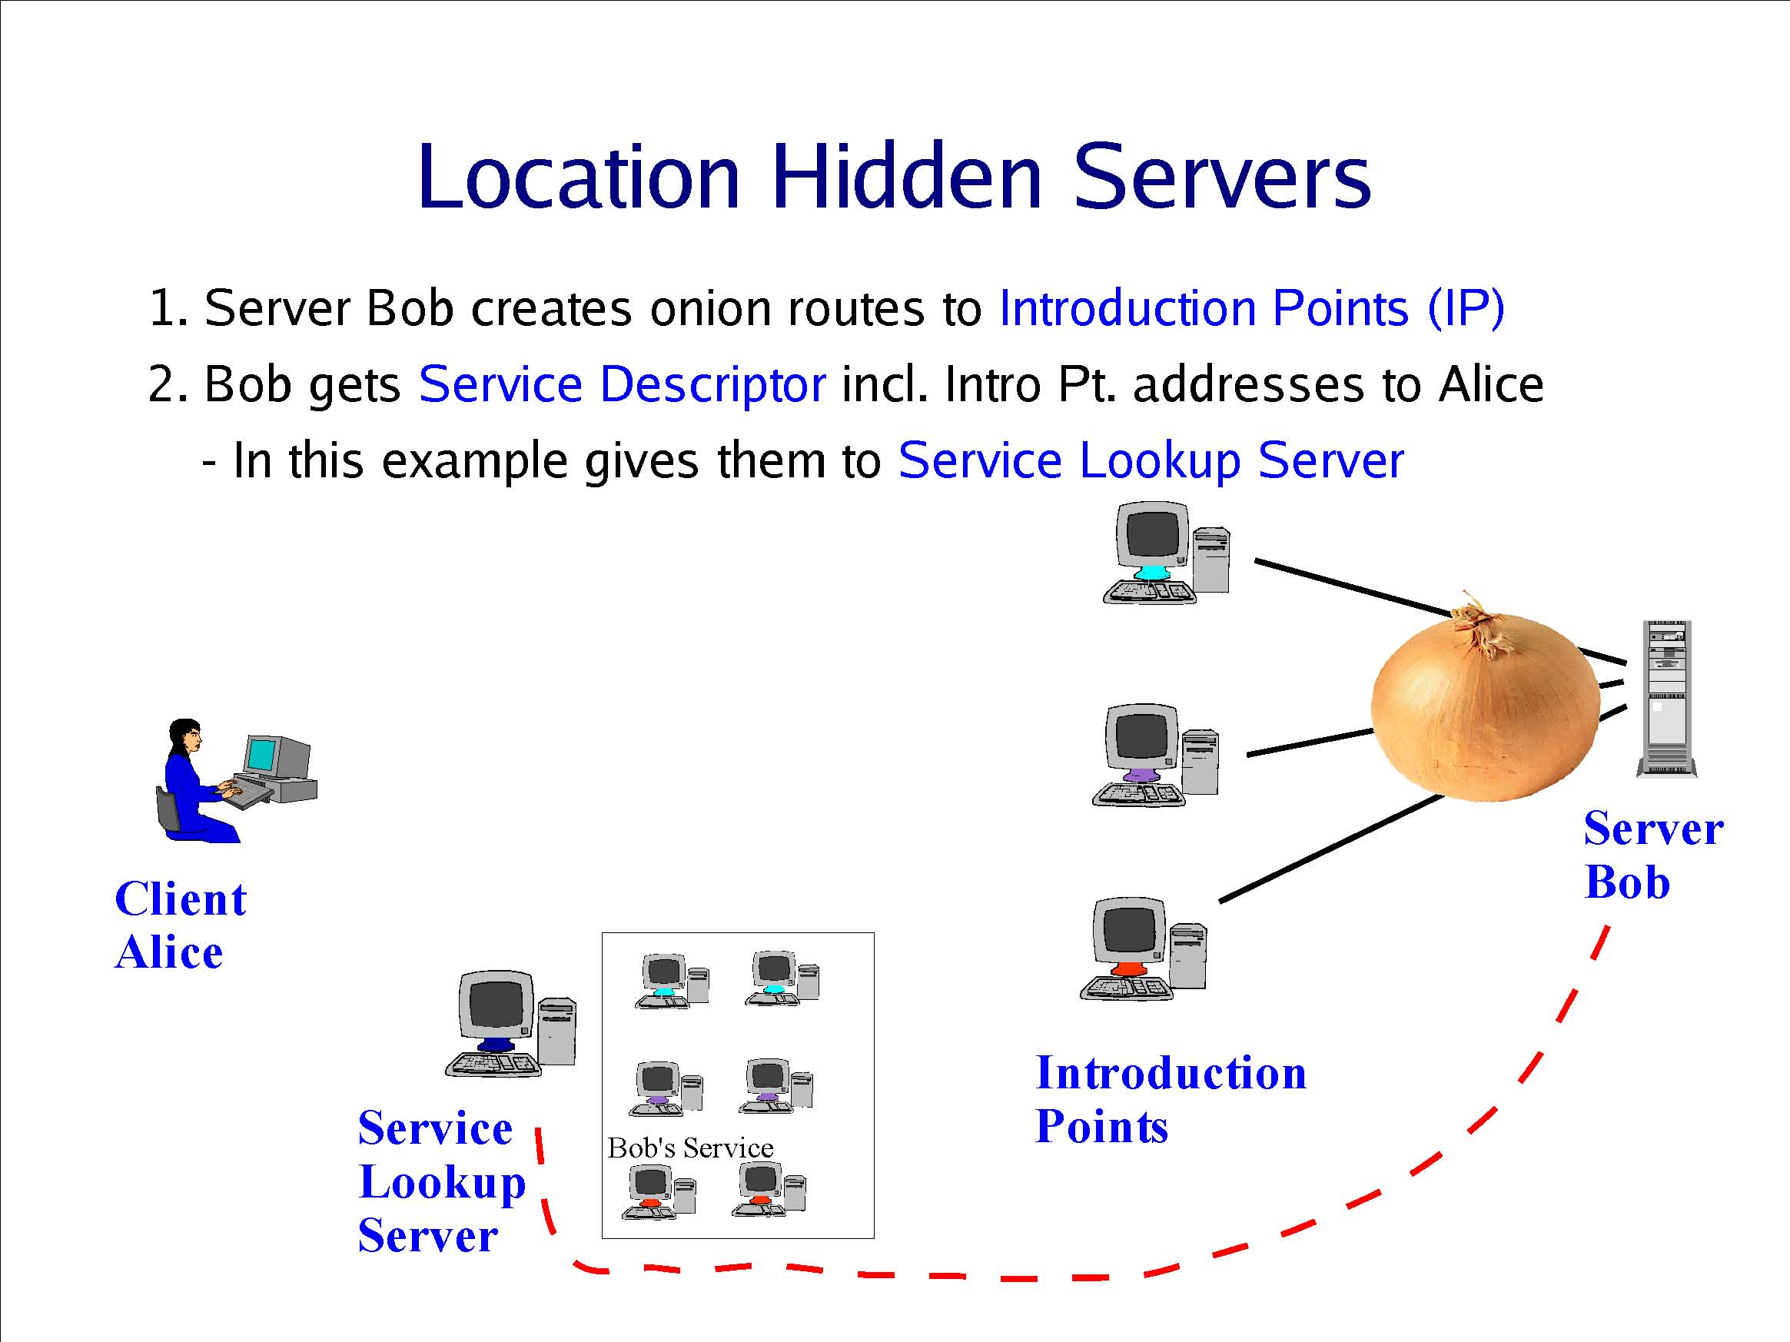
Creating a Location Hidden Server
Server creates circuits
to “introduction points”
Client obtains service
descriptor and intro point
address from directory
Server gives intro points’
descriptors and addresses
to service lookup directory
slide <number>

Slide 22
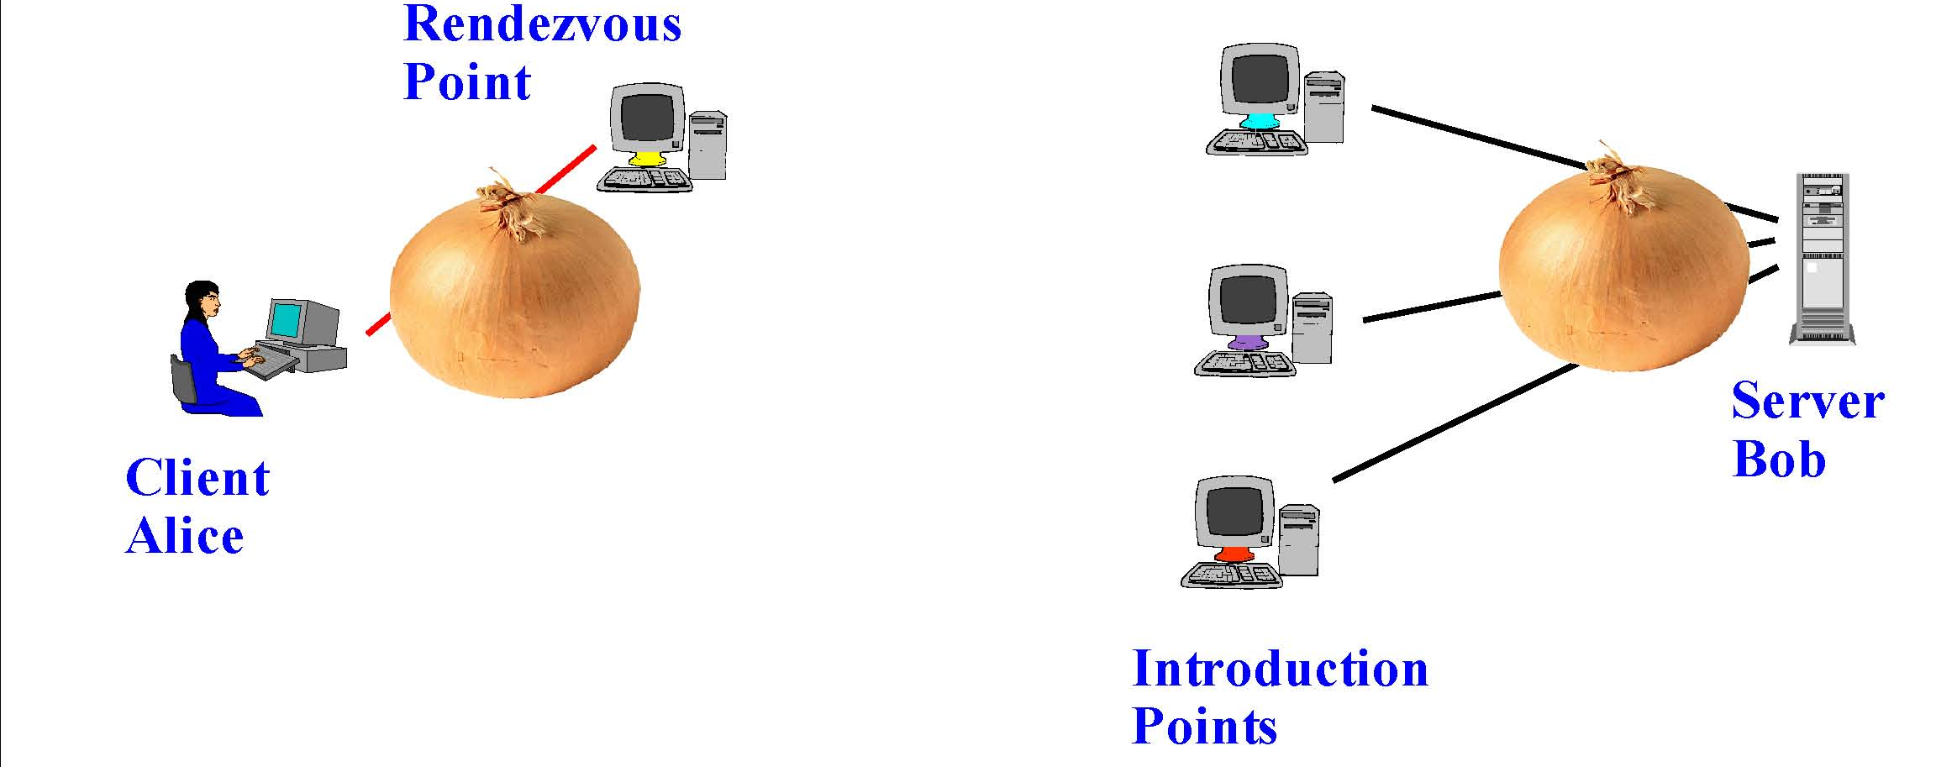
Using a Location Hidden Server
Client creates a circuit
to a “rendezvous point”
Rendezvous point
splices the circuits
from client & server
If server chooses to talk to client,
connect to rendezvous point
Client sends address of the
rendezvous point and any
authorization, if needed, to
server through intro point
slide <number>

Slide 23
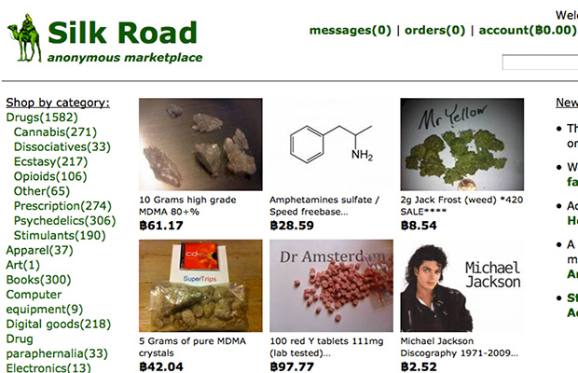
slide <number>

Slide 24


Silk Road Shutdown
Ross Ulbricht, alleged operator of the Silk Road Marketplace, arrested by the FBI on Oct 1, 2013
= ?
slide <number>

Slide 25
Silk Road Shutdown Theories
A package of fake IDs from Canada traced to an apartment to San Francisco?
A fake murder-for-hire arranged by DPR?
A Stack Overflow question accidentally posted by Ulbricht under his real name?
  “How can I connect to a Tor hidden service using curl in php?”
  … a few seconds later, changed username to “frosty”
  … oh, and the encryption key on the Silk Road server ends with the substring "frosty@frosty"
Probably not weaknesses in Tor
slide <number>

Slide 26
Dining Cryptographers
Clever idea how to make a message public in a perfectly untraceable manner
  David Chaum. “The dining cryptographers problem: unconditional sender and recipient untraceability.” Journal of Cryptology, 1988.
Guarantees information-theoretic anonymity for message senders
  This is an unusually strong form of security: defeats adversary who has unlimited computational power
Difficult to make practical
  In a group of size N, need N random bits to send 1 bit
slide <number>

Slide 27
Three-Person DC Protocol
Three cryptographers are having dinner.
Either NSA is paying for the dinner, or
one of them is paying, but wishes to remain anonymous.
Each diner flips a coin and shows it to his left neighbor
  Every diner will see two coins: his own and his right neighbor’s
Each diner announces whether the two coins are the same; if he is the payer, he lies (says the opposite)
Odd number of “same” ⇒ NSA is paying
Even number of “same” ⇒ one of them is paying
  But a non-payer cannot tell which of the other two is paying!
slide <number>

Slide 28


Non-Payer’s View: Same Coins
“same”
“different”
“same”
“different”
?
?
payer
payer
Without knowing the coin toss
between the other two, non-payer
cannot tell which of them is lying
slide <number>

Slide 29
Non-Payer’s View: Different Coins
“same”
“same”
“same”
“same”
?
?
payer
payer
Without knowing the coin toss
between the other two, non-payer
cannot tell which of them is lying
slide <number>

Slide 30
Superposed Sending
This idea generalizes to any group of size N
For each bit of the message, every user generates 1 random bit and sends it to 1 neighbor
  Every user learns 2 bits (his own and his neighbor’s)
Each user announces (own bit XOR neighbor’s bit)
Sender announces (own bit XOR neighbor’s bit XOR message bit)
XOR of all announcements = message bit
  Every randomly generated bit occurs in this sum twice (and is canceled by XOR), message bit occurs once
slide <number>

