Slide 1
Basic Computer Network
WeeSan Lee weesan@cs.ucr.edu

Slide 2
Bandwidth
Data rate measured in bits (not bytes) per seconds
Kbps (Kilobits per seconds)
  125 chars/sec
Mbps (Megabits per seconds)
  1,250 chars/sec
Gbps (Gigabits per seconds)
  12,500 chars/sec

Slide 3
Connecting to the Internet
Requirement
  A computer or PDA or cell phone
  An account with an ISP (Internet Service Provider)
  A modem (modulator/demodulator) for dial-up services or a NIC (Network Interface Card) for DSL/Cable services

Slide 4


Home Network (single machine)
Wall Jack
DSL/Cable Modem
USB/Ethernet Cable

Slide 5
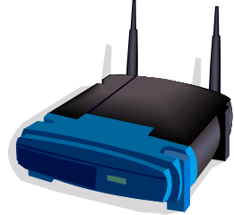
Home Network (multiple machines)
Wall Jack
DSL/Cable Modem
Hub/Switch/Router
USB/Ethernet Cable

Slide 6
Home Network (multiple machines)
Wall Jack
Ethernet Cable
DSL/Cable Modem
Hub/Switch/Router

Slide 7

Home Wireless Network
Wall Jack
Ethernet Cable
DSL/Cable Modem
Hub/Switch/Router

Slide 8
Connection Types
LAN
WLAN
Dial-up Services
Broadband Services
WAN

Slide 9
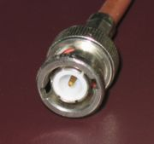
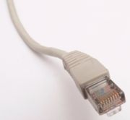
LAN (Local Area Network)
A network of computers that are in the same physical location, such as home or building
Usually connected using Ethernet
  A standard on how computers communicate over a shared media (cable)
Old: BNC connector for coaxial cable
New: RJ45 for twisted pair cable
http://en.wikipedia.org/wiki/Image:BNC_connector.jpg
http://en.wikipedia.org/wiki/Image:Ethernet_RJ45_connector_p1160054.jpg

Slide 10
LAN (Local Area Network)
Ethernet Standard
  10BaseT
    10Mbps (Mega bits per second)
  100BaseT
    100Mbps
  1000BaseT
    1000Mbps or 1Gbps
Correction from the book (pg. 10)
  Why do we get faster connection at work or on campus than at home?

Slide 11
LAN (Local Area Network)
Question: Can 2 computers communicate by connecting each other using an Ethernet cable back-to-back?

Slide 12
WLAN (Wireless LAN)
Wi-Fi (Wireless Fidelity)
  A wireless technology that connects computers without cables
Access Point (AP)
  A device (base station) that connects wireless devices together
  Usually connected to a wired-network
ESSID (Extended Service Set ID)
  A “name” for the AP, eg. mobilenet
Hotspot
  The area covered by wireless access points

Slide 13
WLAN (Wireless LAN)
Standard
  802.11b - 11Mbps
  802.11g - 54Mbps
  802.11a - 54Mbps
Security
  WEP (Wired Equivalen Privacy)
  WPA (Wi-Fi Protected Access)
  To prevent wardriving
2.4G
5G

Slide 14
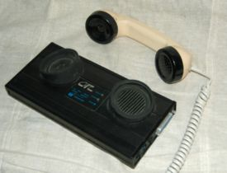
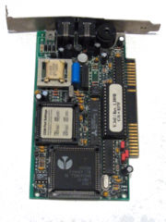
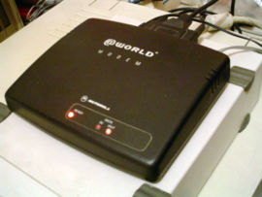
Dial-up Services
Modem
  Modulator/demodulator
  A device that converts analog signal to digital (modulation) and vice versa (demodulation)
  Speed
    1200/2400/9600 bps
    14.4/28.8/33.6 Kbps
    56 Kbps

Slide 15
Dial-up Services
ISDN
  Integrated Services Digital Network
  2 data channel (56K each)
  1 voice channel

Slide 16
Broadband Services
xDSL (Digital Subscriber Line)
  A technology that provides digital data transmission over unused frequencies on traditional telephone lines
  For example, ADSL (Asymmetric DSL): DL > UL
  Speed
    Downlink
      128Kbps - 4Mbps
    Uplink
      64Kbps - 800Kbps
  Need a DSL modem
  Splitters are needed to separate the voice and data signal

Slide 17
Broadband Services
Cable
  A technology that provides digital data transmission over cable TV infrastructure
  Speed
    Downlink
      128Kbps - 3~5Mbps
    Uplink
      64Kbps - 128Kbps~1Mbps
  Need a cable modem

Slide 18
Broadband Services
Satellite
  A technology that provide digital data transmission over satellites
  Speed
    Downlink
      500Kbps - 1Mbps
    Uplink
      50Kbps - 100Kbps
  Need a satellite dish

Slide 19
WAN (Wide Area Network)
A LAN spans a large geographic area, such as connections between cities
Usually connected using leased line
  T1 (1.5Mbps)
  T3 (45Mbps)
  OC3 (155Mbps)
  OC12 (622Mbps)
  OC48 (2.4Gbps)
Telecommunication lines
Fiber optic lines

Slide 20
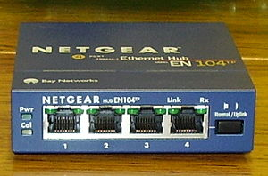

Hub/Switch/Router
To connect multiple segments of networks into a larger one
Hub
  A multiport repeater to enhance signal within the same LAN
Switch
  Like hub but with intelligent
  Better performance
Router
  Forward packets from one LAN to another

Slide 21
Intranet vs. Internet
Intranet
  A private network that is contained within an enterprise
  Could be LANs and WANs
Internet
  A public network of networks
Both are using TCP/IP

Slide 22
TCP/IP
A family of protocols that makes the Internet works
The Robustness Principle
  “Be liberal in what you accept, and conservative in what you send” - Jon Postel

Slide 23
TCP/IP (cont)
Application Layer Eg. WWW, FTP, IRC, Email, telnet, …
Transport Layer Eg. TCP, UDP
Network Layer Eg. IP
Link Layer Eg. Ethernet, WiFi
Physical Layer Eg. Ethernet Cable, fiber-optics
Data
Segments
Packets
Frames
Bits

Slide 24


Packets
A small chunk of data transmitted over the Internet
Alice
Bob
The Internet

Slide 25
VPN (Virtual Private Network)
A secure tunnel to a private network through a public network
Once established, local node appears to be a node in the private network in a secure manner
Correction from the book (pg. 11):
  VPN does not mean using telephone line connection!!!

Slide 26

Host & IP Address
Correction from the book:
  “A host is a computer connected directly to the Internet”
  “You home computer is not a host”
Each host needs an IP address
IP address
  A 32-bit number, arranged in 4 numbers seperated by “.”
  Eg. 74.125.19.147

Slide 27
DNS (Domain Name System)
Domain name to IP address conversion
  Eg. www.google.com → ??.???.??.??
Domain name or IP address lookup
  http://cqcounter.com/whois/

Slide 28
Top-level Domains
gTLDs (generic TLDs)
  .com, .edu, .net, .org, .gov, .mil
  .aero, .biz, .coop, .info, .museum, .name, .pro
ccTLDs (country code TLDs)
  .au, .ca, .br, .de, .fi, .fr, .jp, .hk, .cn, .tw, .my, …
  .us

Slide 29
Second-level Domains
Domains that are directly below a TLD
Eg.
  ucr.edu
  google.com
  sony.co.jp
Must apply to a registrar for the appropriate TLD

Slide 30
Domain Names & Registrars
Profitable domain names
  CreditCards.com - $2.75M
  Loans.com – $3M
  Business.com - $7.5M
Network Solutions, Inc used to monopolize the name registration
Now, ~500 registrars

Slide 31
How To Register A Domain Name?
Come up a new name
2 name servers’ IP addresses
1 administrative contact
1 technical contact
Register the name to an Internet domain registrar
  Eg. www.netsol.com, www.godaddy.com
Used to be done via email or fax, now all web-based!

Slide 32
Policies
AUP (Acceptable Use Policies)
  A legal document, written to protect the ISP from unlawful use of its service, and outlines prohibited uses of the service and possible consequences of misuse
Privacy Policies
  A document describes an ISP’s policy for protecting users’ information

Slide 33
Conclusion
Described how to get connected to the Internet
Talked about the related network technologies and components

Slide 34
References
Internet Effectively (Ch 1-2)
Modem
  http://en.wikipedia.org/wiki/Modem
DSL
  http://en.wikipedia.org/wiki/Digital_subscriber_line
How DSL works?
  http://electronics.howstuffworks.com/dsl.htm
VPN
  http://en.wikipedia.org/wiki/Vpn

Slide 35
References (cont)
RFC1122: Requirements for Internet Hosts
  ftp://ftp.rfc-editor.org/in-notes/rfc1122.txt
Domain Names
  http://www.icann.org/topics/new-gtld-strategy-faq.htm
  http://www.iana.org/root-whois/index.html

Slide 36
Homework 2
Read “Stealing your neighbor's Net”
  http://money.cnn.com/2005/08/08/technology/personaltech/internet_piracy/index.htm
Read “Is stealing wireless wrong?”
  http://news.bbc.co.uk/2/hi/uk_news/magazine/6960304.stm
Post your own comment in 100-150 words to “Homework 2 Forum” by next Mon (10/8) @ 23:55pm
Reply one of the comments from others by next Tue (10/9) @ 23:55pm.

