Slide 1
Introduction

Slide 2
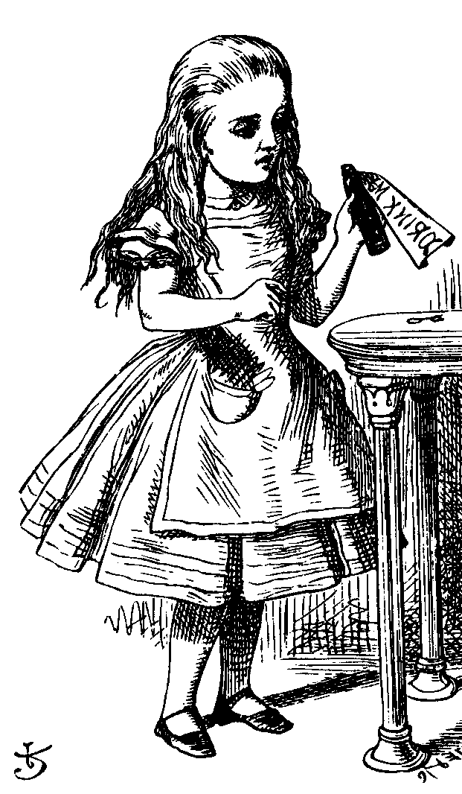
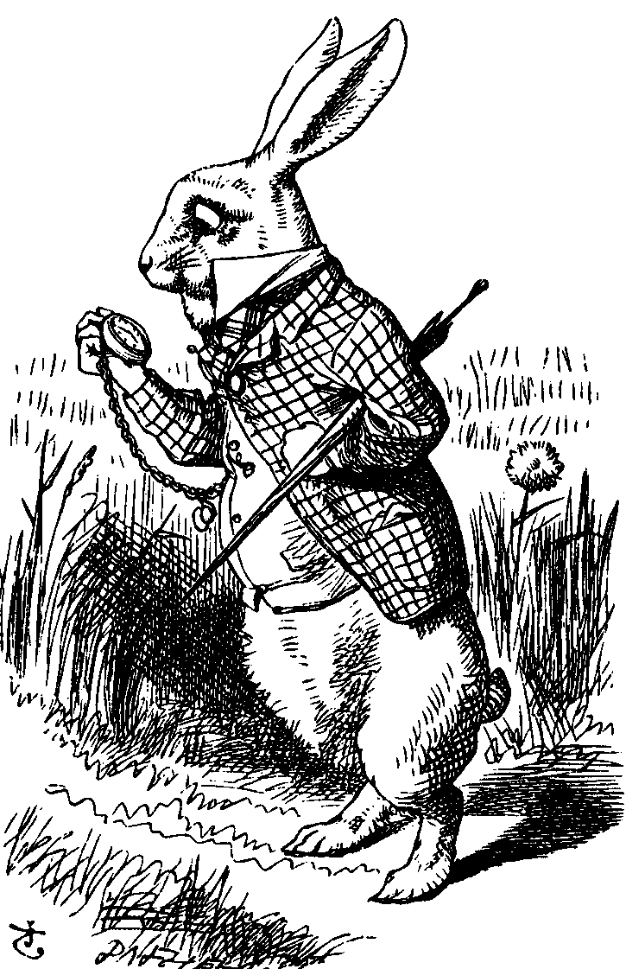
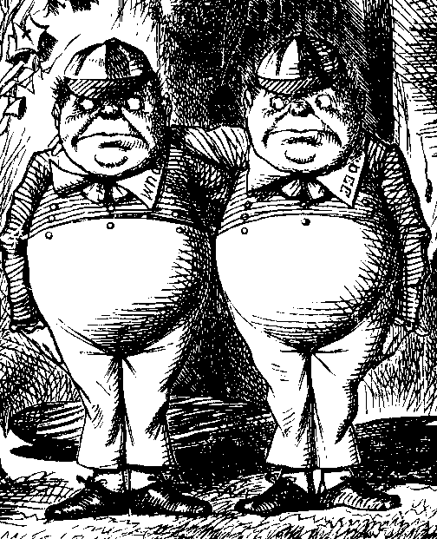
Good Guys and Bad Guys
Alice and Bob are the good guys
Trudy is the bad guy
Trudy is our generic “intruder”

Slide 3
Good Guys and Bad Guys
Alice and Bob want to communicate securely
  Typically, over a network
Alice or Bob might also want to store their data securely
Trudy wants to read Alice and Bob’s secrets
Or Trudy might have other devious plans…
  Cause confusion, denial of service, etc.

Slide 4
CIA
Confidentiality, Integrity and Availability
Confidentiality: prevent unauthorized reading of information
Integrity: prevent unauthorized writing of information
Availability: data is available in a timely manner when needed
  Availability is a “new” security concern
  Due to denial of service (DoS) threats

Slide 5
Crypto
Cryptology ⎯ The art and science of making and breaking “secret codes”
Cryptography ⎯ making “secret codes”
Cryptanalysis ⎯ breaking “secret codes”
Crypto ⎯ all of the above (and more)

Slide 6
How to Speak Crypto
A cipher or cryptosystem is used to encrypt the plaintext
The result of encryption is ciphertext
We decrypt ciphertext to recover plaintext
A key is used to configure a cryptosystem
A symmetric key cryptosystem uses the same key to encrypt as to decrypt
A public key cryptosystem uses a public key to encrypt and a private key to decrypt
  Private key can be used to sign and public key used to verify signature (more on this later…)

Slide 7
Crypto
Underlying assumption
  The system is completely known to Trudy
  Only the key is secret
Also known as Kerckhoffs Principle
  Crypto algorithms are not secret
Why do we make this assumption?
  Experience has shown that secret algorithms are often weak when exposed
  Secret algorithms never remain secret
  Better to find weaknesses beforehand

Slide 8
Crypto as a Black Box
key
key
P_{i}
C_{i}
P_{i}
plaintext
encrypt
decrypt
plaintext
ciphertext
Note P_{i} is i^{th} “unit” of plaintext
And C_{i} is corresponding ciphertext
“Unit” may be bit, letter, block of bits, etc.

Slide 9
Who Knows What?
Alice
key
Trudy
key
Bob
P_{i}
C_{i}
P_{i}
plaintext
encrypt
decrypt
plaintext
ciphertext
Trudy knows the ciphertext
Trudy knows the cipher and how it works
Trudy might know a little more
Trudy does not know the key

Slide 10
Taxonomy of Cryptography
Symmetric Key
  Same key for encryption as for decryption
  Stream ciphers and block ciphers
Public Key
  Two keys, one for encryption (public), and one for decryption (private)
  Digital signatures ⎯ nothing comparable in symmetric key crypto
Hash algorithms

Slide 11
Cryptanalysis
This course focused on cryptanalysis
Trudy wants to recover key or plaintext
Trudy is not bound by any rules
  For example, Trudy might attack the implementation, not the algorithm itself
  She might use “side channel” info, etc.

Slide 12
Exhaustive Key Search
How can Trudy attack a cipher?
She can simply try all possible keys and test each to see if it is correct
  Exhaustive key search
To prevent an exhaustive key search, a cryptosystem must have a large keyspace
  Must be too many keys for Trudy to try them all in any reasonable amount of time

Slide 13
Beyond Exhaustive Search
A large keyspace is necessary for security
But a large keyspace is not sufficient
Shortcut attacks might exist
We’ll see many examples of shortcut attacks
In cryptography we can (almost) never prove that no shortcut attack exists
This makes cryptography interesting…

Slide 14
Taxonomy of Cryptanalysis
Ciphertext only — always an option
Known plaintext — possible in many cases
Chosen plaintext
  “Lunchtime attack”
  Protocols might encrypt chosen text
Adaptively chosen plaintext
Related key
Forward search (public key crypto only)
“Rubber hose”, bribery, etc., etc., etc.

Slide 15
Definition of Secure
A cryptosystem is secure if the best know attack is to try all possible keys
Cryptosystem is insecure if any shortcut attack is known
By this definition, an insecure system might be harder to break than a secure system!

Slide 16
Definition of Secure
Why do we define secure this way?
The size of the keyspace is the “advertised” level of security
If an attack requires less work, then false advertising
A cipher must be secure (by our definition) and have a “large” keyspace
  Too big for an exhaustive key search

Slide 17
Theoretical Cryptanalysis
Spse that a cipher has a 100 bit key
  Then keyspace is of size 2¹⁰⁰
On average, for exhaustive search Trudy tests 2¹⁰⁰/2 = 2⁹⁹ keys
Spse Trudy can test 2³⁰ keys/second
  Then she can find the key in about 37.4 trillion years

Slide 18
Theoretical Cryptanalysis
Spse that a cipher has a 100 bit key
  Then keyspace is of size 2¹⁰⁰
Spse there is a shortcut attack with “work” equal to testing about 2⁸⁰ keys
If Trudy can test 2³⁰ per second
  Then she finds key in 36 million years
  Better than 37 trillion, but not practical

Slide 19
Applied Cryptanalysis
In this class, we focus on attacks that produce plaintext
  Not interested in attacks that just show a theoretical weakness in a cipher
We call this applied cryptanalysis
Why applied cryptanalysis?
  Because it’s a lot more fun…
  And it’s a good place to start

Slide 20
Applied Cryptanalysis: Overview
Classic (pen and paper) ciphers
  Transposition, substitution, etc.
  Same principles appear in later sections
World War II ciphers
  Enigma, Purple, Sigaba
Stream ciphers
  Shift registers, correlation attack, ORYX, RC4, PKZIP

Slide 21
Applied Cryptanalysis: Overview
Block ciphers
  Hellman’s TMTO, CMEA, Akelarre, FEAL
Hash functions
  Nostradamus attack, MD4, MD5
Public key crypto
  Knapsack, Diffie-Hellman, Arithmetica, RSA, Rabin, NTRU, ElGamal
  Factoring, discrete log, timing, glitching

Slide 22
Why Study Cryptography?
Information security is a big topic
  Crypto, Access control, Protocols, Software
  Real world info security problems abound
Cryptography is the part of information security that works best
Using crypto correctly is important
The more we make other parts of security behave like crypto, the better

Slide 23
Why Study Cryptanalysis?
Study of cryptanalysis gives insight into all aspects of crypto
Gain insight into attacker’s mindset
  “black hat” vs “white hat” mentality
Cryptanalysis is more fun than cryptography
  Cryptographers are boring
  Cryptanalysts are cool
But cryptanalysis is hard

