Slide 1
Chapter 3
Block Ciphers and the Advanced Encryption Standard

Slide 2
Outline
3.1 Introduction
3.2 Substitution-Permutation Networks
3.3 Linear cryptanalysis
3.4 Differential cryptanalysis
3.5 The Data Encryption Standard
3.6 The Advanced Encryption Standard
3.7 Modes of Operation

Slide 3
3.1 Introduction
A commonly used design for modern-day block ciphers is that of an iterated cipher:
  The cipher requires the specification of a round function and a key schedule, and the encryption of a plaintext will proceed through Nr similar rounds.
    random key K: used to construct Nr round keys (also called subkeys), which are denoted K¹,…,K^{Nr}.
    key schedule (K¹,…,K^{Nr}): constructed from K using a fixed, public algorithm.
    round function g: takes two inputs: a round key (K^{r}) and a current state (w^{r-1}). w^{r}=g(w^{r-1},K^{r}) is the next state.
    plaintext x: the initial state w⁰.
    Ciphertext y: the state after all Nr rounds done.

Slide 4
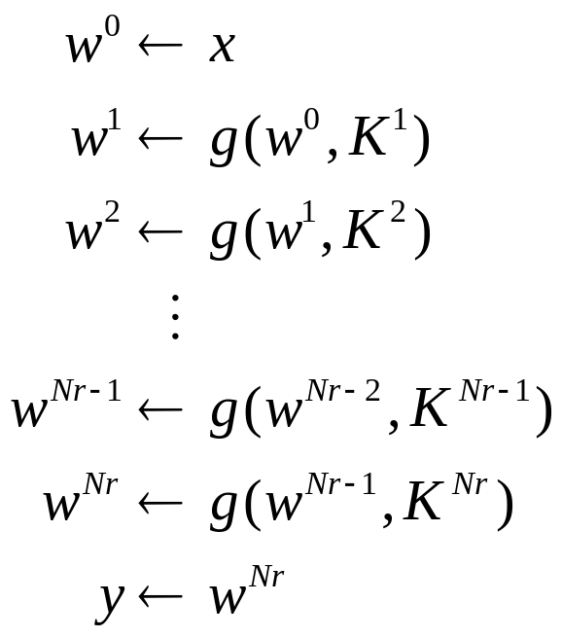
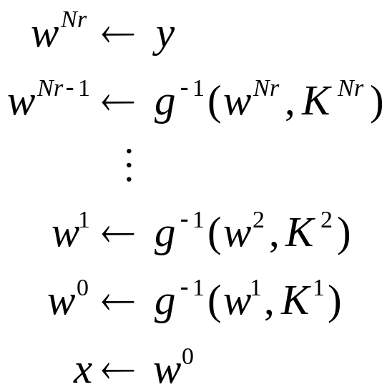
Introduction
Encryption operations: Decryption operations:
Note: function g is injective (one-to-one)

Slide 5

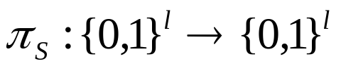




3.2 Substitution-Permutation Networks (SPN)
Cryptosystem 3.1: SPN
  and Nr are positive integers
  is a permutation
  is a permutation.
  , and consist of all possible key schedules that could be derived from an initial key K using the key scheduling algorithm.
  For a key schedule , we encrypt the plaintext x using Algorithm 3.1.

Slide 6
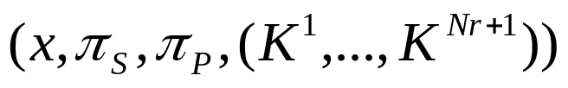
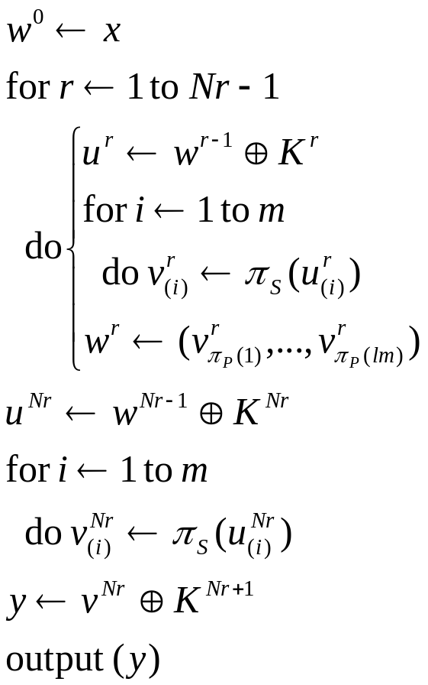

Substitution-Permutation Networks
Algorithm 3.1: SPN
u^{r} is the input to the S-boxes in round r.
v^{r} is the output of the S-boxes in round r.
w^{r} is obtained from v^{r} by applying .
u^{r+1} is constructed from w^{r} by xor-ing with the round key K^{r+1} (called round key mixing).
The very first and last operations are xors with subkeys (called whitening).

Slide 7


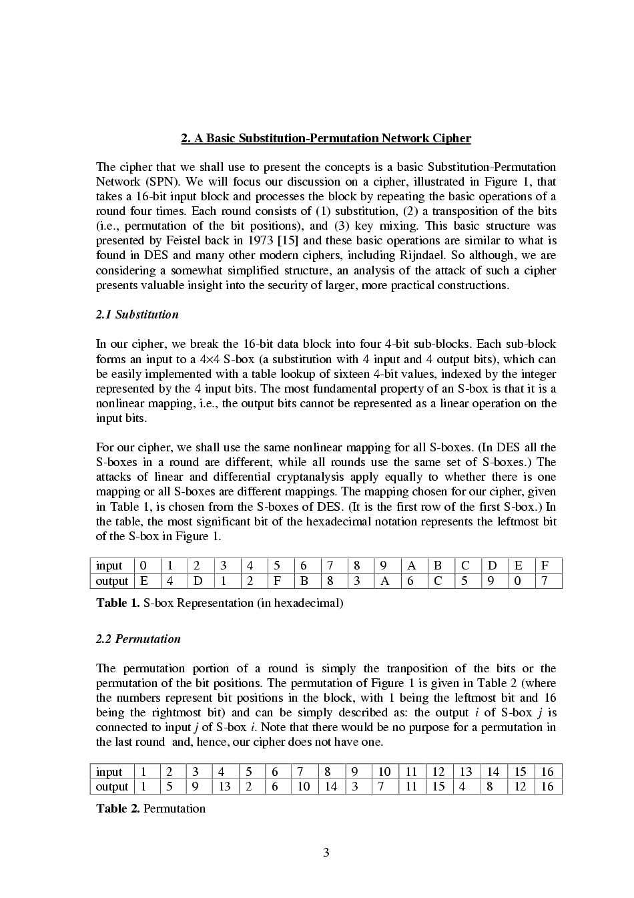

Substitution-Permutation Networks
Example 3.1:
  Suppose . Let be defined as follows, where the input and the output are written in hexadecimal:
  Let be defined as follows:
  See Figure 3.1 for a pictorial representation of this particular SPN, where S_{ir} means i-th round, r-th S-box.

Slide 8
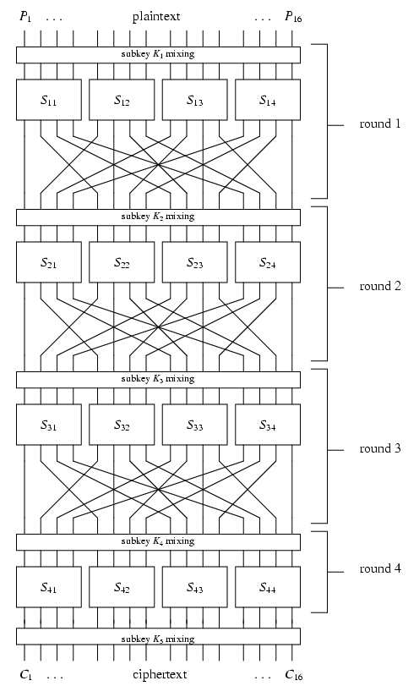
x
u¹
v¹
w¹
u²
v²
w²
u³
v³
w³
Figure 3.1: A substitution-permutation network
u⁴
v⁴
y

Slide 9


Substitution-Permutation Networks
  Key schedule: suppose we begin with a 32-bit key . For , define K^{r} to consist of 16 consecutive bits of K, beginning with k_{4r-3}.
  K= 0011 1010 1001 0100 1101 0110 0011 1111
  Round keys:
K¹= 0011 1010 1001 0100
K²= 1010 1001 0100 1101
K³= 1001 0100 1101 0110
K⁴= 0100 1101 0110 0011
K⁵= 1101 0110 0011 1111

Slide 10
Substitution-Permutation Networks
  Suppose the plaintext is x= 0010 0110 1011 0111.
  Then the encryption of x proceeds as follows:
w⁰= 0010 0110 1011 0111
K¹= 0011 1010 1001 0100
u¹= 0001 1100 0010 0011
v¹= 0100 0101 1101 0001
w¹= 0010 1110 0000 0111
K²= 1010 1001 0100 1101
u²= 1000 0111 0100 1010
v²= 0011 1000 0010 0110
w²= 0100 0001 1011 1000

Slide 11
Substitution-Permutation Networks
K³= 1001 0100 1101 0110
u³= 1101 0101 0110 1110
v³= 1001 1111 1011 0000
w³= 1110 0100 0110 1110
K⁴= 0100 1101 0110 0011
u⁴= 1010 1001 0000 1101
v⁴= 0110 1010 1110 1001
K⁵= 1101 0110 0011 1111, and
y= 1011 1100 1101 0110
is the ciphertext.

Slide 12
3.3 Linear Cryptanalysis
We want to find a probability linear relationship between a subset of plaintext bits and a subset of data bits preceding the last round. This relation behaves in a non-random fashion.
The attacker has a lot of plaintext-ciphertext pairs (known plaintext attack).
For each candidate subkey, we partially decrypt the cipher and check if the relation holds. If the relation holds then increment its corresponding counter. At the end, the candidate key that counts furthest from ½ is the most likely subkey.

Slide 13
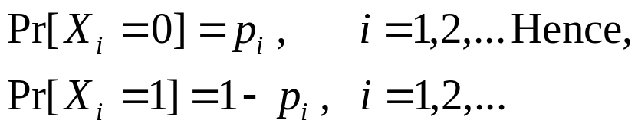
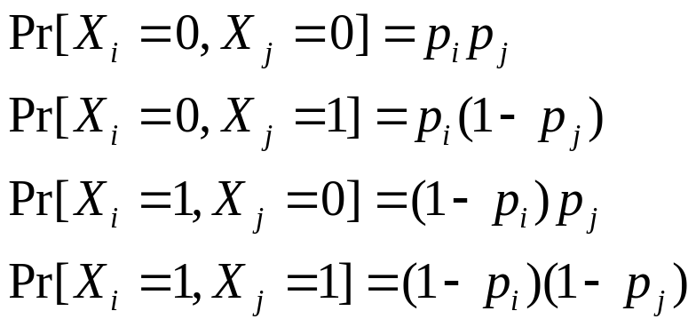
Linear Cryptanalysis
3.3.1 The Piling-up Lemma
  Suppose X₁, X₂,… are independent random variables from {0,1}. And
  The independence of X_{i}, X_{j} implies

Slide 14

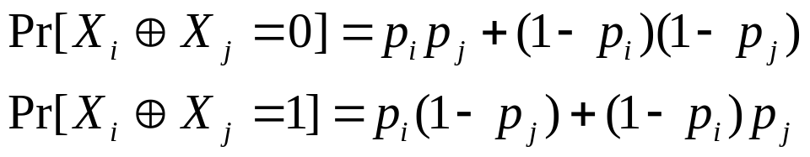
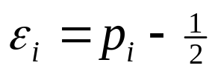
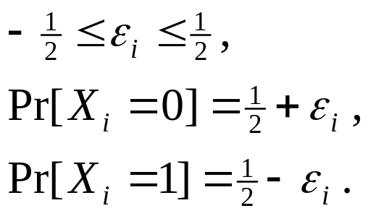
Linear Cryptanalysis
Now consider .
The bias of X_{i} is defined to be the quantity
And we have

Slide 15
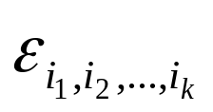

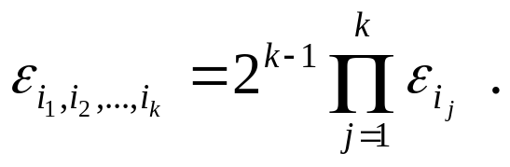
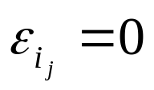
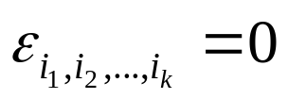
Linear Cryptanalysis
Let denote the bias of .
Lemma 3.1 (Piling-up lemma) : Let denote the bias of the random variable . Then
Corollary 3.2: Let denote the bias of the random variable . Suppose that for some j. Then .

Slide 16
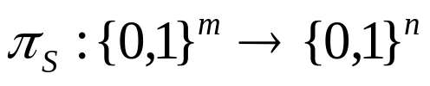
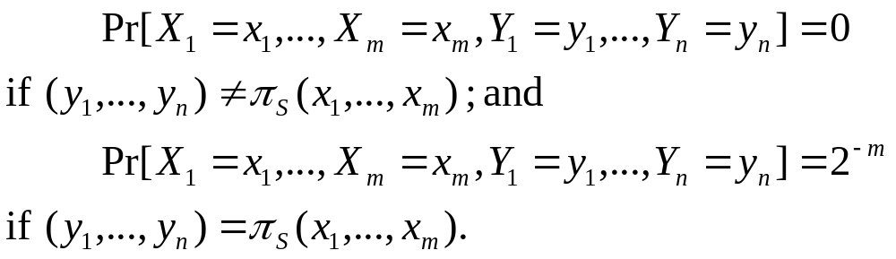

Linear Cryptanalysis
3.3.2 Linear Approximations of S-boxes
  Consider an S-box .
  Let the input m-tuple be X=(x₁,…,x_{m}). And the output n-tuple be Y=(y₁,…,y_{n}).
  We can see that
  Now we can compute the bias of the form
using the formulas stated above.

Slide 17
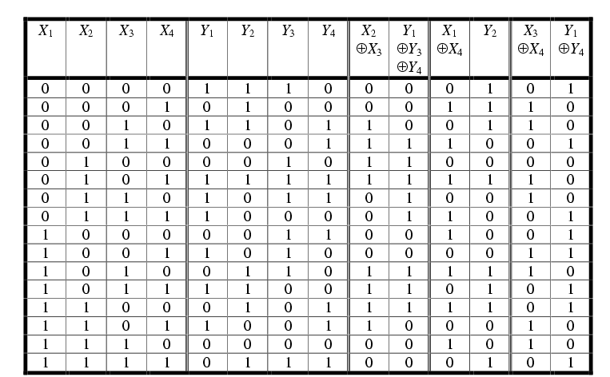
Linear Cryptanalysis
Example 3.2: We use the S-box as Example 3.1.

Slide 18




Linear Cryptanalysis
  Consider . The probability that can be determined by counting the number of rows in which , and then dividing by 16.
  It is seen that
  Hence, the bias is 0.
  If we instead analyze , we find that the bias is –3/8.

Slide 19
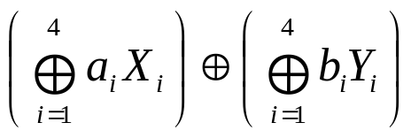

Linear Cryptanalysis
We can record the bias of all 2⁸=256 possible random variables.
We represent the relevant random variable in the form
where .
We treat (a₁,a₂,a₃,a₄) and (b₁,b₂,b₃,b₄) as hexadecimal digit (they are called input sum and output sum, respectively)

Slide 20

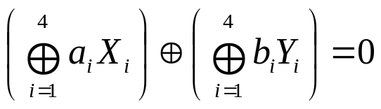

Linear Cryptanalysis
Let N_{L}(a,b) denote the number of binary eight-tuples (x₁,x₂,x₃,x₄,y₁,y₂,y₃,y₄) s.t
and
The bias is computed as .
The table of all N_{L} is called the linear approximation table (Figure 3.2).

Slide 21
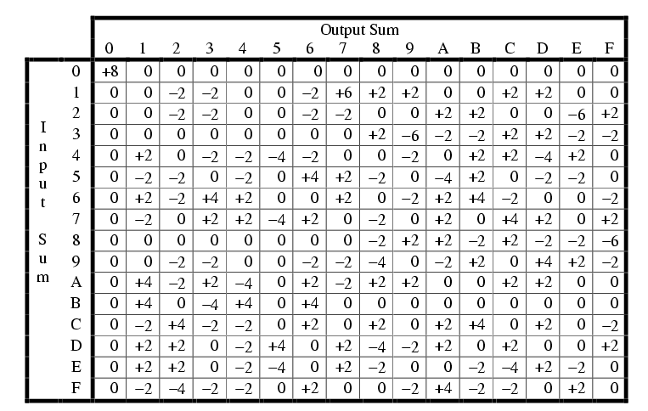
Example
3.2
Figure 3.2: Linear approximation table: values of N_{L}(a,b)-8

Slide 22
Linear Cryptanalysis
3.3.3 Linear Attack on an SPN
  Linear cryptanalysis requires a set of linear approximations of S-boxes that can be used to derive a linear approximation of the entire SPN (excluding the last round).
  Figure 3.3 illustrates the structure of the approximation we will use.
    Arrows are the random variables involved in the approximations and the labeled S-boxes (active S-boxes) are used in the approximations.

Slide 23
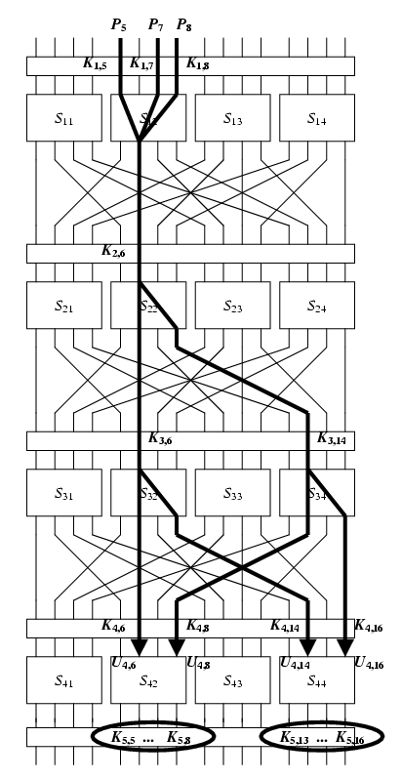
x
u¹
v¹
w¹
u²
v²
w²
u³
v³
w³
Figure 3.3: A linear approximation of an SPN
u⁴
v⁴
y

Slide 24





Linear Cryptanalysis
The approximation incorporates four active S-boxes:
  In S₁₂, has bias ¼
  In S₂₂, has bias -¼
  In S₃₂, has bias -¼
  In S₃₄, has bias -¼
have biases that are high in absolute value. Further, we will see their XOR will lead to cancellations of “intermediate” random variables.

Slide 25

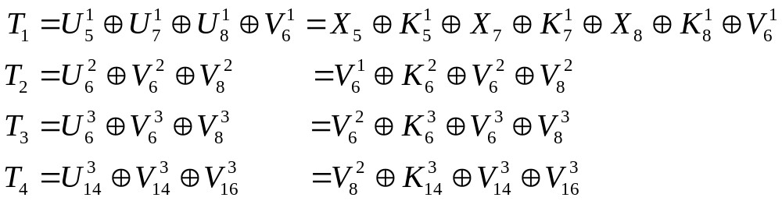
Linear Cryptanalysis
Using Piling-up lemma, has bias equal to 2³(1/4)(-1/4)³=-1/32.
  Note: we assume the four r.v are independent.
Then can be expressed in terms of plaintext bits, bits of u⁴ (input to the last round) and key bits as follows:

Slide 26
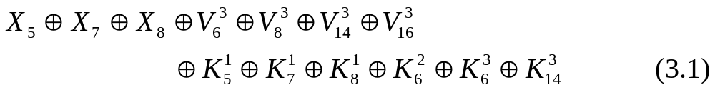


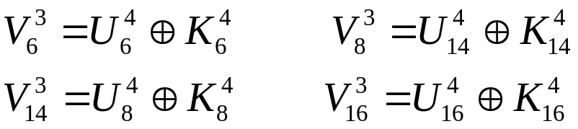
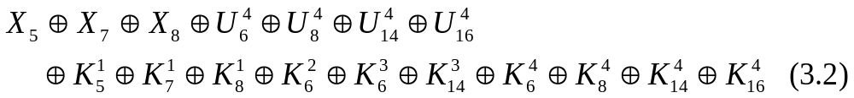
Linear Cryptanalysis
XOR the right side and we get
Then replace by and key bits:
Now substitute them into 3.1:

Slide 27
Linear Cryptanalysis
The expression above only involves plaintext bits, bits of u⁴ and key bits.
Suppose the key bits are fixed. Then
has the (fixed) value 0 or 1.
It follows that
has bias -1/32 or 1/32 where the sign depends on the key bits (=0 or =1).

Slide 28


Linear Cryptanalysis
The fact that (3.3) has bias bounded away from 0 allows us to carry out linear attack.
Suppose that we have T plaintext-ciphertext pairs (denoted by ), all use the same unknown key, K. The attack will allow us to obtain the eight key bits,
There are 2⁸=256 possibilities for the eight key bits. We refer to a binary 8-tuple as a candidate subkey.

Slide 29


Linear Cryptanalysis
For each and for each candidate subkey, we compute a partial decryption of y and obtain the resulting value for .
Then we compute the value
We maintain an array of counters indexed by the 256 possible candidate subkeys, and increment the counter corresponding to a particular subkey when (3.4) has the value 0.
In the end, we expect most counters will have a value close to T/2, but the correct candidate subkey will close to T/2±T/32.

Slide 30



Linear Cryptanalysis
The attack is presented as Algorithm 3.2.
  L₁ and L₂ are hexadecimal value.
  is the inverse of the S-box.
  The output, maxkey, contains the most likely subkey.
In general, it is suggested that a linear attack based on a linear approximation having bias will be successful if the number of plaintext-ciphertext pairs is approximately for some “small” constant c.

Slide 31
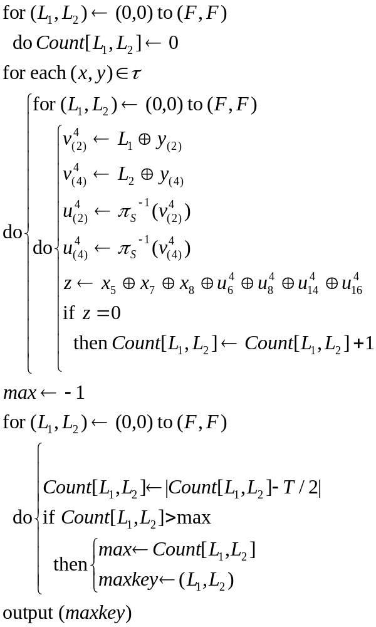

Algorithm 3.2: L_{INEAR}A_{TTACK}( )

Slide 32

3.4 Differential Cryptanalysis
The main difference from linear attack is that differential attack involves comparing the XOR of two inputs to the XOR of the corresponding outputs.
Differential attack is a chosen-plaintext attack.
We consider inputs x and x* having a specified XOR value denoted by .
We decrypt y and y* using all possible key and determine if their XOR has a certain value. Whenever it does, increment the corresponding counter. At the end, we expect the largest one is the most likely subkey.

Slide 33


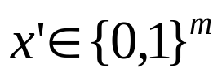

Differential Cryptanalysis
Definition 3.1:
  Let be an S-box. Consider an (ordered) pair of bitstrings of length m, say (x,x*). We say that the input XOR of the S-box is and the output XOR is .
  For any , define the set to consist of all the ordered pairs (x,x*) having input XOR equal to x’.

Slide 34

Differential Cryptanalysis
It is easy to see that any set contains 2^{m} pairs, and that
For each pair in , we can compute the output XOR of the S-box. Then we can tabulate the distribution of output XORs. There are 2^{m} output XORs which are distributed among 2^{n} possible values.
  A non-uniform output distribution will be the basis for a successful attack.

Slide 35
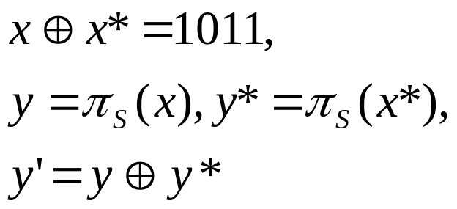
Differential Cryptanalysis
Example 3.3:
  We use the same S-box as before. Suppose we consider input XOR x’=1011. Then
  We compute the following table, where

Slide 36
x | x* | y | y* | y’
0000 0001 0010 0011 0100 0101 0110 0111 1000 1001 1010 1011 1100 1101 1110 1111 | 1011 1010 1001 1000 1111 1110 1101 1100 0011 0010 0001 0000 0111 0110 0101 0100 | 1110 0100 1101 0001 0010 1111 1011 1000 0011 1010 0110 1100 0101 1001 0000 0111 | 1100 0110 1010 0011 0111 0000 1001 0101 0001 1101 0100 1110 1000 1011 1111 0010 | 0010 0010 0111 0010 0101 1111 0010 1101 0010 0111 0010 0010 1101 0010 1111 0101
0000 | 0 | 1000 | 0
0001 | 0 | 1001 | 0
0010 | 8 | 1010 | 0
0011 | 0 | 1011 | 0
0100 | 0 | 1100 | 0
0101 | 2 | 1101 | 2
0110 | 0 | 1110 | 0
0111 | 2 | 1111 | 2
Number of output
Distribution table for x’=1011

Slide 37
Differential Cryptanalysis
In Example 3.3, only 5 of the 16 possible output XORs occur. It has a very non-uniform distribution.
We can compute all possible input XORs as Example 3.3.
Define
  N_{D}(x’,y’) counts the number of pairs with input XOR equal to x’ and output XOR equal to y’. (Figure 3.4)

Slide 38
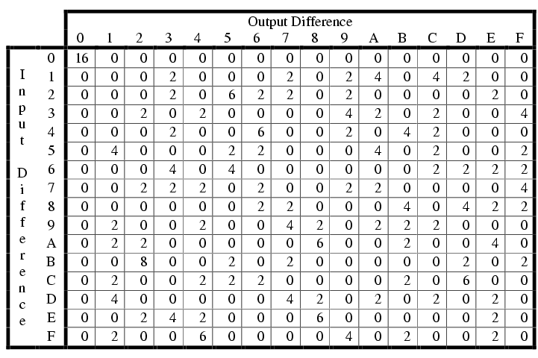
Example 3.3
Figure 3.4: Difference distribution table: values of N_{D}(x’,y’)

Slide 39
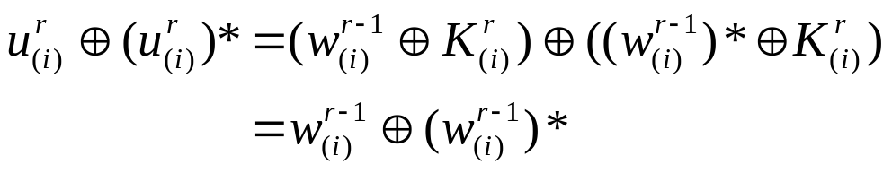
Differential Cryptanalysis
An input XOR is computed as
  Therefore, the input XOR does not depend on the subkey bits used in round r; it is equal to the (permuted) output XOR of round r-1.
Let a’ denote the input XOR and let b’ denote the output XOR. (a’,b’) is called a differential.

Slide 40
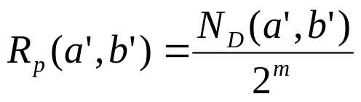
Differential Cryptanalysis
propagation ratio R_{p}(a’,b’):
  R_{p}(a’,b’) can be interpreted as a conditional probability:
We combine differentials in consecutive rounds to form a differential trail. A particular differential trail is shown in Figure 3.5.

Slide 41
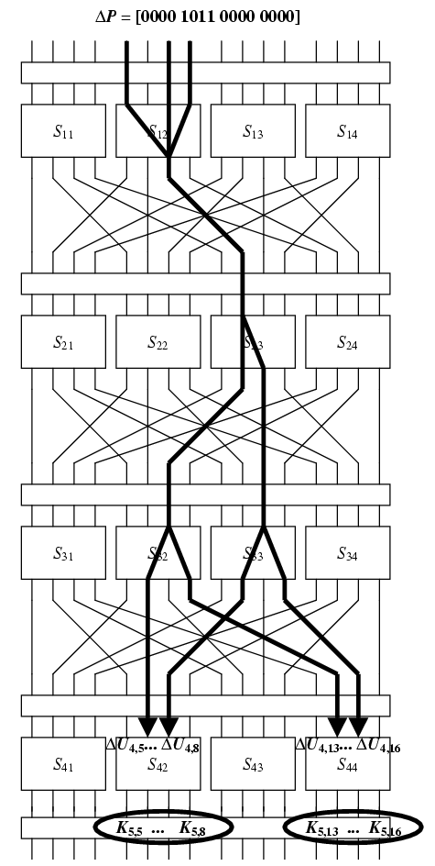
x
u¹
v¹
w¹
u²
v²
w²
u³
v³
w³
u⁴
Figure 3.5: A differential trail for a SPN
v⁴
y

Slide 42
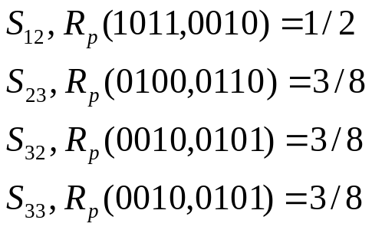
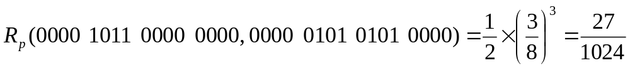
Differential Cryptanalysis
The differential attack arising from Figure 3.5 uses the following propagation ratios of differentials:
  In
  In
  In
  In
We therefore obtain a propagation ratio for a differential trail of the first three rounds of the SPN:

Slide 43
Differential Cryptanalysis
In other words,
with probability 27/1024. However,
Hence, it follows that
with probability 27/1024.

Slide 44
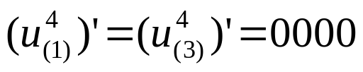


Differential Cryptanalysis
Algorithm 3.3 presents the attack algorithm.
The input and output are similar to linear attack, except that is a set (x,x*,y,y*), where x’ is fixed.
Algorithm 3.3 makes use of a certain filtering operation. Tuples (x,x*,y,y*) for which the differential holds are often called right pairs, and allow us to determine the key bits.
A right pair has the form
Hence we consider those and .

Slide 45
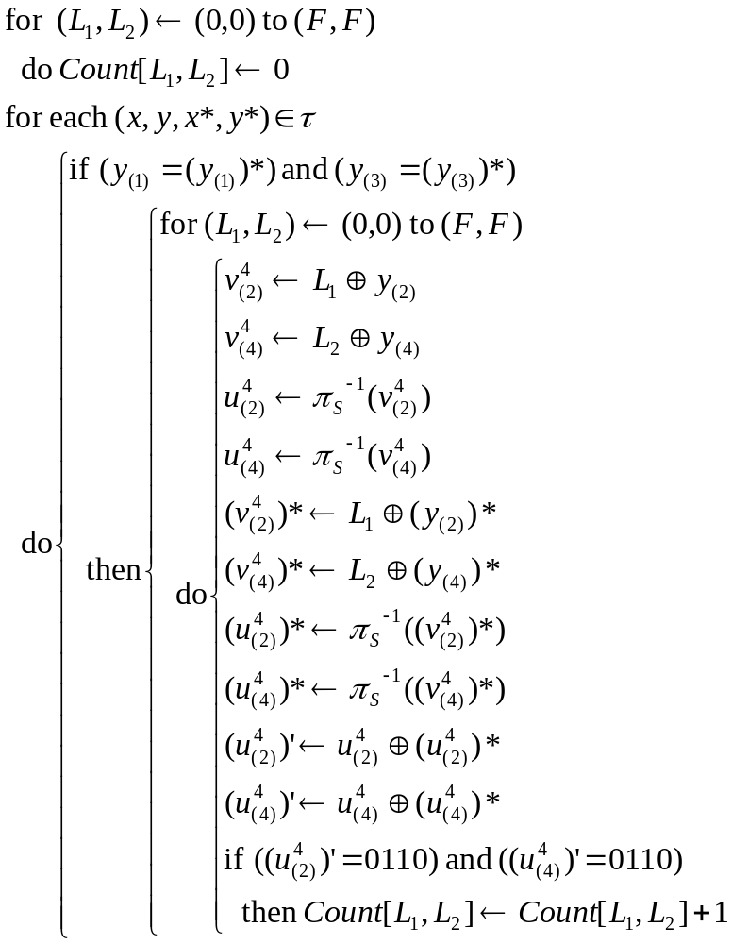

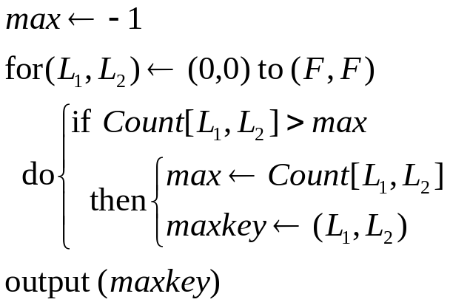
Algorithm 3.3:
DIFFERENTIALATTACK( )

Slide 46

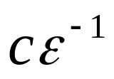
Differential Cryptanalysis
A differential attack based on a differential trail having propagation ratio equal to will often be successful if the number of tuples (x,x*,y,y*), which we denote by T, is approximately , for a “small” constant c.

