Slide 1

Fundamentals of Symmetric-Key Cryptography
Introduction to Practical Cryptography
Cryptanalysis
Notes:
Alcatel-Lucent PowerPoint Design Guidelines
When necessary Portfolio/Program Name can wrap to a second or third line to maintain consistent typographic spec
For title slide only, a 5% gray background has been added
General specifications
Page Setup set to “On Screen” format
Update footer to include appropriate “Portfolio/Program Name”
Ensure that only one font “Trebuchet” is used throughout. Following pages provide font sizes for text and graphic pages.
Ensure all text boxes sit in proper location. Sometimes the automatic PowerPoint settings are not exact
Titles on slides, Agenda and Division pages use “Title Case”
Text is set predominantly with regular weight. Bold Trebuchet is used to highlight key words or phases
When a slide has more text than comfortable fits on the page using standard font sizes, treat this instance as an exemption and reduce the font size of the entire block until it fits
For graphic only slides, use as much of the object area as possible to enhance legibility and emphasis
Slides with multiple logos should be adjusted so all logos appear visually equal in size and weight
Please remove any tinted or light color backgrounds from slides other than Agenda and Division slides

Slide 2
Agenda
Overview
Block Ciphers:
  Linear
  Differential
  Other Attacks
  Statistical Analysis
Stream Ciphers
General
  Side Channel Attacks

Slide 3
Overview
What is cryptanalysis?
Theory
distinguish from random
Less work than exhaustive search, even if not practical 2^127 vs 2^100
Practical – recover key bits, determine plaintext/ciphertext bits

Slide 4
Agenda
Overview
Block Ciphers:
  Linear
  Differential
  Other Attacks
  Statistical Analysis
Stream Ciphers
General
  Side Channel Attacks

Slide 5
Differential and Linear Cryptanalysis Origins
Differential cryptanalysis originally defined on DES
Eli Biham and Adi Shamir, Differential Cryptanalysis of the Data Encryption Standard, Springer Verlag, 1993.
Linear cryptanalysis first defined on Feal by Matsui and Yamagishi, 1992.
Matsui later published a linear attack on DES.

Slide 6
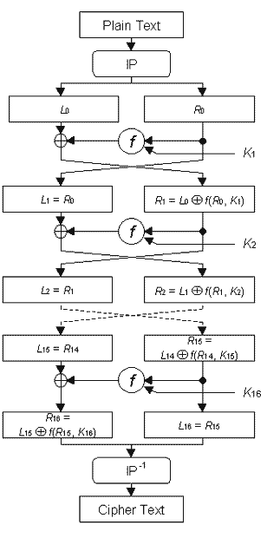
DES
64 bit
block
initial, final
permutations
16 round Feistel network
56 bit key
Decryption same as encryption with round keys used in reverse order.
DES images downloaded from
http://www.chipcenter.com/eexpert/jleiseboer/jleiseboer023.html
(original source unknown)

Slide 7
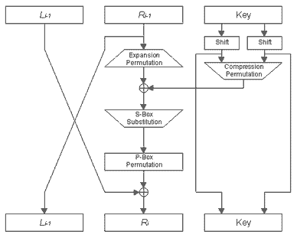

DES
Right half expanded from 32 to 48 bits.
Some of the 32 bits are input to 2 S-Boxes.
Round key
Rotate each half of 56 bit key,
select 48 bits.
Rotation is 1 or 2 bits,
depends on round.
Each key bit used in ≈ 14 rounds
not in same position.
8 S-Boxes
6 bit input
4 bit output
Impacts linear and
differential cryptanalysis
S-Box outputs
permuted

Slide 8
Plaintext, Ciphertext Queries
Ciphertext only
Known plaintext: have set of plaintext, ciphertext pairs (P₁,C₁), (P₂,C₂) … (P_{i},C_{i}):
Chosen Plaintext:
  Choose P_{i}’s, receive C_{i}’s
Chosen Ciphertext:
  Choose C_{i}’s , receive P_{i}’s
Chosen Plaintext – Chosen Ciphertext:
  Choose P_{i}’s and C_{j}’s, receive C_{i}’s and P_{j}’s
P_{i}
C_{i}
P_{i}
C_{i}
P_{i}
C_{i}
P_{j}
C_{j}

Slide 9
Plaintext, Ciphertext Queries
Given queries (P₁,C₁), (P₂,C₂) … (P_{i},C_{i}):
Adaptive Chosen Plaintext:
  Input P_{i}, receive C_{i}, choose P_{i+1} …
Adaptive Chosen Ciphertext:
  Input C_{i}, receive P_{i}, choose C_{i+1} …
Adaptive Chosen Plaintext – Adaptive Chosen Ciphertext:
  Input a P_{i} receive C_{i} or input C_{i} receive P_{i} then choose next query
P_{i}
C_{i}
P_{i}
C_{i}
P_{i}
C_{i}

Slide 10
Attack Categories – Other
related keys – adversary chooses relation between keys, but not keys themselves, and obtains plaintext, ciphertext pairs

Slide 11

Recall PRP, SPRP
Box contains either the block cipher or a random permutation
Pseudorandom permutation (PRP): Attacker cannot make polynomial many adaptive chosen plaintext or adaptive chosen ciphertext queries (but not both) and determine contents of box with probability ½ + e for non-negligible e > 0.
P₁,P₂ … P_{n}
C₁,C₂ … C_{n}
Strong PRP (SPRP): same idea as PRP, but can make queries in both directions
P₁,P₄ … P_{i}
C₁,C₄ … C_{i}
P₂,P₃ … P_{n}
C₂,C₃ … C_{n}

Slide 12
Attack Bounds
If an attack holds with probability ≤ 2^{-x}
x > 0
Block size b
If x ≥ b, need ≥ 2^{b} plaintexts

Slide 13
Agenda
Overview
Block Ciphers:
  Linear
  Differential
  Other Attacks
  Statistical Analysis
Stream Ciphers
General
  Side Channel Attacks

Slide 14
Linear Cryptanalysis
Notation
P = plaintext
p_{i} = i^{th} bit of P
C = Ciphertext
c_{i} = i^{th} bit of C
K = Key (initial or expanded)
k_{i} = i^{th} bit of K
⊕_{i=1,n} p_{i} = p₁ ⊕ p₂ ⊕ …. ⊕ p_{n}
X,Y,Z are subsets of bits (notation on next slide only)

Slide 15
Linear Cryptanalysis
Attack Overview
Obtain linear approximation(s) of the cipher relating P,K,C
  ⊕_{i∈X,} p_{i} ⊕ _{j∈Y} c_{j} = ⊕_{g∈Z} k_{g}
which occur with probability pr = ½ + e for max bias -½ ≤ e_{i} ≤ ½ .
Encrypt random P’s to obtain C’s and compute k_{g}’s.
Known plaintext attack
Guess remaining key bits via exhaustive search.

Slide 16
Example – Single S-Box
Considering only relationships between 1 input bit,1 output bit and 1 key bit:
  (1) Pr(P₁⊕ C₁ = K₁) = 1
  (2) Pr(P₂⊕ C₂ = K₁) = 5/8
  (3) Pr(P₂⊕ C₂ = K₂) = 3/8
For all other triples of P_{i}, C_{i}, K_{i}
  Pr(P_{i}⊕ C_{i} = K_{i}) = ½
Use (1) and (3) to determine the key.
Can determine K₁ from one (P,C) by (1)
  P₁⊕ C₁ = 0 =K₁
One P₂⊕ C₂ = 0 is not enough to infer K₂ is 1
  Additional (P,C)’s needed
  (3) returns 0, implying K₂ is 1.
Guess key = 10
K₂K₁ P₂P₁ | 00 | 01 | 10 | 11
00 | 10 | 11 | 00 | 01
01 | 11 | 00 | 01 | 10
10 | 00 | 01 | 10 | 11
11 | 01 | 10 | 11 | 00
(P,C) pairs
  (a) 00 → 00
  (b) 01 → 01
  (c) 10 → 10
In each pair
  P₁⊕ C₁ = 0
  P₂⊕ C₂ = 0

Slide 17
Example S-Box
Input:Output (4 bits, in hex)
0:E
1:4
2:D
3:1
4:2
5:F
6:B
7:8
8:3
9:A
A:6
B:C
C:5
D:9
E:0
F:7
S-Box Example from Tutorial on Linear and
Differential Crypt. Tutorial, H. Heys,
Memorial U. of of Newfoundland

Slide 18
Example S-Box
Y1
Y2
Y3
Y4
S-Box on 4-bit value
Z1
Z2
Z3
Z4
Y2 ⊕ Y3 = Z1 ⊕ Z3 ⊕ Z4 in 12 of the 16 input, output pairs
12/16 = ½ + ¼ and the bias is ¼
Y1 ⊕ Y4 = Z2 in ½ of the pairs, so there is no bias
Y3 ⊕ Y4 = Z1 ⊕ Z4 in 2 of the 16 pairs, so the bias is -3/8
2/16 = ½ -3/8

Slide 19
Finding Linear Relationships
General form of linear relationship:
  a1Y1 ⊕ a2Y2 ⊕ a3Y3 ⊕ a4Y4
  =
  b1Z1 ⊕ b2Z2 ⊕ b3Z3 ⊕ b4 Z4
ai, bi ∈ {0,1}
Summarize all equations in a table
Only need to do once – upfront work

Slide 20
Finding Linear Relationships
b1b2b3b4
 | 0 | 1 | 2 | 3 | 4 | 5 | 6 | 7 | 8 | 9 | A | B | C | D | E | F
0 | 8 | 0 | 0 | 0 | 0 | 0 | 0 | 0 | 0 | 0 | 0 | 0 | 0 | 0 | 0 | 0
1 | 0 | 0 | -2 | -2 | 0 | 0 | -2 | 6 | 2 | 2 | 0 | 0 | 2 | 2 | 0 | 0
2 | 0 | 0 | -2 | -2 | 0 | 0 | -2 | -2 | 0 | 0 | 2 | 2 | 0 | 0 | -6 | 2
3 | 0 | 0 | 0 | 0 | 0 | 0 | 0 | 0 | 2 | -6 | -2 | -2 | 2 | 2 | -2 | -2
4 | 0 | 2 | 0 | -2 | -2 | -4 | -2 | 0 | 0 | -2 | 0 | 2 | 2 | -4 | 2 | 0
5 | 0 | -2 | -2 | 0 | -2 | 0 | 4 | 2 | -2 | 0 | 4 | -2 | 0 | -2 | -2 | 0
6 | 0 | 2 | -2 | 4 | 2 | 0 | 0 | 2 | 0 | -2 | 2 | 4 | -2 | 0 | 0 | -2
7 | 0 | -2 | 0 | 2 | 2 | -4 | 2 | 0 | -2 | 0 | 2 | 0 | 4 | 2 | 0 | 2
8 | 0 | 0 | 0 | 0 | 0 | 0 | 0 | 0 | -2 | 2 | 2 | -2 | 2 | -2 | -2 | 6
9 | 0 | 0 | -2 | -2 | 0 | 0 | -2 | -2 | -4 | 0 | -2 | 2 | 0 | 4 | 2 | -2
A | 0 | 4 | -2 | 2 | -4 | 0 | 2 | -2 | 2 | 2 | 0 | 0 | 2 | 2 | 0 | 0
B | 0 | 4 | 0 | -4 | 4 | 0 | 4 | 0 | 0 | 0 | 0 | 0 | 0 | 0 | 0 | 0
C | 0 | -2 | 4 | -2 | -2 | 0 | 2 | 0 | 2 | 0 | 2 | 4 | 0 | 2 | 0 | 2
D | 0 | 2 | 2 | 0 | -2 | 4 | 0 | 2 | -4 | -2 | 2 | 0 | 2 | 0 | 0 | 2
E | 0 | 2 | 2 | 0 | -2 | -4 | 0 | 2 | -2 | 0 | 0 | -2 | -4 | 2 | -2 | 0
F | 0 | -2 | 4 | -2 | -2 | 0 | 2 | 0 | 0 | -2 | 4 | -2 | -2 | 0 | 2 | 0
a1a2a3a4
# of times equation holds: a1Y1 ⊕ a2Y2 ⊕ a3Y3 ⊕ a4Y4 = b1Z1 ⊕ b2Z2 ⊕ b3Z3 ⊕ b4 Z4

Slide 21
Finding Linear Relationships
“a” value of E: a1 =1, a2 = 1, a3 = 1, a4 = 0
“b” value of 1: b1 = 0, b2 = 0, b3 = 0, b4 = 1
Row E, Column 1 has a value of 2
Bias is 2/16 = 1/8
Probability X1⊕ X2 ⊕ X3 = Y4 is ½ + 1/8 = 5/8

Slide 22
Piling-Up Lemma
Matsui
Know Pr(V_{i} = 0) = ½ + e_{i}
Pr(V₁⊕V₂⊕ … ⊕V_{n} = 0) = ½ + 2^{n-1}Π e_{i}
V_{i}’s are independent random variables
e_{i} is the bias -½ ≤ e_{i} ≤ ½
Use to combine linear equations if view each as independent random variable
n
i=1

Slide 23
Finding Linear Relationships
Apply same process used for S-Box to other steps within the round function
Determine equations for entire round
Incorporate whitening (if any) into equations

Slide 24
Linear Bounds
Bound a linear equation holds across q rounds: 0 < p ≤ 1
Cipher has nq rounds
Estimate upper bound ≤ p^{n}
2^{b} possible plaintexts
≤ 2^{b}/p^{n} satisfy equations
Round key bits, output of a round/input to next round not independent
If p^{n} ≤ 2^{-b} ,, no attack
q rounds
p
q rounds
p²
q rounds
p³
q rounds
p^{n}

Slide 25
Applying an Attack
When attacking the cipher, try to determine key bits for first or last round, then repeat attack on reduced round version of the cipher
DES has 16 rounds, find round key for 1st or last round, repeat attack for 15 round version …
If same expanded key bits used in multiple rounds, fill in round key bits as they become known

Slide 26
Linear Cryptanalysis DES
Determined linear approximations via exhaustive search
  First for S-Boxes
  Then extended to round function and multiple rounds.
Approximations
  5 good approximations for initial key bits with bias e ranging from ≈ 0.031 to 0.218
  Examples,
    1st round: ⊕_{i∈X} fo_{i,1} ⊕ p₁₅ = k₂₂ X = {7,18,24,29} with probability 19%
    Last round: ⊕_{i∈X} fo_{i,16}⊕ fin_{15,16} = k₂₂ X = {7,18,24} with probability 66%
  1 approximation for round key bits with e = O(2⁻³).
  Others with e= O(2⁻⁵) to O(2⁻³⁰)
fin_{ij} = i^{th} bit of input of round function in j^{th} round
fo_{ij} = i^{th} bit of output of round function in j^{th} round

Slide 27
Linear Cryptanalysis DES
Plaintext Attack
  Found 14 key bits.
  Remaining 42 key bits found by exhaustive search.
  8 rounds required 2²¹ P’s with 96% success.
  16 rounds required 2⁴⁷ P’s with 96% success
Ciphertext Only Attack
  Found 7 key bits.
  Assumed some p_{i}s were 0 to have equations of C, K only.
  8 rounds required 2³⁷ C’s with 78% success, assumed 1 p_{i} is 0
  16 rounds required 1.82 x 2⁵³ C’s with 78% success, assumed 5 p_{i}’s are 0.

Slide 28
Linear Bounds AES
4 rounds ≤ 2⁻⁷⁵
8 rounds ≤ 2⁻¹⁵⁰ exponent > 128 so don’t need to estimate all 10 rounds

Slide 29
Agenda
Overview
Block Ciphers:
  Linear
  Differential
  Other Attacks
  Statistical Analysis
Stream Ciphers
General
  Side Channel Attacks

Slide 30
Differential Cryptanalysis
Notation
P = plaintext
C = ciphertext
(P1,P2) = plaintext pair
(C1,C2) = ciphertext pair
ΔP = P1 ⊕ P2
ΔC = C1 ⊕ C2
Characteristic: Ω = (λ_{i1},λ_{o1},λ_{i2},λ_{o2},….λ_{ir},λ_{or})
  λ_{ij}= ⊕ of inputs to round j
  λ_{oj}= ⊕ of outputs from round j
  If pr_{j}= probability λ_{oj} occurs given λ_{ij}
  then probability of Ω = Π pr_{j} ‘s (upper bound)
Notes:
Differential = (ΔP,ΔC)
Prob. If characteristic is an estimate – assumes independent random variables when S-Boxes, key expansion and other cipher components are not independent (i.e. when design won’t have two = S-Boxes).
Expect 1/probability of char. pairs to get a pair that matches the char and thus can guess key bits. (so use small multiple of this due to prob being estimate and wanting confirmation don’t have wrong pair – want correct result for more than one pair to be sure.)
Differential may hold for some pairs under wrong key guess.
-------------------------------------------------------------------------
Iterative characteristic: one that can be concatenated with itself.

Slide 31
Example: 1 round Ω’s
If ΔR = 0 then
λ_{o}= 0
Ω_{C} = (ΔL,0)
with probability 1.
If ΔR = 60 00 00 00 then
λ_{o}= 00 80 82 00
Ω_{C} = (ΔL ⊕ 00 08 82 00,
60 00 00 00)
with probability 14/64.
Ω_{P} = (ΔL, ΔR)
First round of any Feistel
network does not assist
in preventing differential crypt.
λ_{o}
λ_{i} = ΔR
F
Ω_{C} = (ΔL⊕ λ_{o}, ΔR)
DES without initial and final permutations.
Notes:
This slide and next slide are examples of characteristics for DES.
Probabilities are written in terms of 64 because 6 bits input to S box, 4 bits output so 2⁶ = 64 combinations of inputs/outputs

Slide 32
Finding Characteristics
Process similar to that used in linear crypt example
Enumerate all cases
Only need to do once – one time upfront work

Slide 33
Differential Cryptanalysis - DES
Ω_{P} = (ΔL, ΔR)
3 round Ω with ΔP = ΔC
Probability (14/64)² ≈ 0.048
λ_{o1} = ΔL
F
λ_{i1} = ΔR
14/64
Want output of first F to cancel ΔL
λ_{o2} = 0
F
λ_{i2} = 0
1
λ_{o3} = ΔL
F
λ_{i3} = ΔR
14/64
Same Δ as input to first F
Ω_{C} = (ΔL, ΔR)

Slide 34
Differential Cryptanalysis
Attack Overview
Find Ω with non-negligible probability.
  Minimal key bits to guess, but allow guessing those in last (or first) round.
  Exhaustive search to find best Ω’s.
Determine key bits of last round:
  Choose pairs (P1,P2) such that ΔP provides λ_{i1} .
  Decrypt ciphertext with key guess for last round
  Count # of (C1,C2) pairs such that match characterstic
  Assume correct key bits is guess with highest count.
  Eliminate last round and attack the reduced cipher.
Can also work from 1st round:
  Choose pairs (C1,C2) such that ΔC= λ_{or}
  Determine key bits in 1st round.
Notes:
Over all plaintext pairs, count # of times each key occurs that results in desired characteristic. The correct key should occur with prob. = characteristic’s probability. (and since should have used characteristic with greatest prob., this should be the key that produces the desired result most often.).
May be possible that “wrong” pairs and another key produce correct result.
i.e. pairs are wrong because when used with correct key they don’t produce the characteristic.
If prob. of char. is 1/10000, need ten’s of thousands of P pairs.
Signal to Noise ratio: S/N: mp/(mab/(2^k)) = p2^{k}/ab
p = char. prob, ab = average # of correct keys per pair (estimate it). m = # of pairs. k = key bits need to determine (not already found).
Note: S/N does not depend on # of pairs.
S/N of 1-2 need 20-40 right pairs, lower S/N need more pairs. Lower S/N implies greater % noise.

Slide 35
Finding Ω’s
Manually created distribution tables for input ⊕’s and output ⊕’s for each S-Box.
If input ⊕ is 2, output ⊕ is 5, 4 possible keys.
 | Output ⊕
Input ⊕ | … | 2 | 3 | 4 | 5 | …
2 | … | 0 | 8 | 0 | 4 | …
3 | … | 2 | 2 | 10 | 6 | …
Segment of distribution table for DES S-Box 0
Notes:
First need to find characteristics, for DES this required finding distribution of all delta input/output pairs from S-Boxes over all key values.
Recall 6 key bits used in each S-Box because 48 bits feed into 8 S-Boxes so each S-Box gets 6 Bits.

Slide 36
Differential Cryptanalysis - DES
Ω_{P} = (ΔL, ΔR)
4 round Ω
Ω_{P} with
  ΔL = 20 00 00 00
  ΔR = 00 00 00 00
Then
  λ_{o1} = 00 00 00 00
  λ_{i2} = ΔL = 20 00 00 00
λ_{i2} affect only 1st S-Box so 28 bits of λ_{o2} are 0.
  λ_{o4} = λ_{i3} ⊕ ΔCL
  = λ_{i1} ⊕ λ_{o2} ⊕ ΔCL
  = λ_{o2} ⊕ ΔCL
  know all but 4 bits of λ_{o2}
Know right halves of ciphertexts,
⇒ know inputs into 4th round.
  λ_{i4} : at most 11 non zero bits
ΔCR varies amongst pairs.
λ_{o1} = 0
F
λ_{i1} = 0
k1
λ_{o2}
F
λ_{i2}
k2
λ_{o3}
F
λ_{i3}
k3
λ_{o4}
F
λ_{i4}
k4
Ω_{C} = (ΔCL, ΔCR)
Notes:
Characteristic used is just the first round – occurs with probability 1.
At most 11 bits of input differ in 4th round, and ΔCR varies amongst pairs.
Know λi2, most of λ03 so know most of λ04, know ΔCR thus know input and most of output
Δ’s in 4th round. Use this to determine 4th round key.
The 28 known bits are the XORs of the outputs of S-Boxes 2 to 8.
Use 4 chosen plaintext pairs, find last round key.
For each of the 7 S Boxes, trying all 64 (6 bit key) possible values of the key bits
And check if XOR of inputs = output XOR.
For each key value, count # of pairs for which = holds. The correct key is one that holds for all pairs, since the characteristic has probability 1.
The other 63 key values may cause the = to hold for some of the pairs.
If two keys work for all 4 pairs, add more pairs.
So 7 * 64 * 4 < 2^11 encryptions in worst case.
Above will give 7 * 6 = 42 last round key bits. Using DES key schedule, this is 42 of 56 bits. Try all possible values for remaining 14 bits. (If decrypt C satisfying XOR should result satisfying XOR in characteristic). 2^14 work.
When have 4th round subkey, repeat process on 3 rounds to find round 3 key.
Need to change characteristic (different plaintexts) when get to 2 rounds because mostly 0’s in input, for most S-Boxes, any key bits work.
Overall, 16 chosen plaintexts needed on average., or 2^{33.5} plaintexts.

Slide 37
Differential Cryptanalysis
Number of Plaintexts
Use m = c/pr(Ω) plaintext pairs, for some small c > 0.
Chosen Plaintext: Select m pairs that satisfy ΔP.
Known Plaintext: have set of P’s, but did not choose them, so need to find pairs satisfying ΔP.
  2^{|P|/2}(2m)^{½} plaintexts required
    Can form ½ (2^{|P|/2}(2m)^{½})² = 2^{|P|}m pairs.
    2^{|P|} possible ΔP’s.
    2^{|P|}m/ 2^{|P|} = m pairs on average create each ΔP.
  If > # of possible P’s, attack not possible.

Slide 38
Differential Cryptanalysis - DES
Any reduced round version of DES is breakable via a known plaintext attack faster than via exhaustive key search.
# Rounds | # Chosen Plaintexts | # Known Plaintexts
4 | 2³ | 2³³
6 | 2⁸ | 2³⁶
8 | 2¹⁴ | 2³⁸
9 | 2²⁴ | 2⁴⁴
11 | 2³¹ | 2⁴⁷
13 | 2³⁹ | 2⁵²
16 | 2⁴⁷ | 2⁵⁵

Slide 39
AES – 128 bit block
128 bit plaintext
AddRoundKey
initial whitening
S-Box
Shiftrows
MixColumns
9 rounds
AddRoundKey
S-Box
Shiftrows
last round
AddRoundKey
128 bit ciphertext

Slide 40
AES Differentials
AES: each non-zero byte in delta input to a round contributes 2⁻⁶ or 2⁻⁷ to probability of output difference.
  If difference input to a round is 0 except in one byte, probability specific difference occurs in output of the round is ≤ 2⁻⁶
  If difference input to a round is 0 except in two bytes, probability specific difference occurs in output of the round is ≤ 2⁻¹²
Entirely due to the S-Box – other steps in round do not impact differential probability

Slide 41
AES Differentials
2 round bound: ≤ 2⁻²⁴
4 round bound: ≤ 2⁻⁹⁶ small enough to eliminate differential attack over 10 rounds

Slide 42
MISTY1 Round
b bits
left 32 bits
right 32 bits
FL_{i}
FL_{i+1}
F0_{i}
round
function
F0_{i+1}

Slide 43
MISTY1
Each application of the F0 function contributes ≤ 2⁻⁷ to the probability
So if non-zero difference into exactly one application of the F0 function in a round, the probability a specific difference occurs in the round’s output is ≤ 2⁻⁷
So if non-zero difference into exactly one application of the F0 function in a round, the probability a specific difference occurs in the round’s output is ≤ 2⁻¹⁴
At least one F0 function in a round must have a non-zero input difference. Therefore, lose upper bound on a differential is 2⁻⁵⁶ (2⁻⁷ over each of 8 rounds).

Slide 44
Agenda
Overview
Block Ciphers:
  Linear
  Differential
  Other Attacks
  Statistical Analysis
Stream Ciphers
General
  Side Channel Attacks

Slide 45
Differential Variations
Impossible Differential
  Differential characteristic occurs with probability 0
  Eliminate values for key bits
Partial Differential
  Block size b bits, consider differential in < b bits
Higher Order Differentials
Boomerang Attack and variations

Slide 46
Boomerang Attack
P,P’.Q,Q’ are plaintexts
C,C’,D,D’ are the corresponding ciphertexts
Cipher is a series of rounds
E = encryption function
View E as a composition of two functions E₀,E₁
  for example, if E consists of n rounds, E₀ is the first n₀ rounds, E₁ is the remaining n-n₀ rounds
  E(P) = E₁(E₀(P))

Slide 47
Boomerang Attack
Characteristic for E₀ : Δ→Δ*
Characteristic for E₁⁻¹: ∇→∇*
Want to choose plaintexts such that
P ⊕ P’ produces Δ→Δ*
P ⊕ Q produces ∇→∇*
P’ ⊕ Q’ produces ∇→∇*
Then show
D ⊕ D’ , Q ⊕ Q’ corresponds to Δ*→Δ for E₀⁻¹

Slide 48
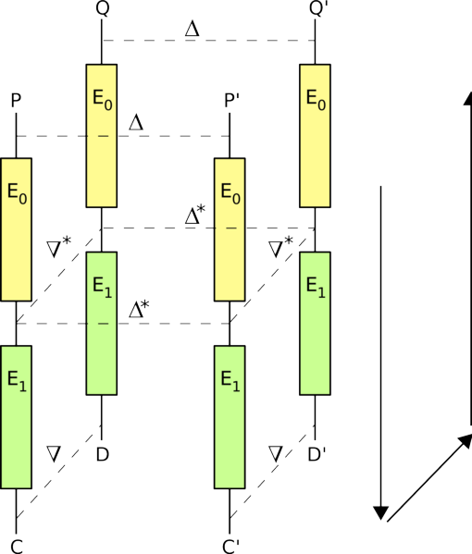
Bommerang Attack

Slide 49
Boomerang Attack
E₀(Q) ⊕ E₀(Q’)
= E₀(Q) ⊕ E₀(Q’) ⊕ E₀(P) ⊕ E₀(P) ⊕ E₀(P’) ⊕ E₀(P’)
= [E₀(P) ⊕ E₀(P’)] ⊕ [E₀(P) ⊕ E₀(Q)] ⊕ [E₀(P’) ⊕ E₀(Q’)]
= [E₀(P) ⊕ E₀(P’)] ⊕ [E₁⁻¹(C) ⊕ E₁⁻¹(D)] ⊕ [E₁⁻¹(C’) ⊕ E₁⁻¹(D’)]
= Δ* ⊕ ∇* ⊕ ∇*
= Δ*

Slide 50
Boomerang Attack
Find characteristic that holds for E₀ and one that holds for E₁
Generate pairs using chosen plaintext –chosen ciphertext queries:
P’ = P ⊕ Δ
Request P,P’ be encrypted to get C, C’
D = C ⊕ ∇
D’ = C’ ⊕ ∇
Request D, D’ be decrypted to get Q,Q’

Slide 51
Key Schedules
Designed to be efficient
  Rekeying (example network applications handling multiple data streams)
  Key (not expanded key) may be stored by application or entered each time cipher is applied – cost of key expansion incurred
Tradeoff – complete lack of randomness in expanded key bits

Slide 52
Key Schedules
Assistance in guessing key bits in any attack
  AES: expanded key bits that are XOR of two other bits
  MISTY1, Camellia: same expanded key bit used in multiple locations
  RC6 : more difficult – no obvious equation relating expanded key bits

Slide 53
Related Keys
Attacker specifies relationship between two keys, but not actual keys
Get plaintext, ciphertext pairs for each key
Try to determine round keys
Example: Slide attack
AES can have two keys K1, K2 such that K2 is K1 slid one round. i.e. expanded key bits of round 1 when using K1 = those for round 2 in expanded key bits of K2
  S-box and XOR with a constant step prevents “sliding” more than one round

Slide 54
Other Attacks
Blockwise Adaptive Attack
Non-linear (algebraic) Cryptanalysis
Square Attack – named for attack on block cipher Square – a predecessor to Rijndael

Slide 55
Reminder: CBC Mode
P₁
P₂
P_{n}
IV
⊕
⊕
⊕
E_{k}
E_{k}
E_{k}
C₁
C₂
C_{n}

Slide 56
Blockwise Adaptive
Consider a block cipher and CBC mode
Environment where see ciphertext from plaintext block i before having to input plaintext block i+1
M1,M2,M3 are three distinct 2b-bit plaintexts.
Know one of M1 and M2 was encrypted. Ciphertext, Cx
CBC mode
Cx
M1, M2 ?
Can form M3 to determine if it is M1 or M2.

Slide 57
Blockwise Adaptive
M3: for first block send an arbitrary b-bit bits, receive the ciphertext, C3[1]
Generate the next b bits of M3 by XORing the first block from Cx, C3[1] and M1[2]
Notation: X[i] = i^{th} block of X

Slide 58
Blockwise Adaptive
M3[2] = Cx[1]
⊕ C3[1] ⊕ M1[2]
M3[1]
IV
⊕
⊕
Cx[1] ⊕ M1[2]
E_{k}
E_{k}
C3[1]
C3[2]
C3[2] = Cx[2] if Cx is the encryption of M1
C3[2] ≠ Cx[2] if Cx is the encryption of M2.

Slide 59
Side Channel Analysis
Differential Fault Analysis – late 1990’s
Timing Analysis – late 1990’s
Power Analysis – late 1990’s
Memory Access – 2005
Applied to Public and Private Key Algorithms
  Public key cipher: attempt to learn non-public parameters
  Block ciphers: attempt to learn input/output of internal rounds and/or expanded key bits.

Slide 60
Agenda
Overview
Block Ciphers:
  Linear
  Differential
  Other Attacks
  Statistical Analysis
Stream Ciphers
General
  Side Channel Attacks

Slide 61
Statistical Tests
Sixteen tests performed on eight sets of data for each cipher.
  Do not prove cipher is secure
  Failing a test indicates a weakness
  NIST AES competition finalists: > 96.33% of cases passing
What if cipher fails a test?
  Some relationship between P,C,K – but don’t know exactly what
  Example, key with a 1 in bit j may be prone to produce ciphertext with more 0’s than 1’s.

Slide 62
Statistical Tests
Frequency (Monobit): are proportions of 0's and 1's in the bit sequence close enough to ½ .
Frequency within a Block: Frequency test applied to fixed-sized blocks within the bit sequence.
Runs: The number of runs (sequence of all 0's or all 1's) in the bit sequence is determined.
Longest Run of Ones within a Block: The longest run of 1's within a block is determined.
Binary Matrix Rank: 32-by-32 matrices are created from the bit sequence and their ranks computed. Determines if any linear dependence among fixed-length segments of bits within the sequence.
Discrete Fourier Transform: determines if there are repetitive patterns in the bit sequence.
Non-overlapping Template Matching: counts the number of times a m-bit pattern occurs in the bit sequence using a sliding window. The window slides 1 bit when no match and slides m bits when a match occurs so a bit will be involved in at most one match for a given pattern. Ex. m = 9
Overlapping Template Matching: same as the previous test except that the window always slides 1 bit.

Slide 63
Statistical Tests
Maurer's Universal Statistical: determines if the bit sequence can be compressed based on the number of bits between occurrences of a pattern.
Lempel-Ziv Compression: determines how much a bit sequence can be compressed based on the number of distinct patterns.
Linear Complexity: Berlekamp-Massey algorithm is applied to a 1000 bit sequence to determine a linear feedback shift register that produces the sequence. The length of the LFRS indicates if the sequence is sufficiently random.
Serial: The number of times each 2^m bit pattern occurs is determined, for some integer m.
Approximate Entropy: The number of times each 2^m and each 2^(m+1) bit pattern is determined, for some integer m.
Cumulative Sums: cumulative sum of the bits is computed for each position in the sequence. The sum is computed by adding -1 for each bit that is 0 and adding 1 for each bit that is 1.
Random Excursions: number of times the cumulative sum crosses zero is determined.
Random Excursions Variant: number of times the cumulative sum is a particular value is determined.

Slide 64
Data Sets
Plaintext Avalanche: key is fixed random value. Random plaintexts. The data tested is the XOR of the encrypted plaintext and the encryption of the plaintext with the ith bit flipped. This is repeated for i = 1 to b+y and for all plaintexts.
Key Avalanche: plaintext of all zeroes. Random keys. The data tested is the XOR of the plaintext encrypted with a random key and the plaintext encrypted with the random key with the ith bit flipped. This is repeated for i= 1 to 128 and for all keys.
Plaintext-Ciphertext Correlation: Random keys and random plaintexts. The data tested consisted of the ciphertext XORed with the plaintext, for all plaintexts and all keys.
High Density Keys: same as the low density keys except keys of all 1's and keys with a single 0 are used instead of all 0's and a single 1.

Slide 65
Data Sets
CBC Mode: Random keys, random plaintexts and an IV of all 0's. For each key, the plaintexts are encrypted using CBC mode.
Low Density Plaintext: Random keys. For each key, a plaintext block of all 0's and every plaintext block containing exactly one 1 are encrypted.
Low Density Keys: Random plaintext blocks. Each plaintext is encrypted with a key of all 0's and every key containing a single 1.
High Density Plaintext: same as the low density plaintexts except plaintexts of all 1's and plaintexts with a single 0 are used instead of all 0's and a single 1.

Slide 66
Agenda
Overview
Block Ciphers:
  Linear
  Differential
  Statistical Analysis
Stream Ciphers
General
  Side Channel Attacks

Slide 67
Cryptanalysis
Single LSRF can easily be broken: Berlekamp-Massey algorithm
Correlation attack
  Keystream generator G consisting of a set of LFSRs and a nonlinear function
  Adversary knows G and some keystream segments
  Try to relate output bits to output of one or more LFSRs
  Exhaustive search over possible states of LFSRs in G
    n LFSRs,
    2^{li} -1 possible initial states for ith LFSR
    Π (2^{li} -1) i = 1 to n combinations
  If each LSFR is correlated to the keystream;
    Σ (2^{li} -1) i = 1 to n combinations (guess 1st LSRF then hold constant, guess 2nd LSFR …)
Notes:
Mention:
Correlation methods are for FRS based ciphers.
For ciphers utilizing other components (S-Box, rounds, functions found in block ciphers) attack depends on design – try to analyze function for flaws
(as we will see with RC4 analysis)
Briefly, distinguishing attacks – indicate if a keystream appears random or not. In doing so, may discover relationship between keystream bits that assists in obtaining the keystream and plaintext; however, as we will see with RC4, just because can distinguish from random, it may not help in breaking the cipher.

Slide 68
Cryptanalysis
Information available to attacker, same idea as with block ciphers:
  Ciphertext only
  Plaintext, ciphertext pairs
    Known plaintext from standard header information in network protocols, file formats
  Chosen, adaptive versions

Slide 69
Cryptanalysis
Distinguishing attacks
  Distinguish keystream from random bits
  Statistical tests
  Does not imply the cipher can be broken in practice
Side channel analysis
  Timing analysis
  Differential Fault
  Memory – are keystream bits and internal state available

Slide 70
Berlekamp-Massey Algorithm
Why LFSR alone is not sufficient
Given a bit sequence, s^{n} = s₀s₁s₂ … s_{n-1,}, finds corresponding LFSR.
Initialize LFSR guess.
Walk through s^{n}, comparing to next output from LFSR.
  If (N+1)^{st} term of LFSR = s_{N} ,LFSR generates s_{N}
  Else modify LFSR
  O(n²) work
Notes:
Berlekamp-Massey
Finds length of LFSR and polynomial representation.
Initial guess is constant LFSR outputs all 0’s
Comparing next LFSR output to next bit in sequence is called:
Next discrepancy d_{N}
Difference between s_{N} and (N+1)^{st} term generated by the LFSR
If length of LFSR ≤ n/2, LFSR is unique
Given bit sequence from a LFSR, algorithm determines the LFSR
Therefore, a keystream generator using only a LFSR is insecure.

Slide 71
LFRS Polynomial Representation
c₁
c₂
c_{n-1}
c_{n}
new b_{n-1}
b₀
b_{n-1}
b_{n-2}
……
b₁
b₀
1 + c₁x + c₂x² + ………..….. c_{n-1}x^{n-1} + c_{n}x^{n}
use b _{n-j} as x^{j} value
new b_{n-1} = c₁b_{n-1} + c₂b_{n-2} + ….. c_{n-1}b₁ + c_{n}b₀
Notes:
Connection Polynomial
1 term = steady state, no feedback
i.e. if LFSR polynomial = 1 then its 1 bit with no feedback

Slide 72
Berlekamp-Massey Algorithm
Input: s^{n} = s₀s₁s₂ … s_{n-1}
C(x) = 1; L = 0; m = -1; B(x) = 1; N = 0; // initialize
while (N < n) {
d = (s_{N} + ∑c_{i} s_{N-i}) mod 2; // next discrepancy
^{i = 1,L}
if (d == 1) { // update LFSR
T(x) = C(x); C(x) = C(x) + B(x)*x^{N-m};
if L ≤ N/2 {
L = N+1-L; m = N; B(x) = T(x);
}
}
++N;
}
return(L,C);
C(X) = polynomial representation of LFSR
c_{i}’s = coefficients of C.
L = linear complexity of LFSR
Notes:
If d_{N} = 1, let m be largest integer < N such that L(s^{m}) < L(s^{N}) (length of LFSR that generates s^{m} is < length of LFSR that generates s^{N}) and let <L(s^{m}),B(D)>be an LFSR of length L(s^{m}) that generates s^{m} then if L > N/2, length does not change.
If L <= N/2, length L changes to N+1-L
In either case, polynomial changes to C(D)+B(D)*D^{N-m}
Algorithm starts by using 1 as polynomial (i.e. no terms), so LFSR outputs 0.
LFSR of length N/2 (N = current # of bits considered in the sequence) is unique, so if it doesn’t match current bit but matched all previous bits, need to change length of LFSR.
Update polynomial: include old polynomial that worked for all previous bits.
Add in correction terms.
L <= N/2: Save current LFSR in B(D) since it generated all previous bits correctly. If mutliply by D^{N-m}, think of as moving bi’s to right (so index increases) by N-m = # of bits seen since last updated L.
L <= N/2, min change in L is N-L+1
(side note: expected change in linear complexity (length) is N+2 –2L statistics presented in Handbook of Applied Cryptography –values computed and graphed).
L > N/2: polynomial not unique. Update, but don’t save old in B(D) or change length.
I.e. in update function B(D) must correspond to polynomial of length <= N/2.
Proof of this equation is by summing all of the terms and showing they produce the desired L.

Slide 73
Berlekamp-Massey Example
Given:
s^{n} = 001101110 , n = 9
Output:
Polynomial: 1+x³+x⁵
Can determine:
values at end of each while loop iteration
s_{n} | d | T(x) | C(x) | L | m | B(x) | N
- | - | - | 1 | 0 | -1 | 1 | 0
0 | 0 | - | 1 | 0 | -1 | 1 | 1
0 | 0 | - | 1 | 0 | -1 | 1 | 2
1 | 1 | 1 | 1+x³ | 3 | 2 | 1 | 3
1 | 1 | 1+x³ | 1+x+x³ | 3 | 2 | 1 | 4
0 | 1 | 1+x+x³ | 1+x+x² +x³ | 3 | 2 | 1 | 5
1 | 1 | 1+x+x²+x³ | 1+x+x² | 3 | 2 | 1 | 6
1 | 0 | 1+x+x²+x³ | 1+x+x² | 3 | 2 | 1 | 7
1 | 1 | 1+x+x² | 1+x+x² +x⁵ | 5 | 7 | 1+x+x² | 8
0 | 1 | 1+x+x²+x⁵ | 1+x³+x⁵ | 5 | 7 | 1+x+x² | 9
x³
x⁵
b₄
b₃
b₂
b₁
b₀
b₀
b₄ = b₀+b₂ mod 2
Initial state 00110
01100: 0 ⊕ 1, move in 1, output 0
10110: 0 ⊕ 1, move in 1, output 0
11011: 1 ⊕ 0, move in 1, output 1
11101: 1 ⊕ 1, move in 0, output 1
01110: 0 ⊕ 1, move in 1, output 0
10111: etc …
N = 4, L = 3: C(x) = c₁s₂ + c₂s₁ + c₃s₀ = 1*1+0*0+1*0 = 1
s₄ = 0≠ C(x), so set d = 1
.
Notes:
In line N = 3, N =2 and L was 0 going in so discrepancy is just s₃ = 1 (i.e. no terms in ∑)
L becomes N+1-L = 2+1-0 = 3
B(D)*D^{N-m} = 1*D^{2—1} = D³
Highest power in polynomial = length of LFSR
When N = 4:
c₁s₃ + c₂s₂ + c_{L}s_{4-L}

Slide 74
Cryptanalysis
Attacks on non-FSR designs
  Depends on components
  Analyze function for relations between
    Keystream and key or initial state
    Keystream bits
Guessing subset of unknown bits used internally to determine state

Slide 75
Cellular Encryption
History of poor algorithm choice
A5/1
A5/3
Don’t create algorithms without understanding requirements and attacks
  Last October received an email from rep on standards committee: if we tweak A5, will it work, need answer in a day

Slide 76
A5/1
Used in Global System for Mobil Communications (GSM)
Example of a cipher manufacturers tried to keep secret, it was leaked and also reversed engineered within 5 years
A5/2 – weaker cipher used in some countries due to export rules
GSM phone conversations are sent as sequences of frames.
One 228 bit frame is sent every 4.6 milliseconds: 114 bits for the communication in each direction.
A5/1 produces 228 bits to XOR with the frame
Initialized using a 64-bit key combined with a publicly-known 22-bit frame number.
In some GSM implementations, 10 key bits are fixed at zero - effective key length is 54 bits.
A5/1 is based around a combination of three LFSRs with irregular clocking.

Slide 77
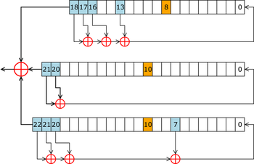
A5/1
Image from Wikipedia

Slide 78
A5/1 LFSRs
19 bits
  x¹⁹ + x⁵ + x² + x + 1
  clock bit 8
  tapped bits: 13, 16, 17, 18
22 bits
  x²² + x + 1
  clock bit 10
  tapped bits 20, 21
23 bits
  x²³ + x¹⁵ + x² + x + 1
  clock bit 10
  tapped bits 7, 20, 21, 22
Least significant bit numbered 0
Tapped bits of each LFSR are XORed to create value of next 0 bit.
Output bits of the three LFSRs are XORed to form the keystream bit

Slide 79
A5/1
Each cycle, look at the three clock bits. The majority value, c_{m}, is determined.
In each LFSR, if the clock bit matches c_{m}, the registers are clocked.
In each cycle, 2 or 3 LFSRs will be clocked.

Slide 80
A5/1 Initialization
Registers set to all 0’s
Incorporate the key and frame number:
  For 64 cycles, the key is mixed in by XORing the ith key bit with the least significant bit of each register
  For 22 cycles, the 22 bit frame value is mixed in – same as with key value
  Normal clocking used
100 cycles are run using the majority clocking, the output is discarded
End result is the initial state

Slide 81
A5/1
Three short LFSRs
Not many tap bits to guess

Slide 82
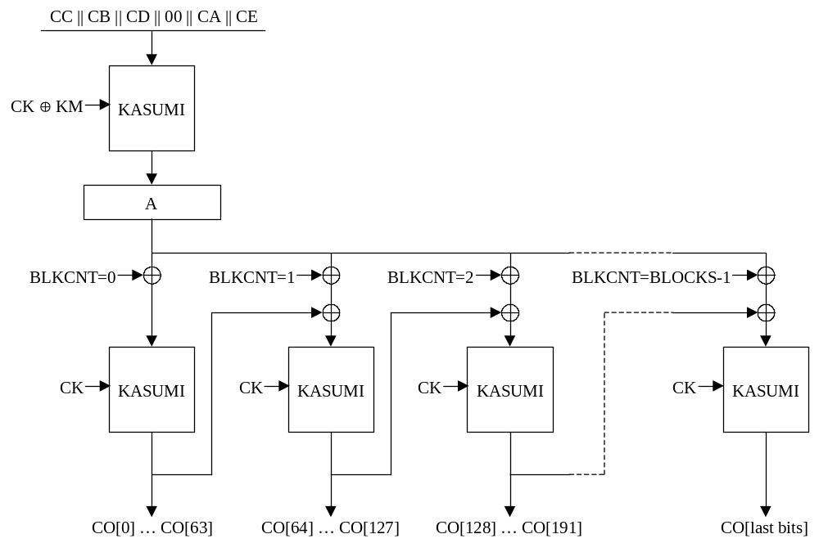
A5/3 Core
BLCNT is a 64 bit counter
KM = 0x555….555 (128 bit key modifier)
CK = key bits
defined on next slide
CBC XORed with counter and key
A ⊕ counter ⊕ previous output

Slide 83
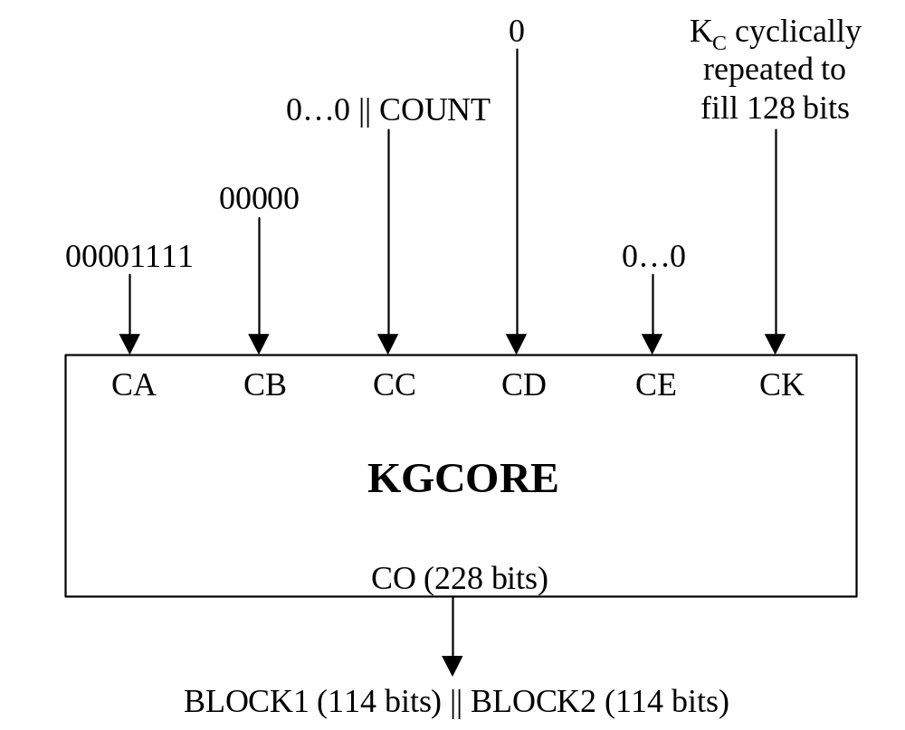
A5/3 GSM
K_{c} = key
http://www.gsmworld.com/using/algorithms/docs/a5_3_and_gea3_specifications.pdf

Slide 84
Agenda
Overview
Block Ciphers:
  Linear
  Differential
  Statistical Analysis
Stream Ciphers
General
  Side Channel Attacks

Slide 85
Side Channel Analysis
Time
  Does the number of CPU cycles depend on exact values used in the operation? ex. RSA exponent
  Memory access – do exact values impact tables used, time to read from a table and/or number of memory accesses? ex. AES using tables of 32-bit values
Acoustics
  Impacted by operations or exact values used?
Memory
  Can intermediate values be read from memory by another process?

Slide 86
Timing – Toy Example
k: array of n key bytes
d: 16 byte data
Suppose encryption is a series of n rounds
n = 16;
d = plaintext;
for (i=0; i < n; ++i) {
d = f(d,k[i]); // do something to the data with k, but
// whose time does not depend on k
  d[i] = d[i] ^{int(k[i])} mod 256; // alter one byte, time depends on k
}

Slide 87
Timing – Toy Example
What if use a table lookup instead?
table(a,b): function retrieves table a, entry b
d = plaintext;
x = 0;
for (i=0; i < n; ++i) {
  // do something to the data with k where time does not depend on k
  d = f(d,k[i]);
  // memory lookup - was table already in cache?
  // (k[i] same as a previous key byte)
  x= table(k[i], d[i]);
}

Slide 88
Timing and Power Analysis
P. Kocher, Timing Attacks on Implementations of RSA, DH, DSS and Other Systems, Crypto 1996.
A. Shamir and E. Tromer, Acoustic Cryptanalysis on Nosy People and Noisy Machines, 2004 presentation
J. Kelsey, B. Schneier, D. Wagner and C. Hall, Side Channel Cryptanalysis of Product Ciphers. Journal of Computer Science, 8(2-3),pages 141-158, 2000. (DES, IDEA, RC5 used in examples)
Companies, ex. Riscure, sell software for performing timing analysis on smart cards.

Slide 89
Differential Fault
Induce faults into the device
Observe outputs without the fault and with the fault
Example: radiation
Exact fault introduced likely to be unknown
Assumes device can be tampered with – chips may be designed to stop working if tampered with, enclosures such as wire mesh
Less practical then timing attacks
Public Key Ciphers: Boneh, Denillo and Lipton, On the Importance of Checking Cryptographic Protocols for Faults. Eurocrypt 1997.
Private Key Ciphers: Biham and Shamir, Differential Fault Analysis of Secret Key Cryptosystems, Technion CS Technical Report 1997.

Slide 90
Memory
Process accessing same memory (cache) used by the cipher may obtain information
Used to attack AES (specific OS, implementation)
If attacker can perform the attack, there are greater security concerns about the system.
Osvik, Shamir, Tromer, Cache Attacks and Countermeasures, the Case of AES. CT-RSA 2006.

