Slide 1
Fundamentals of Applied Cryptanalysis
Dr. Tomáš Rosa, trosa@ebanka.cz

Slide 2

Agenda
Cryptanalytic weaknesses in general
Side channels
Exemplar vulnerabilities
  Fault attack on RSA handshake in SSL/TLS
  CBC with PKCS#5
  El Gamal in former GnuPG
  Misbehaved RSA signature verification
  Combined attack on a S/MIME message

Slide 3
Contemporary Cryptography
Fascination by a black-box approach
  Autonomous, easy-to-deploy modules.
  Weak knowledge or even an active unconcern about the inner mechanisms.
  Ignorance of elementary principles.
  Absence of a usable quality standard.

Slide 4

Contemporary Cryptanalysis
Surprising attacks in unexpected places
  Usually highly effective and hard to detect techniques.
Side channels
  Underestimation of the physical nature of cryptographic devices.
Science leaps
  Underestimation of the heuristic nature of cryptographic algorithms.
Social engineering
  Underestimation of the human factor.

Slide 5
Side Channel
Any undesirable way of information exchange between a cryptographic module and its neighbourhood.
  Timing
  Power
  Electromagnetic
  Fault
  Kleptographic
Side channel

Slide 6
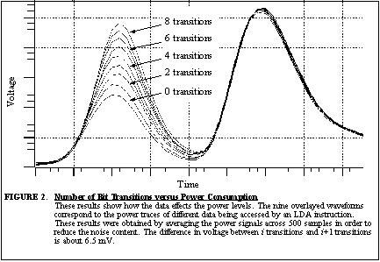
Side Information Leakage – an Example
Hamming distance of two data blocks being accessed by a certain instruction of an analyzed code.
Messerges et al.
USENIX ‘99
Notes:
[MDS99a] Messegers, T.-S., Dabbish, E. A. and Sloan, R. H.: Investigations of Power Analysis Attacks on Smartcards, in Proc. of USENIX Workshop on Smartcard Technology, pp. 151-161, 1999.

Slide 7



Another Example – Fault Channel
clients
SSL/TLS
server
ClientKeyExchange_{RSA}, Finished
C = [ϕ(premaster-secret)]^{e} mod N
computation:
P ← C^{d} mod N
premaster-secret ← ϕ⁻¹(P)
if (exception in ϕ⁻¹)
premaster-secret ← RAND(48)
else
if(bad version of premaster-secret)
“Alert-version”
Fault side channel
Finished/Alert

Slide 8
Erstwhile Cryptanalysis
An analyst had an intercepted ciphertext.
In some cases, she knew even (!) a description of the algorithm used.

Slide 9
Contemporary Cryptanalysis
Analyst directly communicates with the system being attacked – she requests the module to carry out allowed commands.
The attack reminds an ordinary game – when the analyst wins, the system is broken.
  To win usually means to make the device carry out such a command that shall be disallowed.

Slide 10
Science Leaps
Truly provable security remains an illusion.
  We usually hope the system is as secure as a certain problem is hard, and we hope that the problem is infeasible.
  However, there should be “we can prove” instead of “we hope”.

Slide 11
Sudden Breakdown…
…shall be expected for every cryptographic algorithm around the world.
Reality, however, is totally different:
  Applications are unable to change the broken algorithm quickly enough. Some modules cannot do that at all.
    One reason: Missing algorithm identifiers.
  There are no recovery plans for such situations.

Slide 12
Social Engineering (SE)
Abused as a platform for highly effective attacks.
The attacks are based on weaknesses in ordinary behavioral patterns.
  User confusion by counterfeit data.
  Predictability of users reactions on certain exterior stimulations.

Slide 13
Attack on RSA in SSL/TLS
References:
Bleichenbacher, D.: Chosen Ciphertexts Attacks Against Protocols Based on the RSA Encryption Standard PKCS#1, in Proc. of CRYPTO '98, pp. 1-12, 1998
Klíma, V., Pokorný, O., and Rosa, T.: Attacking RSA-based Sessions in SSL/TLS, in Proc. of CHES '03, Cologne, Germany, September 7-11, pp. 426-440, Springer-Verlag, 2003
PKCS#1 v2.1: RSA Cryptography Standard, RSA Laboratories, http://www.rsa.com/rsalabs/node.asp?id=2125

Slide 14

Overview
In 1998, Bleichenbacher shown an attack on RSAES-PKCS1-v1_5. SSL/TLS was regarded to be immune.
  However, certain countermeasures were applied.
We show an extension of Bleichenbacher’s attack which applies to several SSL/TLS implementations and is practically feasible.
  Therefore, SSL/TLS was not as immune as was deemed earlier.
In 2003, the discovery hit approx. 2/3 of internet servers worldwide.

Slide 15
SSL/TLS
Session Setup
server
clients
ClientHello
ServerHello, ..., ServerHelloDone
..., ClientKeyExchange, Finished
Finished
Transport channel

Slide 16
Fault Side Channel
clients
SSL/TLS
server
ClientKeyExchange_{RSA}, Finished
C = [ϕ(premaster-secret)]^{e} mod N
computation:
P ← C^{d} mod N
premaster-secret ← ϕ⁻¹(P)
if (exception in ϕ⁻¹)
premaster-secret ← RAND(48)
else
if(bad version of premaster-secret)
“Alert-version”
Fault side channel
Finished/Alert

Slide 17

Core of the Attack: Valid Padding Oracle
Seeing “Alert-version” we know that P = 00 02 ….
  We write P ∈ <E, F> for certain interval <E, F> ⊂ <0, N>.
Let C₀ be the ciphertext we want to invert (with respect to RSA).
  C₀ = P₀e mod N
Let C = C₀s^{e} mod N, s ∈ Z and denote P = C^{d} mod N.
  P is a known transformation of an unknown plaintext, P = P₀s mod N.
Now, seeing “Alert-version” we know that E ≤ sP₀ mod N ≤ F.
From here, we get a useful information on P₀:
  (E+rN)/s ≤ P₀ ≤ (F+rN)/s, for certain r ∈ Z.
  We obtain a set of intervals which may contain P₀.
Using s producing “Alert-version”, we can narrow the set of solutions for P₀ to get one particular value. This is then the inverse of C₀.
  Each such s roughly halves the set of candidates for P₀.

Slide 18
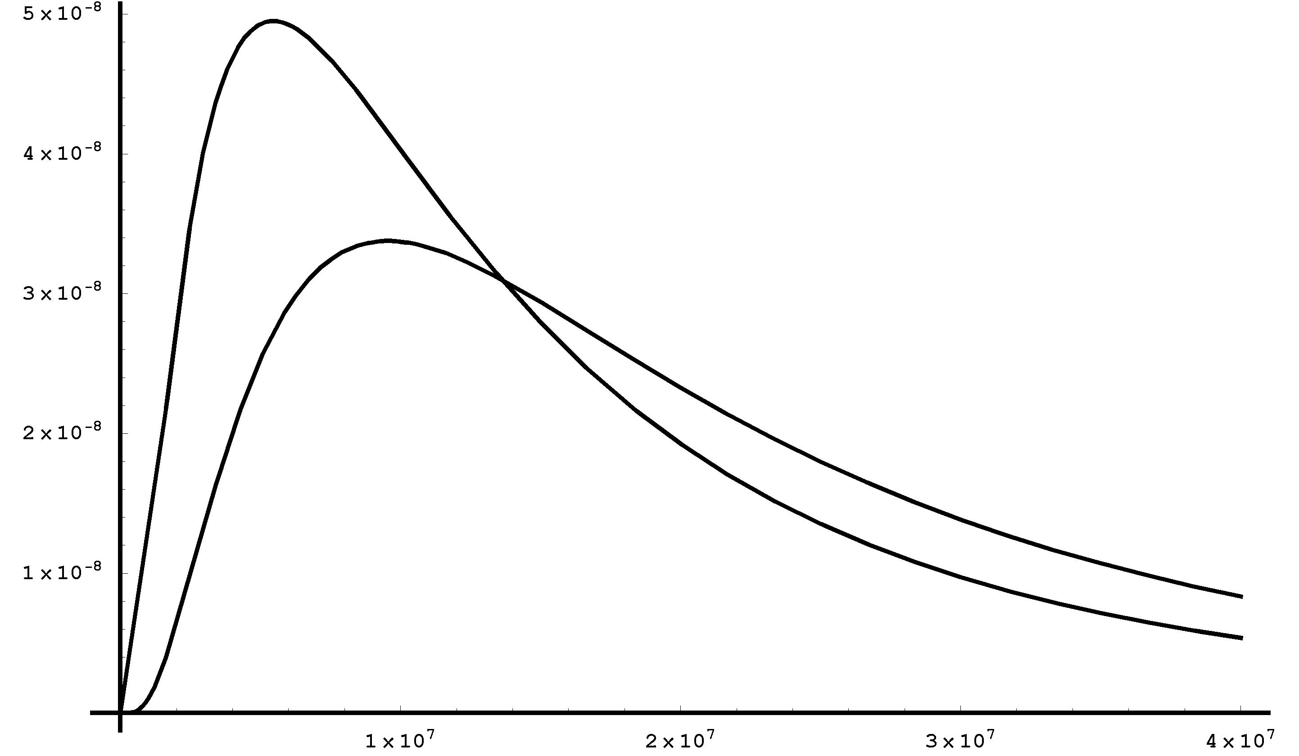
Amount of Server Calls
1024 bit RSA key
min: 815 835
median: 13 331 256
2048 bit RSA key
min: 2 824 986
median: 19 908 079

Slide 19
Countermeasures
If possible, use OAEP padding instead.
  Be aware about similar Manger’s attack.
If PKCS#1 v. 1.5 must be used anyway, then one shall prevent valid-padding-oracle to occur.
  One technique is to generate a new random message payload if the structure of the plaintext is not correct.

Slide 20
CBC with PKCS#5
References:
Vaudenay, S.: Security Flaws Induced By CBC Padding - Application to SSL, IPSEC, WTLS..., in Proc. of EUROCRYPT '02, pp. 534-545, Springer-Verlag, 2002
Black, J. and Urtubia, H.: Side-Channel Attacks on Symmetric Encryption Schemes: The Case for Authenticated Encryption, In Proc. of 11th USENIX Security Symposium, San Francisco, pp. 327-338, 2002
Klíma, V. and Rosa, T.: Side Channel Attacks on CBC Encrypted Messages in the PKCS#7 Format, in Proc. of 2nd International Scientific Conference: Security and Protection of Information, pp. 75-83, NATO PfP/PWP, Czech Republic, 2003
PKCS#5 v2.0: RSA Cryptography Standard, RSA Laboratories, http://www.rsa.com/rsalabs/node.asp?id=2127

Slide 21
Overview
Vaudenay showed that the CBC encryption mode with the PKCS#5 padding is vulnerable through a fault side channel attack.
This result can be easily extended on other cryptographic modes as well on structure oracles.
  Type-Length-Value structure is especially a good candidate for such an attack.

Slide 22
Basic CBC Properties Recalled
P_{i} = D_{K}(C_{i}) ⊕ C_{i -1} , i > 0, C₀ =^{def} IV
  Changes in cipherblock C_{i -1} propagate linearly and deterministically into changes of the plaintext block P_{i}.
  No matter how strong the cipher is.
  An effect of (i –1)^{th} block corruption vanishes starting by block (i + 1).
    It affects only P_{i} and P_{i -1}.

Slide 23
CBC Properties Illustrated
C_{i-1}=
C_{i-1,B}
C_{i-1,2}
C_{i-1,1}
C_{i}=
C_{i,B}
C_{i,2}
C_{i,1}
D_{K}
W_{i}=
W_{i,B}
W_{i,2}
W_{i,1}
+
+
+
P_{i}=
P_{i,B}
P_{i,2}
P_{i,1}

Slide 24
Valid Padding Oracle of PKCS#5
Main issue of CBC-PKCS#5
  There is an oracle telling us for arbitrary chosen binary strings y, γ, and a given key K if:
    the value of x = D_{K}(y) ⊕ γ satisfies x ∈ PAD
    PAD = { *||01, *||0202, *||030303, ... }
      The length of every x, x ∈ PAD, equals to the block length of the particular CBC mode.
  Such an oracle can be used to compute D_{K}(y) effectively.
    First, we search for γ₁ inducing x ∈ {*||01}, then for γ₂ inducing x ∈ {*||0202}, etc.

Slide 25
Countermeasures
If possible, use a different method of padding.
  However, there is not a world wide standard for that. ABYT/ABIT schemes are good candidates.
  Be aware - methods preventing VPO can be still attacked through different oracles.
General countermeasure is to strictly apply integrity check for the ciphertext.
  Even though integrity was not a primary security goal.
  EtA rule: Encrypt then authenticate.

Slide 26
ElGamal in GnuPG
(illustrated on properties of DSA)
References:
Nguyen, P.-Q.: Can We Trust Cryptographic Software? Cryptographic Flaws in GNU Privacy Guard v1.2.3, in Proc. of Eurocrypt ‘04, pp. 151-176, Springer-Verlag, 2004
Rosa, T.: One-Time HNP or Attacks on a Flawed El Gamal Revisited, IACR ePrint archive 2005/460.
Hlaváč, M. and Rosa, T.: Extended Hidden Number Problem and its Cryptanalytical Applications, in Proc. of SAC 2006, pp. 110-128, Montreal, August 2006, Springer-Verlag, 2007

Slide 27
Overview
Versions affected: 1.0.2 … 1.2.3
Current status: Patched
Inappropriately shortened private key and NONCEs opened a vital subliminal channel leaking a part of the private within each signature made.
In fact, one signature was enough to recover the whole private key.

Slide 28
Illustration Using DSA
Let us recall the signature relations of DSA:
  r = (g^{k} mod p) mod q,
  s = (h(m) + xr)k⁻¹ mod q,
  the signature is the ordered pair (r, s),
  k is a secret integer, 0 < k < q, called NONCE,
    NONCE as a Number used ONCE
  x is the private key, 0 < x < q.

Slide 29
Trivially…
Knowing the signature together with its NONCE reveals the private key.
  x = (ks – h(m))*r ^{–1}mod q
Using the same NONCE twice reveals the private key.
  xr₁ – ks₁ + h(m₁) ≡ 0 (mod q)
  xr₂ – ks₂ + h(m₂) ≡ 0 (mod q)
  x = (s₁s₂⁻¹h(m₂) – h(m₁))*(r₁ – s₁s₂⁻¹r₂)⁻¹ mod q

Slide 30
Partially Known NONCEs
We start with a system of linear congruences.
  A = { xr_{i} - k_{i}s_{i} + h(m_{i}) ≡ 0 (mod q) }_{i = 1}^{d}
Heuristically: Knowing a certain bit of certain k_{i} gives us roughly 1b of information about the private key x. Through A, this information cumulates and may finally lead to the private key disclosure.
  Leads (e.g.) to a Hidden number problem that can be solved using popular lattice-base methods (LLL an the others).

Slide 31

GnuPG Flaw in Pictures
modulus
1
private key
zeros
1
NONCE
zeros
1
A few quotes (as Nguyen quotes the developers):
  “I don’t see a reason to have a x of about the same size as the p.”
  “IMO using a k much lesser than p is sufficient and it greatly improves the encryption performance.”

Slide 32
Recommendation
Do not change anything on the particular scheme unless you are pretty sure that you are doing the right thing.

Slide 33
Misbehaved RSA Signature Verification
References:
Bleichenbacher, D.: Forging some RSA signatures with pencil and paper, Rump Session of CRYPTO 2006
http://www.mail-archive.com/cryptography@metzdowd.com/msg06537
PKCS#1 v2.1: RSA Cryptography Standard, RSA Laboratories, http://www.rsa.com/rsalabs/node.asp?id=2125

Slide 34
Overview
It concerns RSA signature scheme according to the worldwide common standard PKCS#1 ver. 1.5.
The core lies in the verification procedure. In particular, it is in the transform ψ*.
The result is that, without knowing the private key, an attacker can produce a (pseudo)signature of any message which is considered valid by the faulty transform ψ*.

Slide 35
We Shall Keep On Mind
It is not always necessary to disclose the private key to be able to mount a successful attack on RSA.
In fact, the attacker wants e.g. to get some money from an account, she usually does not care about the cryptographic keys too much.

Slide 36
Implementation Attack
Under certain conditions, RSA cryptosystems are considered as being secure.
However, not fulfilling these conditions usually produces a disastrous affect.
Implementation procedure is usually the place where this dis-fulfillment occurs.
  The source code can work fine technically, but, from a cryptographer’s viewpoint, it may create a totally different cryptosystem which is intrinsically weak.

Slide 37
Signature Forgery
We exploit a faulty implementation of the verification procedure.
Let s be a signature according to RSASSA-PKCS-v1_5.
For m = s^{e} mod N it shall be verified that:
  m = 00 01 FF … FF 00 ID_{h} h(M), cf. PKCS#1.
modulus N
≠ 0 | .. | .. … .. | .. | .. … ..
m = s^{e} mod N according to EMSA-PKCS1-v1_5
00 | 01 | FF ... FF | 00 | ID_{h}||h(M)

Slide 38
Weakness á la OpenSSL
There can be a nonempty string GRB concatenated to m from the left, cf. bellow.
modulus N
≠ 0 | .. | .. … .. | .. | .. … ..
m = s^{e} mod N according to EMSA-PKCS1-v1_5
00 | 01 | FF ... FF | 00 | ID_{h}||h(M) || GRB

Slide 39
Another Weakness
The one and only check done is that the value of h(M) is at its rights position in m, cf. bellow.
modulus N
≠ 0 | .. | .. … .. | .. | .. … ..
M = s^{e} mod N according to EMSA-PKCS1-v1_5
.. | .. | .. … .. | .. | … || h(M)

Slide 40
Exploitation I
If the implementation is correct, the attacker has to solve a (precise) discrete e-th root problem.
  Given (N, e, m), find s, such that s^{e} mod N = m.
  This is considered as a hard problem for an appropriately generated public key (N, e).

Slide 41
Exploitation II
However, if the implementation is incorrect (in the aforesaid sense), it suffices to solve an approximate discrete e-th root problem.
  Given (N, e, m), find s, such that s^{e} mod N is somehow sufficiently close to m.
  This can be a considerably easier task.

Slide 42
For Instance…
Let e be a natural number and x an integer, such that x^{1/e} ≥ (e-1)/2.
Let v = ⎣x^{1/e}⎦, i.e. v = max { u ∈ Z: u^{e} ≤ x }.
  Such a v can be easily found by an algorithm for integer approximation of the real e-th root.
Then 0 ≤ x – v^{e} < e*x^{(e-1)/e}.
  In particular, let N be an RSA modulus, m a formatted message, and e = 3 a public exponent.
  Then 0 ≤ m – (v^{e} mod N) < 3*N^{2/3}.

Slide 43
Consequences
(!) Easy and straightforward signature forgery for keys with low public exponents (i.e. 3, 5, 7, 17, …).
  The effectiveness depends on modulus size. Prolonging the modulus helps the attacker here!
For higher public exponents (65537) it is at least a significant certification weakness.
  Note that one can hardly be sure about the public exponents of clients’ keys…

Slide 44
Recommendation
Do a penetration test as a prevention.
  Fortunately, all these weaknesses can be tested via a black box approach.
  Using a test RSA key pair, a tester prepares various pseudo-signatures and passes them to the verification procedure.
  If the procedure accepts any one of these pseudo-signatures, it is vulnerable and shall be patched immediately.

Slide 45
Combined Attack on S/MIME Message
Presented as an example of the combined attack.

Slide 46
Overview
Future attacks shall combine:
Elementary mathematical weaknesses
  Formerly hard problem may have a surprisingly easy-to-find solution.
Implementation weaknesses – mainly side channels
  The module under attack cooperates with an attacker.
Human factor weaknesses
  Confused user cooperates with an attacker.

Slide 47
Example of the Attack 1/4
An attacker intercepts an encrypted message addressed to her victim.
  We assume a standard e-mail communication according to S/MIME v. 3 (RFC 2633) using cryptographic structures according to CMS (RFC 3852).

Slide 48
Example of the Attack 2/4
The attacker pretends she sends the victim a message of her own.
  In reality, it is a derivative of the intercepted ciphertext which she wants to decipher.
  We employ a combination of approaches A (encryption mode properties) and B (insufficient integrity check in the e-mail application).

Slide 49
Example of the Attack 3/4
The victim deciphers the attacker’s message, but all that she sees is a gibberish text.
  The attacker convinces the victim to send the gibberish text back. She pretends, for instance, that she tries to identify a bug in her system or simply says the she does not believe the victim that the text is a nonsense.
  The victim slips away and sends the text back, since it all looks “so innocent”.
  We use the approach C (human factor confusion).

Slide 50
Example of the Attack 4/4
The attacker receives the „gibberish“ text from her victim, removes the mask transform influence she used before, and finally gets the plaintext of the intercepted message.
  We use the approach A (encryption mode properties).

Slide 51




Plan of the Attack Illustrated
1
2
3
Former sender
Former receiver
4
Attacker

Slide 52
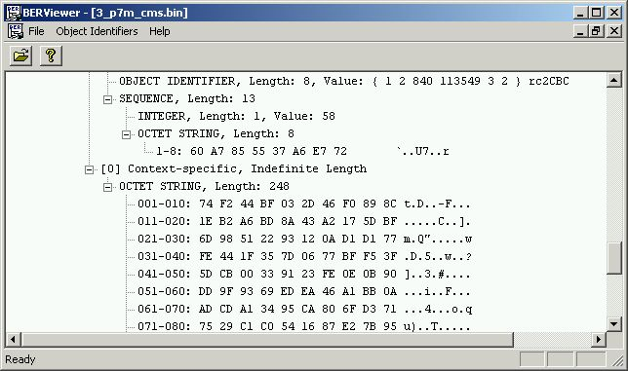
Practice: The attacker modifies the intercepted ciphertext

Slide 53
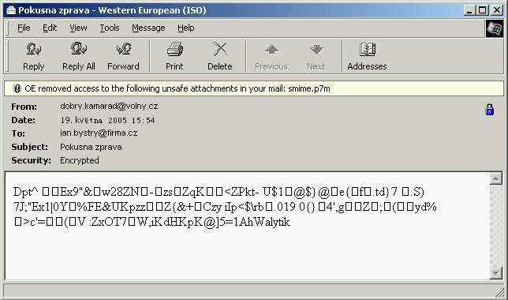
Practice: The victim tries to decipher the message

Slide 54
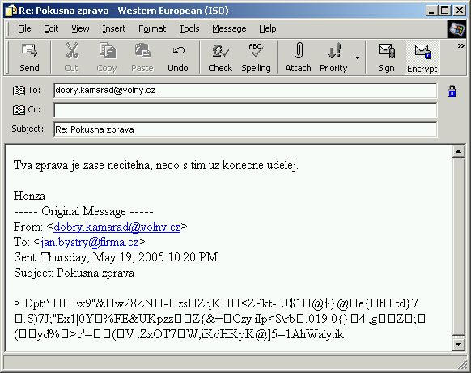
Practice: The victim returns back the „innocent-looking“ text
What the hell is this…?
Resend it, please!

Slide 55
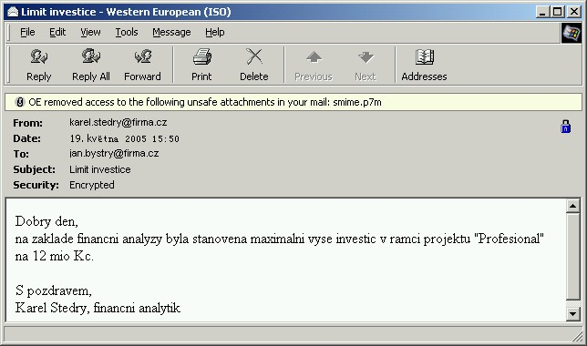
Practice: The attacker gets what she wants
Our budget for that business is at most…

Slide 56
CBC Mode Illustrated
m_{i-1}
m_{i}
m_{i+1}
+
+
+
E
E
E
c_{i-2}
c_{i-1}
c_{i}
c_{i+1}
D
D
D
+
+
+
m_{i-1}
m_{i}
m_{i+1}

Slide 57
The Masking Principle
c_{i-1}
c_{i-1}⊕w_{i}
c_{i}
c_{i}⊕w_{i+1}
c_{i+1}
D
D
D
D
+
+
+
+
ξ_{i}
m_{i}⊕w_{i}
ξ_{i+1}
m_{i+1}⊕w_{i+1}
CT’ = IV ⊕ w₁, c₁, c₁ ⊕ w₂, c₂, c₂ ⊕ w₃, …, c_{n-1}, c_{n-1} ⊕ w_{n}, c_{n}

Slide 58
Recommendation
The e-mail security policy shall tell users not to resend any gibberish text.
  Simply yet powerful countermeasure against the simple yet powerful attack.

Slide 59
Conclusion
Besides the applied cryptography, there is also the applied cryptanalysis.
Cryptographic schemes are not untouchable – they can be attacked and broken.
We shall fully reflect these facts.
  That reflection concerns the application development as well as the security management.

