Slide 1








Introduction to Cryptographic Currencies
Claudio Orlandi cs.au.dk/~orlandi
Thanks to: Jon K. Sørensen and Peter S. Nordholt

Slide 2

Leave while you can!
I will NOT talk about:
Politics
Economics
…
Coming up next:
Algorithms
Cryptography
…

Slide 3




Outline
Part 0: a little history
Part 1: TheoryCoin
How to create coins
How to transfer coins
How to store coins
Part 2: diff( , )
Part 3: Problems and issues

Slide 4
crypto currency

Slide 5
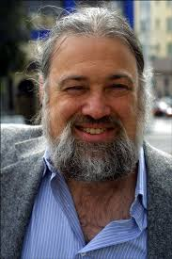
The 1990s David Chaum and anonymous ecash
“The difference between a bad electronic cash system and well-developed digital cash will determine whether we will have a dictatorship or a real democracy”
(attributed to Chaum)

Slide 6







Anonymous payments
M or L?
”withdraw”
”withdraw”

Slide 7


Chaum’s anonymous e-cash
anonymous
secure (no double-spending)
only transfer (no creation/storage)
…and bankrupted in 1999

Slide 8
The advent of Bitcoin
2009: Bitcoin announced by Satoshi Nakamoto
Pseudonym for person or group of person
2009-2011: slow start…
2011-2013: Silk Road and Dread Pirate Roberts
End 2013: Bitcoin price skyrockets
and the world notices!

Slide 9
Outline
Part 0: a little history
Part 1: TheoryCoin
How to create coins
How to transfer coins
How to store coins
Part 2: diff( , )
Part 3: Problems and issues

Slide 10
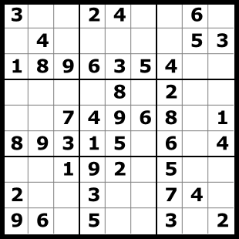

TheoryCoin: How to create money
Everyone tries to solve a puzzle
The first one to solve the puzzle gets 1 TC
The solution of puzzle i defines puzzle i+1

Slide 11
TheoryCoin: How to create money
L ∈ {0,1}*
R ∈ {0,1}*
SolvePuzzle(L){
repeat{
R = my_name || i++
T = H(L,R)
}while(T ≠ 0^{d})
return R
}
H
(a random function)
T ∈ {0,1}^{d}
The puzzle: given L, find R
such that T=0^{d}
* aka Proof-of-Work

Slide 12
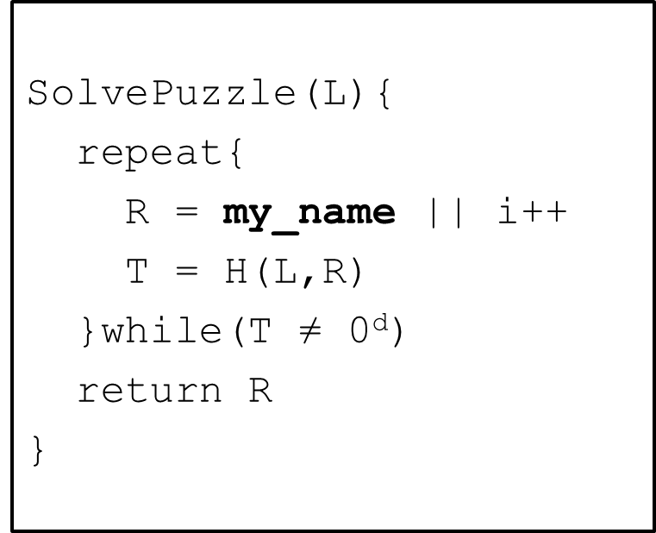
TheoryCoin: (coins to ppl) How to create money
x₀ = Start!
x₁ =(P₁, i₁)
x₂=(P₂, i₁)
x₃=(P₃, i₃)
H
H
H
P₂
x₁
x₂
x3
000…000
000…000
000…000
x₂
P₁
x₁
x₃
P₃
* aka the blockchain

Slide 13
TheoryCoin: How to create money
x₃=(P₃, i₃)
x₆=(P₃, i₆)
x₇=(P₃, i₇)
x₀=Start!
x₁=(P₁, i₁)
x₂=(P₂, i₂)
x₄=(P₄, i₄)
x₅=(P₅, i₅)
* aka the 51% attack

Slide 14
TheoryCoin: How to create money
Recap:
Solve the next puzzle → get a coin
To “solve” puzzle i find x_{i} s.t H(x_{i-1},x_{i})=0^{d}
The longest chain defines “next puzzle”
The name in block x_{i} “gets” coin i.

Slide 15
Outline
Part 0: a little history
Part 1: TheoryCoin
How to create coins
How to transfer coins
How to store coins
Part 2: diff( , )
Part 3: Problems and issues

Slide 16
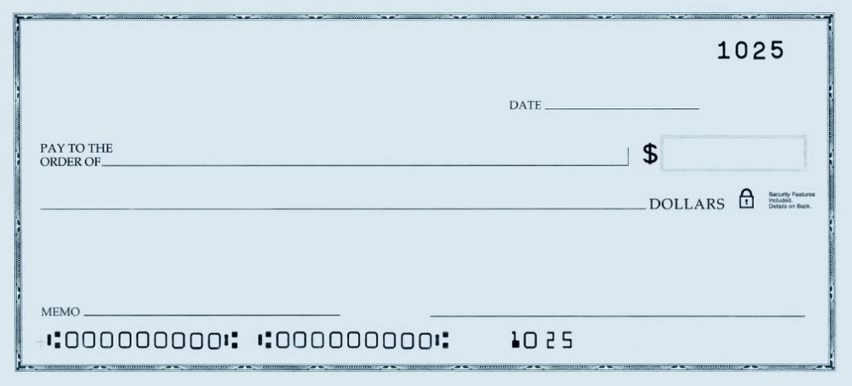
TheoryCoin: How to transfer money
(Digital) Signatures
Only you can sign
Everyone can verify
You cannot deny
Give coin 3 to Jesper
Claudio

Slide 17
TheoryCoin: How to transfer money
Gen
“Your pin code”
“Your username”
secret key
public key
message
message, signature
accept/reject
Sign
Verify

Slide 18
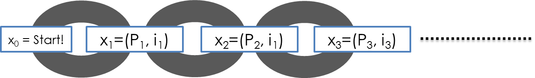
TheoryCoin: How to transfer money
If Ver(pk3,m,s) = accept
and
P3 owns coin 3
then return accept
m=“P3 gives coin 3 to P1”
s=Sig(sk3,m)
P₃
P₁

Slide 19
TheoryCoin: How to transfer money
m1=“P3 gives coin 3 to P1”
s1=Sig(sk3,m1)
P₁
accept
P₃
P₂
accept
m2=“P3 gives coin 3 to P2”
s2=Sig(sk3,m2)
* aka double spending

Slide 20

TheoryCoin: How to transfer money
write (m1,s1)
read (m1,s1)
P₁
write (m4,s4)
accept
...
(m1,s1)
...
(m2,s2)
...
(m4,s4)
P₃
write (m2,s2)
read (m2,s2)
P₂
reject
read (m4,s4)
P₄
m1 = “P3 gives coin 3 to P1”
s1 = Sig(sk3,m1)
m2 = “P3 gives coin 3 to P2”
s2 = Sig(sk3,m2)
m4 = “P1 gives coin 3 to P4”
s4 = Sig(sk1,m4)

Slide 21
Outline
Part 0: a little history
Part 1: TheoryCoin
How to create coins
How to transfer coins
How to store coins
Part 2: diff( , )
Part 3: Problems and issues

Slide 22
TheoryCoin: How to store money
Main Idea:
Record transfers in the blockchain

Slide 23
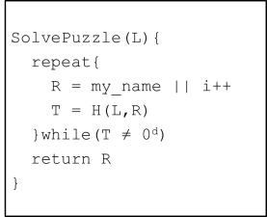
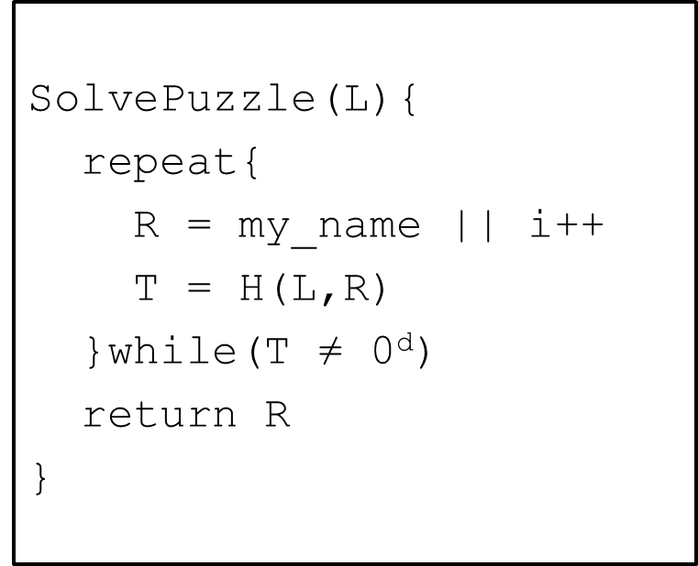
TheoryCoin: How to store money
SolvePuzzle(L,...){
repeat{
R = my_name||(m,s)|| i++
T = H(L,R)
}while(T ≠ 0^{d})
return R
}
P₁
(m,s)
P₃
(m,s)
P₂
(m,s)
P₄
x₄=(P4, (m,s), i₄)

Slide 24
Outline
Part 0: a little history
Part 1: TheoryCoin
How to create coins
How to transfer coins
How to store coins
Part 2: diff( , )
Part 3: Problems and issues

Slide 25
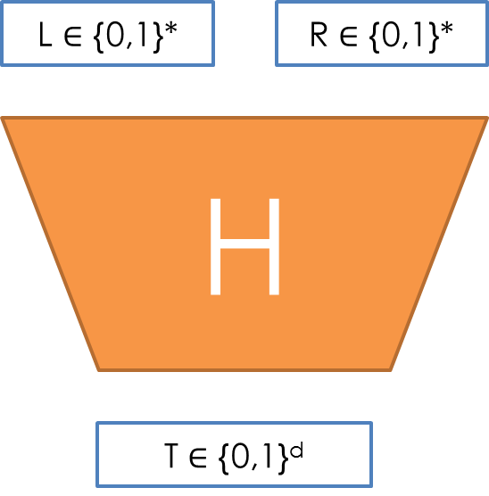
diff( , ) How is money created in Bitcoin?
New block every ~10 mins
d adjusted every ~2000 blocks
H = 2-SHA2
Initial reward: 50 BTC
Halved every ~4 years (now 25 BTC)

Slide 26
diff( , ) How is money transferred in Bitcoin?
Example: P1 wants to give 60 to P2
P1 gives 60 to P2
P2 gives 42 to P3
... gives 50 to P1
P2 gives 17 to P2
P1 gives 14 to P1
… gives 25 to P1
Transaction fee 1
Transaction fee 1

Slide 27
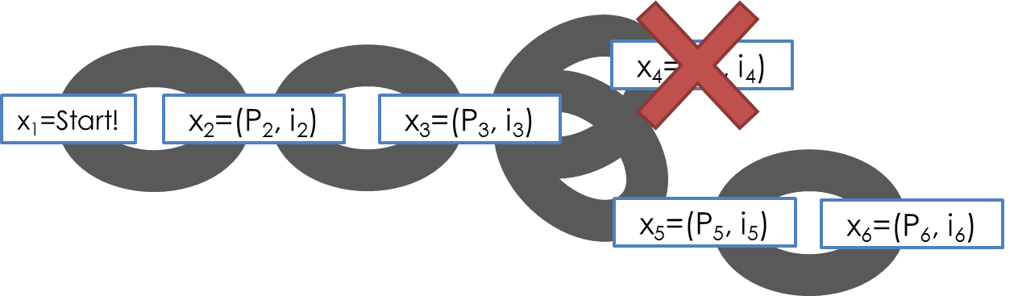
diff( , ) How is money stored in Bitcoin?
Transaction in orphaned blocks are invalid
Wait 6 blocks (~1 hour) before accepting transaction.
Checkpoints to prevent complete history rollback.
All transaction are stored in the blockchain
(Currently ~14 GB)

Slide 28
Outline
Part 0: a little history
Part 1: TheoryCoin
How to create coins
How to transfer coins
How to store coins
Part 2: diff( , )
Part 3: Problems and issues

Slide 29
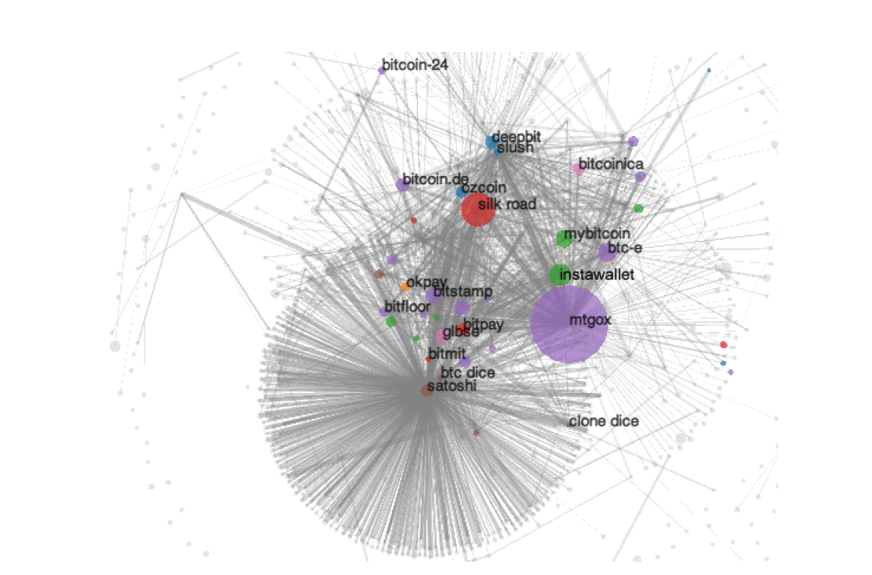
Anonymity?
Problem:
Every transaction ever made is recorded forever
Solution?
Use new identity for each transaction
But:
Heuristics allow to cluster identities
Anonymous alternatives:
Zerocoin, Zerocash…

Slide 30
Users? (and their devices)
Unfortunate property of DSA
This address
1HKywxiL4JziqXrzLKhmB6a74ma6kxbSDj
probably stole ~250000kr this way
(due to bug in Android Java based random generator)
Sig(sk,m1,r)
Extractor
sk
Sig(sk,m2,r)

Slide 31
Programmable money?
“Bitcoin uses a scripting system for transactions. Forth-like, Script is simple, stack-based, and processed from left to right. It is purposefully not Turing-complete, with no loops.”
E.g., “P1 gives 1 BTC to P2 if at least 2 out of (P1,P2,P3) sign this transaction”
Functionality: more than money?
Security: malware payments?

Slide 32
Mining pools
Solving puzzles (mining) is hard!
Miners join pools and share work/reward
How to optimally split work?
Mechanism design?
rational miner?
how to allocate reward?

Slide 33
A final word…
Distributed currencies:
for the good guys or the bad guys?
Crime is bad! Tax evasion is bad!
But sometimes governments are bad too!
Thanks! Questions?

Slide 34
Sources:
Learn about signatures/ecash/cryptography at csaudk https://services.brics.dk/java/courseadmin/crypto/ https://services.brics.dk/java/courseadmin/cpt https://services.brics.dk/java/courseadmin/CryCom
Story of Chaum and DigiCash (to be taken with a grain of salt) http://cryptome.org/jya/digicrash.htm
Bitcoin paper and announcement http://article.gmane.org/gmane.comp.encryption.general/12588/ http://www.mail-archive.com/cryptography@metzdowd.com/msg10142.html
This pizza cost 750,000 usd http://motherboard.vice.com/blog/this-pizza-is-worth-750000
Lily Allen turns down btcs https://twitter.com/lilyallen/statuses/419942070770741249
Signature attack http://eprint.iacr.org/2013/734
Deanonymizing http://cseweb.ucsd.edu/~smeiklejohn/files/imc13.pdf http://eprint.iacr.org/2012/584
Zerocoin/Zerocash http://zerocoin.org/
Graphs, stats etc www.blockchain.info
Comparison with Altcoins http://www.coinwarz.com/cryptocurrency
Bitcoin stolen from TV http://nymag.com/daily/intelligencer/2013/12/bloomberg-anchors-christmas-bitcoin-gets-stolen.html
Visa/Mastercard vs Wikileaks http://www.forbes.com/sites/andygreenberg/2010/12/07/visa-mastercard-move-to-choke-wikileaks/
Not in the talk, but very interesting:
Silkroad essentials http://exitevent.com/privacy-tor-btc-and-what-the-silk-road-crackdown-means-to-you-131112.asp http://arstechnica.com/tech-policy/2013/10/how-the-feds-took-down-the-dread-pirate-roberts/ http://pando.com/2014/01/02/with-130m-of-bitcoin-wealth-and-plans-to-sell-the-fbi-could-rattle-the-virtual-currency-cage
The value overflow bug https://en.bitcoin.it/wiki/Common_Vulnerabilities_and_Exposures#CVE-2010-5139
The March 2013 chain fork https://bitcoin.org/en/alert/2013-03-11-chain-fork
Buggy transaction, mistery miner https://blockchain.info/tx-index/3618498/4005d6bea3a93fb72f006d23e2685b85069d270cb57d15f0c057ef2d5e3f78 https://bitcointalk.org/index.php?topic=67634.0
The problem with “checkpointed” bitcoin http://www.links.org/files/decentralised-currencies.pdf
This presentation contains copyrighted images the use of which has not always been specifically authorized by the copyright owner. I am making the material available for educational purposes only and I believe this constitutes a 'fair use'.

