Slide 1
Public Key Cryptography
Introduction

Slide 2
Public Key Cryptography
Unlike symmetric key, there is no need for Alice and Bob to share a common secret
  Alice can convey her public key to Bob in a public communication:
Notes:
While conveying the public key is not a confidential communication, it involves authentication concerns.
Namely, Carol could send a public key and claim it to be Alice’s. Public key cryptography requires a
“certification” infrastructure to bind public keys to identities, as we shall see later when we study
Public key infrastructures (PKIs).

Slide 3
Encrypting w/ Public Keys
Public key schemes encrypt large blocks of data:
  Smallest system with reasonable security has block sizes at least 160 bits (Elliptic Curves)
  Key size generally equal to or close to block size
  Orders of magnitude less efficient than symmetric key encryption

Slide 4
Why public key?
The reason public keys are used is to establish secure communication when there is no way to exchange a key beforehand.
  Confidential/authenticated channels for free?
Must ensure that the public key belongs to the correct party (binding of identity to key). The public key directory may be corrupted:
  Solution: Use a Public Key Infrastructure to certify your keys (PKI)
Notes:
Public key cryptography allows users to communicate securely with other parties, without having to
previously (i.e, off-band) having exchanged secrets.

Slide 5
Encryption: Details
Alice knows Bob’s public key P_{Bob}
Uses the encryption algorithm:
  Enc(P_{Bob}, Message) = C
Anybody may encrypt messages that only Bob may read, since he knows the private key S_{Bob}
Message = Dec(S_{Bob}, C)
Notes:
Again, given a pair of public key and secret key:
-- The owner of the private key is the only party capable of decrypting messages encrypted with the public key.
-- Any person can encrypt messages using the public key only -- without knowledge of the private key.

Slide 6
How does Bob know S_{Bob}?
How did Bob come to know his private key to start with?
  The answer is that Bob generates the pair (P_{Bob}, S_{Bob}) jointly. The key generation procedure is probabilistic and one-way.
  The security of such methods is closely related to a class of mathematical problems from modular arithmetic
Notes:
The method to generate public keys is a one-way function. It takes a series of random bits and outputs a
public-key/private key pair:
random bits === key generation algorithm =====>>>> (PK, SK)
However, from the knowledge of PK alone, it is not possible to invert the algorithm to find the random bits that
resulted in the computation of the public key and private key -- moreover, it is impossible to compute the
private key from the public key.

Slide 7
Modular arithmetic review
Consider the integer interval [0, N-1] for some integer N.
This is the set of possible remainder values when one divides any integer by N.
  Called the set of residues modulo N
Note that addition is well defined in this set:
  Let A be an integer with residue mod N equal to a; and
  B mod N = b, for a, b in [0, N-1].
  That means: A = kN + a, and B = lN + b, for some k, l (use long division)
  Then A + B = (k + l)N + (a+b)
  So: (A + B) mod N = a + b = [(a mod N) + (b mod N)] mod N

Slide 8
Adding residues
Example:
+ | 0 | 1 | 2 | 3 | 4
0 | 0
1 | 1 | 2
2 | 2 | 3 | 4
3 | 3 | 4 | 0 | 1
4 | 4 | 0 | 1 | 2 | 3
+ | 0 | 1 | 2 | 3
0 | 0
1 | 1 | 2
2 | 2 | 3 | 0
3 | 3 | 0 | 1 | 2
N = 4
N = 5

Slide 9
Properties of modular addition
associativity:
  (a + b mod N) + c mod N = a + (b + c mod N) mod N
commutativity:
  (a + b mod N) = (b + a mod N)
identity element:
  (a + 0 mod N) = (a mod N)
existence of additive inverse:
  For each residue a mod N, there is a residue b such that
  (a + b mod N) = 0 mod N.
  Just take b = N - a (as integers)
  We write b = -a as usual.
Notes:
Modular addition inherits many properties from integer addition

Slide 10
Multiplying residues
We could define multiplication of residues as:
  (a mod N)*(b mod N) := (a * b mod N)
The definition works, because if
  A = k N + a, B = l N + b
  (A * B) = k l N² + (k b + l a)N + a b
  So (A * B mod N) = a b mod N
Multiplication of residues is also associative, commutative, and has an identity element (1 mod N)
It distributes with addition:
  (c mod N)(a + b mod N) = ca + cb mod N

Slide 11
Multiplication Example
* | 0 | 1 | 2 | 3 | 4
0 | 0
1 | 0 | 1
2 | 0 | 2 | 4
3 | 0 | 3 | 1 | 4
4 | 0 | 4 | 3 | 2 | 1
* | 0 | 1 | 2 | 3
0 | 0
1 | 0 | 1
2 | 0 | 2 | 0
3 | 0 | 3 | 2 | 1
N = 4
N = 5

Slide 12
Multiplicative inverse
Not always defined.
  2 is not invertible mod 4, from previous example
if c = 1 mod N, c it is relatively prime to N.
If a is NOT relatively prime to N, then:
  No multiple ab of a is relatively prime to N, and so:
  No b can satisfy ab = 1 mod N
  For a to be invertible mod N it is necessary that GCD(a, N) = 1
From the theory of the greatest common divisor (GCD):
  If g = GCD(a, N) then there exist b, k such that a b + k N = g
  So if a is relatively prime to N, there exists b, k with a b + k N = 1
  b is the inverse of a mod N
  For a to be invertible mod N it is sufficient that GCD(a, N) = 1

Slide 13
Number rings and fields
A set of elements with operations + and *, such that
addition is associative, commutative, has identity “0” and each element a has an additive inverse -a
multiplication is associative, (commutative), and has identity
is called a (commutative) ring
If moreover, each element a (except for “0”) has a multiplicative inverse a⁻¹, the set is called a field.
In cryptography, finite fields and finite rings (finite sets with the above properties) are very important.
Examples of finite rings, which are not fields: The set of residues
[0, N-1] with operations as before, where N is a composite number
Examples of finite fields: The set of residues [0, p-1], where p is a prime.

Slide 14
The discrete logarithm problem
Let p be a prime number
  A large one, say 1000 -- 2000 bits long.
Take g to be in the interval [2, p-2].
Consider the exponential function:
  Exp_{g}(•, mod p): x → g^{x} mod p
Exp_{g}(•, mod p) is hard to invert.
  unless p is a “weak” prime (rare case and easy to test for)

Slide 15
Example
N = 11; g = 2.
2² = 4, 2³ = 8, 2⁴ = 5, 2⁵ = 10, 2⁶ = 9,
2⁷ = 7, 2⁸ = 3, 2⁹ = 6, 2¹⁰ = 1 (mod 11)
3² = 9, 3³ = 5, 3⁴ = 4, 3⁵ = 1 (mod 11)
The residue (2 mod 11) can create all non-zero residues mod 11 via exponentiation. It is called a generator.
The residue (3 mod 11) does not have the same property.

Slide 16
Encrypting a la Elgamal
Take p a non-weak prime:
  p = uq + 1, with q also prime, and u small.
  This guarantees Exp(•, mod p) is hard.
Take g’ in [2, p-2] and choose
  g = g’^{u} mod p.
Choose private key k at random
  k in [2, q -1]
Compute the public key y = g^{k} mod p.
Notes:
The value y = g^k mod p is called an ElGamal public key, associate to the private key k.

Slide 17
ElGamal Encryption
To encrypt m in [1, p-1] for user Bob:
  public key y = g^{k}, private key k
Compute a random value r
Compute
  (A, B) = (g^{r} mod p, m y^{r} mod p)
To decrypt, Bob computes
  m = B(A^{-k}) mod p
Notes:
You can check that A^k = g^(r k) = g^(k r) = y^r mod p. So A^(- k) = y^(- r) mod p and B A^(- k) = m mod p.

Slide 18
Semantic security
Attacker
m₀, m₁
Oracle
C = Enc(m_{b})
b’
If b’ = b, the attacker wins.
If every attacker has only a negligible probability
of success, we say that the scheme is secure
under chosen-plaintext attacks.

Slide 19
Security of Elgamal encryption
When the attacker receives:
  (g^{r}, m_{b}y^{r})
it may divide the second term by m_{b’}
  (g^{r}, m_{b} (m_{b’})⁻¹y^{r}) = (A, B)
To decide if b = b’, need to decide if, given
(g, y, A, B), the last two values have the form:
  (g^{r}, y^{r}) for some r, or not.
This is called the Decision Diffie-Hellman (DDH) problem, and it is considered a difficult number theory problem---no efficient algorithms for it are known.

Slide 20
Elgamal and chosen-ciphertext attacks
Elgamal is NOT secure against chosen ciphertext attacks
Suppose the system wants to prevent you from decrypting a ciphertext (A, B), but may allow you to decrypt a different ciphertext:
  Compute
    (A’, B’) = (A, k B) mod p
  If you get
    m’ = Dec (A’, B’),
  then compute
    m = (k)⁻¹ m’ mod p
  Note that m = Dec(A, B), so the attacker wins.
This is not a problem in practice, because Elgamal is used in practice as a hybrid scheme (see next).

Slide 21
Hybrid Scheme
Use the public key encryption scheme to encrypt a key for a symmetric encryption scheme (e.g., AES)
Use the symmetric key to encrypt the data
More generally, two algorithms:
  Key Encapsulation Mechanism (KEM) wraps a symmetric key using the public key encryption algorithm
  Data Encapsulation Mechanism (DEM) encrypts the message contents using the symmetric key encoded in the KEM

Slide 22
Key Agreement
Alice to Bob:
  gª mod p, with a random
Bob to Alice:
  g^{b} mod p, with b random
Session key derived from shared secret, but without authentication:
  g^{ab} mod p
Computing the key g^{ab} from (g, gª, g^{b}) is the computational Diffie-Hellman problem (CDH)
CDH must be at least as hard as DDH
CDH at most as hard as computing logarithms to basis g mod p

Slide 23
Man-in-the-middle attack
A
C
B
Notes:
Here Carol was able to negotiate keys with Alice and Bob, and moreover convince each that they share
a key with the other.

Slide 24
Adding authentication
A
B
Here, g^{M} = P_{Alice} , the public key of Alice.
Notes:
Now consider the above example. The public key of Alice is g^M mod p. Therefore, only Alice could
compute her half of the secret key. Therefore this protocol can be used to authenticate Alice.

Slide 25
MTI: Authenticated DH
P_{Alice}= gª mod p, h= g^{r} mod p
A
B
P_{Bob}= g^{b} mod p, y= g^{s} mod p
K = (P_{Bob} )^{r} yª mod p
K = (P_{Alice} )^{s} h^{b} mod p
K = g^{sa + rb} mod p
Notes:
The MTI key agreement achieves both mutual authentication and forward security:
*) Mutual authentication: Only a party privy to one of the private keys is capable to complete the computation
of the shared secret K -- then K can be used as a secret key to establish authenticity of the communication parties.
**) Forward security: If Alice deletes value a after recovering K, and B deletes b, then even after a party recovers
the private keys (in a known-key attack) the session keys K cannot be re-constructed.

Slide 26
DSA keys
Generate large prime p = kq + 1,
  p originally 512 bits, today 1024 or more
  q originally 160 bits (still safer today).
Generator g such that g^{q} = 1 mod p.
  Take h ∈ [1, p - 1]; set g = h^{(p-1)/q} mod p
Choose private-public key pair: <T, S>
  S random in [1, q ]; T = g^{S} mod p
Notes:
DSA public/private keys are similar to ElGamal keys -- with the exception of the private key of smaller size.
This is done for efficiency reasons, as q is an exponent in some computations.

Slide 27
Signing w/ DSA
Generate a per-message private/public key pair:
  <T_{m}, S_{m}> : T_{m} = g^{Sm} mod p
d_{m} = digest of message (e.g., SHA-1)
Compute the signature
  X = S_{m}⁻¹ (d_{m} + S T_{m}) mod q
The signing pair is (T_{m} mod q, X)

Slide 28
Verifying the DSA
Calculate the inverse of X:
  X⁻¹ mod q
Calculate d_{m} from the message m
Compute a = d_{m} X⁻¹ mod q
Compute b = T_{m} X⁻¹ mod q
Compute z’ = ( gª T^{b} mod p)
If z = T_{m} mod q , verification succeeds.
Notes:
Notice that operations among exponents are reduced modulo q, while operations on the base are computed
modulo p. The reason the signature verifies is because the way X is computed during the signature
generation algorithm.
There are several drawbacks of DSA -- and several advantages.
It requires the use of very good random number generators to create the per-message private keys.
2) On the other hand, the use of random numbers facilitates the proof of security under the assumption that
the random numbers are perfectly random -- and that the hash function is strong -- collision-resistant.
3) The signature verification is slow -- and in network security protocols, it is performed more often than
signature generation, so it is less suitable for network security purposes than RSA
4) On the other hand, signature generation can be optimized with previous computation of the per-message
public-private key pairs, so it is more efficient for use in small power devices such as smart-cards for the
purpose of strong authentication.
5) It is interoperable with Diffie-Hellman public keys for use with key exchange protocols that provide
forward security.
6) Finally, in the present time, it can be used with Elliptic Curves, which eventually (if current assumptions about
the security of RSA and elliptic curves hold over time) will be more efficient than RSA even for signature verification.

Slide 29
Elliptic Curves
Alternative cryptographic settings for discrete-log based public key schemes
  Elliptic Curve DSA (ECDSA)
  Elliptic Curve Diffie-Hellman Key Exchange
Given a finite field F, an elliptic curve is the set of solutions in F × F to an equation of the form:
  y² = x³ + Ax + B

Slide 30
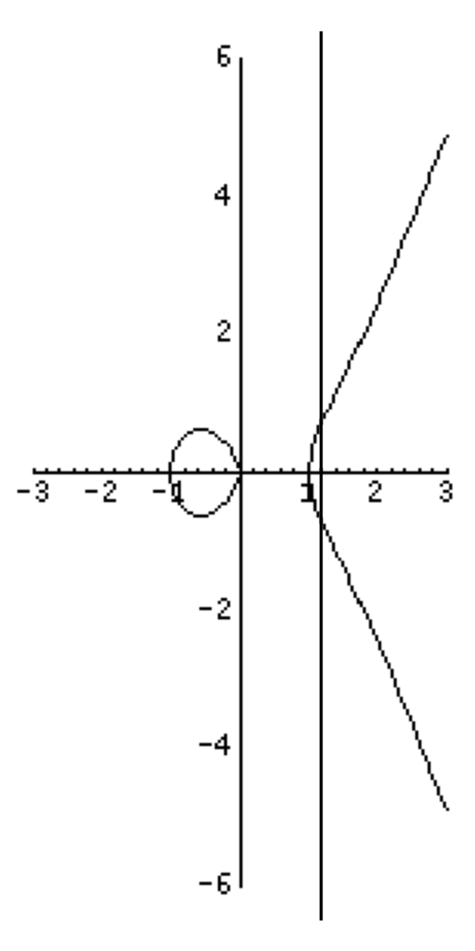
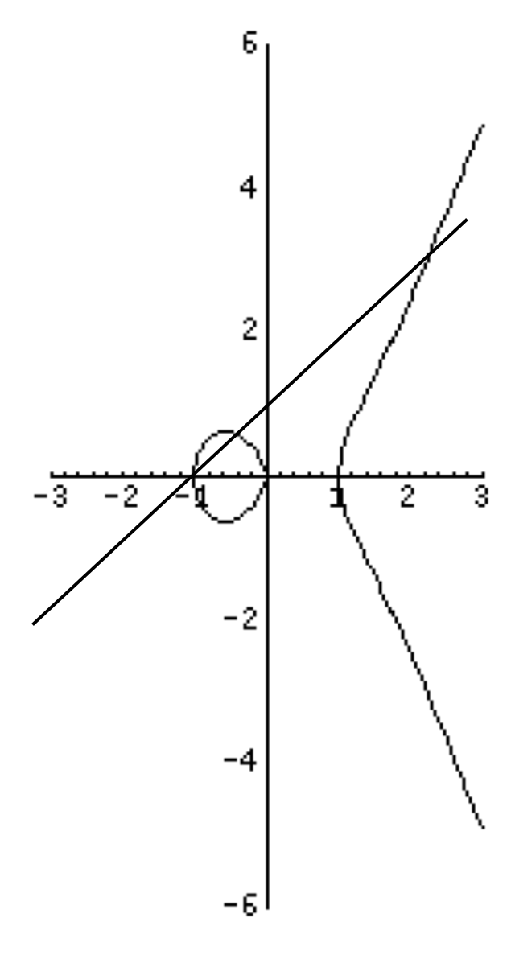
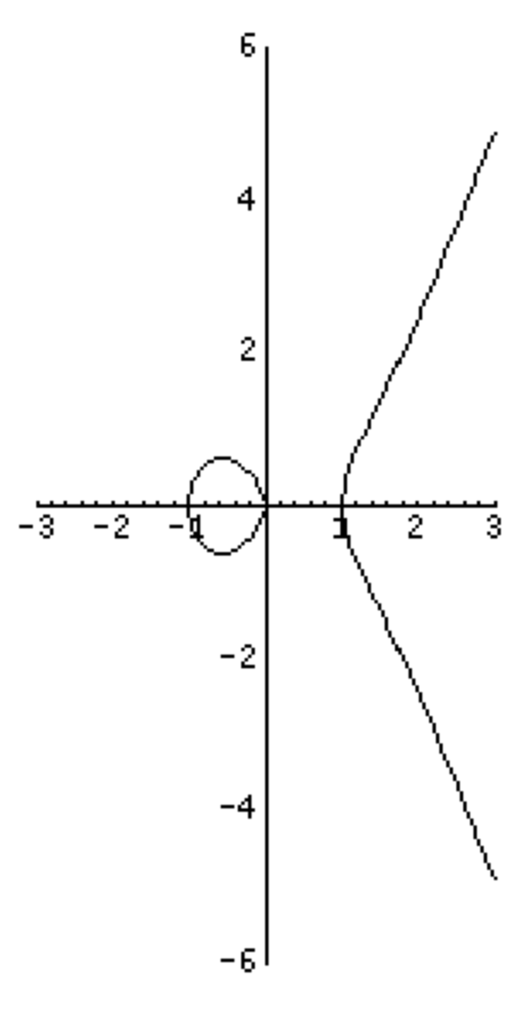
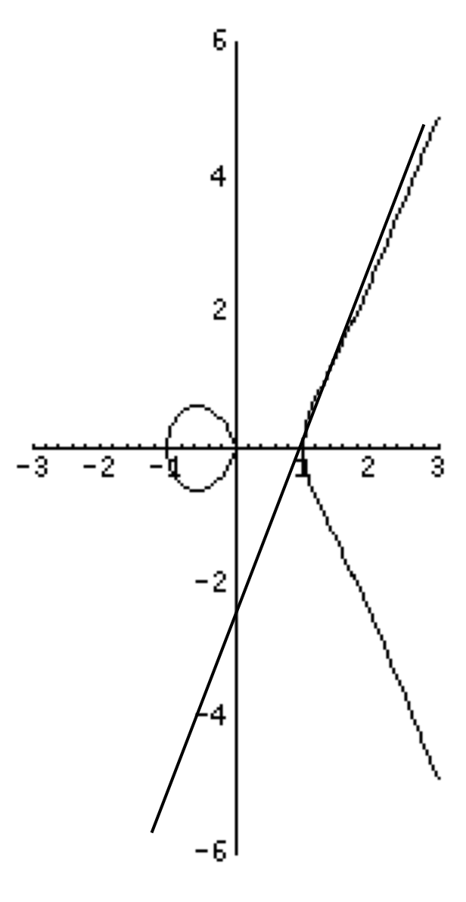
Graph of the equation
y² = x³ - x
Most lines intersect the curve at 3 points
Vertical lines intersect only at 2 points
  Add a “virtual point” O at “vertical infinity” and say all vertical lines pass through it. Then all lines cut the curve in 3 points.

Slide 31
Operating on points
We can define an operation ⊗ on the points of an elliptic curve.
The “point at infinity” O will act as identity:
  O ⊗ P = P ⊗ O = P, for all points
If a line passes through three points, P₁, P₂, and P₃, then we say that
  P₁ ⊗ P₂ ⊗ P₃ = O

Slide 32
Using the rules
The inverse of a point P with coordinates (x, y) is the point Q = (x, -y). Why?
  If P = (x, y) solves y² = x³ + Ax + B, so does Q = (x, -y), so at least makes sense
  P and Q are in a vertical line, so our previous rule say that
  P ⊗ Q ⊗ O = O, or P ⊗ Q = O. Good.

Slide 33
Can we compute the product?
Yes: Take two points, P and Q.
Write the equation of the line α that passes through P and Q.
Compute the third point R in the intersection of α with the curve E.
By our rule, P ⊗ Q ⊗ R = O
Then if S is the inverse of R (which we know how to compute as before), then
  S = P ⊗ Q

Slide 34
Elgamal, Diffie-Hellman, and DSA on Elliptic curves
Now that we learned how to multiply points on the elliptic curve, we can do:
EC-Elgamal encryption:
  Public key (P, Q), where Q = P^{x}.
  Encrypt m as (P^{r}, m ⊕H(Q^{r})). (See next slide)
ECDH: Pª, P^{b} → P^{ab}
ECDSA also same.
Note: Sometimes operation called addition, instead of multiplication. In this case, ECDH would be written
  ECDH: aP, bP → abP
Notes:
Try to write ECDSA from the DSA definition. Try also to write the Diffie-Hellman problem (Computational
& decisional)
Try to write DDH, CDH, EC-Elgamal, and ECDSA in additive notation, where the operation on the elliptic curve
is transformed into addition and the exponentiation into a scalar product.

Slide 35
Caveats
In order for using Elgamal encryption, it would be necessary to encode a message m as a point in the Elliptic curve.
This is cumbersome. More practical to encrypt as:
  (P^{r}, m XOR H(Q^{r})), where H is a hash function from the elliptic curve to binary strings.
  Constructing this hash function is easier than encoding elements in the curve

