Slide 1
Computer Forensics – An Introduction
Jau-Hwang Wang
Central Police University
Tao-Yuan, Taiwan

Slide 2
Outline
Background
Definition of Computer Forensics
Digital Evidence and Recovery
  Digital Evidence on Computer Systems
  Digital Evidence on Networks
Challenges
Ongoing Research Projects

Slide 3
Background
Cyber activity has become a significant portion of everyday life of general public.
Thus, the scope of crime investigation has also been broadened. (source: Casey, Eoghan, Digital Evidence and Computer Crime: Forensic Science, Computer and the Internet,Academic Press, 2000.)

Slide 4
Background (continued)
Computers and networks have been widely used for enterprise information processing.
E-Commerce, such as B2B, B2C and C2C, has become a new business model.
More and more facilities are directly controlled by computers.
As the society has become more and more dependent on computer and computer networks. The computers and networks may become targets of crime activities, such as thief, vandalism, espionage, or even cyber war.

Slide 5
Background (continued)
85% of business and government agencies detected security breaches. (Source:http://www.smh.com.au/icon/0105/02/news4.html.)
FBI estimates U.S. losses at up to $10 billion a year.(Source: Sager, Ira, etc, “Cyber Crime”, Business Week, February, 2000.)

Slide 6
Background (continued)
In early 1990s, the threats to information systems are at approximately 80% internal and 20% external.
With the integration of telecommunications and personal computers into the internet, the threats appear to be approaching an equal split between internal and external agents.
  (Source: Kovacich, G. L., and W. C. Boni, 2000, High-Technology Crime Investigatot’s Handbook, Butterworth Heinemann, p56.)

Slide 7
Background (continued)
Counter measures for computer crime
  Computer & network security
  Effective prosecution, and prevention

Slide 8
Forensic Science
Definition:
  Application of Physical Sciences to Law in the search for truth in civil, criminal, and social behavioral matters to the end that injustice shall not be done to any member of society.(Source: Handbook of Forensic Pathology, College of American Pathologists, 1990.)
Sciences: chemistry, biology, physics, geology, …
Goal: determining the evidential value of crime scene and related evidence.

Slide 9
Forensic Science (continued)
The functions of the forensic scientist
  Analysis of physical evidence
  Provision of expert testimony
  Furnishes training in the proper recognition, collection, and preservation of physical evidence.
  Source: (Richard Saferstein, 1981, Criminalistics—An introduction to Forensic Science, 2nd edition, Prentice Hall)

Slide 10
Computer (or Cyber) Forensics
(Warren, G. Kruse ii and Jay G. Heiser, 2002, Computer Forensics – Incident Response Essentials, Addison Wesley)
Definition:
  Preservation, identification, extraction, documentation, and interpretation of computer media for evidentiary and/or root cause analysis using well-defined methodologies and procedures.
Methodology:
  Acquire the evidence without altering or damaging the original.
  Authenticate that the recovered evidence is the same as the original seized.
  Analyze the data without modifying it.

Slide 11
Network Forensics
Definition
  The study of network traffic to search for truth in civil, criminal, and administrative matters to protect users and resources from exploitation, invasion of privacy, and any other crime fostered by the continual expansion of network connectivity.(Source: Kevin Mandia & Chris Prosise, Incident response,Osborne/McGraw-Hill, 2001. )

Slide 12
Category of Digital Evidence
Hardware
Software
  Data
  Programs

Slide 13
Digital Evidence
Definition
  Digital data that can establish that a crime has been committed or can provide a link between a crime and its victim or a crime and its perpetrator.(source: Casey, Eoghan, Digital Evidence and Computer Crime: Forensic Science, Computer and the Internet,Academic Press, 2000.)
  Categories
    Text
    Audio
    Image
    Video

Slide 14
Where Evidence Resides
Computer systems
  Logical file system
    File system
      Files, directories and folders, FAT, Clusters, Partitions, Sectors
    Random Access memory
    Physical storage media
      magnetic force microscopy can be used to recover data from overwritten area.
  Slack space
    space allocated to file but not actually used due to internal fragmentation.
  Unallocated space

Slide 15
Where Evidence Resides (continued)
Computer networks.
  Application Layer
  Transportation Layer
  Network Layer
  Data Link Layer

Slide 16
Evidence on Application Layer
Web pages, Online documents.
E-Mail messages.
News group archives.
Archive files.
Chat room archives.
…

Slide 17
Evidence on Transport and Network Layers
Internet Service
Provider
Router
Firewall
Host
modem
Host
log files
state tables
log files
state tables
log files
state tables
log files
state tables
log files
state tables

Slide 18
Evidence on the Data-link and Physical Layers
Computer Z
Computer A
ATM Network
Ethernet Network
Router
MAC --> IP
MAC <-- IP

Slide 19
Challenges of Computer Forensics
A microcomputer may have 60-GB or more storage capacity.
There are more than 2.2 billion messages expected to be sent and received (in US) per day.
There are more than 3 billion indexed Web pages world wide.
There are more than 550 billion documents on line.
Exabytes of data are stored on tape or hard drives.
  (Source: Marcella, Albert, et al, Cyber Forensic, 2002.)

Slide 20
Challenges of Computer Forensics (continued)
How to collect the specific, probative, and case-related information from very large groups of files?
  Link analysis
  Visualization
Enabling techniques for lead discovery from very large groups of files:
  Text mining
  Data mining
  Intelligent information retrieval

Slide 21
Challenges of Computer Forensics (continued)
Computer forensics must also adapt quickly to new products and innovations with valid and reliable examination and analysis techniques.

Slide 22
On Going Research Projects
Search engine techniques for searching Web pages which contain illegal contents.
Malicious program feature extraction and detection using data mining techniques.

Slide 23
References
Bickers, Charles, 2001,”Cyberwar: Combat on the Web”, Far Eastern Economic Review.
Casey, Eoghan, Digital Evidence and Computer Crime: Forensic Science, Computer and the Internet,Academic Press, 2000.
Casey, Eoghan, 2002, Handbook of Computer Crime Investigation, Academic Press.
Kovacich, G. L., and W. C. Boni, 2000, High-Technology Crime Investigatot’s Handbook, Butterworth Heinemann.
Lane, C., 1997, Naked in Cyberspace: How to find Personal Information Online, Wilton, CT: Pemberton Press.
Marcella, A. J., and R. S. Greenfield, 2002, Cyber Forensics, Auerbach Publications.
Rivest, R., 1992, “Reqest for comments : 1321 (The MD5 Message-Digest Algorithm)”, MIT Lab. for computer science and RSA data security, Inc.
Saferstein, Richard, 1981, Criminalistics—An introduction to Forensic Science, 2nd edition, Prentice Hall.
Warren, G. Kruse II and Jay G. Heiser, 2002, Computer Forensics – Incident Response Essentials, Addison Wesley

Slide 24
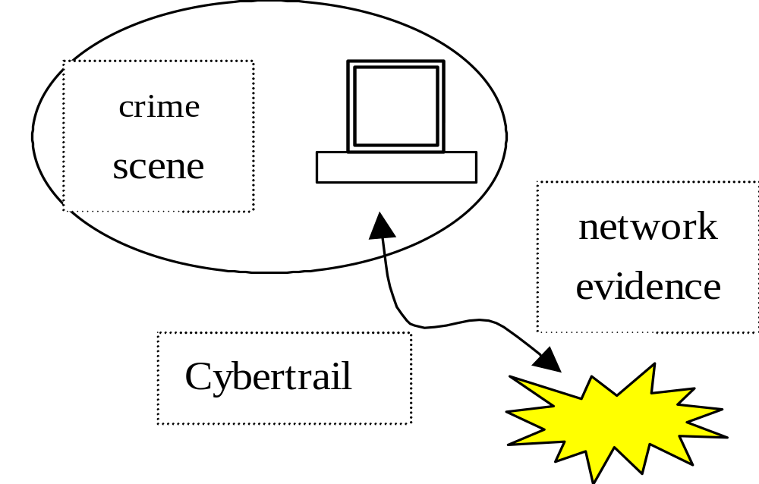
Cybertrail and Crime Scene

Slide 25
Cyberwar or Information Warfare
Information warfare is the offensive and defensive use of information and information systems to deny, exploit, corrupt, or destroy, an adversary's information, information-based processes, information systems, and computer-based networks while protecting one's own. Such actions are designed to achieve advantages over military or business adversaries. (Ivan K. Goldberg)

Slide 26
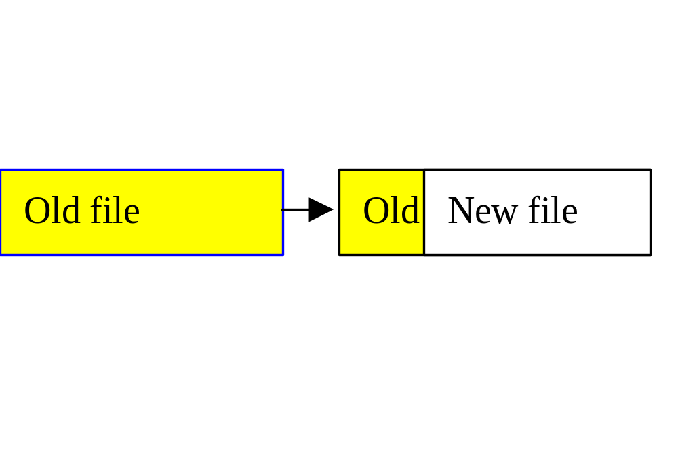
Slack Space

Slide 27

Evidence Recovery from RAMs on modern Unix systems

