Slide 1
Hackers, Crackers, and
Network Intruders
CS-480b
Dick Steflik

Slide 2
Agenda
Hackers and their vocabulary
Threats and risks
Types of hackers
Gaining access
Intrusion detection and prevention
Legal and ethical issues

Slide 3
Hacker Terms
Hacking - showing computer expertise
Cracking - breaching security on software or systems
Phreaking - cracking telecom networks
Spoofing - faking the originating IP address in a datagram
Denial of Service (DoS) - flooding a host with sufficient network traffic so that it can’t respond anymore
Port Scanning - searching for vulnerabilities

Slide 4
Hacking through the ages
1969 - Unix ‘hacked’ together
1971 - Cap ‘n Crunch phone exploit discovered
1988 - Morris Internet worm crashes 6,000 servers
1994 - $10 million transferred from CitiBank accounts
1995 - Kevin Mitnick sentenced to 5 years in jail
2000 - Major websites succumb to DDoS
2000 - 15,700 credit and debit card numbers stolen from Western Union (hacked while web database was undergoing maintenance)
2001 Code Red
  exploited bug in MS IIS to penetrate & spread
  probes random IPs for systems running IIS
  had trigger time for denial-of-service attack
  2nd wave infected 360000 servers in 14 hours
Code Red 2 - had backdoor installed to allow remote control
Nimda -used multiple infection mechanisms email, shares, web client, IIS
2002 – Slammer Worm brings web to its knees by attacking MS SQL Server

Slide 5
The threats
Denial of Service (Yahoo, eBay, CNN, MS)
Defacing, Graffiti, Slander, Reputation
Loss of data (destruction, theft)
Divulging private information (AirMiles, corporate espionage, personal financial)
Loss of financial assets (CitiBank)

Slide 6
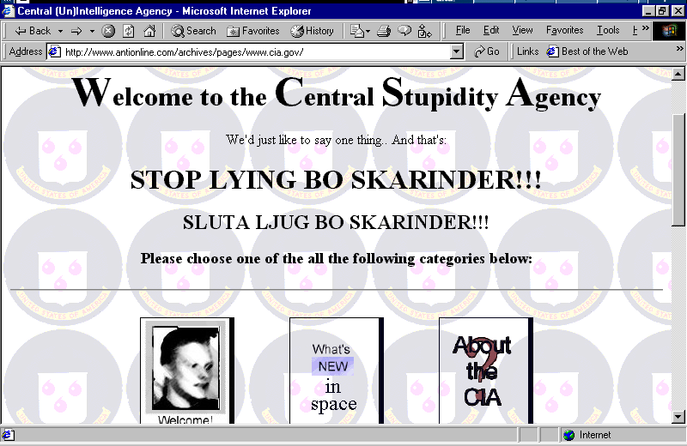
CIA.gov defacement example

Slide 7
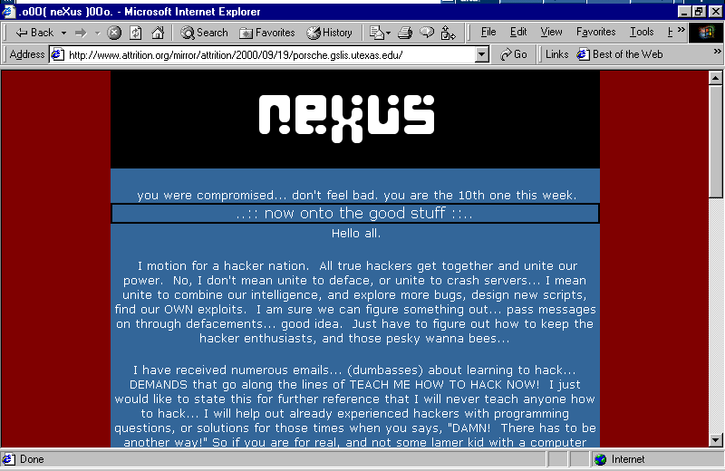
Web site defacement example

Slide 8
Types of hackers
Professional hackers
  Black Hats – the Bad Guys
  White Hats – Professional Security Experts
Script kiddies
  Mostly kids/students
    User tools created by black hats,
      To get free stuff
      Impress their peers
      Not get caught
Underemployed Adult Hackers
  Former Script Kiddies
    Can’t get employment in the field
    Want recognition in hacker community
    Big in eastern european countries
Ideological Hackers
  hack as a mechanism to promote some political or ideological purpose
  Usually coincide with political events

Slide 9
Types of Hackers
Criminal Hackers
  Real criminals, are in it for whatever they can get no matter who it hurts
Corporate Spies
  Are relatively rare
Disgruntled Employees
  Most dangerous to an enterprise as they are “insiders”
  Since many companies subcontract their network services a disgruntled vendor could be very dangerous to the host enterprise

Slide 10
Top intrusion justifications
I’m doing you a favor pointing out your vulnerabilities
I’m making a political statement
Because I can
Because I’m paid to do it

Slide 11
Gaining access
Front door
  Password guessing
  Password/key stealing
Back doors
  Often left by original developers as debug and/or diagnostic tools
  Forgot to remove before release
Trojan Horses
  Usually hidden inside of software that we download and install from the net (remember nothing is free)
  Many install backdoors
Software vulnerability exploitation
  Often advertised on the OEMs web site along with security patches
  Fertile ground for script kiddies looking for something to do

Slide 12
Back doors & Trojans
e.g. Whack-a-mole / NetBus
Cable modems / DSL very vulnerable
Protect with Virus Scanners, Port Scanners, Personal Firewalls

Slide 13
Software vulnerability exploitation
Buffer overruns
HTML / CGI scripts
Poor design of web applications
  Javascript hacks
  PHP/ASP/ColdFusion URL hacks
Other holes / bugs in software and services
Tools and scripts used to scan ports for vulnerabilities

Slide 14
Password guessing
Default or null passwords
Password same as user name (use finger)
Password files, trusted servers
Brute force
  make sure login attempts audited!

Slide 15
Password/key theft
Dumpster diving
  Its amazing what people throw in the trash
    Personal information
    Passwords
    Good doughnuts
  Many enterprises now shred all white paper trash
Inside jobs
  Disgruntled employees
  Terminated employees (about 50% of intrusions resulting in significant loss)

Slide 16
Once inside, the hacker can...
Modify logs
  To cover their tracks
  To mess with you
Steal files
  Sometimes destroy after stealing
  A pro would steal and cover their tracks so to be undetected
Modify files
  To let you know they were there
  To cause mischief
Install back doors
  So they can get in again
Attack other systems

Slide 17
Intrusion detection systems (IDS)
A lot of research going on at universities
  Doug Somerville- EE Dept, Viktor Skorman – EE Dept
Big money available due to 9/11 and Dept of Homeland Security
Vulnerability scanners
  pro-actively identifies risks
  User use pattern matching
    When pattern deviates from norm should be investigated
Network-based IDS
  examine packets for suspicious activity
  can integrate with firewall
  require one dedicated IDS server per segment

Slide 18
Intrusion detection systems (IDS)
Host-based IDS
  monitors logs, events, files, and packets sent to the host
  installed on each host on network
Honeypot
  decoy server
  collects evidence and alerts admin

Slide 19
Intrusion prevention
Patches and upgrades (hardening)
Disabling unnecessary software
Firewalls and Intrusion Detection Systems
‘Honeypots’
Recognizing and reacting to port scanning

Slide 20
Risk management
Contain & Control
(e.g. port scan)
Prevent
(e.g. firewalls, IDS, patches)
Probability
Ignore
(e.g. delude yourself)
Backup Plan
(e.g. redundancies)
Impact

Slide 21
Legal and ethical questions
‘Ethical’ hacking?
How to react to mischief or nuisances?
Is scanning for vulnerabilities legal?
  Some hackers are trying to use this as a business model
    Here are your vulnerabilities, let us help you
Can private property laws be applied on the Internet?

Slide 22
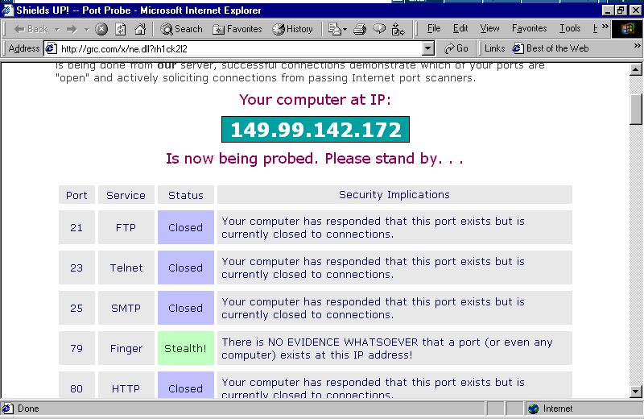
Port scanner example

Slide 23
Computer Crimes
Financial Fraud
Credit Card Theft
Identity Theft
Computer specific crimes
  Denial-of-service
  Denial of access to information
  Viruses Melissa virus cost New Jersey man 20 months in jail
    Melissa caused in excess of $80 Million
Intellectual Property Offenses
  Information theft
  Trafficking in pirated information
  Storing pirated information
  Compromising information
  Destroying information
Content related Offenses
  Hate crimes
  Harrassment
  Cyber-stalking
Child privacy

Slide 24
Federal Statutes
Computer Fraud and Abuse Act of 1984
  Makes it a crime to knowingly access a federal computer
Electronic Communications Privacy Act of 1986
  Updated the Federal Wiretap Act act to include electronically stored data
U.S. Communications Assistance for Law Enforcement Act of 1996
  Ammended the Electronic Communications Act to require all communications carriers to make wiretaps possible
Economic and Protection of Proprietary Information Act of 1996
  Extends definition of privacy to include proprietary economic information , theft would constitute corporate or industrial espionage
Health Insurance Portability and Accountability Act of 1996
  Standards for the electronic transmission of healthcare information
National Information Infrastructure Protection Act of 1996
  Amends Computer Fraud and Abuse Act to provide more protection to computerized information and systems used in foreign and interstate commerce or communications
The Graham-Lynch-Bliley Act of 1999
  Limits instances of when financial institution can disclose nonpublic information of a customer to a third party

Slide 25
Legal Recourse
Average armed robber will get $2500-$7500 and risk being shot or killed; 50-60% will get caught , convicted and spent an average of 5 years of hard time
Average computer criminal will net $50K-$500K with a risk of being fired or going to jail; only 10% are caught, of those only 15% will be turned in to authorities; less than 50% of them will do jail time
Prosecution
  Many institutions fail to prosecute for fear of advertising
    Many banks absorb the losses fearing that they would lose more if their customers found out and took their business elsewhere
      Fix the vulnerability and continue on with business as usual

