Slide 1
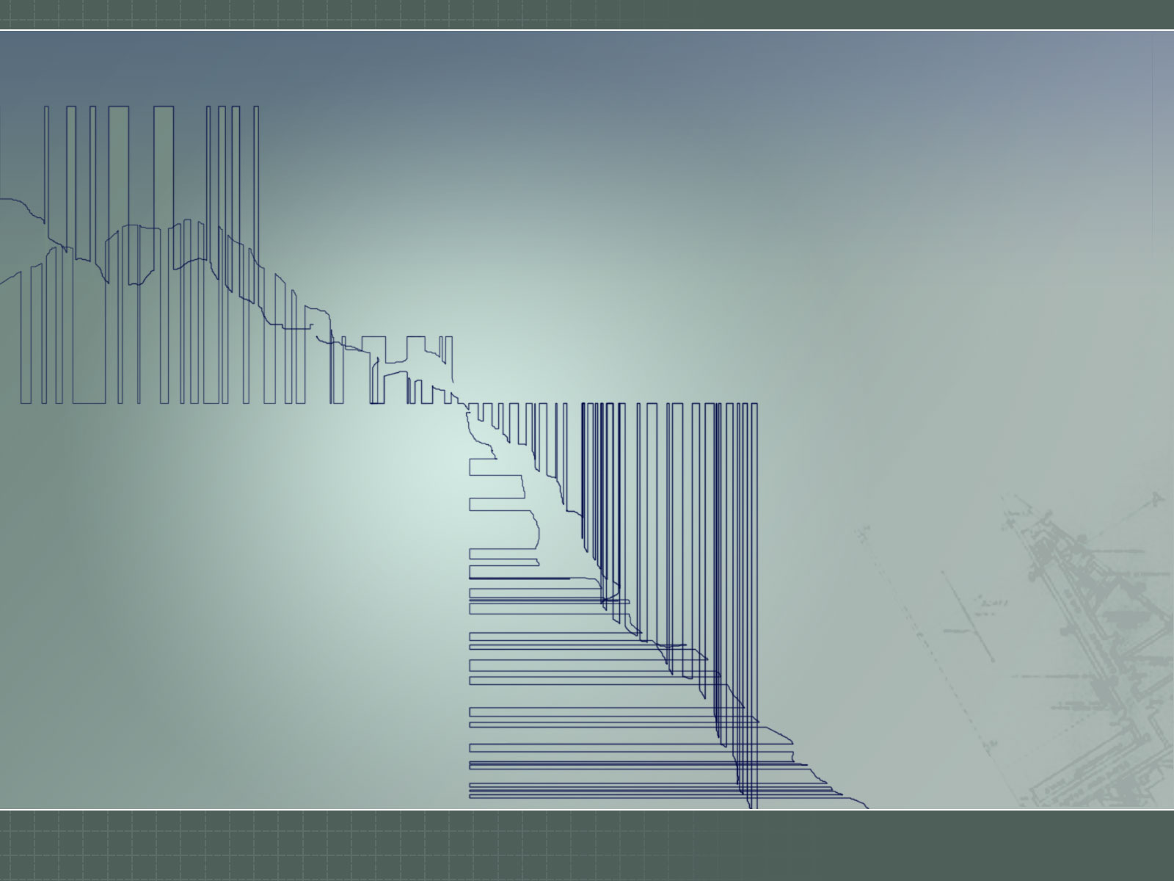
Hacking
Joshua Lackey, Ph.D.

Slide 2

Background
Ph.D., Mathematics. University of Oregon. 1995 – 2000
Senior Ethical Hacker. IBM Global Services. 1999 – 2005
Security Software Developer. Microsoft SWI Attack Team. 2005 –

Slide 3
Introduction
Hacking as a White Hat
Requirements
Technical Talk
One 50 minute lecture
Personal Requirements
Not boring

Slide 4
Question
Why would anyone spend $1.5k – $2k per day for a penetration test?

Slide 5
Answer
Cost/benefit
Risk analysis
  how?
Example
  an MSRC bulletin costs between $100k and $200k.
  design review, threat model review, history of product/feature, training statistics feed into the risk analysis.
  this determines if more work must be performed.

Slide 6
Answer
The goal of any penetration test or ethical hack is to determine the truth.

Slide 7
Truth
Is what we believe, what we have been told actually true?
Is what we designed, what we implemented secure?

Slide 8
Truth
Adversarial Situations
  “of course we did this securely”
Acquisitions
  quality analysis
  unknown environment
Talent
  “never even thought of that”

Slide 9
Truth
The best plans include security analysis in all phases of development.
Design
  Penetration testing during design phase provides feedback before implementation.
  The worst flaws are design flaws.
Implementation
  Software developers who understand how to write secure code.

Slide 10
Truth
Does it really cost $1.5k – $2k per day per penetration tester?
For top-level penetration testers, these are the standard security consultant’s fees.
The main reason is that the talent required is not so common.

Slide 11
Examples
Examples from work.
Problem:
  I cannot discuss any of my good examples.

Slide 12
Examples
Examples from my research.
  802.11 Fragmentation Attack
  VW Key Fob
  GSM

Slide 13
Examples
Most of what I’m going to speak about is works-in-progress.
There will be a lot of questions and very few answers.

Slide 14
802.11 Fragmentation Attack
(This is finished research.)
Serious Design Flaw – trying to gauge how much this cost is difficult. (Especially since most people/companies haven’t addressed this…)
Would have been extremely difficult to find in design phase anyway. (Although possible.)

Slide 15
802.11 Fragmentation Attack
Best previous attack:
  Weaknesses in the Key Scheduling Algorithm of RC4. Fluhrer, Mantin, Shamir.
    Vendors countered by not using weak IVs.
    Unfortunately, this was not enough. (Although many thought it was.)

Slide 16
802.11 Fragmentation Attack
A vulnerability exists in the IEEE 802.11 protocol which allows an attacker the ability to transmit WEP encrypted packets without knowing the encryption key.
This vulnerability allows an attacker to decrypt packets as well.
This was disclosed to CERT on September 16, 2003.

Slide 17
802.11 Fragmentation Attack
RC4 Encryption
If we denote by E_k(P) the encryption of the plain-text message P by the RC4 encryption method with key k, we have
    E_k(P) = X + P
Where X is the pseudo-random bit-stream generated by the RC4 PRGA with key k .
And thus
    E_k(P) + P = X

Slide 18
802.11 Fragmentation Attack
Logical Link Control Packets
The most common LLC/SNAP packet seen on an 802.11 network is the Ethernet type LLC with IP.
Explicitly, this packet consists of the following eight bytes.
  P' = { 0xaa, 0xaa, 0x03, 0x00, 0x00, 0x00, 0x08, 0x00 }

Slide 19
802.11 Fragmentation Attack
Logical Link Control Packets
Each encrypted packet on an 802.11 network is encapsulated in a logical-link control packet.
That is, each packet P is the concatenation of P', given above, and some P'‘.
        P = P' P''

Slide 20
802.11 Fragmentation Attack
Logical Link Control Packets
By the above comments on RC4, we can find the first eight bytes of the pseudo-random bit-stream X' generated by the key used to encrypt this packet,
    X' = E_k(P') + P'
Because we know the plain-text P', we can encrypt any arbitrary eight bytes with key k. We have, for any eight byte text Q,
    E_k(Q) = X' + Q

Slide 21
802.11 Fragmentation Attack
802.11 Fragmentation
Section 9.4 of the 1999 IEEE 802.11 protocol specification provides a method to fragment packets when needed. Moreover, each fragment is encrypted individually.

Slide 22
802.11 Fragmentation Attack
By transmitting packets in fragments, an attacker can inject arbitrary packets into a WEP encrypted 802.11 wireless network.

Slide 23
802.11 Fragmentation Attack Example
Capture a packet, including the 802.11 headers, off a WEP encrypted network.
08 | 41 | 02 | 01 | 00 | 04 | 5a | 37 | ee | 75 | 00 | 0e | 35 | ea | 75 | 17
00 | 00 | 24 | 50 | da | 11 | 00 | 01 | 55 | f9 | 47 | 00 | db | 76 | e1 | 66
14 | cf | 05 | c5 | 51 | 06 | 95 | 41 | 70 | 06 | 2d | 4f | 96 | 0e | 0a | 01
3c | 6f | fc | bd | 38 | a2 | 21 | 02 | 33 | 0c | 50 | f1 | e9 | ae | a4 | 8a
5e | 16 | 49 | 41

Slide 24
802.11 Fragmentation Attack Example
If we parse the 802.11 header, we find this packet contains the following.
type: data frame, data only
to_ds: 1, from_ds: 1, more_frag: 0,
retry: 0, pwr_mgt: 0, more_data: 0,
wep: 1, order: 0
dur: 102
a1: 00-04-5A-37-EE-75
a2: 00-0E-35-EA-75-17
a3: 00-00-24-50-DA-11
seq: frag = 00, num = 0010
data:
55 f9 47 00 db 76 e1 66 14 cf 05 c5 51 06 95 41
70 06 2d 4f 96 0e 0a 01 3c 6f fc bd 38 a2 21 02
33 0c 50 f1 e9 ae a4 8a 5e 16 49 41

Slide 25
802.11 Fragmentation Attack Example
The first 10 encrypted data bytes are:
db 76 e1 66 14 cf 05 c5 51 06
Assuming that we have a IPv4 packet with a Ethertype LLC/SNAP header, the plain-text data is:
aa aa 03 00 00 00 08 00 45 00
Therefore the first ten bytes of the pseudo-random bit-stream are derived as follows.
db 76 e1 66 14 cf 05 c5 51 06
+ aa aa 03 00 00 00 08 00 45 00
-------------------------------
71 dc e2 66 14 cf 0d c5 14 06

Slide 26
802.11 Fragmentation Attack Example
Suppose we wish to transmit an ICMP echo request.
45 00 00 2c 7a 0f 00 00 ff 01 33 b9 01 02 03 04 E..,z.....3.....
0a 01 00 02 08 00 6d 81 5d 02 2f 96 69 6e 6a 65 ......m.]./.inje
63 74 65 64 20 70 61 63 6b 65 74 00 cted packet.

Slide 27
802.11 Fragmentation Attack Example
Break this packet into fragments.
fragment 0:
data: aa aa 03 00 00 00
crc : f2 bb 67 21
fragment 1:
data: 08 00 45 00 00 2c
crc : 22 e7 83 c3
fragment 2:
data: 25 4c 00 00 ff 01
crc : 8a 4d 83 9f
fragment 3:
data: 88 7c 0a 01 00 02
crc : a7 d1 72 ff
[…]

Slide 28
802.11 Fragmentation Attack Example
For each piece of fragmented data, encrypt with the pseudo-random bit stream and attach an 802.11 header.
fragment 0:
type: data frame, data only
to_ds: 1, from_ds: 0, more_frag: 1,
retry: 0, pwr_mgt: 0, more_data: 0,
wep: 1, order: 0
dur: 0
a1: 00-04-5A-37-EE-75
a2: 00-0E-35-EA-75-17
a3: 00-00-24-50-DA-11
seq: frag = 00, num = 0024
data:
55 f9 47 00 db 76 e1 66 14 cf ff 7e 73 27

Slide 29
802.11 Fragmentation Attack Example
Continue.
fragment 1:
type: data frame, data only
to_ds: 1, from_ds: 0, more_frag: 1,
retry: 0, pwr_mgt: 0, more_data: 0,
wep: 1, order: 0
dur: 0
a1: 00-04-5A-37-EE-75
a2: 00-0E-35-EA-75-17
a3: 00-00-24-50-DA-11
seq: frag = 01, num = 0024
data:
55 f9 47 00 79 dc a7 66 14 e3 2f 22 97 c5

Slide 30
802.11 Fragmentation Attack Example
Now transmit the fragments.
The access point will decrypt each fragment and combine them into a single decrypted packet and forward it to the destination.

Slide 31
802.11 Fragmentation Attack Example
I omitted quite a few details, but this is the attack. It has been verified to work against all tested access points. Understandable as all this is specified in the protocol.
For an excellent write-up of this attack, see Andrea Bittau’s paper. (Better version that I co-authored is coming soon.)
  http://www.toorcon.org/2005/slides/abittau/paper.pdf

Slide 32
Research
Now to talk about some research that isn’t finished.
But first, a small aside.

Slide 33
Software Radio
Once upon a time, radio was for hardware geeks.
  Expensive equipment.
  For digital signals, very expensive equipment.
    And sometimes not available to the general public.
  Of course custom hardware was always an option.

Slide 34
Software Radio
Now we have inexpensive “front end” hardware.
Uses your computer as the “back end” processor.
  Every signal is now only a matter of software.
  Free and increasingly full-featured SDR libraries.
USRP
  The Universal Software Radio Peripheral.
    http://www.ettus.com

Slide 35
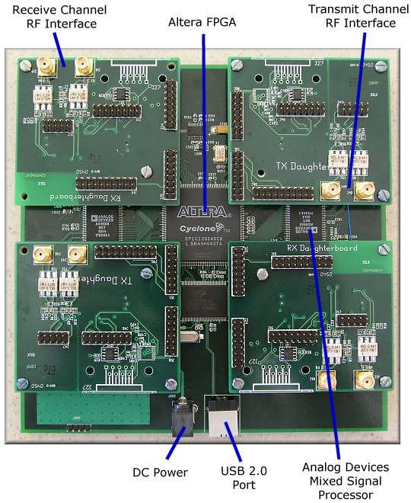
USRP

Slide 36
USRP
Two A/D D/A converters
  A/D @ 64Msamples/sec
  D/A @ 128Msamples/sec
Altera FPGA
  Field Programmable Gate Array
Daughterboard interfaces
  For RF integration
    BasicRX and BasicTX – direct interface to AD/DA
    TVRX – cable TV tuner interface
    DBSRX – satellite TV tuner interface

Slide 37
Daughterboards
BasicRX @ 64Msamples/sec
  Receive frequencies up to 32MHz
    Broadcast AM
    Shortwave
  Aliased frequencies with decreased signal strength.
    Not so good for digital.
BasicTX @ 128Msamples/sec
  Transmit frequencies up to 64MHz

Slide 38
Daughterboards
TVRX – cable TV tuner
  Receive frequencies from 50MHz to 900MHz
    Broadcast FM
    Police (analog and digital)
    Analog cellular phones (AMPS)
    Digital mobile phones
      DAMPS
      GSM
      iDEN
    Etc, etc, etc.

Slide 39
Daughterboards
DBSRX – satellite TV tuner
  Receive frequencies from 800MHz to 2.5(+)GHz
    GSM
    CDMA
    Bluetooth
    802.11
    Hydrogen (Radio Astronomy)
    Etc, etc, etc.

Slide 40
Wireless Communication Security
Software Radio
  Cheap hardware.
  Easily available.
  Highly flexible.
Examining the security of complex wireless protocols is now possible for the independent researcher.
We will gradually see more and more of wireless protocol vulnerabilities announced.

Slide 41
Examples
Volkswagen Key Fob
Every day I unlock my car with a radio. How secure is this? I’m sure if we asked we would be told that, “of course this is secure.”
What is the truth?
What is the
  Algorithm?
  Quality of PRNG? (If used.)
First step is to gather data.

Slide 42
Examples
Volkswagen Key Fob
Find key fob transmit frequency
  FFT signal search
  Frequency grabber
  FCC ID Search:
https://gullfoss2.fcc.gov/prod/oet/cf/eas/reports/GenericSearch.cfm

Slide 43
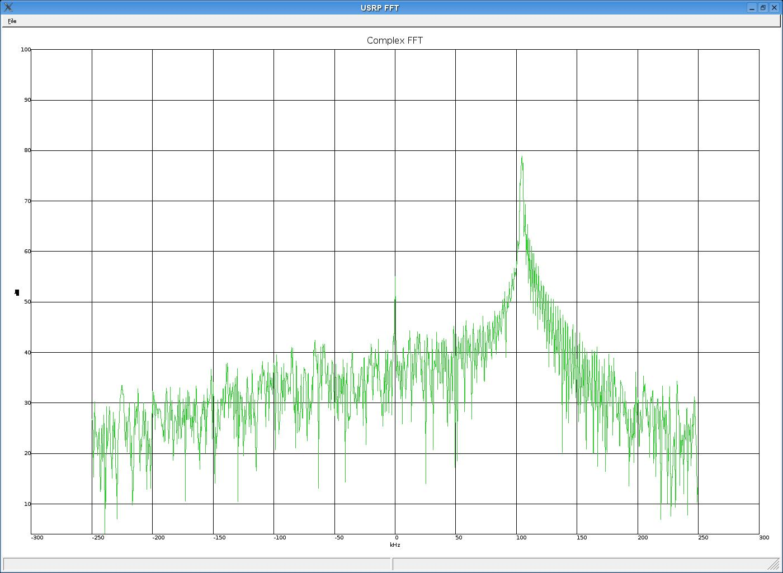
VW Key Fob
FFT Signal Search

Slide 44
VW Key Fob
FCC ID Search
  Get FCC ID from device.
  Grantee code is first three letters.
    VW Key Fob: NBG
  Frequency is 315MHz.
  Modulation type is A1D
    Amplitude modulation data transmission, double sideband, without using a modulating subcarrier.

Slide 45
VW Key Fob
Modulation
  FCC gave us modulation.
  Can recognize different modulation types from FFT and raw signal.
    Estimate bandwidth. Filter. Examine closely.

Slide 46
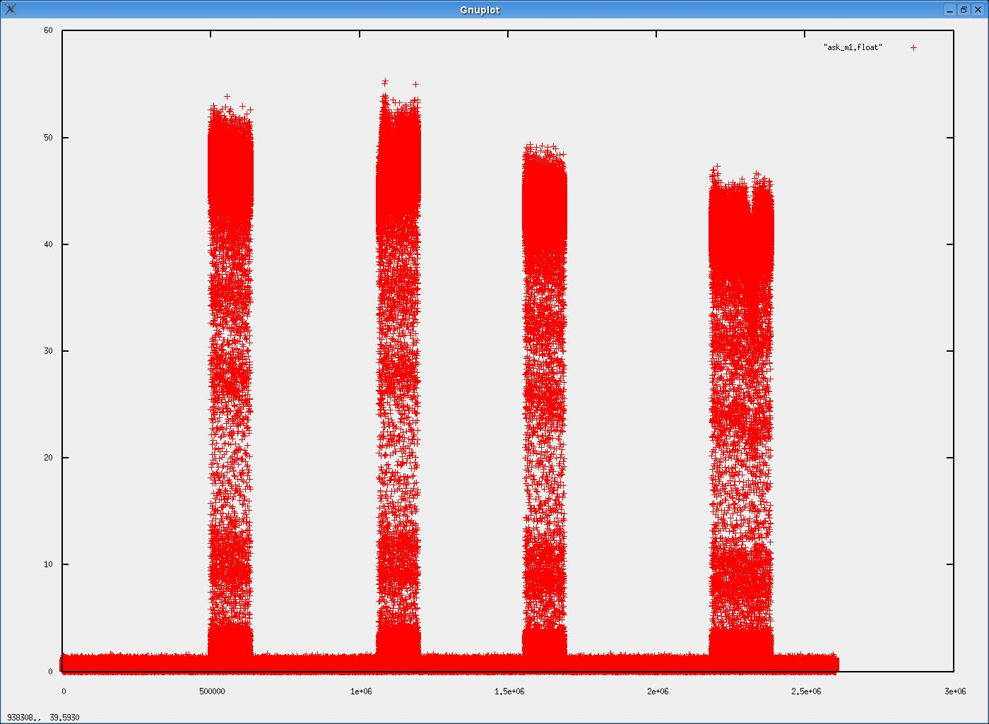
VW Key Fob
Capture signal (amplitude demod)

Slide 47
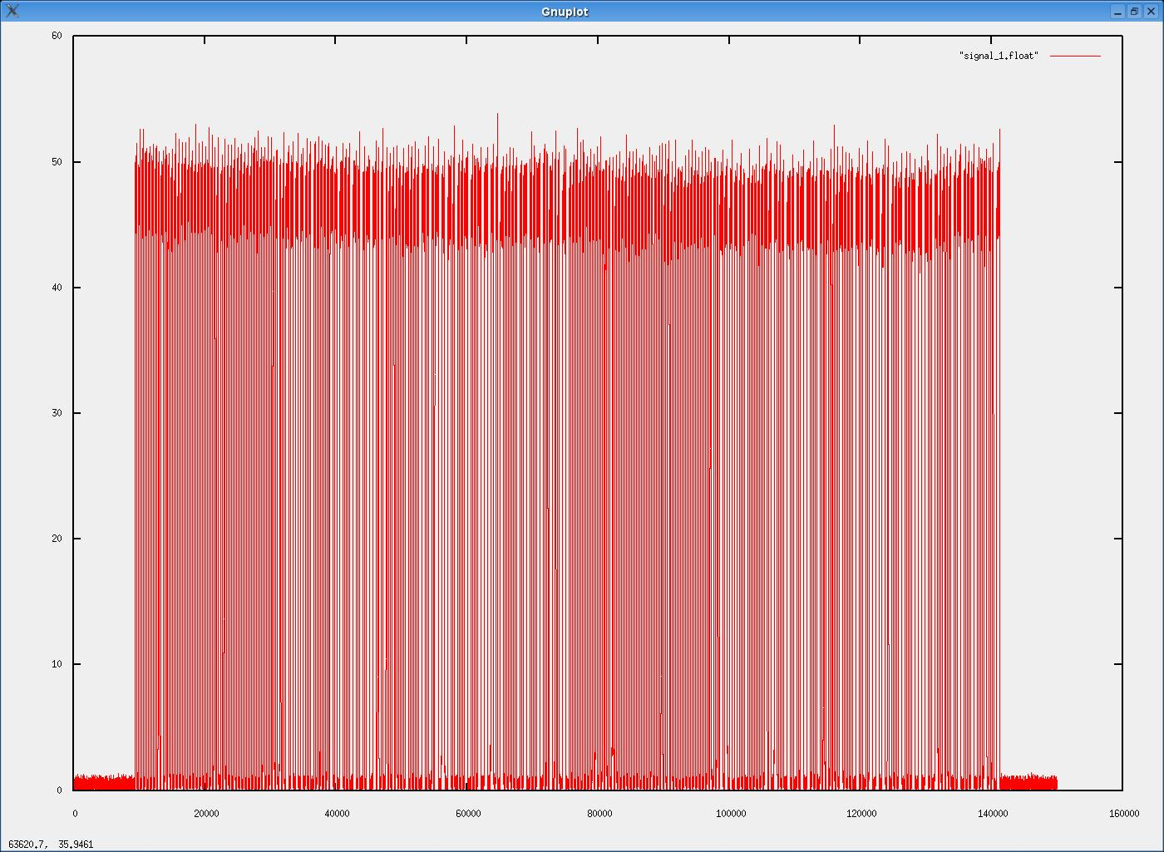
VW Key Fob
First Signal

Slide 48
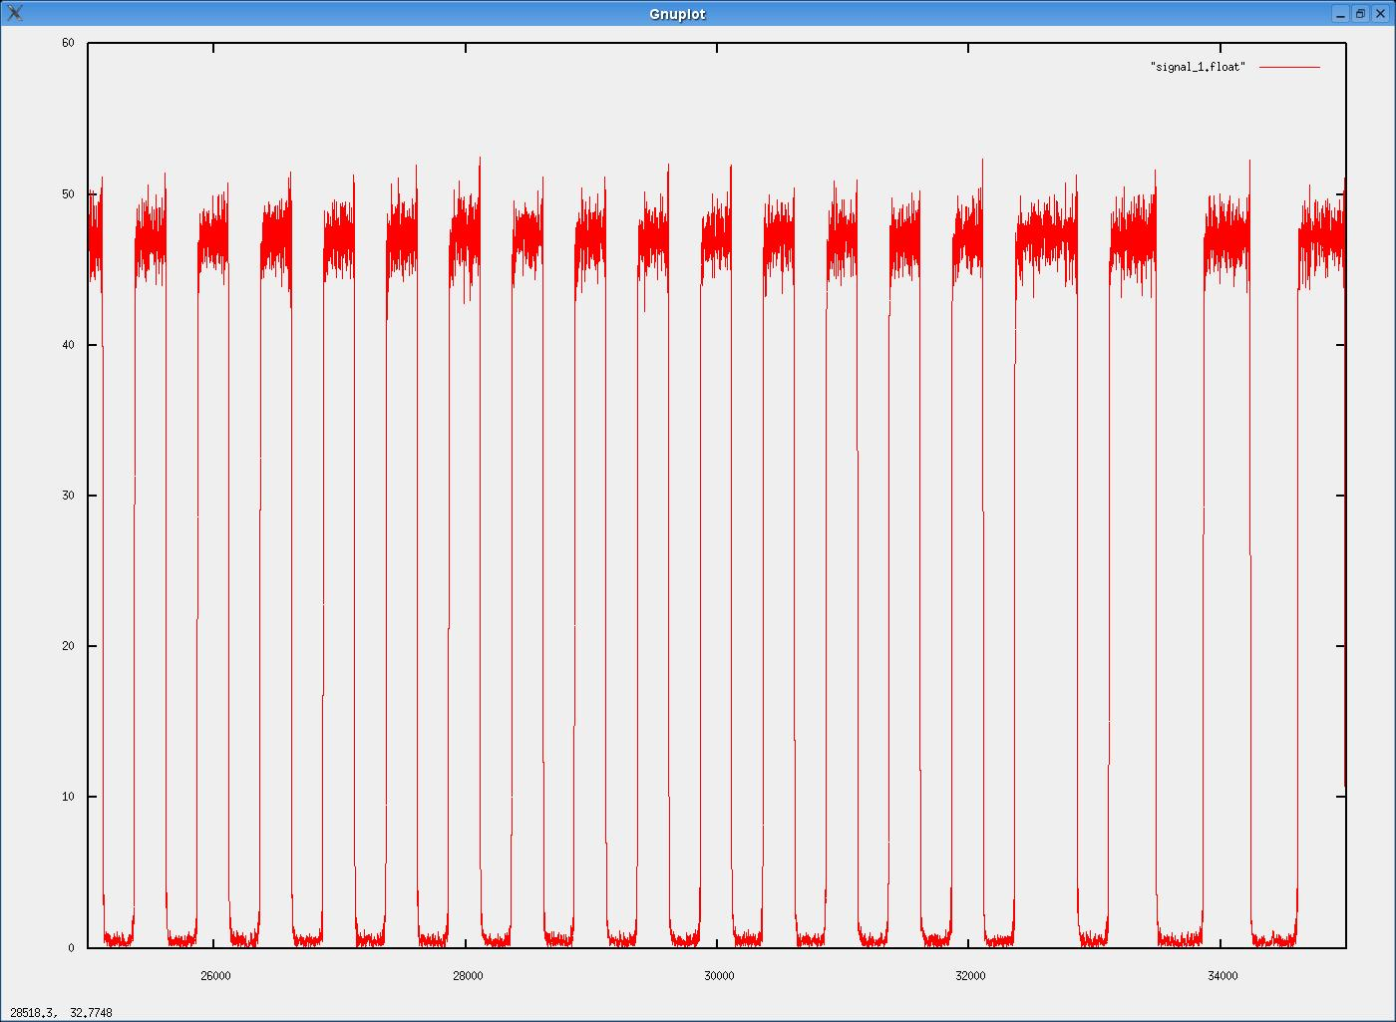
VW Key Fob
Samples 25000 – 35000 of first signal

Slide 49
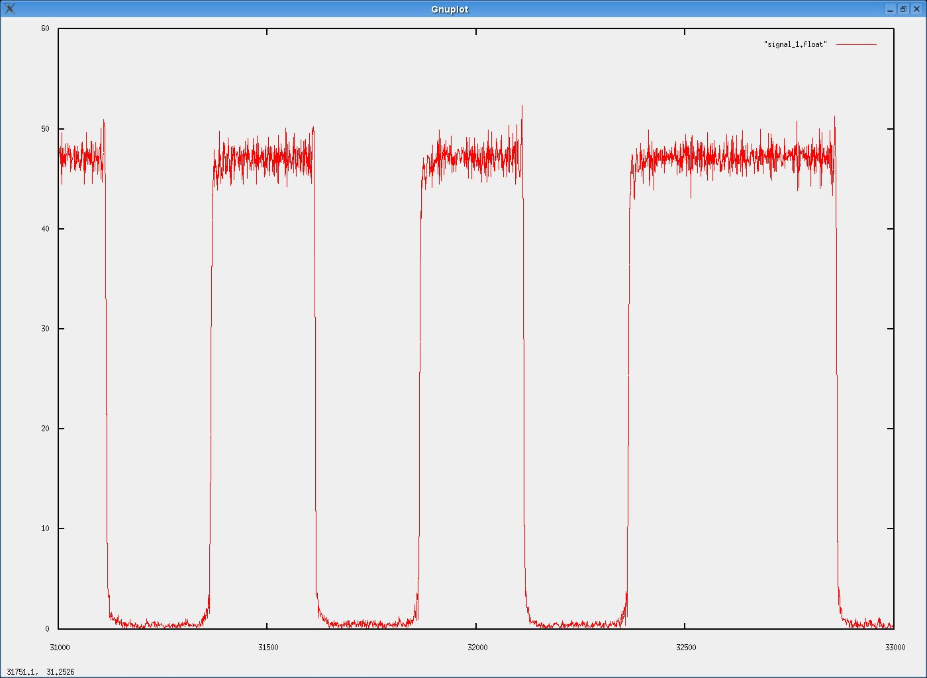
VW Key Fob
Samples 31000 – 33000 of first signal

Slide 50
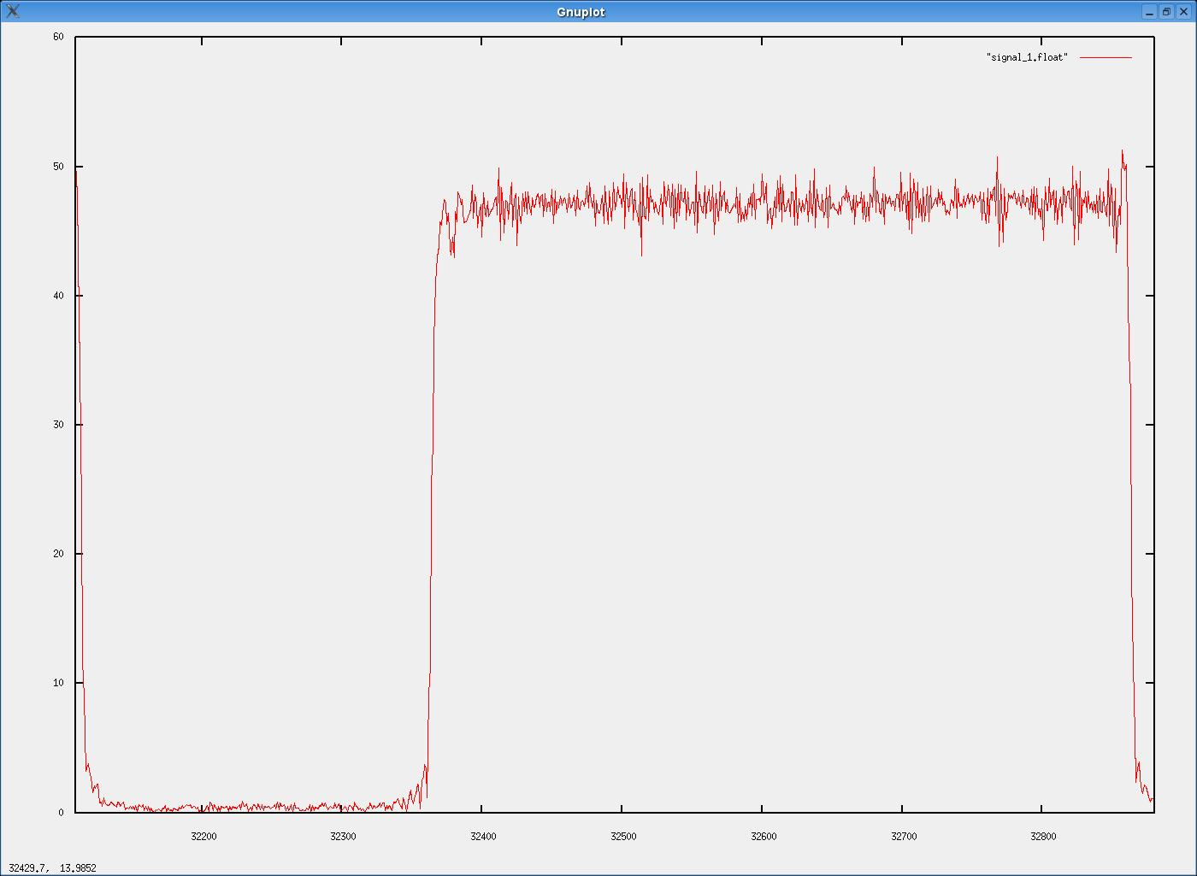
VW Key Fob
Samples 32110 – 32880 of first signal

Slide 51
VW Key Fob
Sampled at 500kHz
  Holds low for 250 samples – .5ms
  Holds high for 500 samples – 1ms
For initial purposes
  Symbol length is .5ms
  Low is 0
  High is 1
So the sample we were looking at was
        011

Slide 52
VW Key Fob
Demod
  transmit Frequency
  signal bandwidth
  guess at symbol modulation
Now just write some software!

Slide 53
VW Key Fob
Examined ~100 examples. No repeats although there are definite patterns.
Next steps
Probably easiest thing to do would be to examine the demoded data for statistical patterns. (Diehard)
See Bindview paper on strange attractors in TCP sequence numbers.
    http://www.bindview.com/Services/Razor/Papers/2001/tcpseq.cfm

Slide 54
Next
GSM
Documentation is very good and design flaws can be identified there. What about implementation flaws?
What encryption does my phone use?
  A5/1 and A5/2 hacked.
  Actually, how do I know I’m using any encryption at all?
How about random numbers?
How about man-in-the-middle attacks?
  Requires transmit and so probably illegal to test.

Slide 55
GSM
Find transmit frequency.
FFT Signal Search
  just knowing the bandwidth is actually good enough
  FCC Search for towers in your area
  Documentation
  http://www.3gpp.org/specs/numbering.htm

Slide 56
GSM
Turns out I have two strong signals reachable from my computer room.
One at 1.9474GHz and the other at 1.9468GHz.

Slide 57
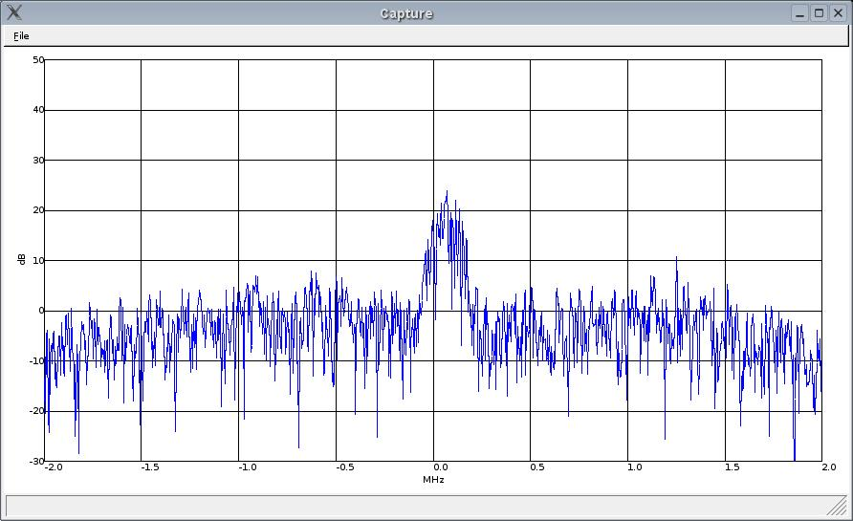
GSM
GSM Tower at 1.9474GHz with 1MHz DBS filter.

Slide 58
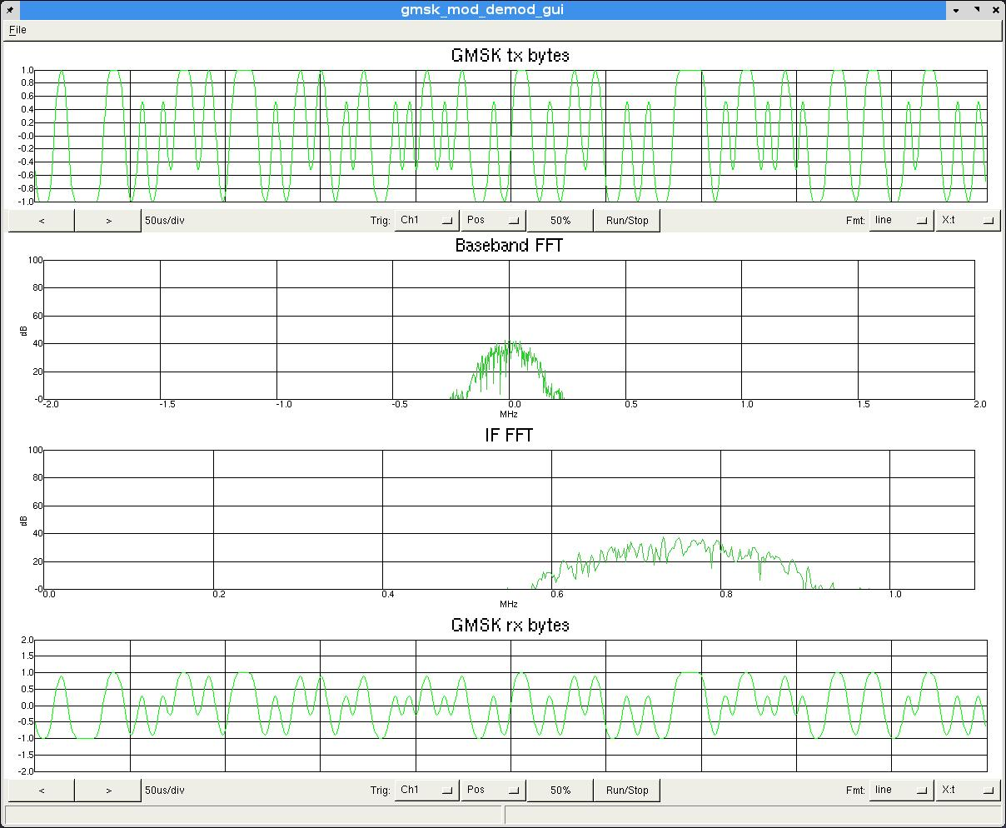
GSM
Modulation type is GMSK (or 8PSK)

Slide 59
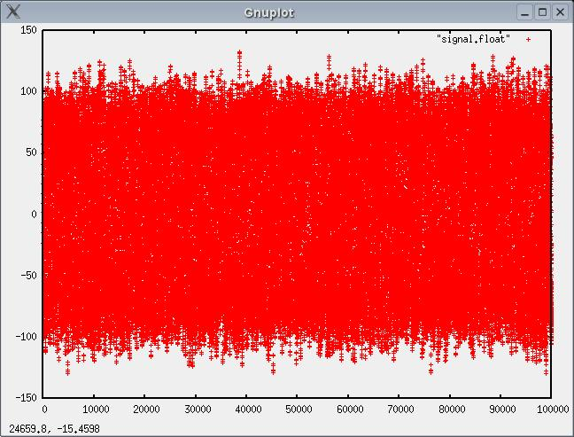
GSM
Capture signal (Samples 2M – 3M @4Msps.)

Slide 60
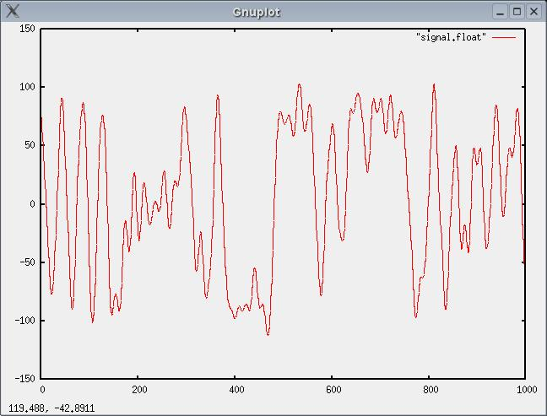
GSM
Samples 2M – 2.001M

Slide 61
GSM
Now, write some software!
BCCH (SCCH)
  FIRE parity
  convolutional encoder / Viterbi decoder
  block interleaving
  map on burst
  content parsing
Next channel

Slide 62
Conclusion
Penetration testing can be useful – cost/benefit. Costs for mistakes can be very high.
Software radio is cool.
More info? Ideas? Send me email:
jl@thre.at

