Slide 1

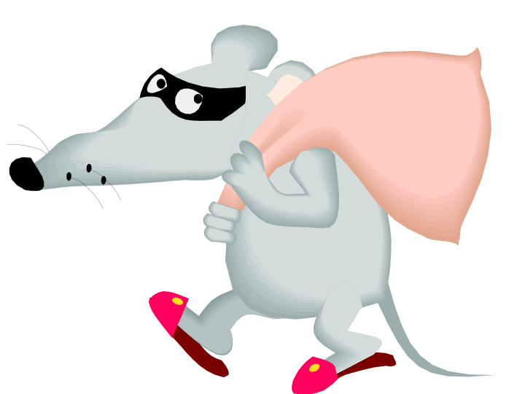
U.S. SECRET SERVICE
“Worthy of Trust and Confidence”
IDENTITY THEFT
HOW TO DEFEND YOUR GOOD NAME
IDs

Slide 2
U.S. SECRET SERVICE
“Worthy of Trust and Confidence”
AGENDA
THE UNITED STATES SECRET SERVICE
ID THEFT STATISTICS
TACTICS OF AN ID CRIMINAL
HOW TO DEFEND YOURSELF
QUESTIONS AND EXPERIENCES

Slide 3

U.S. SECRET SERVICE
“Worthy of Trust and Confidence”
HISTORY OF THE U.S. SECRET SERVICE
1865 – U.S. Secret Service created as a bureau in
the Treasury Department to combat
counterfeit currency.
1901 – U.S. Secret Service assumes responsibility
for protecting the President of the U.S.
2003 – U.S. Secret Service transferred to the
Department of Homeland Security.

Slide 4

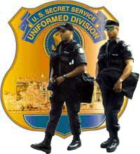

U.S. SECRET SERVICE
“Worthy of Trust and Confidence”
THE U.S. SECRET SERVICE TODAY
Personnel:
Special Agents
Uniformed Division Officers
Specialists
Field Offices:
Headquarters, Washington D.C.
The Secret Service has field offices in every major American city,
resident offices in smaller cities across the country, and liasion
offices throughout Canada, Europe, Asia, and South America.

Slide 5
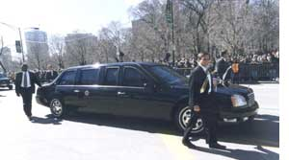

U.S. SECRET SERVICE
“Worthy of Trust and Confidence”
MISSION OF THE U.S. SECRET SERVICE
PROTECTION
INVESTIGATIONS

Slide 6
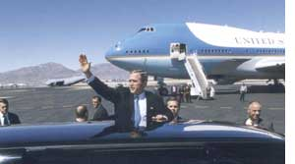
U.S. SECRET SERVICE
“Worthy of Trust and Confidence”
PROTECTION MISSION:
PRESIDENT OF THE UNITED STATES
VICE PRESIDENT OF THE UNITED STATES
PRESIDENT-ELECT AND VICE PRESIDENT-ELECT
IMMEDIATE FAMILIES OF ABOVE INDIVIDUALS
FORMER PRESIDENTS AND SPOUSES
CHILDREN OF FORMER PRESIDENTS UNTIL AGE 16
VISITING HEADS OF FOREIGN COUNTRIES AND THEIR
SPOUSES IN THE US
MAJOR PRESIDENTIAL AND VICE PRESIDENTIAL
CANDIDATES AND THEIR SPOUSES
OTHERS AT THE DIRECTION OF THE PRESIDENT
PROTECTIVE INTELLIGENCE

Slide 7
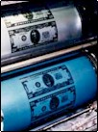
U.S. SECRET SERVICE
“Worthy of Trust and Confidence”
INVESTIGATIONS MISSION:
COUNTERFEIT U.S. CURRENCY
ACCESS DEVICE FRAUD
IDENTITY THEFT
BANK FRAUD
COMPUTER FRAUD
TELECOMMUNICATIONS FRAUD
FORGERY
www.secretservice.gov

Slide 8
U.S. SECRET SERVICE
“Worthy of Trust and Confidence”
IDENTITY THEFT FACTS AND FIGURES:
#1 CRIME IN THE NATION
TEXAS IS 5TH IN THE US FOR MOST ID
THEFT VICTIMS
APPROXIMATELY 7.2 MILLION PEOPLE
BECAME VICTIMS OF ID THEFT IN
2004
ID THEFT COST TO BUSINESSES AND
CONSUMERS IN 2005 WAS $56.6 BILLION
(ESTIMATE)
STATISTICS PROVIDED BY ITRC

Slide 9
U.S. SECRET SERVICE
“Worthy of Trust and Confidence”
IDENTITY THEFT FACTS AND FIGURES:
(CONT’D)
VICTIMS SPEND AN AVERAGE OF 330 HRS
RECOVERING FROM ID THEFT CRIME
VICTIMS SPEND AN AVERAGE OF $1400
IN OUT-OF-POCKET EXPENSES
APPROXIMATELY 85% OF VICTIMS FOUND
OUT ABOUT THE CRIME DUE TO AN
ADVERSE SITUATION
STATISTICS PROVIDED BY ITRC

Slide 10


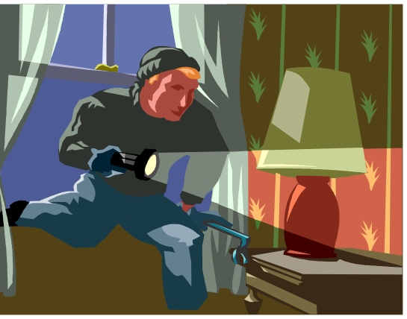
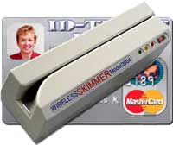
U.S. SECRET SERVICE
“Worthy of Trust and Confidence”
TACTICS OF AN ID CRIMINAL
IDs

Slide 11
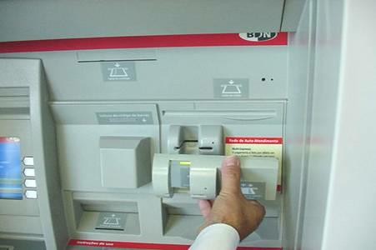
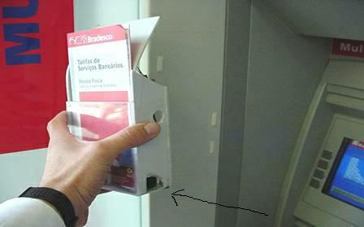
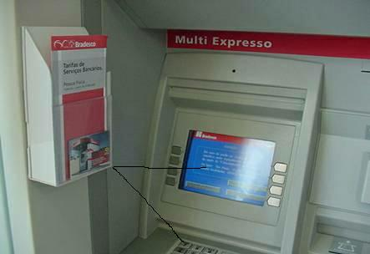
U.S. SECRET SERVICE
“Worthy of Trust and Confidence”

Slide 12
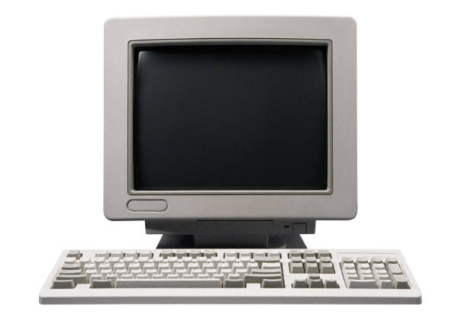
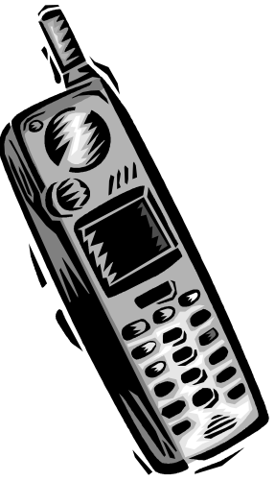
U.S. SECRET SERVICE
“Worthy of Trust and Confidence”
TACTICS OF AN ID CRIMINAL
IDs

Slide 13
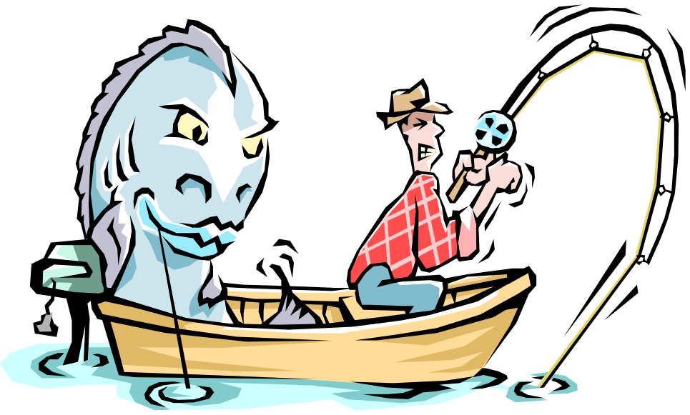
U.S. SECRET SERVICE
“Worthy of Trust and Confidence”
PHISHING
A fraudulent scheme involving Identification Theft typically
by email.
Sender pretends to be a legitimate company, bank or
official.
Use a website that looks like the website of the legitimate
company.
BAD
GUY
YOU

Slide 14

U.S. SECRET SERVICE
“Worthy of Trust and Confidence”
“I GO CHOP YOUR DOLLARS!”
“419 is just a game, you are the losers,
we are the winners.
White people are greedy, I can say they
are greedy.
White men, I will eat your dollars, will
take your money and disappear.”
“Cyber-Scammers Anthem” by Osofia
Popular song in Lagos, Nigeria
SOURCE: LA TIMES

Slide 15
U.S. SECRET SERVICE
“Worthy of Trust and Confidence”
NIGERIAN ADVANCE FEE SCHEME
VICTIM PAYS MONEY TO SOMEONE IN ANTICIPATION
OF RECEIVING SOMETHING GREATER IN VALUE BUT
RECEIVES NOTHING IN RETURN:
Self-Proclaimed Government Official
Forged Official Looking Documents
Sense of Urgency
Confidential nature emphasized
Recipient encouraged to give out account info

Slide 16
U.S. SECRET SERVICE
“Worthy of Trust and Confidence”
TACTICS OF AN ID CRIMINAL
How identity thieves use your information:
Open a new credit card account using your
SSN, name and date of birth
Use your credit card number to make purchases
Open up bank accounts in your name and
write bad checks/counterfeit checks
Drain your bank accounts
Buy a car and take out a loan in your name
Set-up phone, wireless or utility service
If arrested, they give your name and info to
police and don’t show up for court

Slide 17


U.S. SECRET SERVICE
“Worthy of Trust and Confidence”
HOW TO DEFEND YOURSELF
THE BEST DEFENSE IS A GOOD
OFFENSE!
YOU

Slide 18
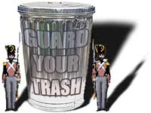
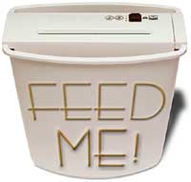
U.S. SECRET SERVICE
“Worthy of Trust and Confidence”
HOW TO DEFEND YOURSELF
BUY A SHREDDER:
Charge receipts
Copies of credit applications
Insurance forms
Physician statements
Checks and bank statements
Expired charge cards
Credit offers you get in the mail

Slide 19
U.S. SECRET SERVICE
“Worthy of Trust and Confidence”
HOW TO DEFEND YOURSELF
Deposit outgoing mail in post
office collection boxes or
at your post office rather
than an unsecured mailbox
Promptly remove mail from
your mailbox
Request a vacation hold from
Post Office if away for an
extended time
MAIL THEFT
Failure to receive bills, statements OR receiving
statements you did not apply for

Slide 20
U.S. SECRET SERVICE
“Worthy of Trust and Confidence”
HOW TO DEFEND YOURSELF
Opt Out of Pre-Approved Credit
Card Offers
Call (888)5-OPT-OUT or
www.optoutprescreen.com
Opt Out of Receiving Junk Mail
Send Letter To:
Direct Marketing Association
Mail Preference Service
P.O. Box 643
Carmel, NY 10512
OR www.dmaconsumers.org/cgi/offmailinglistdave
MAIL THEFT

Slide 21
U.S. SECRET SERVICE
“Worthy of Trust and Confidence”
HOW TO DEFEND YOURSELF
Limit the identification info and
the number of credit/debit
cards you carry to what you
actually need
Never carry your Social Security
Card in your wallet
Monitored Alarm System at Home
STOLEN PERSONAL INFO
WALLET, WORK, HOME
Secure/hide personal information
in your home
Ask about security procedures at your place of work and
at businesses/doctor’s offices that collect your
personal information. Why my SSN? Disposal?

Slide 22
U.S. SECRET SERVICE
“Worthy of Trust and Confidence”
HOW TO DEFEND YOURSELF
SKIMMING/ATM FRAUD
Pay Cash instead of using
a credit/debit card
When using your credit card/
or writing a check:
- Be wary of your surroundings
- Attempt to conceal your personal information
- Try to keep an eye on what the store clerk,
waiter does with your credit card

Slide 23
U.S. SECRET SERVICE
“Worthy of Trust and Confidence”
HOW TO DEFEND YOURSELF
SKIMMING/ATM FRAUD
When possible, use ATM machines you are
familiar with; contact your bank if you notice
anything out of the ordinary
Monitor your bank and credit card accounts
frequently

Slide 24
U.S. SECRET SERVICE
“Worthy of Trust and Confidence”
HOW TO DEFEND YOURSELF
LOOSE LIPS, SINK SHIPS!!
THINK FIRST! ACT SECOND!!
Before giving out personal information,
verify this is a real representative of the
company. Conduct your own background
investigation.
Never give out your personal info over the
phone unless you initiate the contact
and you know that you are speaking
to a true company employee.
“PRETEXTING”
Area Code Decoder:
http://decoder.americom.com/cgi-bin/decoder.cgi

Slide 25
U.S. SECRET SERVICE
“Worthy of Trust and Confidence”
HOW TO DEFEND YOURSELF
Do not open or respond to emails
you know are scams – DELETE!
Never provide personal information
over the internet unless you
initiate the contact AND …
PHISHING
You are using a secure browser to guard the online
transaction:
    https://www.website.com
    Look for security icons

Slide 26
U.S. SECRET SERVICE
“Worthy of Trust and Confidence”
HOW TO DEFEND YOURSELF
Companies should never ask you
for personal information with
an email, SO DON’T RESPOND!
Independently contact company
supposedly sending the email
  DO NOT use links or phone #s listed in the
suspect email
PHISHING
Update your virus protection software regularly;
recommend using a Firewall
Use complex passwords; do not use auto log-in

Slide 27
U.S. SECRET SERVICE
“Worthy of Trust and Confidence”
HOW TO DEFEND YOURSELF
ORDER YOUR FREE CREDIT REPORTS!!!
www.annualcreditreport.com
OR CALL 877-322-8228
Review your credit reports. Look for:
  Inquiries from companies you did not contact
  Accounts you did not open
  Debts on your accounts you can’t explain
  Check for accuracy of your personal info
  Get fraudulent or inaccurate info removed/corrected

Slide 28
U.S. SECRET SERVICE
“Worthy of Trust and Confidence”
THREE CREDIT BUREAUS
Equifax
1-800-525-6285
www.equifax.com
TransUnion
1-800-680-7289
www.transunion.com
Experian
1-888-EXPERIAN
www.experian.com

Slide 29
U.S. SECRET SERVICE
“Worthy of Trust and Confidence”
HELPFUL WEBSITES
Federal Trade Commission
www.consumer.gov/idtheft/
Identity Theft Resource Center
www.idtheftcenter.org/index.shtml
ScamBusters
www.scambusters.org
Looks Too Good To Be True
www.lookstoogoodtobetrue.com

Slide 30
U.S. SECRET SERVICE
“Worthy of Trust and Confidence”
QUESTIONS???

