Slide 1

VICARS
VICTIMS INITIATIVE FOR COUNSELING, ADVOCACY,
AND RESTORATION OF THE SOUTHWEST
A program of the Texas Legal Services Center supported by Grant No. 2007-VF-GX-K032 awarded by the Office for Victims of Crime, Office of Justice Programs, U.S. Department of Justice. Points of view in this document are those of the author and do not necessarily represent the official position or policies of the U.S. Department of Justice.
A Consumer Guide to
Identity Theft & Financial Fraud

Slide 2


What is Identity Theft?
The theft or misuse of personal identifying information in order to gain something of value or facilitate other criminal activity
Texas Penal Code § 32.51:
to obtain, possess, transfer, or use a person’s “identifying information” or “telecommunication access device” with the intent to harm the person.
Notes:
Top is the commonly used definition propounded by the FTC. Bottom is the definition from the Texas Penal Code. Bottom line, ID theft has 3 elements: (1) to obtain, possess, transfer or use (2) personal identifying information or a telecommunication access device aka cell phone, palm pilot, etc. (3) with intent to harm the person, i.e., steal money, use credit, etc.

Slide 3
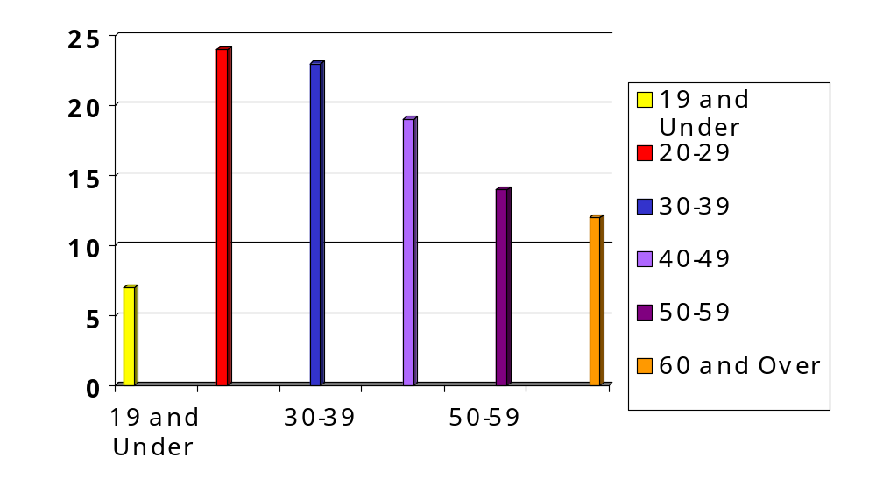
Identity Theft Complaints By Age,
FTC 2008
P
E
R
C
E
N
T
A
G
E
AGE
Notes:
Ten percent of 26,000+ cases of ID theft in 2007 were Texans 60 and over – that’s over 2600 cases in one year.
Note that the majority of ID theft victims are ages 18-30. This age group is specially targeted. It is thought this is due to the perception that young adults are new to financial matters, are just beginning to build and use credit, and may be naïve about the need to protect themselves.

Slide 4
Types of ID Theft in Texas
2008
Employment-Related | 8,545 | 27%
Government Documents or Benefits | 5,596 | 18%
Credit Card | 4,620 | 15%
Bank | 3,418 | 11%
Phone or Utilities | 3,204 | 10%
Loans | 1,401 | 4%
Other | 6,455 | 20%
Notes:
Source: FTC Consumer Sentinel data. Adds up to more than 100% because so many people are victims of multiple types – 18% of Texas complaints involved more than one type.
Employment related includes impostors using fake identities to obtain employment (due to illegal immigration, poor employment history, or to evade criminal record) as well as employees taking personal identity information of fellow employees;
Credit card related ID theft is a major source of monetary loss to businesses. Impostors use stolen information to make charges on victims’ accounts both via internet and in person (exacerbated by electronic card readers) and open new accounts using victim identities.
Bank includes unauthorized ATM use, electronic fund transfers, passing forged checks and stolen checks, opening new accounts using victim identities, and accessing victims’ existing accounts.
Phone/utility includes unauthorized charges to existing accounts and opening new accounts using victim identities.
Government includes filing fraudulent tax returns, issuance of forged drivers’ licenses or other government issued IDs (Social Security cards), and applying for or receiving benefits using victim identities.
Types of loans used by imposters include mortgages, home equity loans, business, personal, and auto.
“Other” includes criminal, medical, child support, bankruptcy, property rental, and securities.

Slide 5

How is information stolen?
Trash diving
Lost/stolen wallet/purse
Mail theft
Burglary
Skimming
Computer hacking
Data breach
Scams/fraud
Notes:
These are most common; however, there are as many ways of getting information as there are identity thieves. Often it is someone the victim knows, such as a family member. When you are working with victims of violent crimes, do not overlook the possibility that they can become victims of identity theft. Many victims of domestic violence get into the shelter system and file for divorce only to find that their abuser has wrecked their credit. Victims who lose their purse or wallet in the commission of another crime need to be alert to the possibility of identity theft. In Houston, an identity theft ring operated by recruiting employees of hospitals and clinics to steal personal information of patients.

Slide 6
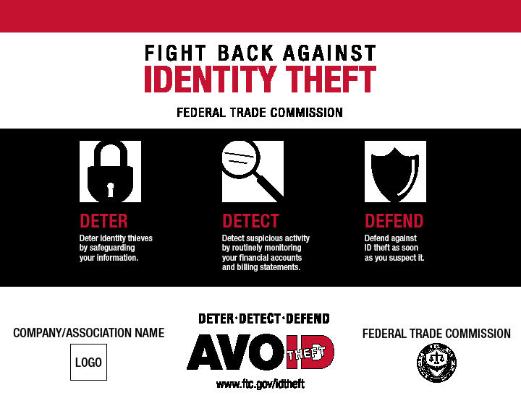

Notes:
This is the FTC’s catchphrase for ID theft. We are now going to walk you through deterring (protection), detecting, and defending yourself.
Describe the FTC’s 3 part strategy to fight ID theft and how we are going to discuss each component.
For more information on the FTC’s efforts to combat ID theft, see their website www.ftc.gov/idtheft
First, Deter – Protect yourself

Slide 7
DETER: prevention tips and Tricks
Documents, Credit Cards, and Mail:
Shred all documents with personal information.
Do not give your SSN to businesses.
Use a locked mail box or remove mail promptly.
Take outgoing mail to a blue box or post office.
Opt out of credit card offers.
Carry only what you need in your wallet or purse.
Remove your SSN from other items in your wallet.
Notes:
Can’t be stressed enough how important it is to shred documents – especially credit card offers and bills. A $20 shredder can help avert hundreds or thousands lost to ID thieves. Why? some thieves have gotten pretty sophisticated at phishing for information over the internet or using a skimmer to record credit card information. (Describe phishing and skimmers). Surprisingly, most ID thieves still rely on dumpster diving and mailbox theft. This is especially true of drug addicts who do not have the financial means to purchase a skimmer or who have to use public computers.
The Social Security Administration says to ask the following questions BEFORE giving your SSN to ANYONE:
Why your number is needed;
How your number will be used;
What happens if you refuse; and
What law requires you to give your number.
If they can’t cite a law that gives them access to your number, you may refuse to give it.
You can opt out of credit card offers. This is a two step process. First, call 1-888-5-OPT-OUT (1-888-567-8688). You will be sent a form. You have to fill out the form and return it before the offers are stopped. You may also visit the website: https://www.optoutprescreen.com/. This is a free service. Do not use any resource that requires you to pay to opt out!

Slide 8

Prevention tips and Tricks
Internet &Phone
Do: Get on the do not call list
Don’t:
  Give personal information unless you see “https” or lock symbol.
  Donate to charity via email or phone.
  Wire transfer to someone you don’t know – especially overseas.
  Respond to SPAM.
  Open email attachments from someone you do not know.
  Call a phone number for a business that is listed in an email.
Notes:
Revisit phishing.
The person emailing or calling for a charity may be an impostor, and the charity may be fake. Check out all charities before giving your money at www.charitynavigator.org; www.guidestar.org; or www.give.org.
Get on the No Call list by visiting www.donotcall.gov or by calling 1-888-382-1222. Note that the FTC will not call you! If someone calls you about the no call registry, it is a scam!
The phone numbers listed in scam and spam emails are FAKE! If you call them, you are being phished! Always look up the phone number in the phone book.

Slide 9
What Is Fraud? or anatomy of a scam
A Legal Definition:
A false representation of fact
Made knowingly
With the intention that the victim rely on it
To the victim’s detriment
In Plain English:
Fraud is telling a lie or omitting important information to get a victim to do something he or she would not otherwise do and that causes the victim harm.
Notes:
You can tell these legal definitions are written by lawyers!
Financial fraud involves getting mislead, doing something you wouldn’t normally do (something you may feel stupid about later), and suffering financial harm

Slide 10
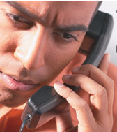
Who initiated the contact?
If not you, it’s a scam.
Notes:
If your bank contacts you, they don’t need to ask for your account number. They gave it to you in the first place. If you contact your bank, they need enough of your personal information to verify that you are you. Never call a number listed in a phishing email. Look it up in the phone book. Refer to handout of common scams.

Slide 11
COMMON SCAMS
The Nigerian scam
  Tale of woe by a sender claiming to be rich
  Sender cannot access own money
  Plea for help with promise to repay
  Wire transfer or money order to account
The Lottery scam
  Victim has won or inherited a large amount of money
  Must pay taxes up front by wire transfer or money order

Slide 12
COMMON PHONE SCAMS
Scare tactic
  Caller pretends to be from a trusted source
  Caller states that something is wrong
  Caller requests that victim “verify” personal or account information
Fake charity
  Caller purports to be soliciting for a charity
  Caller takes credit card and personal information for donation

Slide 13
DON’T FALL FOR THESE!
Jury Duty
Easy Credit – Pay in advance
Foreign royalty
Foreign lotteries
Work-at-home or investment schemes
Fake ebay or craigslist sales
Fake emails
Internet dating scams
Medicare Part D scams
Notes:
Jury Duty – You receive a call or email stating there’s a warrant for your arrest because you failed to show up for jury duty.
Easy Credit – You receive an offer by mail directing you to call or call a number on TV for a credit card – even though you have bad credit. Over the phone, they take your personal information including your bank account number. After taking your personal information, they tell you that there is a $200 fee for getting the card. You decline, but they begin deducting money from your bank account.

Slide 14
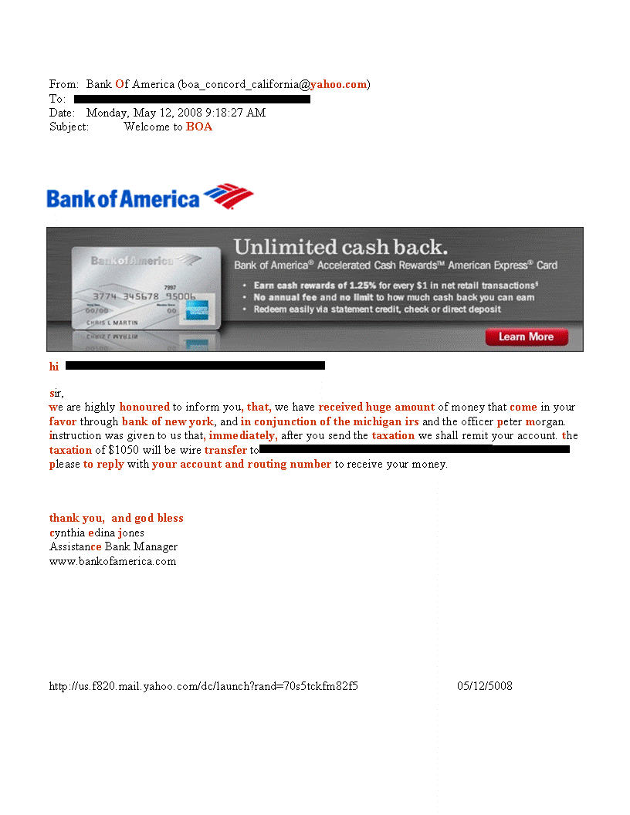
Notes:
1. Compare BOA in From line to the logo. Of should not be capitalized. The real bank would not make that mistake.
2. Major banks do not use yahoo accounts for email. This probably came from an individual’s email account.
3. A welcome message from a business would use its full name not an acronym in the subject line – Note that it is attempting to hook people who may have made a recent inquiry or account change.
4. Notice how sneaky this scammer is! They’ve copied the BOA logo and a BOA advertisement onto the email to make it look real.
5. There are no capital letters in the body of the email. Banks have proofreaders and editors who would never let such a mistake in an official bank communication.
6. Notice the syntax. The way the words are put together indicates that the writer is not fluent in English.
7. There’s no such thing as the Michigan IRS. If you received an email like this, hopefully you would not open it in the first place. If you did open it, hopefully, you would ask yourself: Why would I be getting money from Michigan? If I were getting money from Michigan, why would it be send from a Bank of New York account? Why would a Bank of America branch in Concord, California be collecting taxes for the State of Michigan?
8. These sneaky scammers are going for a double dip. They’re asking the victim to wire transfer money, and they’re fishing for a bank account and routing number. Why? So they can drain the victim’s bank account. By the way, we blacked out the information about the wire transfer because the scammers opened a bank account using a previous victim’s name and address. So, when future victims realize they’ve been scammed, they will naturally go after the person whose name and address are associated with the account where the money went. That person never knew the account existed and did not get the money.
9. No bank would risk offending a potential customer by using a religious letter closing.
9. A bank official would capitalize her name.
10. There’s no such thing as an Assistance Bank Manager.
Now that you know a little about how people become victims, let’s talk about the effect of financial crimes on victims.
Point out that the bank is a victim of corporate ID theft

Slide 15
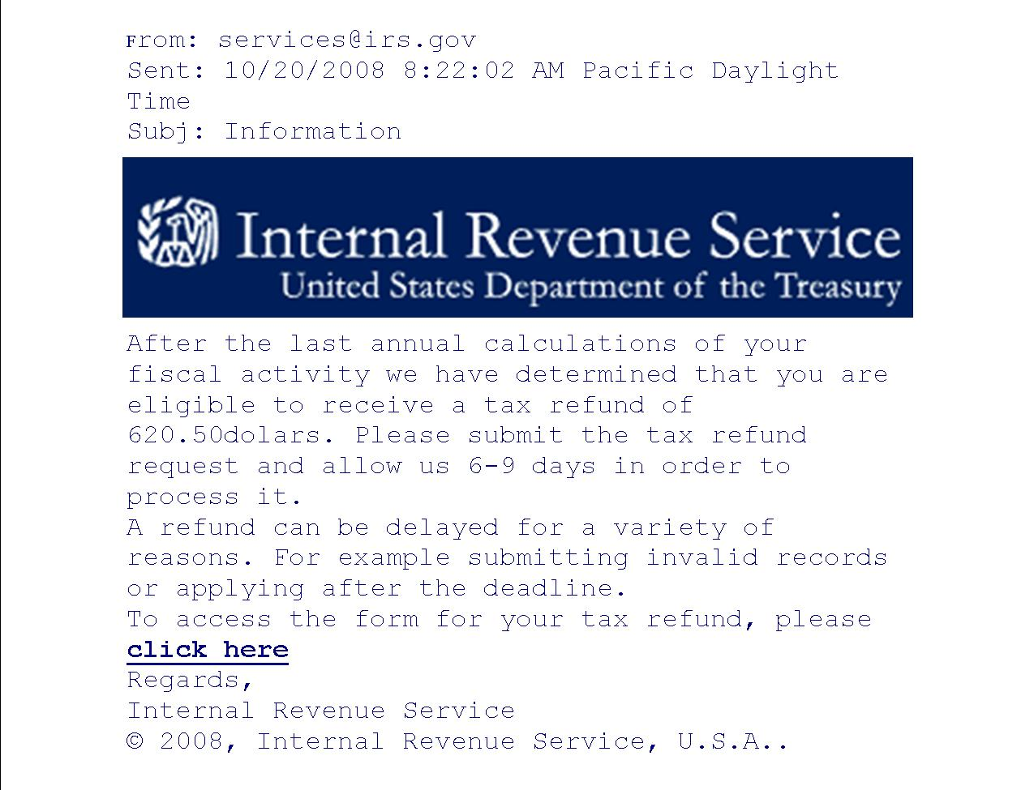

Slide 16
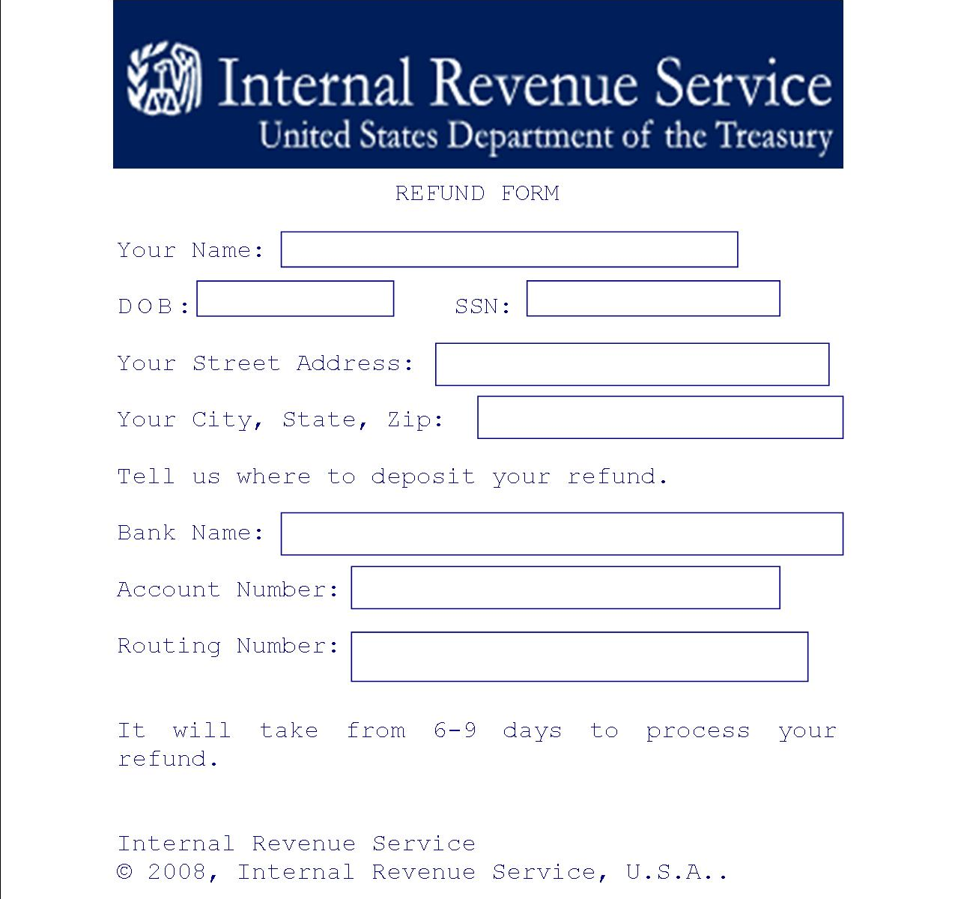

Slide 17

Detect
Check your credit report regularly.
Monitor bank & credit card statements.
Be alert to mail that does not arrive.
Do not ignore harassing phone calls or collection letters.
Check your Social Security Earnings record.
Check your criminal history.
Notes:
Common scenarios: receive collection letters or harassing phone calls; get arrested at a routine traffic stop; get denied when apply for credit
BE active! Can get a free credit report every year. There are 3 credit bureaus. Order one every 4 months from a different one. Put it on your calendar! Use www.annualcreditreport.com to get it downloaded free to your computer.
At www.ssa.gov, you can check your SS earnings record free online. You should also receive a copy of your earnings record every year or so.
You can check your own criminal record for about $3.50 at http://www.txdps.state.tx.us/administration/crime_records/pages/index.htm

Slide 18


How to Spot Dishonest Service Providers
Be alert for service providers who—
  Isolate you from friends and family;
  Ask about your Will or finances;
  Ask to be given power of attorney;
  Do not respect your privacy;
  Try to make you feel sorry for them.
Report to their boss, tell family members, or call Adult Protective Services at 1-800-252-5400.
Notes:
Senior citizens are sometimes targeted by care givers or other service providers who come into their homes. Be alert to these signs of possible dishonesty. Early detection and notification are critical. Note that in Texas a crime (including financial fraud) committed against an elderly victim (defined as someone over age 65) or a minor child carries a harsher sentence than the same crime committed against a person aged 21-64.
APS hotline number: 1-800-252-5400.
Doesn’t just affect the elderly. If you see the cable guy looking through your bedroom or the plumber in a room that doesn’t have plumbing – send them away and report them to their employer!

Slide 19

Defend
IMMEDIATE CONCERNS:
Stop impostor activity
Report the crime
Repair the damage
Notes:
Equifax: 1-800-525-6285
Experian: 1-888-397-3742
TransUnion: 1-800-680-7289
Use police if you live within city limits and sheriff if you live outside city limits. If mail is tampered with, also contact US postal inspector.
FCRA protections: When you notify credit bureaus they have to remove items within 4 days & investigate. But, you have to request in writing, send proof of identity, and send police report or fraud affidavit
Special situations: Briefly discuss criminal and medical ID theft

Slide 20
Order your credit report and place a fraud alert or freeze.
Close accounts that have been tampered with or opened by an impostor.
Report to law enforcement and the FTC.
Write credit bureaus and creditors:
  Attach a copy of the police report.
  Attach a copy of ID card.

Slide 21
Fraud Alert vs. Credit Freeze
One call
Creditors must take “reasonable steps” to verify identity
Less effective
90 day, 7 years
Write each bureau
No one can apply for new credit – must thaw the report
More effective
Effective until thawed
Fee if no police report
No credit? No problem!
Neither will prevent new accounts with merchants that do not check credit reports.

Slide 22
3 Things Needed to Enforce Victim’s Rights Under
Federal Law
Proof of identity, i.e., copy of driver’s license or ID card;
Police report, ID theft affidavit, or both;
Complete description of account, debt, or other item being disputed.

Slide 23

If it’s not in writing,
it doesn’t
count!
Notes:
Tell about clients whose first contact by phone, they tell person on phone they are a victim, next contact is a lawsuit.

Slide 24
FAIR CREDIT REPORTING ACT
Free credit report each year;
Removal of first 5 digits of SSNs on request;
Fraud alerts for 90 days/7 years;
Blocks of portions of credit reports attributable to identity theft (4 days on written notification);
Allows active duty military alerts;

Slide 25
FAIR CREDIT REPORTING ACT
Written summary of ID theft victims’ rights upon request;
Allows victims to get account documentation if requested in writing;
Requires collection agencies to report ID theft to creditors and provide information about the alleged debt to the victim if requested in writing;
Prevents a creditor from placing a debt for collection after being notified that the debt was incurred through ID theft.

Slide 26
How can VICARS help?
Help victims deal with creditors and debt collectors
Help victims compile documents
Represent victims in civil lawsuits
Provide emotional support and guidance
Help victims understand the criminal justice system
Help victims fill out victim impact statements and requests for restitution
Services are free
Call 1-888-343-4414 or visit www.idvictim.org

