Slide 1

Internet Security and Identity Theft
Brad Weaver • January 17, 2007

Slide 2
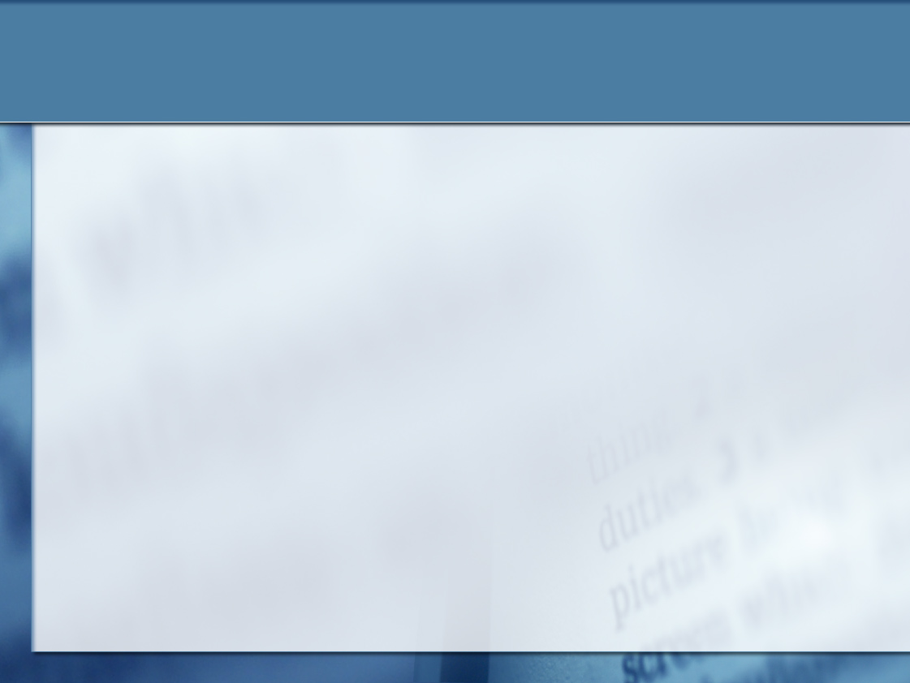
What is Identity Theft?
Theft of personal information (SSN, credit card, account information)
Information is used to commit fraud
Theft from existing accounts
Creation of new accounts

Slide 3
General Precautions
Take responsibility for your personal info
Monitor account activity
Shred financial documents
Don’t give out personal info over phone/email/Internet
Check credit report annually (www.AnnualCreditReport.com)

Slide 4
Identifying Email Scams
“You’ve Been Phished” video
Adopt a suspicious attitude
Email messages and web sites are easy to spoof (let’s see how easy…)
Never send personal information in response to an email message
Check with the Help Desk if in doubt

Slide 5
Staying Safe Online
Choose good passwords
Use different usernames and passwords for different systems
Keep software up-to-date
Run spyware (SpySweeper, Microsoft Windows Defender) and antivirus (Norton, McAfee) software

Slide 6
Protecting Your Family
StaySafeOnline.org
GetNetWise.org
Consider filtering/control programs (CyberPatrol, NetNanny)

Slide 7
If You’re a Victim
FTC has excellent online resources
If SSN is involved, place an Initial Fraud Alert with any of the 3 credit reporting agencies
Close affected accounts
Monitor credit report frequently during the first year
File reports with police, FTC

Slide 8
As Wabash Employees…
Treat personal information from current and prospective students, alumni, and parents with care
Shred documents with personal information
Don’t share account information
Be alert for fraudulent calls
Report loss or theft of personal info immediately

Slide 9
Online Resources
IT Services Security Web Page (www.wabash.edu/technology/security)
FTC (ftc.gov/idtheft)
Let’s Review

