Slide 1
CS 432/532
Computer and Network Security
Spring 2019
Albert Levi
levi@sabanciuniv.edu
FENS 1091, ext.9563

Slide 2
What is this course about?
This course is to discuss
  security needs
  security services
  security mechanisms and protocols
for data stored in computers and transmitted across computer networks

Slide 3
What we will/won’t cover?
We will cover
  security threats
  practical security issues (practice in labs)
  security protocols in use
  security protocols not in use
  securing computer systems
  introductory cryptography
We will not cover
  advanced cryptography
  computer networks
  operating systems
  computers in general
  how to hack ☺

Slide 4
What security is about in general?
Security is about protection of assets
  D. Gollmann, Computer Security, Wiley
Prevention
  take measures that prevent your assets from being damaged (or stolen)
Detection
  take measures so that you can detect when, how, and by whom an asset has been damaged
Reaction
  take measures so that you can recover your assets

Slide 5
Real world example
Prevention
  locks at doors, window bars, secure the walls around the property, hire a guard
Detection
  missing items, burglar alarms, closed circuit TV
Reaction
  attack on burglar (not recommended ☺), call the police, replace stolen items, make an insurance claim

Slide 6
Internet shopping example
Prevention
  encrypt your order and card number, enforce merchants to do some extra checks, using PIN even for Internet transactions, don’t send card number via Internet
Detection
  an unauthorized transaction appears on your credit card statement
Reaction
  complain, dispute, ask for a new card number, sue (if you can find of course ☺)
  Or, pay and forget (a glass of cold water) ☺

Slide 7
Information security in past & present
Traditional Information Security
  keep the cabinets locked
  put them in a secure room
  human guards
  electronic surveillance systems
  in general: physical and administrative mechanisms
Modern World
  Data are in computers
  Computers are interconnected
  Computer and Network Security
Notes:
Traditionally information security provided by physical (eg. rugged filing cabinets with locks) and administrative mechanisms (eg. Personnel screening procedures during hiring process).
Growing computer use implies a need for automated tools for protecting files and other information stored on it.
This is especially the case for a shared system, such as a time-sharing system, and even more so for systems that can be
accessed over a public telephone network, data network, or the Internet.

Slide 8
Terminology
Computer Security
  2 main focuses: Information and Computer itself
  tools and mechanisms to protect data in a computer (actually an automated information system), even if the computers/system are connected to a network
  tools and mechanisms to protect the information system itself (hardware, software, firmware, *ware ☺)
Against?
  against hackers (intrusion)
  against viruses
  against denial of service attacks
  etc. (all types of malicious behavior)

Slide 9
Terminology
Network and Internet Security
  measures to prevent, detect, and correct security violations that involve the transmission of information in a network or interconnected networks

Slide 10
A note on security terminology
No single and consistent terminology in the literature!
Be careful not to confuse while reading papers and books
See the next slide for some terminology taken from Stallings and Brown, Computer Security who took from RFC4949, Internet Security Glossary

Slide 11
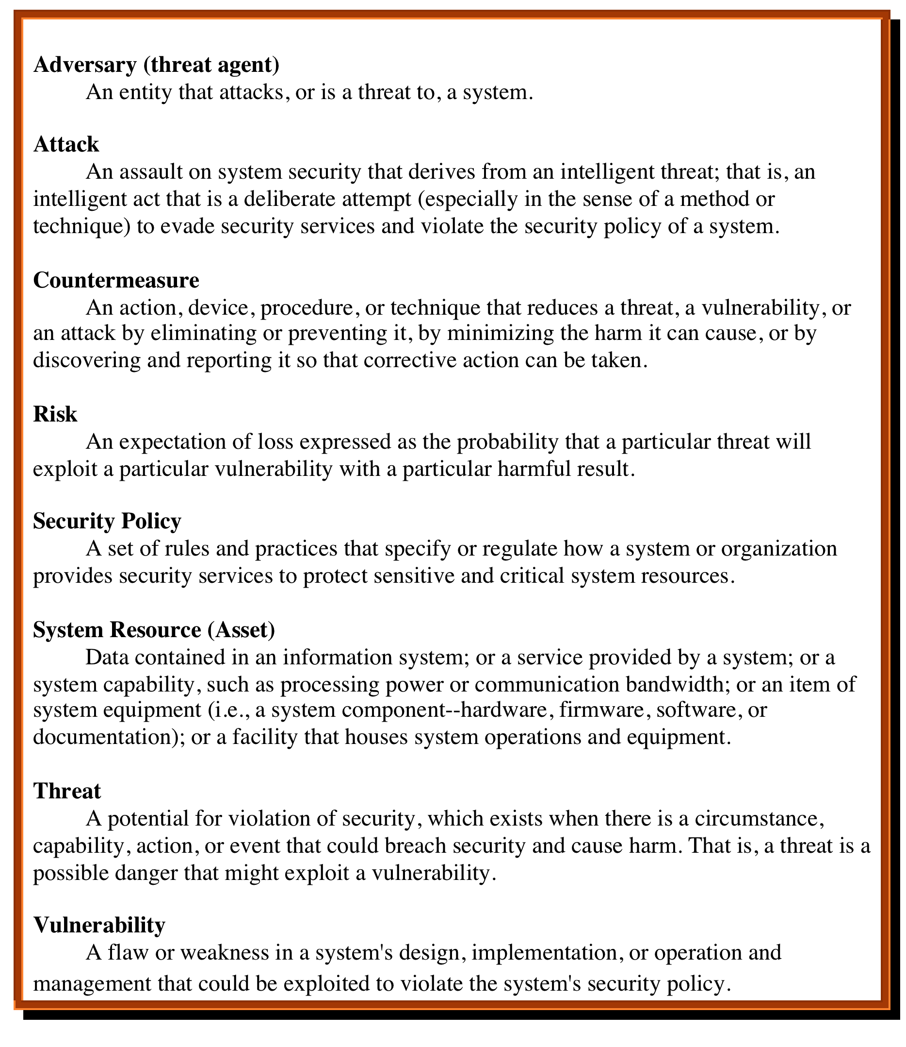

Computer Security
Terminology
RFC 4949, Internet Security Glossary, May 2000
Notes:
We now introduce some terminology that will be useful throughout the book, relying
on RFC 4949, Internet Security Glossary . Table 1.1 defines terms.

Slide 12
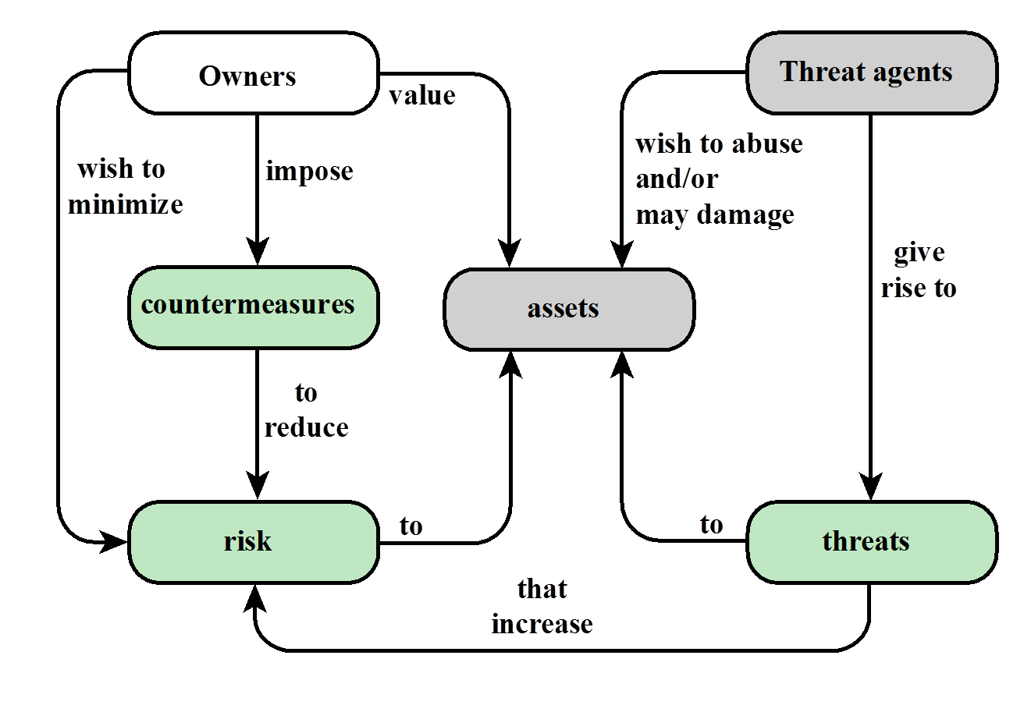
Relationships among the security Concepts

Slide 13
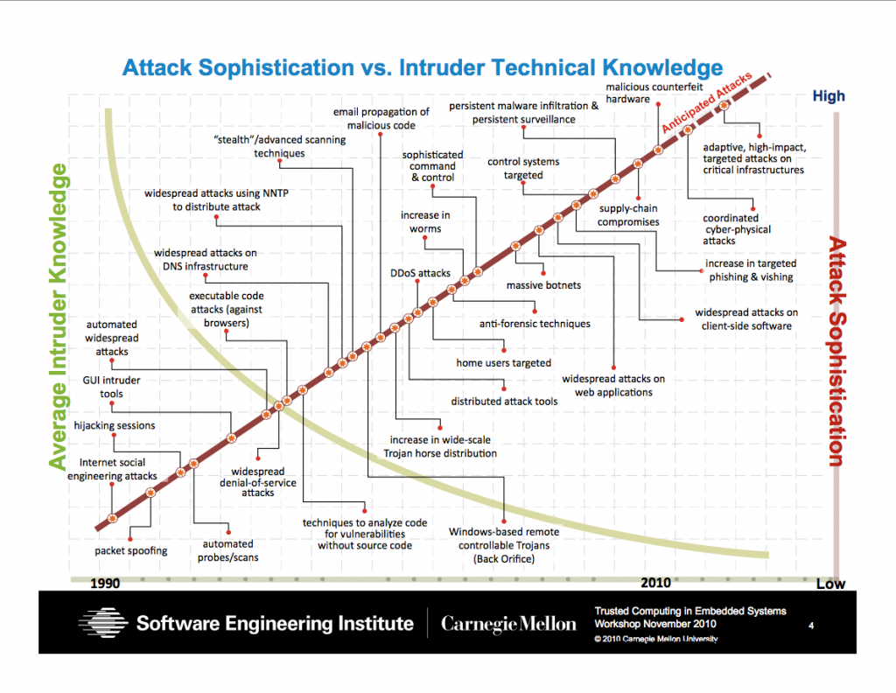
Security Trends
Skill and knowledge required to mount an attack
Notes:
Discussion: Attacks became more sophisticated to find out and more automated so that any kid can mount.

Slide 14
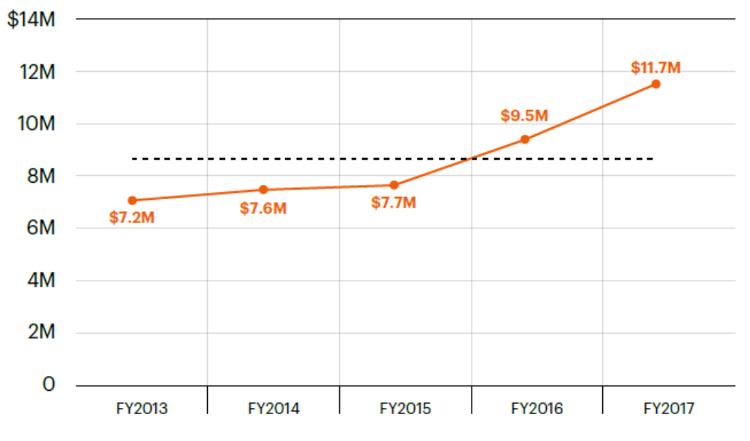

The global average cost of cyber crime/attacks
2017 Cost of Cyber Crime Study by Accenture*
Steeper increasing trend in the recent years
* https://www.accenture.com/t20170926T072837Z__w__/us-en/_acnmedia/PDF-61/Accenture-2017-CostCyberCrimeStudy.pdf

Slide 15
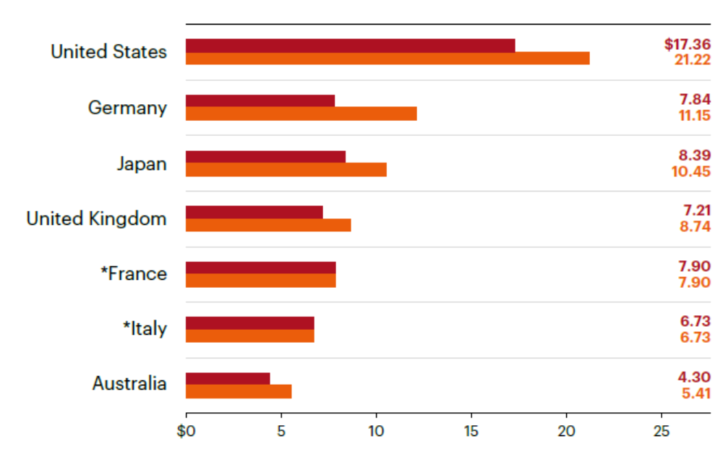
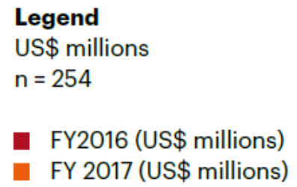
Average cost of cyber crime for seven countries
2017 Cost of Cyber Crime Study by Accenture*
- Germany has highest percentage increase;
- UK, US are around the mean in percentage increase
254 institutions responded
* https://www.accenture.com/t20170926T072837Z__w__/us-en/_acnmedia/PDF-61/Accenture-2017-CostCyberCrimeStudy.pdf

Slide 16
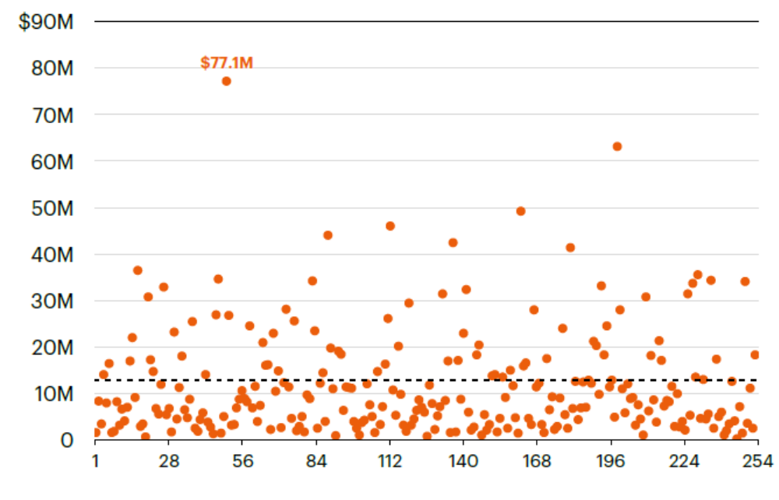
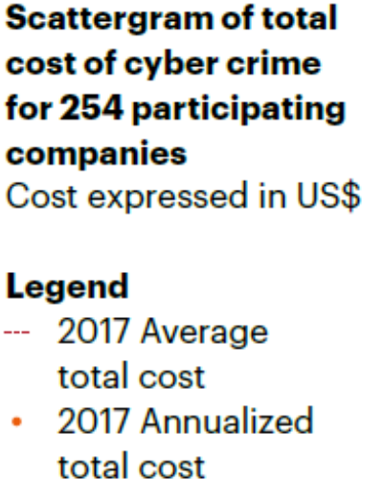
A Scattergram of Respondents
2017 Cost of Cyber Crime Study by Accenture*
- Mean is US$11.7 M
- High variance
- 163 institutions are below mean (out of 254)
* https://www.accenture.com/t20170926T072837Z__w__/us-en/_acnmedia/PDF-61/Accenture-2017-CostCyberCrimeStudy.pdf

Slide 17

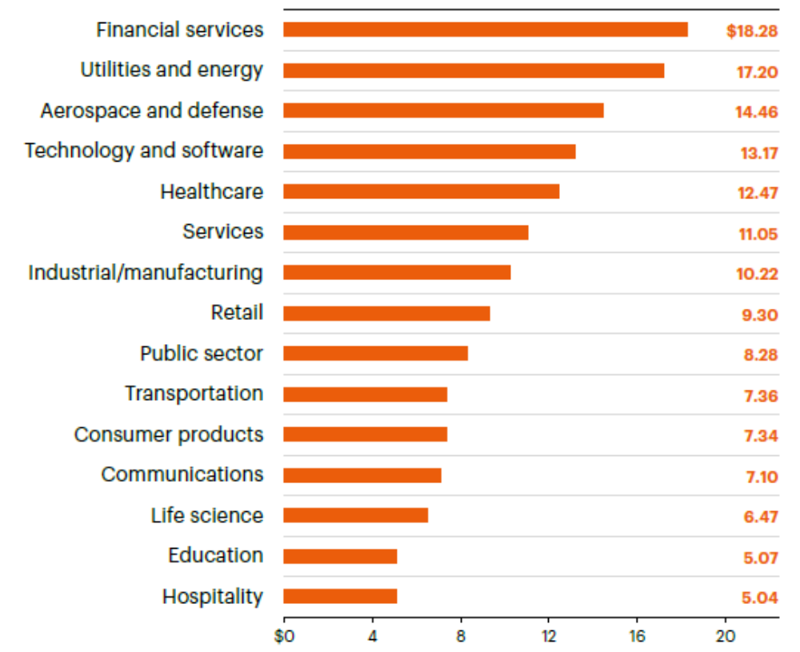
Breakdown by Sector
2017 Cost of Cyber Crime Study by Accenture*
- Financial Services Sector has the Highest Cost due to Cyber Crime
* https://www.accenture.com/t20170926T072837Z__w__/us-en/_acnmedia/PDF-61/Accenture-2017-CostCyberCrimeStudy.pdf

Slide 18
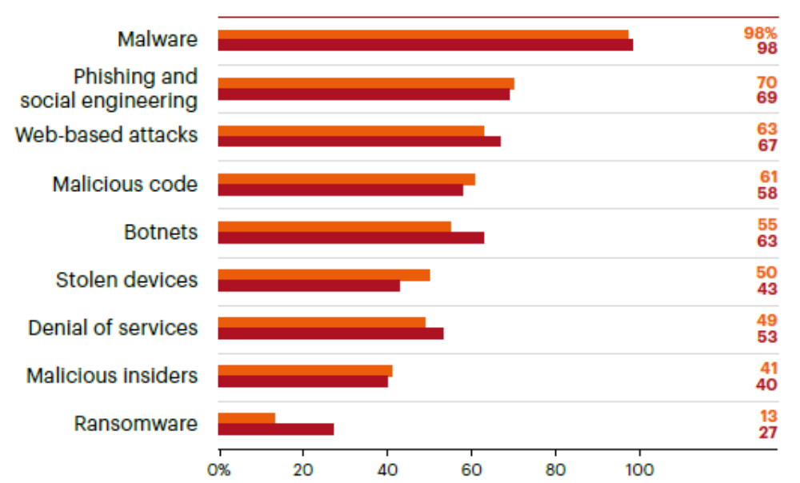
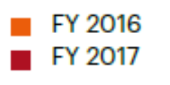
Types of cyber attacks experienced
2017 Cost of Cyber Crime Study by Accenture*
- Percentage of the respondents experienced
- Ransomware doubled
* https://www.accenture.com/t20170926T072837Z__w__/us-en/_acnmedia/PDF-61/Accenture-2017-CostCyberCrimeStudy.pdf

Slide 19
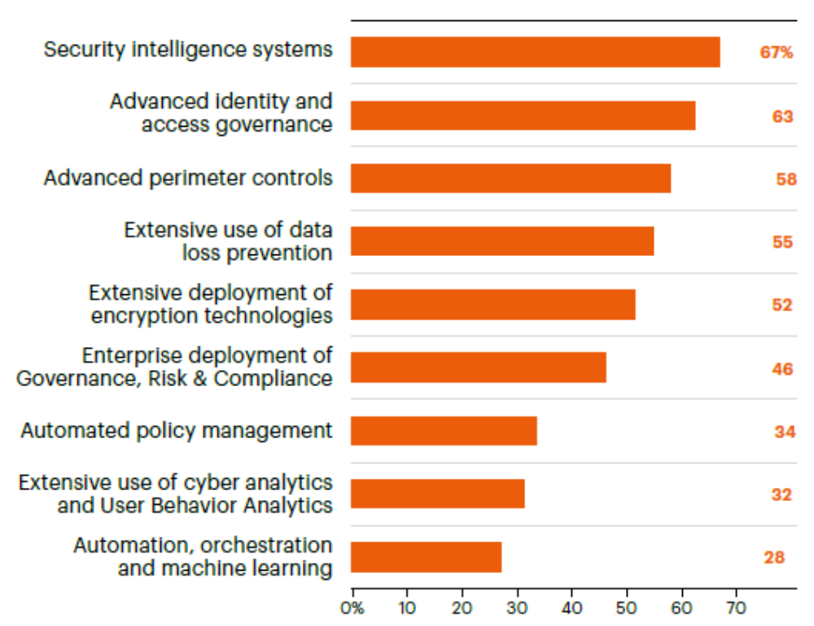
Deployment Rate of Security Technologies
2017 Cost of Cyber Crime Study by Accenture*
- Percentage of the respondents experienced
- Ransomware doubled
* https://www.accenture.com/t20170926T072837Z__w__/us-en/_acnmedia/PDF-61/Accenture-2017-CostCyberCrimeStudy.pdf

Slide 20
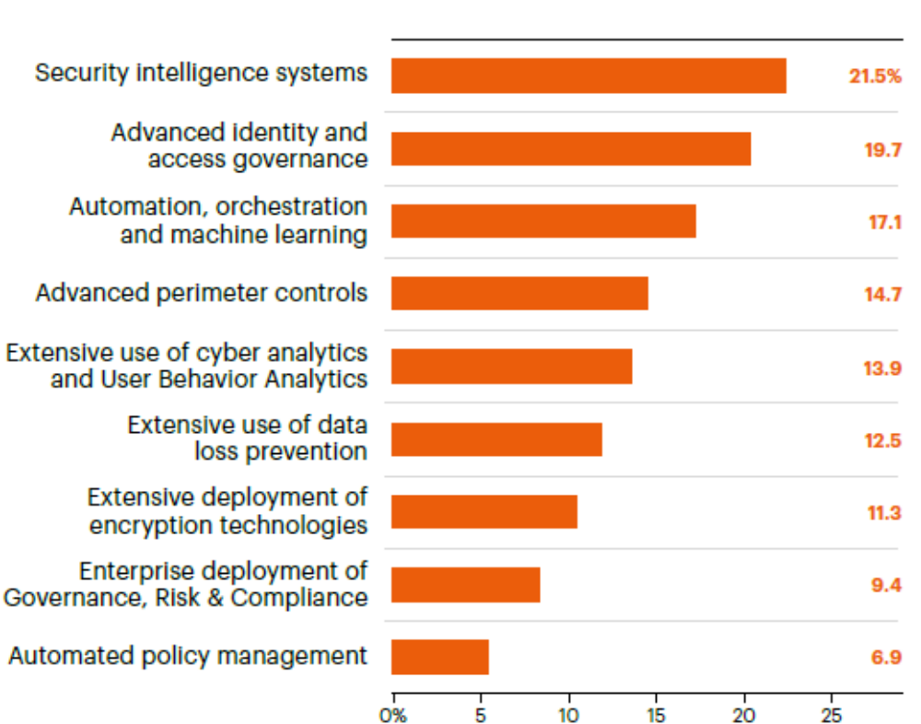
Annual Return of Investment (RoI)
2017 Cost of Cyber Crime Study by Accenture*
- More or less in parallel with deployment rate
- But AI, Data Mining based novel techniques have higher RoI
- Bad performance for encryption and DLP, but they are needed
* https://www.accenture.com/t20170926T072837Z__w__/us-en/_acnmedia/PDF-61/Accenture-2017-CostCyberCrimeStudy.pdf

Slide 21
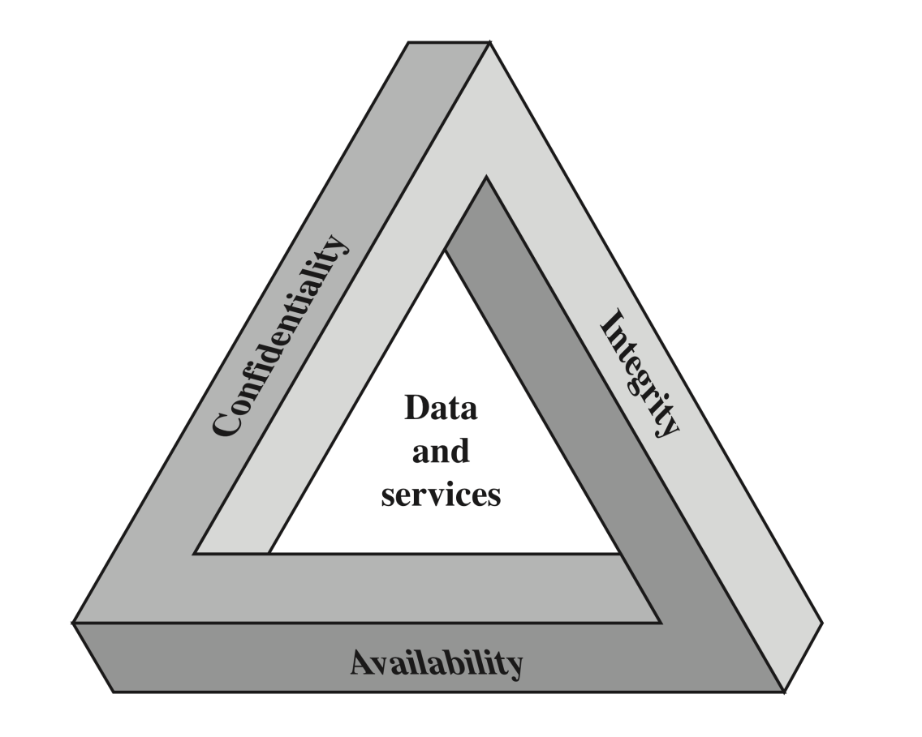
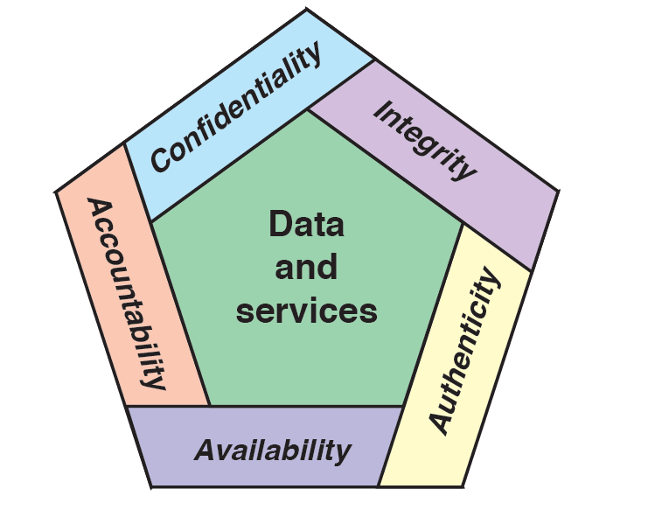
Security Objectives: CIA Triad and Beyond
Notes:
These three concepts form what is often referred to as the CIA triad . The three
concepts embody the fundamental security objectives for both data and for information
and computing services. For example, the NIST standard FIPS 199 (Standards
for Security Categorization of Federal Information and Information Systems ) lists
confidentiality, integrity, and availability as the three security objectives for information
and for information systems. FIPS 199 provides a useful characterization of
these three objectives in terms of requirements and the definition of a loss of security
in each category:
• Confidentiality: Preserving authorized restrictions on information access
and disclosure, including means for protecting personal privacy and proprietary
information. A loss of confidentiality is the unauthorized disclosure of
information.
• Integrity: Guarding against improper information modification or destruction,
including ensuring information nonrepudiation and authenticity. A loss
of integrity is the unauthorized modification or destruction of information.
• Availability: Ensuring timely and reliable access to and use of information.
A loss of availability is the disruption of access to or use of information or an
information system.

Slide 22
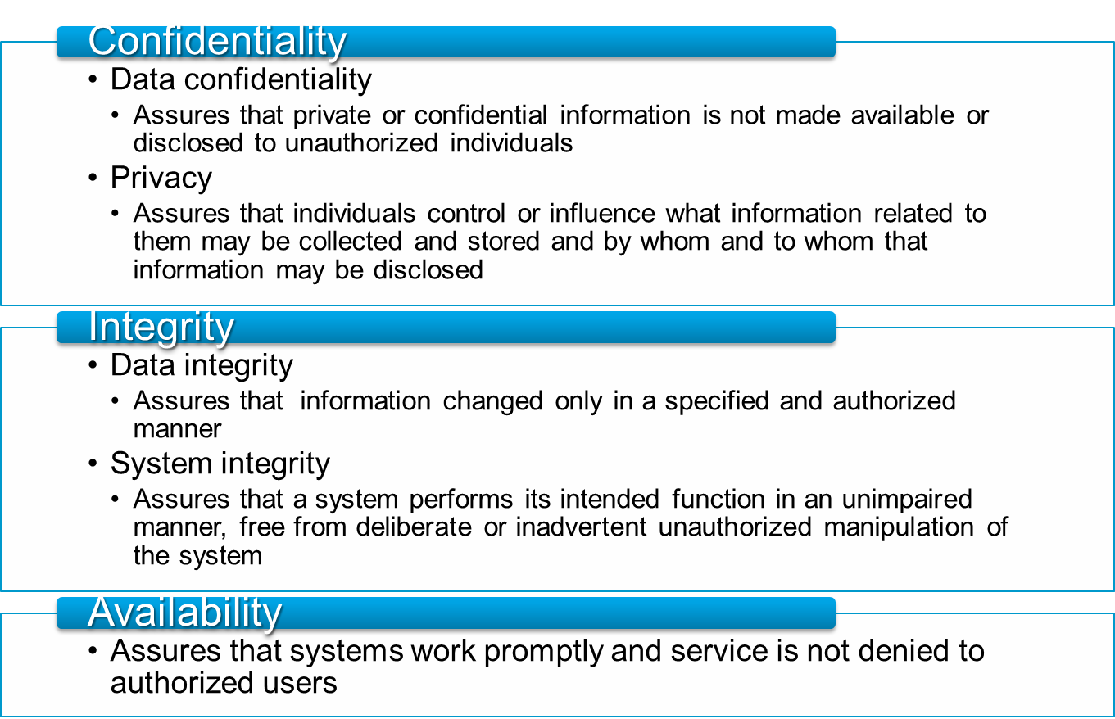
Computer Security Objectives
Notes:
This definition introduces three key objectives that are at the heart of computer
security:
• Confidentiality: This term covers two related concepts:
Data confidentiality: Assures that private or confidential information is
not made available or disclosed to unauthorized individuals.
Privacy: Assures that individuals control or influence what information
related to them may be collected and stored and by whom and to whom
that information may be disclosed.
•Integrity: This term covers two related concepts:
Data integrity: Assures that information and programs are changed only in
a specified and authorized manner.
System integrity: Assures that a system performs its intended function in
an unimpaired manner, free from deliberate or inadvertent unauthorized
manipulation of the system.
• Availability: Assures that systems work promptly and service is not denied to
authorized users.

Slide 23
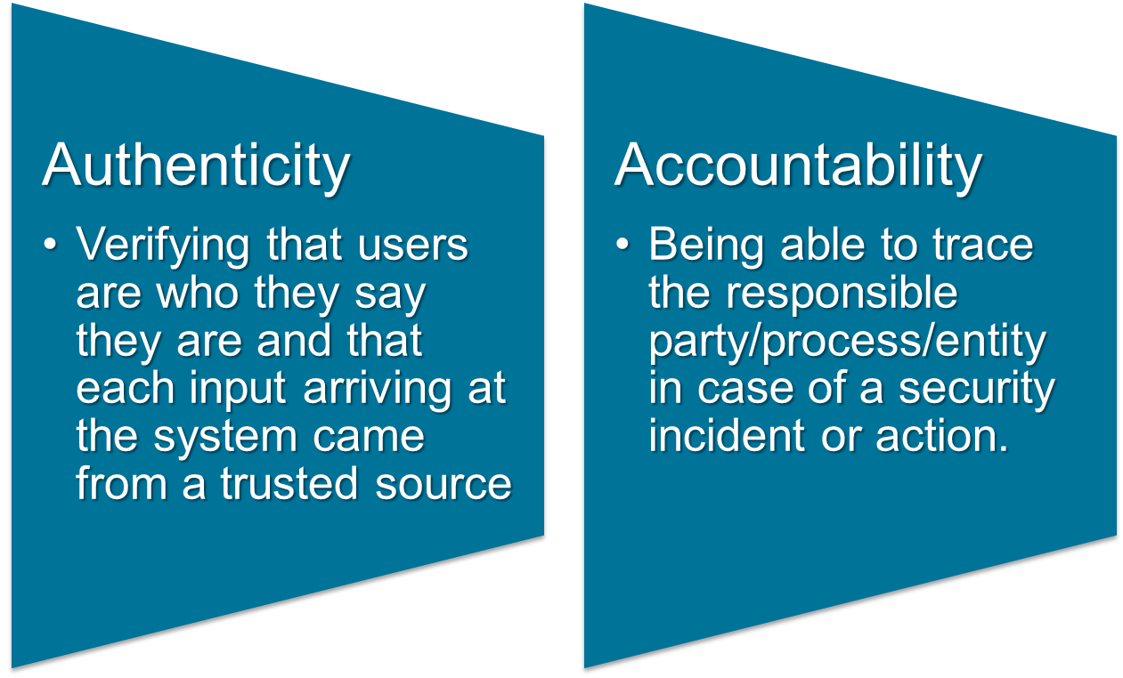
Additional concepts:
Notes:
Although the use of the CIA triad to define security objectives is well established,
some in the security field feel that additional concepts are needed to present
a complete picture. Two of the most commonly mentioned are as follows:
• Authenticity: The property of being genuine and being able to be verified and
trusted; confidence in the validity of a transmission, a message, or message
originator. This means verifying that users are who they say they are and that
each input arriving at the system came from a trusted source.
• Accountability: The security goal that generates the requirement for actions
of an entity to be traced uniquely to that entity. This supports nonrepudiation,
deterrence, fault isolation, intrusion detection and prevention, and after action
recovery and legal action. Because truly secure systems are not yet an
achievable goal, we must be able to trace a security breach to a responsible
party. Systems must keep records of their activities to permit later forensic
analysis to trace security breaches or to aid in transaction disputes.

Slide 24
Services, Mechanisms, Attacks
3 aspects of information security:
  security attacks (and threats)
    actions that (may) compromise security
  security services
    services counter to attacks
  security mechanisms
    used by services
    e.g. secrecy is a service, encryption (a.k.a. encipherment) is a mechanism

Slide 25
Attacks
Attacks on computer systems
  break-in to destroy information
  break-in to steal information
  blocking to operate properly
  malicious software
    wide spectrum of problems
Source of attacks
  Insiders
  Outsiders

Slide 26
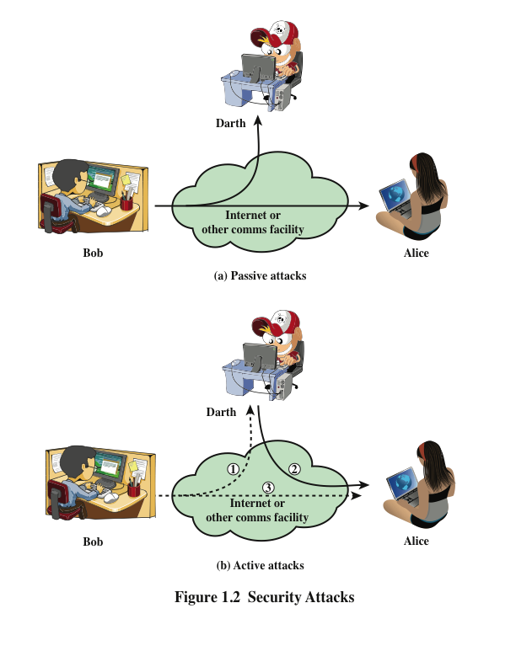
Attacks
Network Security
  Active attacks
  Passive attacks
Passive attacks
  interception of the messages
  What can the attacker do?
    use information internally
      hard to understand
    release the content
      can be understood
    traffic analysis
      hard to avoid
  Hard to detect, try to prevent

Slide 27
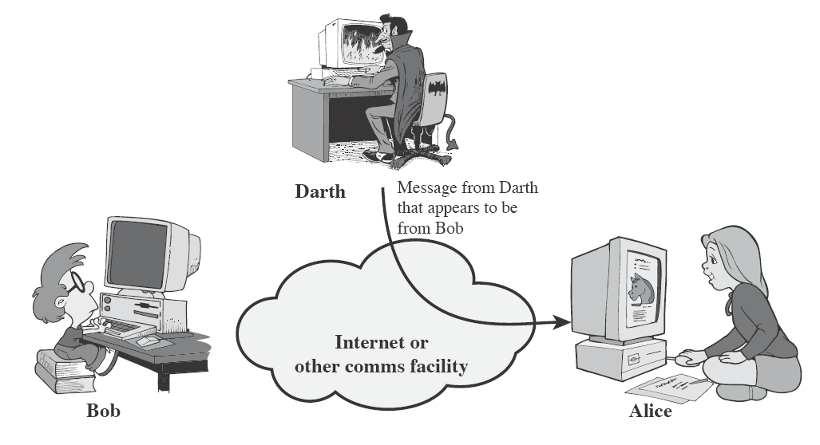
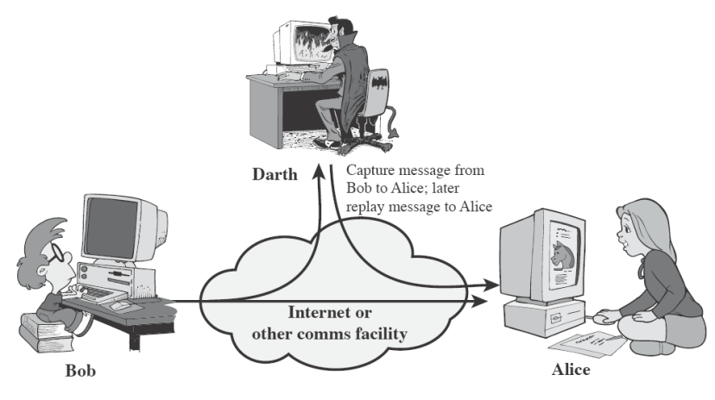
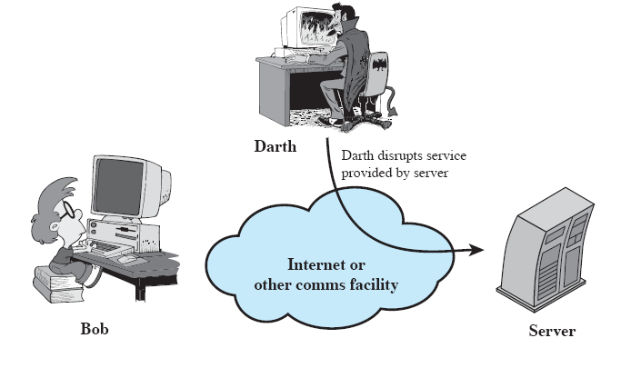
Attacks
Active attacks
  Attacker actively manipulates
  the communication
  Masquerade
    pretend as someone else
    possibly to get more privileges
  Replay
    passively capture data
    and send later
  Denial-of-service
    prevention the normal use of
    servers, end users, or network itself

Slide 28
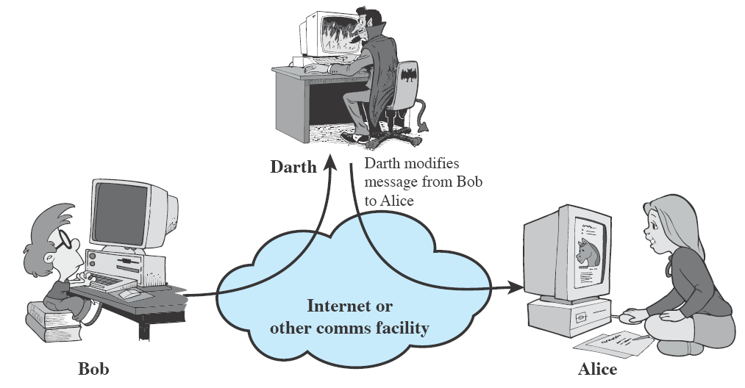
Attacks
Active attacks (cont’d)
  deny
    repudiate sending/receiving a message later
  modification
    change the content of a message

Slide 29
Security Services
to prevent or detect attacks
to enhance the security
replicate functions of physical documents
  e.g.
    have signatures, dates
    need protection from disclosure, tampering, or destruction
    notarize
    record

Slide 30
Basic Security Services
Authentication
  assurance that the communicating entity is the one it claims to be
  peer entity authentication
    mutual confidence in the identities of the parties involved in a connection
  Data-origin authentication
    assurance about the source of the received data
Access Control
  prevention of the unauthorized use of a resource
  to achieve this, each entity trying to gain access must first be identified and authenticated, so that access rights can be tailored to the individual

Slide 31
Basic Security Services
Data Confidentiality
  protection of data from unauthorized disclosure (against eavesdropping)
  traffic flow confidentiality is one step ahead
    this requires that an attacker not be able to observe the source and destination, frequency, length, or other characteristics of the traffic on a communications facility
Data Integrity
  assurance that data received are exactly as sent by an authorized sender
  i.e. no modification, insertion, deletion, or replay

Slide 32
Basic Security Services
Non-Repudiation
  protection against denial by one of the parties in a communication
  Origin non-repudiation
    proof that the message was sent by the specified party
  Destination non-repudiation
    proof that the message was received by the specified party

Slide 33
Relationships
among integrity, data-origin authentication and non-repudiation
Non-repudiation
Authentication
Integrity

Slide 34
Security Mechanisms
Cryptographic Techniques
  will see next
Software and hardware for access limitations
  Firewalls
Intrusion Detection and Prevention Systems
Traffic Padding
  against traffic analysis
Hardware for authentication
  Smartcards, security tokens
Security Policies / Access Control
  define who has access to which resources.
Physical security
  Keep it in a safe place with limited and authorized physical access

Slide 35
Cryptographic Security Mechanisms
Encryption (a.k.a. Encipherment)
  use of mathematical algorithms to transform data into a form that is not readily intelligible
    keys are involved

Slide 36
Cryptographic Security Mechanisms
Message Digest
  similar to encryption, but one-way (recovery not possible)
  generally no keys are used
Digital Signatures and Message Authentication Codes
  Data appended to, or a cryptographic transformation of, a data unit to prove the source and the integrity of the data
Authentication Exchange
  ensure the identity of an entity by exchanging some information

Slide 37
Security Mechanisms
Notarization
  use of a trusted third party to assure certain properties of a data exchange
Timestamping
  inclusion of correct date and time within messages

Slide 38
And the Oscar goes to …
On top of everything, the most fundamental problem in security is
  SECURE KEY EXCHANGE
    mostly over an insecure channel

Slide 39

A General Model for Network Security

Slide 40
Model for Network Security
using this model requires us to:
  design a suitable algorithm for the security transformation
  generate the secret information (keys) used by the algorithm
  develop methods to distribute and share the secret information
  specify a protocol enabling the principals to use the transformation and secret information for a security service

Slide 41
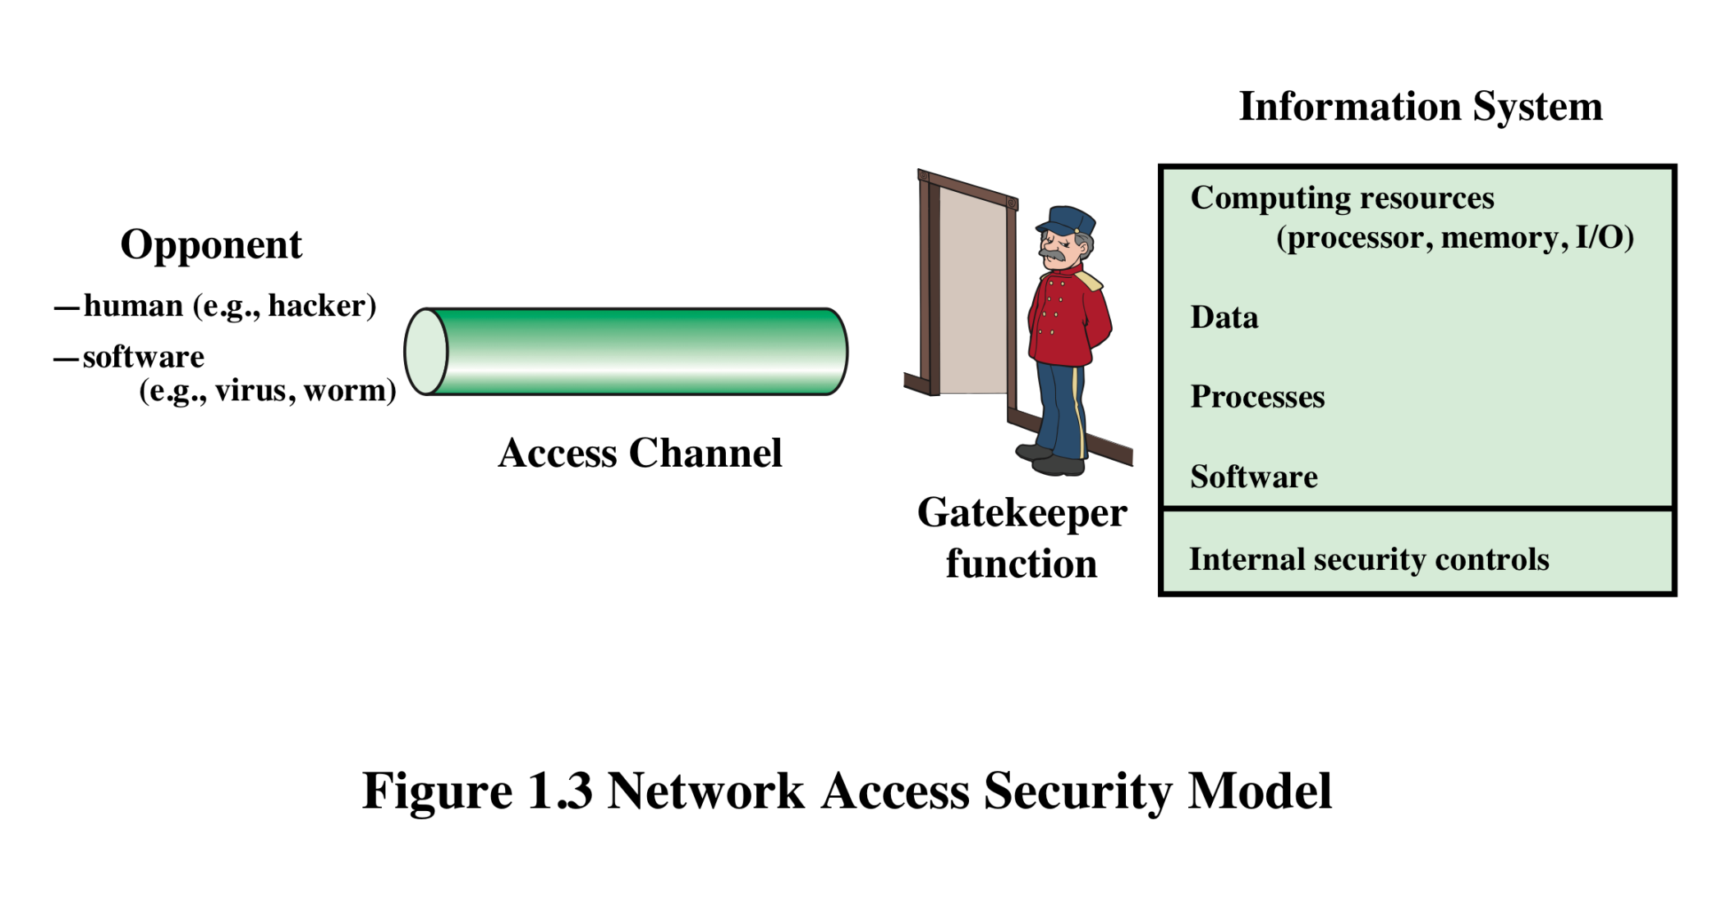
Model for Network Access Security
Notes:
The second model is concerned with controlled access to information or resources on a computer system, in the presence of possible opponents. Here appropriate controls are needed on the access and within the system, to provide suitable security.

Slide 42
Model for Network Access Security
using this model requires us to:
  select appropriate gatekeeper functions to identify users and processes and ensure only authorized users and processes access designated information or resources
  Internal control to monitor the activity and analyze information to detect unwanted intruders

Slide 43
More on Computer System Security
Based on “Security Policies”
  Set of rules that specify
    How resources are managed to satisfy the security requirements
    Which actions are permitted, which are not
  Ultimate aim
    Prevent security violations such as unauthorized access, data loss, service interruptions, etc.
  Scope
    Organizational or Individual
  Implementation
    Partially automated, but mostly humans are involved
  Assurance and Evaluation
    Assurance: degree of confidence to a system
    Security products and systems must be evaluated using certain criteria in order to decide whether they assure security or not
Notes:
Organizational security policy: Laws, rules, and practices that regulate how an organization manages and protects resources to achieve its security objectives.
Automated security policy: Restrictions and properties that specify how a computing system prevents security violations.

Slide 44
Aspects of Computer Security
Mostly related to Operating Systems
Similar to those discussed for Network Security
  Confidentiality
  Integrity
  Availability
  Authenticity
  Accountability
  Dependability

Slide 45
Aspects of Computer Security
Confidentiality
  Prevent unauthorised disclosure of information
  Synonyms: Privacy and Secrecy
    any differences? Let’s discuss
Integrity
  two types: data integrity and system integrity
  In general, “make sure that everything is as it is supposed to be”
  More specifically, “no unauthorized modification, deletion” on data (data integrity)
  System performs as intended without any unauthorized manipulations (system integrity)
Notes:
More on integrity: According to Orange Book, data integrity refers to “computerized data are the same as the source documents”. To implement this we should have a base to compare. It is not so easy to implement automated processes (internal to computer) for this.

Slide 46
Aspects of Computer Security
Availability
  services should be accessible when needed and without extra delay
Accountability
  audit information must be selectively kept and protected so that actions affecting security can be traced to the responsible party
  How can we do that?
    Users have to be identified and authenticated to have a basis for access control decisions and to find out responsible party in case of a violation.
    The security system keeps an audit log (audit trail) of security relevant events to detect and investigate intrusions.
Dependability
  Can we trust the system as a whole?

Slide 47
Attack Surfaces
An attack surface consists of the reachable and exploitable vulnerabilities in a system
Examples:
  Open ports on outward facing Web and other servers, and code listening on those ports
  Services available in a firewall
  Code that processes incoming data, email, XML, office documents, etc.
  Interfaces and Web forms
  An employee with access to sensitive information vulnerable to a social engineering attack
Notes:
An attack surface consists of the reachable and exploitable vulnerabilities in a system
[MANA11, HOWA03]. Examples of attack surfaces are the following:
■ Open ports on outward facing Web and other servers, and code listening on
those ports
■ Services available on the inside of a firewall
■ Code that processes incoming data, email, XML, office documents, and industry-
specific custom data exchange formats
■ Interfaces, SQL, and Web forms
■ An employee with access to sensitive information vulnerable to a social
Engineering attack

Slide 48
Attack Surface Categories
Network attack surface
  Refers to vulnerabilities over an enterprise network, wide-area network, or the Internet
    E.g. DoS, intruders exploiting network protocol vulnerabilities
Software attack surface
  Refers to vulnerabilities in application, utility, or operating system code
Human attack surface
  Refers to vulnerabilities created by personnel or outsiders
  E.g. social engineering, insider traitors
Notes:
Attack surfaces can be categorized as follows:
■ Network attack surface: This category refers to vulnerabilities over an enterprise
network, wide-area network, or the Internet. Included in this category are network
protocol vulnerabilities, such as those used for a denial-of-service attack,
disruption of communications links, and various forms of intruder attacks.
■ Software attack surface: This refers to vulnerabilities in application, utility,
or operating system code. A particular focus in this category is Web server
Software.
■ Human attack surface: This category refers to vulnerabilities created by
personnel or outsiders, such as social engineering, human error, and trusted
insiders.

Slide 49
Fundamental Dilemma of Security
“Security unaware users have specific security requirements but no security expertise.”
  from D. Gollmann
  Solution: level of security is given in predefined classes specified in some common criteria
    Orange book (Trusted Computer System Evaluation Criteria) is such a criteria

Slide 50
Fundamental Tradeoff
Between security and ease-of-use
Security may require clumsy and inconvenient restrictions on users and processes
“If security is an add-on that people have to do something special to get, then most of the time they will not get it”
Martin Hellman,
co-inventor of Public Key Cryptography
Notes:
There is a similarity between security and taxation. Jean Baptiste Colbert (French Economist and Minister of Finance under King Louis XIV of France. 1619-1683) once said that “The art of taxation consists in so plucking the goose as to obtain the largest possible amount of feathers with the smallest possible amount of hissing”. The main story behind security measures is also the same. If the security measures are too tight, most probably people will try to circumvent it.

Slide 51
Good Enough Security
“Everything should be as secure as necessary, but not securer”
  Ravi Sandhu, “Good Enough Security”, IEEE Internet Computing, January/February 2003, pp. 66- 68.
Read the full article at
  http://dx.doi.org/10.1109/MIC.2003.1167341

Slide 52
Some Other Security Facts
Not as simple as it might first appear to the novice
Must consider all potential attacks when designing a system
Generally yields complex and counterintuitive systems
Battle of intelligent strategies between attacker and admin
Requires regular monitoring
Not considered as a beneficial investment until a security failure occurs
  Actually security investments must be considered as insurance against attacks
too often an afterthought
  Not only from investment point of view, but also from design point of view

