Slide 1
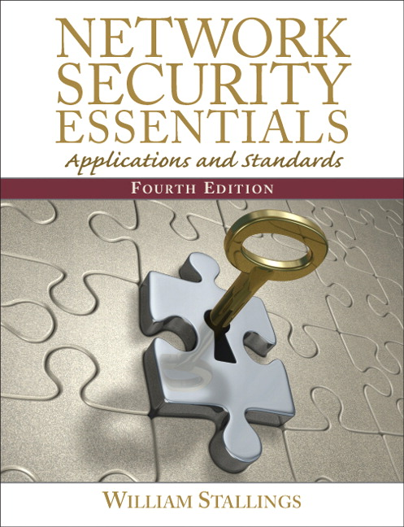
Another perspective on Network Security
Network Security Essentials:
Applications and Standards, 4/E
William Stallings
ISBN-10: 0136108059
ISBN-13: 9780136108054
Publisher: Prentice Hall
Copyright: 2011
Format: Paper; 432 pp
Published: 03/12/2010
http://williamstallings.com/NetSec/NetSec4e.html

Slide 2
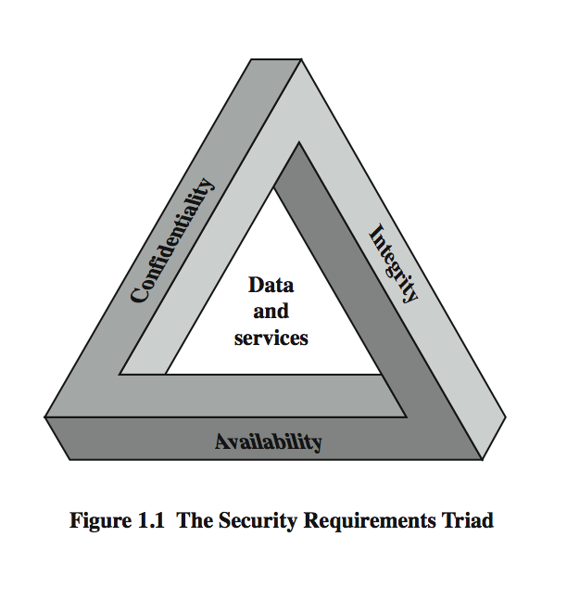

The Security Requirements Triad
Computer Security
The protection afforded to an automated information system in order to attain the applicable objectives of preserving the integrity, availability and confidentiality of information system resources (includes hardware, software, firmware, information/data, and telecommunications)
http://csrc.nist.gov/publications/fips/fips199/FIPS-PUB-199-final.pdf

Slide 3
Security Requirements
Confidentiality
  Preserving authorized restrictions on information access and disclosure, including means for protecting personal privacy and proprietary information.
Integrity
  Guarding against information modifications or destruction, including ensuring information non-repudiation and authenticity.
Availability
  Ensuring timely and reliable access to and use of information

Slide 4
Security Attacks,
Mechanisms & Services
Security Attack
  Any action that compromises the security of information
Security Mechanism
  A process / device that is designed to detect, prevent or recover from a security attack.
Security Service
  A service intended to counter security attacks, typically by implementing one or more mechanisms.

Slide 5
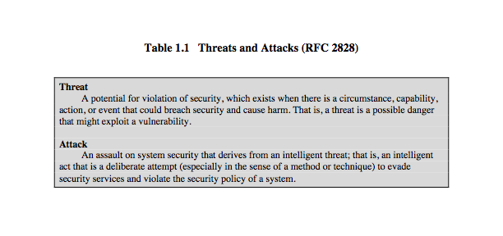
Threats & Attacks
… but threat and attack used nearly interchangeably

Slide 6
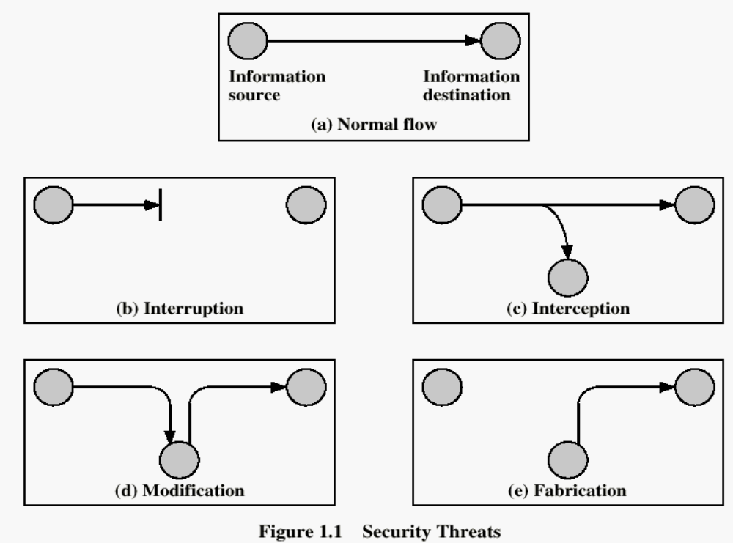

Security Threats / Attacks
…
…

Slide 7
Security Threats / Attacks

Slide 8
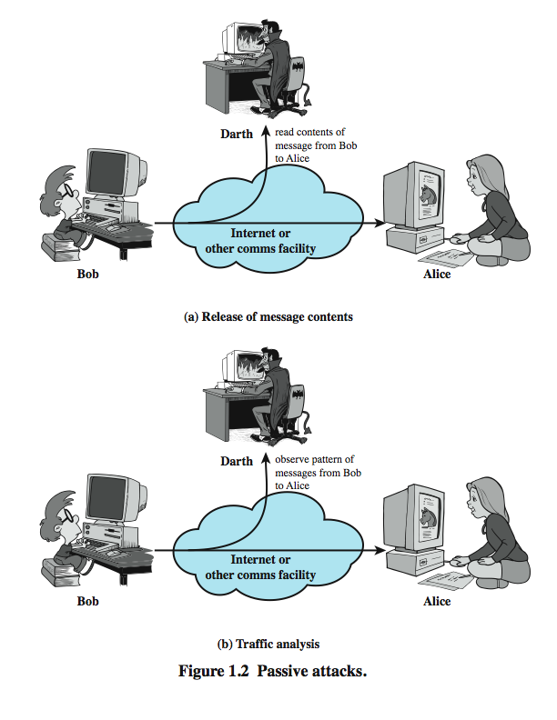
Passive Attacks

Slide 9
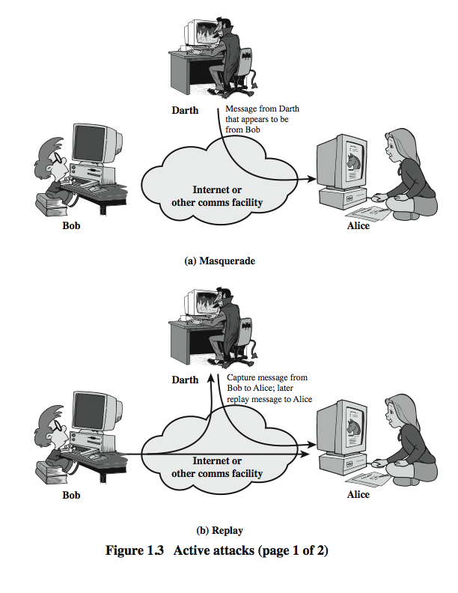
Active Attacks (1)

Slide 10
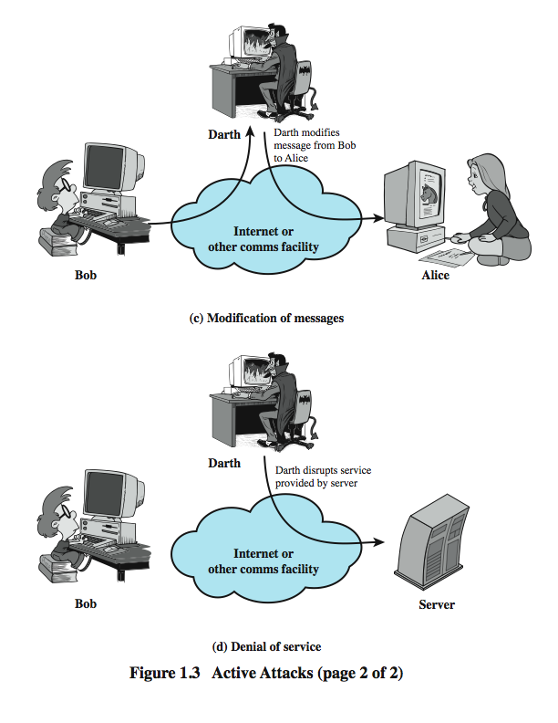
Active Attacks (2)

Slide 11

Security Services (X.800)
Authentication
  The assurance that the communicating entity is the one it claims to be
Access Control
  The prevention of unauthorized use of a resource
    who can have access to a resource,
    under what conditions access can occur,
    what those accessing the resource are allowed to do
Data Confidentiality
  The protection of data from unauthorized disclosure
Data Integrity
  The assurance that data received are exactly as sent by an authorized entity (i.e., contains no modification, insertion, deletion or replay).
Non-Repudiation
  Provides protection against denial by one of the entities involved in a communication of having participated in all/part of the communication.

Slide 12
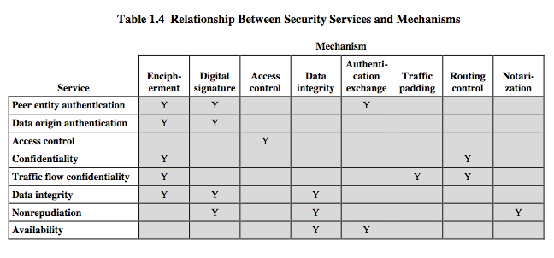
Security Mechanisms (X.800)
http://www.itu.int/rec/T-REC-X.800-199103-I/e

Slide 13
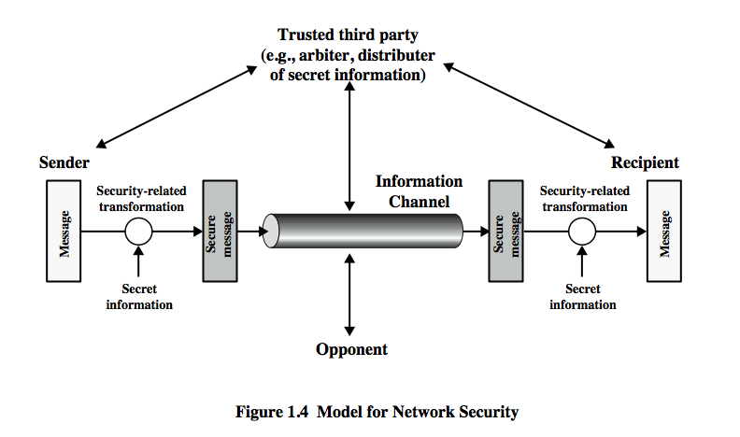
Model for Network Security

Slide 14

The Human Element
“Humans are incapable of securely storing high-quality cryptographic keys, and they have unacceptable speed and accuracy when performing cryptographic operations. (They are also large, expensive to maintain, difficult to manage, and they pollute the environment. It is astonishing that these devices continue to be manufactured and deployed. But they are sufficiently pervasive that we must design our protocols around their limitations.)”
-- C. Kaufman, R. Perlman, and M. Speciner.
Network Security:
Private Communication
in a Public World, 2/E
Kaufman, Perlman & Speciner
Prentice Hall, 2003

Slide 15
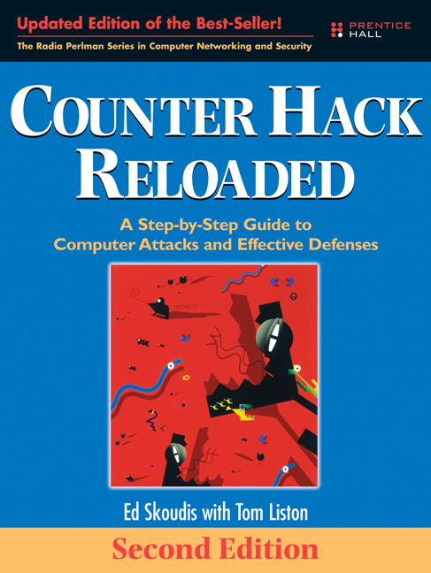
Understanding Opponents
Anatomy of an Attack
  Phase 1: Reconnaissance
  Phase 2: Scanning
  Phase 3: Gaining Access
  Phase 4: Maintaining Access
  Phase 5: Covering Tracks and Hiding
Counter Hack Reloaded:
A Step-by-Step Guide
to Computer Attacks and
Effective Defenses, 2/E
Skoudis & Liston
Prentice Hall, 2006

Slide 16


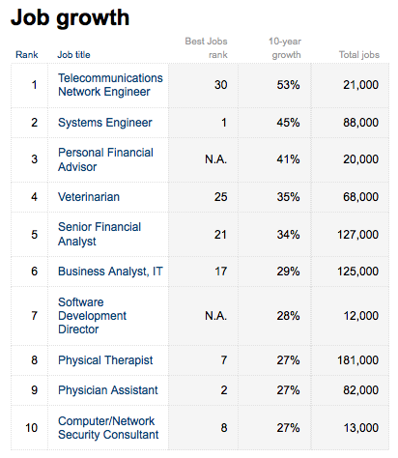
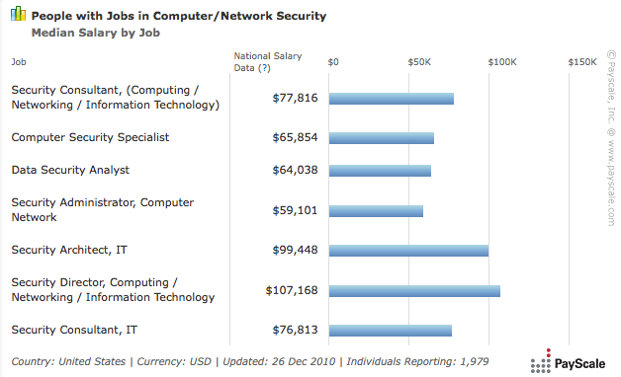

Network Security Jobs

