Slide 1
Network Firewall Security
Auditing Firewalls

Slide 2
Module 1:
Understanding Firewalls
Firewall Architecture Overview

Slide 3
What is a Firewall?
A firewall is a security policy enforcement point that regulates access between computer networks
Filters are inherently insecure services
Controls TCP protocols
  http, smtp, ftp, telnet etc
Only one of many different security tool’s to control and regulate network traffic

Slide 4
What do Firewalls Protect?
Data
  Proprietary corporate information
  Financial information
  Sensitive employee or customer data
Resources
  Computing resources
  Time resources
Reputation
  Loss of confidence in an organization
  Intruder uses an organization’s network to attack other sites

Slide 5

Who do Firewalls Guard Against?
Internal Users
Hackers
Corporate Espionage
Terrorists
Common Thieves

Slide 6
Basic Firewall Components
Policy
Advanced authentication
Packet inspection
Application gateways

Slide 7
Common Internet Threats
Denial of service attacks
  Specific attacks that can cause a server crash
  Flooding the server with traffic to disrupt or deny service
Intrusion threats
Attacks on services/exploits
  The backend server may not be hardened enough for adequate protection, but the firewall can block external attacks
Information threats
“Viral” threats
Defacement

Slide 8
How Vulnerable are Internet Services?
E-mail or smtp – Simple Mail Transfer Protocol
  TCP/IP based port 25 (POP 110)
  Risks Include
    E-mail bombing (stalking)
      Anonymous harassment
      Large amounts of e-mail to a single user address
    Spamming
      Messages sent to numerous different users from a host
    Virus download mechanism
      Code Red
      Nimda
    Not always traceable
  POP and IMAP can be very insecure

Slide 9
How Vulnerable are Internet Services?
FTP - File Transfer Protocol
  TCP/IP based port 20/21
  Risks Include
    Unencrypted authentication and data transfers
      Usernames and passwords can be”sniffed”
    Unencrypted data transfers
      Data can be viewed
    Often part of default installations
    Anonymous ftp is possible
    Privilege escalation

Slide 10
How Vulnerable are Internet Services?
Telnet
  TCP/IP based port 23
  Risks include
    Unencrypted authentication
    Unencrypted interactive session
    Session hijacking
    Included in default installations
    Can allow remote root login

Slide 11
How Vulnerable are internet services?
HTTP – Hypertext Transfer Protocol
  TCP/IP based port 80
  Risks Include
    Browsers can be used to run dangerous commands
    Protocol can be used between user agents and other protocols i.e.. smtp, nntp, ftp
    Difficult to secure
    Remote execution of commands and execution (server side)
    Non-secure add-on applications
      Java
      Cookies
      soap
Notes:
Arbitrary auth of remote requests and web servers, abuse of server resources, features, and security hole exploits, pose information extraction i.e.. ip info, domain info and file info

Slide 12
How Vulnerable are Internet Services?
HTTPS – Secure Hypertext Transfer Protocol
  TCP/IP based port 443
  Risks Include
    Browsers can be used to run dangerous commands
    Remote execution of commands and execution (server side)
    Becomes a tunnel for any data
    Can be used to subvert firewall/security controls
Notes:
Arbitrary auth of remote requests and web servers, abuse of server resources, features, and security hole exploits, opsec information extraction i.e.. ip info, domain info and file info

Slide 13
How Vulnerable are Internet Services?
DNS
  TCP and UDP based ports 53 and 1024
  Risks include
    DNS cache poisoning
      Bad data to redirect valid connections to the wrong server
    DNS spoofing
      Bad data to redirect valid connections to the wrong server
    Absolutely needed for network services

Slide 14
How Vulnerable are Internet Services?
SNMP – Simple Network Management Protocol
  UDP based
  Risk include
    Unencrypted data transfers
    Poor authentication through “community relationships”
    Transfer of highly sensitive data
    Does use access lists

Slide 15
How Vulnerable are Internet Services?
NFS – Network File System
  NFS is a shared file structure
  Based on a trust model of network machines
    Certain machines can access shared file systems
  Risks include
    No “user”authentication
    IP Spoofing to gain access
    Most secure NFS is still very insecure

Slide 16
The“2002 Computer Security Institute /FBI Computer Crime and Security Survey” Reported:
90% of survey respondents (primarily larger corporations) detected computer security breaches. Respondents reported a wide range of attacks:
44% detected system penetration from the outside
44% detected denial of service attacks
76% detected employee abuse of Internet access privileges
85% detected computer viruses, worms, etc.
80% acknowledged financial losses due to computer security breaches
44% were willing and/or able to quantify their financial losses (these losses were $455 million).
Most serious losses occurred through theft of proprietary information and financial fraud.
74% cited their Internet connections as a frequent point of attack and 33% cited their internal systems ands frequent point of attack
34% reported intrusions to law enforcement (up from only 16% in 1996)

Slide 17
Firewall Architecture Overview
Basic Firewall Components
  Software
  Hardware
  Purpose Built/Appliance based
Notes:
Time For a Break!

Slide 18
Module 1:
Understanding Firewalls
Firewall Software Types

Slide 19
Firewall Software Types
Problems to watch for
  Administrative limitations
    Access
    Monitoring
    logging
  Management requirements
    Additional control points
    Additional non-secure applications required
  Software limitations
    Capacity
    Availability
    Hardware

Slide 20
Packet Filtering Firewalls
Packet filtering is one of the oldest, and one of the most common types of firewall technologies. Packet filters inspect each packet of information individually, examining the source and destination IP addresses and ports. This information is compared to access control rules to decide whether the given packet should be allowed through the firewall.
Packet filters consider only the most basic attributes of each packet, and they don't need to remember anything about the traffic since each packet is examined in isolation. For this reason they can decide packet flow very quickly.
Because every packet of every connection is checked against the access control rules, larger, complex rule bases decrease performance. And because packet filters can only check low-level attributes, they are not secure against malicious code hiding in the other layers. Packet filters are often used as a first defense in combination with other firewall technologies, and their most common implementation today is seen in the access control lists of routers at the perimeters of networks.
For simple protocols or one-sided connections, like ICMP or SNMP traps, it is still useful to use packet filtering technology.

Slide 21
Packet Filtering Firewalls
Products
  Cisco Pix
  Typically routers
First Generation Firewall Technology
  Fast but not very flexible
Can be used as a first line of defense

Slide 22
Application Level Firewalls
Application level firewalls are the third firewall technology traditionally seen in the market. These firewalls, also known as application proxies, provide the most secure type of data connection because they can examine every layer of the communication, including the application data. To achieve this security proxies, as their name suggests, actually mediate connections. The connection from a client to a server is intercepted by the proxy. If the proxy determines that the connection is allowed, it opens a second connection to the server from itself, on behalf of the original host. The data portion of each packet must be stripped off, examined, rebuilt, and sent again on the second connection.
This thorough examination and handling of packets means that proxy firewalls are very secure and generally slow. Proxies are also limited as firewalls, because they must understand the application layer. As new protocols are developed, new proxies must be written and implemented to handle them.

Slide 23
Application Level Firewalls
Web Proxy Severs
Application Proxy Servers
Products
  None that are strictly Proxy based
  “Gateway Servers”
Second Generation Firewall Technology
  Makes connections on behalf of the client
  Not flexible

Slide 24
Hybrid Firewalls
Performs Packet Filtering functions
Performs Application Proxy functions
Third Generation Firewall Technology
Products
  Raptor Firewall by Symantec
  Firewall 1 by Checkpoint
  Sidewinder Firewall by Secure Computing
  Lucent Brick by Lucent

Slide 25
Stateful Inspection ©
Stateful inspection architecture utilizes a unique, patented INSPECT Engine which enforces the security policy on the gateway on which it resides. The INSPECT Engine looks at all communication layers and extracts only the relevant data, enabling highly efficient operation, support for a large number of protocols and applications, and easy extensibility to new applications and services.
The INSPECT Engine is programmable using Check Point's powerful INSPECT Language. This provides important system extensibility, allowing Check Point, as well as its technology partners and end-users, to incorporate new applications, services, and protocols, without requiring new software to be loaded. For most new applications, including most custom applications developed by end users, the communication-related behavior of the new application can be incorporated simply by modifying one of Firewall-1's built-in script templates via the graphical user interface. Even the most complex applications can be added quickly and easily via the INSPECT Language.

Slide 26
Stateful Inspection
New technology incorporating
  Patented technology
  INSPECT engine
  Application Level Proxy
Products
  Checkpoint NG (Exclusive)

Slide 27
Multi-Layer Inspection ©
Multi-layer inspection is a packet and connection verification process developed by Stone soft to ensure maximum security without compromising system throughput. StoneGate's security policies determine when to use stateful connection tracking, packet filtering, or application-level security. The system expends the resources necessary for application-level security only when the situation demands it and without unnecessarily slowing or limiting network traffic.

Slide 28
Multi-Layer Inspection
New technology incorporating
  Application proxies
  State Inspection
  Packet filtering
Products
  StoneGate by Stone soft (exclusive)

Slide 29
Firewall Software Types
Be sure to understand what your customer is using
  Know your products
  Speak to the firewall vendor for insight
  Compare responses of customer and vendor
  One firewall type or multiple types

Slide 30
Module 1:
Understanding Firewalls
Firewall Hardware Types

Slide 31
Firewall Hardware Types
Three basic hardware options
  Appliance based systems
    Purpose built
    Simple
    Highly integrated
  3rd Party servers
    General use systems
    Additional support channel
    Greater flexibility
  Hybrid servers
    Purpose built for a limited product line
    Often closely integrated with software offerings
    May have separate support channel
    Most have highly integrated components

Slide 32
Firewall Hardware Types
Appliance based system problems
  OS and Kernel hardening and security may be done by vendor only
  Tightly coupled software and hardware may have insecure code unknown to user
    Hard to inspect or verify
  All security controls are determine through a single vendor
  Appliances are used to simplify implementation and support efforts causing some loss of administrative control
Notes:
Time for a break

Slide 33
Firewall Hardware Types
3rd Party server problems
  OS and Kernel hardening and security must be done by implementation staff
    Expertise
    procedures
  OS software may have many known vulnerabilities/security holes
    Each must be plugged
  All security controls are determine through corporate policy
    Implementation difficulties
    Consistency challenges
  3rd party systems require a larger degree of administration and procedure

Slide 34
Firewall Hardware Types
Hybrid servers
  OS and Kernel hardening is started by vendor and completed by end user security staff—can help to make it more robust
  Packaged software and hardware are generally reviewed for security
    May or may not adhere to policy
  All security controls are determine through a more partnered structure
  Hybrid servers are also used to simplify implementation and support efforts without giving away administrative control

Slide 35
Module 1:
Understanding Firewalls
Network Firewall Architecture

Slide 36
Network Firewall Architectures
Screening Router
Simple Firewall
Multi-Legged firewall
Firewall Sandwich
Layered Security Architecture

Slide 37
Screening Router
Access Lists provide security
Routers are not application aware
  Only inspects network level information
  Layer 3 of the OSI model
Does not provide a great deal of security
Very fast
Not commonly used alone for security

Slide 38
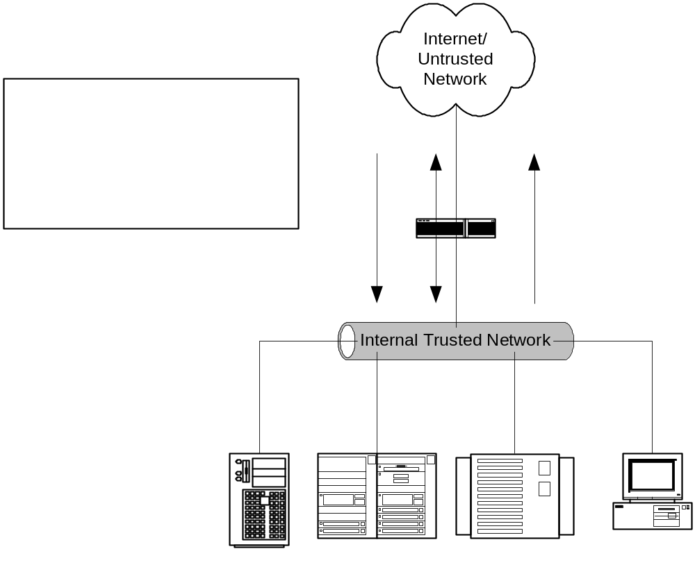
Screening Router

Slide 39
Simple Firewall
Small Companies with limited security needs
Only utilizes two interfaces
  Trusted
  Un-trusted
Provides modest security
Does not offer dmz sandbox
Inherently allows some level of connections between trusted and un-trusted networks

Slide 40
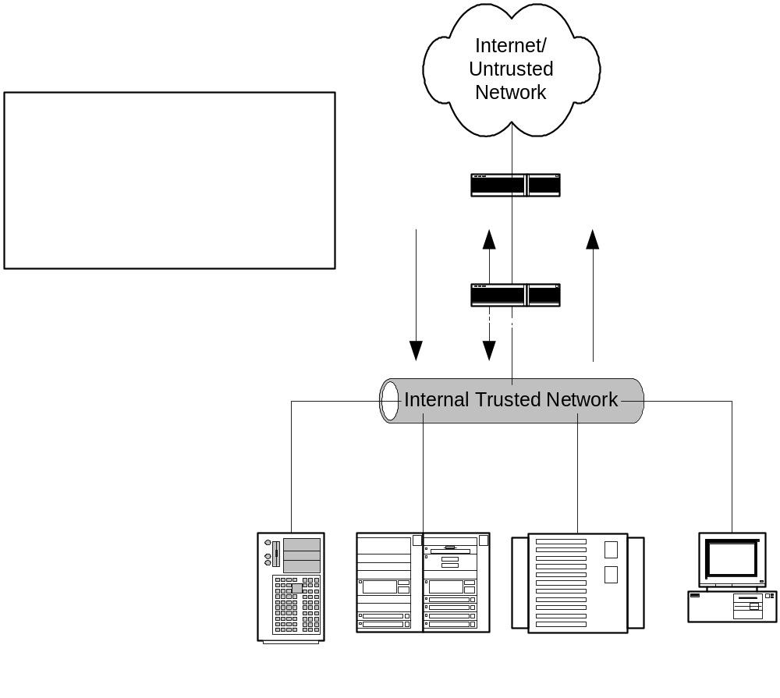
Simple Firewall

Slide 41
Multi-Legged Firewall
Small to large sized business
Security need is expanded
Provides stronger security
Creates a secure sandbox for semi-trusted services
Flexible and secure

Slide 42
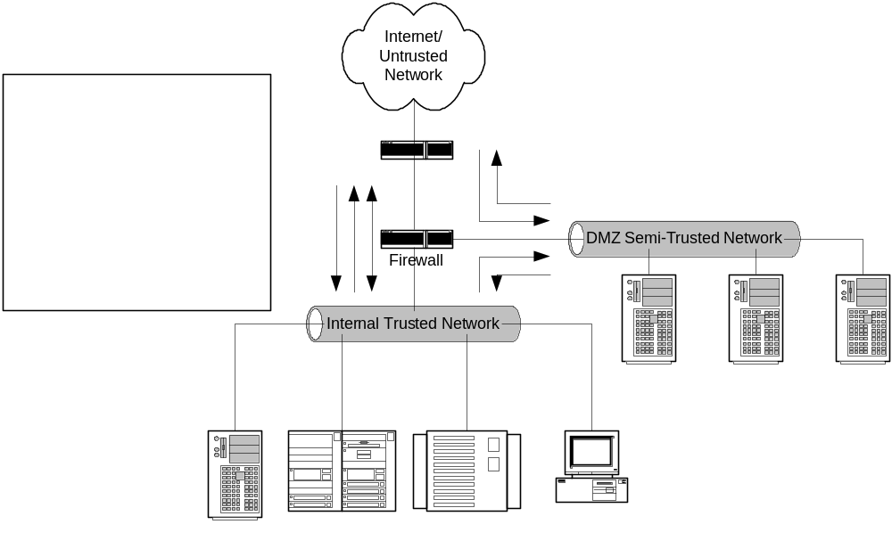
Multi-Legged Firewall

Slide 43
Firewall Sandwich
Medium to large businesses
  Higher costs
More serious need for security
  Provides a physical separation of networks
Provides policy segregation between inside and outside firewalls
  Reduces administrative holes

Slide 44
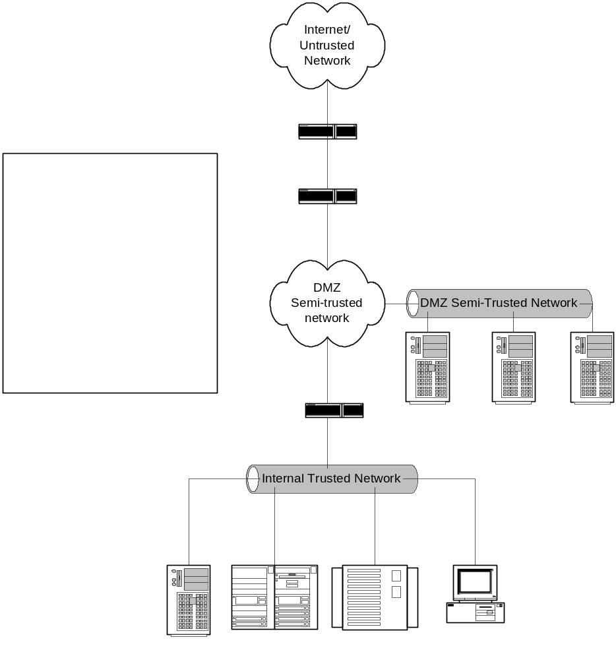
Firewall Sandwich

Slide 45
Layered Firewall Approach
Large enterprises with low risk tolerance
  Separates internal environments
  Reduces computer crimes
    Most attacks are internally based
    Deters malicious activities
  Controls overhead administrative traffic
  Allows IDS to work more effectively

Slide 46
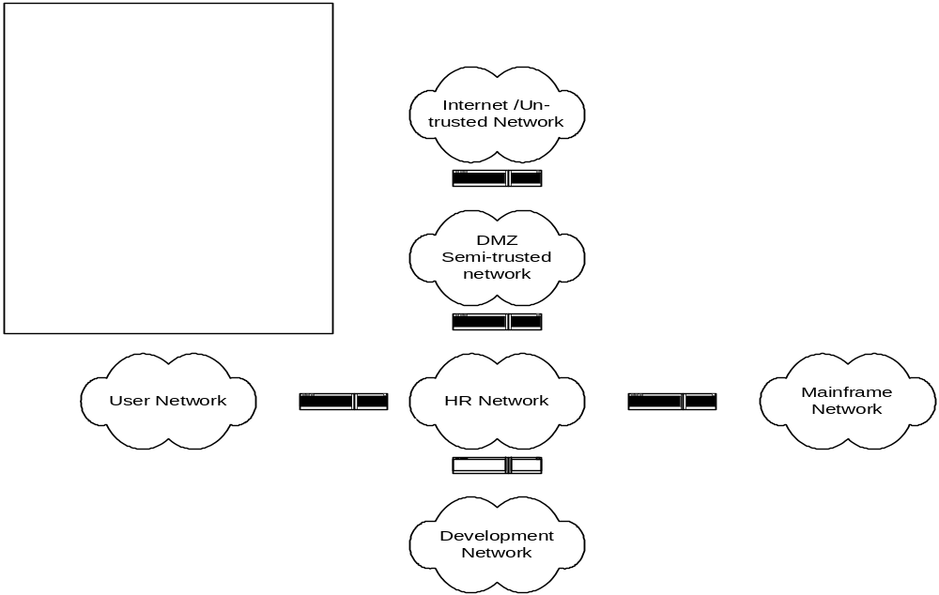
Layered Firewall

Slide 47
Defense in depth
Security has no single right answer
  Use every tool available to bolster security
Layered security is always the best approach
Strong security controls coupled with audit, administrative reviews, and an effective security response plans will provide a strong holistic defense

Slide 48
End of Module 1
Questions?

Slide 49
Network Firewall Security
Auditing Firewalls

Slide 50
Module 2:
Security Operations
Firewall Administration Overview

Slide 51
Firewall Administration Overview
Administrative Access
Break Fix Response
Monitoring and Alarming
Logging
Policy/Rule set Administration

Slide 52
Module 2:
Security Operations
Administrative Access

Slide 53
Administrative Access
What is Administrative access?
  Administrative Access refers to a group’s need to gain control over a system for the purpose of discharging their chartered duties. This access includes, but is not limited to: Monitoring, Log Analysis, Break fix support, User administration, Rule/Policy implementation, OS configuration , software/hardware implementation, and patch/upgrade implementation.
  The need of any group to have this control should be carefully considered. Control rights delegated to teams should be clearly stated in your Corporate Security Policy.

Slide 54
Administrative Access
Who might need access?
  Support Staff
  Implementation staff
  Design staff
  Network staff
  Audit or Review staff
  Many groups depending on your organizational structure

Slide 55
Administrative Access
Types of access
  Read/View
    Typical need for design or Network staff
  Add
    Typical needs for Support and/or Implementation
  Change
    Typical needs for Support and/or Implementation
  Delete
    Typical needs for Support and/or Implementation
  Audit/Over-site
    Typical for Audit or review teams

Slide 56
Administrative Access
Software Access control
  Most systems are restrictive
    Role based access is often missing
    Inherent user rights of root/admin cause challenges
      Root/Admin privilege is required to run firewall app
      Root privilege is same on OS and firewall
    Access to view often equals access to change or delete
      Elevation of privileges
    Organizational roles add complexity
      The have and have nots vs. need and function

Slide 57
Administrative Access
Products to help provide control
  Many and diverse: sudo
  All have limitations
    Control commands
    Create separate user group from root
    Privilege can be upgraded inappropriately by user
    Most provide a patch and not the solution
Firewall products need to incorporate the required control

Slide 58
Administrative Access
Passwords
  Strong passwords
  Centralized administration
    De-centralized management in a large environment is trouble
  Two factor authentication
Physical access
  Access points for administration a must
  Operation Center with strong physical controls

Slide 59
Module 2:
Security Operations
Break Fix Response

Slide 60
Break Fix Response
Business units must have clear notification path
Organizations must have clear response plan
  What teams perform support?
    What support level is each responsible for
      1ST LEVEL
      2ND LEVEL
      3RD LEVEL
    What privileges do each of these team have

Slide 61
Break Fix Response
Talent
  Each group must be properly trained
    For every product they support
    Certifications
    General security knowledge
      Running firewalls and running them securely are different
    Procedurally
      How they discharge their responsibilities properly
        i.e. Allowable change
        Break fix clearly defined from change

Slide 62
Break Fix Response
Vendor relationships and support
  Notification path clear to all team members
    Internal web site a good communication device
  Support contracts
    Up to date
    Inclusive of all products
    Repercussions of no support agreement
      Patch update access
      Security fix access

Slide 63
Break Fix Response
Interaction with product owners
  Business units own application and are experts in the business need which typically conflicts with security policy/process
    Put in a change when fixing a problem
    Make changes on the BU side that requires a firewall change that is insecure
    Without regard implement changes that break service and require firewall changes to restore production
      Re-IP a dB sever
      Change the communication protocol

Slide 64
Break Fix Response
Oversight
  Does the fix change security
    Policies are done slowly with forethought
    Break fix is done fast and in a vacuum
  Does the fix change the design
    Updating designs/risk matrixes
    Who is responsible
    How do we ensure it is done?

Slide 65
Module 2:
Security Operations
Monitoring and Alarming

Slide 66
Monitoring and Alarming
Firewall Monitoring Problems
  OPSEC
    Greatly limits a groups ability to perform good monitoring
    Monitoring and communication fly in the face of “need to know” security concepts
  Products
    Geared toward functionality—not security
    Host Agents often open serious security holes
      Remote login access
      Random ports
      Root level access for tools
  Customer disclosure
    Customer want access to tools to track system performance
    Good monitoring often discloses sensitive information

Slide 67
Monitoring and Alarming
Who performs monitoring?
  Requires access
  Discloses information
Is access being delegated to others for any reason?
  Who has access?
  What controls are in place?
  What rights have they been delegated?
What product is being used?
  Check for encryption and transport protocol
  Check loading and maintenance plans

Slide 68
Monitoring and Alarming

Slide 69
Module 2:
Security Operations
Logging

Slide 70
Logging
Logging is very important
  Provides history of access
  Provides attack information
  Provides for Policy audit checking
  Provides trending analysis for capacity planning
  Provides evidence for events

Slide 71
Logging
Firewall Logging Problems
  Many firewalls do not log effectively
  Extremely large files
  Difficult to manage and review
  Products have logs written to different files
  Access to many logs requires root access to firewalls
  Log analysis products are add-on and expensive
  Few organizations log effectively

Slide 72
Logging
Logging Methods
  Local
    Directed to files (poor from a security perspective)
  Remote
    Syslog
      Udp protocol is not reliable or secure (new syslog is better)
      Cannot be used as evidence: not credible
    Separated management network
      Some products are managed and logged in an isolated network
      Logging can be reliable and separate from firewall system
  Firewall products often account for good logging
    Ask good questions

Slide 73
Policy/Rule set Administration
General security Policy Guidelines
  Least Privilege Concept
    Allow least amount of access to allow someone to complete their duties
  Government orange and red books
    Detailed security controls
    Great reference material

Slide 74
Policy/Rule set Administration
General security Policy Guidelines
  Modems
    Very insecure
    Look for them on routers as a backup
    Remote vendor administration
    Banned by policy, allowed only by documented exceptions
  Protocols
    Tcp is the most easily controlled
      Session oriented
      Firewall compatible

Slide 75
Policy/Rule set Administration
General security Policy Guidelines
  Protocols continued
    UDP
      Use as little as possible
        Needed for some require and some desired functions
        Monitoring, logging, snmp management
    Netbios
      Easily attacked
      Bad trust model

Slide 76
Policy/Rule Set Administration
General Security Policy Guidelines
  Authentication
    Passwords
    Two factor
    Controls
    CA and digital certificates
  Encryption
    Data classification
    Strength
    Where/when

Slide 77
Policy/Rule set Administration
General security Policy Guidelines
  Allowed Services
    Should be known and highly controlled
      www
      http
      smtp
      vpn service
      dns
    Avoid inherently insecure services where possible
      Finger
      Telnet
      ftp
      nfs
      Remote admin tools (some have good controls others do not)

Slide 78
Network Firewall Security
Auditing Firewalls

Slide 79
Module 3:
Security Policy
Understanding Firewall Policies, Standards and Procedures

Slide 80
Why Conduct a Policy Audit
The policy audit is the most difficult portion of a firewall audit
The security policy is the single most important part of the firewall setup
Security policy must be tied to the overall risk –vs.– cost benefit
  If your security policy does not account for backups, risk is not controlled.
Today we will discuss a department audit (firewalls)

Slide 81
Policy Defined
Policy
  The rules and regulations set by the organization. Policy determines the type of internal and external information resources employees can access, the kinds of programs they may install on their own computers as well as their authority for reserving network resources.
  Generally a security policy is a document that states in writing how a company plans to protect the company's physical and information technology assets. A security policy is often considered to be a “living document”
  Policy is typically general and set at a high level within the organization. Polices that contain details generally become too much of a “living document”

Slide 82
Standards
Ensure that a product is fit for it’s intended purpose and to ensure compatibility between computers
  Industry Standards
  For a Department audit, standards should exist between different business units and internally so that all team members understand how the different products work together

Slide 83
Procedure
Established or prescribed methods to be followed routinely for the performance of designated operations or in designated situations -- called also standing operating procedure
Notes:
How they handle their day to day activities and respond it issues

Slide 84
Example
The policy may indicate what type of data or protocol must run through a firewall
Standards will dictate the type of firewall
Procedure will show how the day to day tasks ensure that the spirit of the policy is maintained
Today we will use the term policy to include Policy, Standards, and Procedure

Slide 85
Overview of this Module
Policy Minimums
Access
Break Fix Response
Monitoring and Alarming
Logging
Policy/Rule Set Administration

Slide 86
Starting the Policy Audit
Identify who are the player
  implementation, support, and design
Wait to define scope until you understand the policy and players
Does the division support the company’s goals
Does the department support the division policy
Interaction with other groups (network, IDS, Anti-virus, business units,)
Notes:
Who are the players—implementation, support, design –all can be one

Slide 87
Identify Right Away
Does the policy permit anything that’s not explicitly prohibited, or does it prohibit everything that's not explicitly permitted
  Pros and Cons to each approach
  Depends on the corporate philosophy but either is acceptable; however, most will tend to be more restrictive

Slide 88
Identify Right Away
Authority for Policy
  Without authority no security policy can succeed
  Business units will always attempt to meet their needs, security is in their way
  Must have authority to make business follow the policy
  If they violate there must be consequences

Slide 89
Initial Items to Review
Contingencies
  How many items must line up for the policy to be effective.
Complexity
  Length of policies
Part of overall organization risk management strategy
  You can not do a firewall audit without familiarity of general security policy

Slide 90
Initial Items to Review
Out of date
Version control of the policy
Approval process/Change management
Who will own findings

Slide 91
Initial Items to Review
Does policy innumerate the apps in use
  Does policy address the hardware/software, versions
How is policy updated
  Can it react with the speed of new technology
Define responsibility of tasks
Overall controlling authority
  Internal audit controls
  Tools
  Oversight
Process to update failed procedures
Information sharing

Slide 92
Specifics Necessary in Policy
Policy should address
  Risk vs. cost trade off
    Sign off for exceptions
    Risk avoidance or informed acceptance
  Who polices / enforces the policy
  Role based admin
    Root password control
    How is access defined and controlled
    Password strength/resets grant access
  Reporting, alarming

Slide 93
Specifics Necessary in Policy
The groups that should be accounted for:
  Implementation
    Changes, new systems, removing, tracking changes, proper approval,
    Easiest to audit and everyone focuses on the most, spend the least amount of time here
  Design
    Approval, templates/format, traffic allowed, protocols, general defined guidelines, channel back to policy makers to get new changes
    Hardest, so many spend little time, should spend the most time

Slide 94
Specifics Necessary in Policy
  Support
    Inventory control, response to issues, engage vendors, track issues, trend problems, access to designs,
    Almost equal to design, ok one day does not matter if someone makes a simple change to the system
    Hands on audit
  Others optional

Slide 95
Specifics Necessary in Policy
Sensitive data storage/transportation
  Rule sets
  System Backup
  Logs
Physical security of systems
  Good network security will not help if the firewall has unrestricted physical access
  On premises
  Off premises
  Transit

Slide 96
Module 3:
Security Policy
Policy as the Underpinnings of a Secure Infrastructure

Slide 97
Access Control Policy
The box
The software
The connected storage devices
Roles
  Controls
  Tools

Slide 98
Break Fix Response
Controls to maintain system integrity
Availability
Response times
Skills of available engineers
Interaction with other groups
  Vendors
  Business units
  Support partners

Slide 99
Administration
Security is a function of system administration
System administration must be based in policy
Tools
  System configuration checkers
Build documents
  Allows for consistency
Lists of installed software
  Location within file structure
  Permissions

Slide 100
Code
Software/Hardware Vendors
  Patches/fixes
  New applications/OS upgrades
  Kernel changes
Business Unit requests
  Application updates
  New applications
  Authentication changes
Security updates/patches
  Sense of urgency/timelines
Testing
  Procedures
  Not co-mingled with production environment

Slide 101
Policy to Ensure Security of the Code
Why
  Most secure environments can be breached through a firewall accessible services
    Poor coding allows remote administrative access through common HTTP services
Problems
  Buffer overflows
  Cross Site Scripting
Mechanisms
  Code review
  Application firewall products
  Applications proxies

Slide 102
Infrastructure in Support of Policy
Infrastructure allow you to meet policy requirements
Once you know version check available resources for known issues and compare to the firewalls
Engineering resources available
  Can they fulfill the policy requirements
  Training

Slide 103
Module 3:
Security Policy
Rule Base, Logging, Reporting

Slide 104
Monitoring
What is required to be monitored in order to comply with policy
Reporting
  Who has access to the data
  What tools are used to parse data
Transportation of data
  Tools and protocols allowed
  If policy requires certain levels of data to be encrypted how is monitoring data transported
    SNMP (version 3 is encrypted) /Mail/UDP/TCP
Alarming
  How
  To where

Slide 105
Logging
Daily review at a minimum
  Tools are important, more reliable than a person and can be done constantly
Done by someone with knowledge of what they are looking for
Forensic analysis
What is logged
  successful attempts, failed?
Where is the data stored
  Should be remote to server
  How is it transported

Slide 106
Response to Alerts
Does the policy differentiate alerts
  Incident response (hacking)
  System problems
  Network problems
  Application problems
Interaction with outside agencies
  Police
  Press
Discloser of information
  Who/when

Slide 107
Rule Set Administration
Firewall rules are the heart of any firewall system. A mistake in the firewall rules can undermine all security controls.
  Who designs the changes
    Who approves the designs
  Are there standards to creating a design
    E-mail, FTP, Web
    Blocking Sites/Ports
  Who is authorized to change the rules
    Who reviews these changes
  Mechanics of making the change
    On the machine directly
    Staged
    Access points

Slide 108
Backup/Restore
Media
  Tape
  Mainframe
  Another host
Frequency of backups
  Consider the type of data
  Consider frequency of changes to the environment
Restoration
  Contingencies for types of problems
    Hacking
    Loss of hardware
    Loss of network
    Loss of data center

Slide 109
Module 3:
Security Policy
Mapping Policy to the Firewall

Slide 110
Goals
Match policy to the physical systems
Match policy to team member processes
Random sample of systems
Review of system inventory
System review
  Define Files to see
  Results of previous internal/external scans
  Penetration tests

Slide 111
Mechanics
Interview
  Establish a rapport
  Down play your role
  Sympathize
  Discuss opportunities that audits can present
  Ask for “off the record” feedback about processes
  Look for opportunities to move in a new direction
  Identify others to interview
Job shadow
  Is it difficult to do the work in compliance with policy
    Do short cuts result

Slide 112
Mechanics
System review
  Define files to see
    Rule sets
    Password
    Operating system
    Software configuration
    Logs
      Must be archived elsewhere
  Define the manner in which you will have access

Slide 113
Pitfalls of too Much Policy
Can’t be followed
Impedes implementation
Costs too much to the organization
Too restrictive for business
Does not allow for risk (risk avoidance opposed to informed acceptance)

Slide 114
Module 3:
Security Policy
Understanding Firewall Policies, Standards and Procedures

Slide 115
Network Firewall Security
Auditing Firewalls

Slide 116
Module 4:
Understanding Firewalls
Building An Audit Plan

Slide 117
Overview of the Basic Steps
Review the policy
Get an organization chart
Determine the abilities of the firewall
  What “add on” applications (e.g. IDS, anti-virus)
  Can it enforce the policy
  Does the design enforce the policy
Identify the supporting components
  Log server
  Backup server
  Access points
Review the configuration of the firewall
Conduct spot tests

Slide 118
Firewall Review
As you are auditing the implementation
  Build a list of:
    Software used (include versions)
      Don’t forget the remote access software
      Don’t forget any clients running on the users end
    Hardware
      Operating system
      Custom kernels

Slide 119
Research
Check available online resources looking for known security holes
Follow up with the manufacture to find out their recommendations for configuration/administration
What are the newest versions and why are they not being utilized
  Watch for end of life products

Slide 120
Back to the Firewall
Check to see if is susceptible to any of the known vulnerabilities
  Patches
  Mitigating controls
Proceed to the “Detail Audit” and use of tools
  Run netstat to identify open ports
  Run LSOF = list of open files

Slide 121
Spot Checks
Attempt to bypass various controls
  If an outbound only rule try to run the service inbound
    FTP
    Telnet
  If it is suppose to filter content, try to pass the content
Ensure you have management approval, plan to do the work after business hours

Slide 122
Tools to Aid the Audit
Be careful to trust in tools too much
  A lack of findings does not mean the system is set up well
Use them to verify what you have already found out
We are not doing a penetration test
Firewalls have changed so fast that good comprehensive auditing tools have not been developed

Slide 123
Tools to Aid the Audit
Port Scanner (nmap)
  Should re-enforce what you found from running netstat
Security scanning tools should show little information
  Satan, Internet Scanner, work good to audit a trusted network for obvious issues but do not work well on a bastion hosted locked down OS
Go to a class and be proficient

Slide 124
Detail Audit
Access to the firewall should be authorized
  How are employees and non employees given access
  Obtain a list of users on the firewall
  Cross check with staff lists/organization chart
  Remote Administration
    Onetime passwords
    Other secure methods
    Encrypted link
  How is access changed or revoked
  How is access reviewed
    Mechanics of authentication
    Frequency of review
    Password reset/changing passwords
    Root password control

Slide 125
Detail Audit
Firewall should enforce security policy (encryption, viruses, URL blocks, proxy/packet filter types of traffic)
  Obtain the rule set
  How are rule sets stored to maintained to ensure that they have not been tampered with
    Checksums regularly verified?
  Is effectiveness of firewall tested
  Review processes running on firewall; are they appropriate
  Does the firewall provide adequate notice when an exploit is attempted?

Slide 126
Detail Audit
Control
  Physical access to the firewall controlled
  How are software updates done
  Control of sensitive information
    IP addresses
  Access tied to an individual
    Control of hidden/system accounts
  Control of devices used to manage firewalls

Slide 127
Detail Audit
Network configuration
  Obtain a design
  Does the firewall properly protect the DMZ
  Identify the monitoring and control of traffic procedures used
  NAT to protect internal address space
  Does firewall use dynamic or static address translation

Slide 128
Detail Audit
Connections should be logged and monitored
  What events are logged
    Inbound services
    Outbound services
    Access attempts that violate policy
  How frequent are logs monitored
    Differentiate from automated and manual procedures
  Alarming
    Security breach response
    Are the responsible parties experienced?
  Monitoring of privileged accounts

Slide 129
Detail Audit
Custom written scripts
  Prolific in Unix environments
  Should be listed, and reviewed
Use of mail services

Slide 130
Detail Audit
Management Reports
  Capacity
  Incidents
  Alerts
  Trending

Slide 131
Detail Audit
Changes to the firewall configuration
  How are they authorized
  How are they tested
    Safe environment
    Tracked
    Back out plan
  Staging of rules/review by a second party
  Change control vs. break fix
    Changes should be scheduled and approved
    Break fix should be limited to restore to working state without adding anything new
    Any new IP addresses, URL changes must be approved and can not be addressed as break fix

Slide 132
Detail Audit
Recovery
  Plan developed in compliance with business continuity requirements
  Are the time limits acceptable and achievable
  Frequency of testing
  Review the results of the most recent test

Slide 133
Resources
www.bugtraq.com
www.cert.org
RFC 2196 Site Security Handbook
  For drafting security policies
“firewalls and Internet Security” Repelling the Wily Hacker”, by Bill Cheswick and Steve Bellovin
“Building Internet Firewalls”, by Brent Chapman and Elizabeth Zwicky
Current up to date information from mailing lists
  BugTraq
  Security Focus

