Slide 1
Greek Islands
Accommodation Analysis
Christos Andreopoulos - Business Administrator
Antonis Zormpalas - Graphic Designer for Digital Media Marketing

Slide 2
Project Overview
Which month suits better for holidays according to desirable budget,
style and facilities?
Where can I find the most cost-effective accommodations?
Which are the key facility factors that hold paramount importance for the customers?

Slide 3
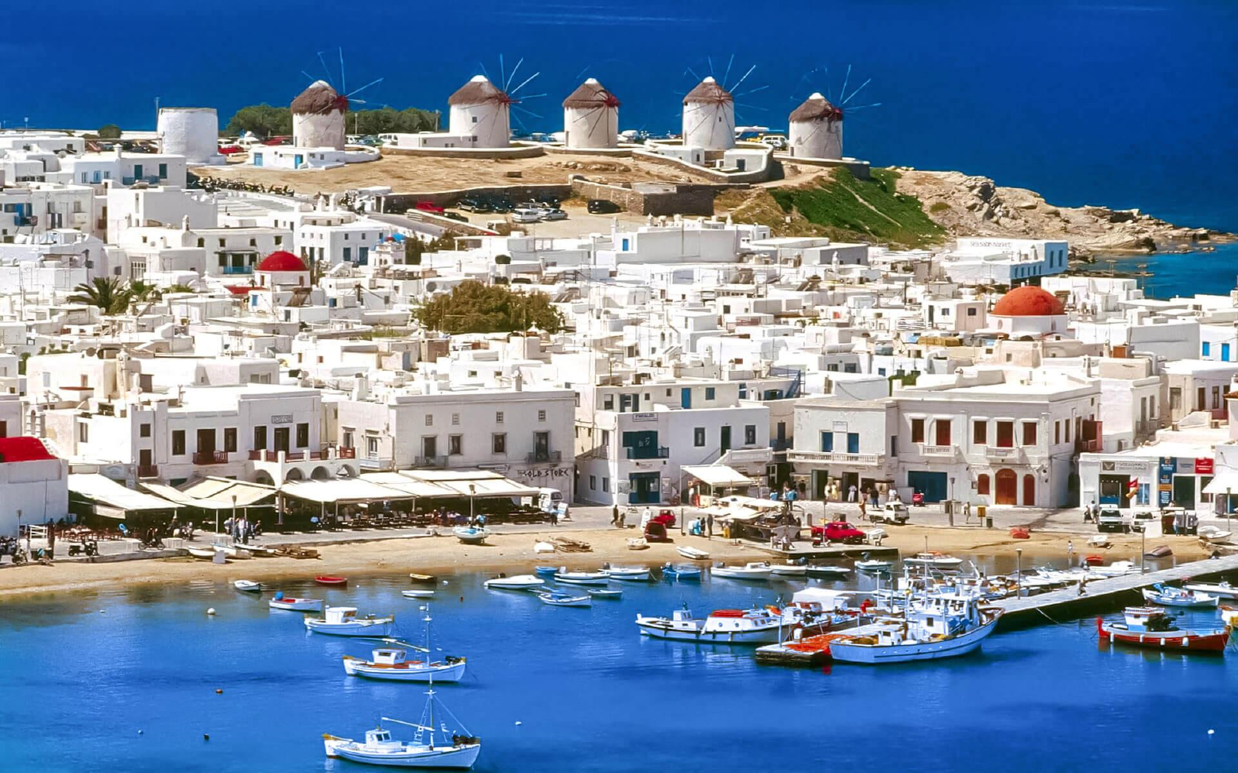

General Insights
Accommodations:
June: 6942
July: 5070
August: 10550
Locations:
Crete
Rhodes
Lefkada
Samos
Naxos
Tinos
Santorini
Mykonos
Paros
The dataset pertains to the last week of each summer month,
specifically focusing on data scraping from booking.com at the beginning of June.

Slide 4






Project Roadmap
1. Web Scraping Booking.com
2. Code Automatization
3. Merging & Cleaning
4. EDA
Exploratory Data Analysis
5. Collecting Insights
6. Data Visualization
in Power BI

Slide 5
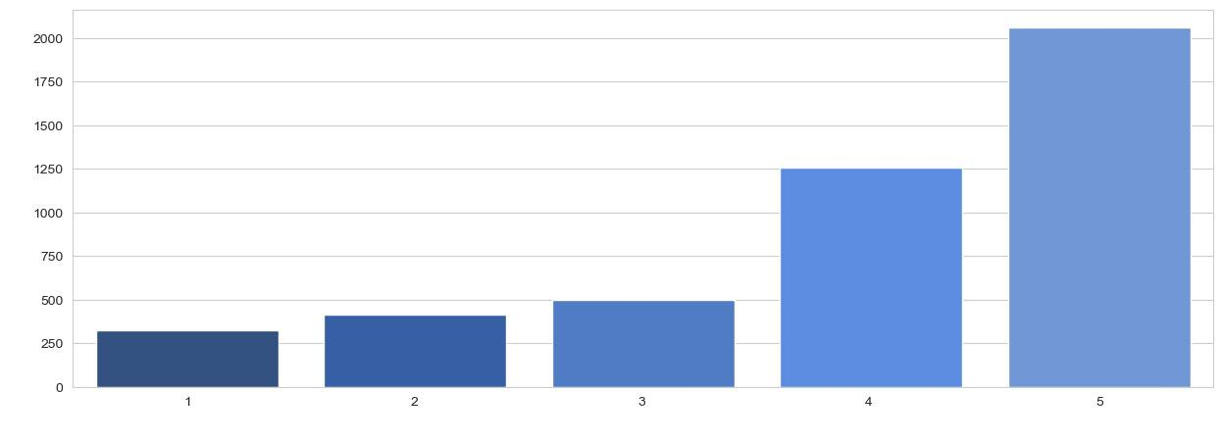
5-star accommodations
High-Quality-
Well-trained Stuff-
-Variety of Facilities
Price in relation with Stars
during summertime
Price €
Stars

Slide 6
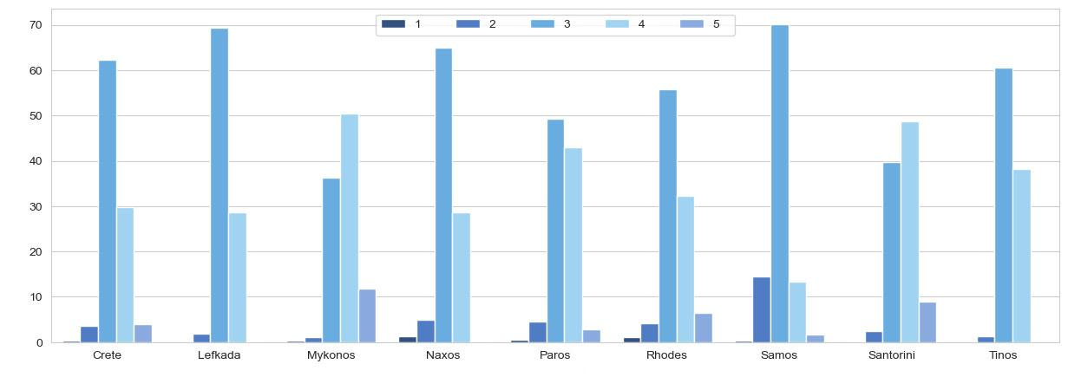
Star Distribution
across Location
3-star accommodations
consists of family-owned hotel and guesthouses.
Percentage %
Location

Slide 7
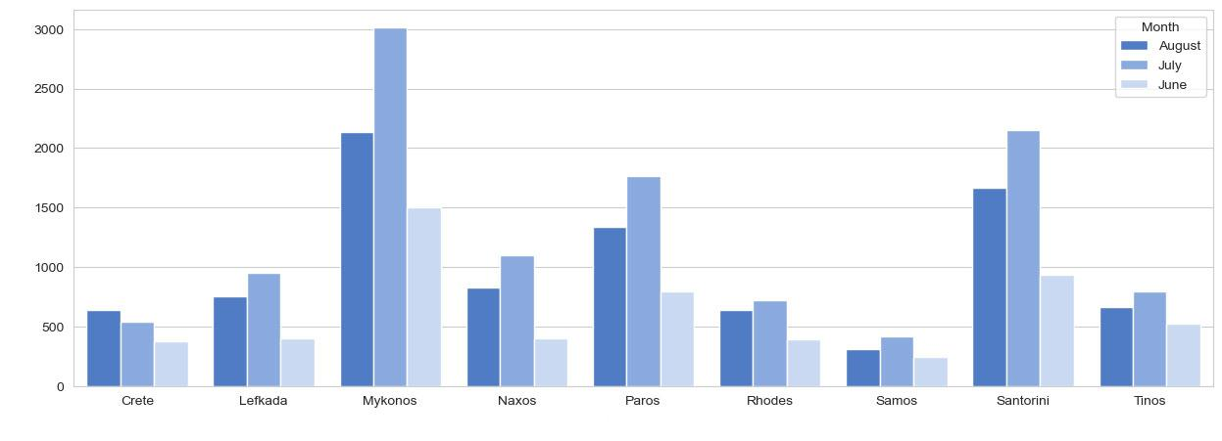
Price Distribution
according to Month
Mykonos and Santorini stands out as they offer the most 4 and 5-star accommodations in relation with the other islands.
Price €
Location

Slide 8
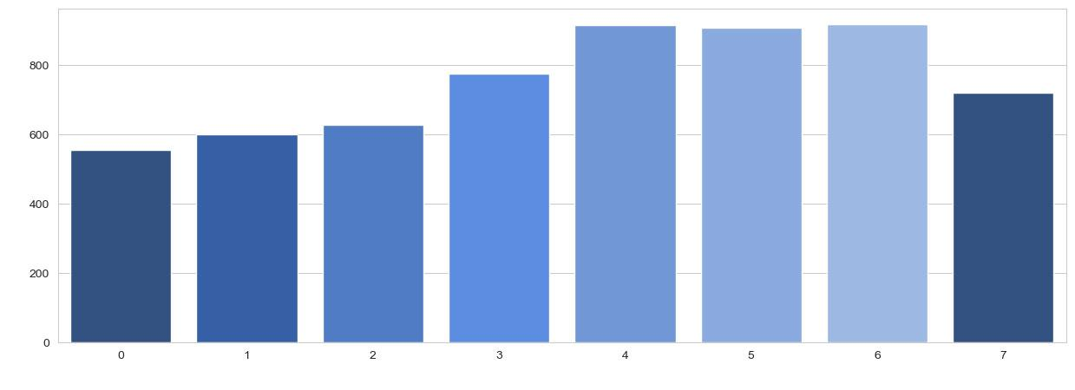
Price Distribution
according to Facilities
Why does this occur?
Price €
Number of Facilities

Slide 9
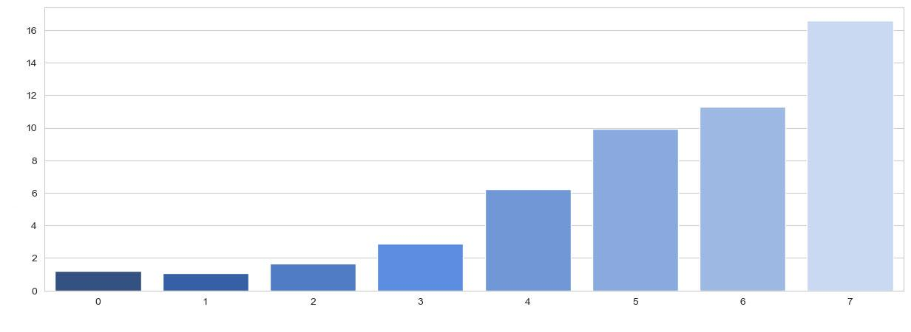
Reviews Distribution
according to Facilities
Well-Satisfied Customers
Average Reviews
Number of Facilities

Slide 10
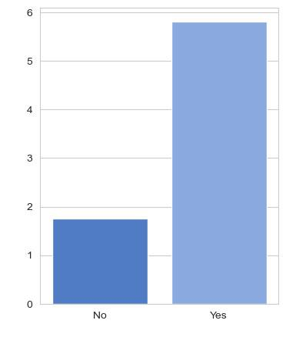
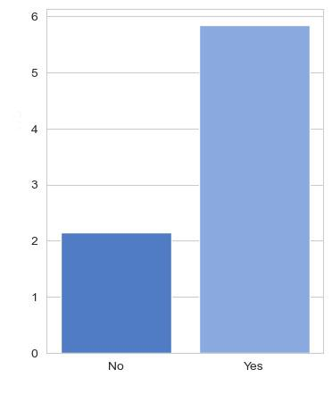
Reviews Distribution
according to Facilities
Customer’s Satisfaction
- Key Factors
Average Reviews
Average Reviews
Airport Shuttle
Pool

Slide 11



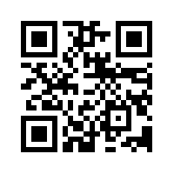
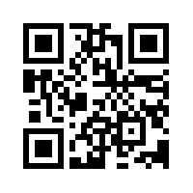
Thank you
for your attention
Christos Andreopoulos
Antonis Zormpalas
Special Thanks to Big Blue Data Academy

