Slide 1
Linear Algebra
A gentle introduction
Linear Algebra has become as basic and as applicable
as calculus, and fortunately it is easier.
--Gilbert Strang, MIT

Slide 2
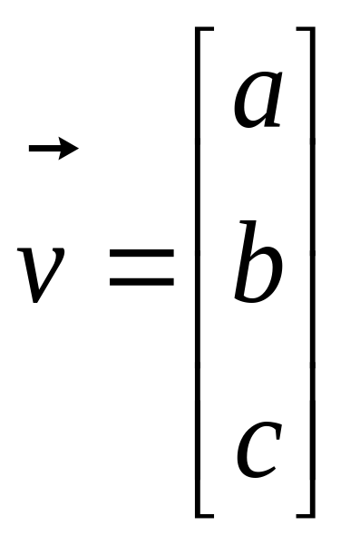
What is a Vector ?
Think of a vector as a directed line segment in N-dimensions! (has “length” and “direction”)
Basic idea: convert geometry in higher dimensions into algebra!
  Once you define a “nice” basis along each dimension: x-, y-, z-axis …
  Vector becomes a N x 1 matrix!
  v = [a b c]^{T}
  Geometry starts to become linear algebra on vectors like v!
y
v
x
Notes:
From 2D to 3D
In 2D,(a,b) is the point, combined with origin, [a,b]’is a direction.
upgrade to 3D, [a b c]’also can decide a direction
2. Emphasize the transpose and column vector

Slide 3
Vector Addition: A+B
A+B
A
A+B = C
(use the head-to-tail method to combine vectors)
B
C
B
A

Slide 4
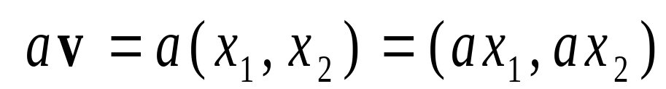
Scalar Product: av
av
v
Change only the length (“scaling”), but keep direction fixed.
Sneak peek: matrix operation (Av) can change length,
direction and also dimensionality!
Notes:
A scalar is just a number, no direction included.
So scalar product does not change direction.

Slide 5
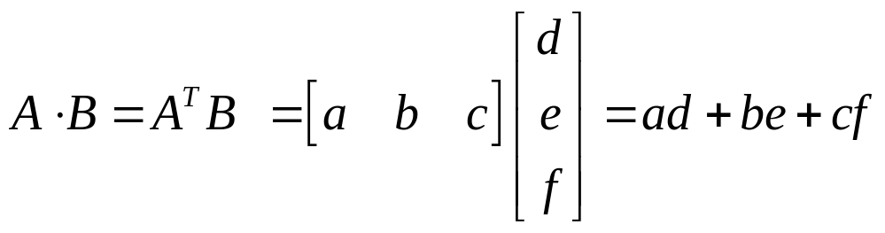
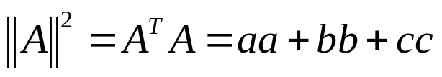

Vectors: Dot Product
Think of the dot product as a matrix multiplication
The magnitude is the dot product of a vector with itself
The dot product is also related to the angle between the two vectors

Slide 6
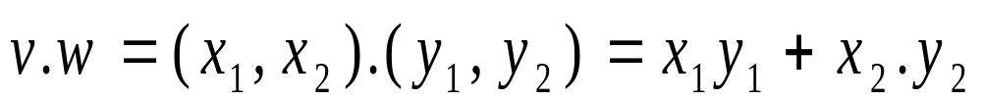
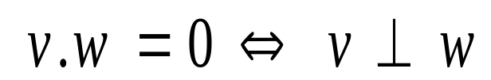
Inner (dot) Product: v.w or w^{T}v
v
α
w
The inner product is a SCALAR!
If vectors v, w are “columns”, then dot product is w^{T}v
Notes:
Do the operation first
Example: [a1 a2].[b1 b2]=??
[a1 a2 a3].[b1 b2 b3]=
Show m*n n*b trick to emphasize the result of dot product is scalar

Slide 7
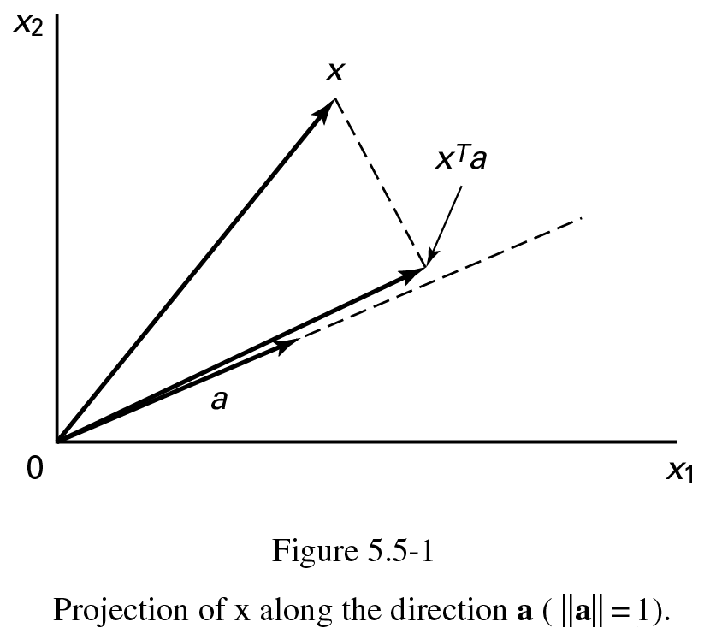
Projection: Using Inner Products (I)
p = a (a^{T}x)
||a|| = a^{T}a = 1

Slide 8
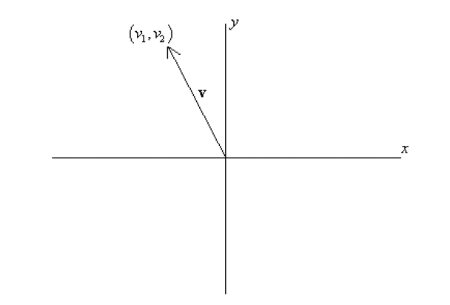
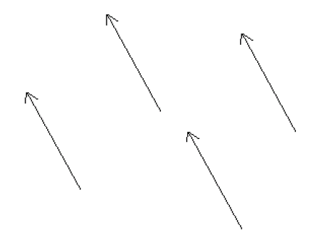
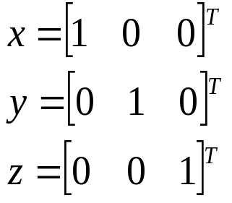
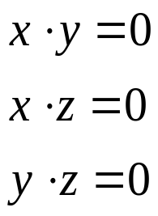
Bases & Orthonormal Bases
Basis (or axes): frame of reference
vs
Basis: a space is totally defined by a set of vectors – any point is a linear combination of the basis
Ortho-Normal: orthogonal + normal
[Sneak peek:
Orthogonal: dot product is zero
Normal: magnitude is one ]

Slide 9
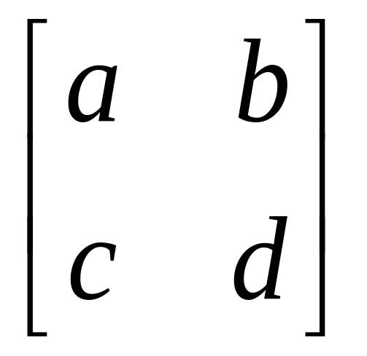
What is a Matrix?
A matrix is a set of elements, organized into rows and columns
rows
columns

Slide 10
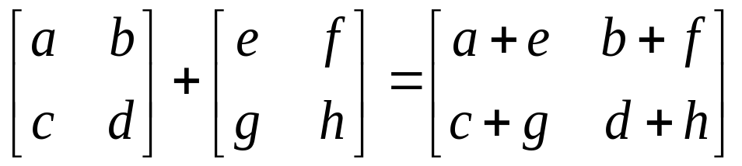
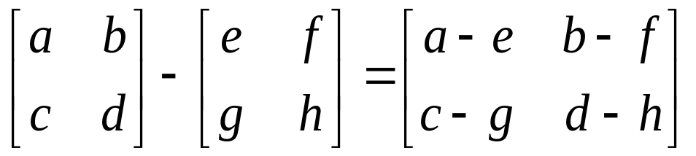
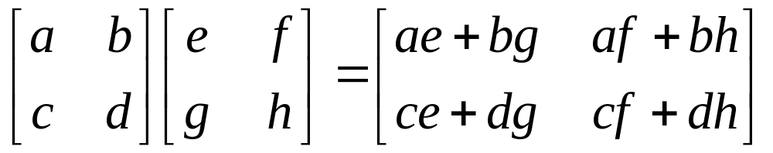
Basic Matrix Operations
Addition, Subtraction, Multiplication: creating new matrices (or functions)
Just add elements
Just subtract elements
Multiply each row by each column
Notes:
Addition and subtraction must be done in same dimension
Do multiplication together

Slide 11

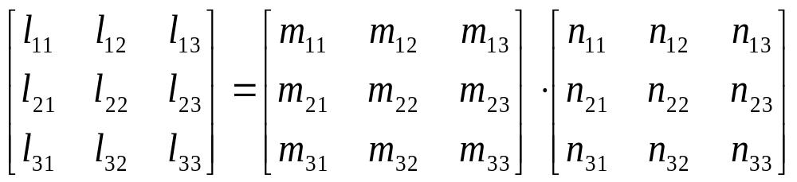
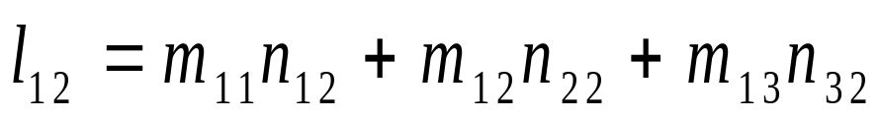
Matrix Times Matrix

Slide 12
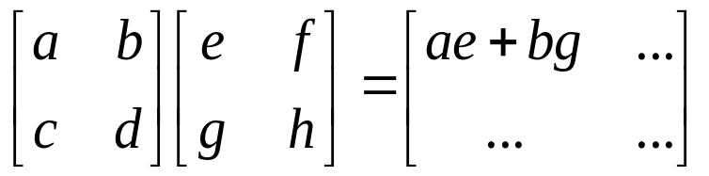
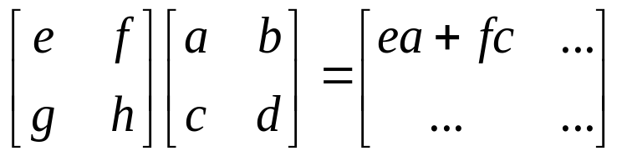
Multiplication
Is AB = BA? Maybe, but maybe not!
Matrix multiplication AB: apply transformation B first, and then again transform using A!
Heads up: multiplication is NOT commutative!
Note: If A and B both represent either pure “rotation” or “scaling” they can be interchanged (i.e. AB = BA)

Slide 13
Matrix operating on vectors
Matrix is like a function that transforms the vectors on a plane
Matrix operating on a general point => transforms x- and y-components
System of linear equations: matrix is just the bunch of coeffs !
x’ = ax + by
y’ = cx + dy
⎡
a
b
⎤
⎡
x
⎤
⎡
x
'
⎤
=
⎢
⎥
⎢
⎥
⎢
⎥
⎣
c
d
⎦
⎣
y
⎦
⎣
y
'
⎦

Slide 14
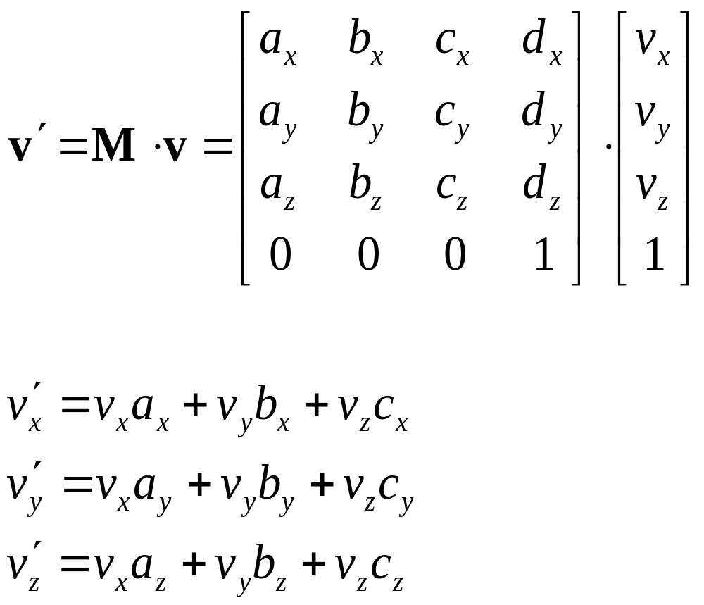
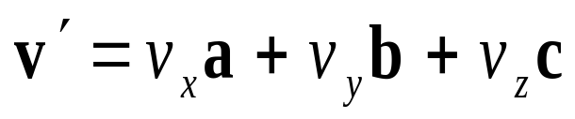
Direction Vector Dot Matrix

Slide 15
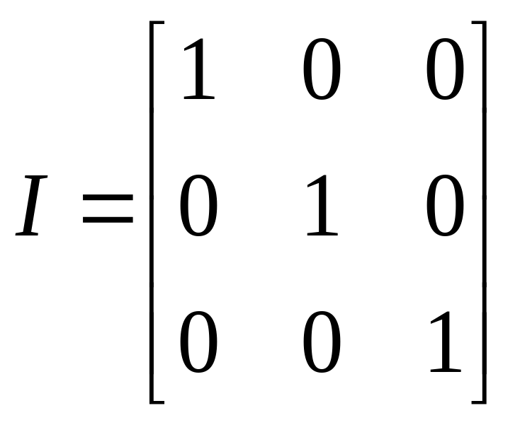
Inverse of a Matrix
Identity matrix:
AI = A
Inverse exists only for square matrices that are non-singular
  Maps N-d space to another N-d space bijectively
Some matrices have an inverse, such that:
AA⁻¹ = I
Inversion is tricky:
(ABC)⁻¹ = C⁻¹B⁻¹A⁻¹
Derived from non-commutativity property

Slide 16
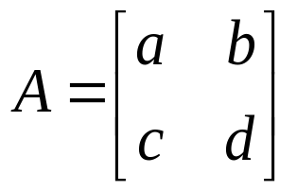
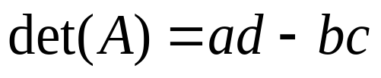
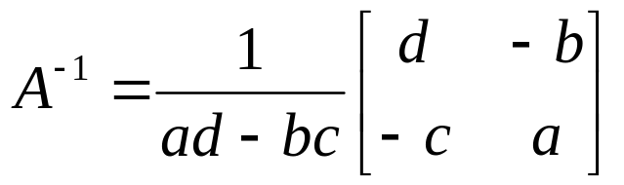
Determinant of a Matrix
Used for inversion
If det(A) = 0, then A has no inverse
http://www.euclideanspace.com/maths/algebra/matrix/functions/inverse/threeD/index.htm

Slide 17
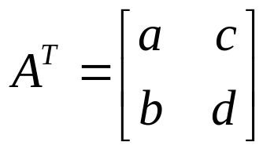
Transpose of a Matrix
Written A^{T} (transpose of A)
Keep the diagonal but reflect all other elements about the diagonal
a_{ij} = a_{ji} where i is the row and j the column
in this example, elements c and b were exchanged
For orthonormal matrices A⁻¹ = A^{T}

Slide 18
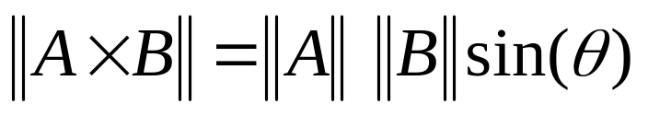
Vectors: Cross Product
The cross product of vectors A and B is a vector C which is perpendicular to A and B
The magnitude of C is proportional to the sin of the angle between A and B
The direction of C follows the right hand rule if we are working in a right-handed coordinate system
A×B
B
A

Slide 19
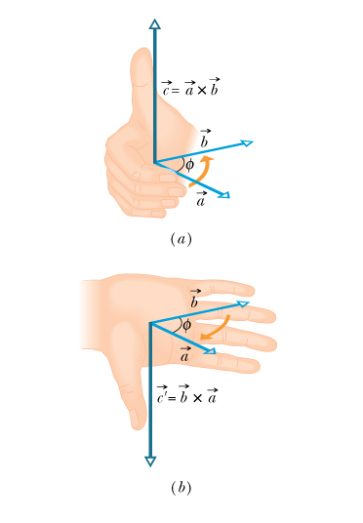
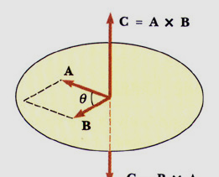
MAGNITUDE OF THE CROSS PRODUCT

Slide 20
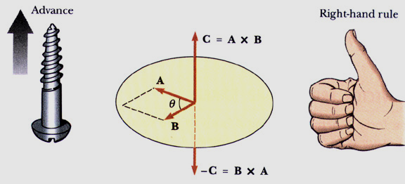
DIRECTION OF THE CROSS PRODUCT
The right hand rule determines the direction of the cross product

Slide 21
For more details
Prof. Gilbert Strang’s course videos:
http://ocw.mit.edu/OcwWeb/Mathematics/18-06Spring-2005/VideoLectures/index.htm
Esp. the lectures on eigenvalues/eigenvectors, singular value decomposition & applications of both. (second half of course)
Online Linear Algebra Tutorials:
http://tutorial.math.lamar.edu/AllBrowsers/2318/2318.asp

