Slide 1





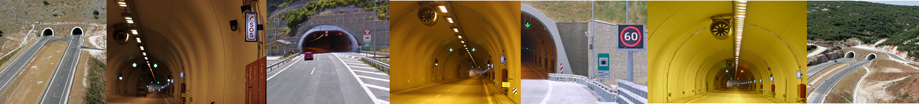
Tools Development for management resources optimization inside tunnels in case of an incident
Christodoulos Asiminidis

Slide 2


H.M.R.T. Research work

Slide 3
Notification system/group management of the freeway using T. P.
Web application for notification sending/Incident recording (capturing images – extracting forms automatically)
GIS real time personnel tracking system on the map
Android Application for sending notification to the personnel from the headquarters to the personnel on the freeway/ position recording of all the personnel groups
Interface along with Mass Notification System in order to send notifications to third parties
Interface with BLE smart exits using sensors and microcontrollers inside tunnels

Slide 4
Smart algorithms and system possibilities
Distance estimation of the group personnel which is closer to the incident (Distance Algorithm)
Response time estimation based on position/incident category
Completion time estimation based on the incident category/position of the incident
Response/completion recording times automatically
Real-time tracking system (for those who trapped inside the tunnels – the emergency personnel group/ form and procedures fulfilment automation)

Slide 5
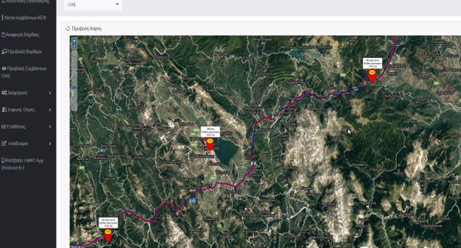
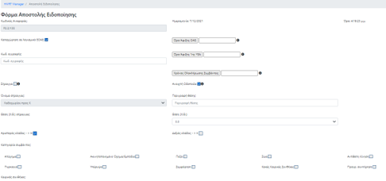
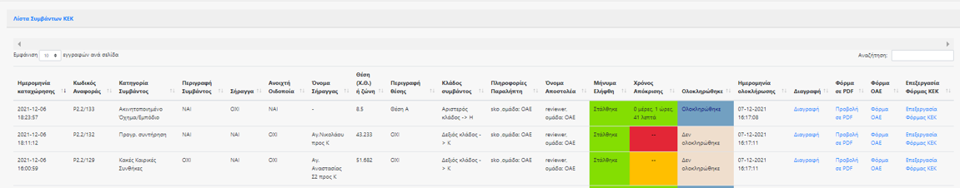
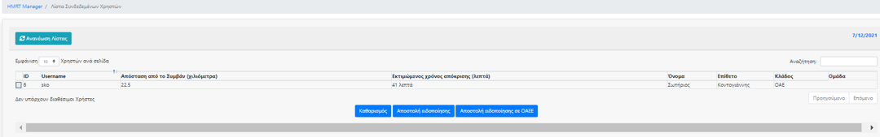
Resources Management System Web Application

Slide 6
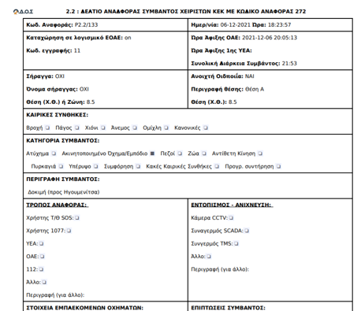
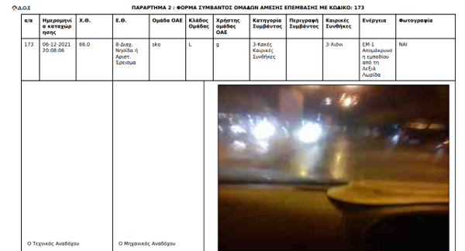
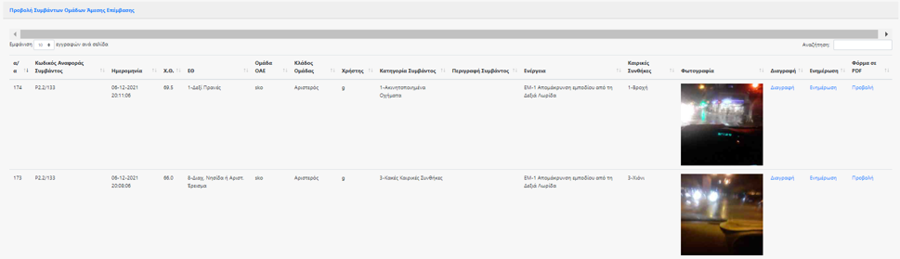
…and more

Slide 7
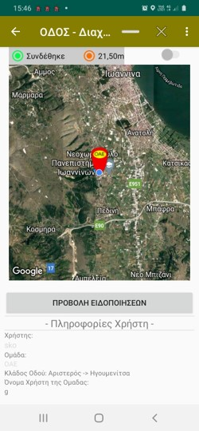
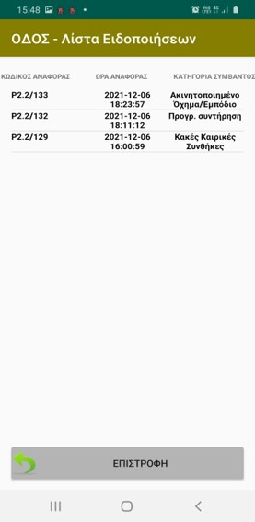
Resources Management System Android Application – H.M.R.T.

Slide 8
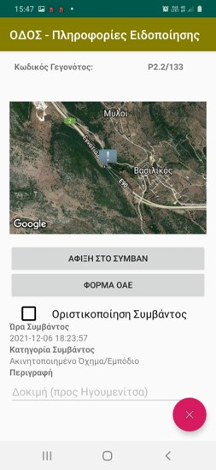
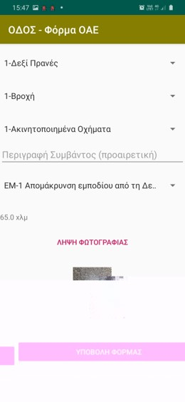
…and more

Slide 9
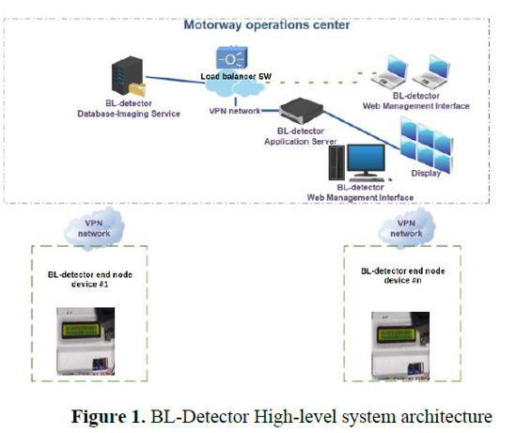
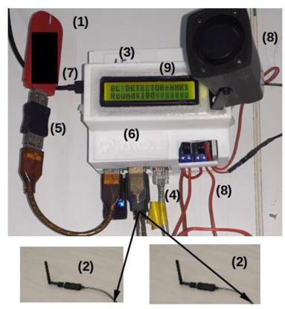
Smart Exit System

Slide 10
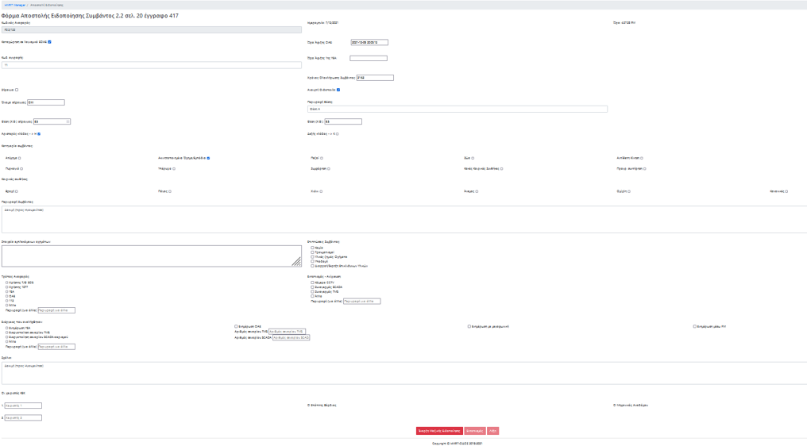
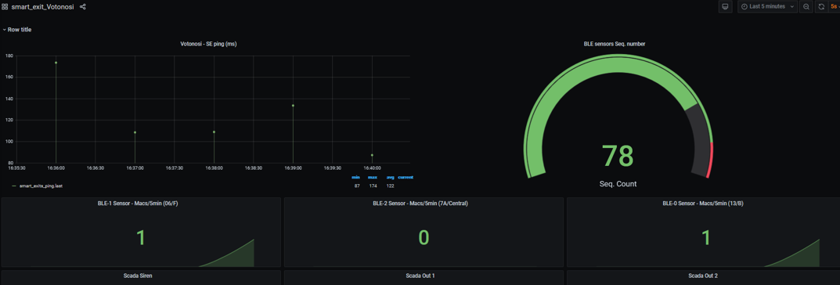
Interface with Mass Notification System – H.M.R.T.

Slide 11




Thank you for your attention!
https://www.facebook.com/odos.hmrt/
https://twitter.com/HmrtOdos

