Slide 2
X array wrapper
Data in xarray with a wrapper that handles:
Variable naming conventions and unit conventions (CF?)
QAQC conventions
Manages NC global and variable attributes
QAQC recording and comments
Derived parameters
Other misc utilities

Slide 3
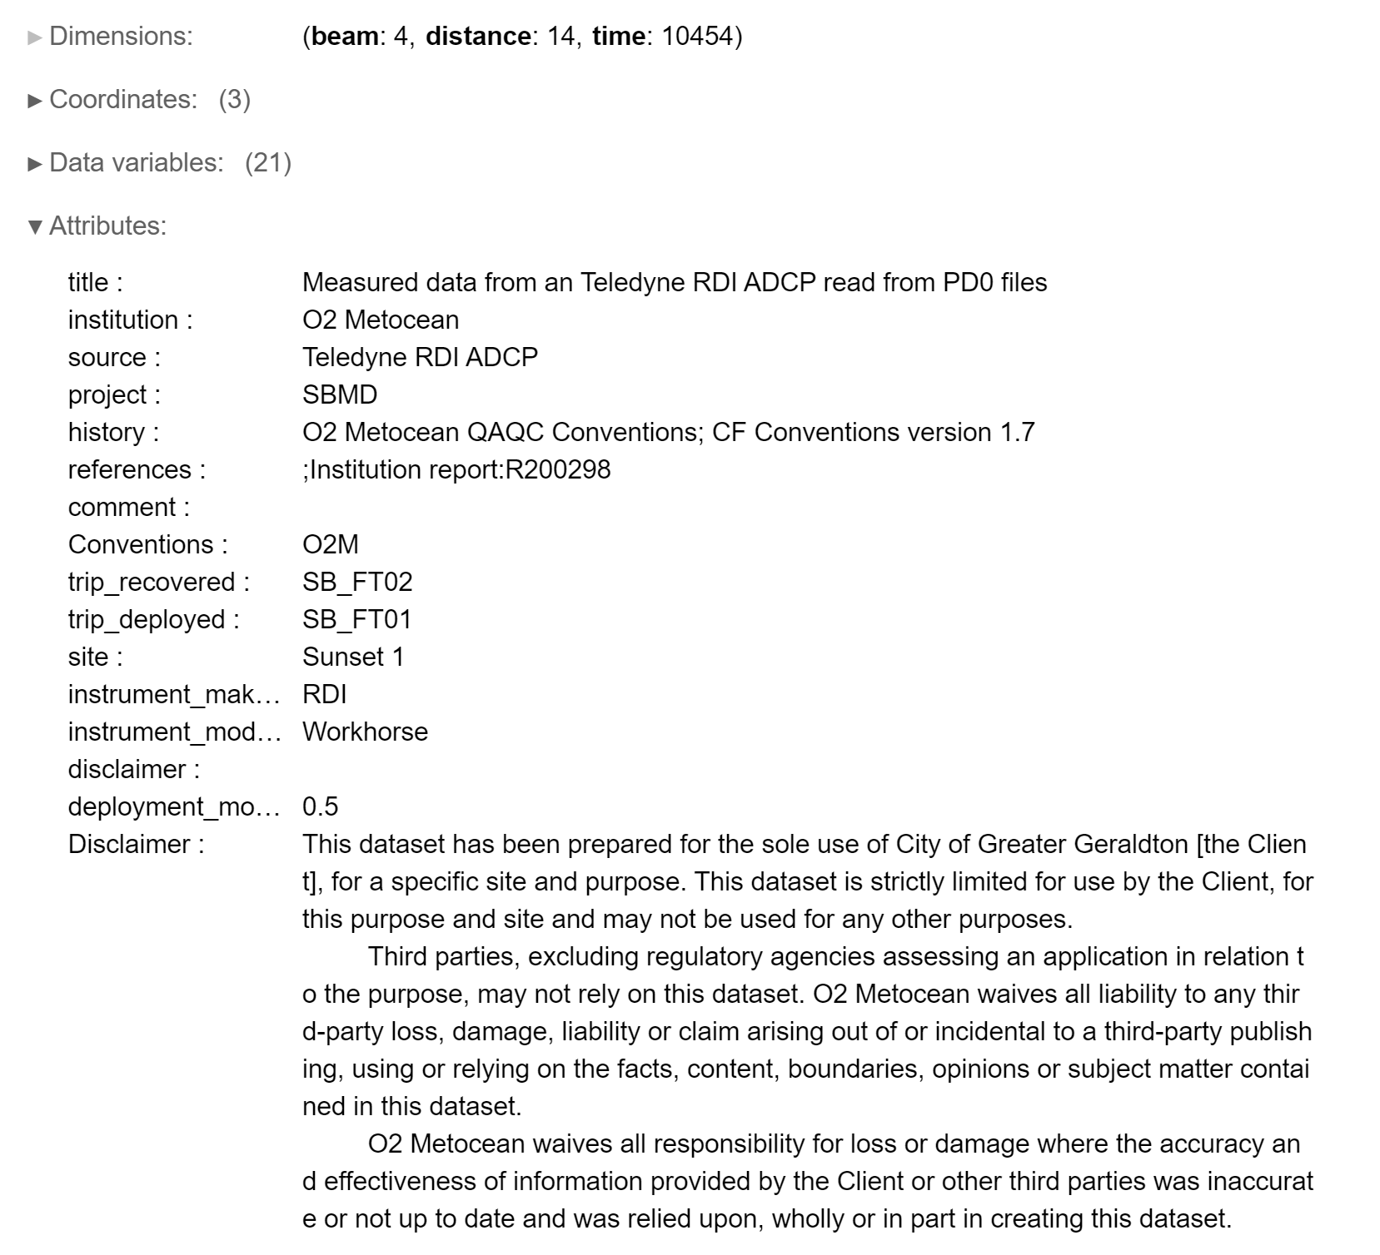
EXAMPLE– TRDI ADCP measured in ENU
How committed are we to CF?

Slide 4
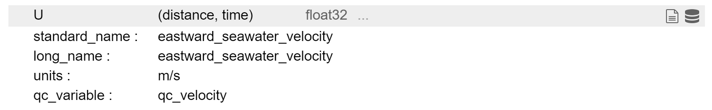
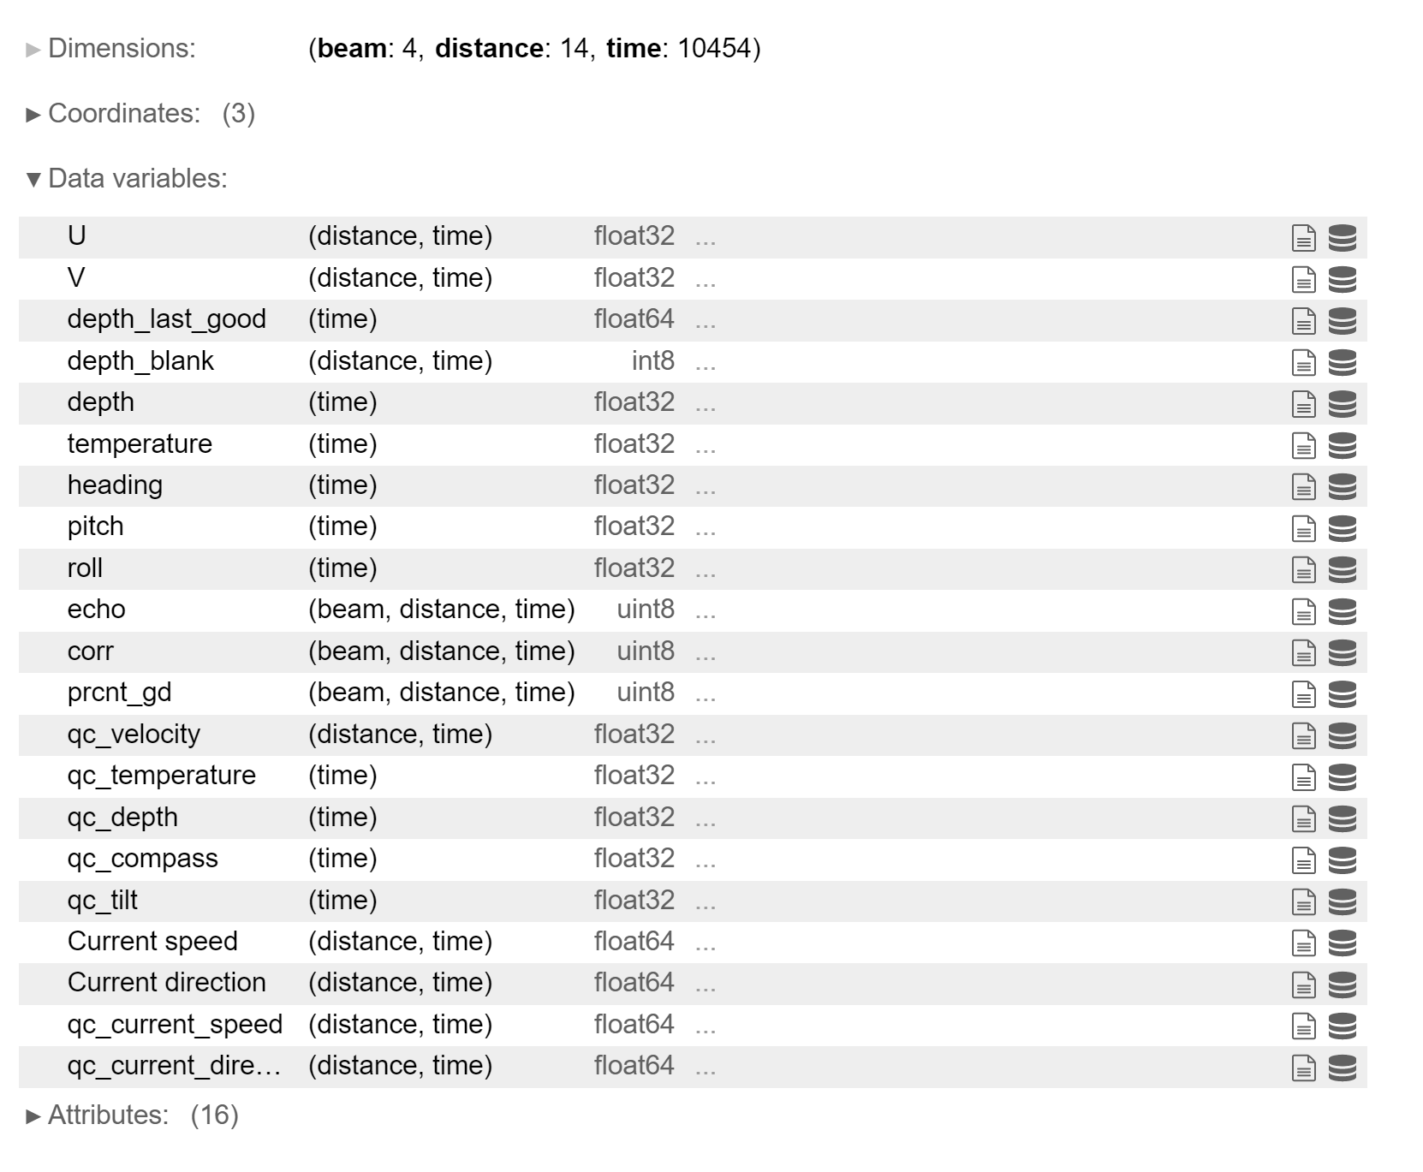
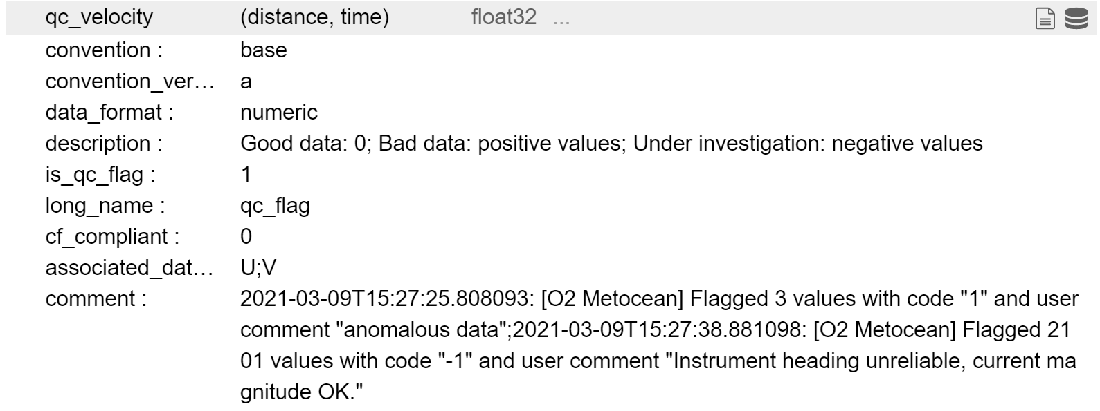
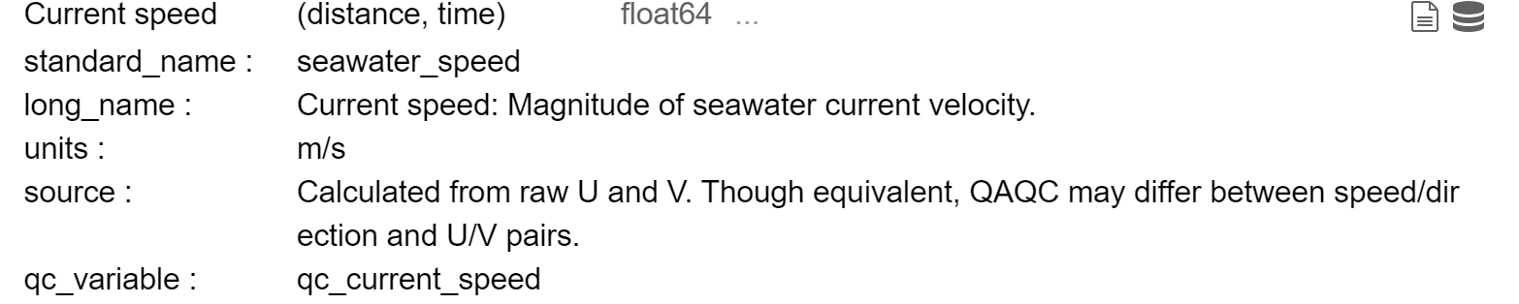
EXAMPLE– TRDI ADCP measured in ENU

Slide 5
Questions…
How committed are we to CF conventions?
Is there a better alternative?
Do we want to make our own up?
How complex do we wish for the QAQC to be?
Is good, bad, under investigation enough?

Slide 6
Where are we at?
Hours spent: ~20
Step 1) Base class: ready
Step 2) Ms Access Database: ready
Instrument specific items: in the table below
Instrument | Step 4) Python reader | Step 5) Xarray Wrapper | Step 6) Raw Archived? | Step 7) QAQC + Derived Archived?
RDI ADCP | Yes [binary] | Base class | - | -
SBE 56 | Yes [cnv] | Base class | - | -
SBE 37 | Yes [cnv] | Base class | - | -
SBE 39 | Yes [asc] | Base class | - | -
Nortek Vector | Yes [binary] | Base class | - | -
Nortek Signature | This is a Tough one! | Base class | - | -
Wetlabs NTU | Billy??? | Base class | - | -
LISST | Billy??? | Base class
Microstructure profiler | Significant inroads made on boat – will take some work | Base class | - | -
Profiling CTD | Matt???

Slide 7
Particular challenges
Nortek Signature:
59 GB file.
Can borrow from Dolfyn
Must do a netcdf stream due to RAM constraints
Took me a day and a half to do this for the vector
A day and a half is not really a day and a half anymore
Rockland VMP
They have a pretty big Matlab library
2 Options:
Use Matlab for this one [not good – too much duplication of effort!]
Use Matlab as an intermediate parser [ok not great!]
pyODAS?
I did do the bulk of this on the Solander [lost some friends in the process]
The results differ between ODAS and pyODAS so will need more testing/dev
Rockland MP
I don’t really want to go here at all!

Slide 8
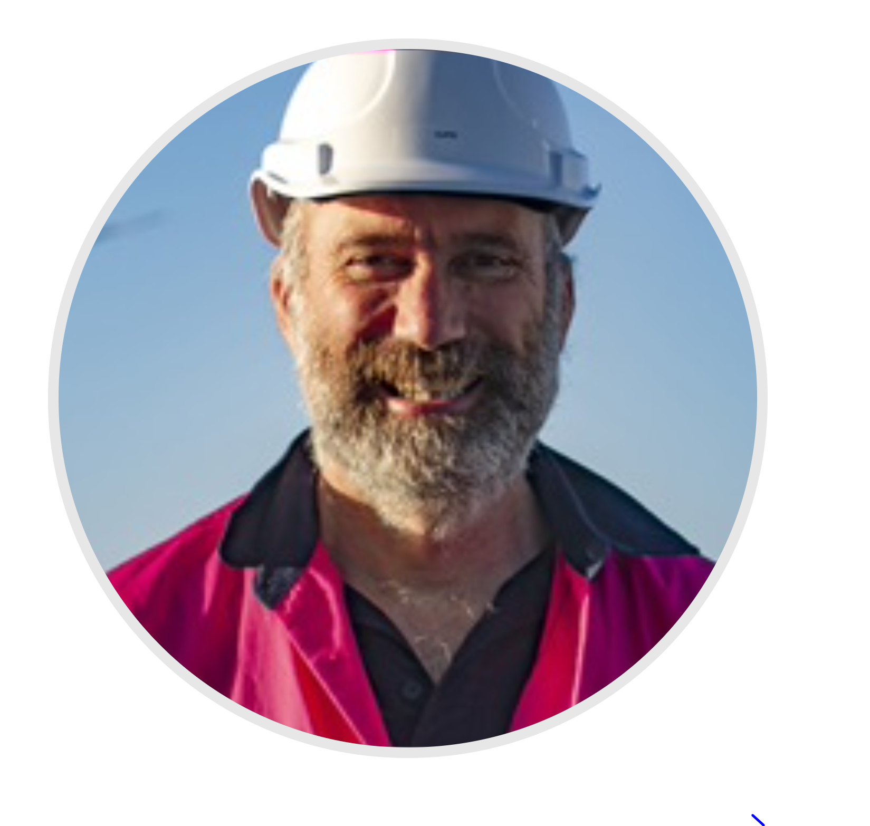
Had a to this guy also:

Slide 9
CSIRO Field team use IMOS toolbox
Nick doesn’t really get into is
Doesn’t like the duplication of metadata in the field database and the netcdf metadata
Doesn’t like the difficulty of collaboration
Doesn’t like the manual arbitrary QAQC
Doesn’t like the fact that the underlying files could change [especially in the case where files are processed by third party software e.g. Nortek Storm] and the netcdf file doesn’t ‘know’
Has advocated for some kind of ‘make file’ type library which tracks the dependencies [input files and perhaps a parameter file [.yml?]], the methods, and the outputs.
You can track changes in input files by a MD5 hash for example.

