Slide 1
InTouch

Slide 2
What is it?

Slide 3
Mind

Slide 4
Mind
Action

Slide 5
Mind
Action
Health

Slide 6
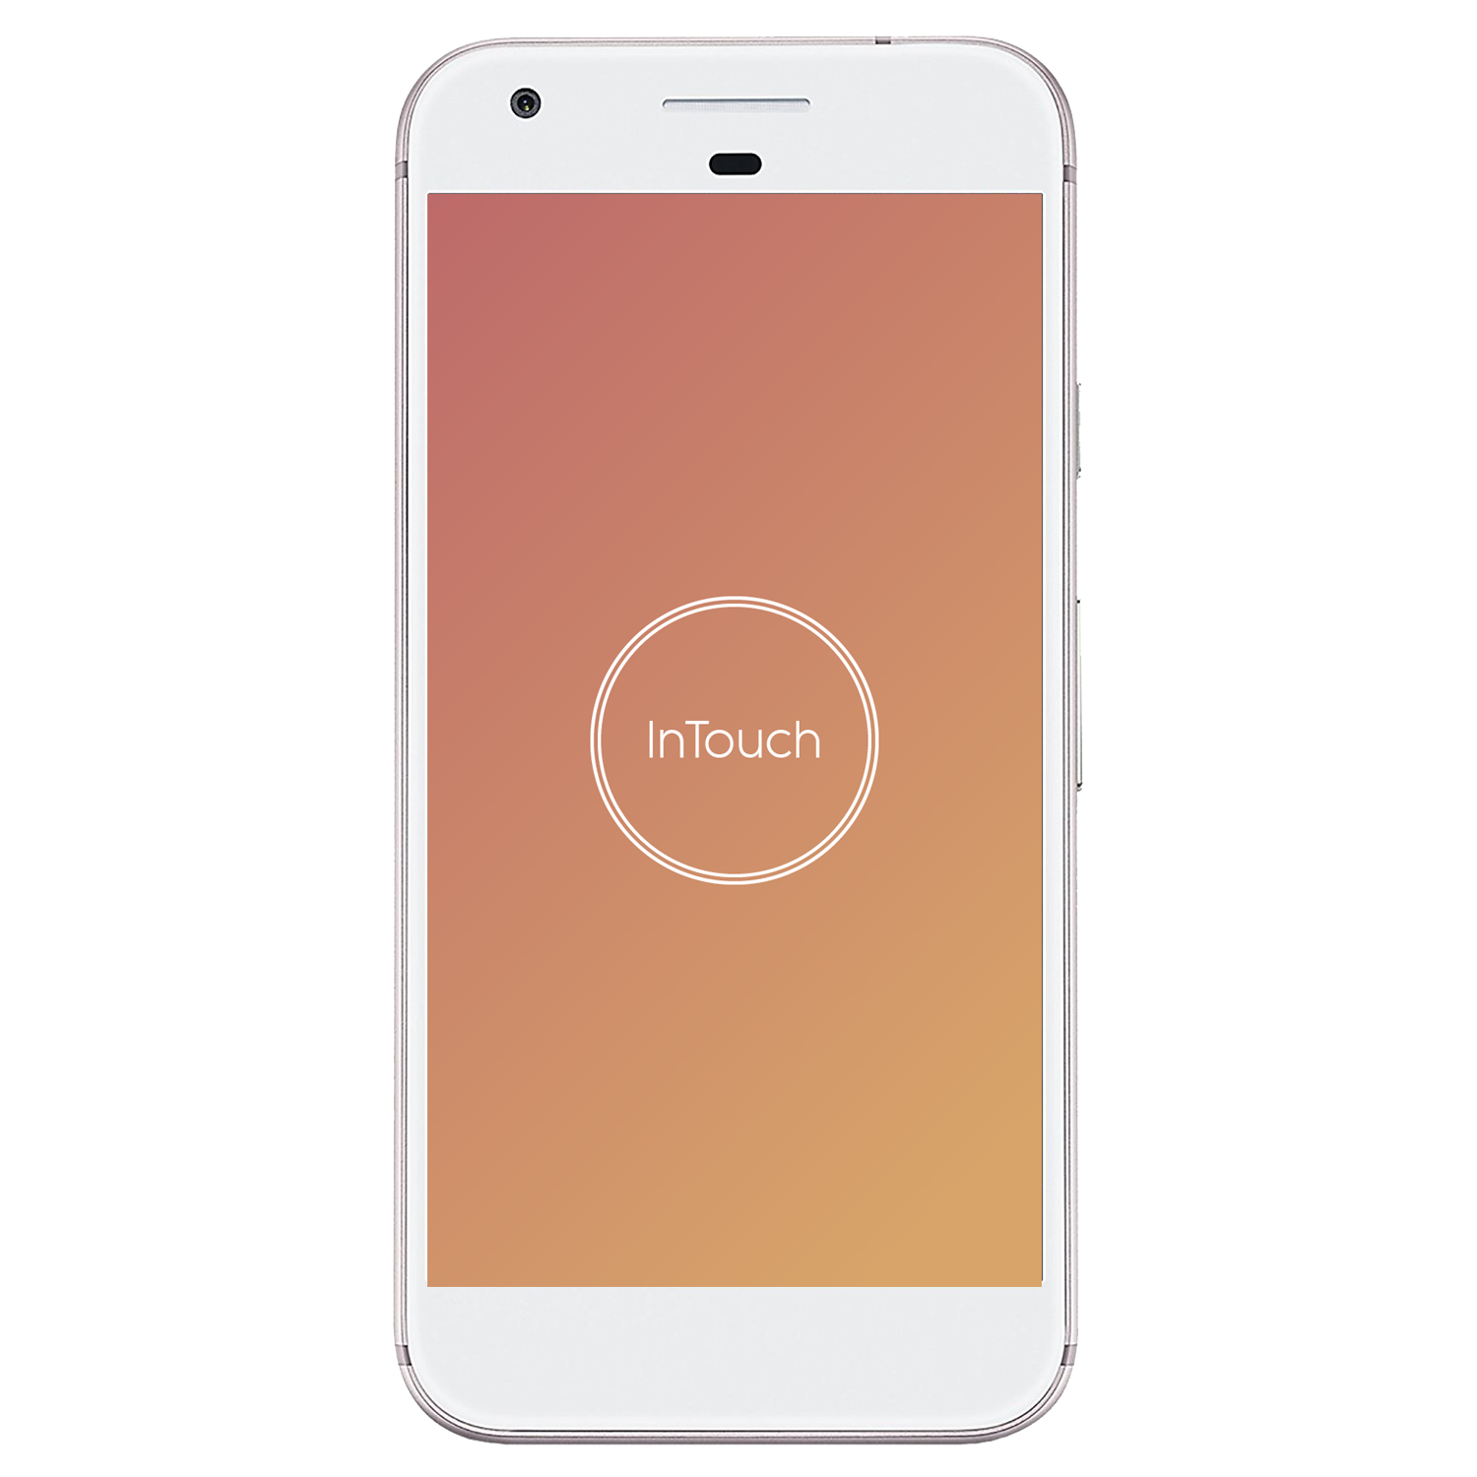
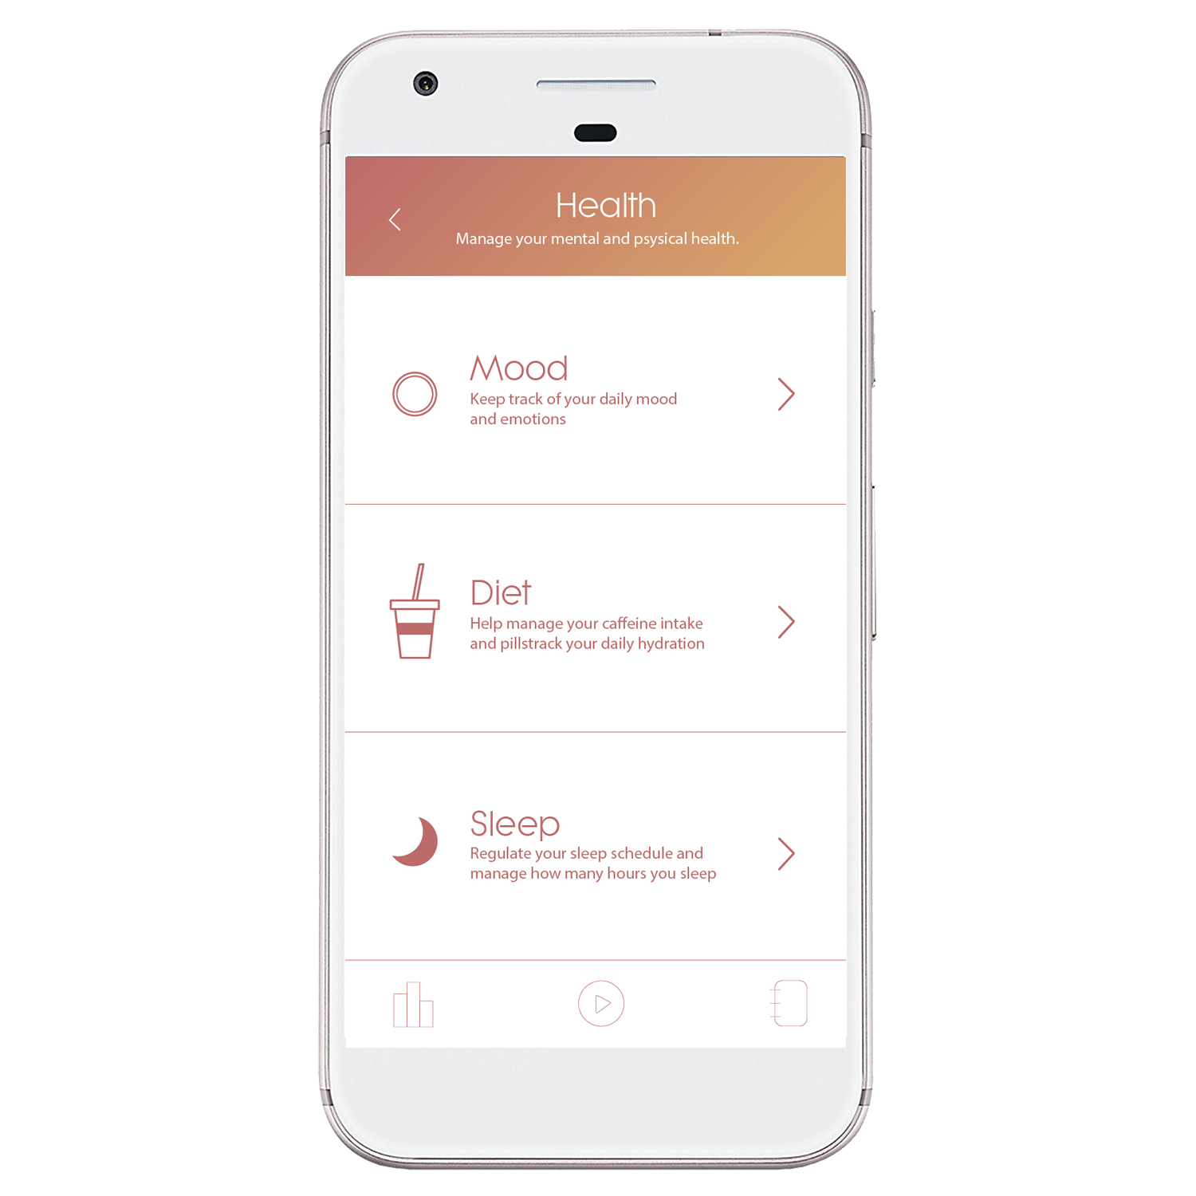
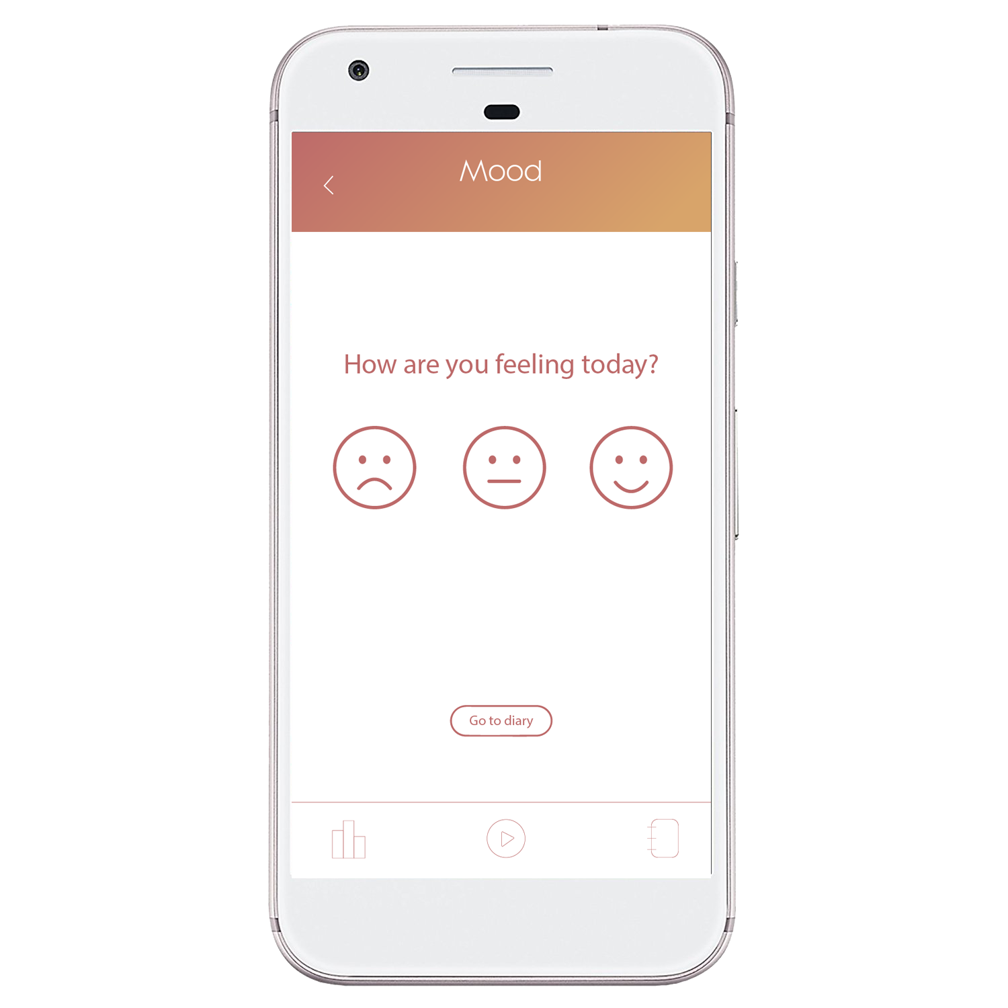
Designed to improve
daily lifestyle

Slide 7
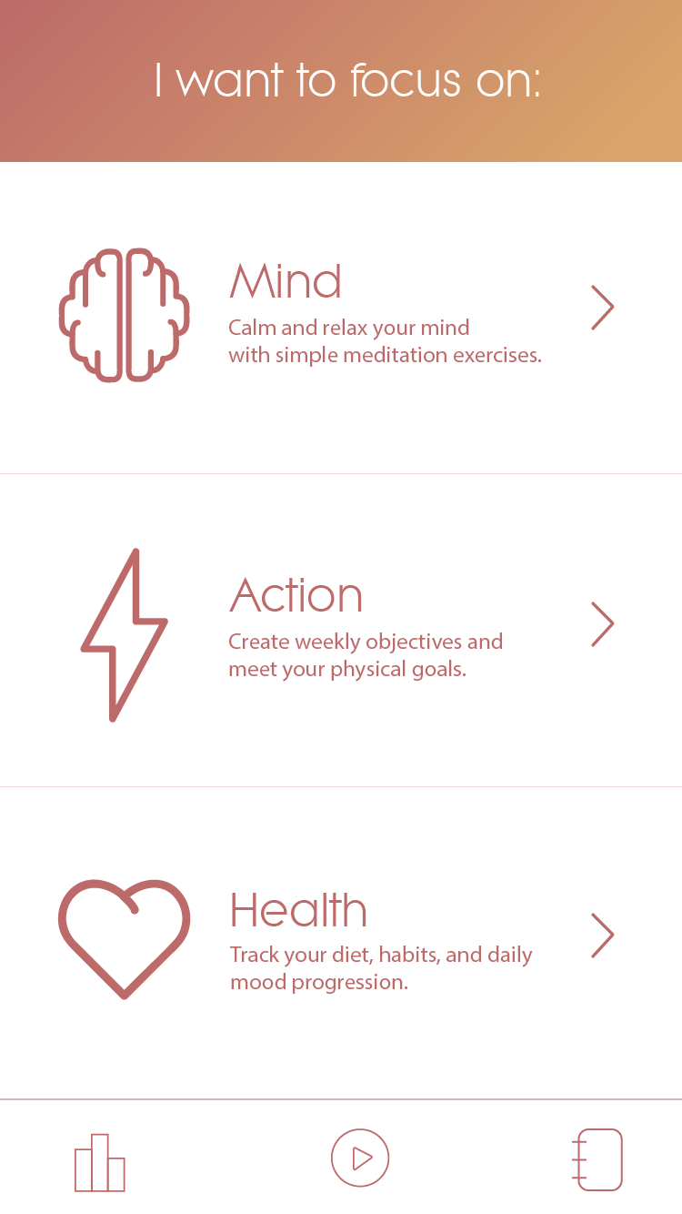
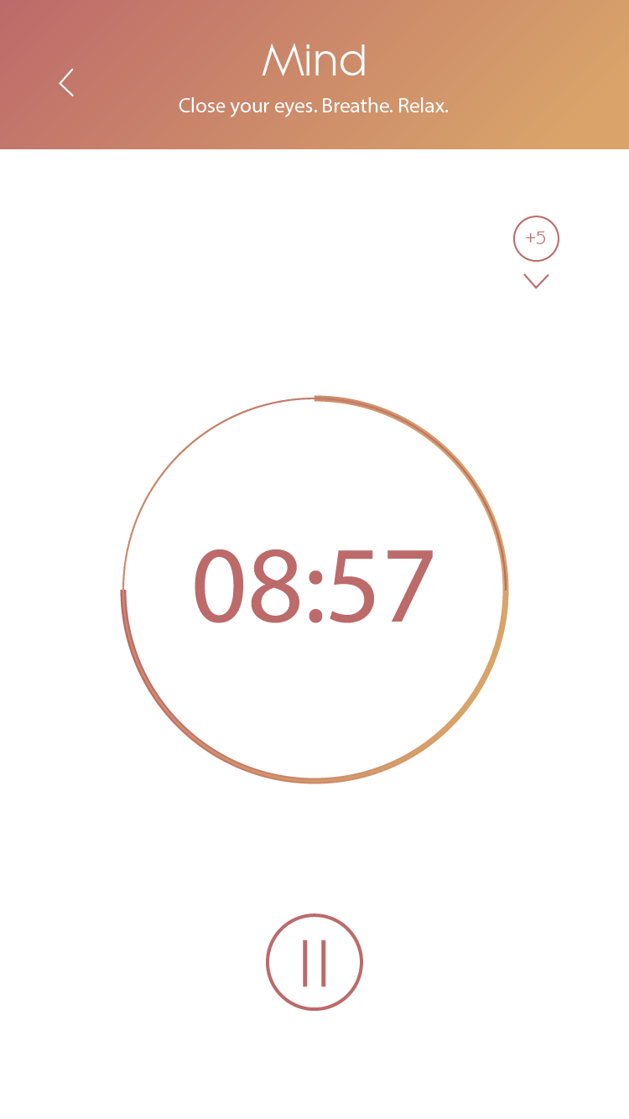
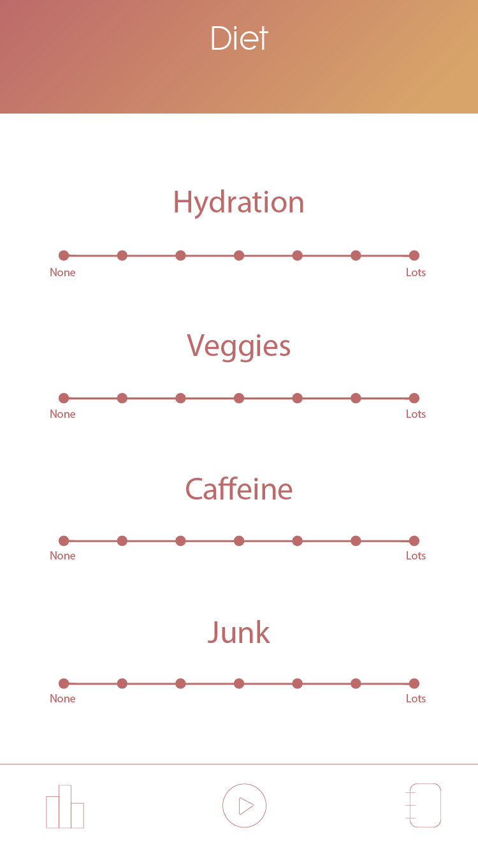

Slide 8
Created for families.

Slide 9
Created for families.
Created for students.

Slide 10
Created for families.
Created for students.
Created for me.

Slide 11
Created for families.
Created for students.
Created for me.
Created for you.

