Slide 1
Using Git with LabVIEW
Tools and processes for Windows

Slide 2
Who has previously used…
Bash/Git Bash?
Git?
Git with LabVIEW?

Slide 3
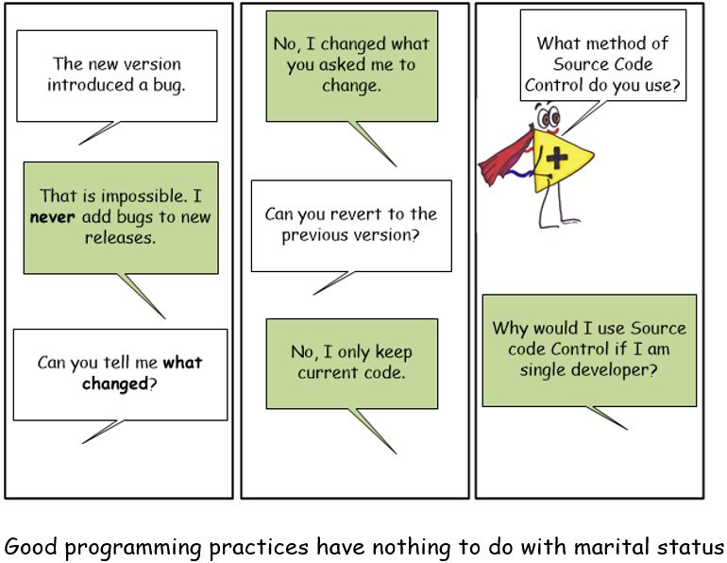

Slide 4
Git is
A distributed version control system (DCVS)
Use it to:
Store history
Go back in time
Split out features into “branches” until they’re ready for use
Compare two sets of history/state
Merge different sets of state

Slide 5
LabVIEW source files are binary code
This makes them difficult to do the previous things…
National Instruments provides two tools (with LabVIEW Professional Development version) to help with this issue
LVMerge
LVCompare
These are available for Windows, MacOS and Linux.
They provide graphical diff and merge tooling.

Slide 6
To get it working
Build the vidiff.exe and vimerge.exe executables from the project
Add bash shell scripts to handle paths and files
Add git config (global) to specify handling
Add a .gitattributes file to the repository to specify which tool to use for which file extensions

