Slide 1
Autonomous Multi-Cycle Farming in SPACE (AMCFIS)
Chris Millsap & Giampiero Corsbie
Client & Sponsor: Philip Chan PhD *hopefully NASA too*

Slide 2
Project Stakeholders
CSE Team:
Chris Millsap
Giampiero Corsbie
CSE Client/Sponsor:
Dr. Philip Chan
Potential Clients/Sponsors:
NASA
Companies that want prolonged human habitation in space and/or on other planets
Blue Origin Shepard Payloads
Other Interdisciplinary Members:
BIO:
POC: Dr. Andrew Palmer
David Masaitis
MEE:
Elisabeth Kames Ph.D. - Coordinator
Courtney Cline - MEE Project POC
Heat Transfer:
Dominic Allard
Joseph Luya
POC: Dr. Najafi
Electrical:
Bryce Johnson
Philip Bernhard
Chris Mateo
POC: Ken Gibbs
Materials:
Timothy Frazier
Joshua Calhoun
Kali Jenson

Slide 3
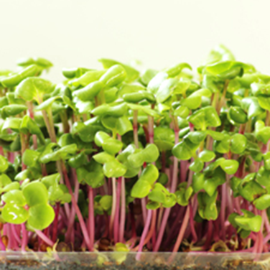
Motivation
Providing a renewable food source for astronauts
Sustain long term space missions
Free up time for astronauts
Expensive to deliver materials and resources in space

Slide 4
Goals
To achieve our goals we must design a system with high reliability, low power consumption, and ideal form factor. To do this the following software elements must be implemented:
Data from sensors will be used to make decisions at each phase of the cycle
Commanding various actuators to complete certain tasks
Timing sensors and actuators to match the growth cycle of the farm
Scheduling all the components to balance observation/action with energy efficiency to maximize throughput
Interfacing with the ISS lockers & other payload lockers (degrees of portability)

Slide 5
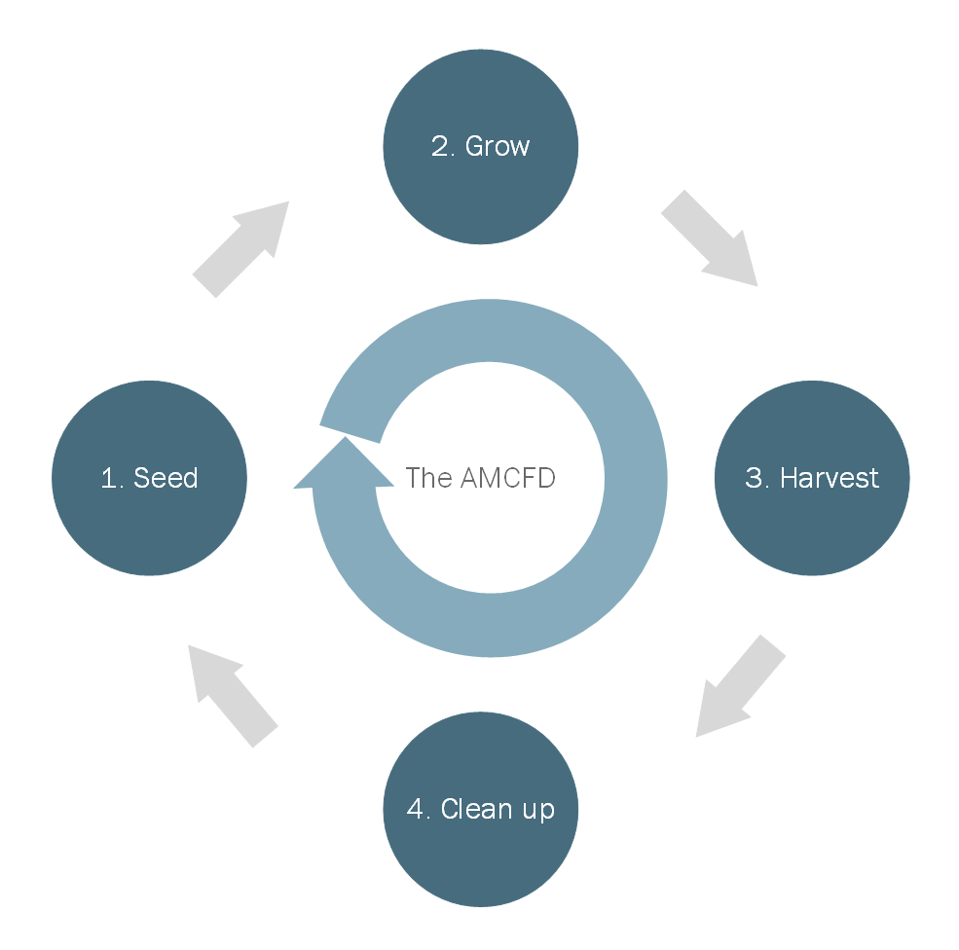
Approach
With the use of single-board computers and/or microcontrollers, the system will use cycle through the following stages:
Seed
Timing the actuators to plant the seeds
Using sensors to detect germination and transition
Grow
Use sensors to detect environment composition and trigger appropriate system responses. E.g. water, light, nitrogen, CO₂
Track plant growth and autonomously make adjustments
Harvest
Control actuators to remove mature plants
Control actuators to divide the harvest
Clean up
Remove particulates
Reorder all actuators and queues for the next cycle

Slide 6
Novel Features
Low-power autonomous multiple-cycle growth and harvesting of food for astronauts
Utilizing the latest in sensor, actuator, and software technology to protect and optimize throughput of said food
Detecting diseased or under-grown plants using vision-based data

Slide 7
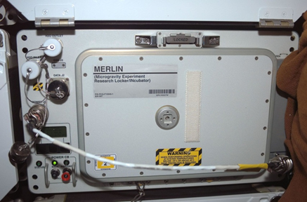
Technical Challenges
Programming microcontrollers, possibly in conjunction with and/or parallel to other single board computers
Scheduling of sensors and mechanical components to reduce energy consumption and maximise throughput in a microgravity environment
Communicating between sensors and mechanical components interfaced within the installed craft’s locker
Processing and abstracting sensor data in a new environment
Creating a custom embedded linux OS with yocto for power efficiency
New algorithms no one on the team has used before
Possibly Artificial Intelligence to detect diseased or dying plants

Slide 8
First Milestone
Choosing microcontroller
Decide on the development OS, Linux/Windows
Install and configure Visual Studio
Compare and select collaboration tools
Provide “Hello World” demos for selected tools
Create requirements document with client
Create design documents
Create test plan and matrices
Define change management process using agile
Work Breakdown Structure
Have interdisciplinary meeting with all stakeholders on project

Slide 9
Second and Third Milestone
Second
Create state diagram and design for the system
Implement inheritable high-level interfaces/classes for sensor communication
Create simulated farm for testing
Create baselining requirements and process
Third
Decide which set of computers/microcontrollers will be used to control the system
Implement C/C++ libraries for serial communication
Plan the design for a custom OS
Start development toolchain
Start a preliminary product breakdown structure
At least one sensor and actuator functioning according to some schedule and simulated environment

Slide 10
Some Resources
Horticulture:
http://old-hos.ifas.ufl.edu/faculty/alpaul - (Publications list)
https://www.nature.com/articles/npjmgrav201523
https://www.nasa.gov/feature/nasa-testing-method-to-grow-bigger-plants-in-space
https://www.nasa.gov/content/growing-plants-in-space
https://www.businessinsider.com/mit-student-invented-robot-for-food-in-space-2016-4
https://www.nasa.gov/feature/how-does-your-space-garden-grow
Payload design:
https://www.blueorigin.com/new-shepard/new-shepard-payloads/
https://www.nasa.gov/pdf/360394main_P05_0940_MSFC.pdf

Slide 11
Questions?
? ? ?

