Slide 1
Autonomous Multi-Cycle Farming in SPACE
Chris Millsap & Giampiero Corsbie
Client & Sponsor: Philip Chan PhD *hopefully NASA too*

Slide 2
Project Stakeholders
CSE Team:
Chris Millsap
Giampiero Corsbie
CSE Client/Sponsor:
Dr. Philip Chan
Potential Clients/Sponsors:
NASA
Companies that want prolonged human habitation in space and/or on other planets
Blue Origin Shepard Payloads
Other Interdisciplinary Members:
BIO:
POC: Dr. Andrew Palmer
David Masaitis
MEE:
Elisabeth Kames Ph.D. - Coordinator
Courtney Cline
Heat Transfer:
Dominic Allard
Joseph Luya
POC: Dr. Najafi
Electrical:
Bryce Johnson
Philip Bernhard
POC: Ken Gibbs
Materials:
Timothy Frazier
Joshua Calhoun
Kali Jenson

Slide 3
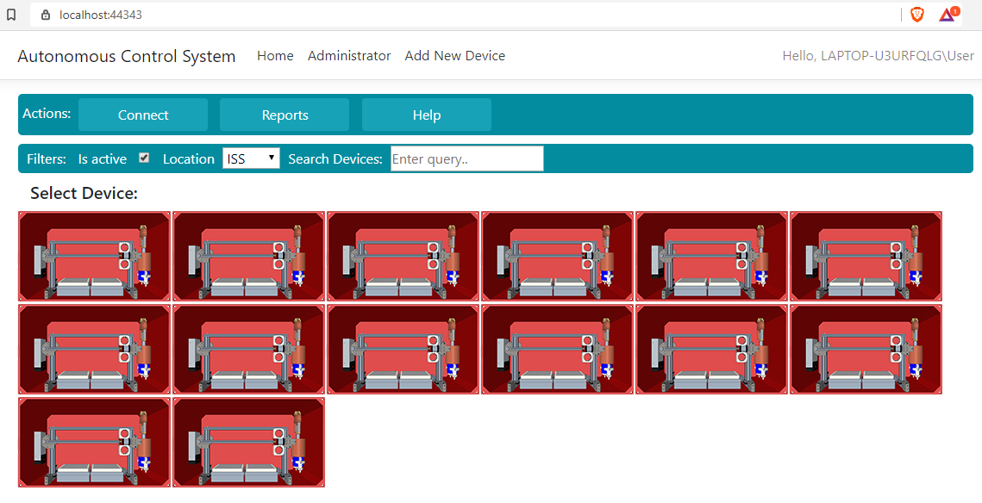
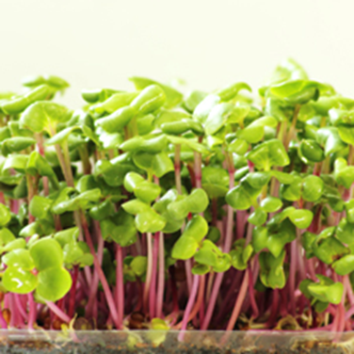
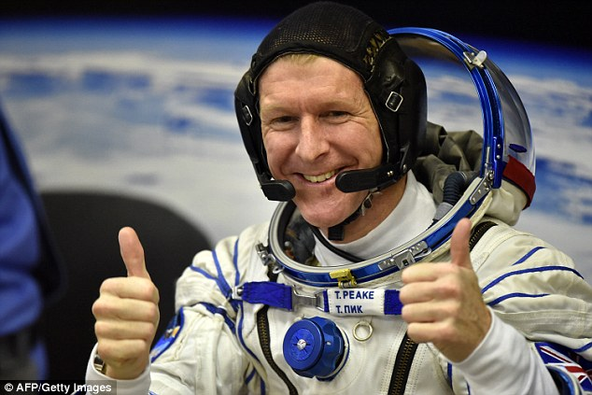
Motivation
Goals:
To provide a renewable food source for astronaut
High crop yield
In accordance with what NASA produces
Improve crew morale
Automate various parts of the device
Scheduling stability
Where the tasks of the device are completed correctly; on time, in expected order, & efficiently
An application
Providing configuration tools, reports, and manual control of the device

Slide 4

Novel Features
Low-power autonomous multiple-cycle growth and harvesting of food for astronauts
Utilizing the latest in sensor, actuator, and software technology to protect and optimize throughput of said food
Detecting diseased or under-grown plants using vision-based data
Web application that can run on Mac, Linux, and Windows to control autonomous device(s)
Library to store and access configurations for autonomous devices

Slide 5
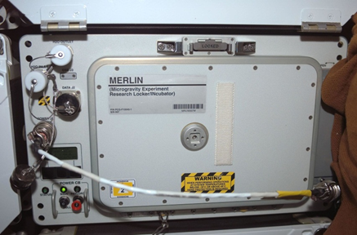


Technical Challenges
Programming microcontrollers, possibly in conjunction with and/or parallel to other single board computers.
Scheduling of sensors and mechanical components to reduce energy consumption and maximise throughput.
Communicating between sensors and mechanical components.
Processing and abstracting sensor data.
New algorithms no one on the team has used before.
Enterprise web application
Designing effective reports
USB and Wi-Fi communication

Slide 6
Progress Summary
Task | Progress
Design for application used to manage device: | 64%
Configuration Design for configuration library service where users can select new configurations for device, i.e. apples, lettuce, et | 50%
Reports System performance and status globally down to each individual subsystem of a single device Appropriate metrics and report hierarchy based on user selected feature | 50%
Manual control Stop, start, restart, pause, and reset | 90%
UX/UI survey for CS Forum with appropriate hierarchy based on what user selected | 100% (for now)
One actuator working on production control board | 100%
Testing progress | 30%

Slide 7
Progress Summary
All tasks from last semester completed

Slide 8
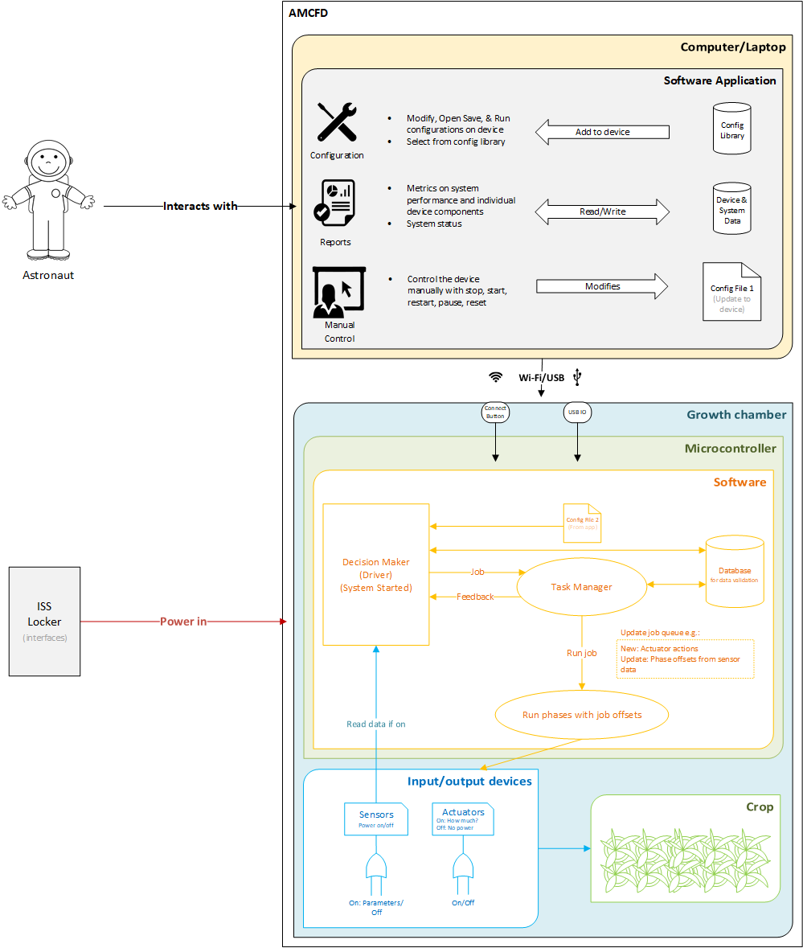
Approach
An application will be the one-stop-shop for managing and configuring the device(s):

Slide 9
Approach
An application will be the one-stop-shop for managing and configuring the device(s):
Builds gui and saves device configuration

Slide 10
Approach
An application will be the one-stop-shop for managing and configuring the device(s):
Saves device configuration, may be stored in db field. Modified when device is connected and config is updated.

Slide 11
Approach
An application will be the one-stop-shop for managing and configuring the device(s):
Saves device configuration, may be stored in db field. Modified when device is connected and config is updated.
Probably will be stored here

Slide 12
.NET Core web app attempt 1

Slide 13
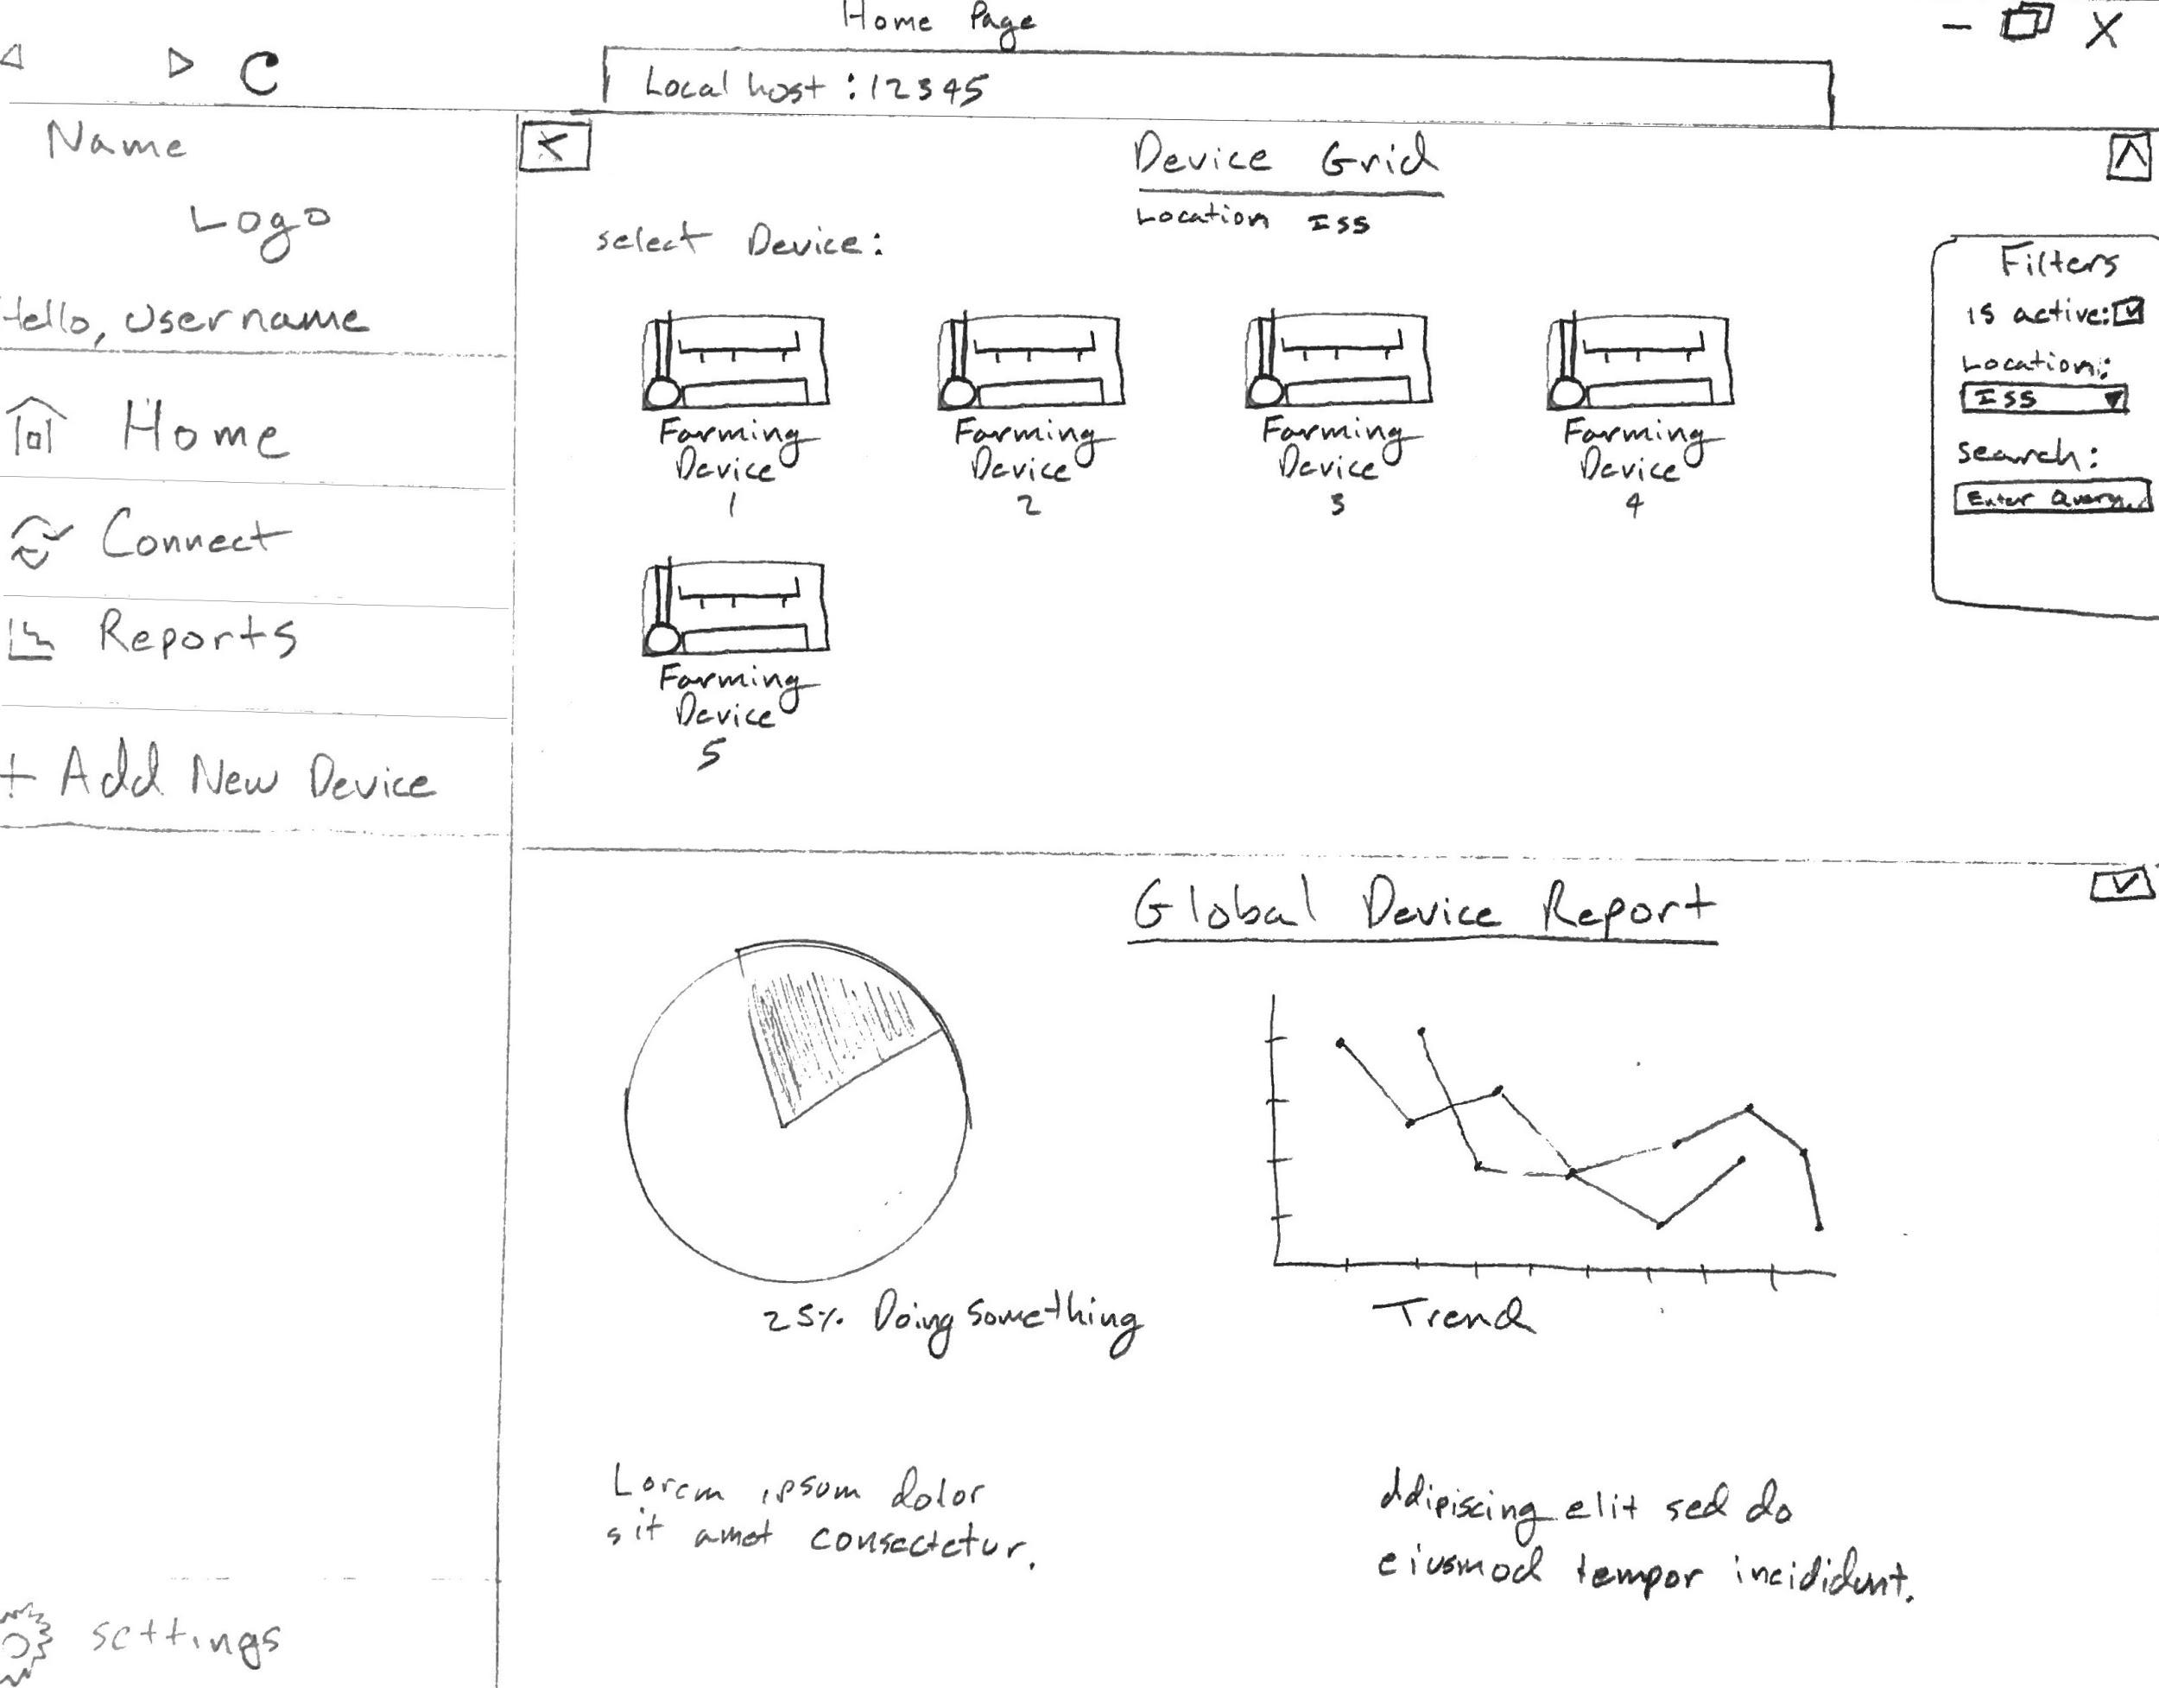
.NET Core web app design: Home Page

Slide 14
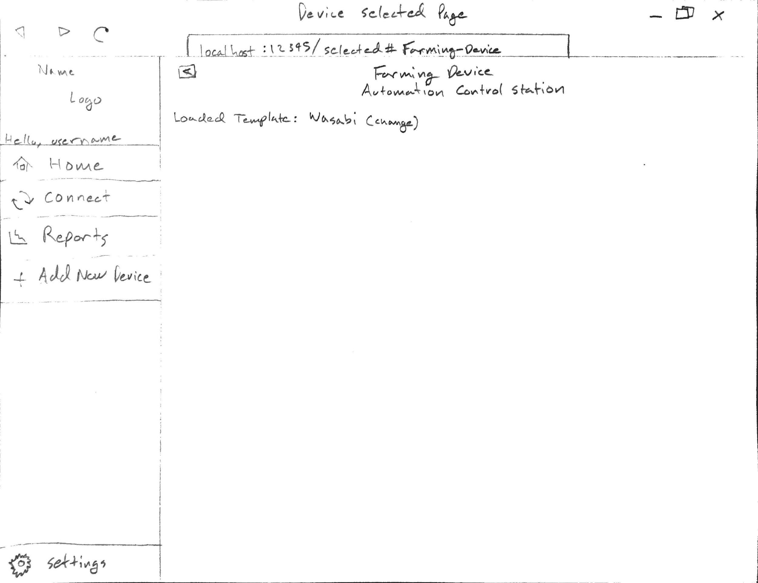
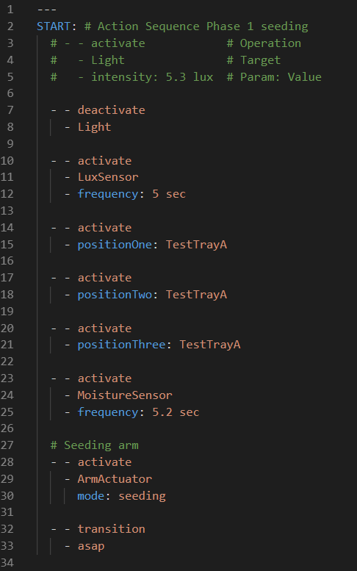
Config file 1 builds GUI here
.NET Core web app design: Device Selected Page

Slide 15
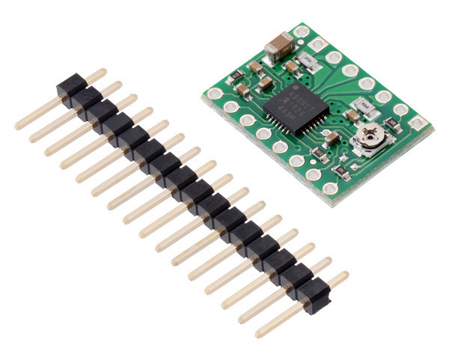
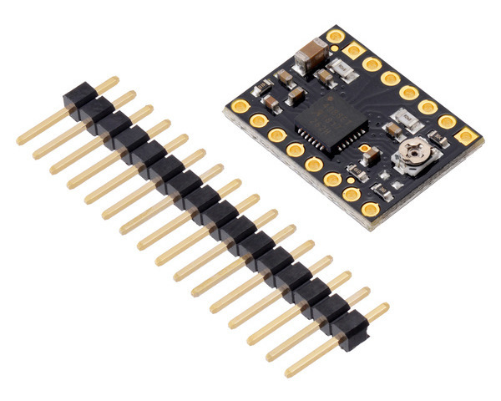
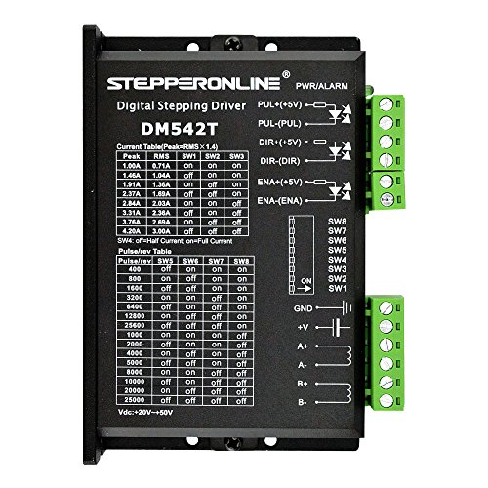
Progress
All milestone tasks prior to milestone 4 completed
Purchased three different models of driver to test
A4988 Stepper Motor Driver Carrier, Green version
A4988 Stepper Motor Driver Carrier, Black Edition
Delivers approximately 20% more current than the two-layer (green) version
STEPPERONLINE CNC Stepper Motor Driver
Created .NET Core app shown above
Tested system with two week run with no issues
Notes:
There are several reasons that adjusting the stepper driver current is important. If the current is too high the stepper motors themselves will get hot and are more likely to end up in your trash bin, and no one wants that, but on the other side if your current is to low, you will end up with shifted layers in your prints or movements that are inconsistent. If you are having the following issues you definitely need to check the driver current: Hot or extremely warm motors, Shifted Layers in middle of the print, odd pauses or inconsistent.

Slide 16
Fourth Milestone - Due February 17th
Design for application used to manage device
Configuration
Design for configuration library service where users can select new configurations for device, i.e. apples, lettuce, etc.
Reports
System performance and status globally down to each individual subsystem of a single device
Appropriate metrics and report hierarchy based on user selected feature
Reporting solutions
Manual control
Stop, start, restart, pause, and reset
UX/UI survey for CS Forum
Appropriate hierarchy based on what user selected
One production actuator working on control board
Not working in system
Testing progress
Notes:
Reporting solutions used telerik, can use something like My-FyiReporting

Slide 17
Fifth & Sixth Milestone
Fifth Milestone - Due March 23rd
Functional setup of actual actuators and sensors working with system
Seeding head on track
Light and fan
Linear actuator
Nema motors
Moisture sensor
Working POC of application to configure and manage device
Working config feature - low priority
Metrics for reports
Testing rules in SonarQube
Testing scripts
Sixth Milestone - Due April 20th
Finalized build of device with system
Finished application
Finished download service
Final user manual
Finished reports
Testing
User manual complete draft
Evaluation on:
Crop yield
Multicycle experiments and tests
Failure and success criteria

Slide 18
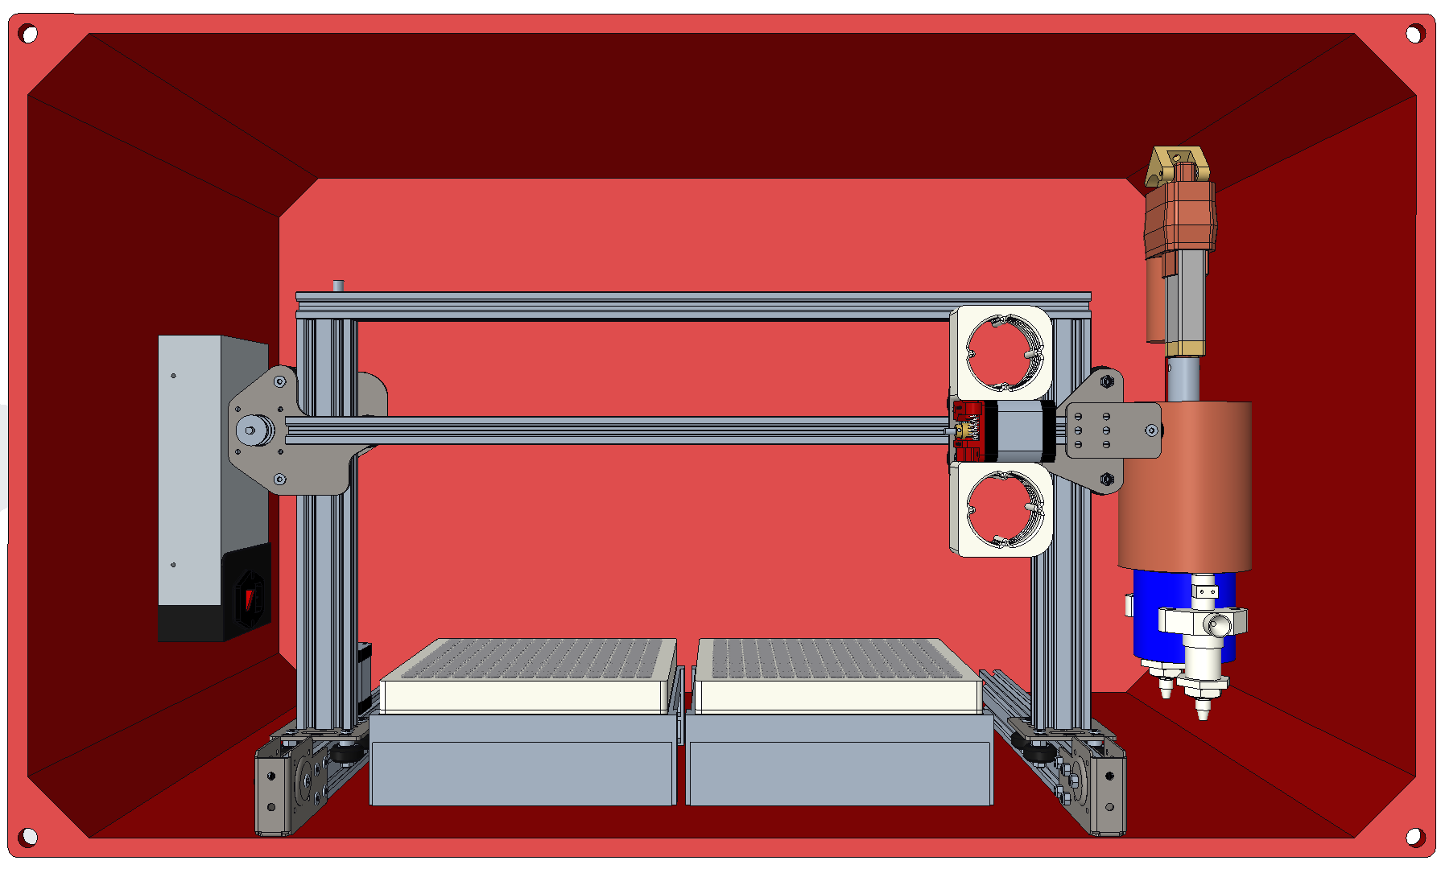

Slide 19
Questions?

