Slide 1
Autonomous Multi-Cycle Farming in SPACE (AMCFIS)
Chris Millsap & Giampiero Corsbie
Client & Sponsor: Philip Chan PhD *hopefully NASA too*

Slide 2
Project Stakeholders
CSE Team:
Chris Millsap
Giampiero Corsbie
CSE Client/Sponsor:
Dr. Philip Chan
Potential Clients/Sponsors:
NASA
Companies that want prolonged human habitation in space and/or on other planets
Blue Origin Shepard Payloads
Other Interdisciplinary Members:
BIO:
POC: Dr. Andrew Palmer
David Masaitis
MEE:
Elisabeth Kames Ph.D. - Coordinator
Courtney Cline
Heat Transfer:
Dominic Allard
Joseph Luya
POC: Dr. Najafi
Electrical:
Bryce Johnson
Philip Bernhard
Chris Mateo
POC: Ken Gibbs
Materials:
Timothy Frazier
Joshua Calhoun
Kali Jenson

Slide 3
Motivation
Current goals:
High crop yield
In accordance with what NASA produces
Scheduling stability
Where the tasks of the device are completed correctly; on time, in expected order, & efficiently

Slide 4
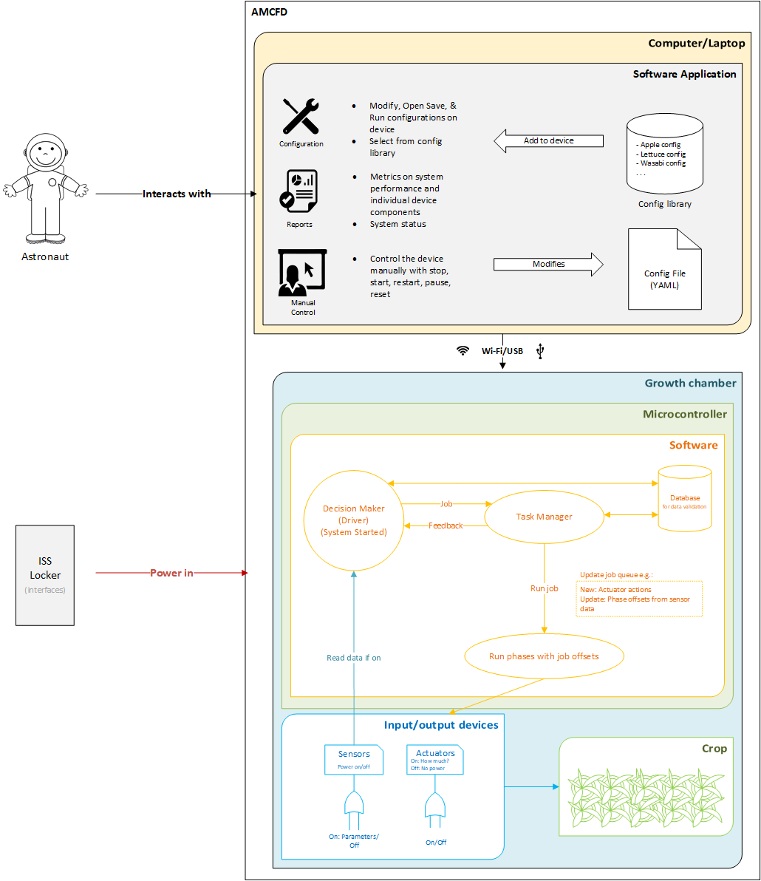
Approach
An application will be a one-stop-shop for managing and configuring the device(s):

Slide 5
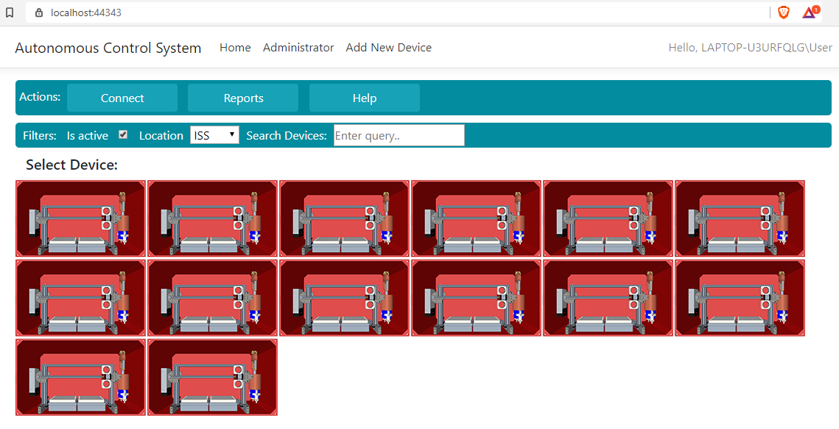
.NET Core web app attempt 1

Slide 6
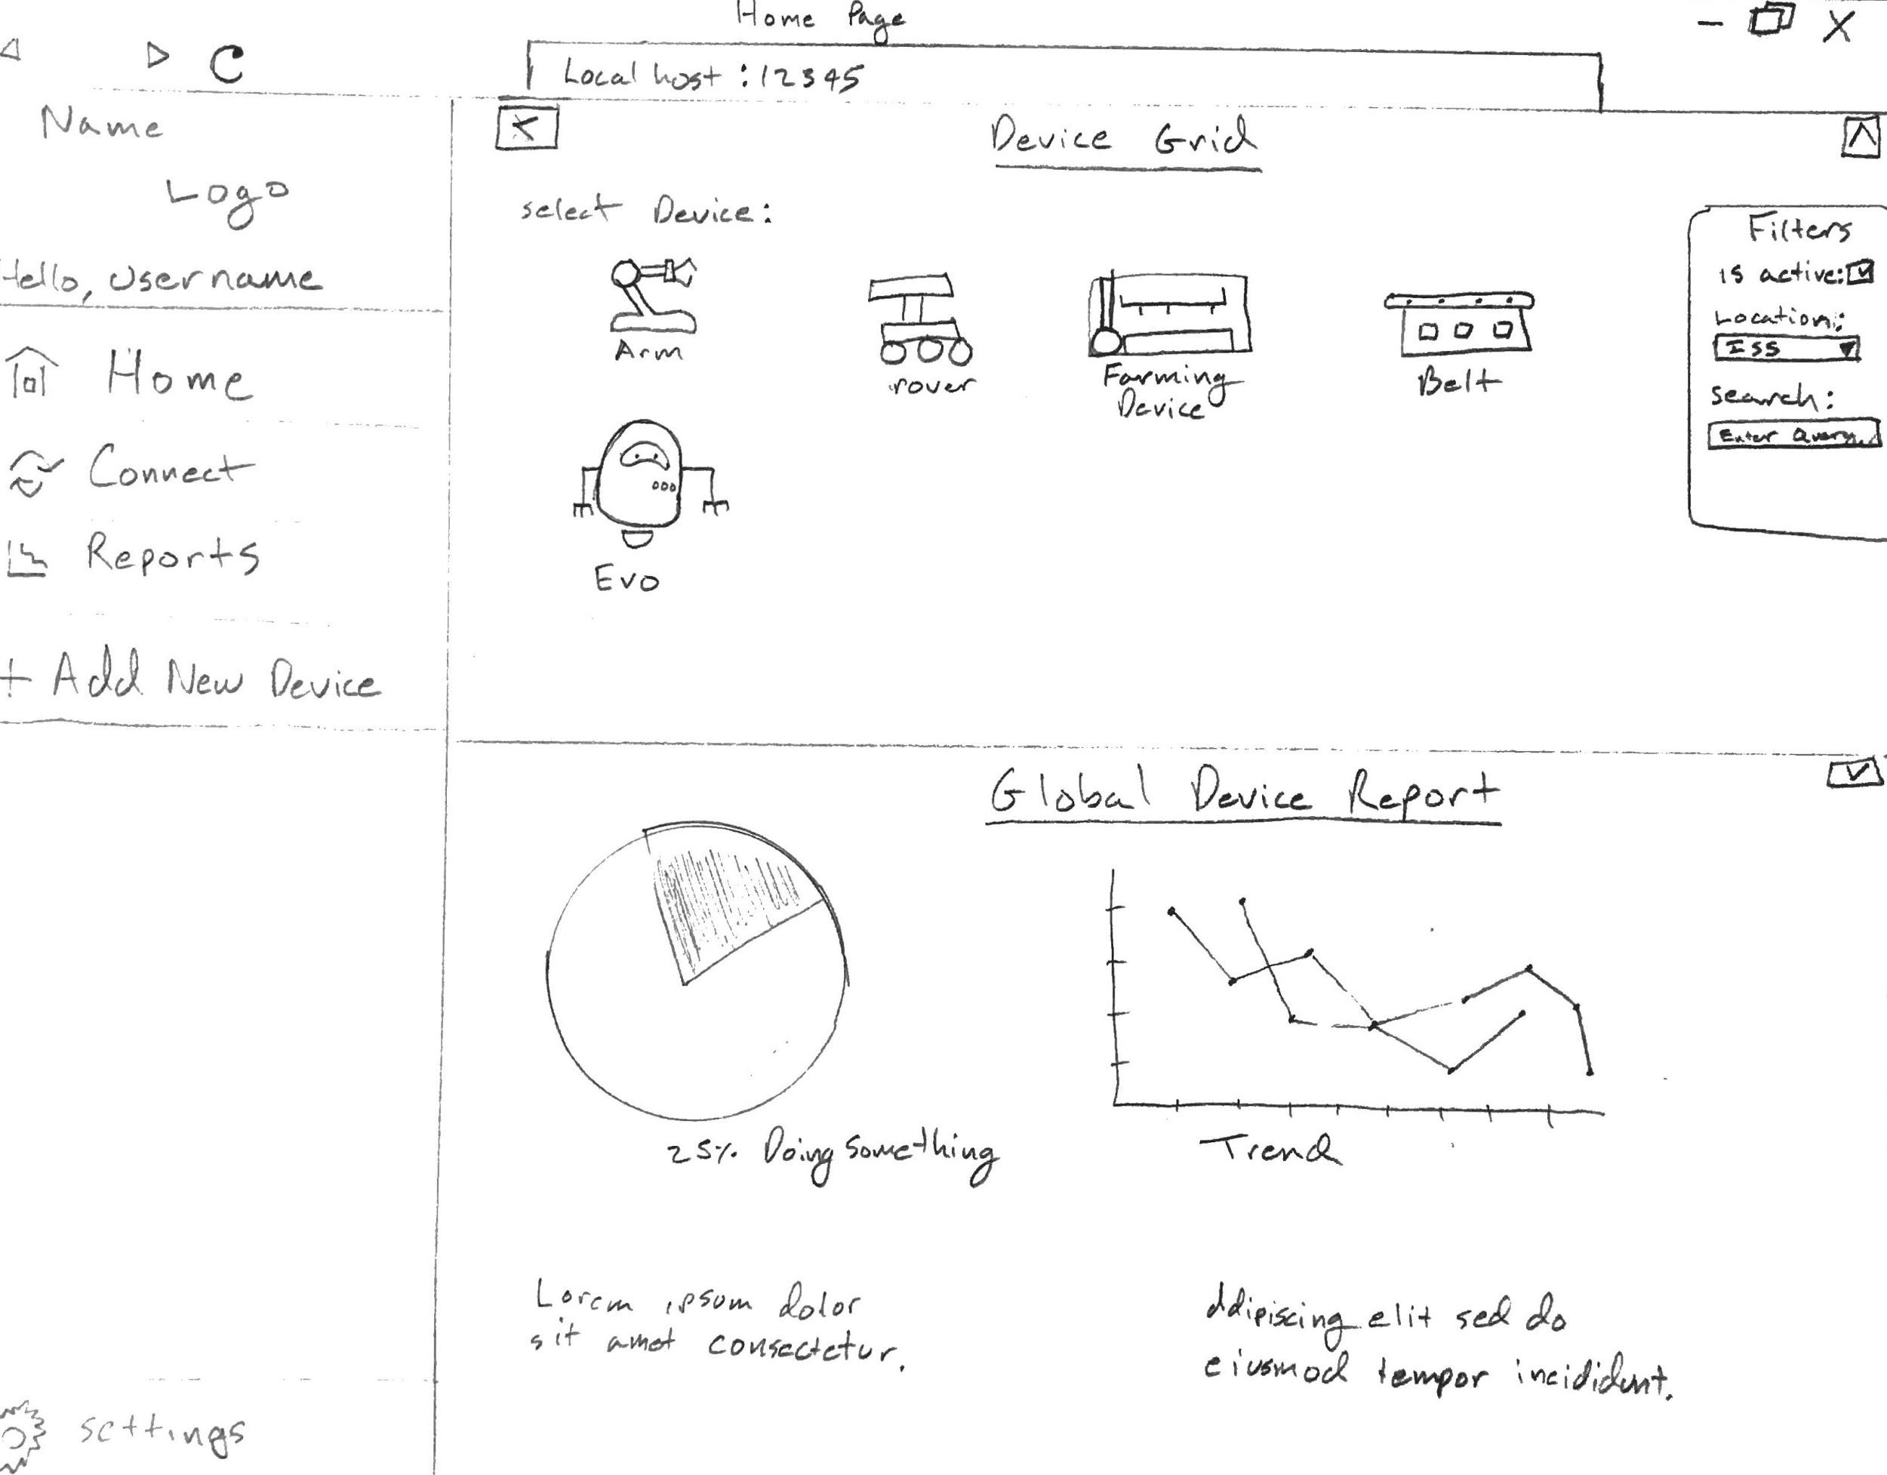

Slide 7
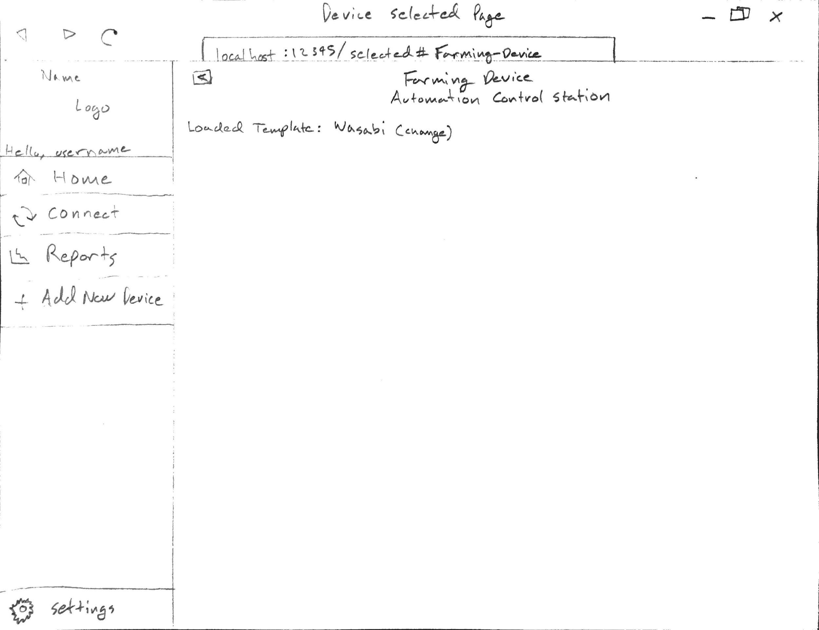
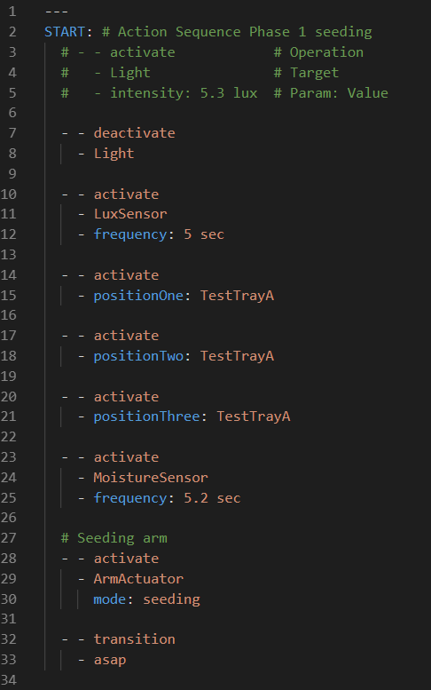
Config file builds GUI here

Slide 8
Novel Features
Low-power autonomous multiple-cycle growth and harvesting of food for astronauts
Utilizing the latest in sensor, actuator, and software technology to protect and optimize throughput of said food
Detecting diseased or under-grown plants using vision-based data
Web application that can run on Mac, Linux, and Windows to control autonomous devices.
Library to store and access configurations for autonomous devices.

Slide 9
Technical Challenges
Client/Server design
Enterprise web application
Designing effective reports
USB and Wi-Fi communication

Slide 10
Fourth Milestone - Due February 17th
Design for application used to manage device
Configuration
Design for configuration library service where users can select new configurations for device, i.e. apples, lettuce, etc.
Reports
System performance and status globally down to each individual subsystem of a single device
Appropriate metrics and report hierarchy based on user selected feature
Manual control
Stop, start, restart, pause, and reset
UX/UI survey for CS Forum
Appropriate hierarchy based on what user selected
One production actuator working on control board
Not working in system
Testing progress

Slide 11
Fifth & Sixth Milestone
Fifth Milestone - Due March 23rd
Functional setup of actual actuators and sensors working with system
Seeding head on track
Light and fan
Linear actuator
Nema motors
Moisture sensor
Working POC of application to configure and manage device
Working config download service - low priority should be easy
Metrics for reports
Testing rules in SonarQube
Testing scripts
Sixth Milestone - Due April 20th
Finalized build of device with system
Finished application
Finished download service
Final user manual
Finished reports
Testing
User manual complete draft
Evaluation on:
Crop yield
Multicycle experiments and tests
Failure and success criteria

Slide 12
Questions?

