Slide 1
Autonomous Multi-cycle Farming in Space
Christopher Millsap , Giampiero Corsbie
Client/ Sponsor: Dr. Philip Chan

Slide 2
Task | Progress
Design for application used to manage device: | 64%
Configuration Design for configuration library service where users can select new configurations for device, i.e. apples, lettuce, et | 50%
Reports System performance and status globally down to each individual subsystem of a single device Appropriate metrics and report hierarchy based on user selected feature | 50%
Manual control Stop, start, restart, pause, and reset | 90%
UX/UI survey for CS Forum with appropriate hierarchy based on what user selected | 100% (for now)
One actuator working on production control board | 100%
Testing progress | 30%

Slide 3
Device Progress

Slide 4
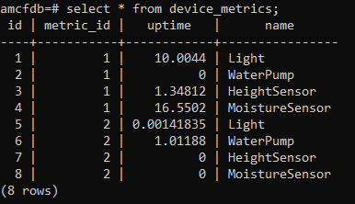
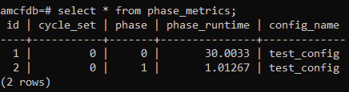
Metrics
The system now will record metrics in its local (client-side) database after every phase, or on restart or shutdown.
Cycle Set
System uptime
Total Phase uptime
Actuator phase uptime
Sensor phase uptime
Todo:
Sensor readings

Slide 5
Manual Control - Commands
The system can now be controlled manually via the database, where command history is also recorded.
Available commands include:
Pause - Halts the system and any running actuator system threads.
Resume - Resumes the system and any running actuator system threads.
Restart - Will reset actuators systems, record their metrics for the current phase, then reload the config on disk before starting from phase 0.
Shutdown - Saves the current state of the system (just cycle_set for now) then resets actuator systems and shuts down.

Slide 6
Manual Control - Event Handler
The event handler is a parallel thread that includes a listener for database changes corresponding with commands.
The database includes a trigger that creates a notification event that is picked up by the listener in the event handler. The event handler then sets flags that are read by the main thread.

Slide 7
New Config Features - Global Settings
The user can now specify global settings in the first YAML “page” of the system config. Currently the only value being used is the name for the current config.

Slide 8
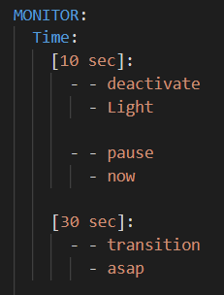
New Config Features - Schedulable Pause
The user can now schedule pause commands to halt the system and let it await a resume command. It functions similar to a transition command where “asap” or “now” can be specified. If not specified, it will default to “now”.

Slide 9
New Config Features - Monitoring Time
The user can now set the system to monitor time in the MONITOR section of the config. The scheduled actions for a time will be scheduled only once after the runtime of the executed phase has passed the time specified. Sleep times are also accounted for.

Slide 10
Hardware

Slide 11
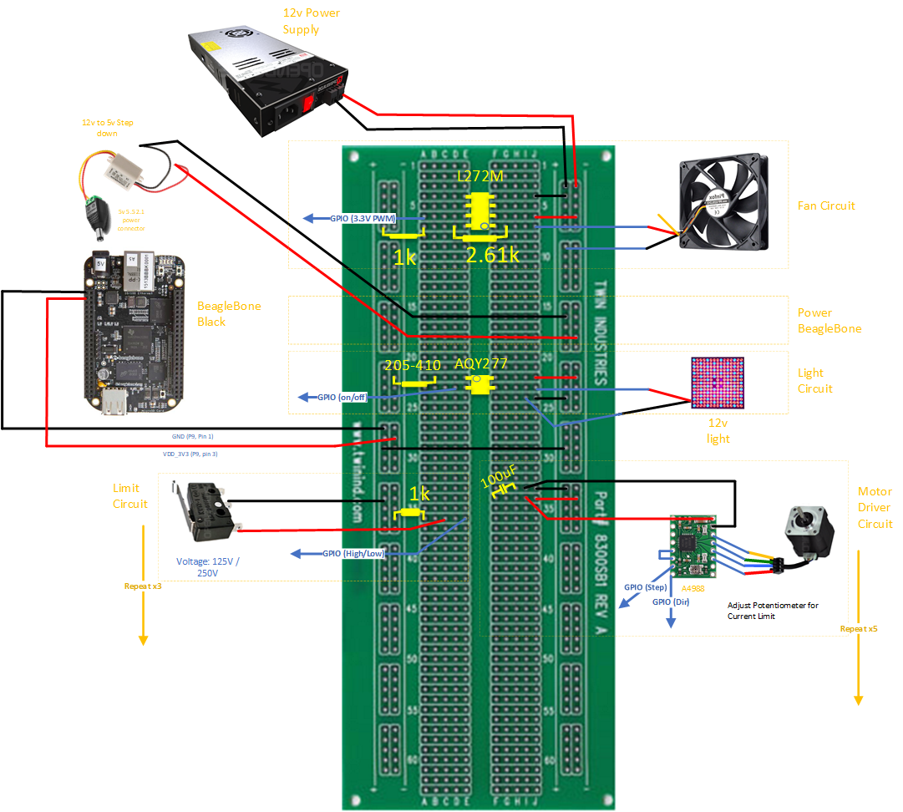
Board Design
Demo Limit switch:
Notes:
Operational Amplifiers: needed for PWM so we can control fan speed
Relay: Switch high voltage
Capacitor 100uf based on what the driver documentation said

Slide 12
Application Progress

Slide 13
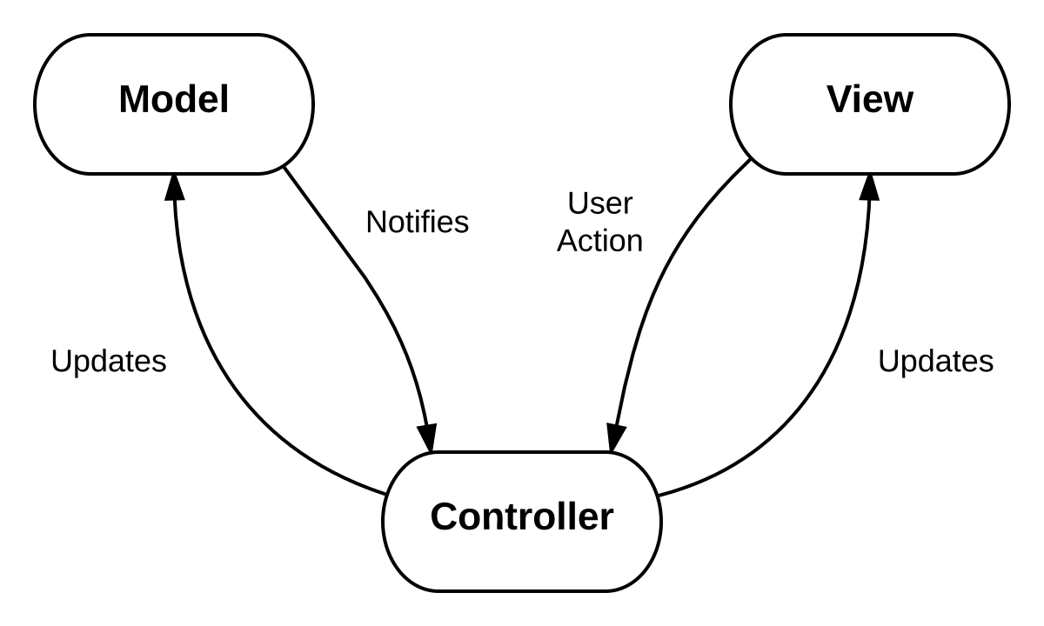
Design Paradigm
YAML values to JS/CSHTML for reports and/or config page
YAML Serialized
ds
YAML Parser

Slide 14
Design Paradigm
DB values to JS for reports
DB Values ds
DB Parser

Slide 15
Application
Can edit certain elements of config file
Can send commands to device
TODO:
Start, restart, pause, shutdown, resume (buttons)
TODO:
Parsing problem
Biggest issue is representing Dictionary as a key with a list or tuple of values that the YAML DotNet parser can accept
Selection and user interaction for clickable items
Hover mouse pointer hand
Highlighted/underlined

Slide 16
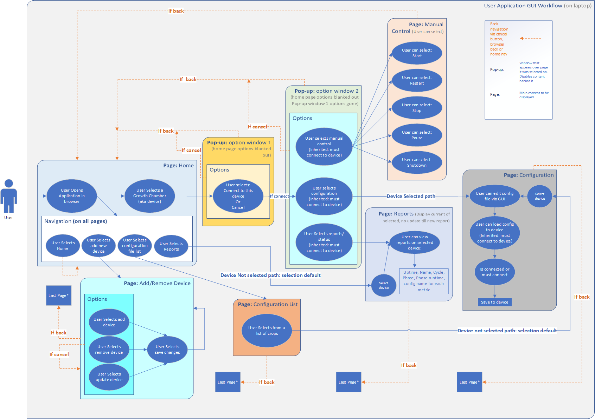

Slide 17
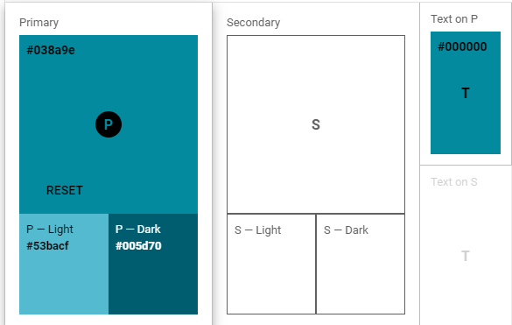
Application - Color

Slide 18
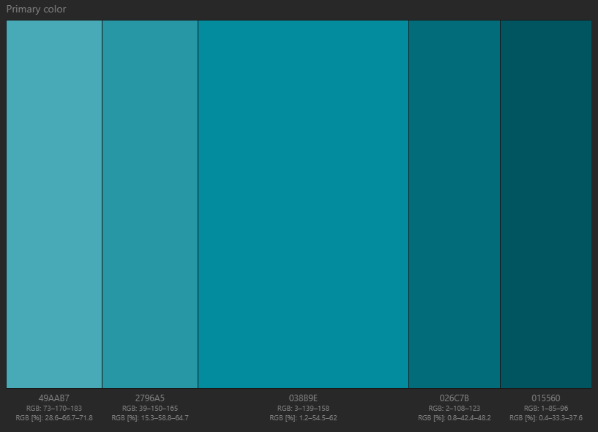
Application - Color

Slide 19
Survey/Design

Slide 20
Design
Flat
Responsive
Icons based on:
https://material.io/resources/icons/?style=baseline
https://google.github.io/material-design-icons/
Colors NASA Blue with Plant Green
Inspirations: growth and life
Smooth transitions between elements
Lightweight

Slide 21
Color

Slide 22
Color

Slide 23
Survey
For them:
A concise description of the product
A series of use cases to map responses to expected values
For us:
Which GUI element(s) gives the largest deviation?
Which GUI element(s) does not allow for expected user workflow?
What the user prefers when given choices of GUI elements
Pros and cons of certain elements
Users:
Ideally astronauts since their workflow efficiency is important
Students and faculty for general opinions on design and experience feedback

Slide 24
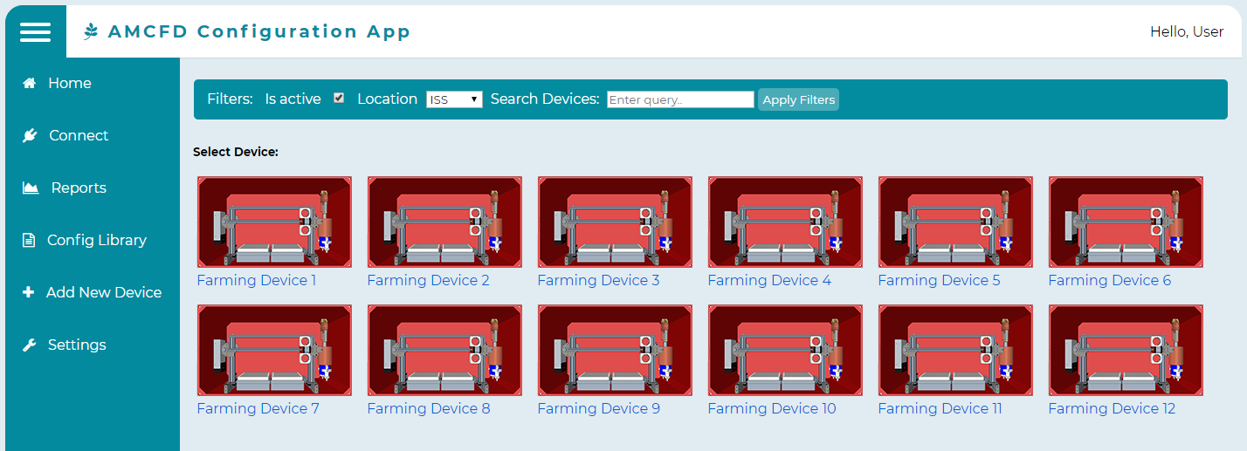
You are asked to browse for a new crop to try
Which button do you select?
A
D
B
C
E

Slide 25
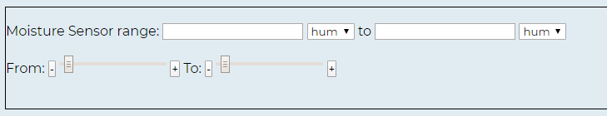
You are asked to adjust the parameters on Moisture Sensor
Do you use the sliders and/or enter in the values? - more specific to the astronaut

Slide 26
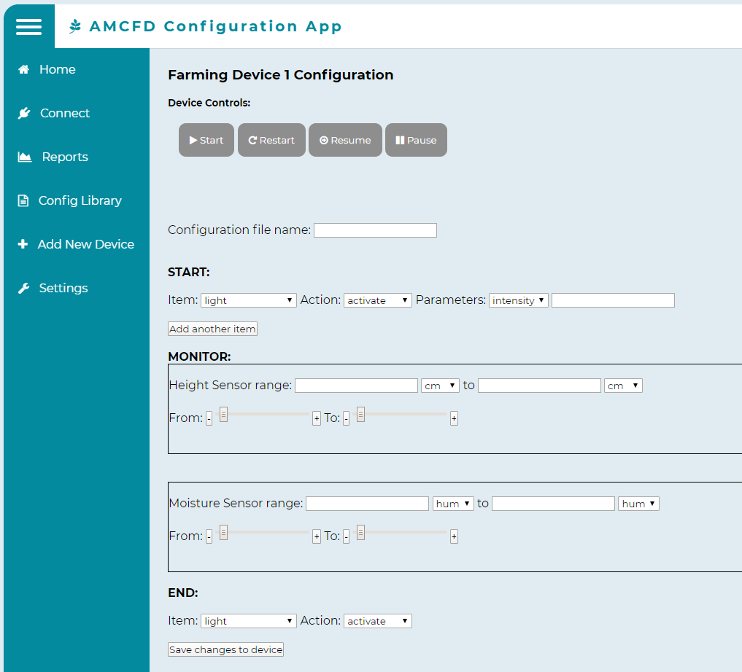
You are asked to start the device.
Where do you look first?

Slide 27
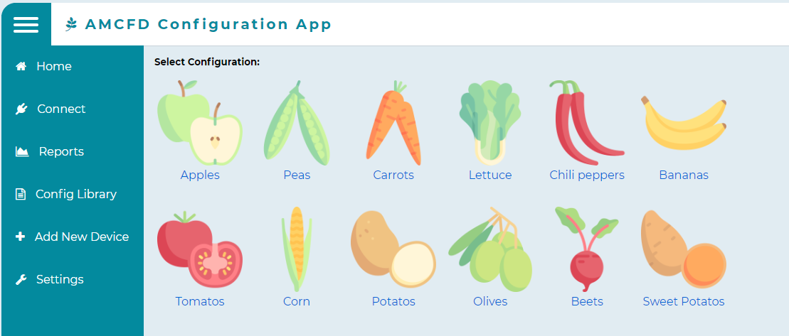
Table of crops:

Slide 28
Table of crops:
These elements, though pretty, may be distracting or costly on resources.

Slide 29
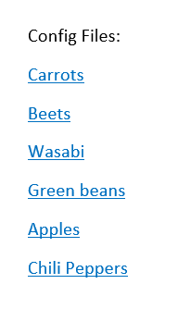
Or simple list?

