Slide 1
Autonomous Multi-cycle Farming in Space
Christopher Millsap , Giampiero Corsbie
Client/ Sponsor: Dr. Philip Chan

Slide 2
Milestone 2
Task | Giampiero | Christopher | Completion | To Do
Create state diagram for the system | Responsible - 50% | Responsible - 50% | 100% | none
Implement inheritable high-level interfaces/classes for sensor/actuator communication | Responsible - 50% | Responsible - 50% | 100% | Branch Actuator into ActuatorSwitch and ActuatorSystem
Create simulated farm for testing | Responsible - 50% Test | Responsible - 50% Test/Demo |  | Create simulated farm for all phases
Create a configuration file for at least one phase in system and run in simulation | Responsible - 75% Test/Demo | Responsible - 25% Test/Demo | 100% | Determine config file readability

Slide 3
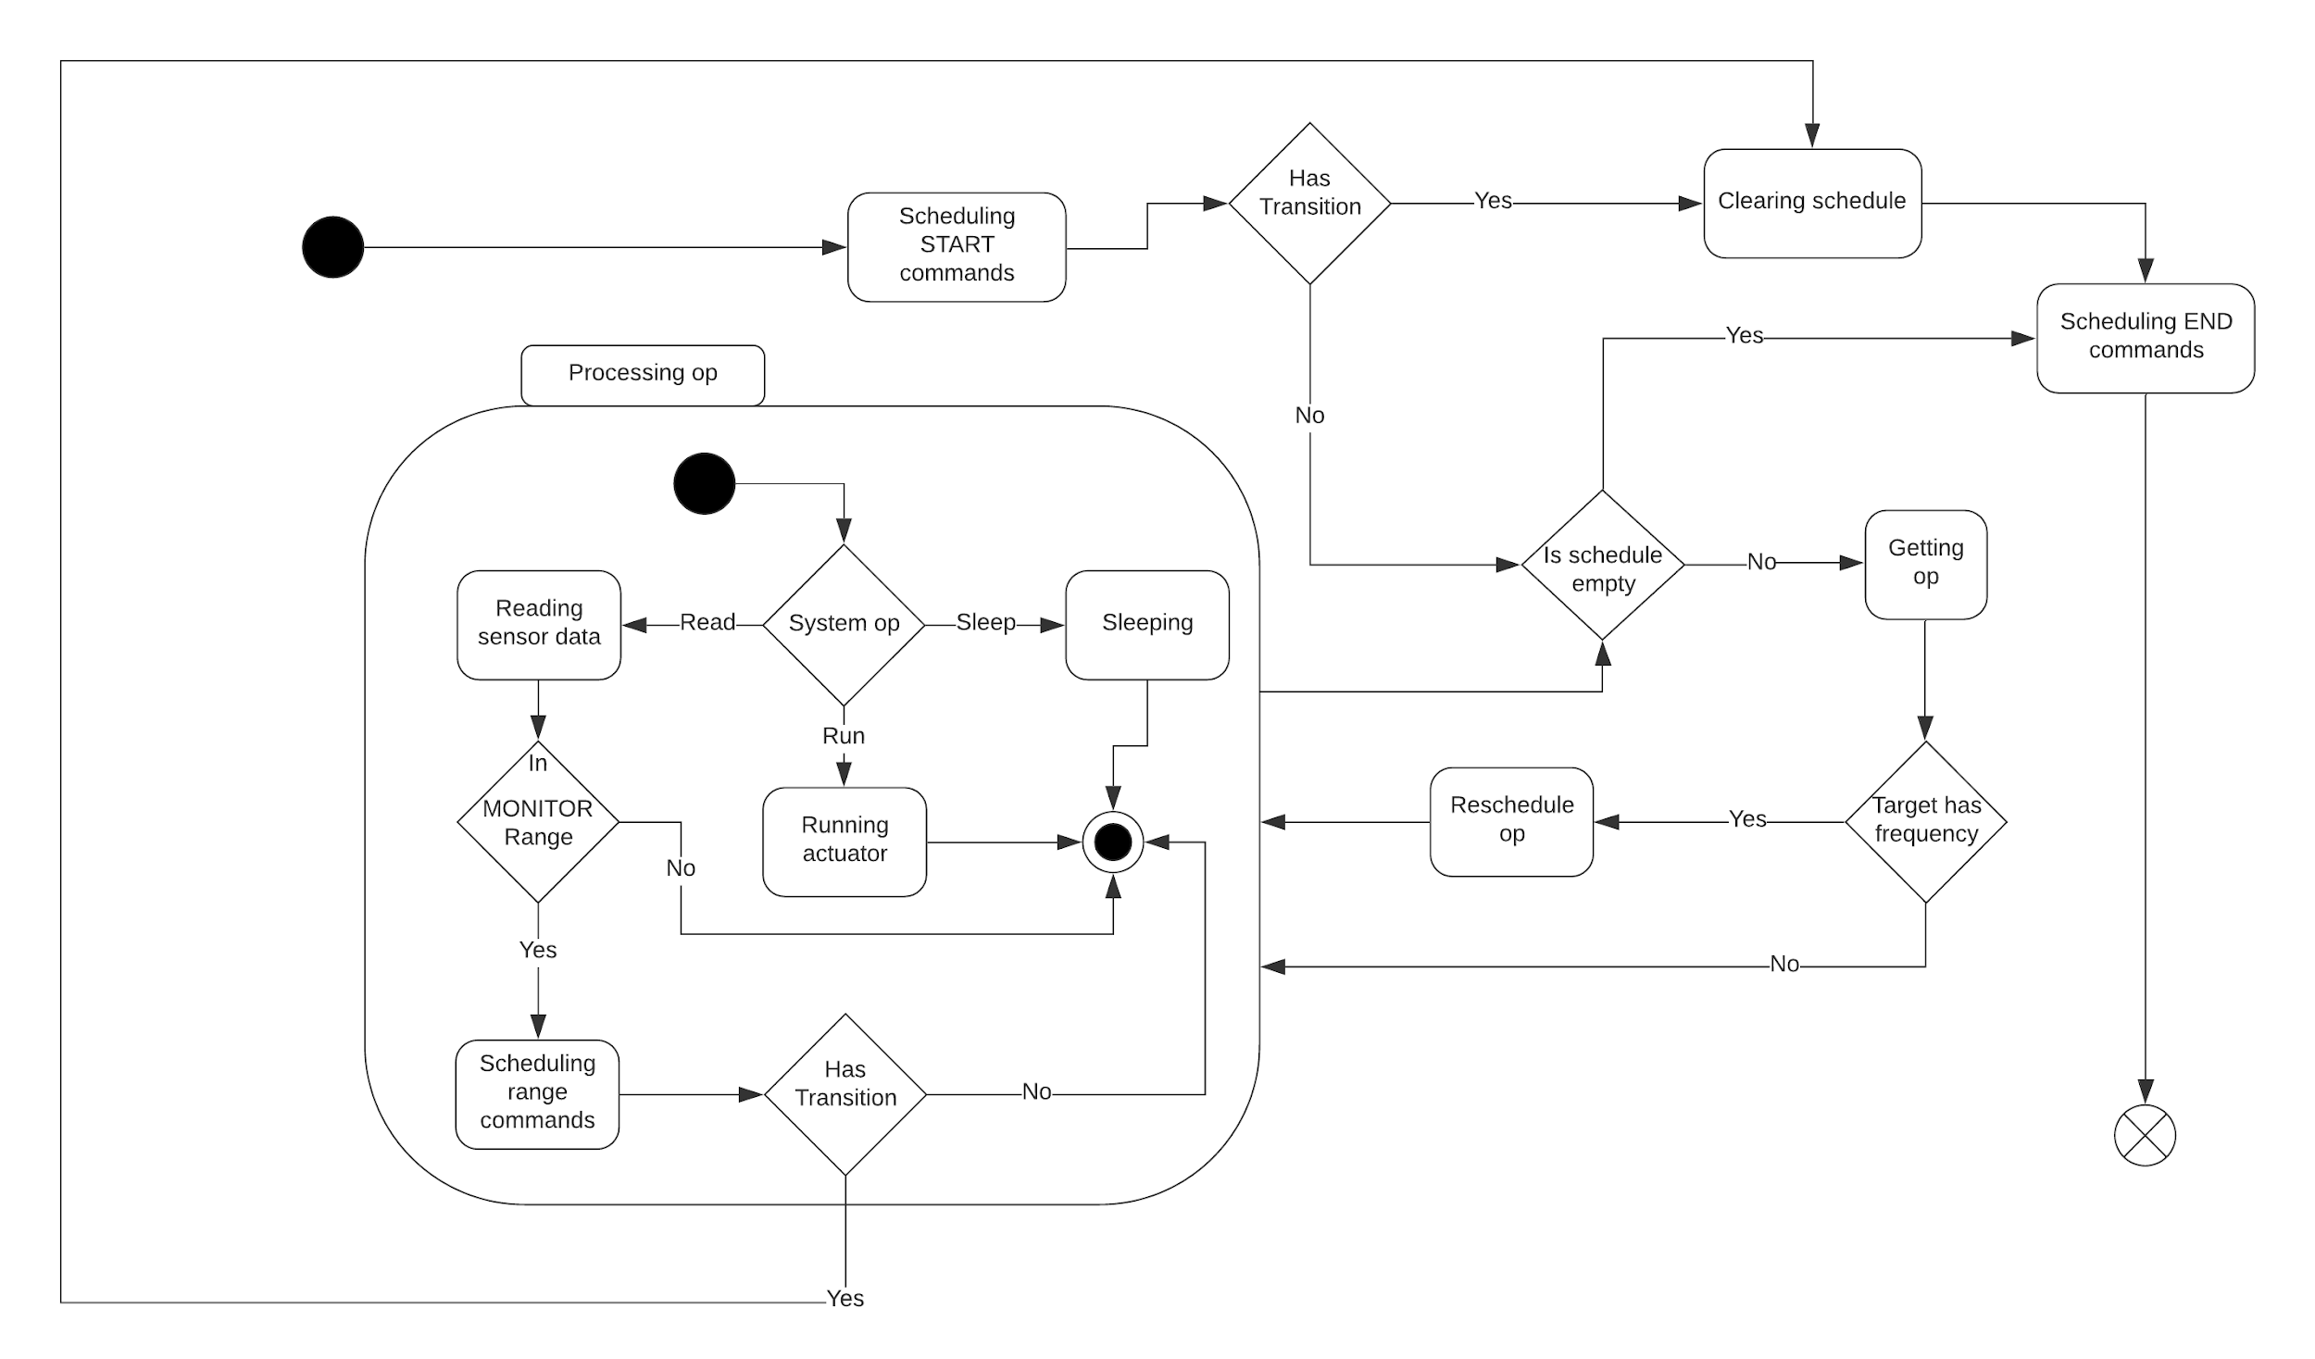
Task 1
Created state diagram

Slide 4
Task 2
Implemented sensor base class
Activate method to initialize actuator parameters and to communicate with hardware, if it behaves like a switch. A deactivate method is also included.
Contains a read function for powering on the sensor, reading in data from the hardware, then powering off the sensor.
Has a frequency attribute, where “read” operations are rescheduled based on it’s value
Implemented height sensor and moisture sensor classes for testing

Slide 5
Task 2
Implemented actuator base class
Similar to sensor class
Implemented water pump and light classes for testing
Contains activate method to initialize actuator parameters and to communicate with hardware, if it behaves like a switch
Frequency attribute is optional
Without it, an actuator will only run once
May have a run function
Without this function, actuator activate and deactivate functions will behave like a switch
With it, the run operations are inserted into the scheduler
Plan on splitting Actuator base class into ActuatorSystem and ActuatorSwitch child classes
Just rename Actuator to ActuatorSwitch
And replace the run attribute checks with is instance checks
Notes:
ActuatorSystem and ActuatorSwitch change just requires:
Renaming Actuator to ActuatorSwitch
Replacing the run attribute check, before “run” command insertion, with is ActuatorSystem check

Slide 6
Task 2
Implemented scheduling algorithm
System operations consist of “run”, “read”, and “sleep”
Delay, or the position in the list relative to scheduled sleeps, is 0 or calculated from frequency.
Inserting a command will iterate over the schedule, subtracting sleeptimes from delay until delay is less that the current sleep time.
If it does not land perfectly on either side of a sleep command, it will split the “sleep” into two commands on either side.
When a command is retrieved, reschedule it, if the target has a frequency attribute.
If a frequency changes, remove the respective command from the schedule and merge any sleep commands preceding and succeeding the target command.
Notes:
ActuatorSystem and ActuatorSwitch change just requires:
Renaming Actuator to ActuatorSwitch
Replacing the run attribute check, before “run” command insertion, with is ActuatorSystem check

Slide 7
Task 3
Created simulated farm for testing
Simulated farm Growth Phase:
SeedObject()
actuator() -- stepperCurrent, start, speed, stepsOfRev, setAcceleration
waterPump()
linActuator() -- Not used in sim today
lightSensor()
light()
moistureSensor()
Called in states over time
Using System time
Biased return values based on estimates of environment calculated from system actions
Height sensor returns the average height of the 500 seeds over time
Water pump influences the value read by the moisture sensor

Slide 8
if h > 98:
self.healthy = False
self.maxHeight = random.randrange(1, growHeight-1)
g = random.randrange(100)
if g > 98:
self.canGerminate = False
pass
pass
if self.canGerminate:
self.germinateTime = random.randrange(
germinateTime - 5, germinateTime + 5)
# time till germinate is also time of germination once passed
self.timeTillGerminate = time.time() + self.germinateTime
pass
else:
self.germinateTime = 0
pass
self.currentHeight = 0
def grown(self):
if self.healthy and self.canGerminate and self.timeTillGerminate <= time.time():
self.currentHeight = random.uniform(growRate, growRate+0.02) * \
(time.time() - self.timeTillGerminate)
return self.currentHeight
else:
return 0
Excerpt from SeedObject()
Setting if the generated seed can germinate
When it will germinate
How much it grows over time

Slide 9
Task 4
Created configuration file
Uses a subset of the YAML Syntax.
Each phase consists of START, MONITOR, and END entries.
The entry for MONITOR contains sensor names, whose entries are multiple ranges of values, each of which correspond to a sequence of config actions.
START contains a sequence of config actions that initialize the system for a phase.
END contains a sequence of config actions that are executed on transitions.
Each config action comprises as a 3 part sequence
The first element is the operation “activate”, “set”, or “deactivate”
The second is the target of the operation. This is either an actuator or sensor name.
The third is parameters, each with a corresponding value.

Slide 10
Task 4
Simple configuration file example
---- START: # Action Sequence - - activate # Operation - light # Target - intensity: 5 lux # Param: Value - - activate - moistureSensor - frequency: 6 hr - - activate - heightSensor - frequency: 3 d | MONITOR: heightSensor: [1 cm, 2 cm]: - - set - heightSensor - frequency: 2 d moistureSensor: [0 hum, 2 hum]: - - activate - waterPump - duration: 10 sec frequency: 1 d - - set - moistureSensor - frequency: 6 hr [2 hum, 3 hum]: - - set - moistureSensor - frequency: 1 d | END: - - deactivate - light - - deactivate - moistureSensor - - deactivate - heightSensor

Slide 11
Task 4
Created configuration file parser
Converts the config file to the systems internal representation of the configuration.
Validates the internal structure.
Validates the syntax against reserved words and whether targets contain parameters specified.
Normalizes units provided to a standard internal representation.
e.g. minutes, hours, and days get converted into seconds.

Slide 12
Demo
https://youtu.be/hHuZy_kJaAg

Slide 13
Milestone 3
Task | Giampiero | Christopher | Completion | To Do
Decide which set of computers/microcontrollers will be used to control the system other than the microcontroller | Responsible - 50% | Responsible - 50% | 100% | none
Implement Python libraries for serial communication | Responsible - 50% | Responsible - 50% | 100% | Branch Actuator into ActuatorSwitch and ActuatorSystem
Finalize development toolchain (maybe do this next semester when arch is decided?) | Responsible - 50% | Responsible - 50%
Start a preliminary product breakdown structure with MEE
At least one sensor & actuator functioning according to some schedule These will run based on simulated data along with simulated cycles

Slide 14
Milestone 3
Task | Giampiero | Christopher | Completion | To Do
Full simulated farm with well-defined input parameters | Responsible - 50% | Responsible - 50% |  | Add simulations for {seed, harvest, clean, err}
Configuration file for all phases in system to run in simulation | Responsible - 50% | Responsible - 50% | 24%
Testing Document inheriting from test plan from milestone 1: | Responsible - 50% | Responsible - 50% | 5% | Test cases Static - Done by reading code through formal reviews Functional - Verifies that each function of the software application operates in conformance with the requirement specification Structural - Whitebox testing, testing trigger conditions, etc Performance - Responsiveness and stability under a particular workload Testing scripts - Automated testing
We will also use SonarQube to review, with static analysis, our code to detect bugs, code smells and security vulnerabilities.
 | Simulated Farm | Sensor | Actuator
Single Stage | State cases | Expected data behavior for features | Expected actions and reactions for features
One Cycle | State and transitions cases | Expected data behavior for features | Expected actions and reactions for features
Multi Cycle | Multiple sets of state and transition cases | Expected data behavior for features | Expected actions and reactions for features

Slide 15
Questions?

