Slide 1
Autonomous Multi-cycle Farming in Space
Christopher Millsap , Giampiero Corsbie
Client/ Sponsor: Dr. Philip Chan

Slide 2
Milestone 1
Task | Giampiero | Christopher | To do
1. Choosing microcontroller | Responsible - 50% | Responsible - 50% | none
2. Decide on development OS | Informed | Responsible | Based on sensors and actuators
3. Install and configure VS | Responsible | Responsible | demo
4. Compare and select collaboration tools | Responsible | Informed | none
5. Provide demos | Responsible - 50% | Responsible - 50% | Not done as of 9/29/19
6. Create requirements document | Responsible - 50% | Responsible - 50% | none
7. Create design document | Responsible - 50% | Responsible - 50% | none
8. Create test plan | Responsible - 50% | Responsible - 50% | More defined
9. Define change management process | Responsible - 25% | Responsible - 75% | Verify with MEE

Slide 3
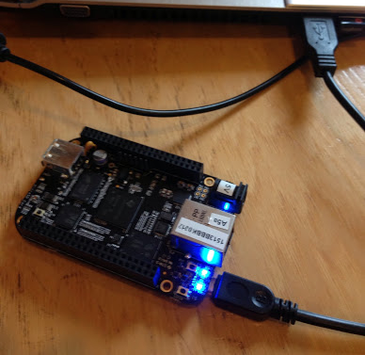
Task 1: Choosing microcontroller
SPI - Blue model
eMMC
Embedded
Linux
Ethernet
2x 46 pin headers
Cloud9 IDE
Little chance of EOL
Decent documentation
(DEMO) - in class only
Extra: Mapping out custom board plan

Slide 4
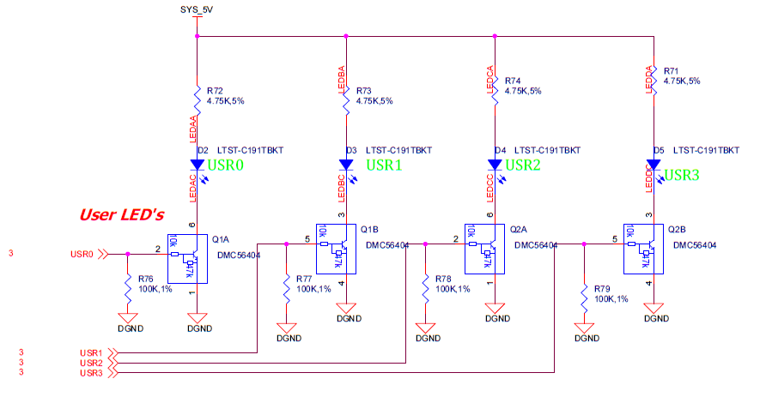
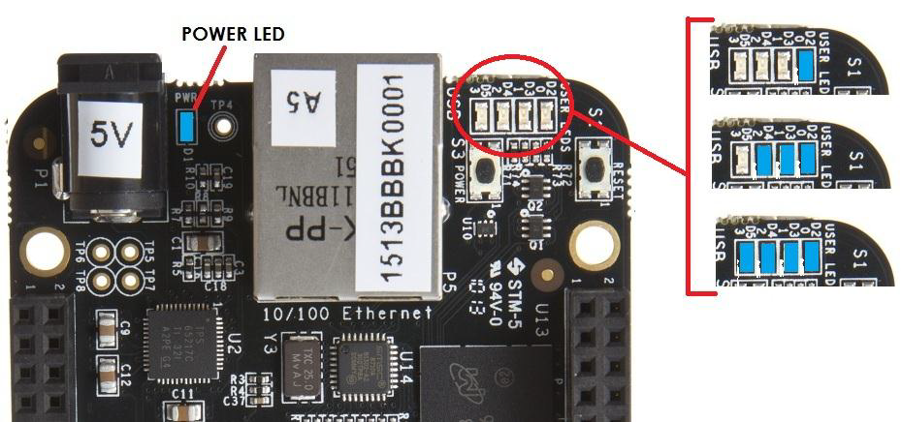
HelloWorld - LEDS say “hello” in Morse Code using Python! (DEMO) - in class only

Slide 5
Milestone 1
2-5 No slides needed
Task | Giampiero | Christopher | To do
1. Choosing microcontroller | Responsible - 50% | Responsible - 50% | none
2. Decide on development OS | Informed | Responsible | Based on sensors and actuators
3. Install and configure VS | Responsible | Responsible | demo
4. Compare and select collaboration tools | Responsible | Informed | none
5. Provide demos | Responsible - 50% | Responsible - 50% | Not done as of 9/29/19
6. Create requirements document | Responsible - 50% | Responsible - 50% | none
7. Create design document | Responsible - 50% | Responsible - 50% | none
8. Create test plan | Responsible - 50% | Responsible - 50% | More defined
9. Define change management process | Responsible - 25% | Responsible - 75% | Verify with MEE

Slide 6
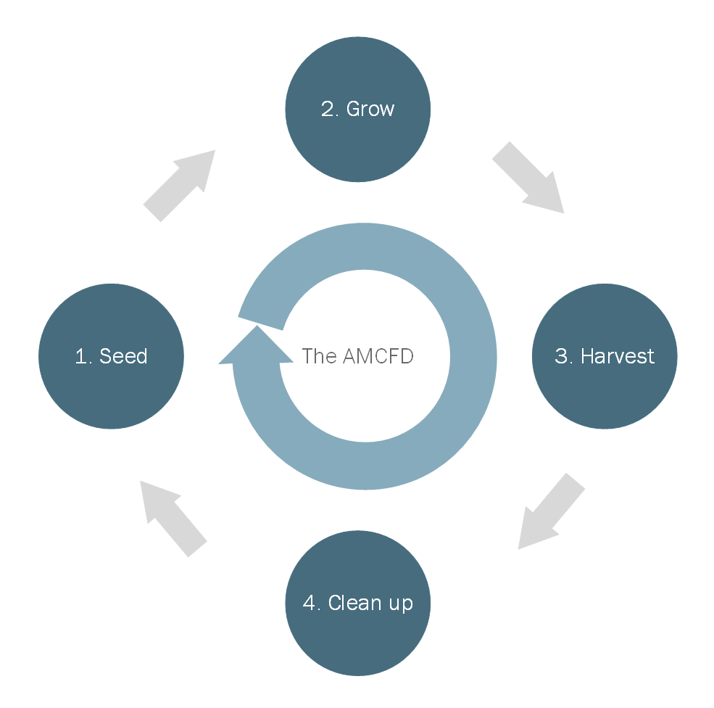
Task 6: Requirements Document
Deciding on the structure of the software was the most difficult problem so far, but designing the syntax of the configuration file may be more of a challenge in the future.
Requirements:
NFR:
Lockers and interfaces:
Express locker with ethernet
700w < power
FR:
Define control flow:
Input from config file
Run phases start 1-4 with config
On/Off how much for actuators
Power sensors then read sensors
Traceability
WBS
Astronauts can be considered in autonomy

Slide 7
Task 6: Requirements Document
0 - Preseeding Environment:
Transition: Start
1 - Seeding:
Get
Move
Plant
Observe/React
Transition:
Germination
2 - Grow:
Observe/React
Transition:
Height=grown
3 - Harvest:
Cut
Gather
Separate
Store
Observe/React
Transition: Crop gathered
4 - Clean:
Must match states before seeding as set by config file
Observe/React
Transition:
State = 0/config

Slide 8
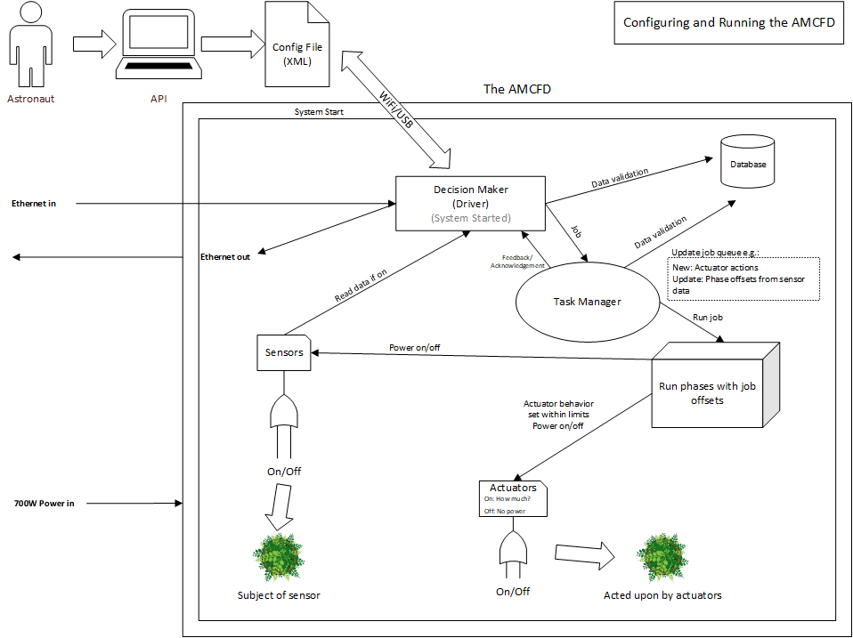

Slide 9
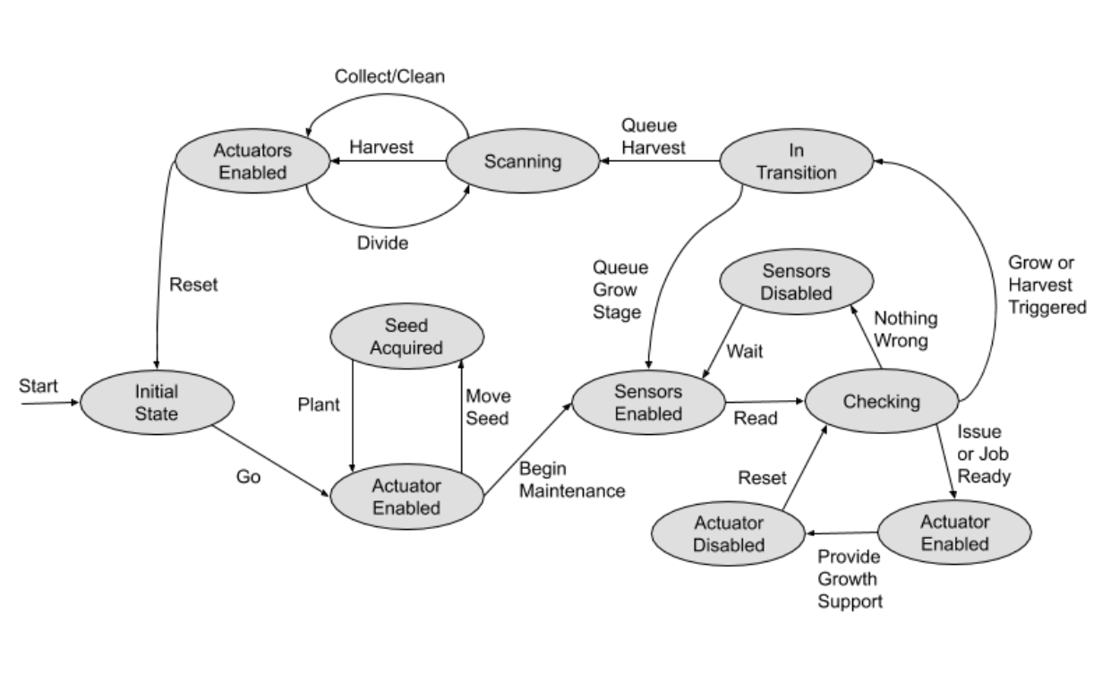
Actuator State Diagram

Slide 10
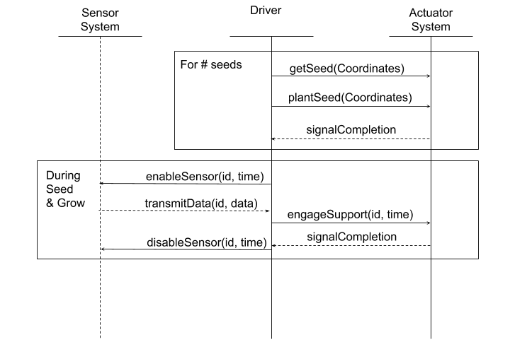
SSD
Use Case Example: Seed and Grow Loops
Get seeds
Plant seeds
Cycle sensor activation
Engage support systems

Slide 11
Task 7: Create design document - Requirements and Config
XML Parser:
Pros:
Easy to parse
Cons:
Verbose
May be difficult to debug
Parser may be large
Parser:
Configurations fall into:
Actions
Specifying a conditions
Duration
Frequency
Intensity

Slide 12
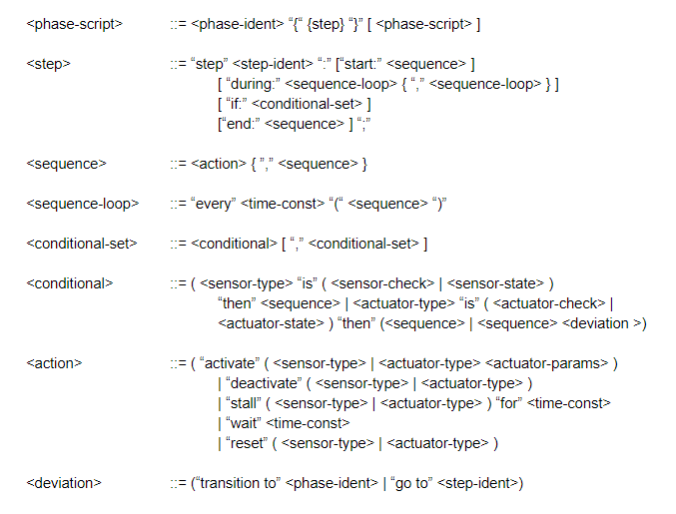
Task 7: Create design document - Requirements and Config (Some Ideas)

Slide 13
Task 7: Create design document - Requirements and Config (Some Ideas)
Simpler syntax/grammar than XML is probably achievable...
One possible idea is keyword:value pair
An action can be a list of keyword:value pair
activate:waterpump duration:10s
activate:moistureSensor frequency:6h
activate:light intensity:5
Other things to consider:
Processes parallel or sequential and how to specify

Slide 14
Task 8: Test plan - Overview
The first run will be a single stage, going through the respective queue of actions and jobs. The second run will operate through one cycle, consisting of each stage and its transitions. The third run will have the simulated farm and software go through multiple cycles. With each testing session following the format of the matrix below:
 | Simulated Farm | Sensor | Actuator
Single Stage | State cases | Expected data behavior for features | Expected actions and reactions for features
One Cycle | State and transitions cases | Expected data behavior for features | Expected actions and reactions for features
Multi Cycle | Multiple sets of state and transition cases | Expected data behavior for features | Expected actions and reactions for features
Defined pass/fail criteria

Slide 15
Task 9: Change Management - Overview
All hardware changes are handled by MEE subteam
Software changes will be versioned by GitHub
Software changes for bug fixes and requirements will be discussed by team and reviewed by project sponsor
Software changes for adding or removing features must be approved by sponsor and validated through testing
Baselining will occur after testing and sponsor approval

Slide 16
Milestone 2
Task | Giampiero | Christopher
Implement inheritable high-level interfaces/classes for sensor communication | Responsible - 50% | Responsible - 50%
Create simulated farm for testing | Responsible - 50% Test | Responsible - 50% Test/Demo
Create baselining requirements and process | Responsible - 25% | Responsible - 75%
Added this task 9/30/19 to create a configuration file for at least one phase in system and run in simulation | Responsible - 50% Test/Demo | Responsible - 50% Test/Demo

Slide 17
Questions?

