Slide 1
Autonomous Multi-cycle Farming in Space
Christopher Millsap , Giampiero Corsbie
Client/ Sponsor: Dr. Philip Chan

Slide 2
Milestone 1
2-5 No slides needed
Task | Giampiero | Christopher | To do
1. Choosing microcontroller | Responsible - 50% | Responsible - 50% | none
2. Decide on development OS | Informed | Responsible | Based on sensors and actuators
3. Install and configure VS | Responsible | Responsible | demo
4. Compare and select collaboration tools | Responsible | Informed | none
5. Provide demos of tools | Responsible - 50% | Responsible - 50% | Not done as of 9/29/19
6. Create requirements document | Responsible - 50% | Responsible - 50% | none
7. Create design document | Responsible - 50% | Responsible - 50% | none
8. Create test plan | Responsible - 50% | Responsible - 50% | More defined
9. Define change management process | Responsible - 25% | Responsible - 75% | Verify with MEE

Slide 3
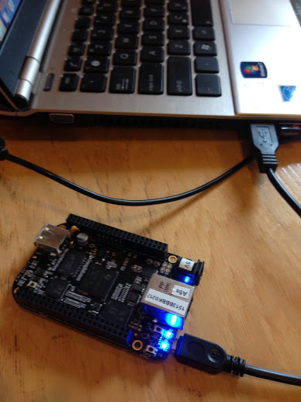
Task 1: Choosing microcontroller
SPI
eMMC
Embedded
Linux
Ethernet
2x 46 pin headers

Slide 4
Task 6: Requirements Document
Deciding on the structure of the software was the most difficult problem so far, but designing the syntax of the configuration file may be more of a challenge in the future.
Actions:
NFR
FR
Traceability
WBS

Slide 5
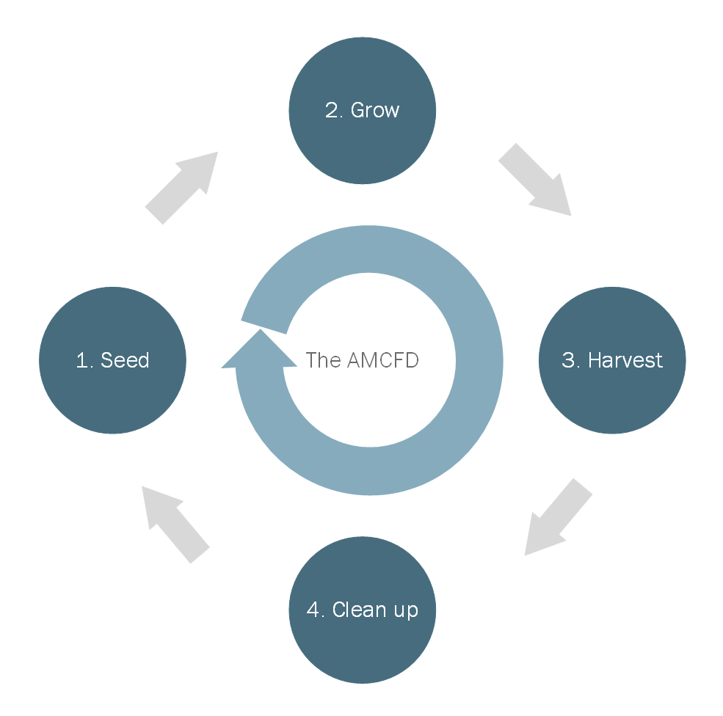

Slide 6
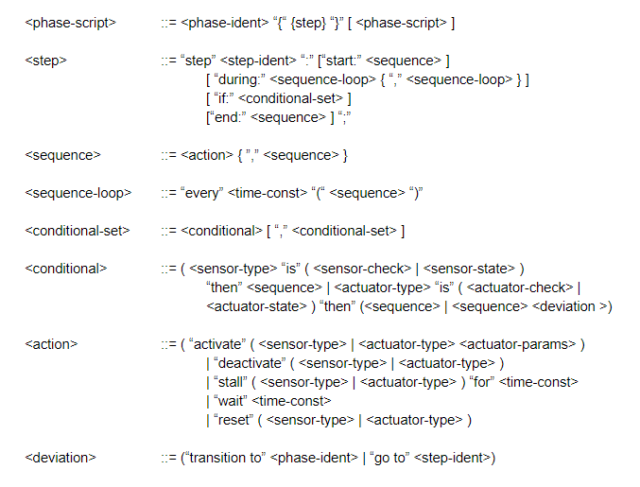
Task 7: Create design document - Requirements and Config

Slide 7
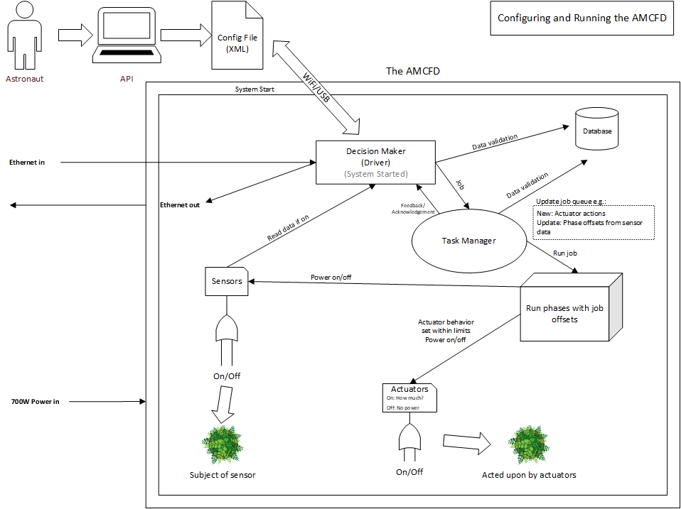

Slide 8
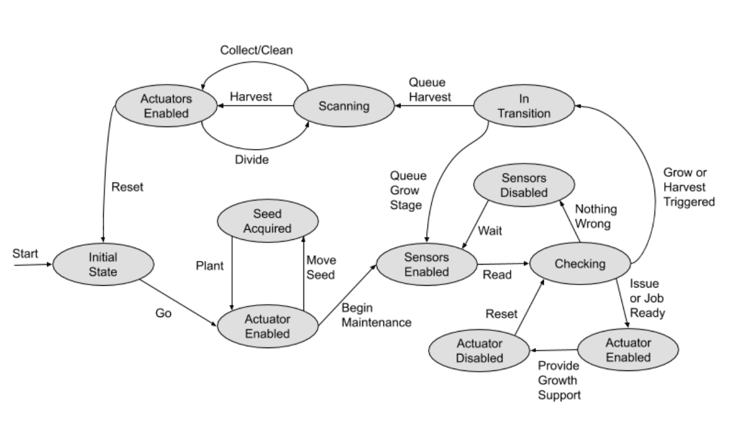
Actuator State Diagram

Slide 9
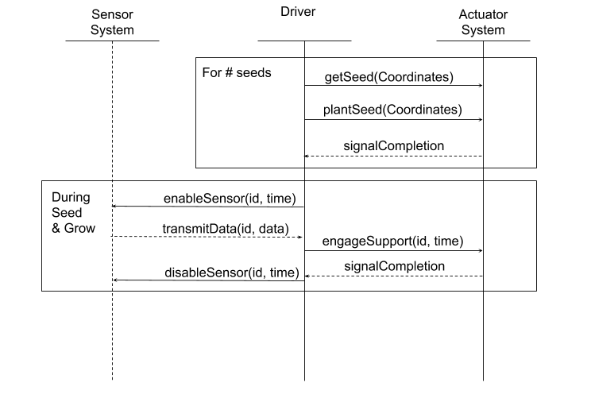
SSD Diagram
Use Case Example: Seed and Grow Loops
Get seeds
Plant seeds
Cycle sensor activation
Engage support systems

Slide 10
Task 8: Test plan - Overview
The first run will be a single stage, going through the respective queue of actions and jobs. The second run will operate through one cycle, consisting of each stage and its transitions. The third run will have the simulated farm and software go through multiple cycles. With each testing session following the format of the matrix below:
 | Simulated Farm | Sensor | Actuator
Single Stage | State cases | Expected data behavior for features | Expected actions and reactions for features
One Cycle | State and transitions cases | Expected data behavior for features | Expected actions and reactions for features
Multi Cycle | Multiple sets of state and transition cases | Expected data behavior for features | Expected actions and reactions for features

Slide 11
Task 9: Change Management - Overview
All hardware changes are handled by MEE subteam
Software changes will be versioned by GitHub
Software changes for bug fixes and requirements will be discussed by team and reviewed by project sponsor
Software changes for adding or removing features must be approved by sponsor and validated through testing
Baselining will occur after testing and sponsor approval

