Slide 1
Autonomous Multi-cycle Farming in Space
Christopher Millsap , Giampiero Corsbie
Client/ Sponsor: Dr. Philip Chan

Slide 2
Change of plans due to shutdown
Progress loss & update
Time lost working on configuring hardware
Water pump linear actuator was working now hardware is disassembled
Solenoid valves disassembled
Before HSDC closed valves worked together to allow water flow
No moisture sensors due to not having a water tray
All time debugging axes lost
Numerous hardware issues found and fixed during
All axes could move with installed limit switches
All XYZ movement possible
Seeding end effector was working and could dispense seed but no video was taken since no one foresaw the HSDC closing
All components installed and at %90+ operating capacity
We spent days at HSDC perfecting the hardware operation in anticipation of creating a timelapse video of the farming chamber operating

Slide 3
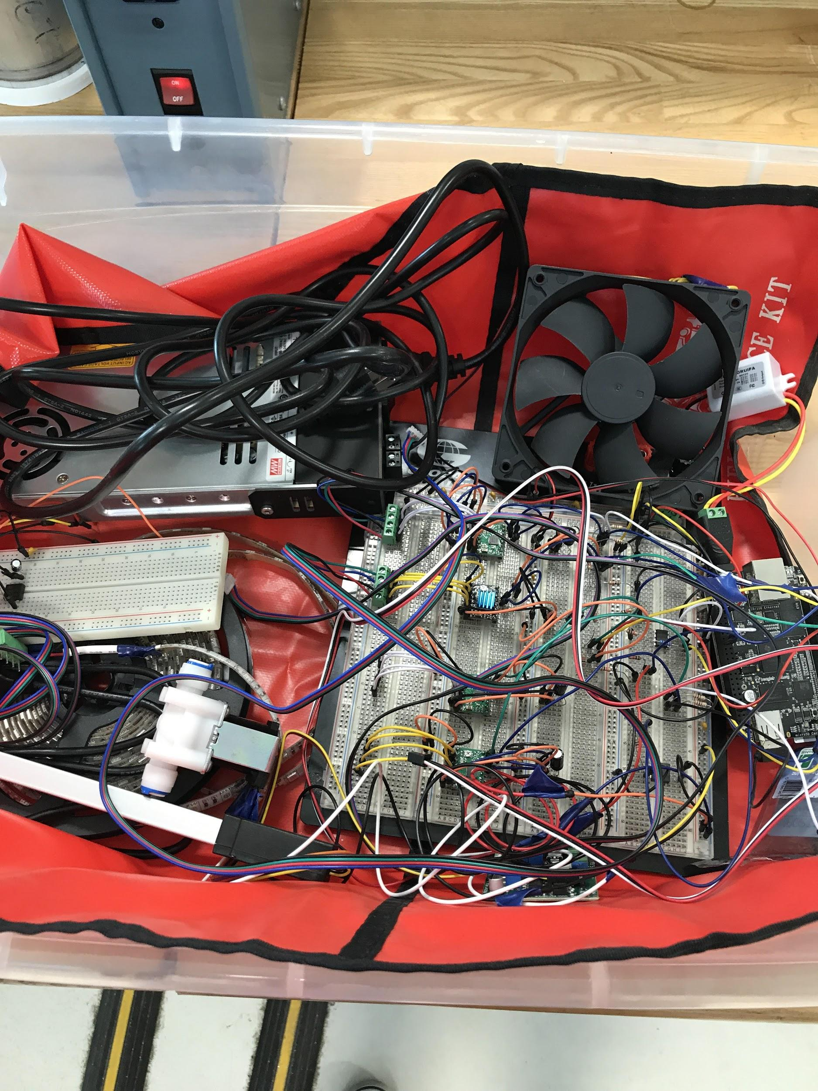
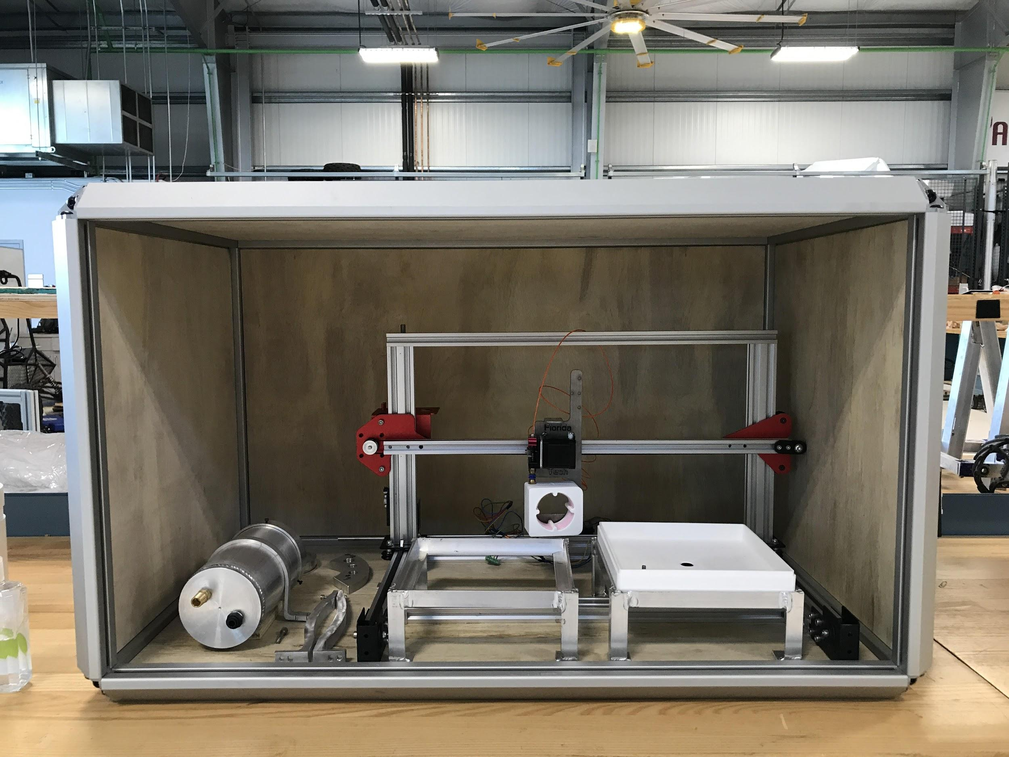

Slide 4
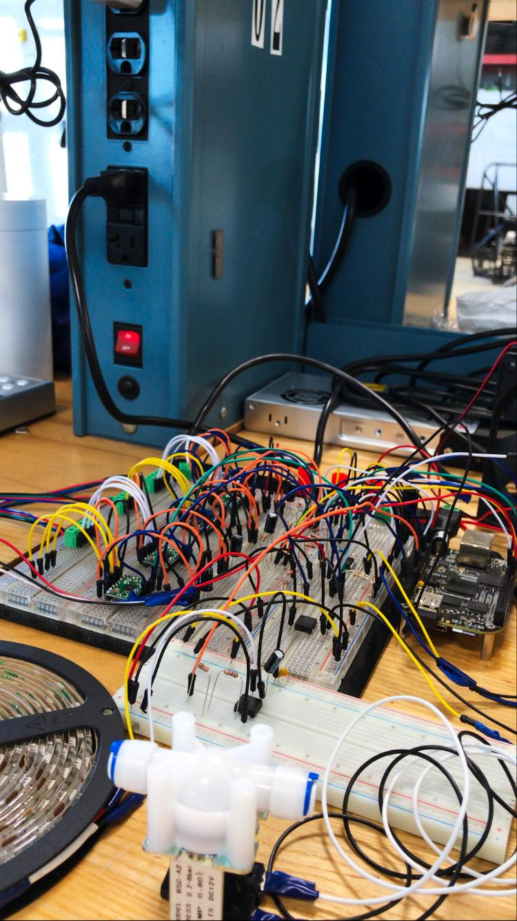
Some media of the Hardware:
More recent picture of circuits:
An older video:
https://www.youtube.com/watch?v=HUDDWKfFF1g

Slide 5
Usable progress
# | Task | Progress
1 | Functional setup of actual actuators and sensors working with system Seeding head on track Light and fan Linear actuator Nema motors Moisture sensor Seeding end-effector | 90%
2 | Working POC of application to configure and manage device | 70%
3 | Working config feature in application | 60%
4 | Metrics for reports | 100%
5 | Testing | 10%

Slide 6
Functional Setup
All actuators and sensors have been connected to the growth chamber and interfaced with it’s software.
However, due to the shutdown of the HSDC all further development has been halted and the hardware can no longer be used with the growth chamber.

Slide 7
Metrics for reports
The internal database is completed providing:
System runtimes
Cycle counts
Configurations run
Actuator uptimes
Sensor uptimes
The application can now query these metrics via a database connection.

Slide 8
Plan for next milestone
# | Task | Christopher | Giampiero
1 | Finished Farming User Station: Editor for config file | 80% | 20%
2 | Finished config library | 20% | 80%
3 | Finished reports | 80% | 20%
 | Live status diagram if we have time? | 80% | 80%
4 | User Manual | 20% | 80%
5 | Poster, ebook page | 50% | 50%
6 | Another hardware demo | 80% | 20%
Notes:
Draft poster and ask for comments. Keep on working on it.. Comments on and on...

