Slide 1
Autonomous Multi-cycle Farming in Space
Christopher Millsap , Giampiero Corsbie
Client/ Sponsor: Dr. Philip Chan

Slide 2
Plan for this milestone
# | Task | Christopher | Giampiero
1 | Finished Farming User Station: Editor for config file | 80% | 20%
2 | Finished config library | 20% | 80%
3 | Finished reports | 80% | 20%
 | Live status diagram if we have time? | 50% | 50%
4 | User Manual | 20% | 80%
5 | Poster, ebook page | 50% | 50%
6 | Another hardware demo | 80% | 20%
Notes:
Draft poster and ask for comments. Keep on working on it.. Comments on and on…
Status diagram: Visual abstraction of of the growth chamber. Provides state of microcontroller, actuators, and sensors. Provides information on the previous, current, and next state of the growth chamber.
User manual: separated into Astronauts, botanists, computer sysadmins, and developers.

Slide 3
# | Task | Progress | Chris | Piero | Todo:
1 | Finished Application | 90% | 90% | 10% | Dynamic GUI form
2 | Config library | 80% | 50% | 50% | Selection to editor by user
3 | Finished reports | 50% | 20% | 80% | Display them
4 | User Manual | 40% | 10% | 90% | Introduction, Astronaut, & Developer Sections
5 | Poster | 100% | 100% | 0% | Final edits
6 | Another hardware demo | 50% | 100% | 0% | Put hw back together

Slide 4
Todo (over the weekend):
Fix up application
Finalize showroom items
Finalize poster
Ebook page
Video
Simulation (talking over instead/and of words)
Software video integrated with hw
Show demo of application
user station
running of config file - important info only from script
different config file specs - for crop types to drive system autonomously
Finish user manual

Slide 5
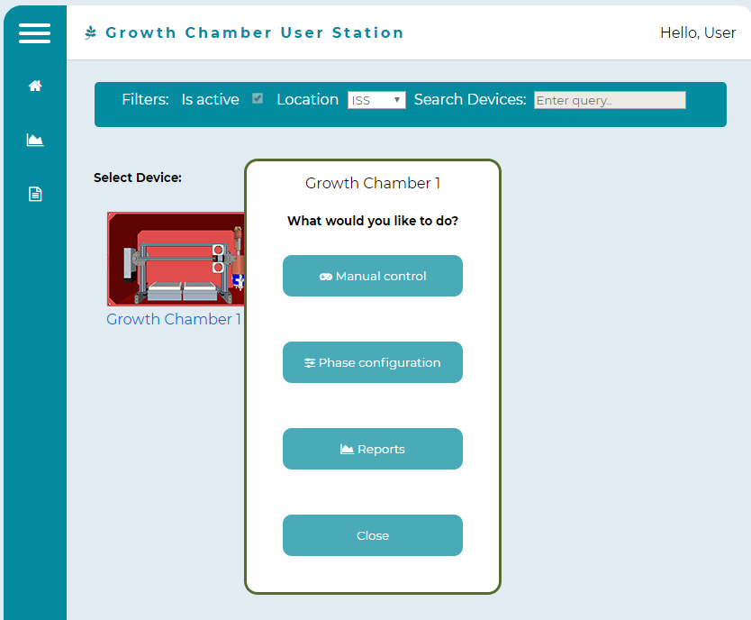
Application

Slide 6
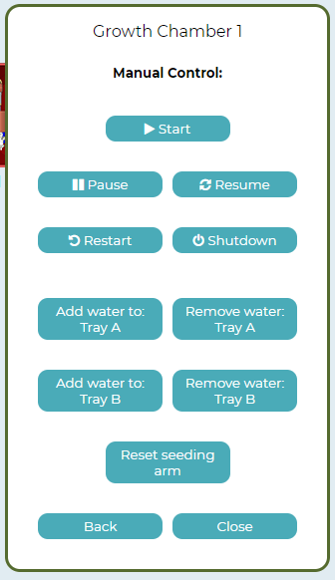

Slide 7
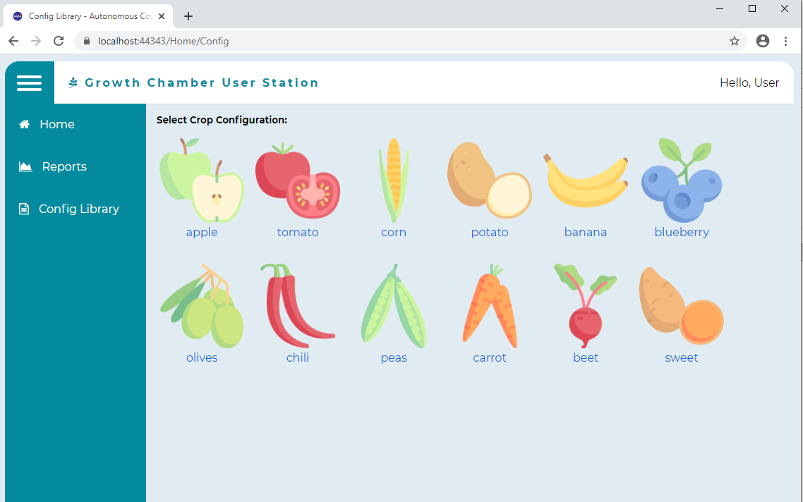

Slide 8
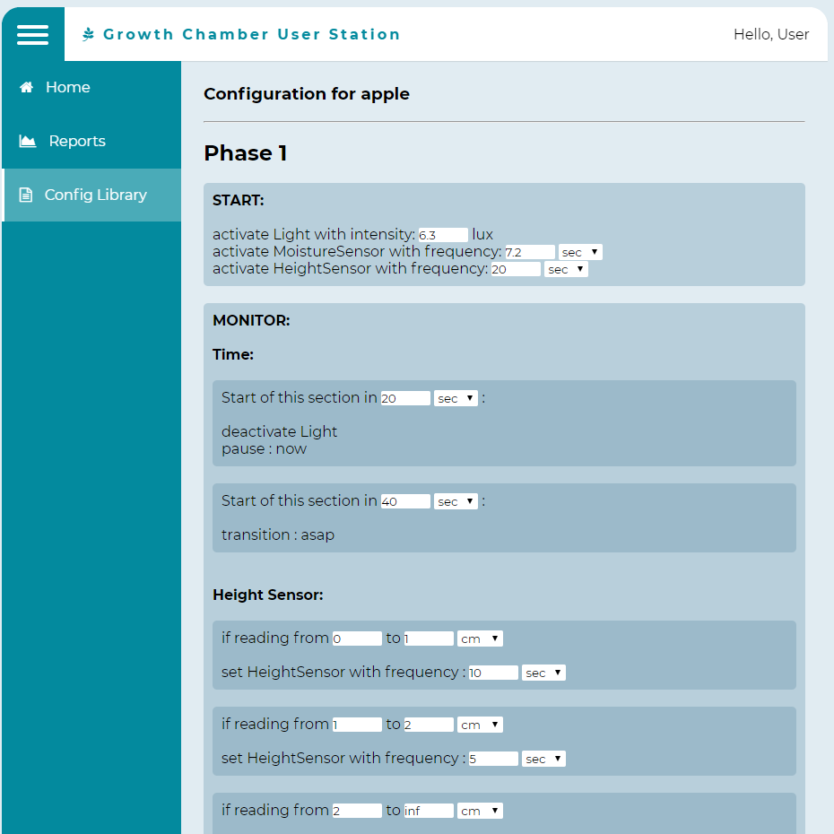

Slide 9
Simulation - Demo

