Slide 1
Autonomous Multi-cycle Farming in Space
Christopher Millsap , Giampiero Corsbie
Client/ Sponsor: Dr. Philip Chan

Slide 2
Overview of Milestone 6 Tasks
# | Task | Christopher | Giampiero
1 | Finished Farming User Station: Editor for config file | 80% | 20%
2 | Finished config library | 20% | 80%
3 | Finished reports | 80% | 20%
 | Live status diagram if we have time? | 50% | 50%
4 | User Manual | 20% | 80%
5 | Poster, ebook page | 50% | 50%
6 | Another hardware demo | 80% | 20%
Notes:
Draft poster and ask for comments. Keep on working on it.. Comments on and on…
Status diagram: Visual abstraction of of the growth chamber. Provides state of microcontroller, actuators, and sensors. Provides information on the previous, current, and next state of the growth chamber.
User manual: separated into Astronauts, botanists, computer sysadmins, and developers.

Slide 3
# | Task | Progress | Chris | Piero | Todo:
1 | Finished Application | 95% | 90% | 10% | Dynamic GUI form
2 | Config library | 100% | 50% | 50% | Selection to editor by user
3 | Finished reports | 100% | 20% | 80% | Display them
4 | User Manual | 100% | 10% | 90% | Introduction, Astronaut, & Developer Sections
5 | Poster | 100% | 100% | 0% | Final edits
6 | Another hardware demo | 50% | 100% | 0% | Put hw back together

Slide 4
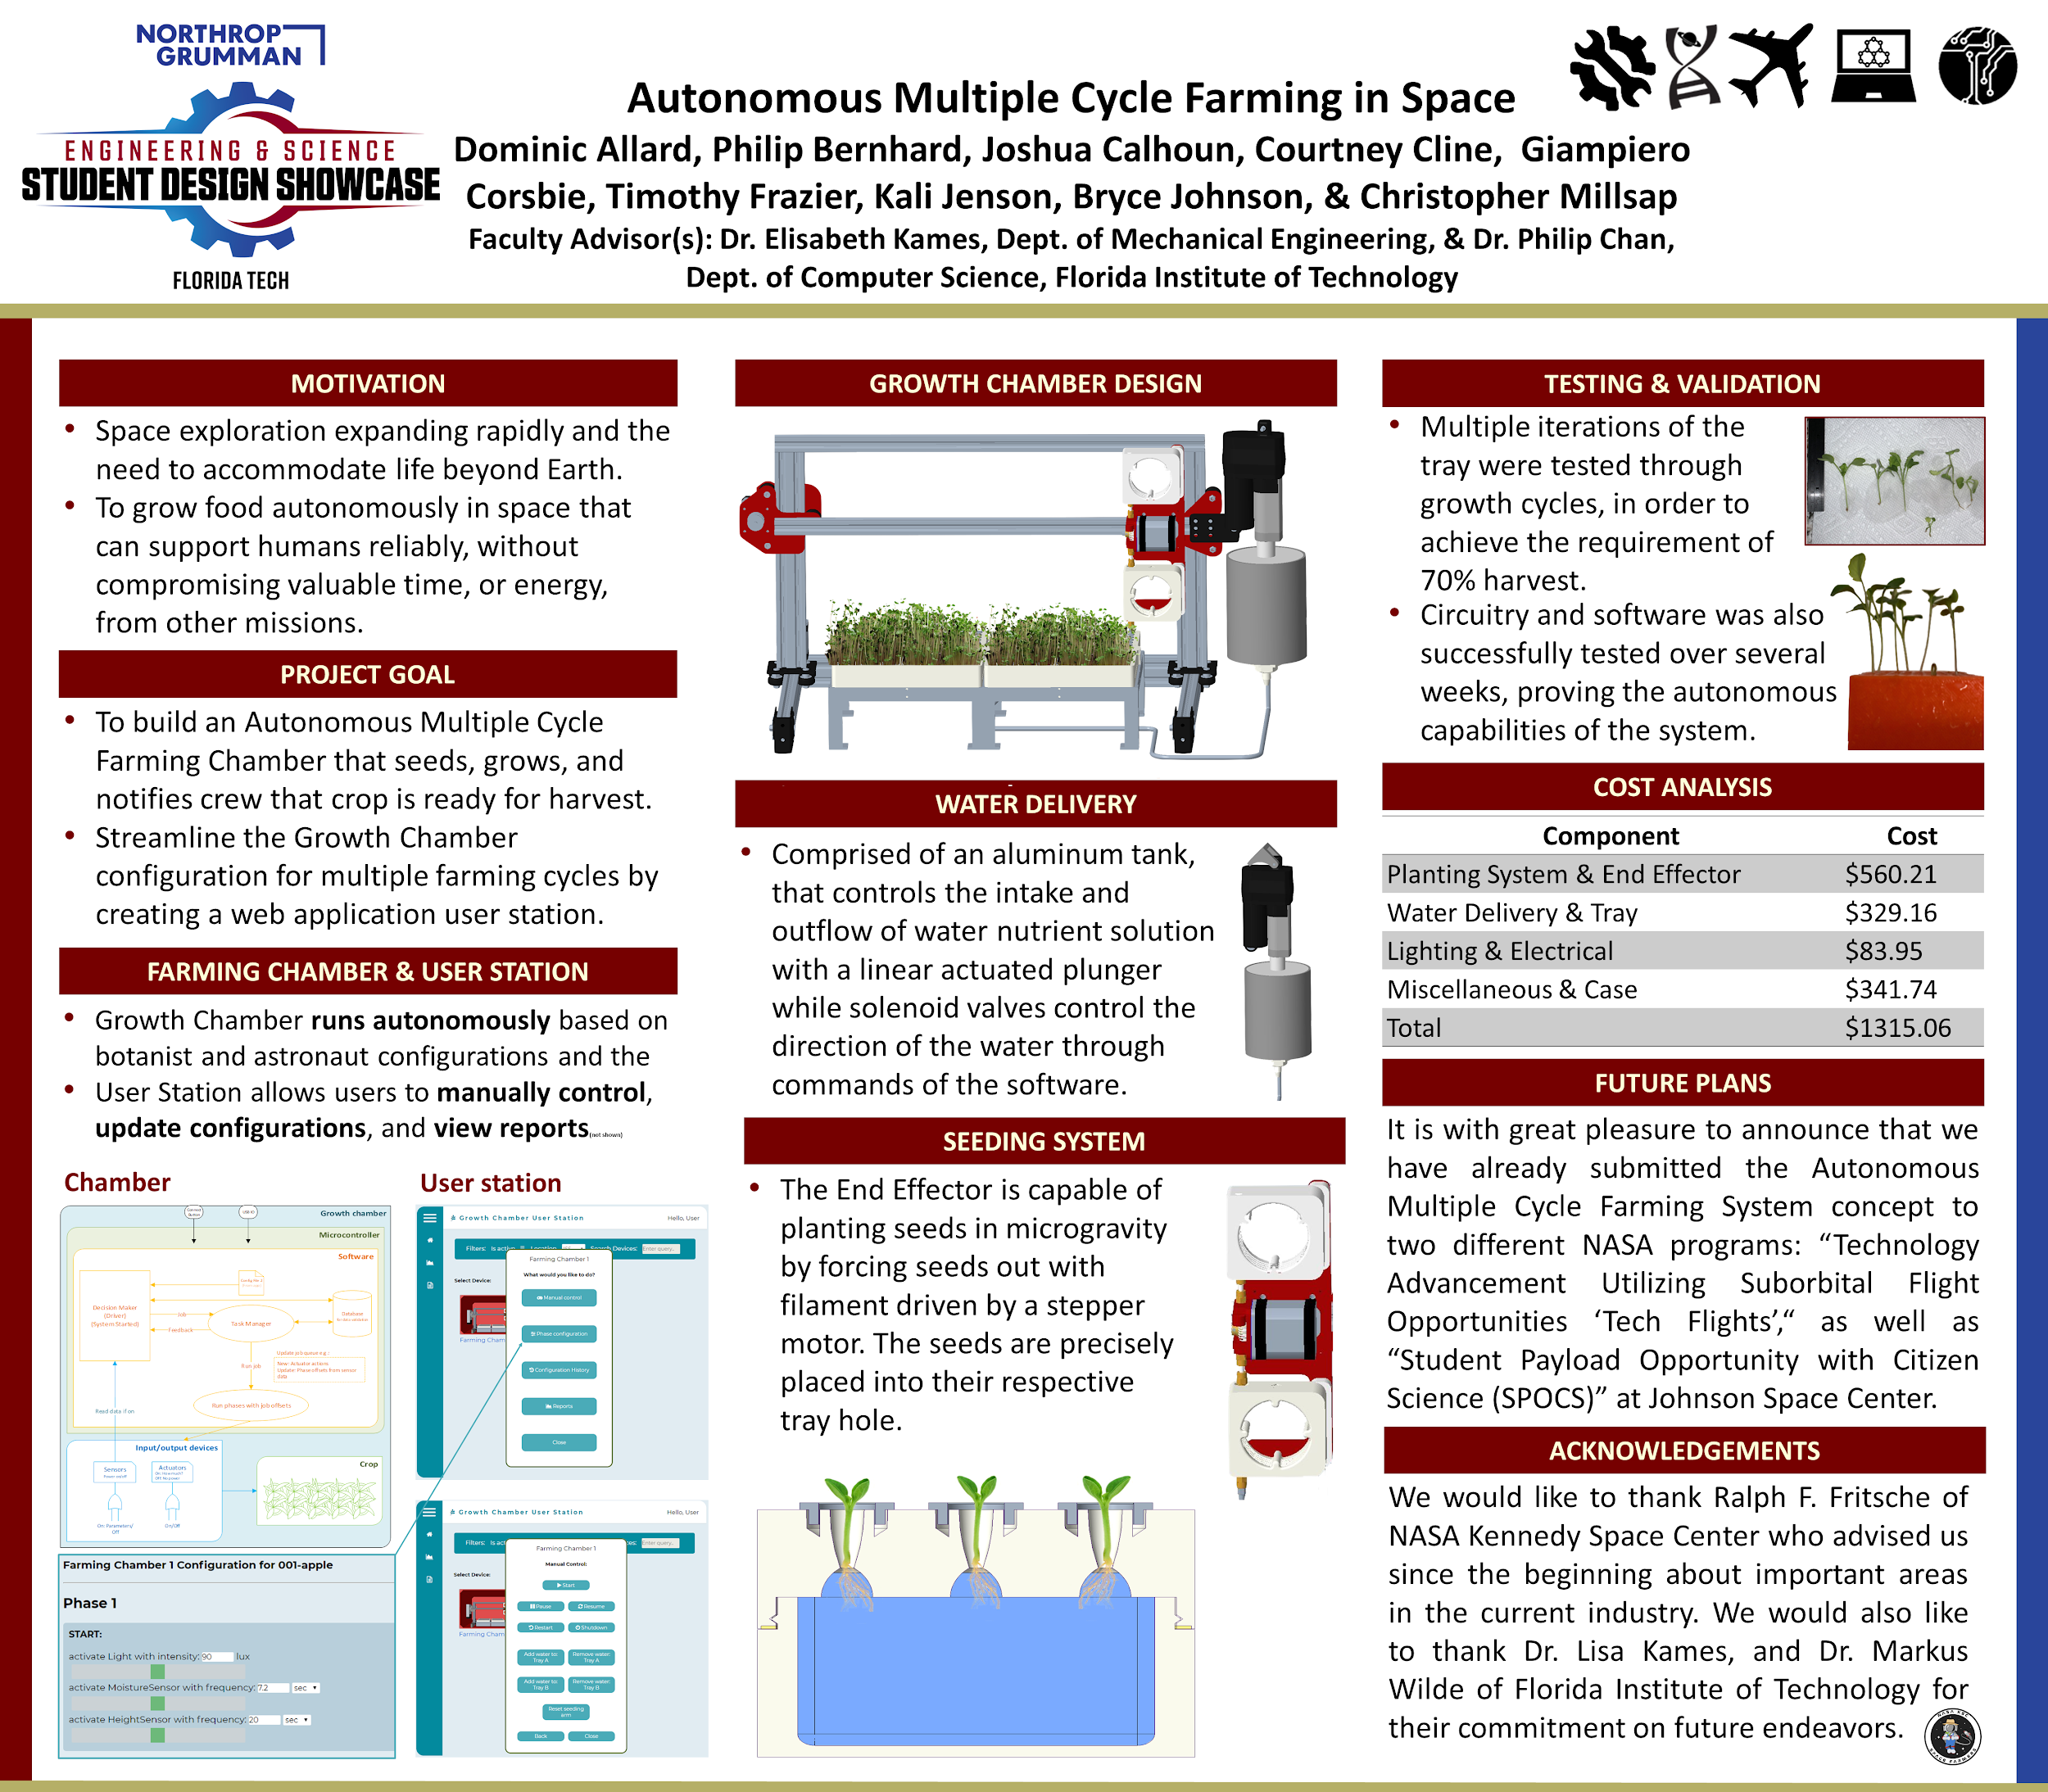
Showcase Poster

Slide 5
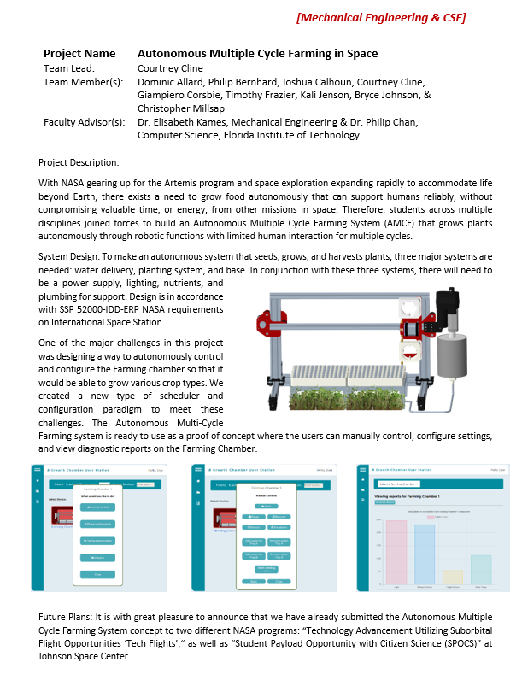

Slide 6
Final Features

Slide 7
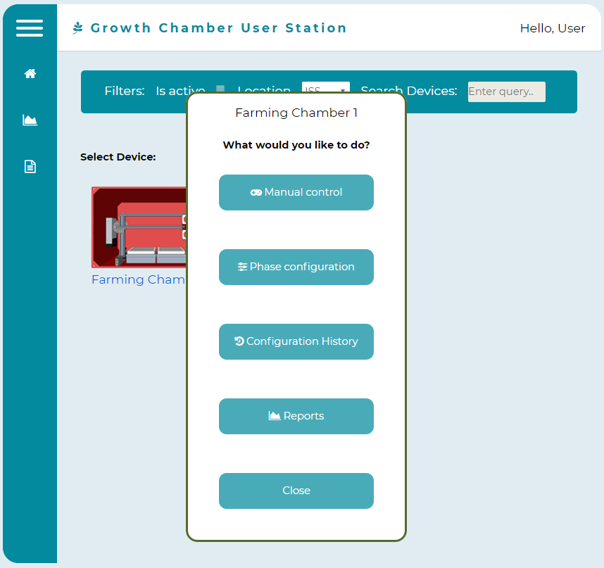

Slide 8
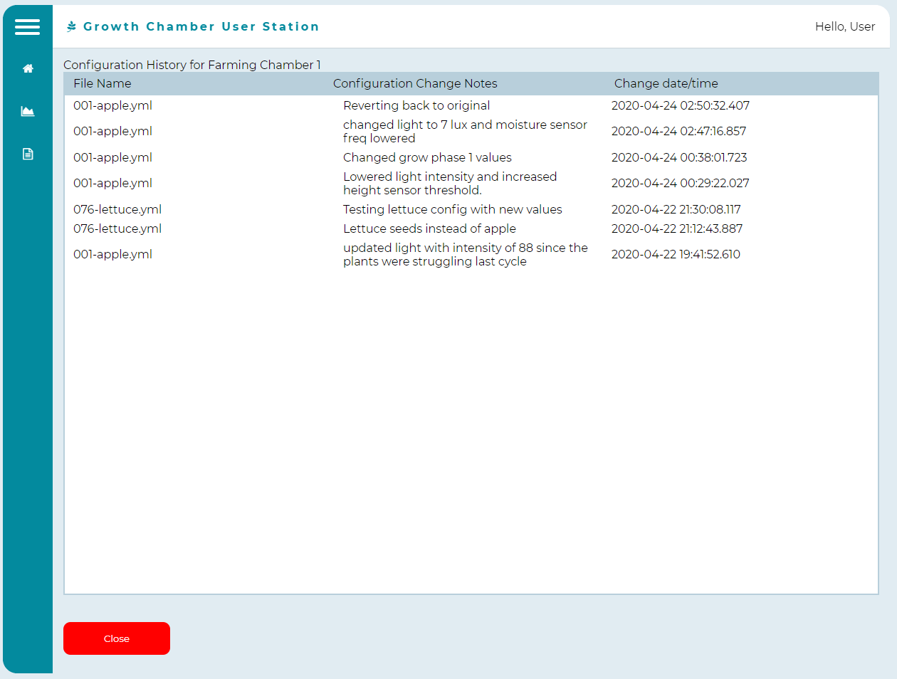
Actually revision control

Slide 9
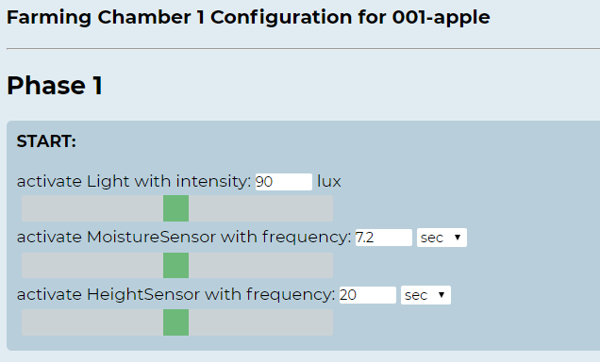

Slide 10
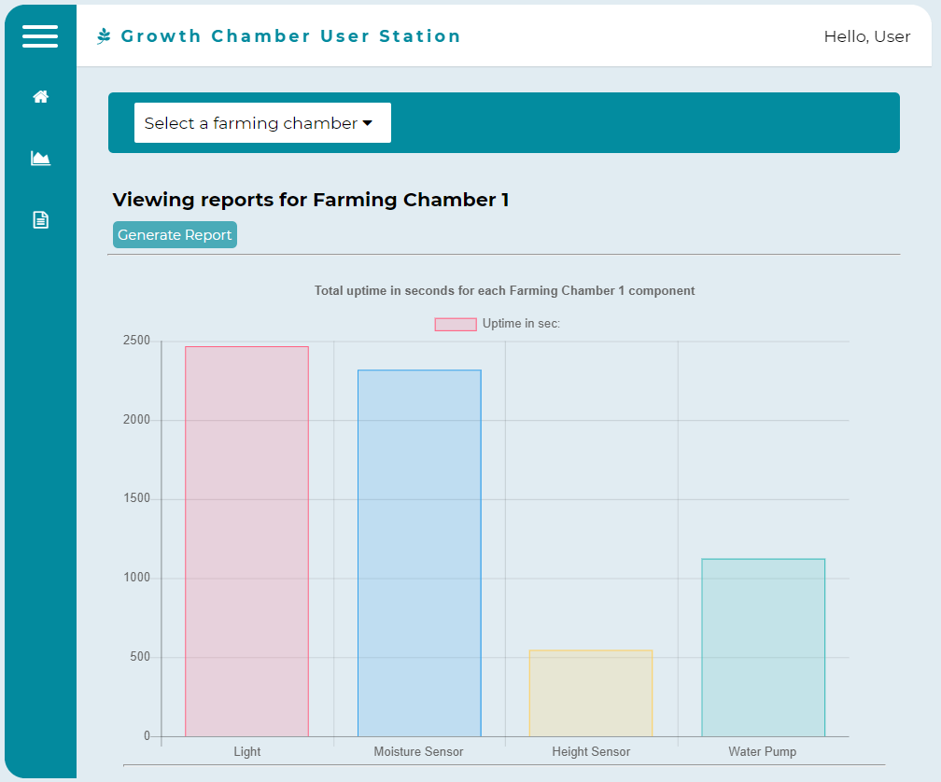

Slide 11
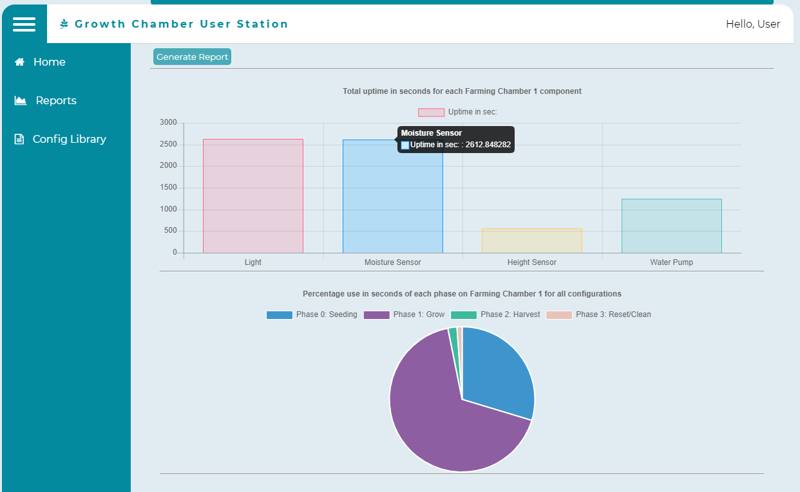

Slide 12
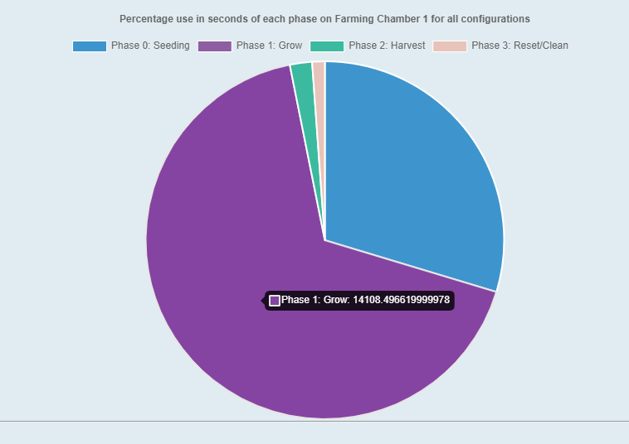

Slide 13
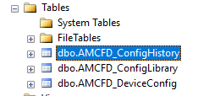
Other features added
Admin scripts:
Add device
Add config library
Database backend to
configure application and Farming Chamber
Farming Chamber ip addresses and config files
Record config history, etc.

Slide 14
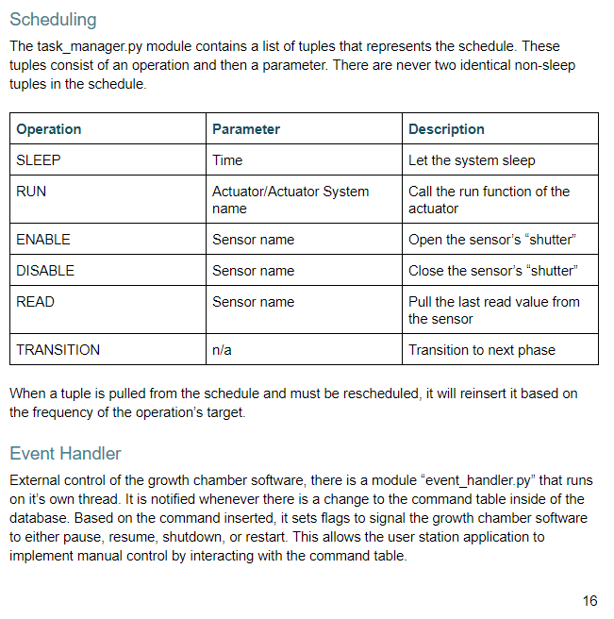
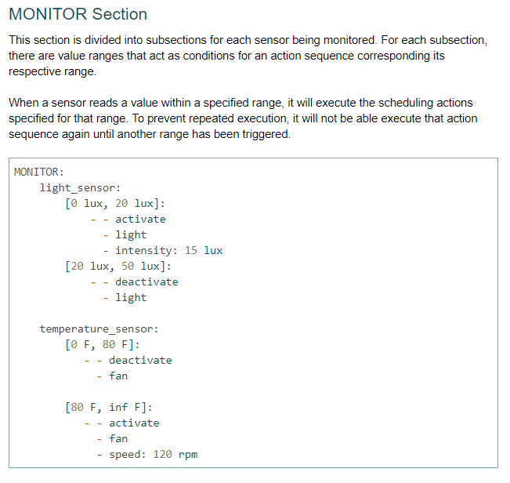

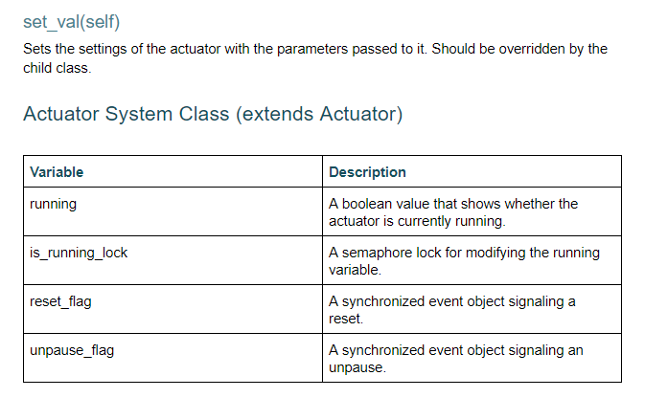
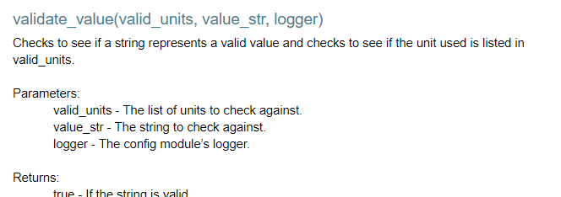
Documentation
All this and more
All in one manual:
Divided by user:
Astronauts
Botanists
Computer Sys Admin
Developer

Slide 15
Todo:
Voice over for video
Add to the manual and video:
Workflow of config file farming chamber process for each of the users
Finalize user manual
Finalize poster

Slide 16
Lessons Learned
Lesson 1: Clear goals from the beginning
Lesson 2: A multi-disciplinary project with the same goal but different requirements is difficult to manage
Lesson 3: Enterprise Web applications take time to develop
Lesson 4: Clear documentation is not just in the comments, variable and function names
Lesson 5: Communication with large team difficult
Lesson 6: Do not add more than you can handle to your project
Lesson 7: Teams with overlapping deliverables with different due dates can be frustrating

Slide 17
Demo Video / Simulation

Slide 18
Thank
You!

