Slide 1
Autonomous Multi-cycle Farming in Space
Christopher Millsap , Giampiero Corsbie
Client/ Sponsor: Dr. Philip Chan

Slide 2
Milestone 2
Task | Giampiero | Christopher | Completion | To Do
Create state diagram for the system | Responsible - 50% | Responsible - 50% | 100% | none
Implement inheritable high-level interfaces/classes for sensor/actuator communication | Responsible - 50% | Responsible - 50% | 100% | Branch Actuator into ActuatorSwitch and ActuatorSystem
Create simulated farm for testing | Responsible - 50% Test | Responsible - 50% Test/Demo | 100% | Create simulated farm for all phases
Create a configuration file for at least one phase in system and run in simulation | Responsible - 75% Test/Demo | Responsible - 25% Test/Demo | 100% | Determine config file readability

Slide 3
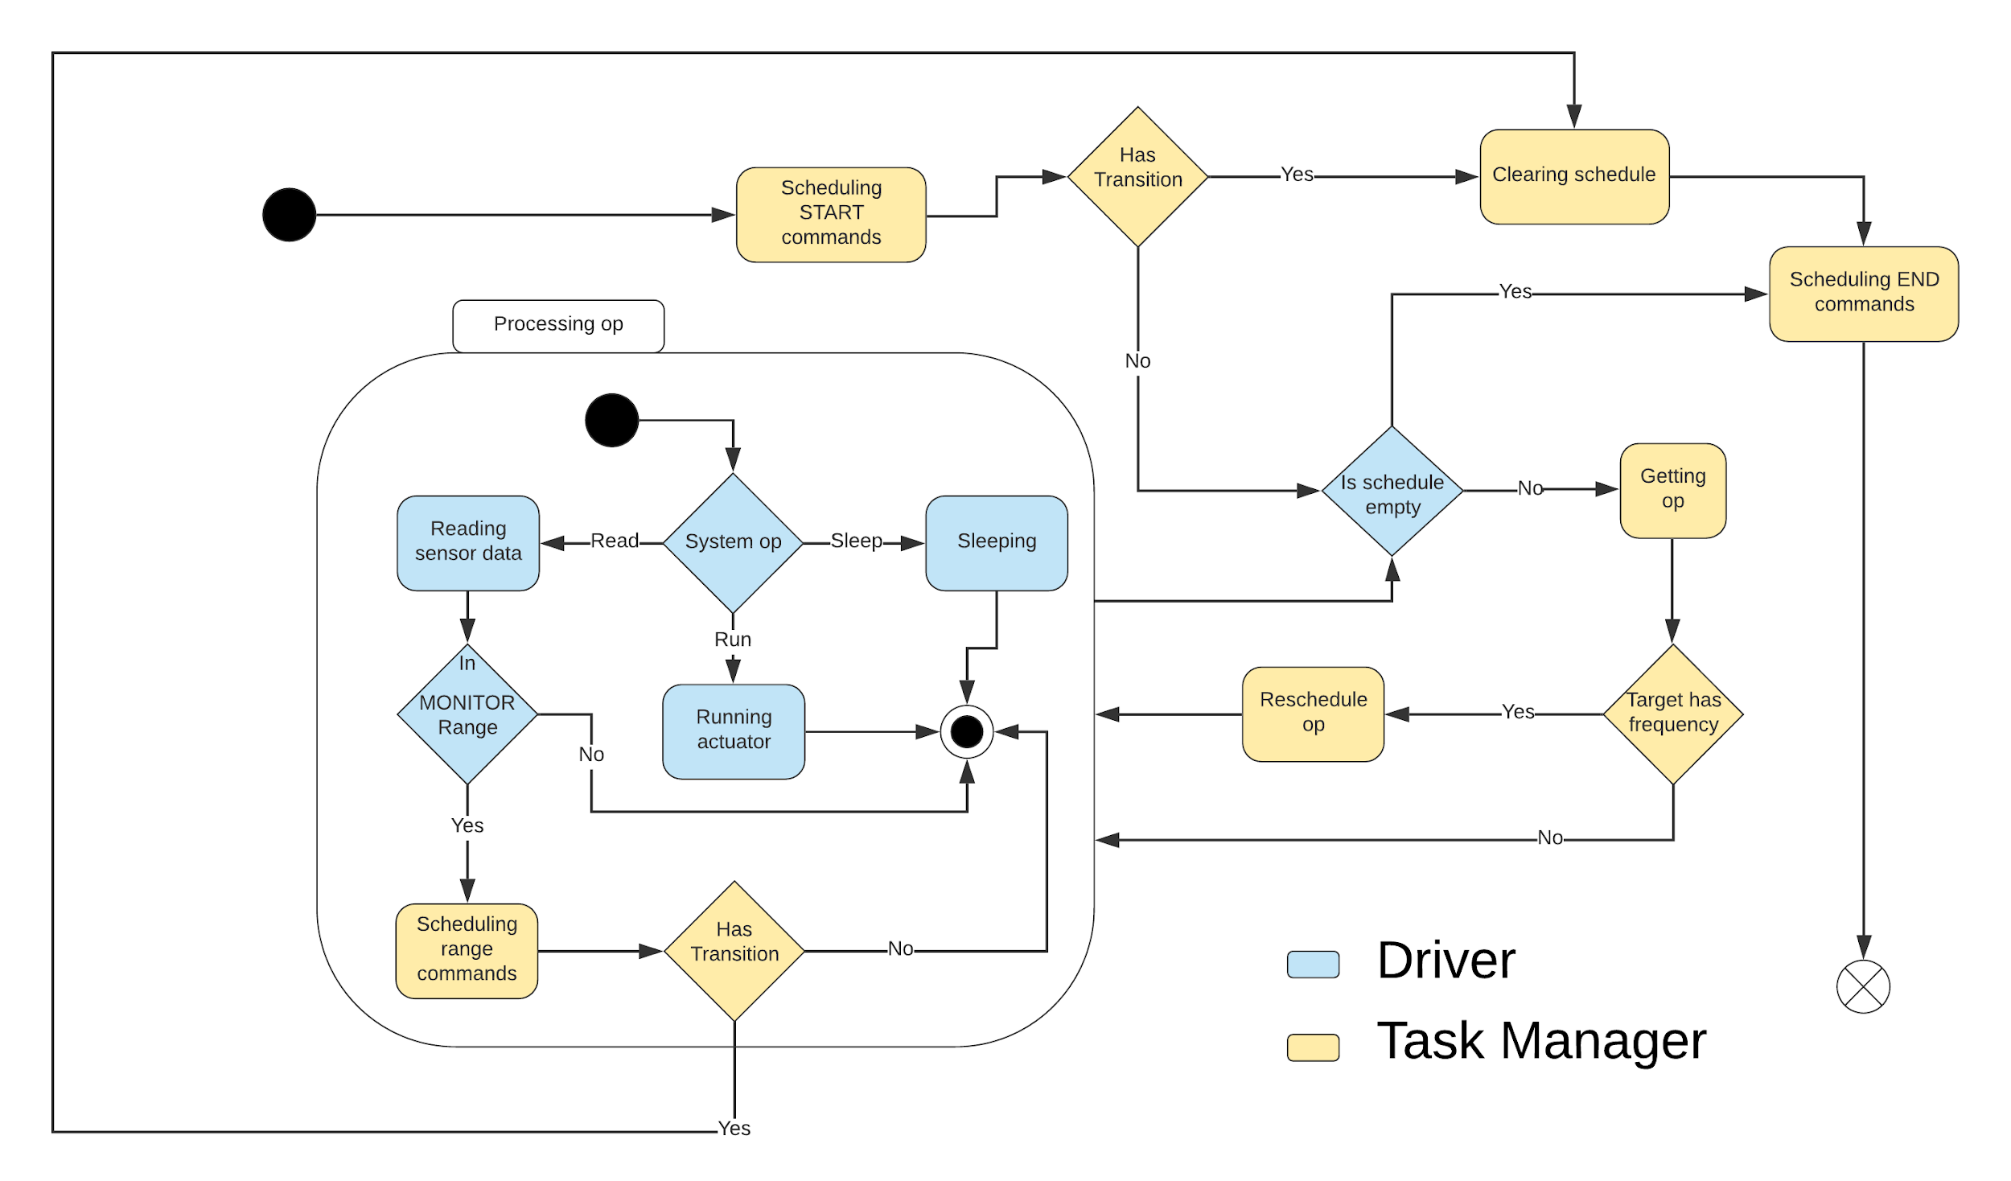
Task 1
Created state diagram

Slide 4
Task 2
Implemented sensor base class
Activate method to initialize actuator parameters and to communicate with hardware, if it behaves like a switch. A deactivate method is also included.
Contains a read function for powering on the sensor, reading in data from the hardware, then powering off the sensor.
Has a frequency attribute, where “read” operations are rescheduled based on it’s value
Implemented height sensor and moisture sensor classes for testing
Simplifies integration of new sensors

Slide 5
Task 2
Implemented actuator base class
Similar to sensor class
Implemented water pump and light classes for testing
Contains activate method to initialize actuator parameters and to communicate with hardware, if it behaves like a switch
Frequency attribute is optional
Without it, an actuator will only run once
May have a run function
Without this function, actuator activate and deactivate functions will behave like a switch
With it, the run operations are inserted into the scheduler
Plan on splitting Actuator base class into ActuatorSystem and ActuatorSwitch child classes
Notes:
Possibly multithreading actuator systems that need to run independently of the driver

Slide 6
Task 2
Implemented scheduling
System operations consist of “run”, “read”, and “sleep”
Delay, or the position in the list relative to scheduled sleeps, is 0 or calculated from frequency.
Inserting a command will iterate over the schedule, subtracting sleeptimes from delay until delay is less that the current sleep time.
If it does not land perfectly on either side of a sleep command, it will split the “sleep” into two commands on either side.
When a command is retrieved, reschedule it, if the target has a frequency attribute.
If a frequency changes, remove the respective command from the schedule and merge any sleep commands preceding and succeeding the target command.

Slide 7
Task 4
Created configuration file
Uses a subset of the YAML Syntax.
Each phase consists of START, MONITOR, and END entries.
The entry for MONITOR contains sensor names, whose entries are multiple ranges of values, each of which correspond to a sequence of config actions.
START contains a sequence of config actions that initialize the system for a phase.
END contains a sequence of config actions that are executed on transitions.
Each config action comprises as a 3 part sequence
The first element is the operation “activate”, “set”, or “deactivate”
The second is the target of the operation. This is either an actuator or sensor name.
The third is parameters, each with a corresponding value.

Slide 8
Task 4
Simple configuration file example
---- START: # Action Sequence - - activate # Operation - light # Target - intensity: 5 lux # Param: Value - - activate - moistureSensor - frequency: 6 hr - - activate - heightSensor - frequency: 3 d | MONITOR: heightSensor: [1 cm, 2 cm]: - - set - heightSensor - frequency: 2 d moistureSensor: [0 hum, 2 hum]: - - activate - waterPump - duration: 10 sec frequency: 1 d - - set - moistureSensor - frequency: 6 hr [2 hum, 3 hum]: - - set - moistureSensor - frequency: 1 d | END: - - deactivate - light - - deactivate - moistureSensor - - deactivate - heightSensor

Slide 9
Task 4
Created configuration file parser
Converts the config file to the systems internal representation of the configuration.
Validates the internal structure.
Validates the syntax against reserved words and whether targets contain parameters specified.
Normalizes units provided to a standard internal representation.
e.g. minutes, hours, and days get converted into seconds.
Plans to include validation of sensor/actuator dependencies instead of using reserved words.

Slide 10
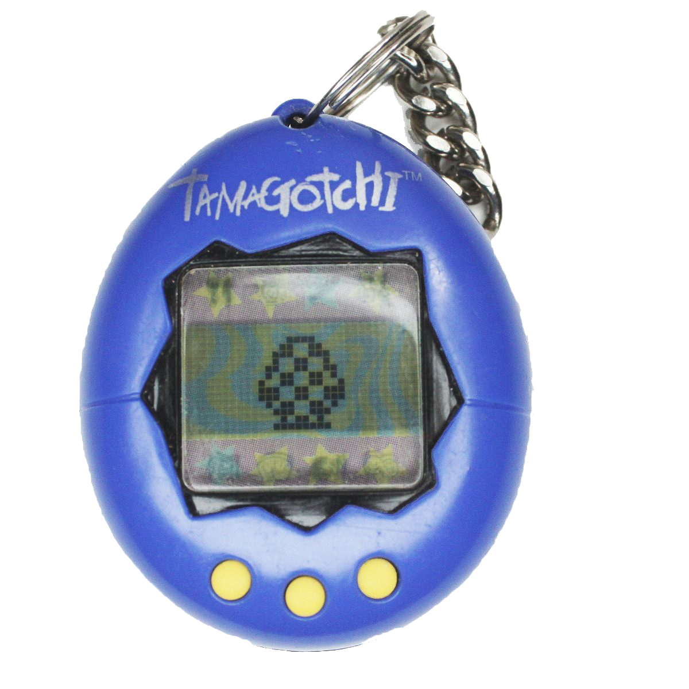
Task 3
Created simulated farm for testing
Simulated farm for Growth Phase
Properties of simulation:
Seed object
Can germinate?
Time till germination if time with/without water & light allows for survival
Is healthy?
Max height and growth rate affected
Max height
Growth rate
Tray of seeds - each seed grows differently
Light object - For this simulation it is on the entire grow period
Water pump - properties of actuator:
stepper current position, start, speed, steps of revolution, acceleration
Time delta
Sensors:
Moisture sensor - Biased return based on water pump
Height sensor - Time delta changes plant height, after germination, at state call by task manager

Slide 11
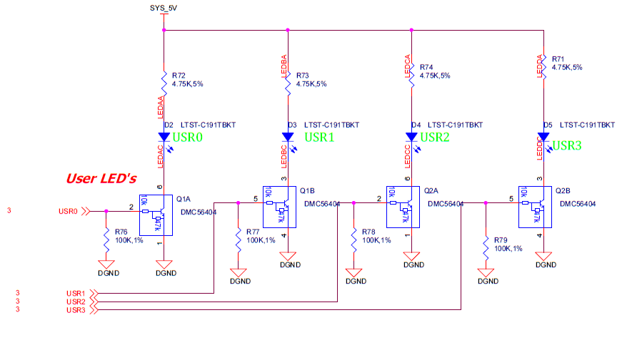
Task 3
Created simulated farm for testing
Height Sensor is USR0
Water Pump is USR1
Light is USR2
Moisture Sensor is USR3
Notes:
Height Sensor is USR0
Water Pump is USR1
Light is USR2
Moisture Sensor is USR3

Slide 12

Task 3
Created simulated farm for testing
To do:
Water consumption hoagland’s 2 ratio change each cycle
Drain/Fill speed of tank
All phases in simulation
How to handle seeds that did not germinate

Slide 13
Demo
https://youtu.be/pCXd5KeTDBE

Slide 14
Milestone 3
Task | Giampiero | Christopher | Completion | To Do
Decide which set of boards will be used to control the system other than the microcontroller | Responsible - 50% | Responsible - 50% | 100% | none
Implement Python libraries for serial communication | Responsible - 50% | Responsible - 50% | 100%
Finalize development toolchain (maybe do this next semester when arch is decided?) | Responsible - 50% | Responsible - 50%
Start a preliminary product breakdown structure with MEE | Responsible - 50% | Responsible - 50%
At least one sensor & actuator functioning according to some schedule These will run based on simulated data along with simulated cycles | Responsible - 50% | Responsible - 50%

Slide 15
Milestone 3
Task | Giampiero | Christopher | Completion | To Do
Full simulated farm with well-defined input parameters | Responsible - 50% | Responsible - 50% |  | Add simulations for {seed, harvest, clean, err}
Configuration file for all phases in system to run in simulation | Responsible - 50% | Responsible - 50% | 24%
Testing Document inheriting from test plan from milestone 1: | Responsible - 50% | Responsible - 50% | 5% | Test cases Static - Done by reading code through formal reviews Functional - Verifies that each function of the software application operates in conformance with the requirement specification Structural - Whitebox testing, testing trigger conditions, etc Performance - Responsiveness and stability under a particular workload Testing scripts - Automated testing
We will also use SonarQube to review, our code with static analysis to detect bugs, code smells and security vulnerabilities.
 | Simulated Farm | Sensor | Actuator
Single Stage | State cases | Expected data behavior for features | Expected actions and reactions for features
One Cycle | State and transitions cases | Expected data behavior for features | Expected actions and reactions for features
Multi Cycle | Multiple sets of state and transition cases | Expected data behavior for features | Expected actions and reactions for features

Slide 16
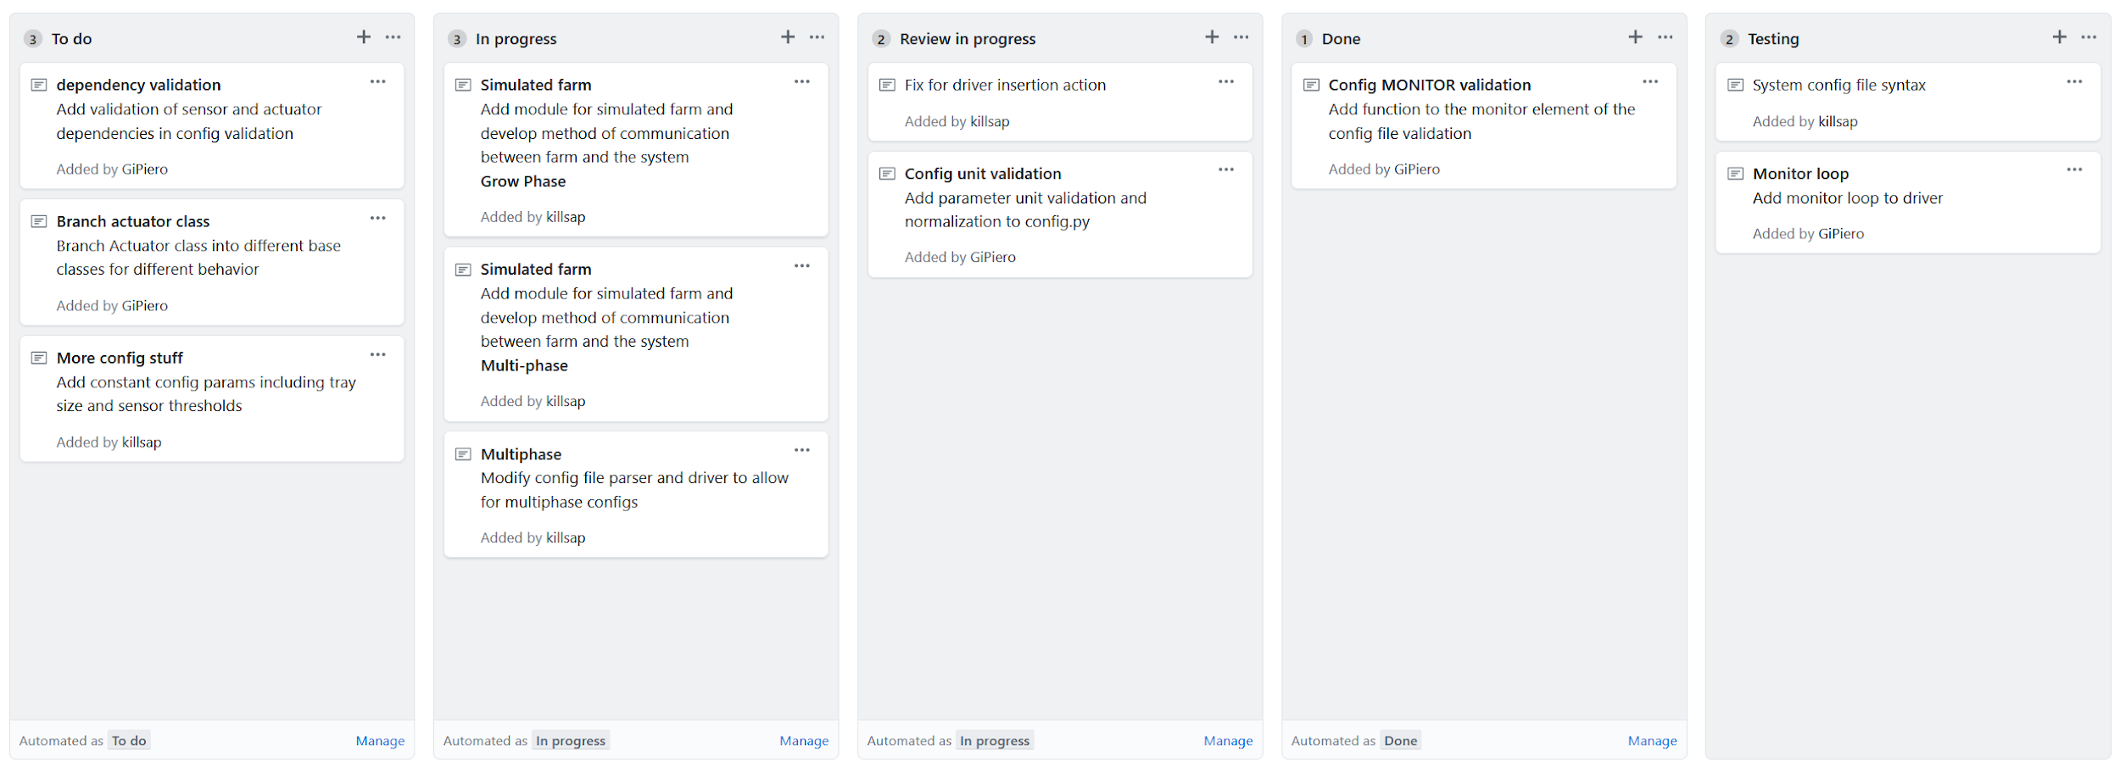
To do

Slide 17
Questions?

